Slide 1
Paper E talk @ASHG

Slide 2
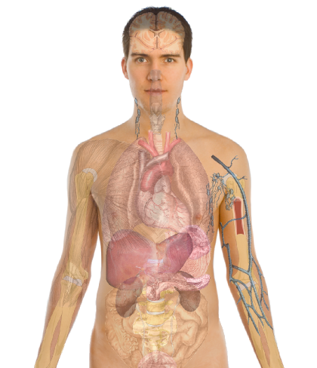
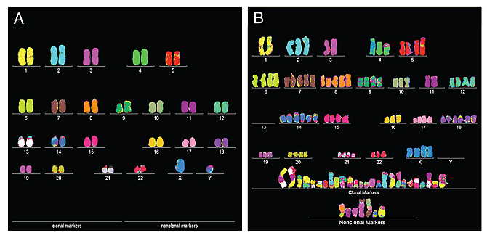
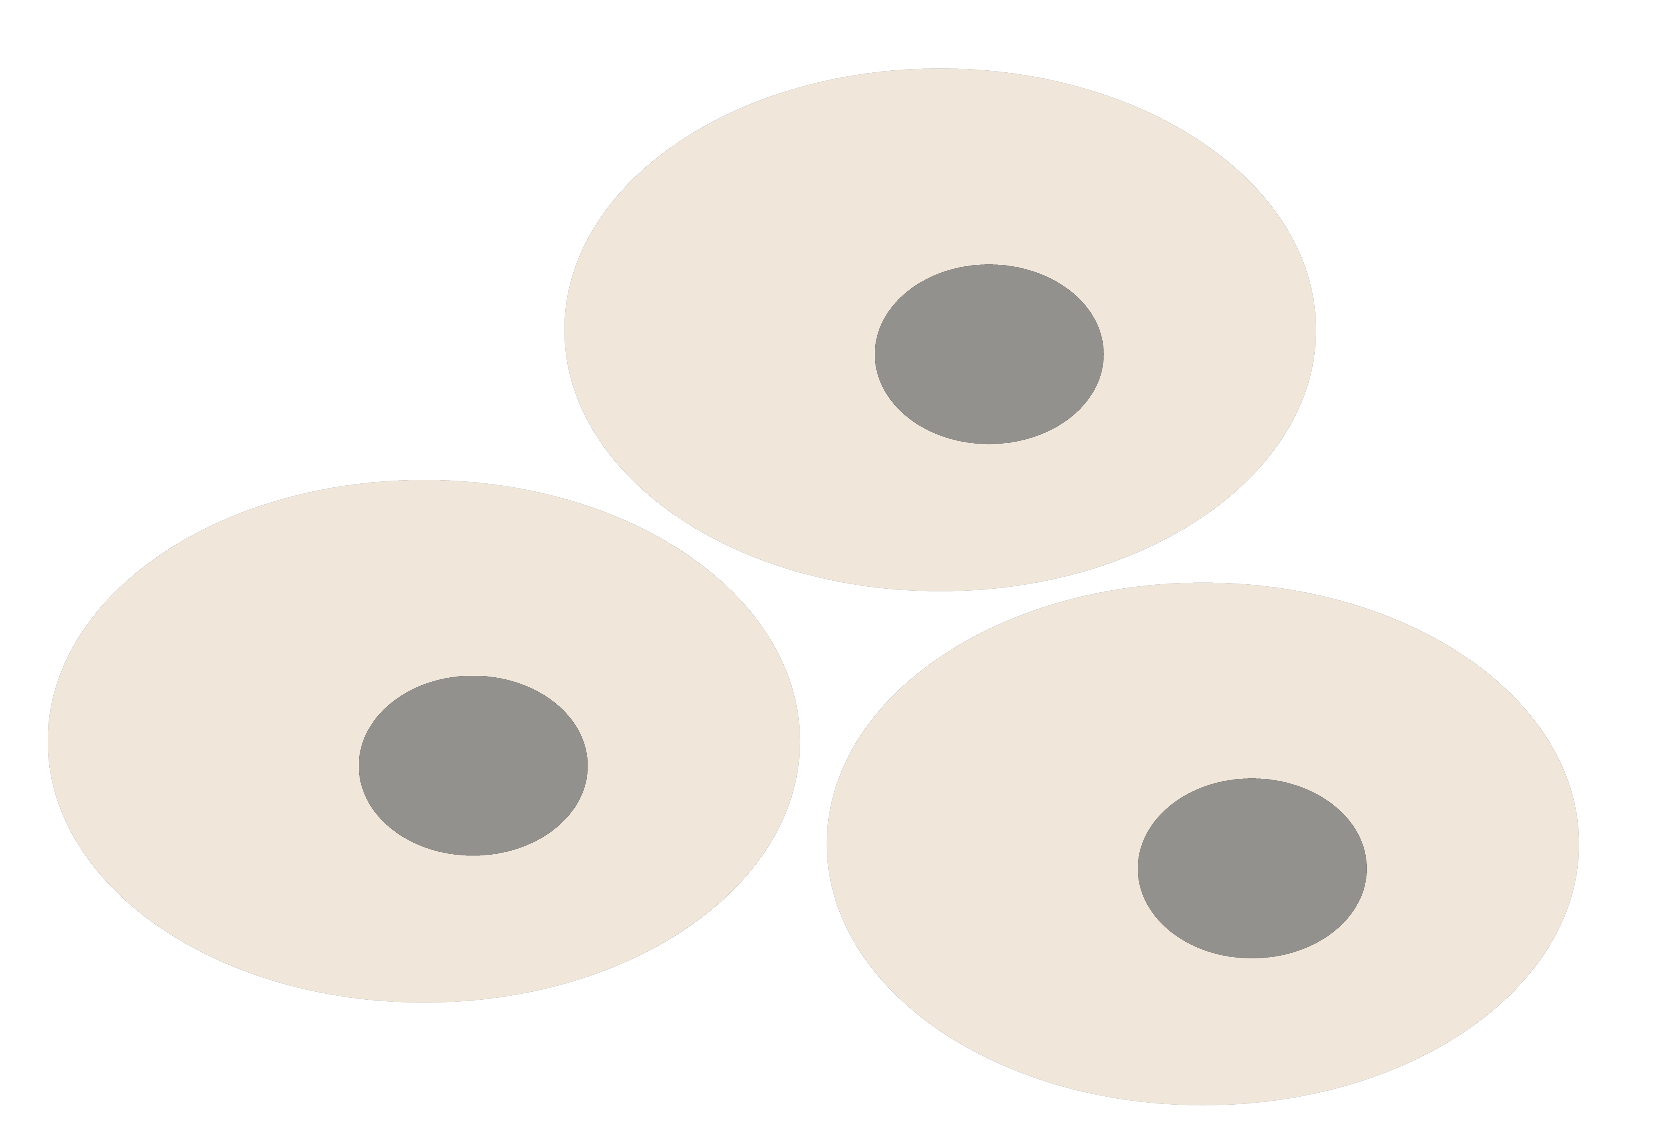

Personal Genomics
as a Gateway into Biology
Personal genomes soon will become a commonplace part of medical research & eventually treatment (esp. for cancer). They will provide a primary connection for biological science to the general public.
normal
tumor

Slide 3
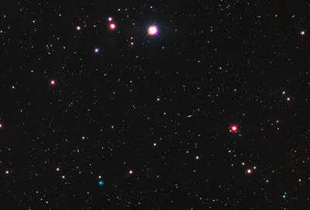











Sequence Universe
SRA ~1 petabyte
TCGA endpoint: ~2.5 Petabytes
~1.5 PB exome
~1 PB whole genome
TCGA 2.3 Petabytes
in CGHub
Clinical
RNASeq
Epigenome
222
TB
miRNA
ARRA
Autism
29
TB
32 TB
34 TB
NHLBI ESP
68 TB
40
TB
GTeX
ADSP
NHGRI LSSP
Star formation
100K Genomes England
Heidi Sofia, 7-16-15
Notes:
TCGA is the largest single project in the visible sequence universe to date.
TCGA is depicted at the center of the solar system because it integrates DNA, RNA-Seq, miRNA, epigenomic, and clinical data.
Currently there is over a Petabyte of TCGA data deposited in the CGHub cancer genomics repository (https://cghub.ucsc.edu/summary_stats.html).
This scale dwarfs its closest competitors which are shown as planets in orbit:
1000G 222 TB http://www.ncbi.nlm.nih.gov/bioproject/28889
ADSP 68 TB http://www.ncbi.nlm.nih.gov/bioproject/202226
NHGRI LSSP 40 TB http://www.ncbi.nlm.nih.gov/bioproject?term=NHGRI%20Large%20Scale%20Sequencing%20Program%5BTitle%5D
GTeX 34 TB http://www.ncbi.nlm.nih.gov/bioproject/75899
NHLBI ESP 32 TB http://www.ncbi.nlm.nih.gov/bioproject/165957
HMP 29 TB http://www.ncbi.nlm.nih.gov/bioproject/43021
ARRA Autism 24 TB http://www.ncbi.nlm.nih.gov/bioproject/74861
ENCODE 9 TB http://www.ncbi.nlm.nih.gov/bioproject/63441
Projects just starting now, like 100K Genomes England, may eventually overtake TCGA.

Slide 4
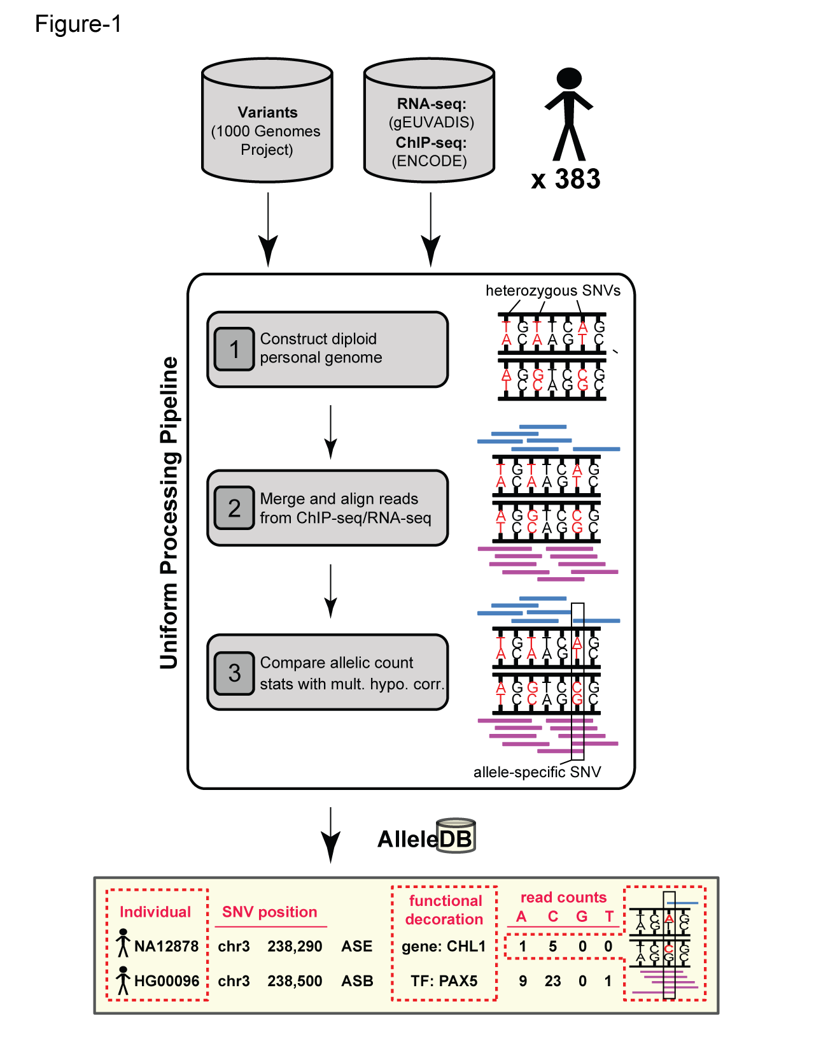
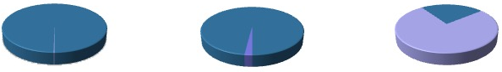
Human Genetic Variation
Population of
2,504 peoples
A Cancer Genome
A Typical Genome
Origin of Variants
Class of Variants
 | Coding | Non-coding
Germ-line | 22K | 4.1 – 5M
Somatic | ~50 | 5K
SNP | 3.5 – 4.3M
Indel | 550 – 625K
SV | 2.1 – 2.5K (20Mb)
Total | 4.1 – 5M
SNP | 84.7M
Indel | 3.6M
SV | 60K
Total | 88.3M
Prevalence of Variants
Common
Common
Passenger
Driver (~0.1%)
Rare* (1-4%)
Rare (~75%)
* Variants with allele frequency < 0.5% are considered as rare variants in 1000 genomes project.
The 1000 Genomes Project Consortium, Nature. 2015. 526:68-74
Khurana E. et al. Nat. Rev. Genet. 2016. 17:93-108

Slide 5

Finding Key Variants
Somatic
CAN YOU FIND THE PANDA?
Overall
  Often these can be conceptualized as very rare variants
  A challenge to identify somatic mutations contributing to cancer is to find driver mutations & distinguish them from passengers.
Drivers
  Driver mutation is a mutation that directly or indirectly confers a selective growth advantage to the cell in which it occurs.
  A typical tumor contains 2-8 drivers; the remaining mutations are passengers.
Passengers
  Conceptually, a passenger mutation has no direct or indirect effect on the selective growth advantage of the cell in which it occurred.
Vogelstein B. Science 2013. 339(6127):1546-1558

Slide 6
How to identify drivers – mutation recurrence (LARVA) and functional impact (Funseq)

Slide 7


Mutation recurrence
Cancer Type 1
Cancer Type 2
Cancer Type 3

Slide 8
Mutation recurrence
Cancer Type 1
Cancer Type 2
Cancer Type 3
Early replicated regions
Late replicated regions

Slide 9
Noncoding annotations
Cancer Type 1
Cancer Type 2
Cancer Type 3
Early replicated regions
Late replicated regions
Does not format to std. theme

Slide 10
Noncoding annotations
Cancer Type 1
Cancer Type 2
Cancer Type 3
Early replicated regions
Late replicated regions
Does not format to std. theme

Slide 11
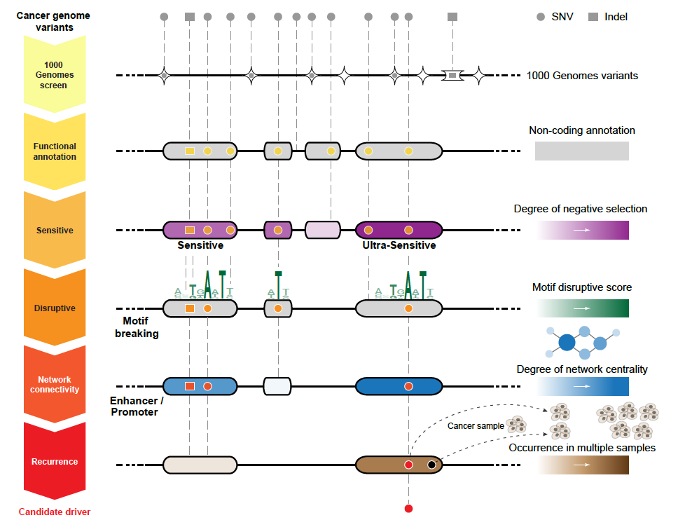
Identification of non-coding candidate drivers amongst somatic variants: Scheme
[Khurana et al., Science (‘13)]

Slide 12
PCAWG rich resource to look at variations in cancer

Slide 13
PCAWG : most comprehensive resource for cancer whole genome analysis
Goal of PCAWG:
To understand role of non-coding regions of cancer genomes in cancer progression.
Looking beyond single nucleotide variants in cancer genome
    Large structural variations
    Somatic copy number aberrations
    Extending know mutational signature repertoire
    Mapping cancer evolution history by analyzing clonal architecture
Jointly analyzing ~2800 whole genome tumor/normal pairs
  > 580 researchers
  16 thematic working groups
  > 130 research project

Slide 14
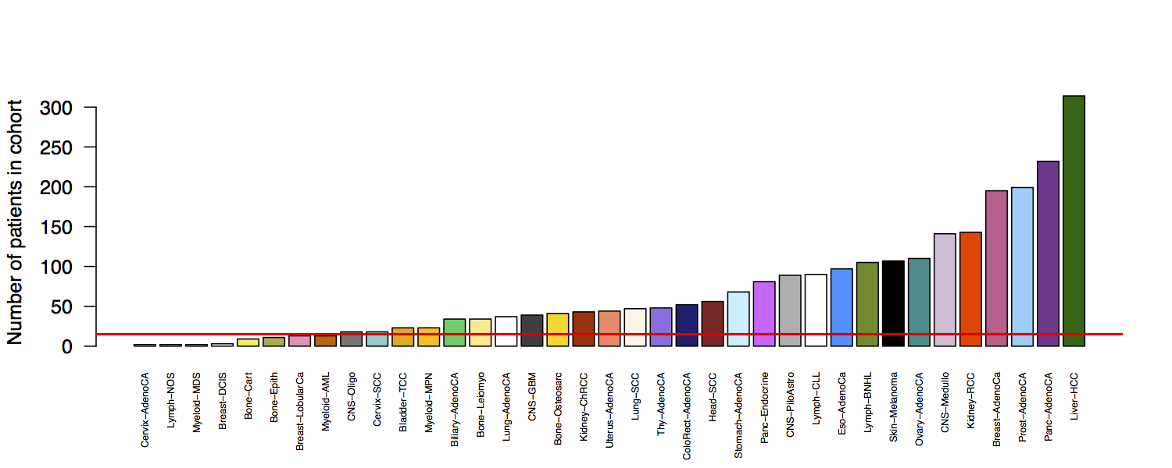
Cohorts: 29 individual tumor types + 3 lineages + 1 pan-cancer = 33 cohorts
2583 representative samples
29 cohorts with 2528 cases (>97.5% of all cases)
Red line indicates 15 patients
Rhienbay et. al.

Slide 15
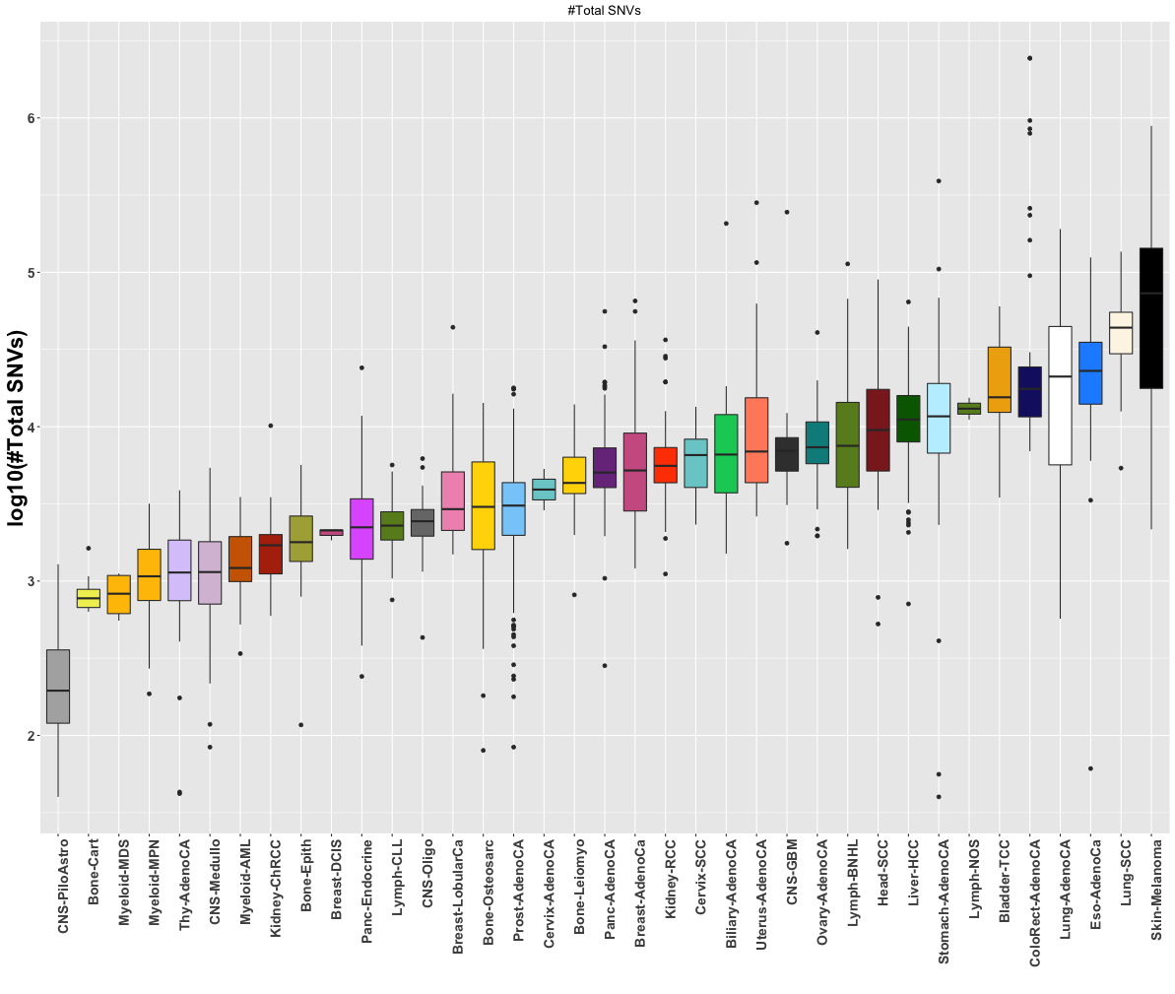
PCAWG : Mutation frequency distribution across cohorts
  Only handful of driver mutations ( <= 4) but thousands of passengers.
  What are these passengers doing in a typical cancer genome

Slide 16
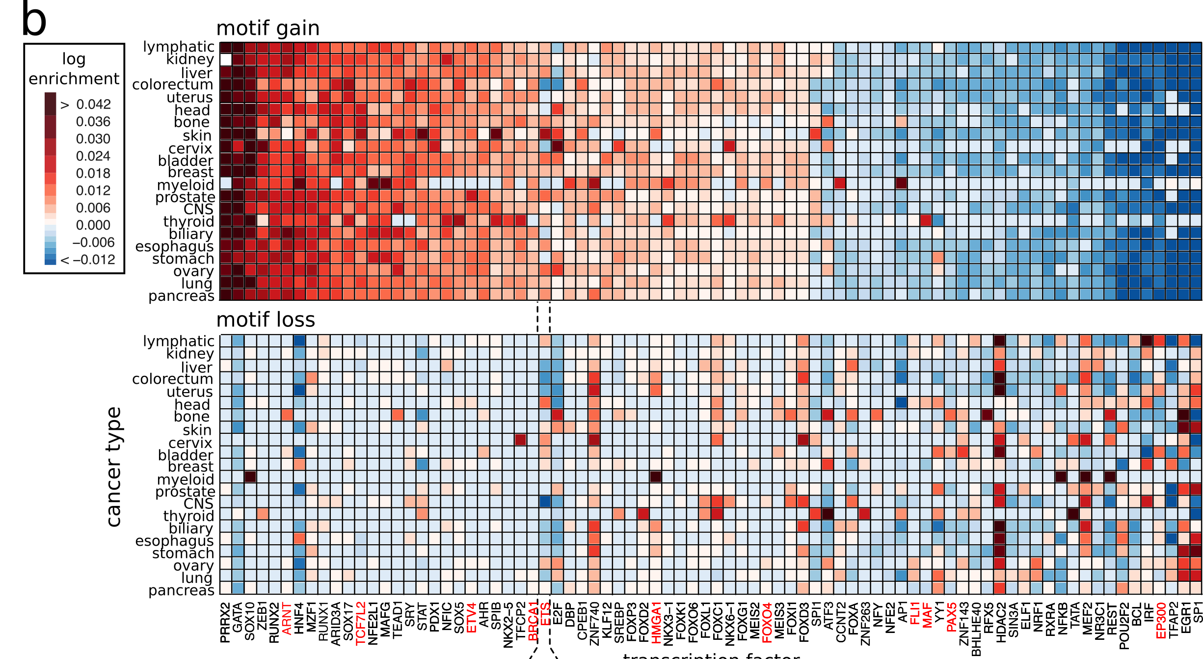
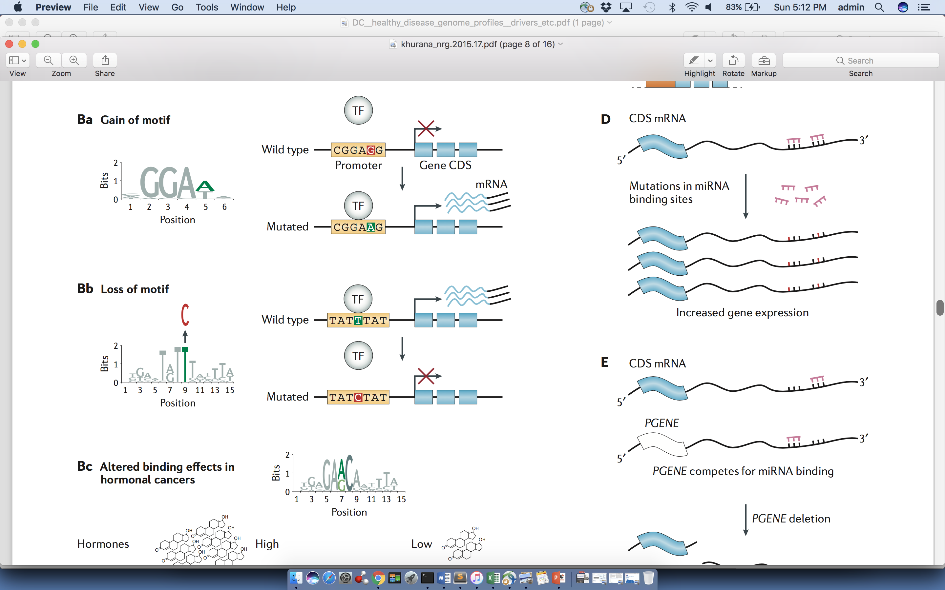
Passengers burdening of TF binding landscape
≈ç

Slide 17
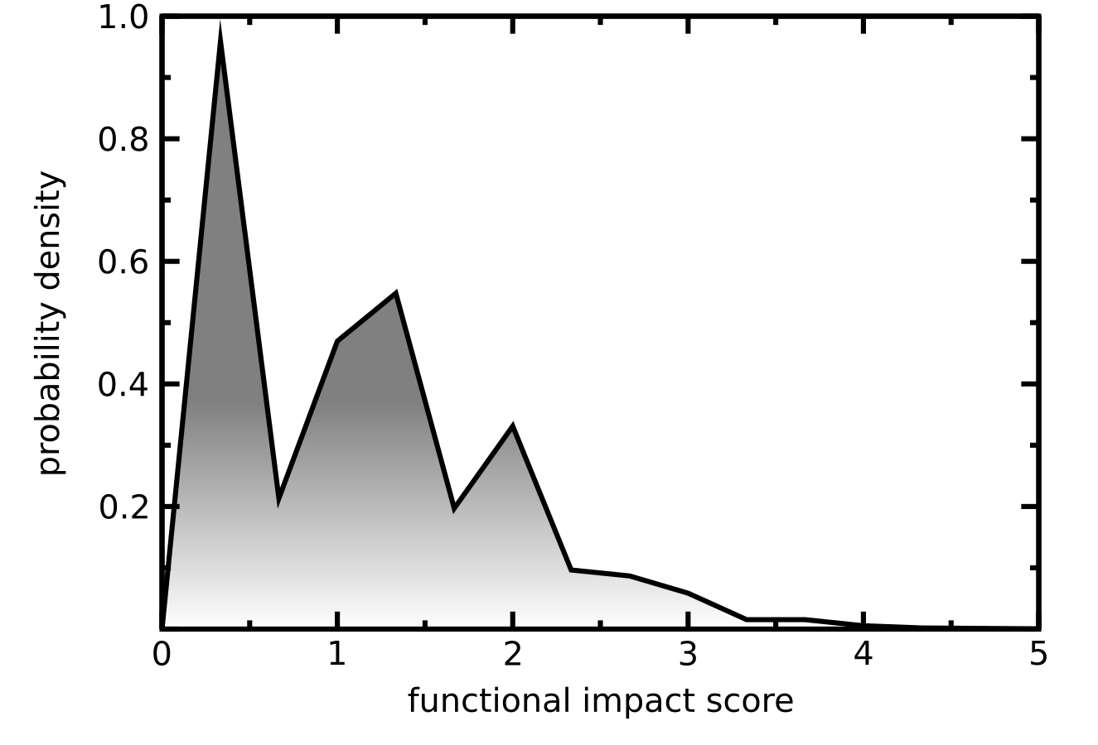
Functional impact distribution of PCAWG non-coding mutations
Multimodal functional impact score distribution
    High impact score region presumably enriched with potential driver mutations.
    Low impact region corresponds to true passengers.

Slide 18
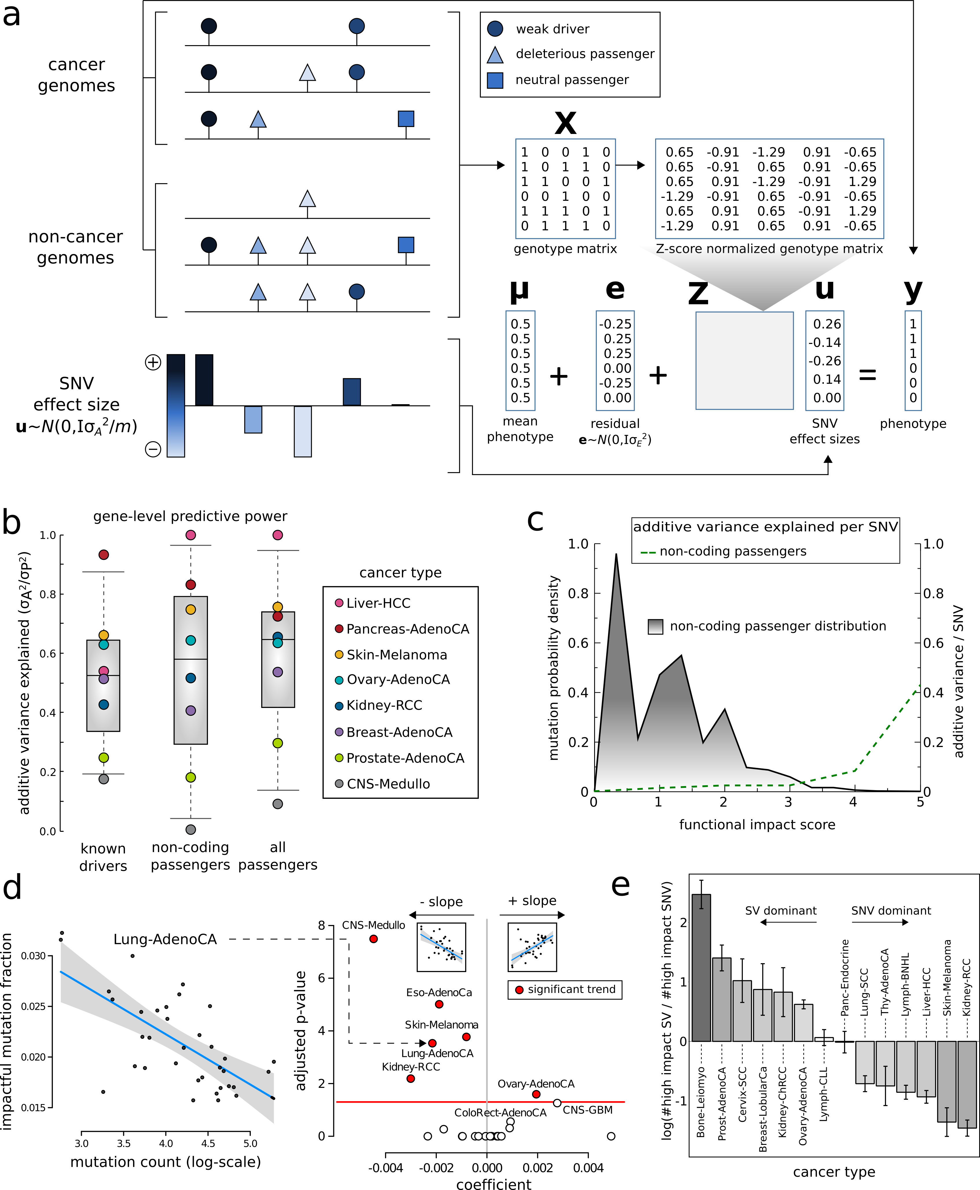
Fraction of high impact nominal passengers in PCAWG
In many PCAWG cohorts, we observe that fraction of impactful passengers decreases with increase in total mutation burden.

Slide 19
Differential burdening and intermediate peak can be attributed to mutational processes or selection

Slide 20
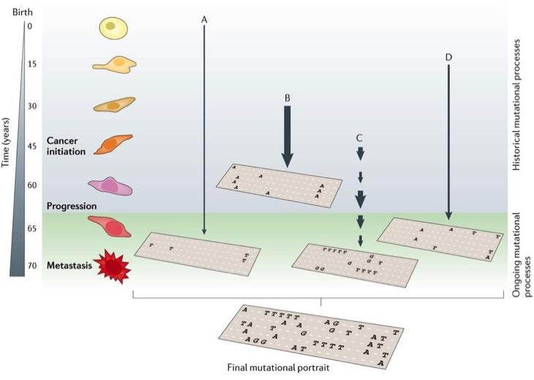
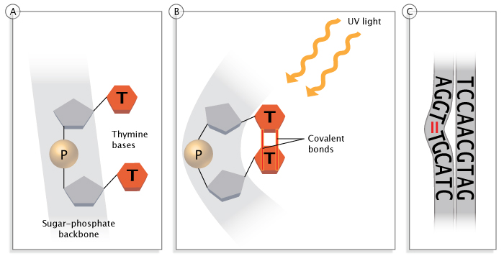
Mutational Processes
Multiple processes shape the genome
  Tumor sequencing shows a life-long accumulation of mutations
Mutational processes carry signatures
  e.g. UV light cause pyrimidine dimer
Clancy, Nature Education, 2008
Helleday, Eshtad & Nik-Zainal, Nature Reviews Genetics, 2014

Slide 21
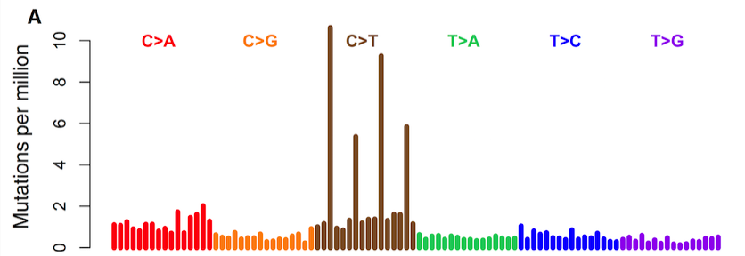
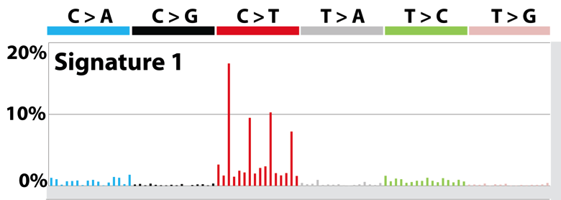
Mutational Context and Signatures
We can decompose the mutations based on the context
Mutation spectrum is further broken down to mutation signatures, which represent mutational processes
  NMF/clustering on large cancer cohorts
  Linked some signatures with biological processes/mutagens
Mutation spectrum observed
Mutation signature inferred

Slide 22
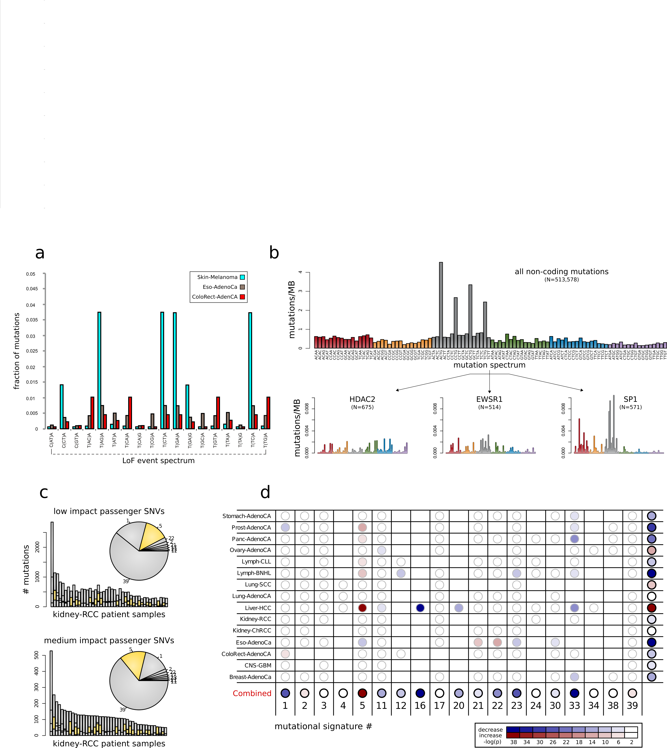
De-convoluting mutational signature and functional impact of nominal passengers in PCAWG

Slide 23
De-convoluting functional impact and mutational signature

Slide 24
Let’s look at mutational process in pRCC closely

Slide 25
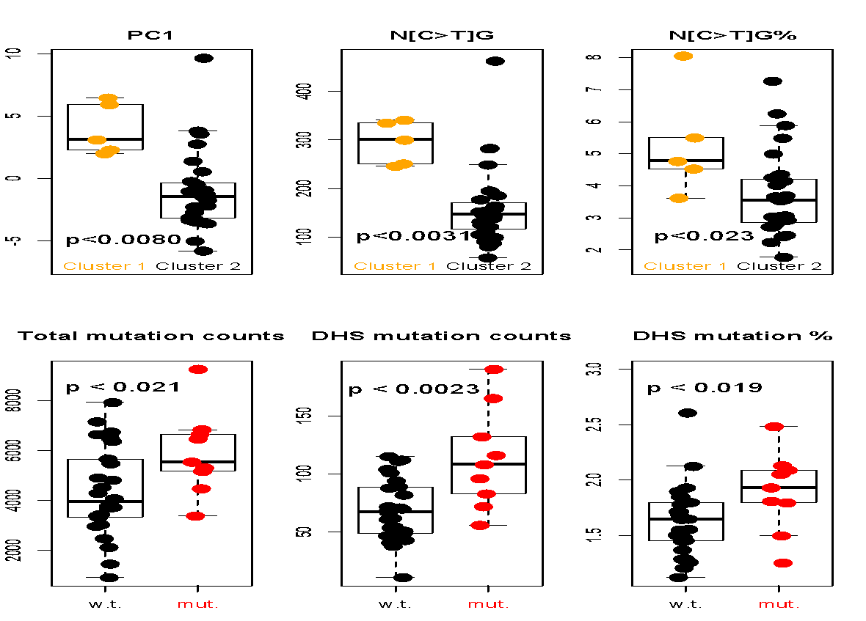
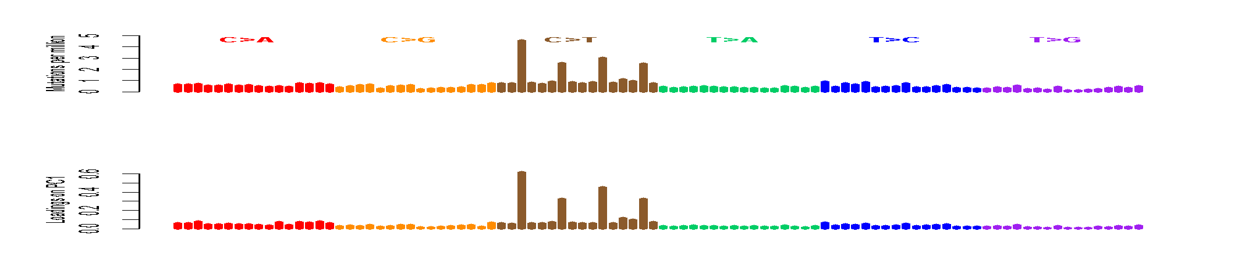
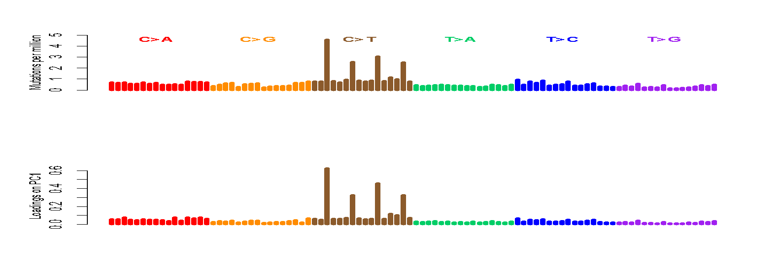
CpGs Drive Inter-patient Variation
The Loading on PC1 is mostly [C>T]G
Confirmed by higher C>T% in CpGs in the hypermethylated group (cluster1)
A[C>T]G
G[C>T]G
C[C>T]G
T[C>T]G
S. Li, B. Shuch and M. Gerstein PLOS Genetics 2017

Slide 26
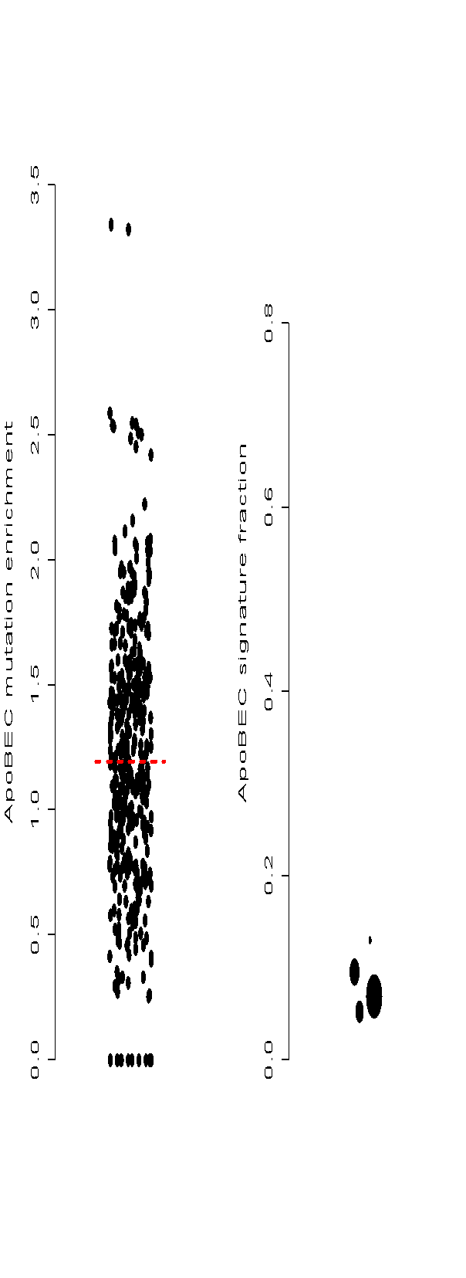


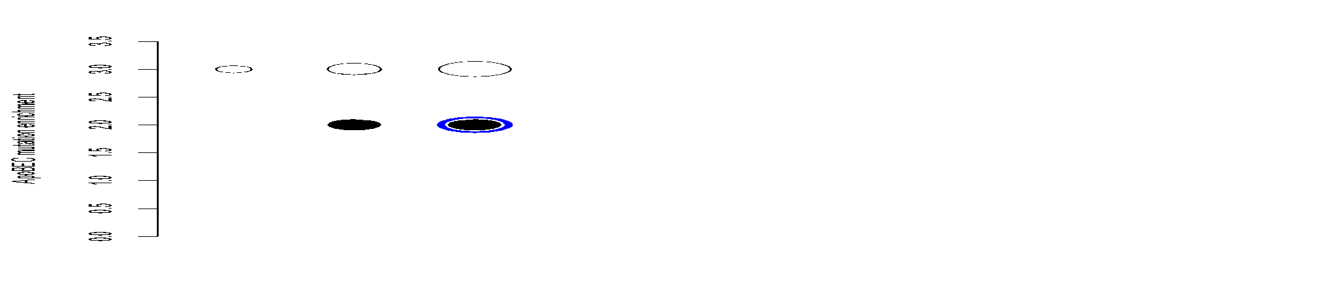
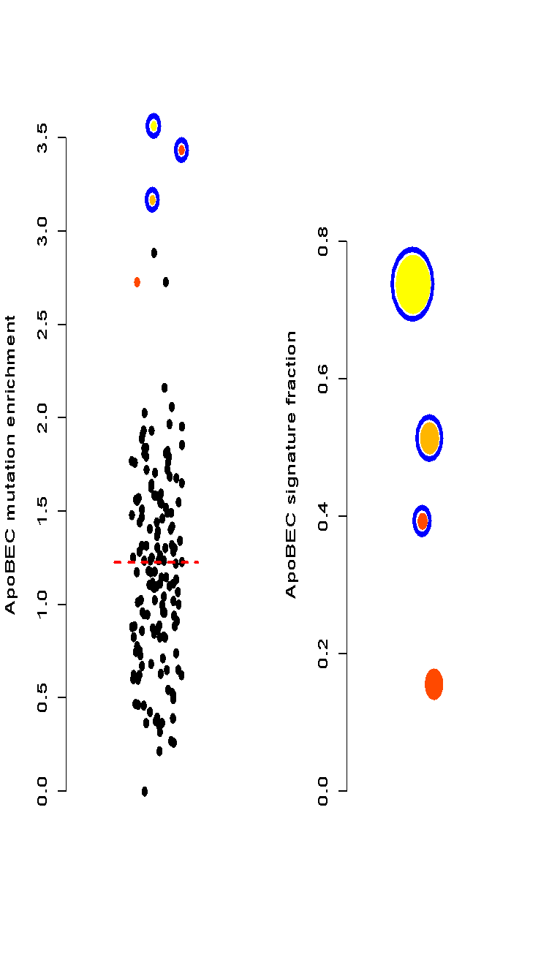

Discover ApoBEC Signature
enrichment
-log(p-value)
3.6
7.2
22
50
100
150
ApoBEC signature is observed
in chRCC but never in ccRCC.
We found a pRCC has ApoBEC
signature
Three samples that are urothelial
cancer (UC) but mislabeled
and processed through the
pipeline (internal positive controls)
RCC samples
total mutations
UC samples
pRCC & UC
ccRCC
S. Li, B. Shuch and M. Gerstein PLOS Genetics 2017

Slide 27

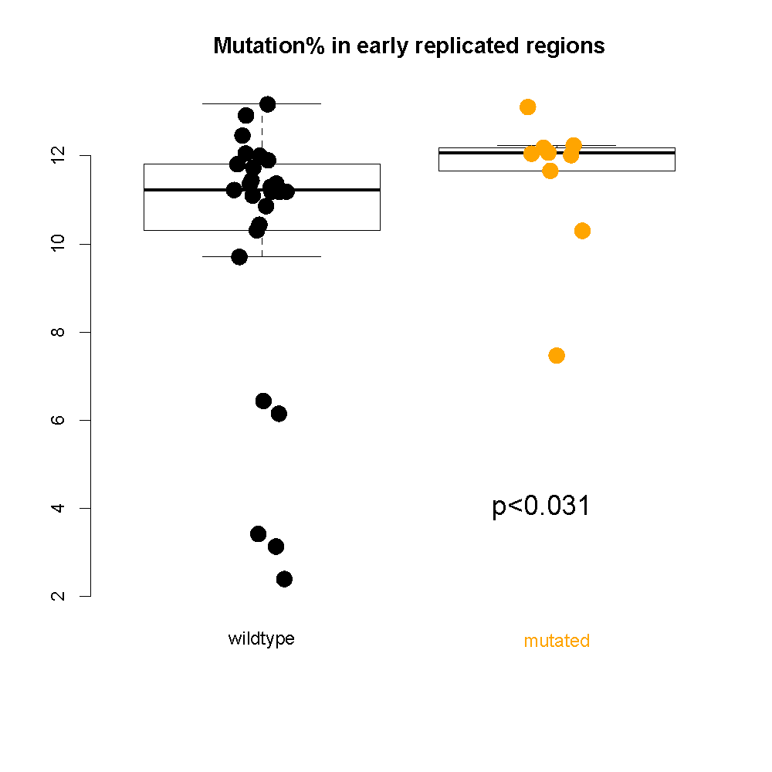
Chromatin remodeling failure changes mutational landscape
Samples with CR defect accumulate more mutations in open chromatin/early replicated regions; Interactions between mutational landscape and driver mutations.
S. Li, B. Shuch and M. Gerstein PLOS Genetics 2017

Slide 28
Now let’s look at potential role of selection among nominal passengers

Slide 29
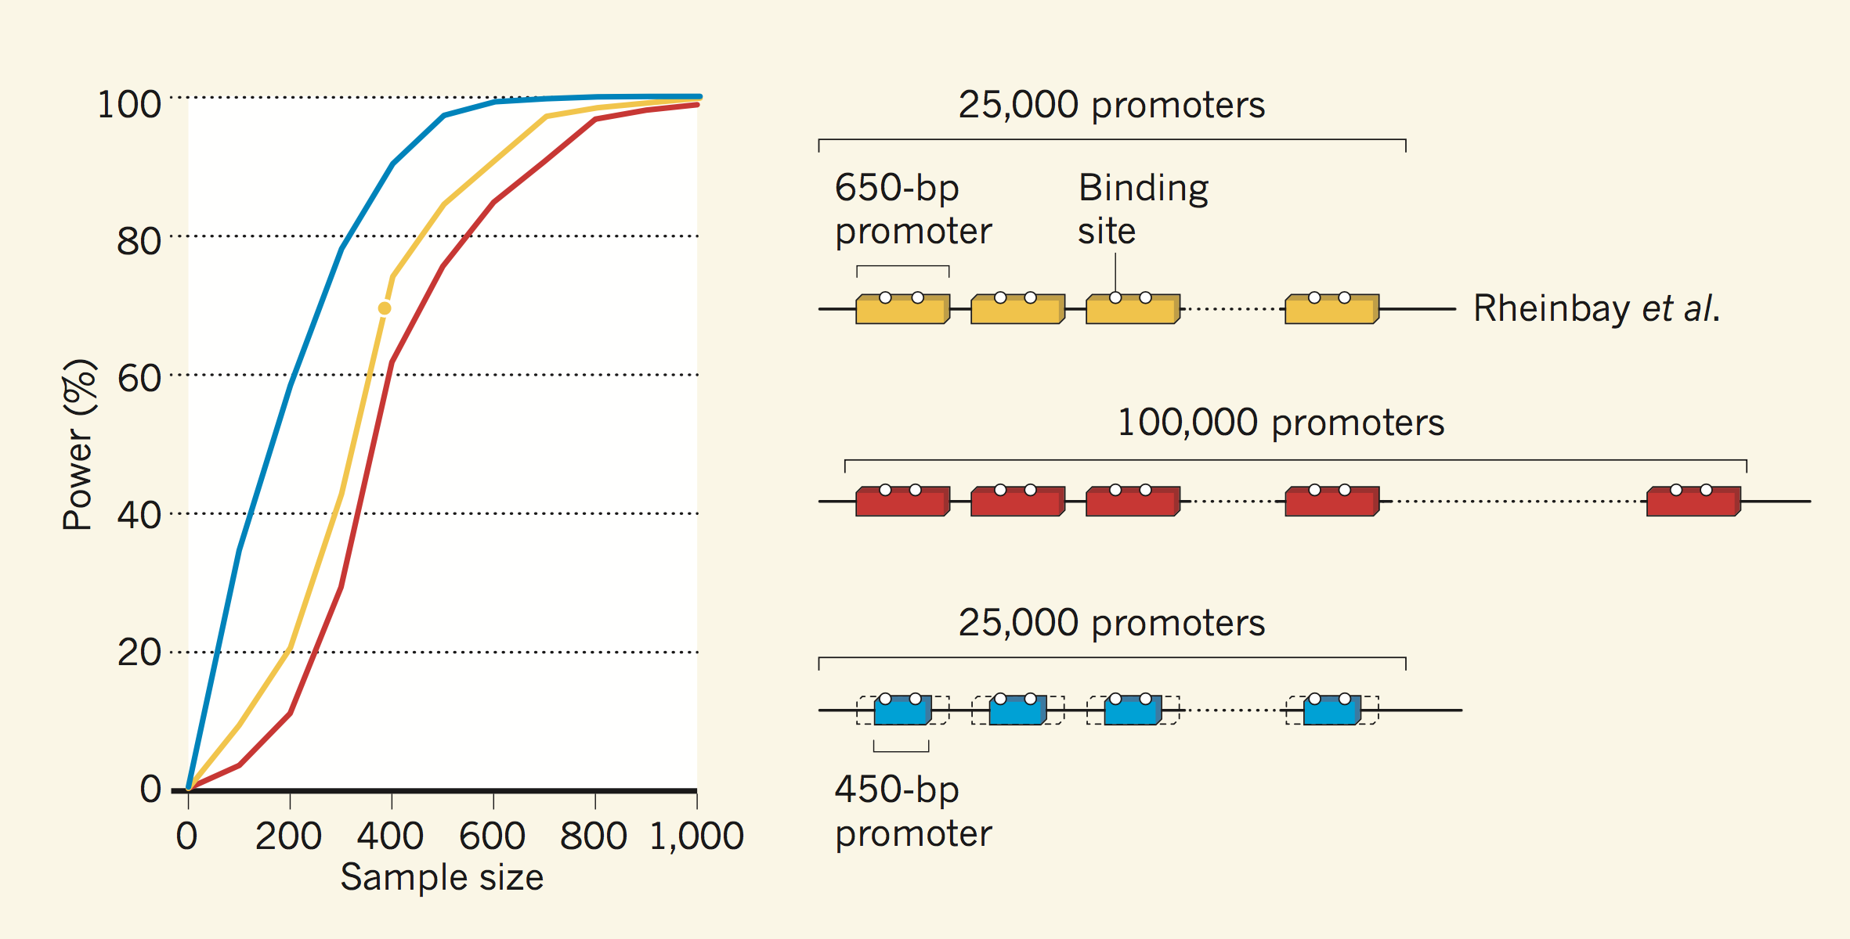
Power is a big issue to identify rare/weak drivers
S. Kumar & M. Gerstein, Nature (2017)

Slide 30

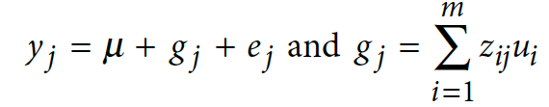


Additive effects model to quantify cumulative effect of passengers
Model for the effect of an individual SNP on a phenotype
Extension to model the combined effects of multiple SNPs
where: y=phenotype; x_ij is the ’genetic dosage’ of the i’th SNP in individual j, taking values {0,1}; a_i is the fixed effect size of SNP i, and e_j is the residual effect
where: z_ij is a ‘normalized genetic dosage’, i.e. the z-score of x_ij; u_i is the effect
size of SNP i treated as a random variable; g_j is the combined effect of all SNPs for individual j

Slide 31
Additive variance for multiple cancer cohorts in PCAWG

Slide 32
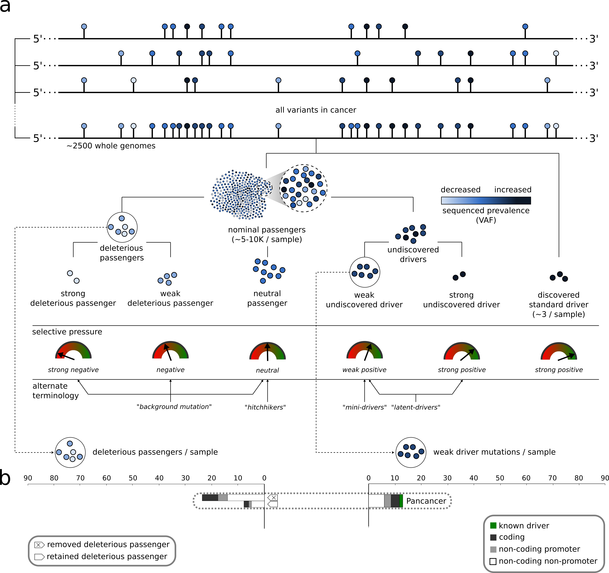
Extending canonical model of driver and passengers

