Slide 1
Journal club 9/27
Leonidas Salichos

Slide 2
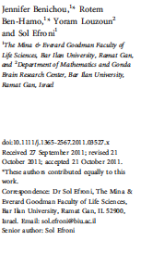
#B_cell #Immunological_repertoire #next-gen_sequencing #T_cell
Next gen DNA and RNA sequencing technologies are used in the study of B-cell and T-cell receptor repertoire
Repertoire properties can now be studied at large scale through nexgen sequencing
Rep-seq (repertoire sequencing), to portray achievements in the field of #nextgenseq to understand immune response
New computational algorithms needed to transition to system-wide analysis in personilized medicine and understanding of immune behavior and response

Slide 3
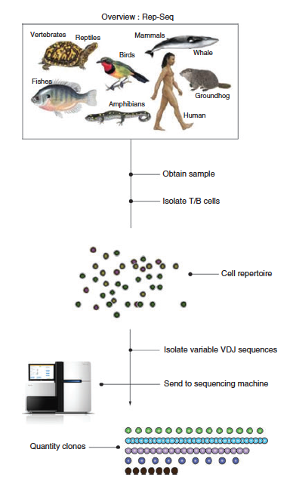
Large scale > powerful results
Temporal snapshot of immune repertoire
Understanding of the how IS disposes unwanted infections
Use in therapeutic contexts
T and B cells (adaptive immune system) are activated by antigen contact via receptors.
The receptors are diversified through a sequence of mechanisms that maximize diversity including:
Non-precise V(D)J rearrangements
Templated and non templated nucleotide additions
Nucleotide deletions
The immense theoretical combinatorial diversity challenges immunology. As recent as 2006 impossibly to sequence enough DNA or RNA to obtain a statistically sound sample of repertoire

Slide 4
An important issue is clone identification, eg classification of the reads into clusters assuming close sequences originate from
Once sequences are available we are interested in:
Size of the repertoire;
similarities between repertoires;
VDJ segment use;
insertions/deletions;
CDR length
Estimating the number of unique receptors (the unseen species problem, Fisheret al >60 years ago)
Analyses may also be performed at:
Individual level
Naïve vs memory
B cell isotypes, CD$ and CD8 T cells or lymphocytes
At different levels of development

Slide 5
recombination of V, D and J segments,
insertions and deletions at junction points
somatic hypermutation
crucial for immune defense against infectious pathogens and has implications for understanding
autoimmunity
immunodeficiency syndromes
anti-tumor immune response to malignant diseases
Brain (multiple sclerosis)

Slide 6
Previous methods depend upon PCR amp. followed by long read amplicon sequencing on VDJ junctions
Often not feasible due to cost or limited material
B-cell lineage gene expression signatures are strongly prognostic in multiple solid tumor types
Many existing datasets where short read RNA sequencing are available
V’Djer > an assembly-based method that reconstructs repertoires from short-read RNA sequencing data
This method captures expressed BCR repertoires from short read mRNA-seq data
Applied to 473 Melanoma samples from TCGA

Slide 7
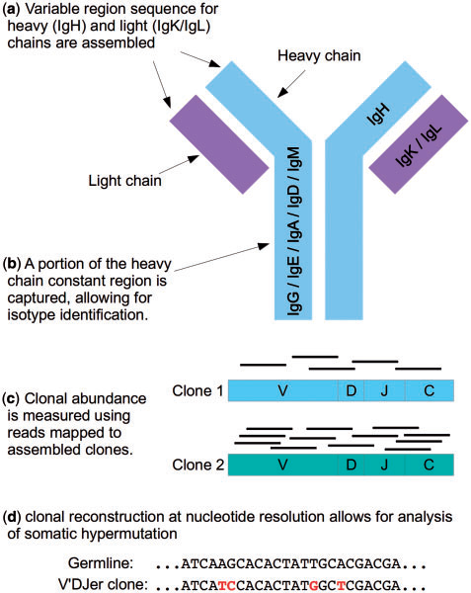
V’DJer (vē-jur), an assembly-based approach to reconstruction and relative quantitation of:
immunoglobulin heavy-chain (IgH),
kappa light-chain (IgK) and
lambda light-chain (IgL)
sequences from short read mRNA-Seq data with read lengths of 48 bp or longer.

Slide 8
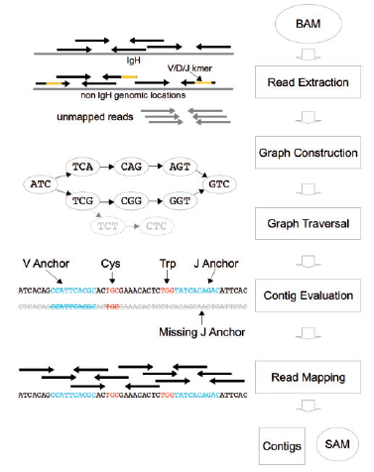
V]Djer workflow
VDJer accepts a BAM file of mapped mRNA-seq short reads as input. Then:
Read extraction to isolate reads that may have arisen from a BCR
De Bruijn graph construction from candidate reads
Graph traversal using BCR specfic heuristics
Maps reads to and evaluation of candidate BCR sequences
Outputs a fasta file containing BCR contigs and a SAM file with reads mapped to these contigs

Slide 9
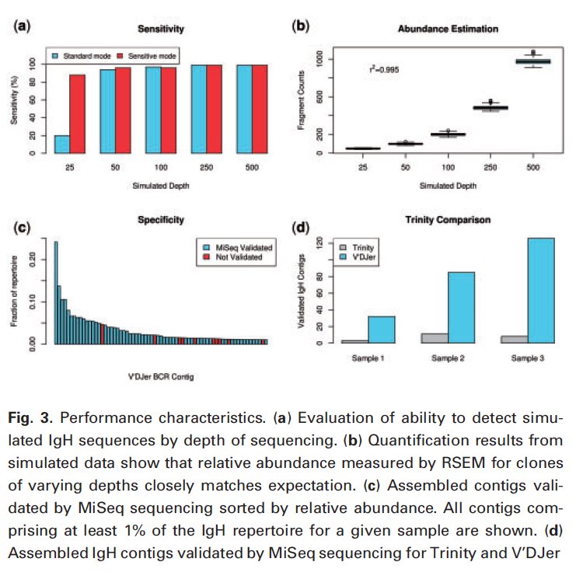
Simulation results
Short paired reads at average depths varying from 25x to 500x
>90% sensitivity for 50x
Sensitivity is achived with:
Smaller k-mer size
More exhaustive graph traversal
Less aggressive graph pruning/contig filtering
(B) count estimates in agreement with simulated clonotype depths using RSEM

Slide 10
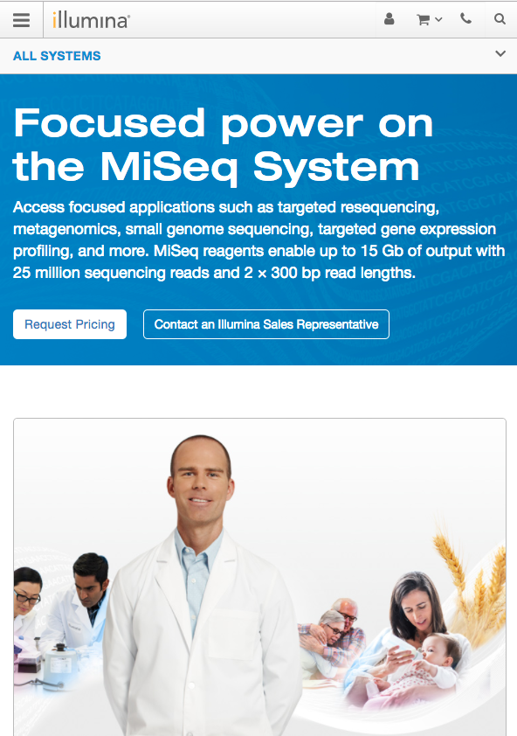
MiSeq systems

Slide 11
Long read validation
VDJer performance to targeted IgH amplicon sequencing of breast cancer derived RNA samples
MiSeq 2x250 paired end sequencing was used for comparison
85% VDJer contigs were validated by MiSeq sequencing
91.3 when allowing two mismatches

Slide 12
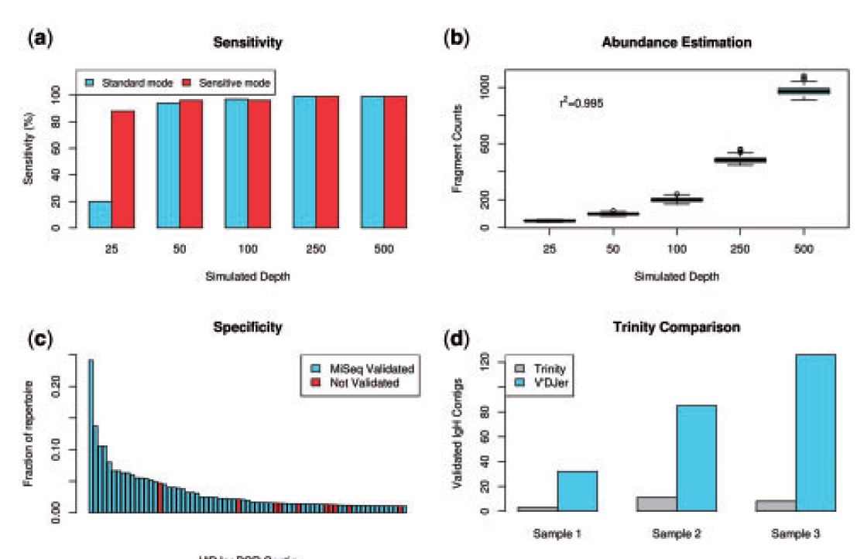

Slide 13
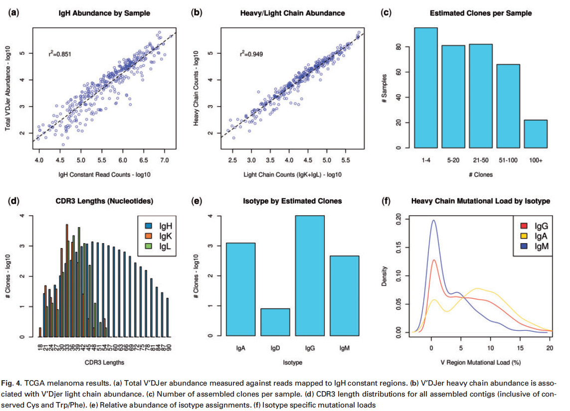
473 TCGA melanoma results
an average of 35 clonotypes
increased incidence of somatic hypermutation in IgG and IgA clonotypes compared to IgM
no IgE clonotypes

Slide 14
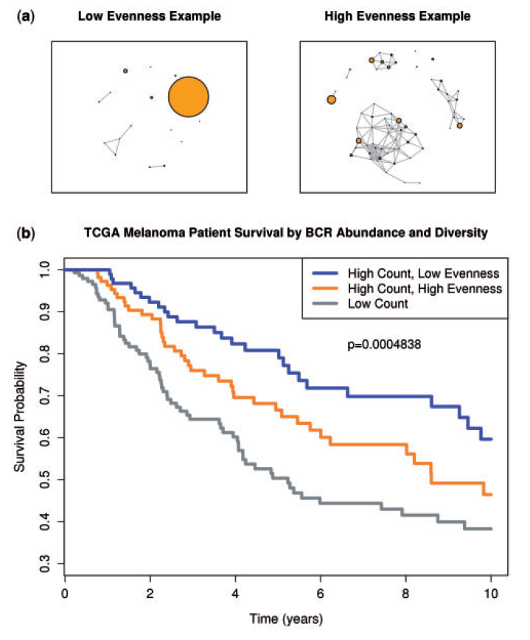
BCR diversity prognostics
Measures of diversity can include assessments of richness and evenness
Richness: number of distinct members
Evenness: variance of abundance of clonotypes within the repertoire
The group with high abundance and low evenness showed best survival
Conf. Hypothesis: a selected antigen driven B-cell response is present in tumor immune microenvironment
TCGA bladder samples was not shown to be a prognostic indicator

Slide 15
Individual variation in germline and expressed B-cell immunoglobuline has been associated with:
Aging, disease susceptibility and differential response to infection
Repertoire properties can now be studied at large scale through nexgen sequencing
Accurate analysis of repertoire sequencing requires identifying the germline variable (V), diversity (D) and joining (J) segments
Existing databases are likely incomplete and novel polymorphisms are hard to identify
develop a tool for Ig Genotype Elucidation via Rep-Seq (TIgER)
Identified 11 novel V segment alleles

Slide 17
Co-evolution of a broadly neutralizing HIV-1 antibody and founder virus
HIV-1 vaccines elicit strain-specific neutralizing antibodies
Cross neutralizing antibodies arise in 20% of infected individuals
Here, they report the isolation, evolution and structure of a broadly neutralizing antibody from infection
Antibody CH103 neutralized 55% of HIV-1 isolates
Virus and antibody gene sequencing revealed concominant virus evolution and antibody maturation

Slide 18
A few words
80% of heterosexual HIV-1 infections are established by one founder virus. Then:
The initial neutralizing antibody response to virus arises 3 months after transmission and is strain specific
The antibody response drives viral escape
The virus becomes resistant to neutralization
Poor specificities of neutralizing antibodies in 80% of patients
But 20% evolve variants with considerable neutralization breadth
Here they report the isolation of CH103 CD4 binding site BnAb from acute HIV-1 to BnAB development
The idea is to target naive B cells that lead to BnAB with vaccination

Slide 19
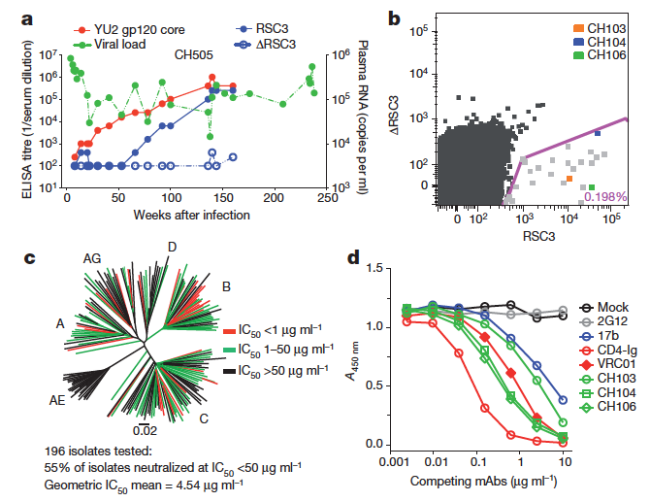

Slide 20
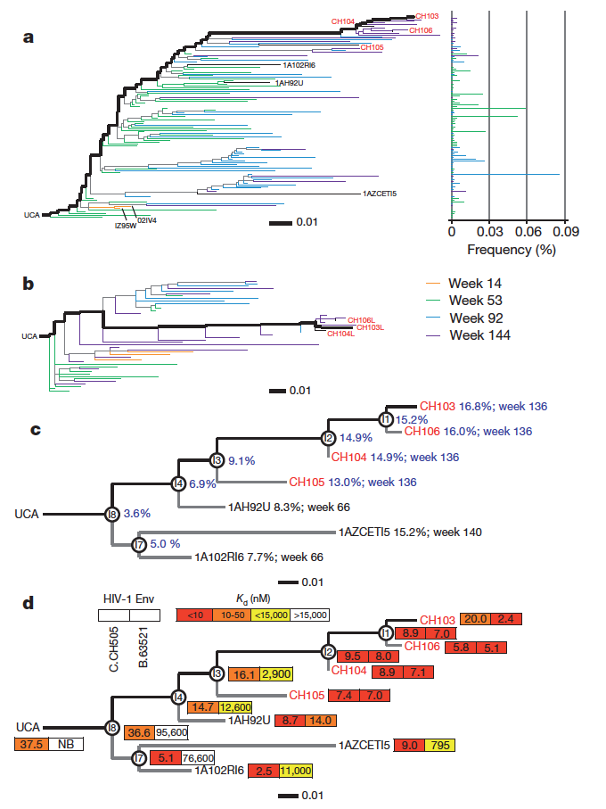
a,b antibodies were representatives of a single
clonal lineage designated as the CH103 clonal lineage
c, Maximum likelihood phylogram showing the CH103 lineage with the inferred intermediates (circles, I1–4, I7 and I8)
Binding affinities (Kd, nM) of antibodies to
autologous subtype C CH505 (C.CH505; left box) and heterologous B.63521

Slide 21
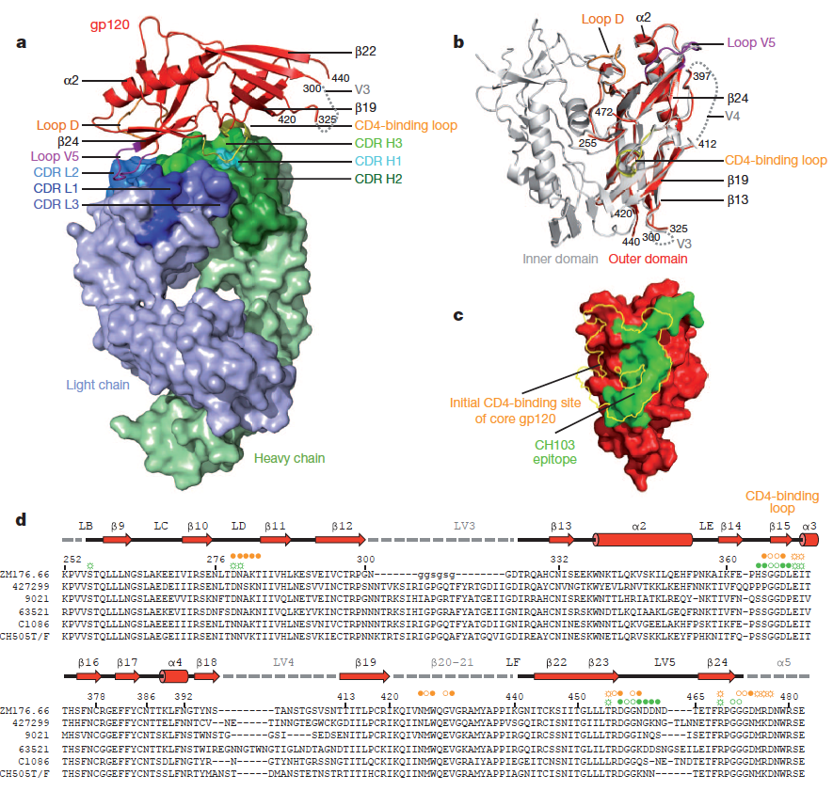

Slide 22
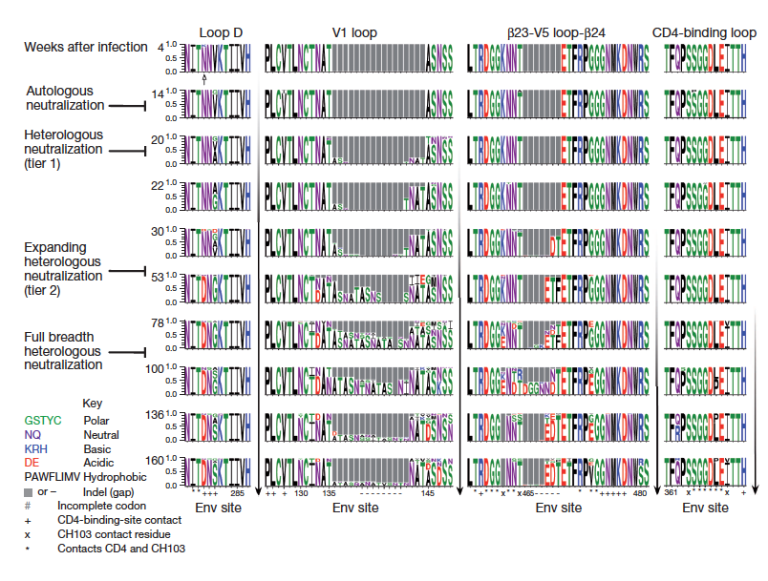

Slide 23
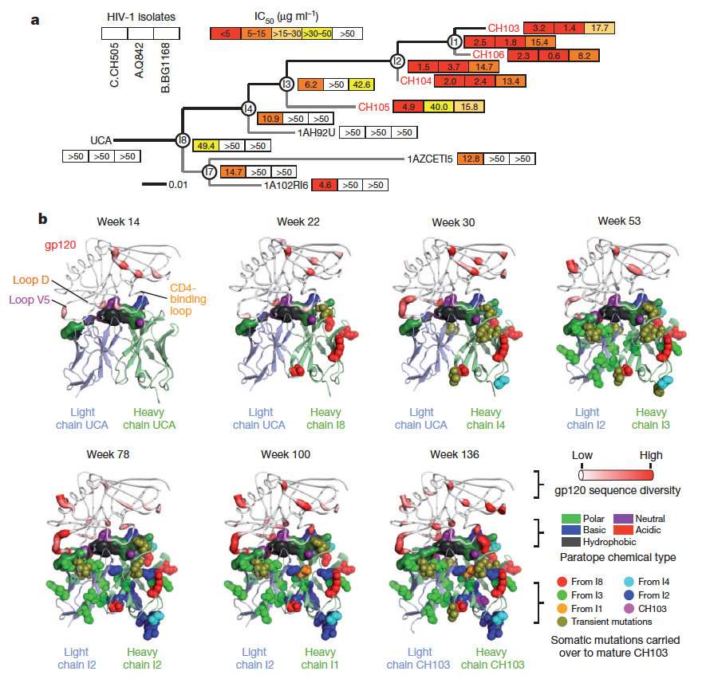

Slide 24
My Future work
Use RNA seq (and DNA seq) to map and construct the evolution of B and T cells
Associate specific types of subclones with cancer properties
Using Bayesian phylogenetic models, to predict the variations in size and clonality during tumor growth

