Slide 1
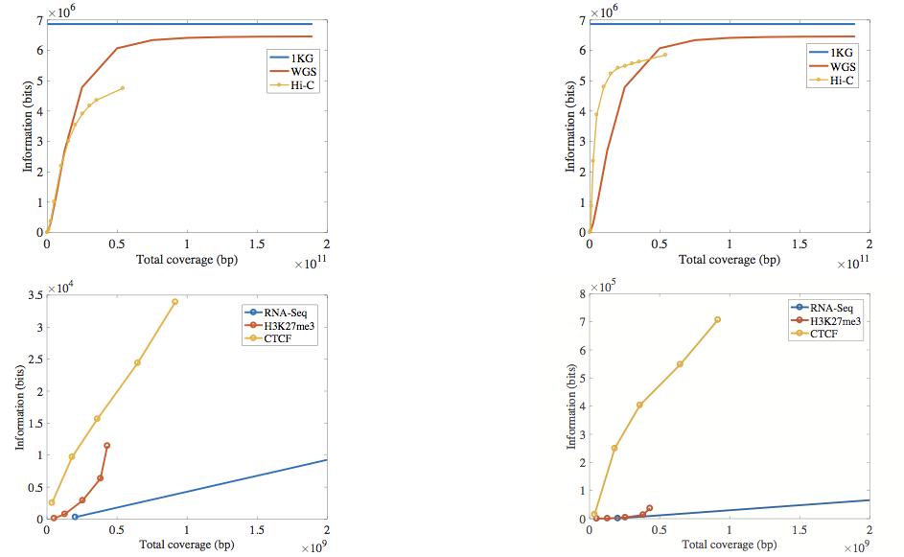
Functional genomics data comes with a great deal of sequencing \
  NA12878 as case study - 1000 genomes variants are used as gold standard
How much information, for example, RNA-Seq reads or ChIP-Seq reads contain? Does that information enough to identify individuals?
  HeLa genome is locked, but we have access to its ChIP-Seq reads!
Is it safe to share the fastq/bam files from these experiments?
with imputation

Slide 2
It might seem like we don’t infer much information from single ChIP-Seq and RNA-Seq experiments compared to WGS
  However putting 10 different ChIP-Seq experiments and RNA-Seq together with imputation provides a great deal of information about the individual

Slide 3
Small Deletions and RNA-seq Signal
RNA-Seq
Signal
Genomic
Coordinate
A C G T A C G
Small Deletion

Slide 4
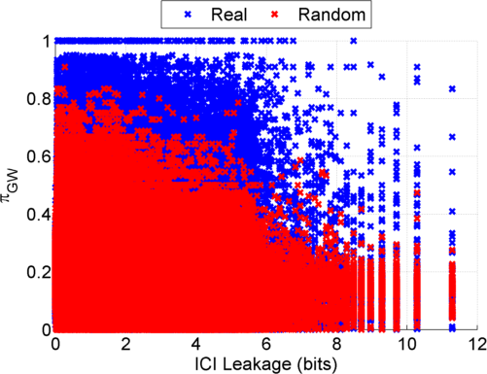
Predictability and Information Leakage: GEUVADIS Dataset
Notes:
GEUVADIS ICI-\Pi_GW estimates:

Slide 5
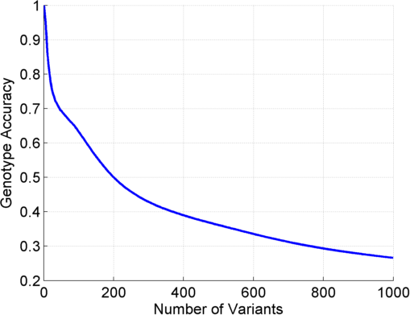
Genotype Prediction Accuracy

Slide 6
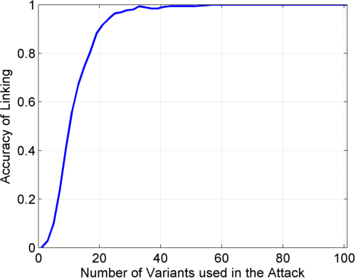
Linking Attack: GEUVADIS Dataset

