Slide 1

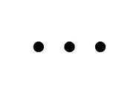
Mutation recurrence
Cancer Type 1
Cancer Type 2
Cancer Type 3

Slide 2
Mutation recurrence
Cancer Type 1
Cancer Type 2
Cancer Type 3
Early replicated regions
Late replicated regions

Slide 3
Noncoding annotations
Cancer Type 1
Cancer Type 2
Cancer Type 3
Early replicated regions
Late replicated regions

Slide 4
Noncoding annotations
Cancer Type 1
Cancer Type 2
Cancer Type 3
Early replicated regions
Late replicated regions

Slide 5
Cancer Somatic Mutational Heterogeneity, across cancer types, samples & regions
[Lochovsky et al. NAR (’15)]

Slide 6


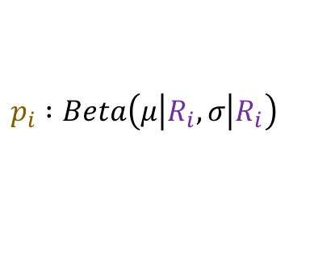
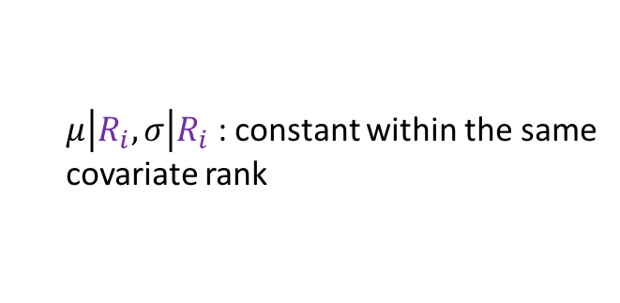

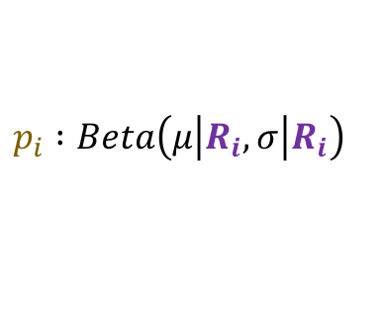

Cancer Somatic Mutation Modeling
Parametric
Models
Model 1: Constant Background Mutation Rate (Model from Previous Work)
4 models to evaluate the significance of mutation burden
  3 parametric
  1 non-parametric
Suppose there are k genome elements. For element i, define:
  n_{i}: total number of nucleotides
  x_{i}: the number of mutations within the element
  p: the mutation rate
  R_{i}: the covariate rank of the element
Non-parametric model is useful when covariate data is missing for the studied annotations
  Also sidesteps issue of properly identifying and modeling every relevant covariate (possibly hundreds)
Non-Parametric Model: Random Permutation
of Input Data
$$x_{i} :Binomial\left(n_{i},p\right)$$
Assume constant background mutation rate in local regions.
Shuffle variants or annotations within local region to assess background mutation rate.
Model 2a: Varying Mutation Rate with Single Covariate Correction
$$x_{i} :Binomial\left(n_{i},p_{i}\right)$$
$$p_{i} :Beta\left(μ\left|R_{i}\right.,σ\left|R_{i}\right.\right)$$
[Lochovsky et al. under review]
$μ\left|R_{i}\right.,σ\left|R_{i}\right.$ : constant within the same
covariate rank
Model 2b: Varying Mutation Rate with Multiple Covariate Correction
$$x_{i} :Binomial\left(n_{i},p_{i}\right)$$
$$p_{i} :Beta\left(μ\left|R_{i}\right.,σ\left|R_{i}\right.\right)$$
$μ\left|R_{i}\right.,σ\left|R_{i}\right.$ : constant within the same
covariate rank
[Lochovsky et al. NAR (’15)]

Slide 7
Non-parametric Model Overview
Mutations Overburdening Annotations Tool: MOAT
Provide an nonparametric method for determining significant mutation burdens in genome variant datasets
Permute variants in accordance with known background mutation rate patterns
Demonstration with cancer genomes, although method is applicable to any genome variant set
Computationally expensive
  Address with general purpose GPU acceleration
Notes:
MOAT represents an alternative approach to the mutation burden problem, which doesn’t rely on a statistical model, but instead on creating permutations of the variant and annotation data within a local genome context to get a sense of what the background mutation rate is, and evaluate mutation counts accordingly. Hence, this approach represents an empirical, nonparametric method for finding elevated mutation burdens. No knowledge of the underlying covariates that influence the mutation rate is necessary, we merely work with the variants as observed in the surrounding genome.

Slide 8
MOAT-a: Annotation-based permutation
Is the mutation burden of a randomly placed bin of the same length in the local genome region greater or less than the burden of the annotation?
Pick n permutation bins within the boundaries of d_min and d_max (upstream and downstream)
Out of the n variant counts from permutation bins, how many are >= the variant count of the actual annotation a?
annotation
permutations
d_max
d_max
d_min
d_min
…
Notes:
Formally, this method incorporates the annotation length l, the number of random bins we’re going to place in the surrounding genome, n, and two parameters that determine the boundaries of the local genome in which we place random bins, d_min and d_max. d_max has to be small enough that the background mutation rate is roughly constant, while d_min exists to ensure that, if there’s some transitionary region between the mutation rate of a and the mutation rate of the surrounding genome, that the signal from a won’t bleed into our analysis of the local genome context.

Slide 9
MOAT-v: Variant-based Permutation
Move the variants semi-randomly to new positions in the local genome, then count the intersecting variants in the annotation
Set bin width W to the length of the local genome context
  Assume slowly varying (essentially constant) BMR in this context
Create n permutations of the input variants
Out of the n variant permutations, how many have variant count of the annotation >= the variant count for the original input variants?
W ≈ 2*d_max
annotation
bin width W
…
Notes:
The second version of MOAT operates on the idea of variant-based permutation. We place bins over the entire genome that each represent a local genome context, shuffle the variants in each bin, and track permuted variant counts for the annotation we’re studying.

Slide 10
MOAT-v: Variant-based Permutation
For each bin, repeat n times:
  Iterate through intersecting variants: pick a new location in the bin that has the same trinucleotide context in the reference genome as the original variant location
    Pick with uniform probability, excluding the original variant location as a possible new location
new variant
original variant
alt
T
T
ref
CTTCAAGTTCTCAACTCCTGTCAATATCCCTTCCCCTCAACTTGACAATC
*
*
*
*
* = candidates for variant’s new location
Notes:
When we move the variants’ to new locations, we want to preserve the trinucleotide context of the variant, which includes the nucleotide where the variant occurs, and the two neighboring nucleotides on either side. To do this, we index every trinucleotide in the reference genome within the variant’s bin, and select one of these new locations with uniform probability, excluding the original variant site. With this, we maintain the mutation frequencies of the trinucleotides in each bin, and it ensures that the trinucleotide mutation rates are consistent in our permutations.

Slide 11
MOAT-s
A somatic variant simulator
  Given a set of input variants, shuffle to new locations, taking genome structure into account
  MOAT-v’s permutation step without the p-value calculations
bin width
W
Binning whole genome
…
Marking equivalence classes (bins with similar covariate vectors)
…
Overlaying variants (with tri-nucleotide indexing)
…
Shuffling variants
…

Slide 12
Funseq2 Integration
Funseq2¹ integration with MOAT
  Computational method developed in the Gerstein lab
  Assesses the functional impact of whole genome sequence variants
  Uses a vast range of coding and noncoding annotations to prioritize variants most likely to be associated with cancer
MOAT identifies input variants with significantly elevated Funseq scores
  Computations performed alongside mutation burden analysis
  Works with MOAT-a and MOAT-v
1. Fu, Y. et al. FunSeq2: a framework for prioritizing noncoding regulatory variants in cancer. Genome biology 15, 480 (2014).
Notes:
Just as mutation burden is intended to help find the important stuff in cancer, we can also prioritize important parts of the genome with a functional impact analysis.

Slide 13
Funseq2 Integration
Run Funseq2 over the whole genome
  Produce signal track that is the maximum score at each position
  Calculate an annotation signal by summing the intersecting variants’ scores
  Use the same procedure on permuted data
  These are background scores to determine if the observed score is significantly elevated
80
80
50
20
20
50
+
30
20
= 50
0
40

Slide 14
Funseq2 Integration
Compiled list of annotations with significantly elevated Funseq2 scores
  TSSes, promoters, enhancers
  Results comparable to the elevated mutation burden analysis
MOAT implementation is generalizable to any whole genome signal track
  e.g. can plug in a GERP score or K27 acetylation file
Negligible effect on runtime
  Parallelization scalability preserved
Notes:
Seems that the list for Funseq2 is longer than for mutation burden → higher false positive rate?

Slide 15
LARVA Model Comparison
Comparison of mutation count frequency implied by the binomial model (model 1) and the beta-binomial model (model 2) relative to the empirical distribution
The beta-binomial distribution is significantly better, especially for accurately modeling the over-dispersion of the empirical distribution
[Lochovsky et al. NAR (’15)]

Slide 16
Adding DNA replication timing correction further improves the beta-binomial model
[Lochovsky et al. NAR (’15)]
Bottom 10% of rep. timing bins requires large correction
Top 10% of rep. timing bins
requires little correction

Slide 17
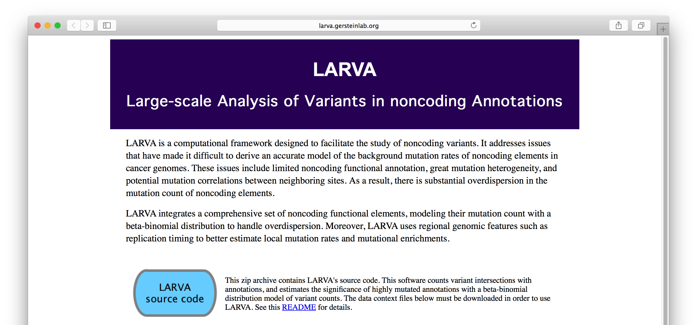
LARVA Implementation
http://larva.gersteinlab.org/
Freely downloadable C++ program
  Verified compilation and correct execution on Linux
A Docker image is also available to download
  Runs on any operating system supported by Docker
Running time on transcription factor binding sites (a worst case input size)
is ~80 min
  Running time scales linearly with the number of annotations in the input

Slide 18
LARVA Results
TSS LARVA results
These have
literature-verified
cancer associations
β-binomial
binomial
noncoding annotation
p-values in sorted order
18
[Lochovsky et al. NAR (’15)]

Slide 19
MOAT-a Timing Results
Number of variants | Number of permutations | CPU version running time | GPU version running time | Fold speedup of GPU version
7,000 | 1,000 | 3m 18s | 14s | 14
7,000 | 10,000 | 40m 6s | 24s | 100
7,000 | 100,000 | 8h 31m | 2m 17s | 256

