Slide 1
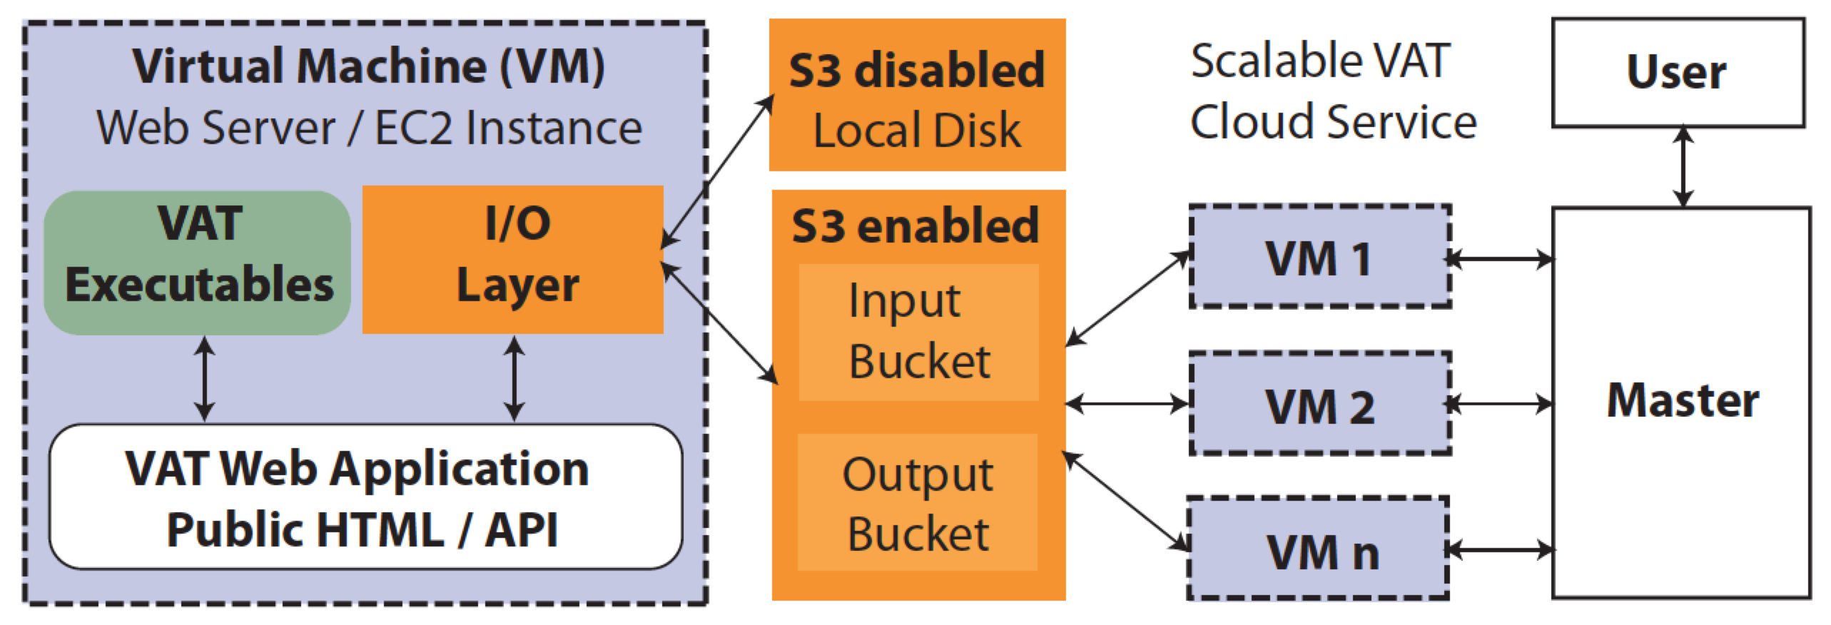
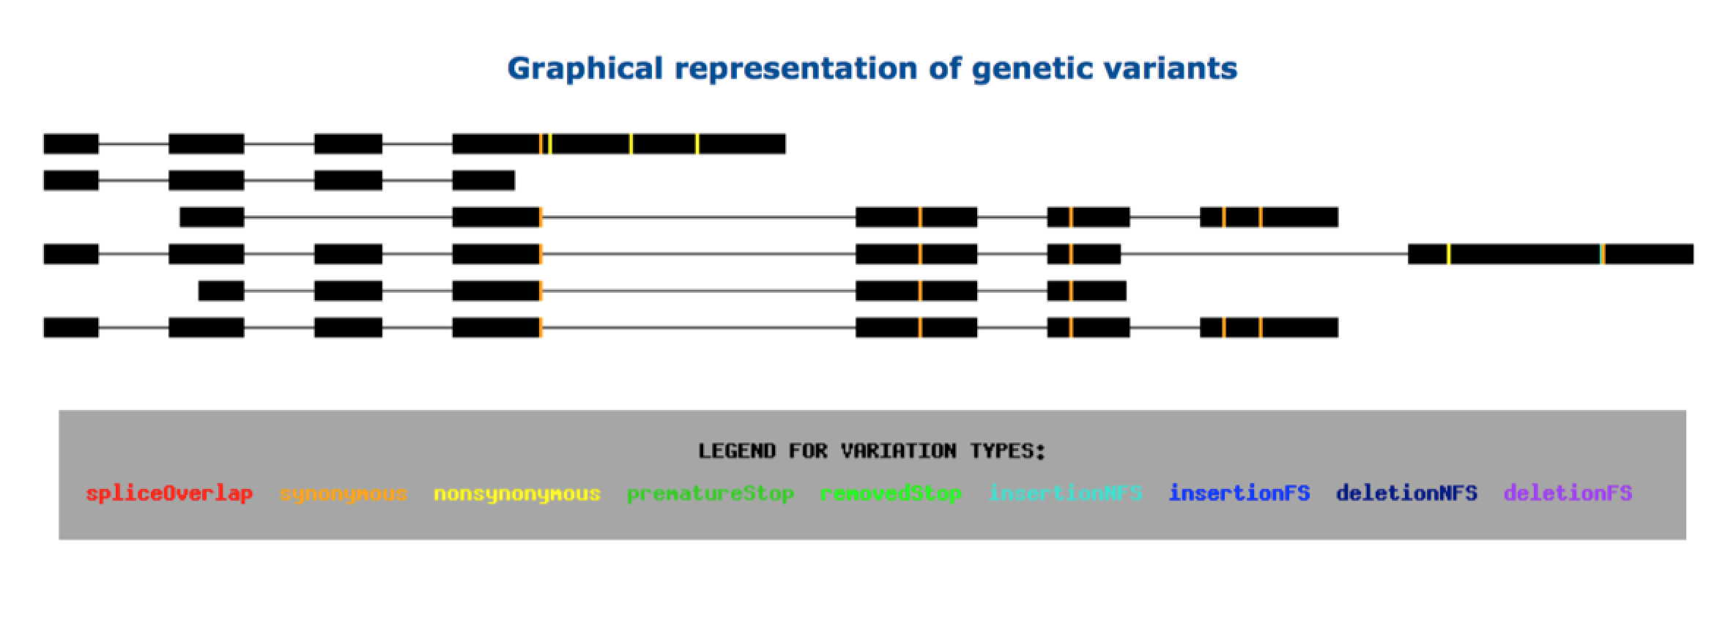
vat.gersteinlab.org
Variant Annotation Tool (VAT)
Similar to VEP
Input
Uses GENCODE (with option of CCDS & other annotations)
Overlaps with 1000G SNPs, MNPs, indels & SVs (other input VCFs possible)
Output
Annotated VCFs
Graphical representations of
functional impact on transcripts
Access
Source freely available
Webserver
AWS cloud
instance
CLOUD APPLICATION
Habegger L.*, Balasubramanian S.*, et al. Bioinformatics, 2012
Notes:
1
Big data challenge, graphical interface is important

Slide 2
Loss-of-function (LoF) variant effect varies by location
Transcript isoforms affected.
Distance of mut to stop codon.
Functional domains affected.
Other attributes – disease gene networks, conservation,
How can we systematically assign a predicted effect to LoF mutations?
[Balasubramanian et al., Genes Dev., ’11]

Slide 3
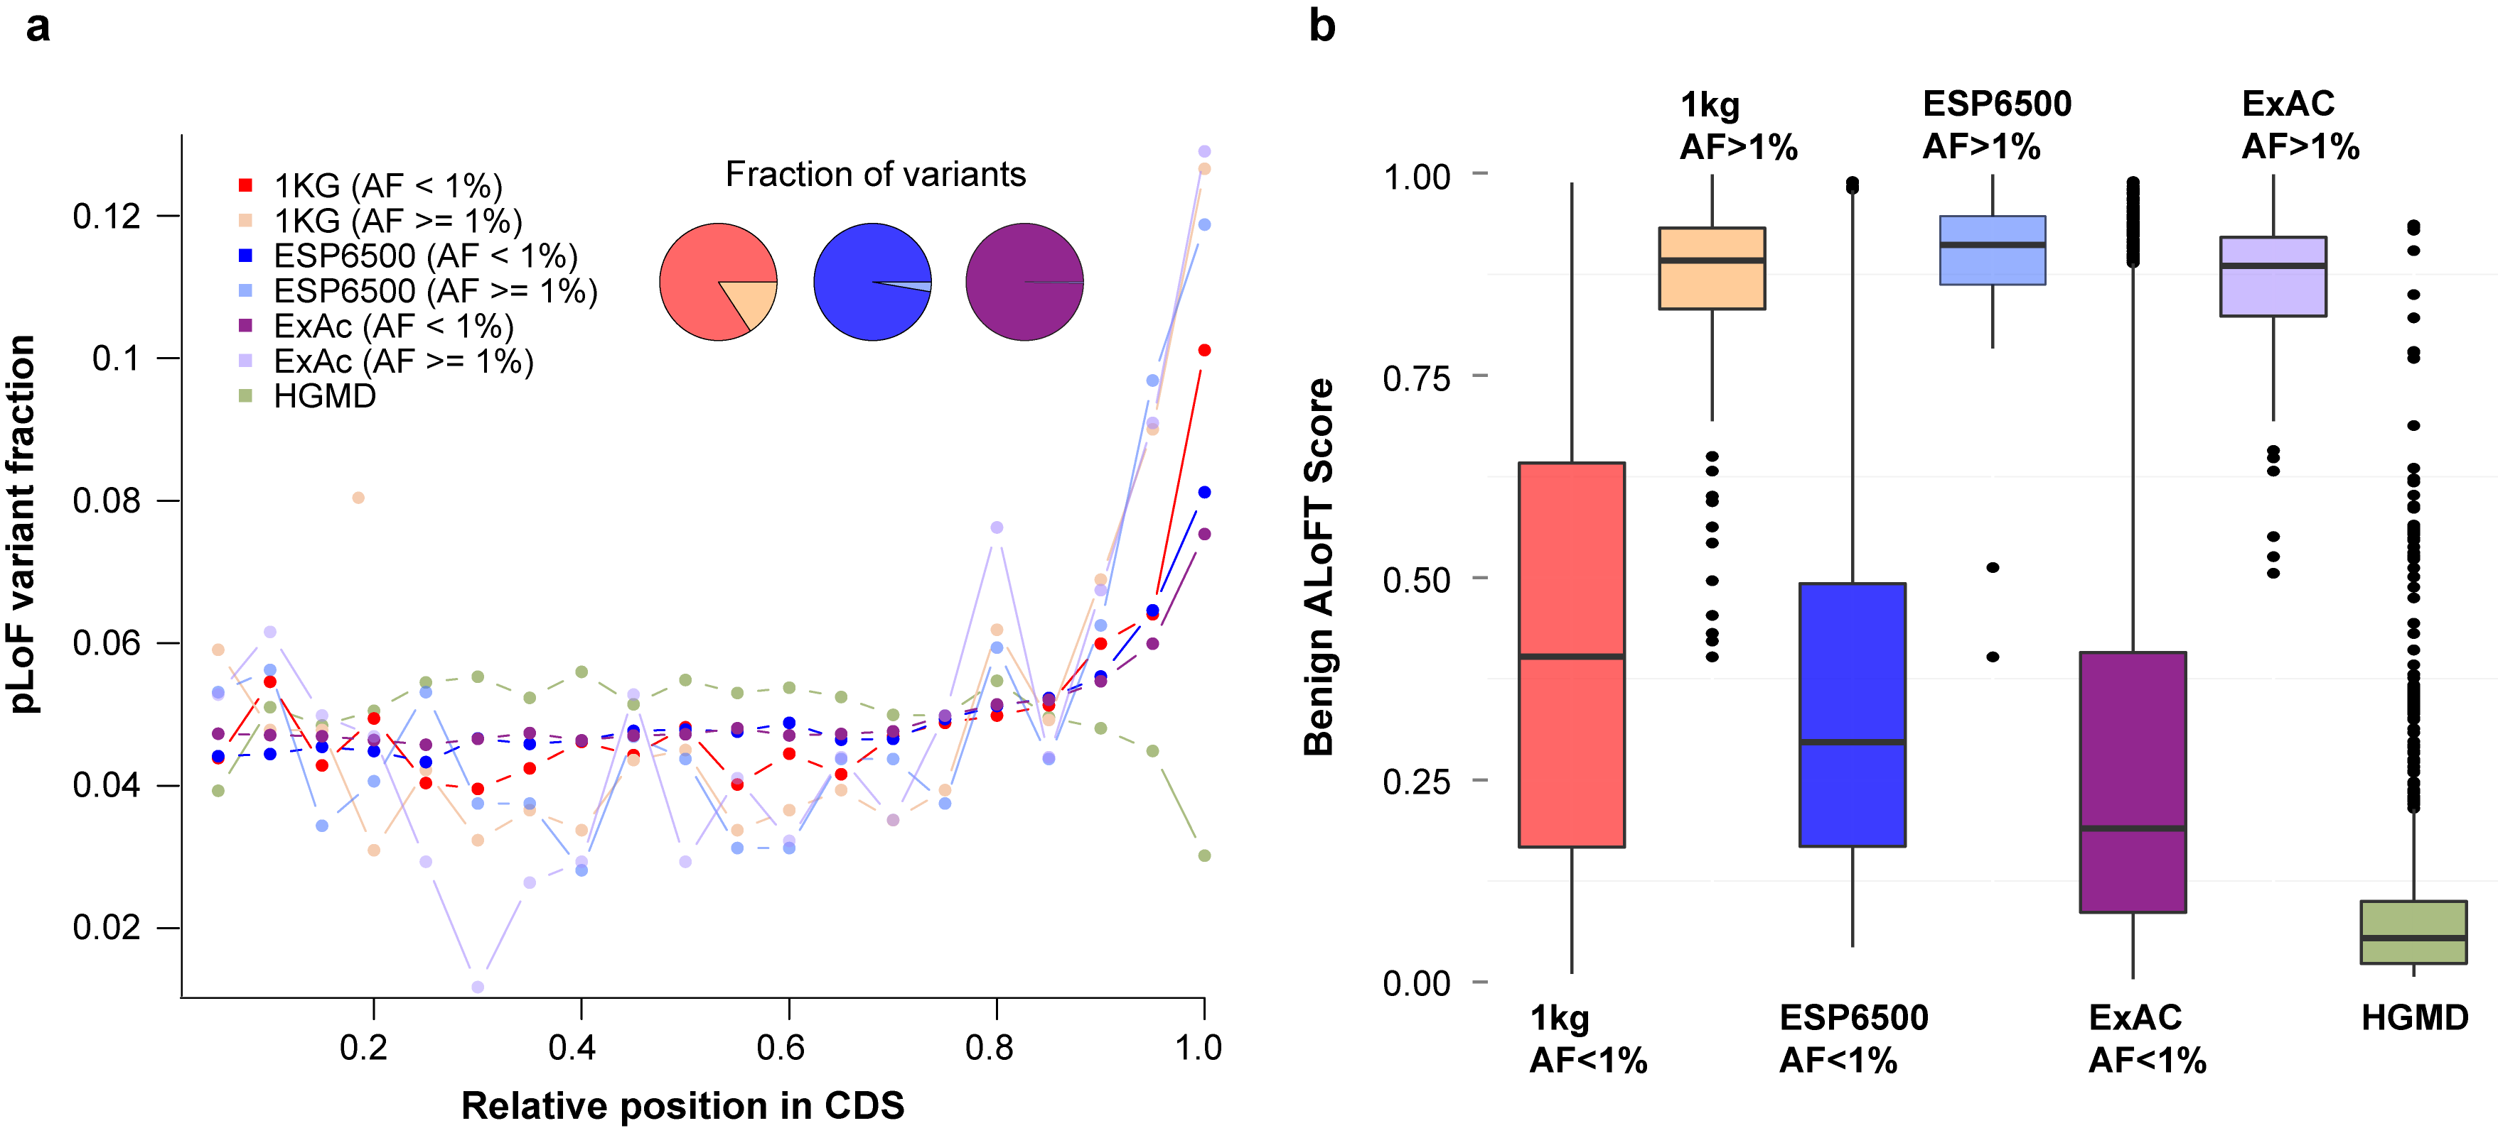
LoF CDS position distribution varies by cohort
Earlier in transcript:
HGMD (disease variants)
Rare variants (AF <1%)
Later in transcript:
1KG, ExAC, ESP6500
Common variants (AF >1%)

Slide 4
Annotation of Loss-of-Function Transcripts (ALoFT)
aloft.gersteinlab.org
VCF file input.
Automatic annotation of variants, incl. mismapping, function, conservation, etc.
Predicts disease-causing potential:
Benign vs. deleterious
Assigns prediction confidence.
Notes:
-- YZ (comment below) --
NMD prediction - Prediction of nonsense-mediated mRNA decay (NMD)
Information of benign, dominant and recessive are from HGMD-DM
Prediction model based on random forests
Wiki:
In genetics, a nonsense mutation is a point mutation in a sequence of DNA that results in a premature stop codon, or a nonsense codon in the transcribed mRNA, and in a truncated, incomplete, and usually nonfunctional protein product.
Wiki:
Nonsense-mediated mRNA decay (NMD) is a surveillance pathway that exists in all eukaryotes. Its main function is to reduce errors in gene expression by eliminating mRNA transcripts that contain premature stop codons. If these aberrant mRNA transcripts were translated, the result would be deleterious gain-of-function or dominant-negative activity of the resulting proteins.
Biostars:
Neutral Evolution (drift): dN/dS ratio = 1 implies there has been equal numbers of synonymous (dna substitutions that do not affect the protein sequence) and non-synonymous changes (dna substitutions that do affect the protein sequence) during the time between ancestral to the modern versions of the protein.
Positive Selection (adaptive evolution): dN/dS ratio > 1 implies there has been more non-synonymous changes than synonymous changes. There has been evolutionary pressure to escape from the ancestral state - i.e. positive selection pressure. This can occur for example in paralogues that are required to serve a novel function, or in proteins of parasites that need to escape host immune recognition (e.g. changes to avoid MHC-1 binding to evade T-cell attack).
Negative Selection (conservation): dN/dS ratio < 1 implies there has been more synonymous changes than non-synonymous changes. There has been evolutionary pressure to conserve the ancestral state - i.e. negative selection pressure. This can occur for example in orthologues that are required to maintain (conserve) some function encoded in the protein sequence, since changes from this state would lead to disruption of function.

Slide 5
ALoFT identifies variants with disease causing potential

Slide 6
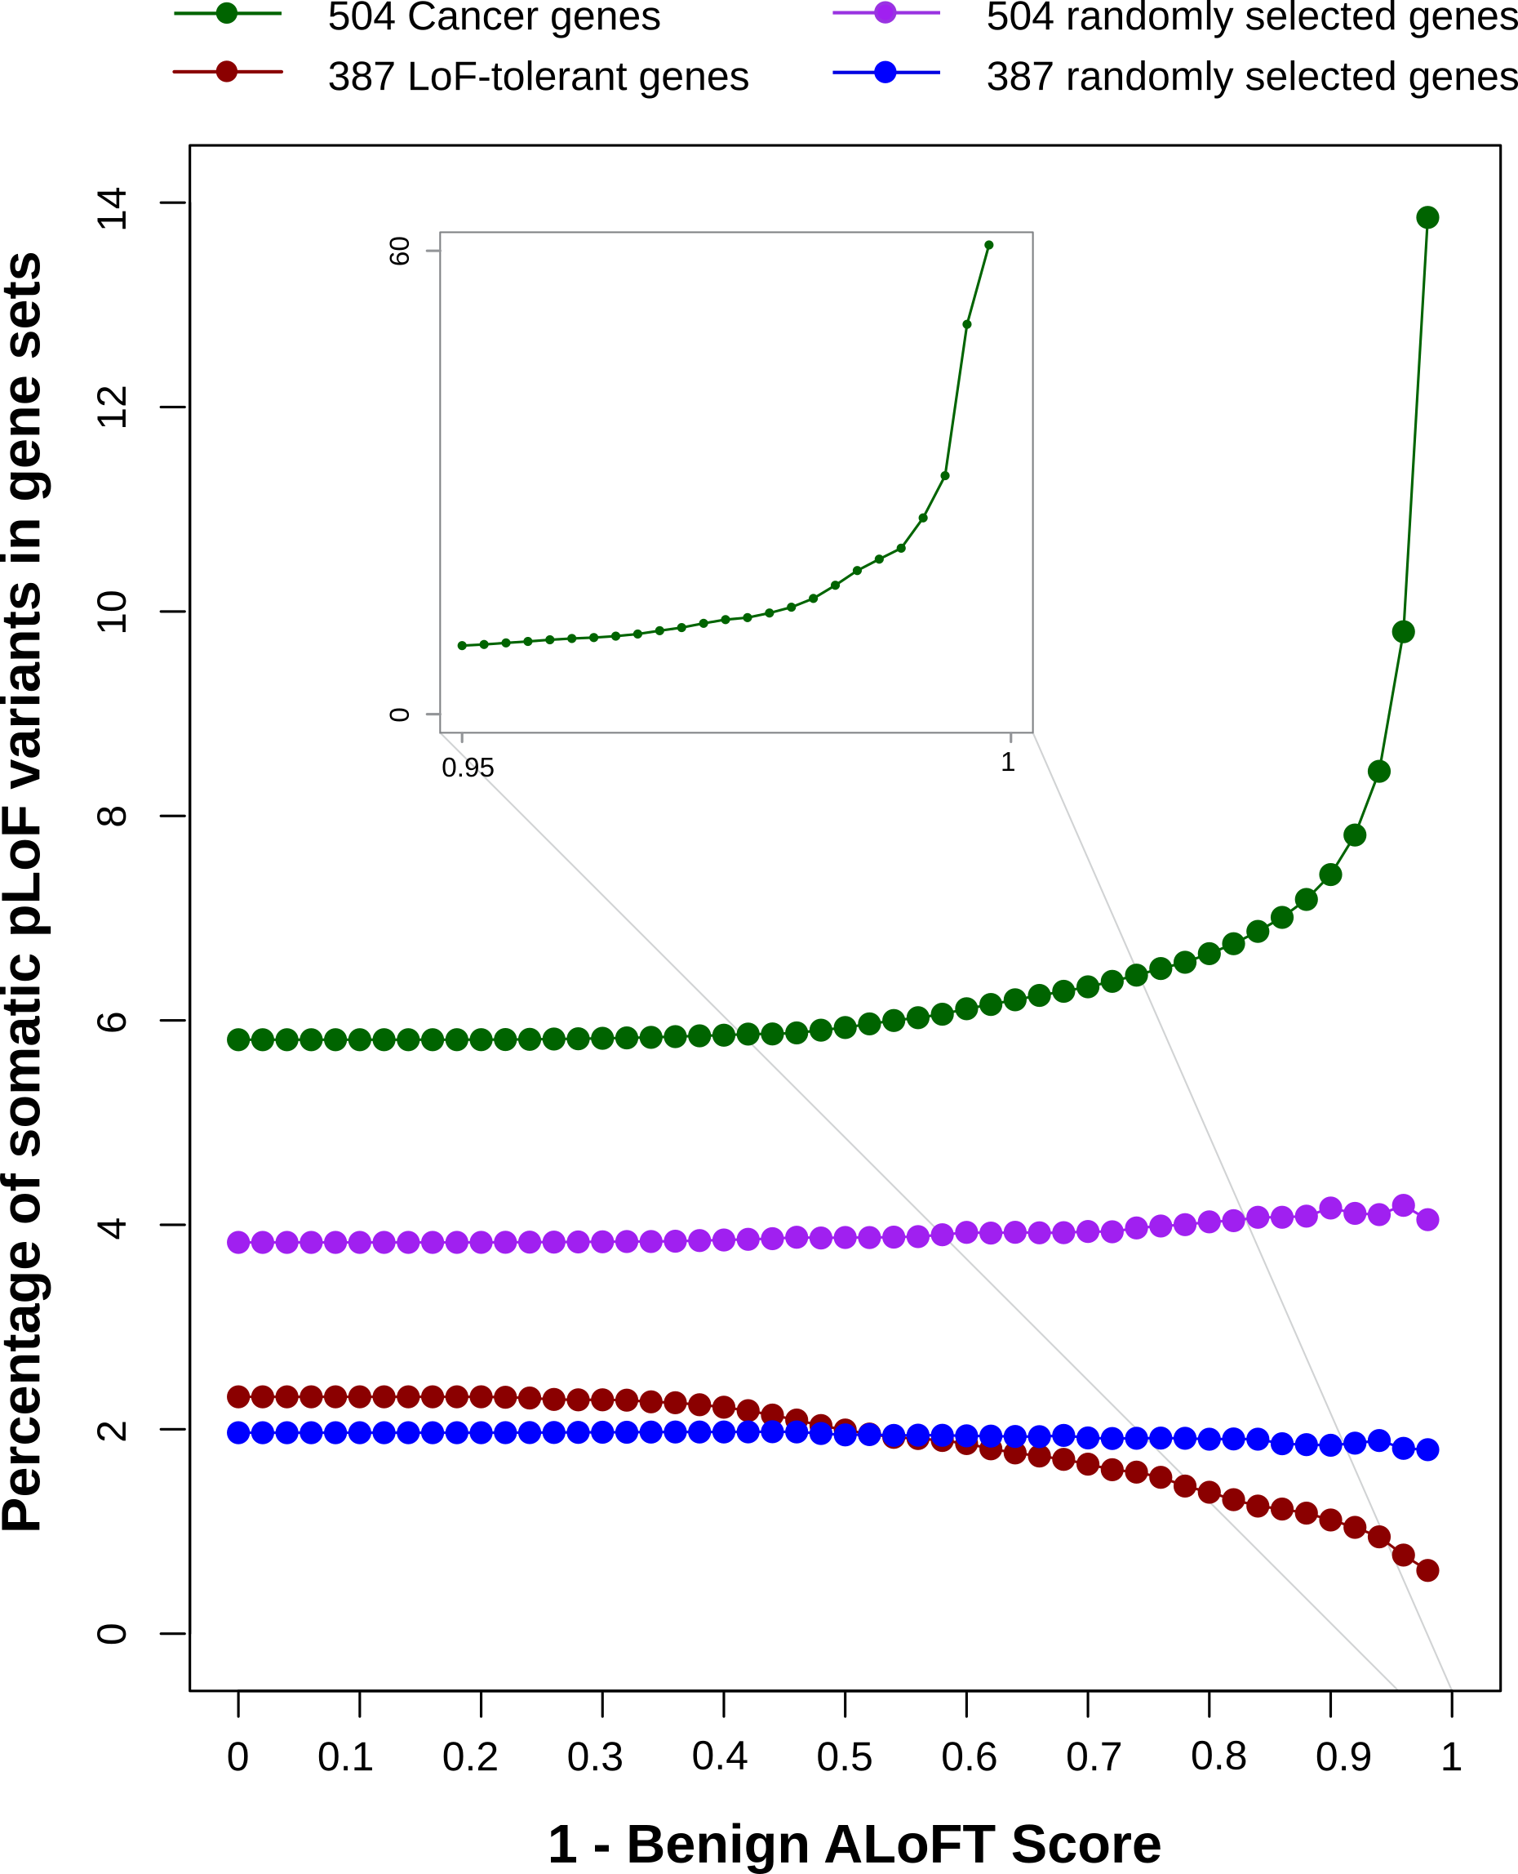
ALoFT identifies deleterious somatic LoF variants
LoF tolerant genes:
LoF in the 1KG cohort.
Depleted in deleterious LoFs.
Cancer genes:
COSMIC consensus.
Enriched in deleterious LoFs.

Slide 7
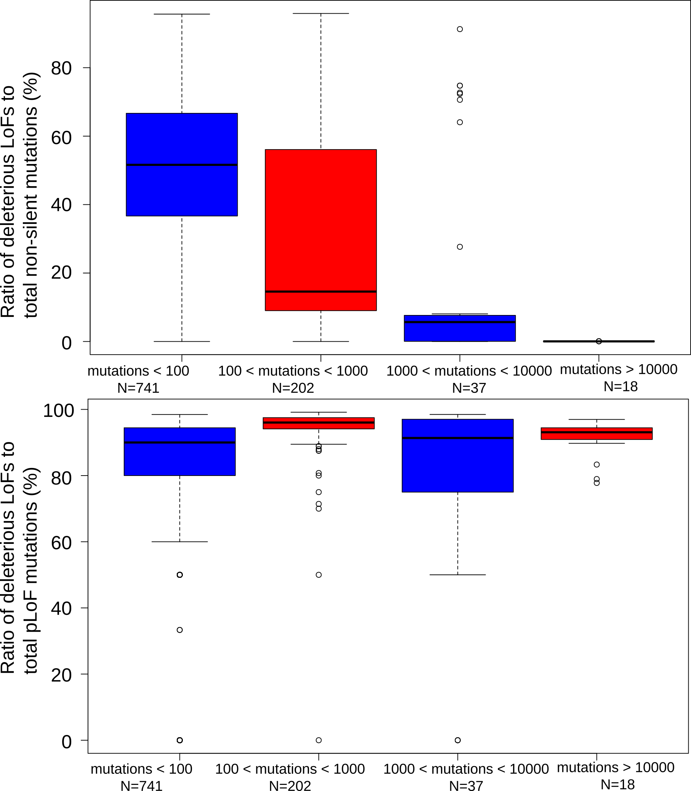
Deleterious LoF mutations vs. total tumor mutational burden
Higher mutational burden samples have proportionally fewer deleterious LoF mutations.
The ratio of benign/deleterious LoF mutations is reliably high.

Slide 8
Tumor suppressor genes: the 20/20 rule
Vogelstein et al. 2013: “To be classified as a tumor suppressor gene, we require that >20% of the recorded mutations in the gene are inactivating”
ALoFT has the potential to further refine 20/20 rule predictions.

