Slide 1
3rd GTEx Community Meeting
JULY 11TH, 2016
Stanford University

Slide 2
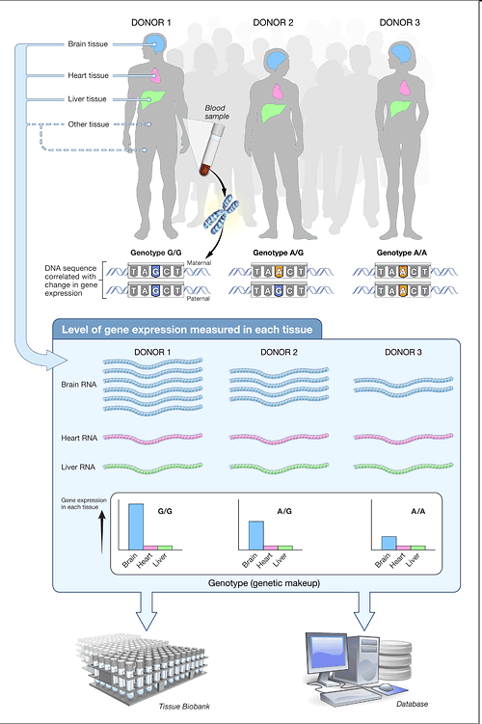



GTEx = Genotype-Tissue Expression
NIH Common Fund (commonfund.nih.gov/gtex)
GTEx GOAL:
to help unravel the complex interplay between genetic variation and gene expression across a wide range of non-diseased human tissues.
  Atlas of gene expression & eQTLs
  Biobank of tissues, DNA, RNA
by end 2017:
~960 Postmortem Donors
WES & WGS
RNA-Seq of ~30 tissues/donor (>20,000 tissues)
Beyond Gene Exp

Slide 3
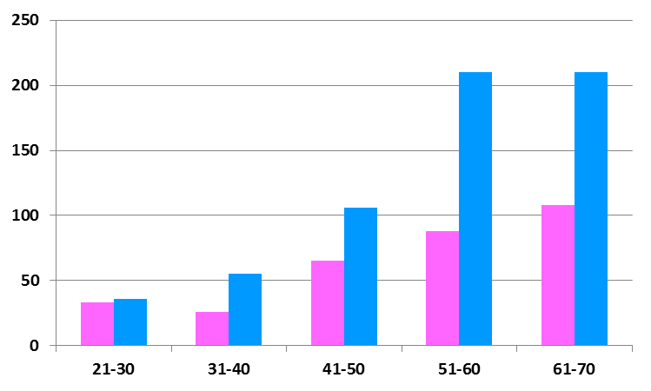
Donor Demographics
Donors (N)
Age

Slide 4
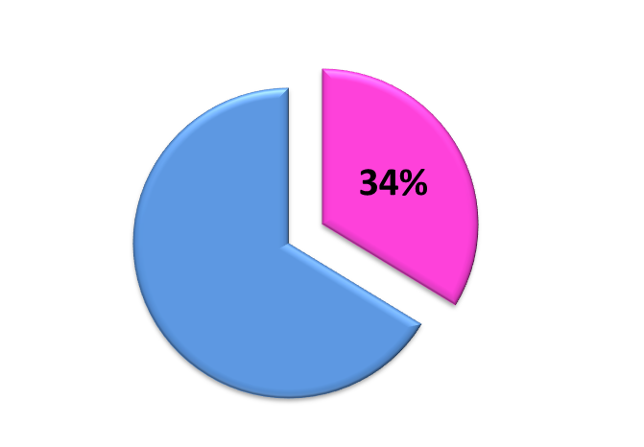
Donors - Sex and Race
Female
Asian 1%
African American
13%
66%
American Indian/Alaska Native <1%
Unknown
<1%
Male
White
85%

Slide 5
Cause of Death
Cause of Death | 21 - 40 | 41 - 70
Stroke | 18% | 28%
MI | 5% | 33%
Trauma - Blunt Injury, MVA, Falls, GSW | 42% | 8%

Slide 6
Death classification
Hardy Scale | overall
0 | 53%
1 | 4%
2 | 25%
3 | 6%
4 | 12%
Low PMI
Brain donors
0. Ventilator Case
1. Violent and fast death Deaths due to accident etc; terminal phase (TP) < 10 min
2. Fast death of natural causes; sudden unexpected deaths; TP < 1 hr
3. Intermediate death; 1<TP<24 hrs; patients who were ill but death was unexpected
4. Slow death; TP> 1 day, deaths that are not unexpected

Slide 7
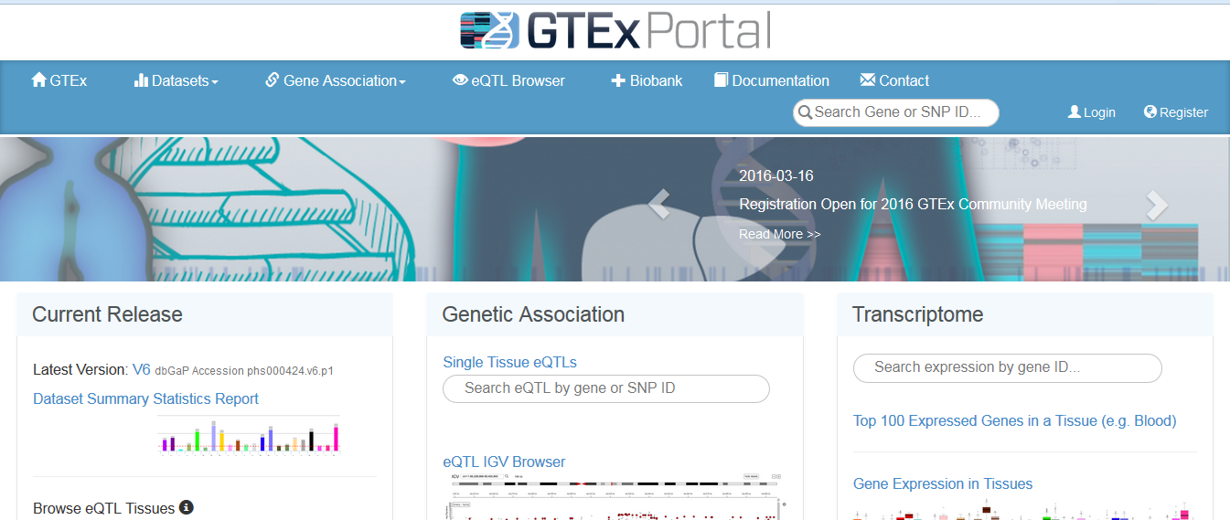
GTEx resources
GTEx Portal: an open access database of GTEx summary data: http://www.gtexportal.org
Jared Nedzel for the GTEx portal
Daniel Zerbino for ENSEMBLE

Slide 8
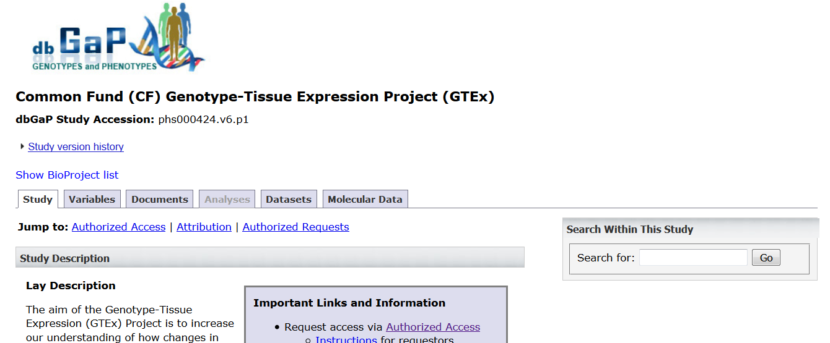
GTEx resources cont.
dbGaP: controlled access of comprehensive GTEx clinical and raw sequencing data: http://www.ncbi.nlm.nih.gov/gap

Slide 9
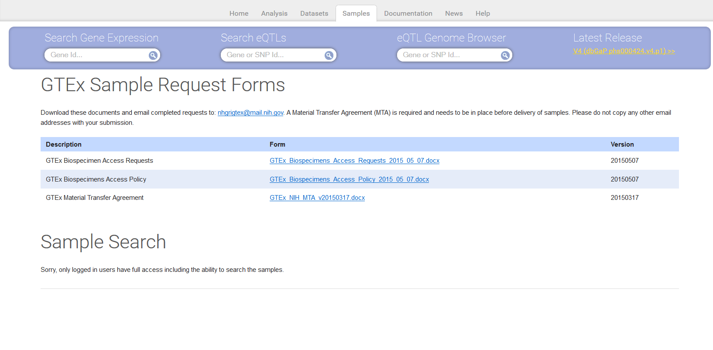
Sample Access
http://www.gtexportal.org/home/samplesPage
Available Biospecimens
  PAXgene fixed, frozen tissue; PAXgene Fixed, Paraffin Embedded Tissue; RNA; DNA
  Flash frozen brain
  Lymphoblastoid and fibroblast cell lines

Slide 10
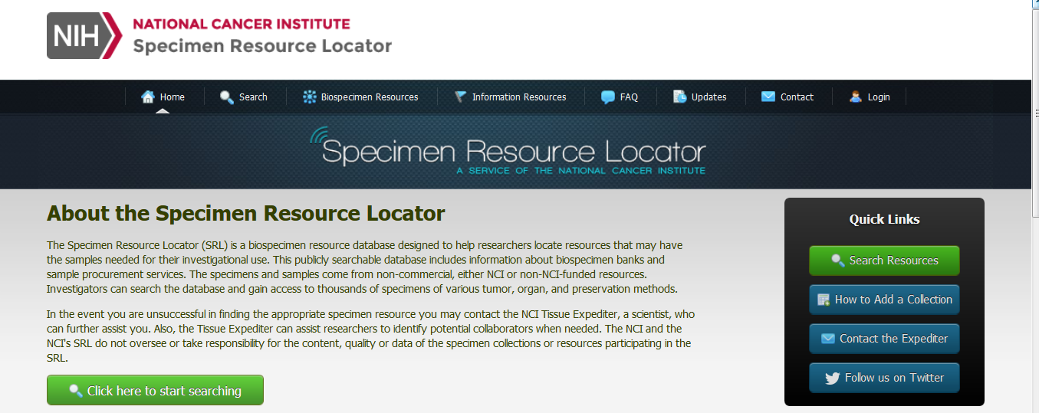
Sample Access cont.
https://specimens.cancer.gov/
The Specimen Resource Locator (SRL) is a biospecimen resource database designed to help researchers locate resources that may have samples needed for their investigational use.
The specimens come from non-commercial, either NCI or non-NCI-funded resources.

Slide 11
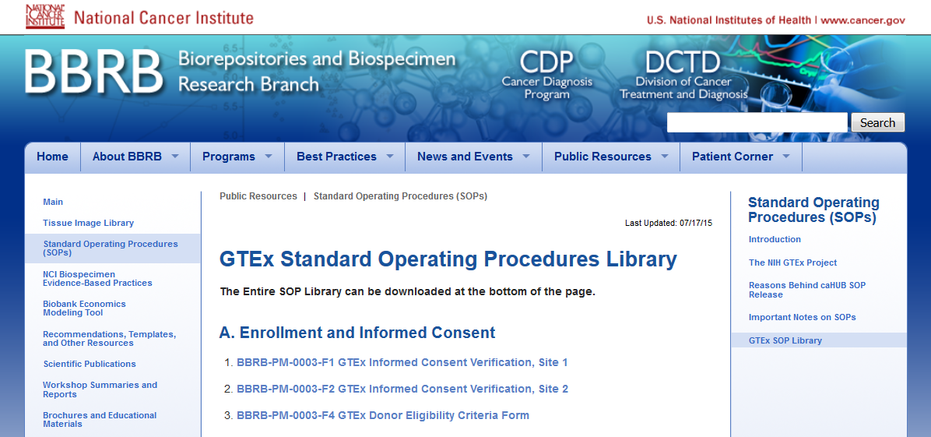
GTEx biospecimen collections SOPs
http://biospecimens.cancer.gov/resources/sops/library.asp
SOPs cover various operations including ethical and regulatory practices, biospecimen collections, data collection, shipping kits and checklists, and pathology review.

Slide 12
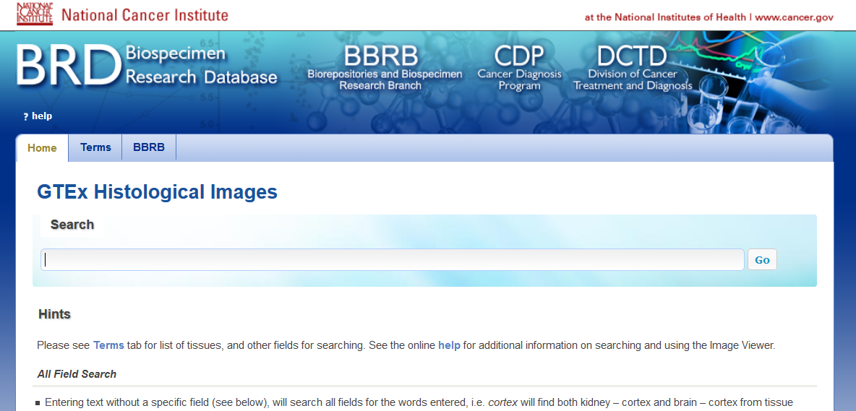
GTEx histological image viewer
http://biospecimens.cancer.gov/resources/tissue_image_library.asp
There are numerous search options for a specific field search (tissue type, autolysis score, gender, acceptability, etc). No software is required, and the images can be viewed with zooming capability.

Slide 13
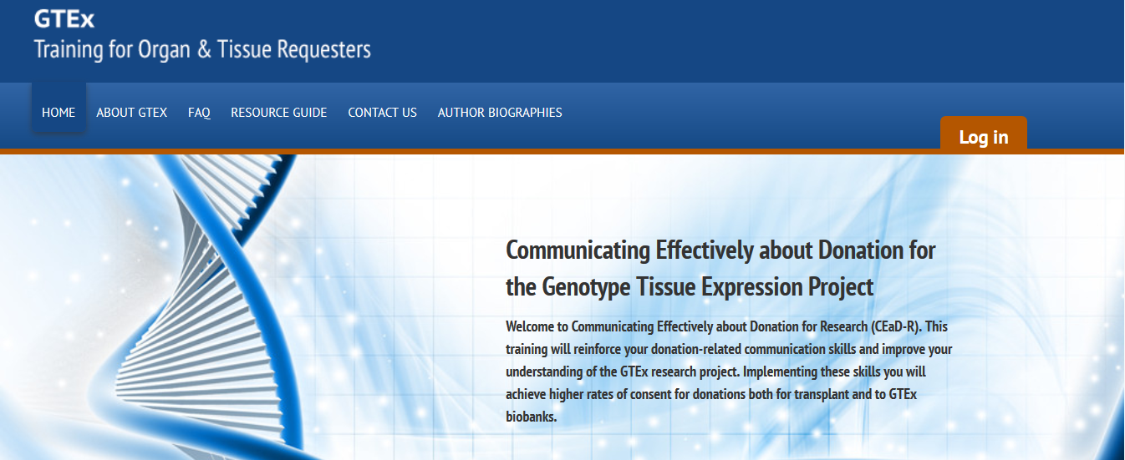
Training videos for consenting personnel
http://gtextraining.org/
Designed to help requesters communicate effectively about donation for GTEx.

Slide 14
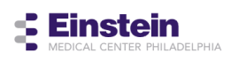



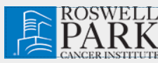


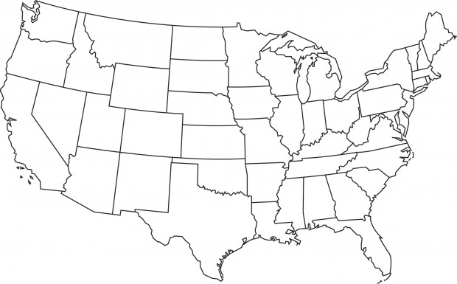

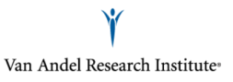
















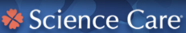

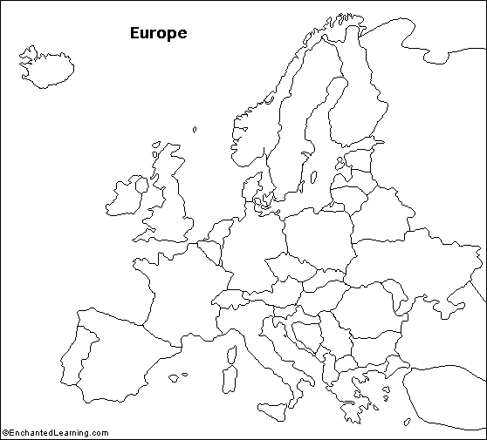






CDR
PRC
Virginia Beach
Roanoke
Richmond
Data analysis
LDACC
eGTEx
ELSI
BSS
NIH
OPO
CBR
CDR
Brain bank
Inactive site

Slide 15
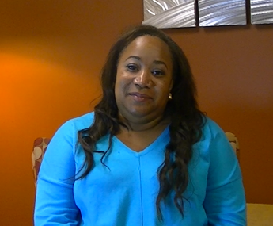
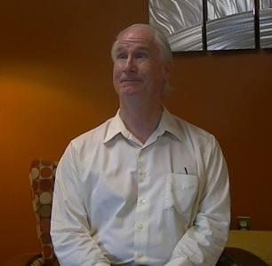
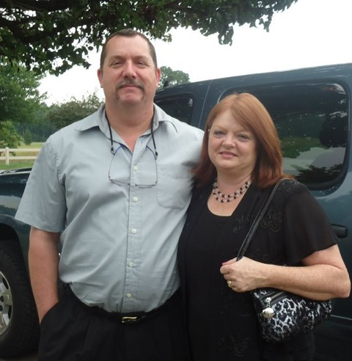
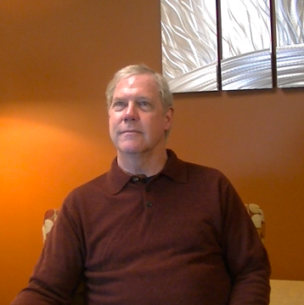
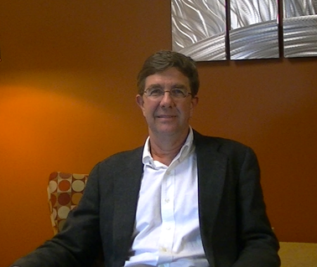
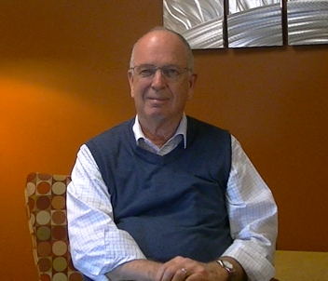
Thank you!

