Slide 1
mHealth data and its similarity to SeeClickFix & Crime
17 August 2017
DS
mHealth

Slide 2
SeeClickFix and Crime
To determine correlations between SeeClickFix use and crime by neighborhood
Current Goal: relate to mHealth
Features
  Data variability (e.g. seasonality)
  Hard to see effect of interventions amongst hidden variables (e.g. changing police chief, big FBI crackdown, change in diet, travel)
  Lots of potential subcategorizations (e.g. what type of SCF posts has an effect on what type of crime)
    Broken windows hypothesis: graffiti & crime

Slide 3
Crime Rate in Each Neighborhood Over Time
Neighborhood
01/2000
Month
08/2012

Slide 5
East Rock
West Rock

Slide 6
mHealth Datasets available
mPower - mobile Parkinson Disease study
Snyder - “Digital Health: Tracking Physiomes and Activity Using Wearable Biosensors Reveals Useful Health-Related Information”
ADAMM -
  had call on Mon (08/14/17), will send NDA

Slide 7
mPower
Demographics. In this survey participants responded to questions about general demographic topics and health history.
MDS-UPDRS. In this survey participants responded to selected questions from the Movement Disorder Society’s Unified Parkinson’s Disease Rating Scale.
PDQ-8. In this survey participants responded to the Parkinson’s Disease Questionnaire short form .
Memory. In this module participants complete a short visuospatial game related to the Corsi block tapping test. [Corsi, P.M. (1972). Human memory and the medial temporal region of the brain (Ph.D.). McGill University.]
Tapping. In this module participants repeatedly tap their phone’s screen.
Voice. In this module participants first record ambient noise level for 5 seconds and if acceptable, they record themselves saying “aaah” for 10 seconds.
Walking. In this module participants walk back and forth for 20-30 seconds with their smartphone in their pocket. They are then asked to stand still for another 20-30 seconds.

Slide 8
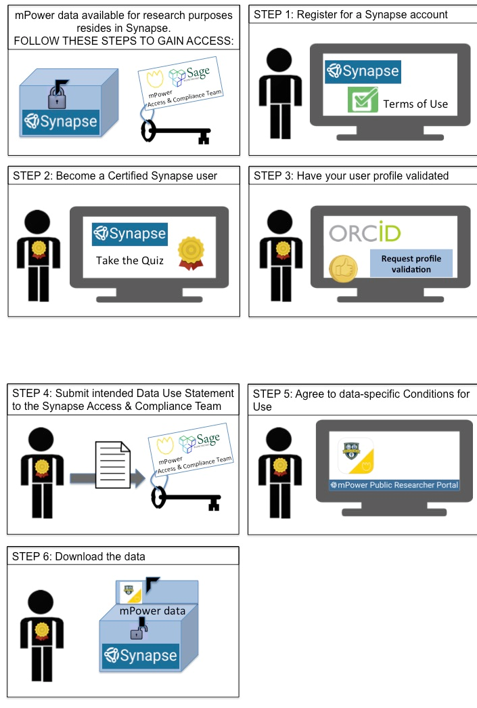
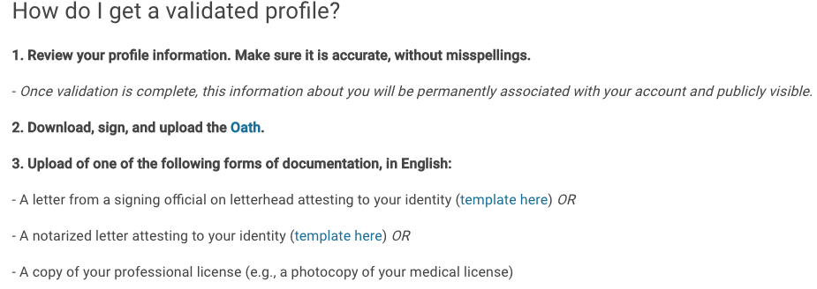

Slide 9
Snyder data
Switch to html

Slide 10
Conclusions
Make a fig relating activity MOVES activity tracking & weight to SCF and crime
In order to figure out the effect of, say, biking, you need ppl that bike a lot and a little – don’t yet have that with the mHealth data (just have Snyder)
For the SCF data
  Treat neighborhoods as different individuals

