Slide 1
RADAR
09 / 07 / 2017

Slide 2
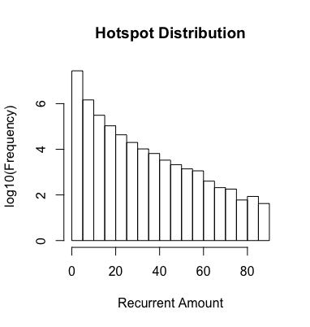
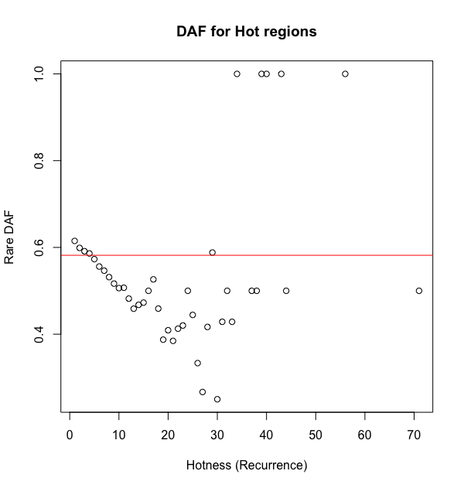
Rare DAF for RBP (uncorrected)
genomic average
genomic average
Coding
Noncoding

Slide 3
Investigation of rare DAF in DDX3X
Coding Genome Avg | Noncoding Genome Avg
0.653 | 0.581
DDX3X, a well-known cancer gene, has the lowest rare DAF in noncoding regions, much lower than genomic average.
Questions:
Could DDX3X have a low quality replicate biasing the rare DAF?
DAF%
Coding DDX3X region | Noncoding DDX3X region
0.584 | 0.401
DAF%
Rep1 Non-coding | Rep1 Coding
0.351 | 0.559
Rep2 Non-coding | Rep2 Coding
0.312 | 0.492

Slide 4
Could blacklist regions bias rare DAF?
Preserved Percent of SNPs after Blacklist Removal
 | Rare | Common
Non-coding region | 0.9997892 | 0.9997994
*Blacklist regions rarely intersect coding regions, so the SNP preservation rate is even higher

Slide 5
Investigating GC content and Rare DAF %
Average GC content in CDS regions is calculated (bigwigaverageoverbed).
We rank the CDS regions based on their GC content.
Take the top 20K (10%) and bottom 20K ranked regions and calculate their rare DAF%
 | Top 20K CDS region | Bot 20K CDS region
Rare DAF % | 49.26% | 69.43%

Slide 6
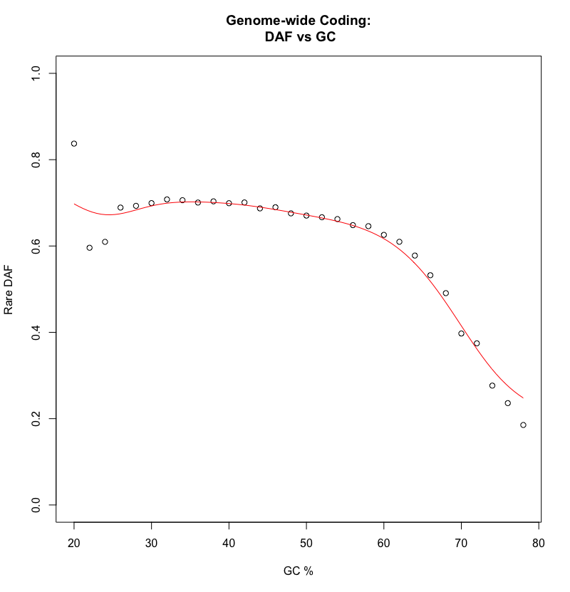
Schematic for RBP rare DAF Correction using local GC content
500bp
GC
…
…
Group together 500 bp regions in genome with similar GC content.
Here 2% GC bins are used
For each 2% GC bin on genome, we calculate rare DAF %
Limit the range of GC% from 20% to 80%, other GC% is rare and few SNPs fall in those regions
30.3
31.2
32.6
64.3
65.2
65.1
30.3
29.5
28.1
…
GC
28-30%
GC
30-32%
GC
32-34%
…
GC
62-64%
GC
64-66%
GC
66-68%
…
Calculate rare DAF for each 2% bin

Slide 7
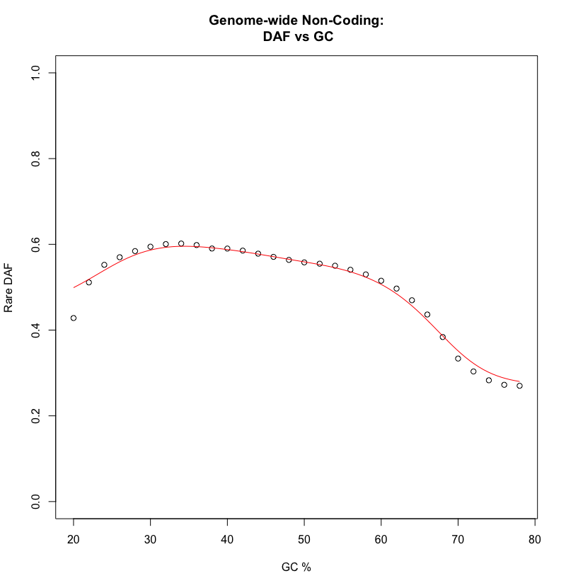
Kernel smoother based on relationship between rare DAF% and GC content gives function for correcting DAF
A kernel smoother (R: ksmooth) is used to smooth the coding and non-coding curves.
Kernel: Gaussian
bandwidth = 10
This forms a quasi-continuous function to calculate a corrected rare DAF % based on the GC content.

Slide 8
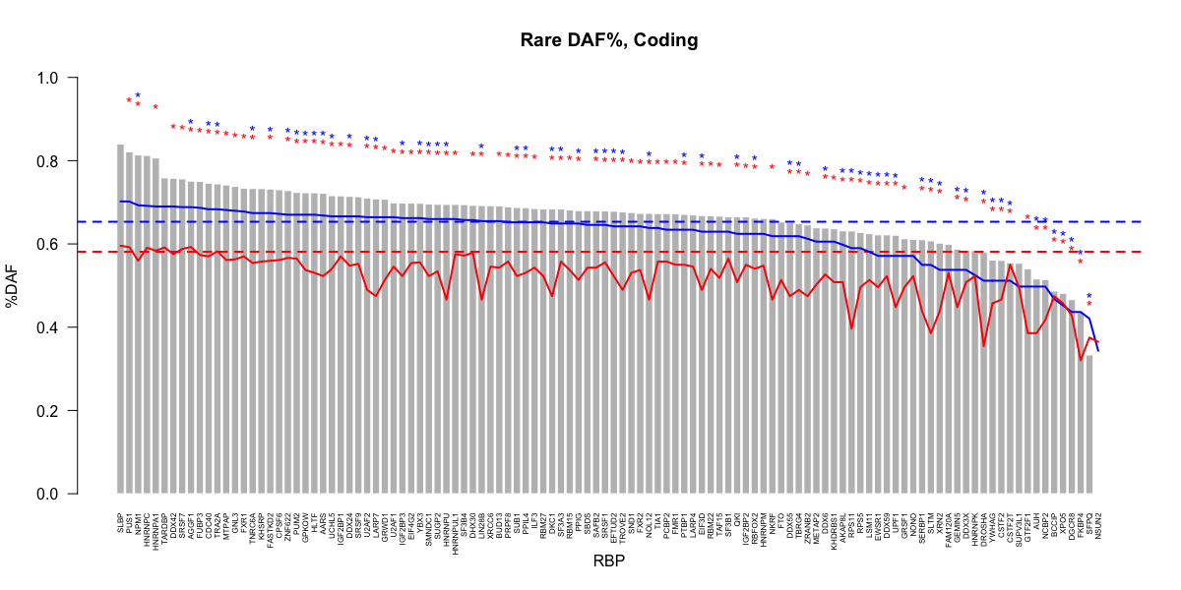
Coding
Noncoding

Slide 9
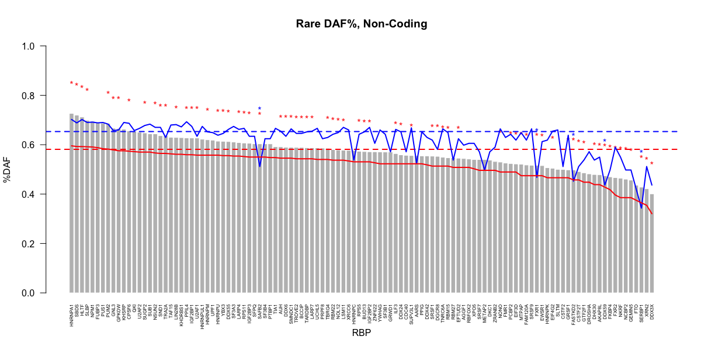
Coding
Noncoding

Slide 10
% Statistically significant RBP rare DAF
using Binomial Test
RBP rare DAF # > genome average
 | Corrected | Uncorrected
C>C | 54% | 41%
C>NC | 82% | 63%
NC>NC | 62% | 19%
NC>C | 4% | 2%
 | Corrected | Uncorrected
C>C | 87% | 67%
C>NC | 96% | 88%
NC>NC | 91% | 45%
NC>C | 17% | 12%

