Slide 1
Private information leakage in functional genomics data
Gamze Gursoy
August 29, 2017

Slide 2
Objectives
1- How can we quantify the information leakage in functional genomics data (Hi-C, ChIP-Seq, RNA-Seq)?
2- Is the leaked information enough to identify an individual in a population of individuals?

Slide 3
Quantification of Information Leakage
Privacy preserving mapping
S → set of variables that should remain private
Y → set of measurements that S can be inferred
U → distorted version of Y
S → Y →
→ U
Privacy preserving mapping
Calmon and Fawaz,2012
Example:
S: Set of SNPs
Y: WGS data
U: Summary statistics
Assume:
S: Set of SNPs
Y: WGS data → private data
U: reads from FGE → public data
Can we asses the leakage in U?

Slide 4
* Let S be a set of SNVs that can directly be inferred from Y
S={S₁,S₂,..,S_{i},…,S_{N}}
Total information that Y contains can be defined as:
where n_{i}=total number of individuals with SNV S_{i} in a database d
Let S’ is a subset of S, which are the SNVs that can be directly inferred from U; S’’ is a subset
of S, which are the SNVs that can be “imputated” from U with confidence ρ ∈ (0,1]
Relative information that U contains with respect to Y
S’={S’₁,S’₂,..,S’_{i},…,S’_{N’}}
S’’={S’’₁,S’’₂,..,S’’_{i},…,S’’_{N’’}}
P={ρ₁, ρ₂,.., ρ_{i},…, ρ_{N’’}}

Slide 5
Data
Experiment | Total reads | Sequencing length | Total coverage(bp)
WGS | 757,704,193 | 250 | 189,426,048,250
Hi-C exp 1 PE1 | 219,616,072 | 101 | 22,181,223,272
Hi-C exp 1 PE2 | 220,087,882 | 101 | 22,228,876,082
Hi-C exp 2 PE1 | 448,843,710 | 101 | 45,333,214,710
Hi-C exp 2 PE2 | 451,088,484 | 101 | 45,559,936,884
Hi-C exp 3 PE1 | 536,684,803 | 101 | 54,205,165,103
Hi-C exp 3 PE2 | 536,101,709 | 101 | 54,146,272,609
RNA-Seq | 227,501,266 | 202 | 45,955,255,732

Slide 6
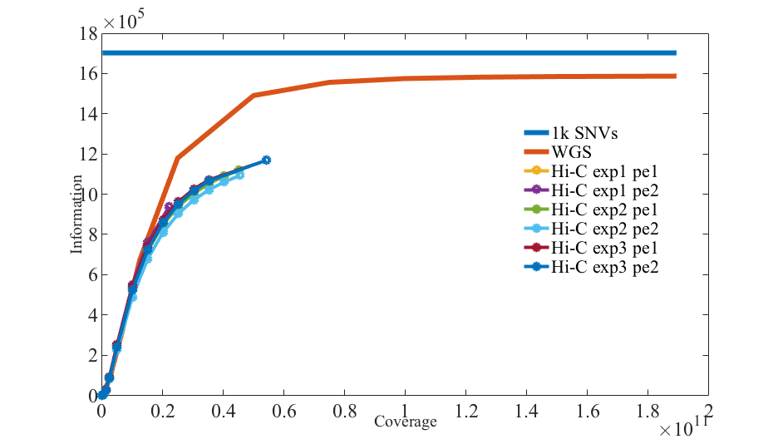
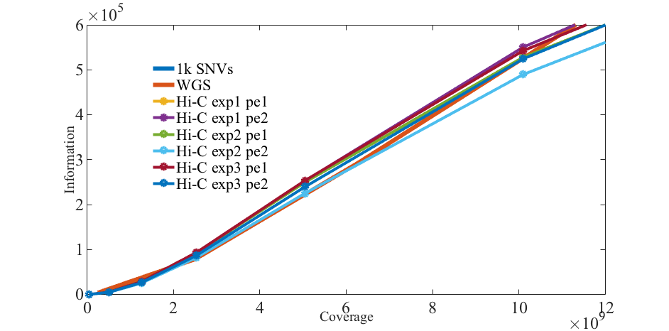
WGS vs Hi-C

Slide 7
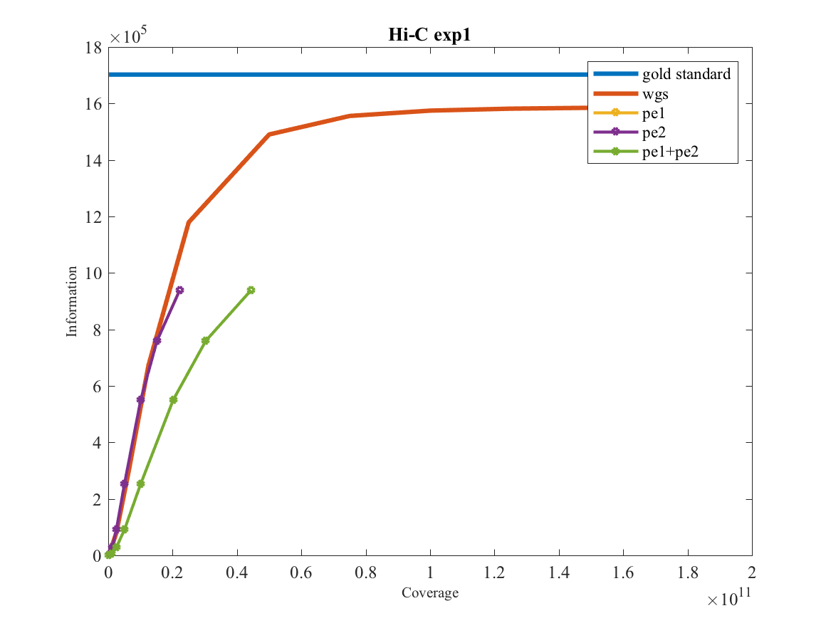
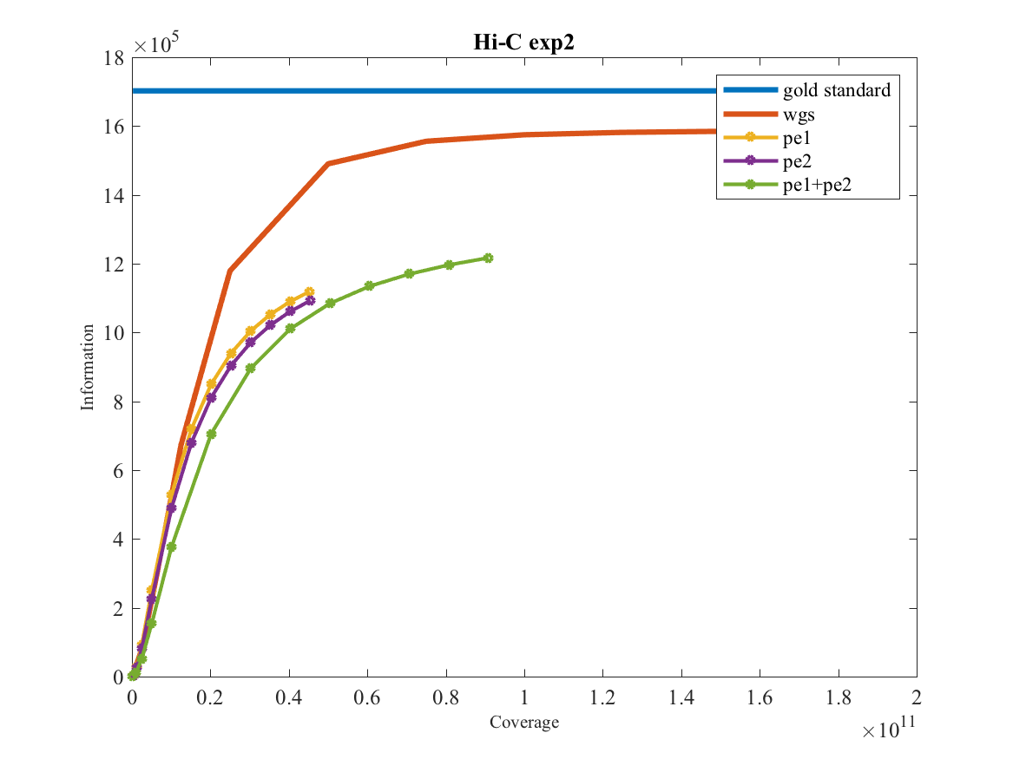
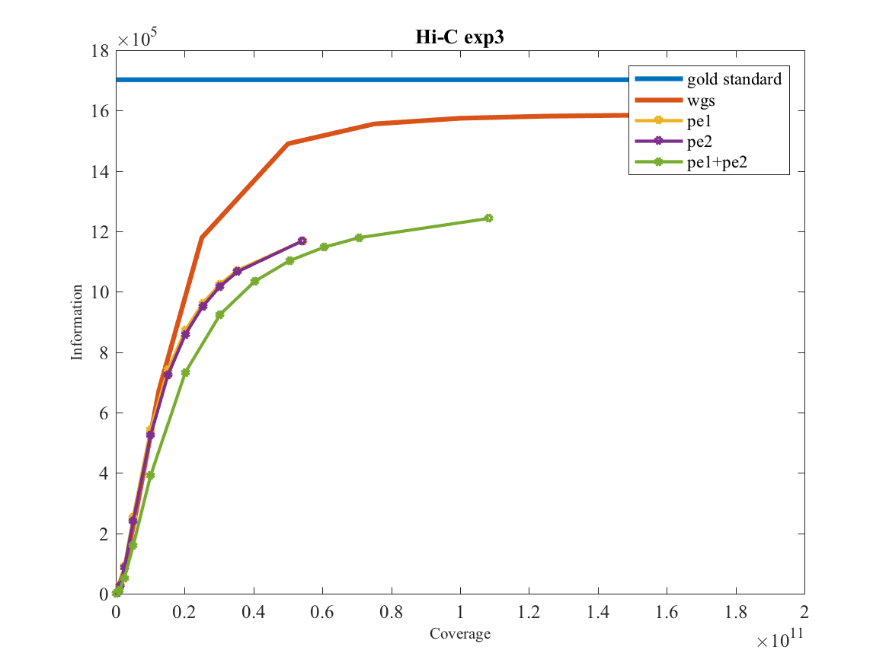
Putting together paired-ends does not change the outcome

Slide 8
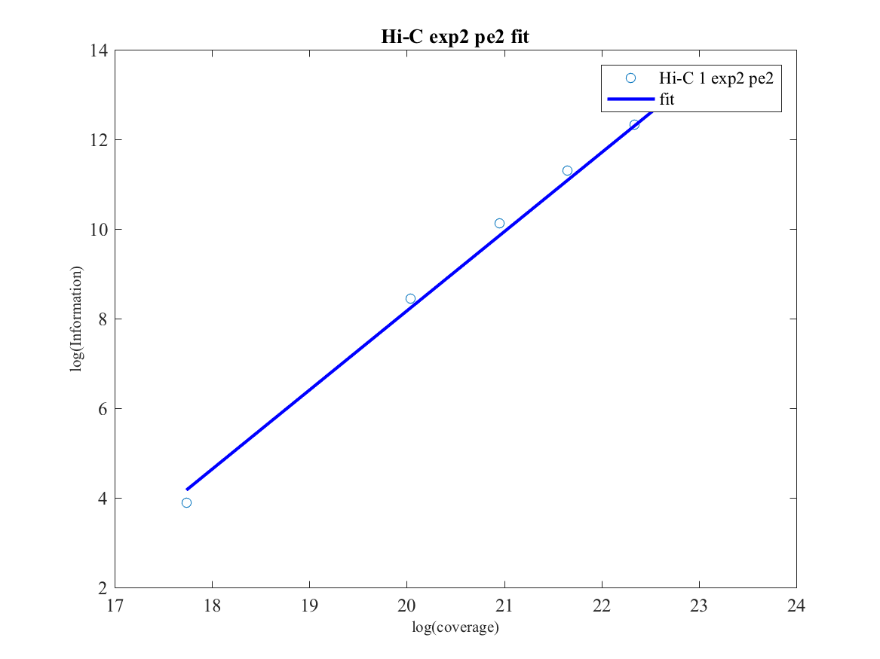
The slope of the curve can show the difference
When we assume an exponential fit
Information ~ coverage^m
log(I)~m*log(c)+n

Slide 9
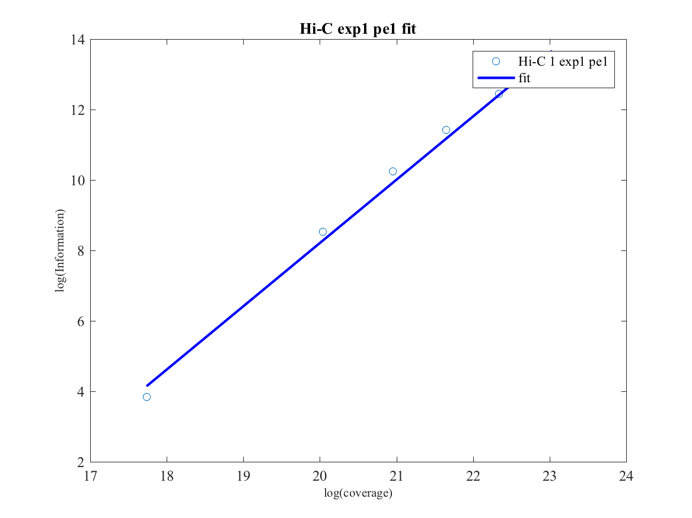
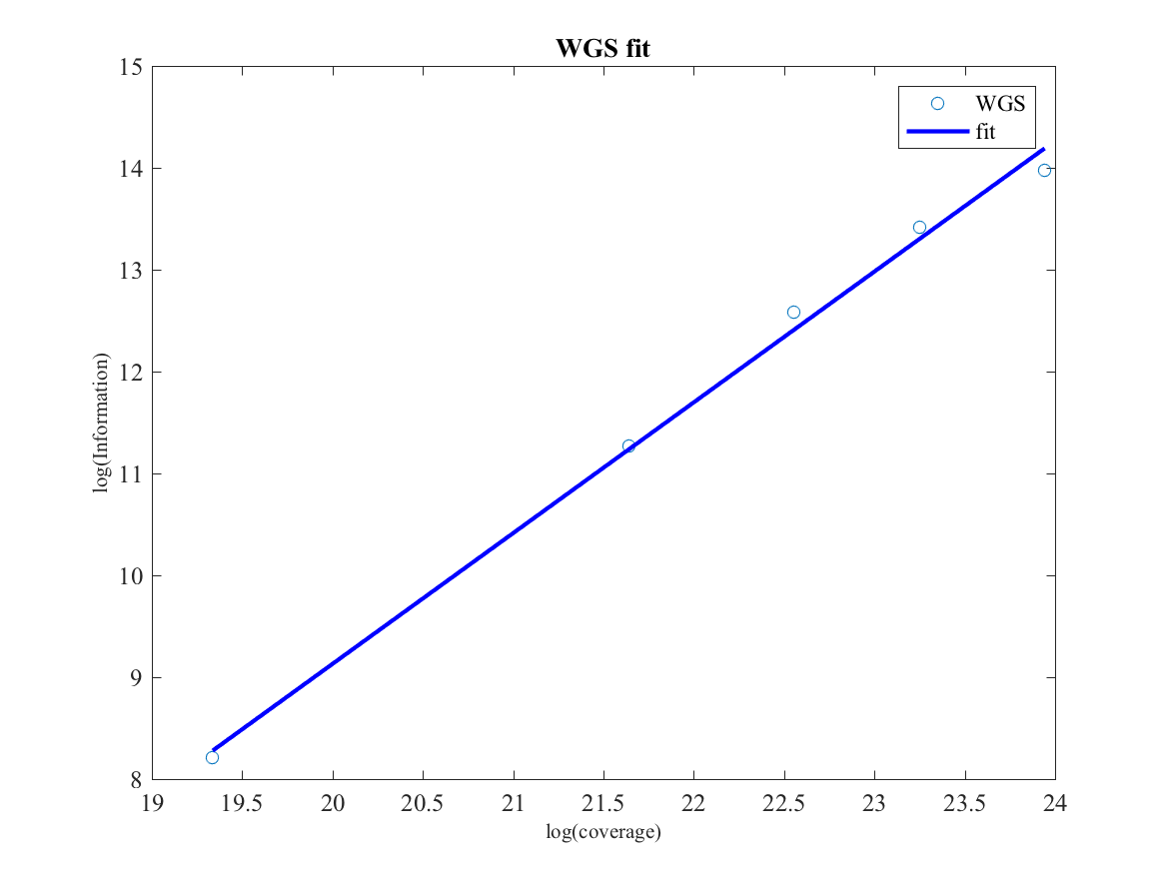
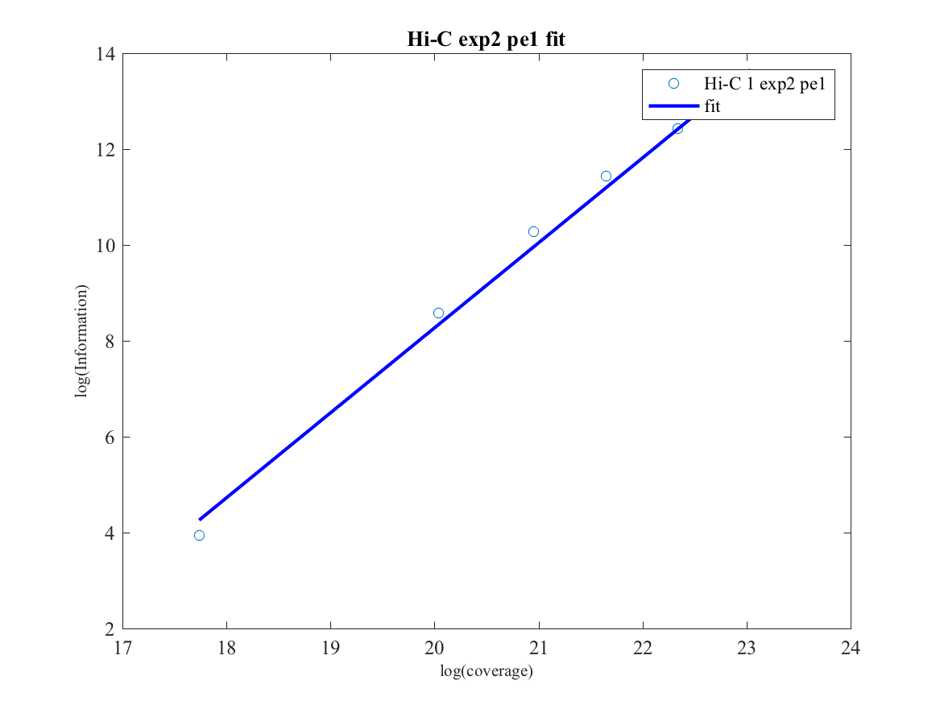
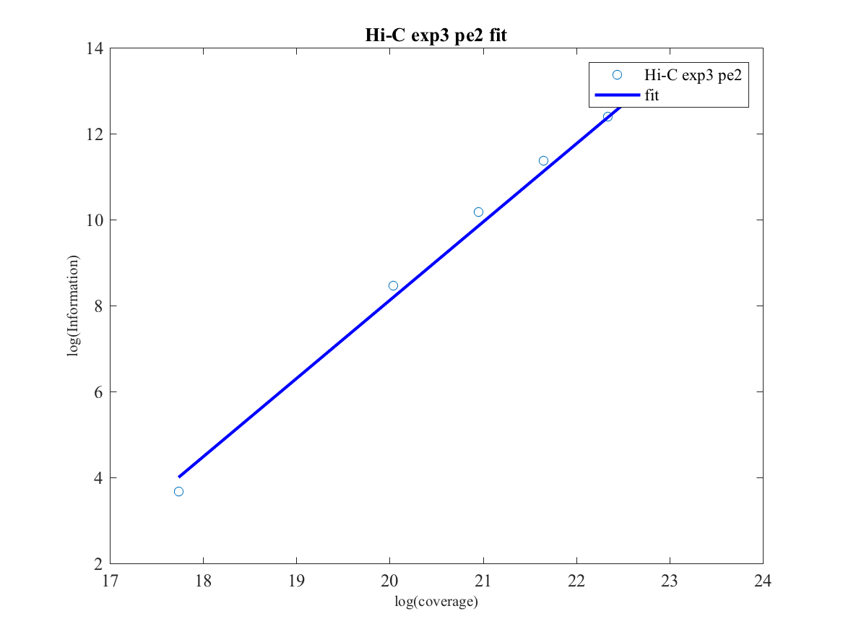
Hi-C provides more information than WGS in short coverages
R^2~0.99 for all

Slide 10
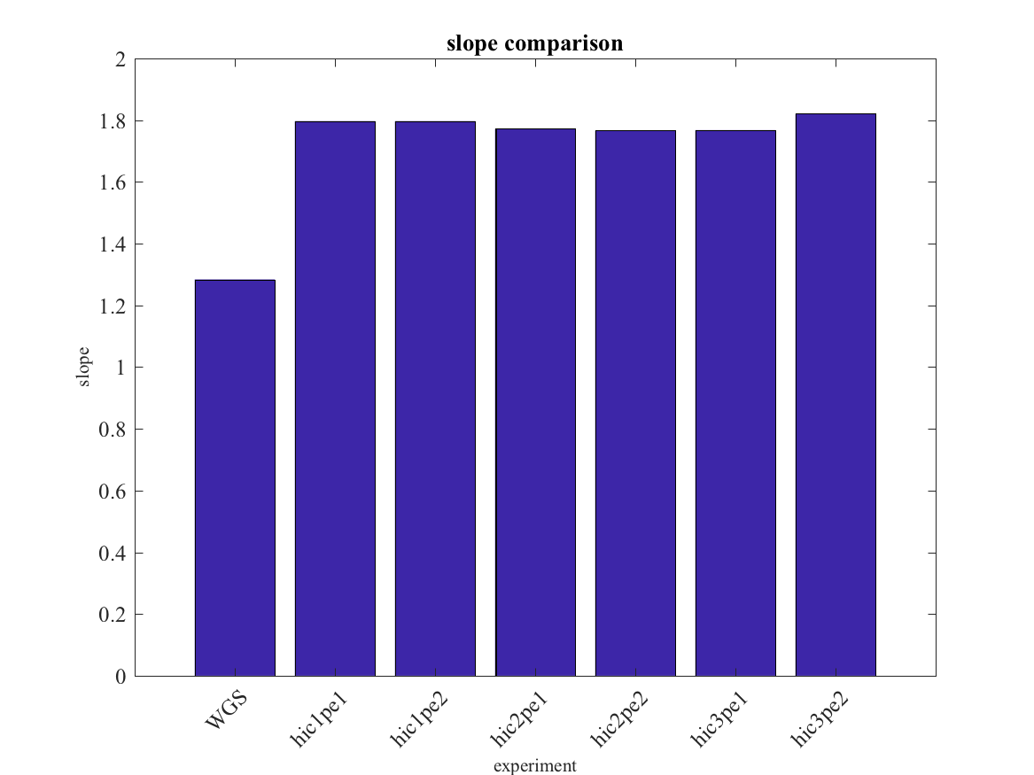
Hi-C provides more information than WGS in short coverages

Slide 11
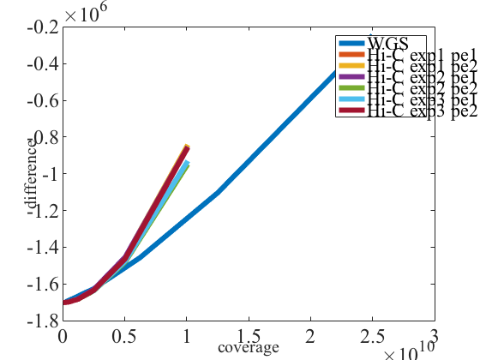
Hi-C provides more information than WGS in short coverages
Difference between the gold standard (1k genome SNVs) and the SNVs from the experiments
at every coverage also shows how close the genotypes from experiments to the real genotypes

Slide 12
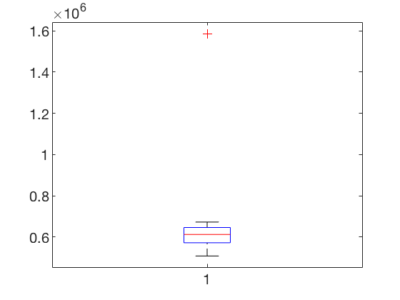
First gap fold change
Measure to show how well we can identify the individual from a panel of individuals
d_1
d_2

Slide 13
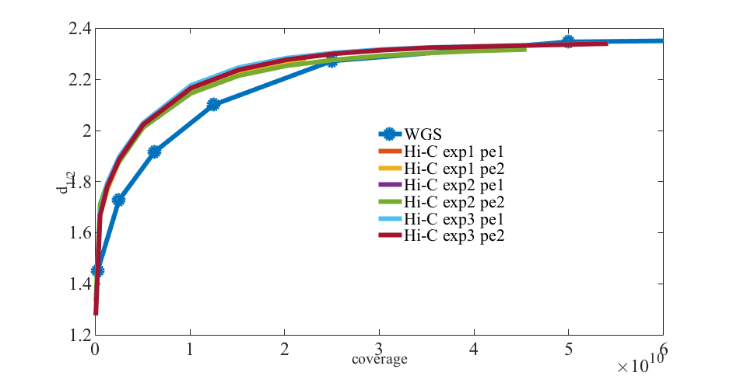
Hi-C identifies individuals better than WGS at low coverages, equally at high coverages

Slide 14
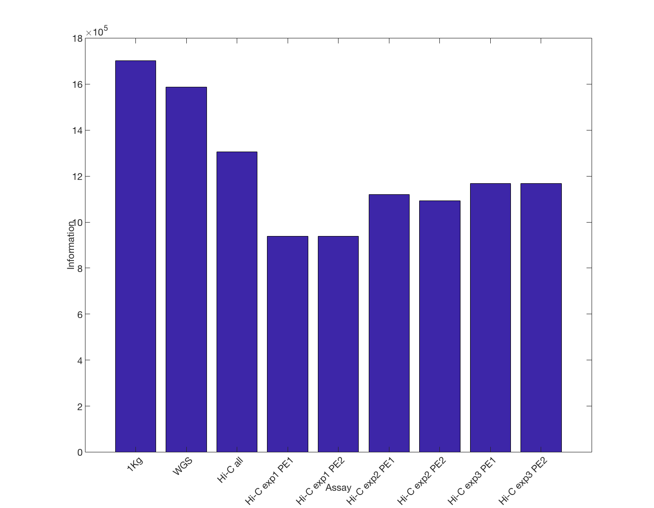
Putting 3 Hi-C experiments together

Slide 15
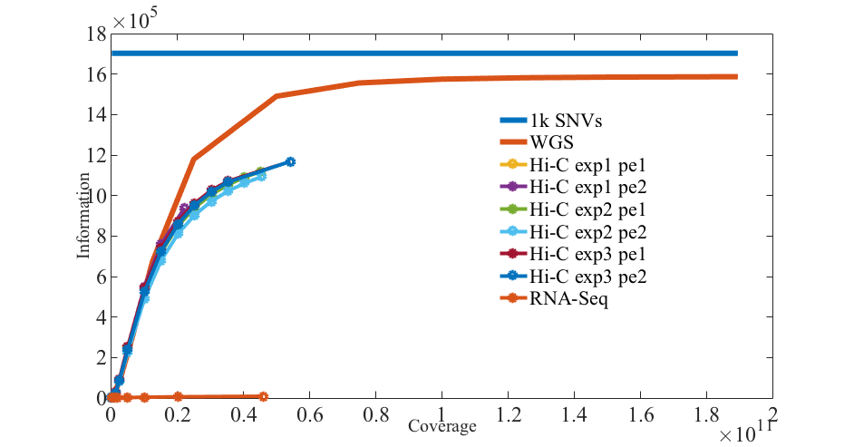
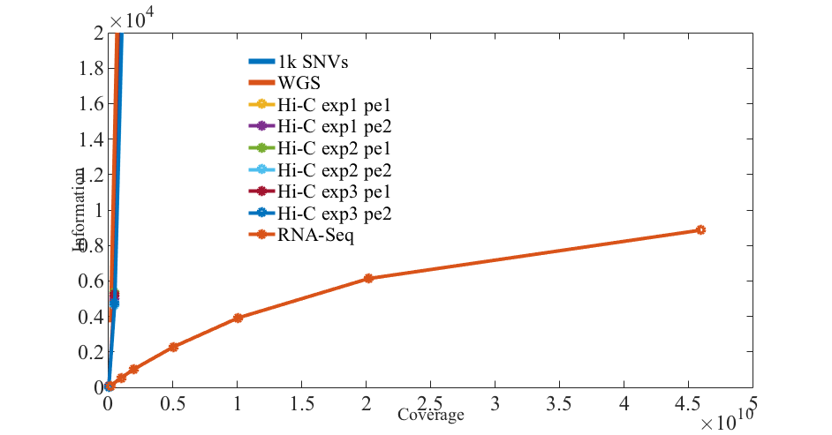
How does RNA-seq fit into this picture? Answer: poorly!

Slide 16
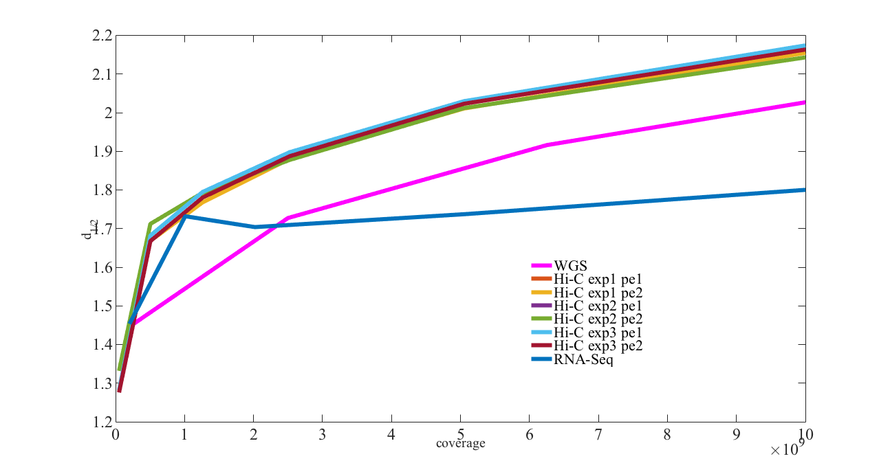
Tough still can identify NA12878 even at low coverages!
First gap fold change

Slide 17
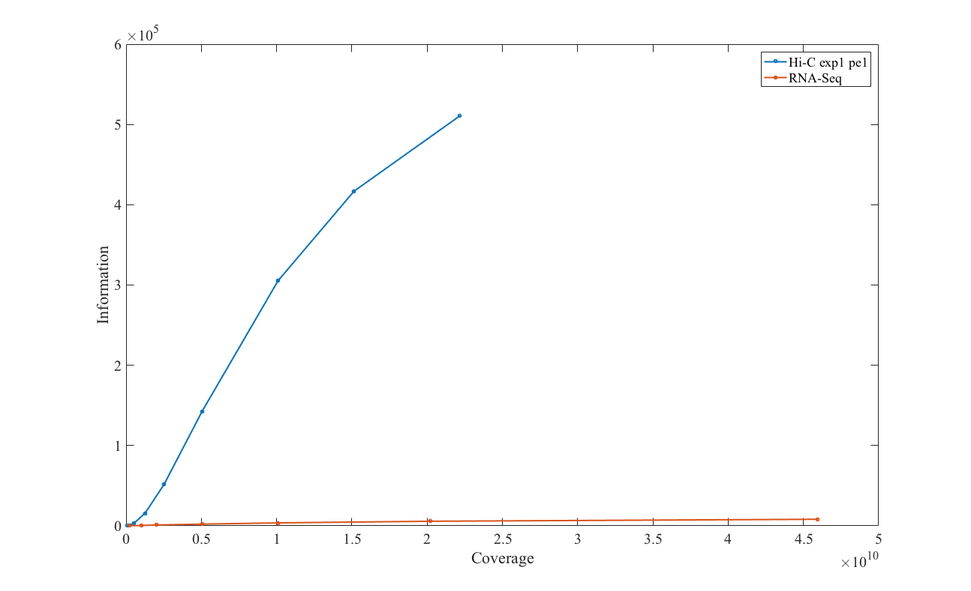
Which one of the assays does better SNV calling in the transcriptome?

Slide 18
More Data: ChIP-Seq
Experiment | Total reads | Sequencing length | Total coverage (bp)
H3K4me1 | 42,763,056 | 36 | 1,539,470,016
HDGF | 41,626,373 | 101 | 4,204,263,673
RELB | 25,652,682 | 101 | 2,590,920,882
CTCF-Snyder | 25,463,397 | 36 | 916,682,292
H3K4me3 | 20,221,959 | 36 | 727,990,524
JUND | 18,701,295 | 36 | 673,246,620
rnap2 | 17,677,527 | 36 | 636,390,972
H3K79me2 | 16,073,184 | 36 | 578,634,624
H3K36me3 | 15,239,685 | 51 | 777,223,935
H2AFZ | 14,724,790 | 36 | 530,092,440
H3K9me3 | 14,049,420 | 36 | 505,779,120
CTCF-Broad | 11,026,086 | 51 | 562,330,386
rnap2 | 10,428,778 | 36 | 375,436,008
H3K27ac | 10,410,928 | 51 | 530,957,328
H3K4me2 | 9,815,194 | 51 | 500,574,894
H4K20me1 | 9,757,368 | 51 | 497,625,768
H3K27me3 | 8,454,639 | 51 | 431,186,589
H3K9ac | 7,981,456 | 51 | 407,054,256
CTCF-Iyer | 7,614,943 | 35 | 266,523,005
rnap2 | 7,516,461 | 36 | 270,592,596
PBX3 | 6,119,046 | 36 | 220,285,656

Slide 19
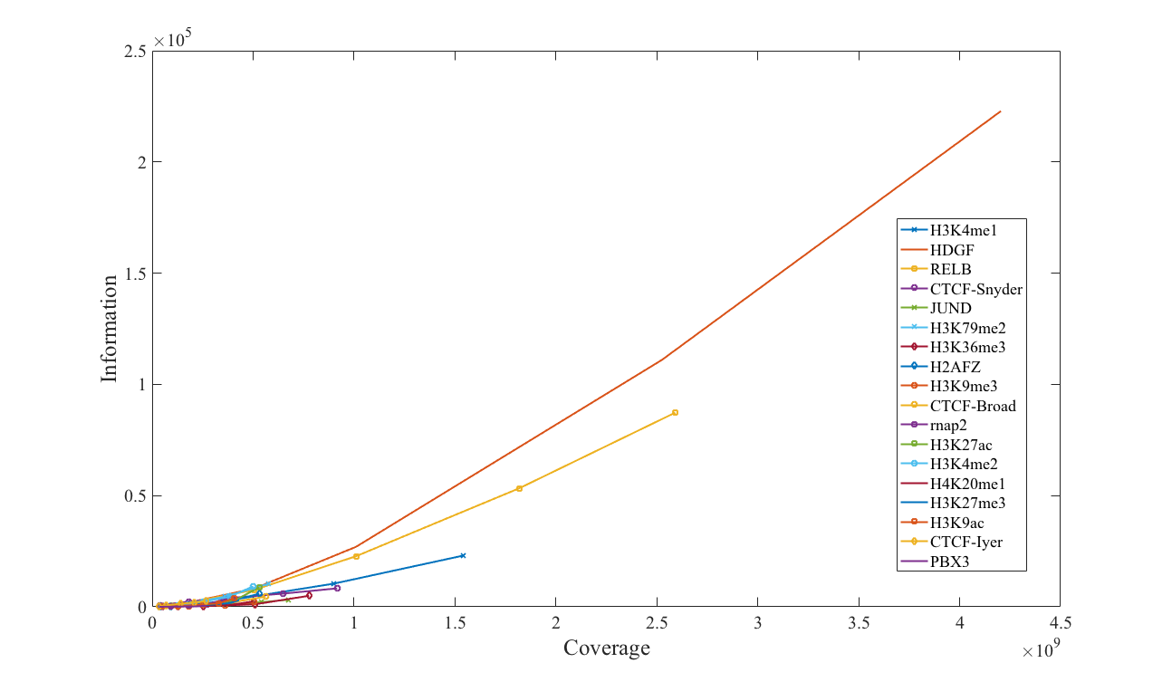
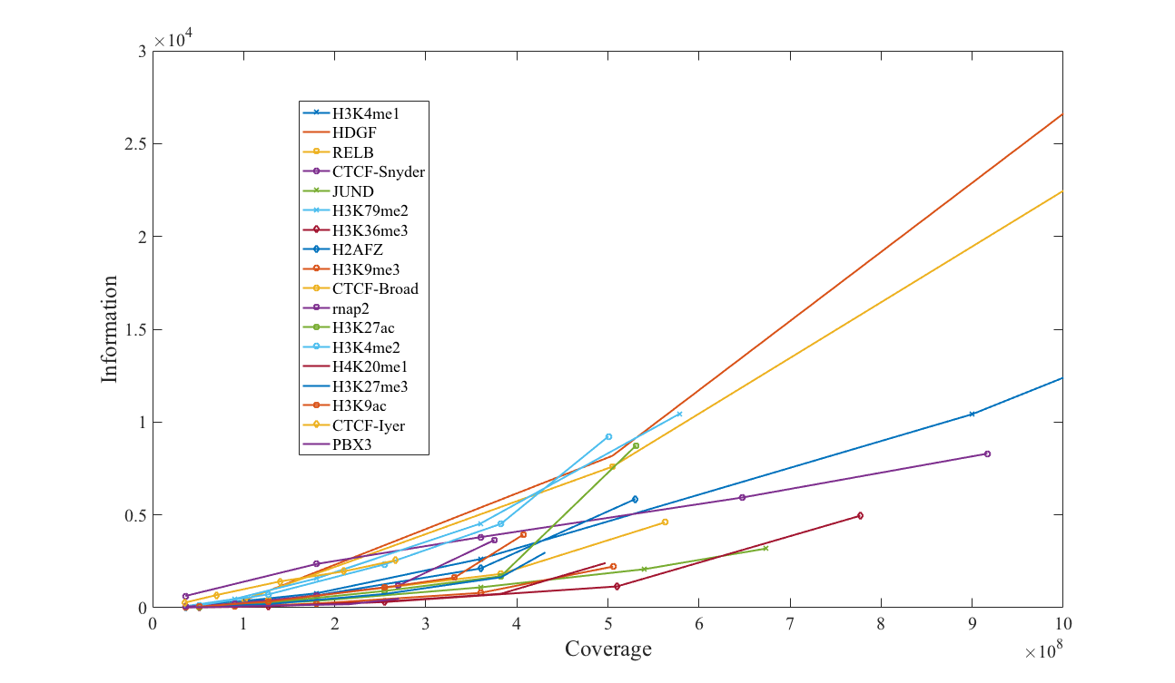

Slide 20
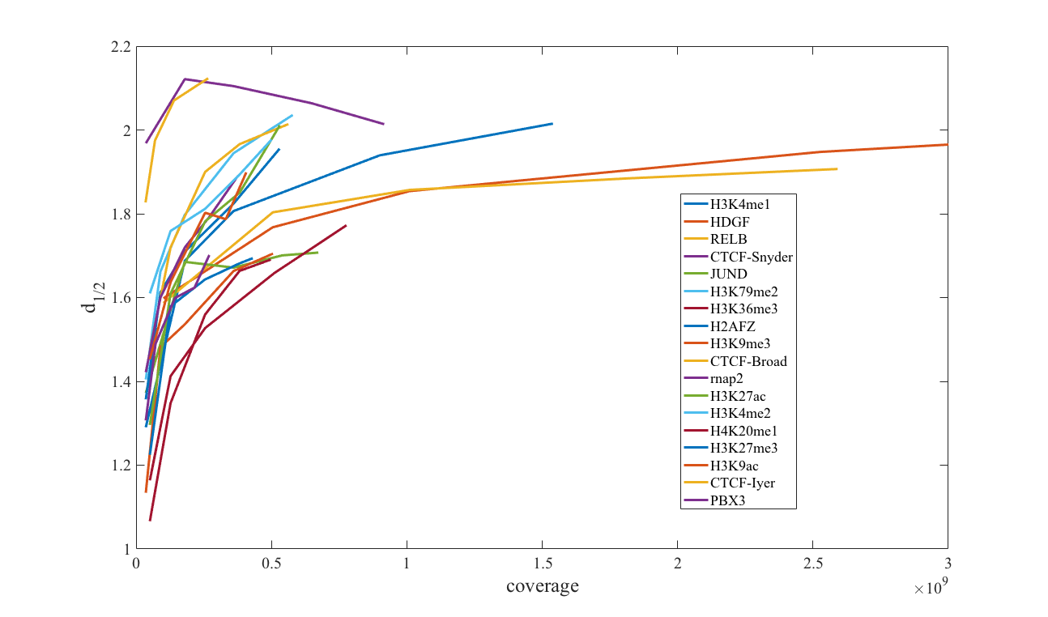
NA12878 is vulnerable even at the lowest coverage

Slide 21
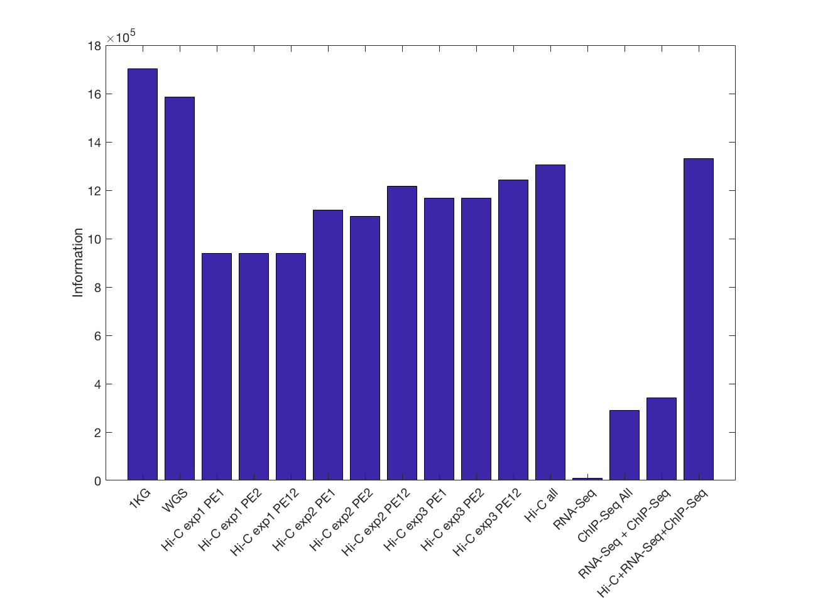
Putting together all the functional genomics data at their highest coverage

Slide 22
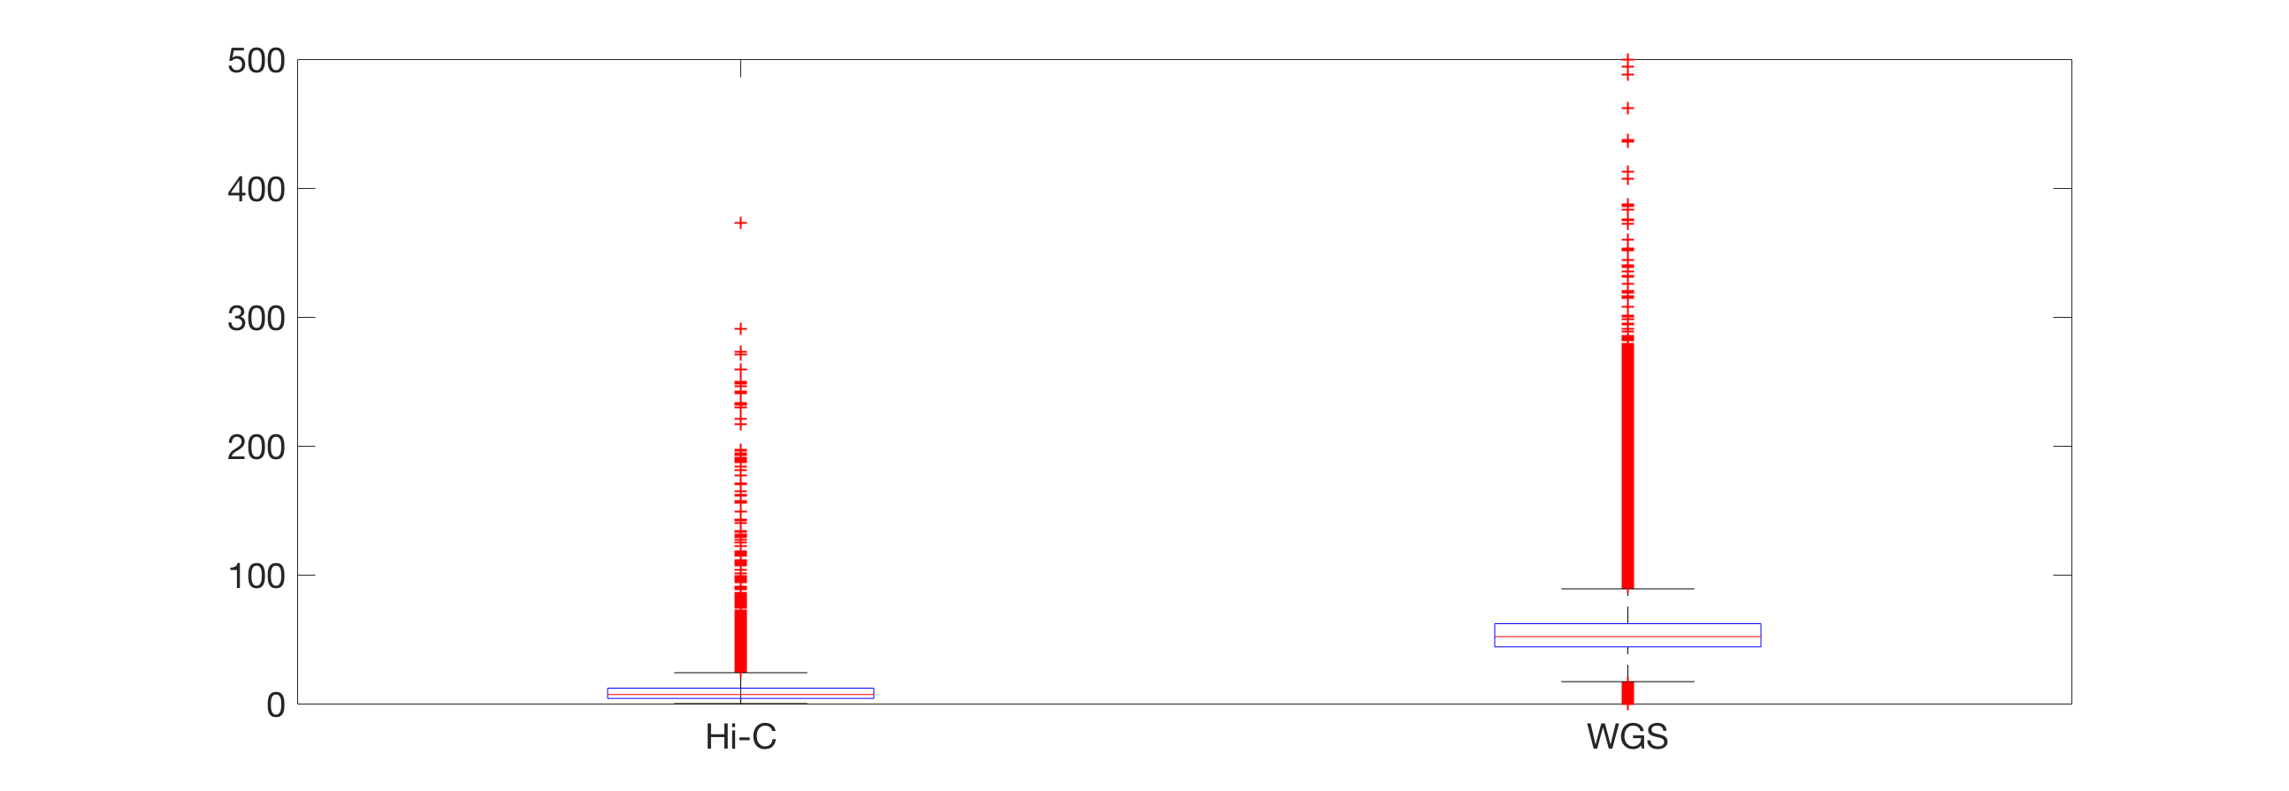
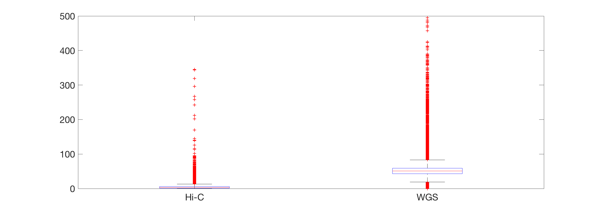
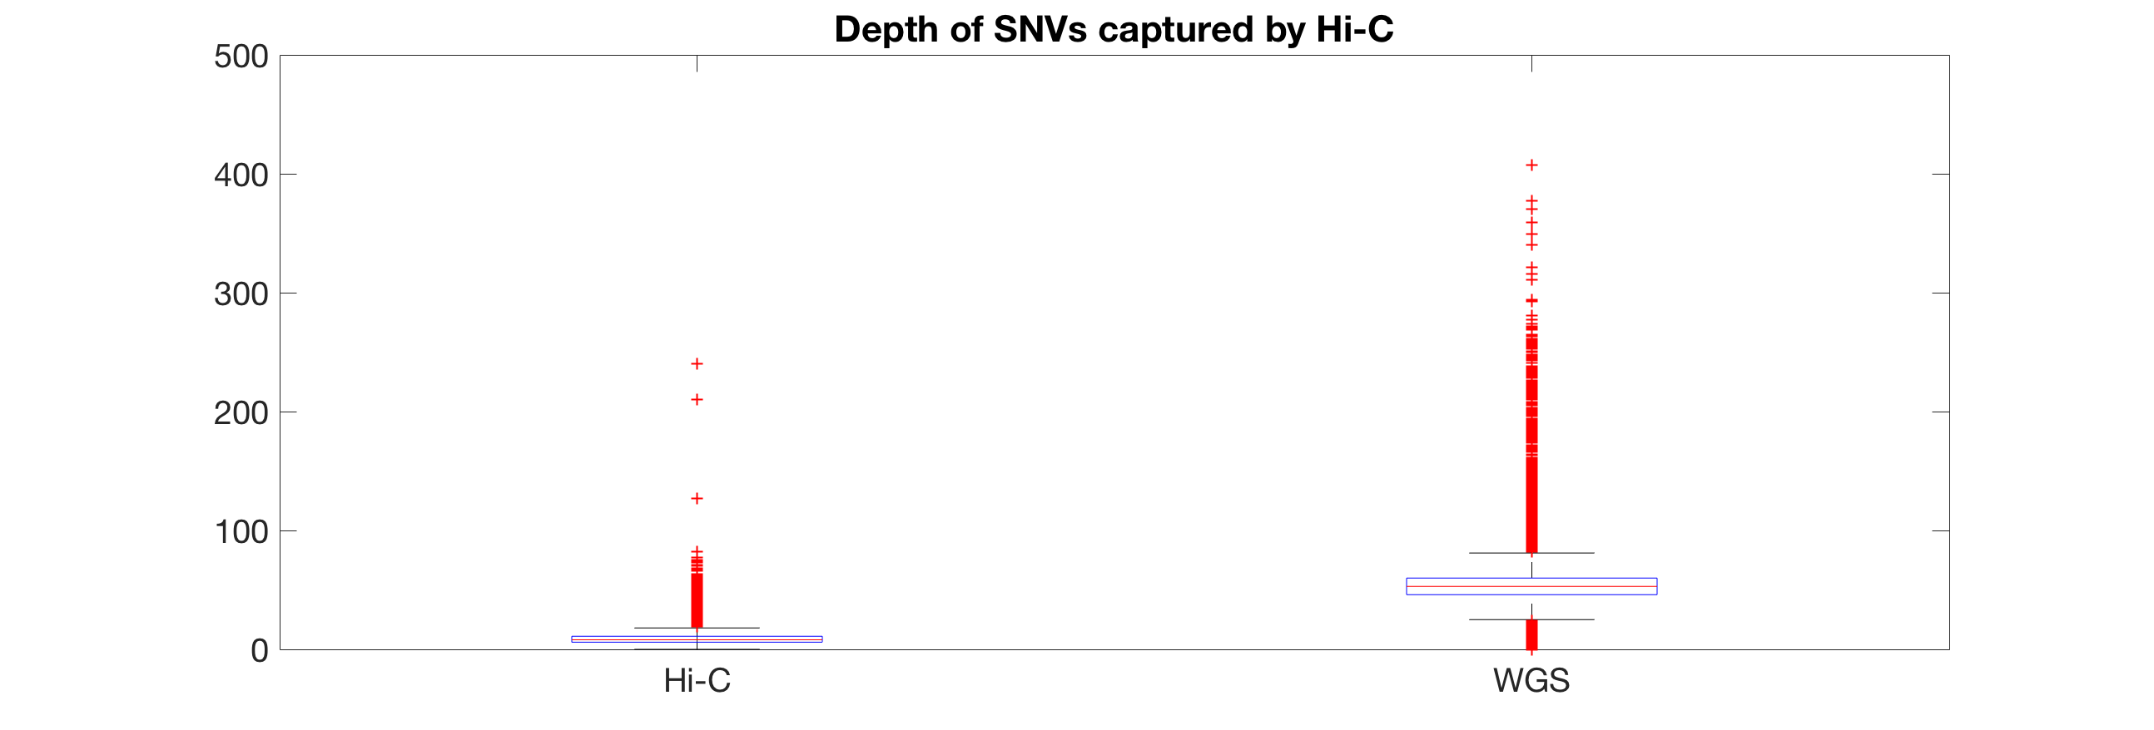
Depth analysis on Chr1 for Hi-C exp1 PE1 and WGS
Depth of FPs
Depth of SNVs missed by Hi-C
mean=16
mean=4
* Hi-C missed SNVs have relatively low depth than the captured SNVs
* misrepresentation
* Hi-C FPs have relatively high depth than the captured SNVs
* overrepresentation
* also contains misrepresented bps detected as false positive indels
mean=9

Slide 23
Hi-C does better 10X SNV calling compared to WGS
EN-TEx Data
ENC-002 (1K2DA) transverse colon data
Gold Standard = WGS
Gold Standard = 10X
Total # of gold standard SNVs | 4,467,330
SNVs called from Hi-C | 4,154,507
Matching Hi-C SNVs | 3,666,194
False Positives | 985,924
Accuracy | 82%
FPR | 24%
Total # of gold standard SNVs | 4,334,605
SNVs called from Hi-C | 4,154,507
Matching Hi-C SNVs | 3,650,755
False Positives | 503,752
Accuracy | 84%
FPR | 12%

Slide 24
Muscle+Colon Hi-C does better capturing Colon SNVs then Colon Hi-C
10X SNVs for colon!
Colon
Muscle
Total # of gold standard SNVs | 4,334,605
SNVs called from Hi-C | 4,154,507
Matching Hi-C SNVs | 3,650,755
False Positives | 503,752
Accuracy | 84%
FPR | 12%
Total # of gold standard SNVs | 4,334,605
SNVs called from Hi-C | 3,902,259
Matching Hi-C SNVs | 3,224,822
False Positives | 677,434
Accuracy | 74%
FPR | 17%
Colon+Muscle
Total # of gold standard SNVs for colon! | 4,334,605
SNVs called from Hi-C | 4,651,818
Matching Hi-C SNVs | 3,699,619
False Positives | 952,199
Accuracy | 85%
FPR | 20%

Slide 25
Next week: Imputation
Note to self: Dan Geschwind has brain cell specific hi-c data, 4 individuals 3? cell types. It was published a year ago:
not sure if those individuals have WGS?
“This sample record is submitted but not yet released for the dbGaP study phs001190. “
Should I email to ask for the data?

