Slide 1
RNA editing site detection
Jing Zhang
Journal Club

Slide 2
Types of RNA editing sites: insertion or deletions
RNA editsome complex

Slide 4
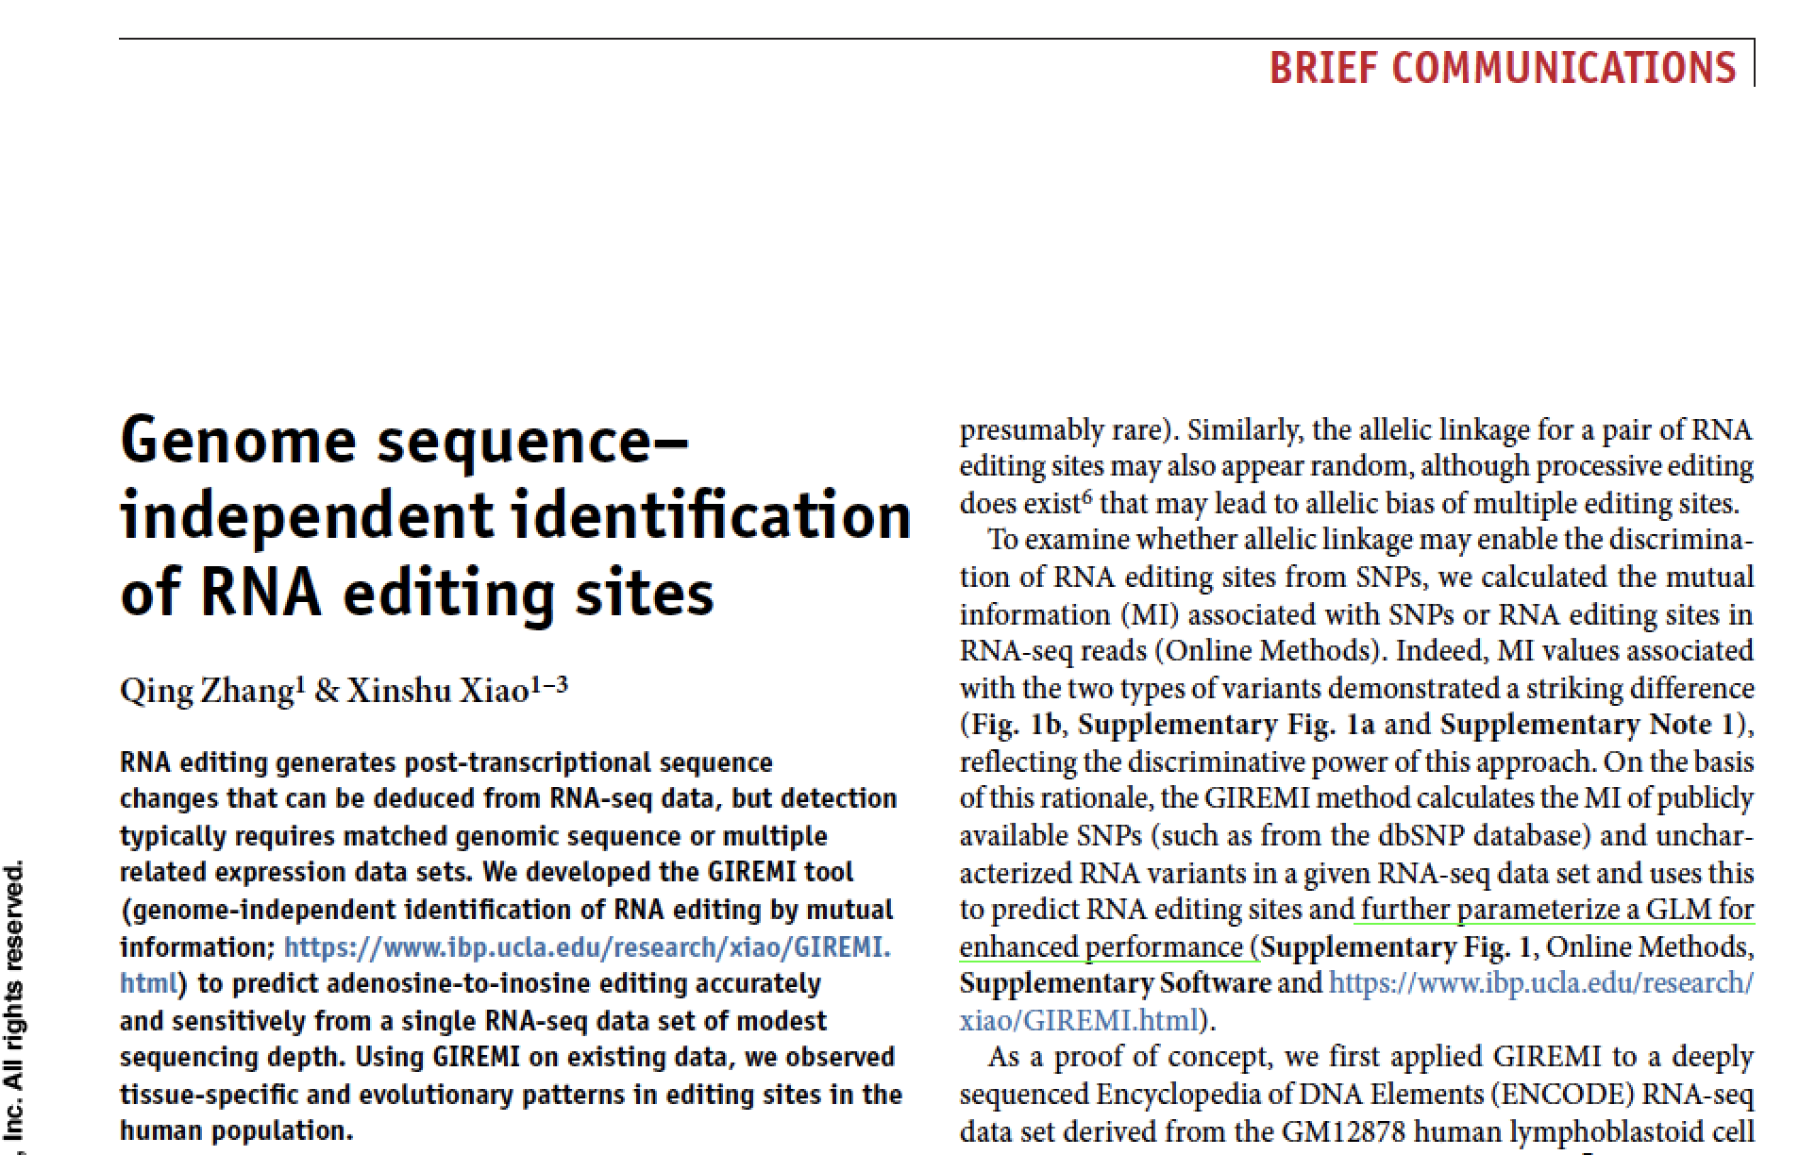
Paper 1: from Grace Xiao’s lab

Slide 5
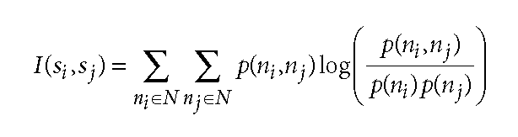
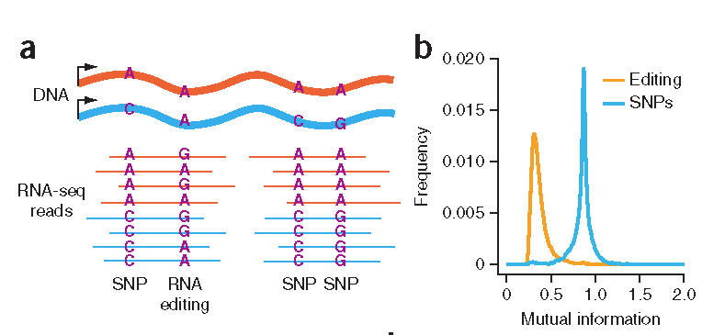
Mutual information

Slide 6
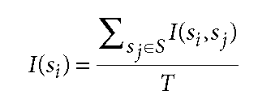
Steps in calculating H0 for SNPs:
1. Use public SNP database like SNPdb
2. Define known SNP pairs: SNPs that are within the same RNA-SEQ read (pairs)
3. For each SNP, calculate the average MI of all known SNP pairs as the left
Steps in calculating H1 for SNVs:
1. Search for all SNVs that are NOT in public SNP database like SNPdb
2. Define known SNV pairs: SNV/SNPs that are within the same RNA-SEQ read (pairs)
3. For each SNV , calculate the average MI of all SNV/SNPs pairs as the left
4. Use the H0 to provide the P value, and P<0.05 was called RNA-editing sites.
5. No multiple test correction was calculated
This is purely non-parametric approach. No prior distribution was assumed!

Slide 7

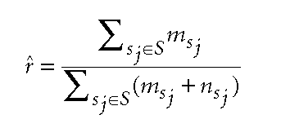
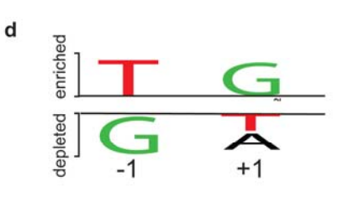
Question: how about the SNPs/SNVs without pairs (those have no neighbors in the same read)?
Allelic difference of the SNV vs the gene average
PWM score of the MI predictions

Slide 8
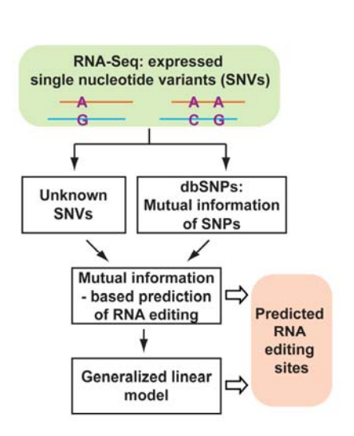
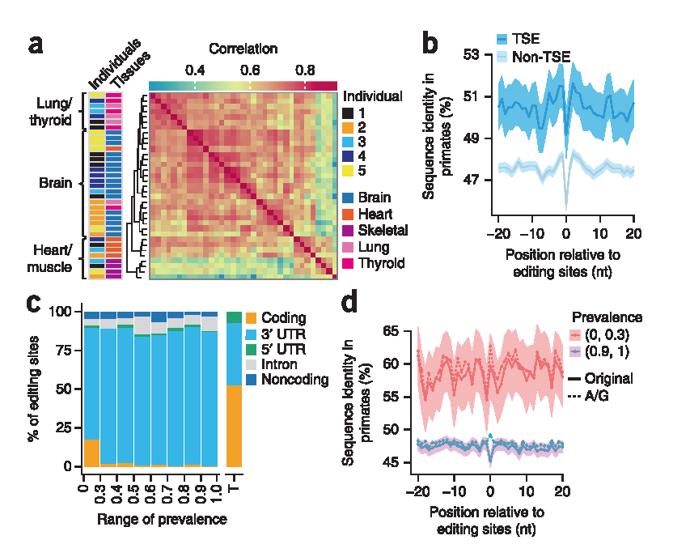

Slide 9
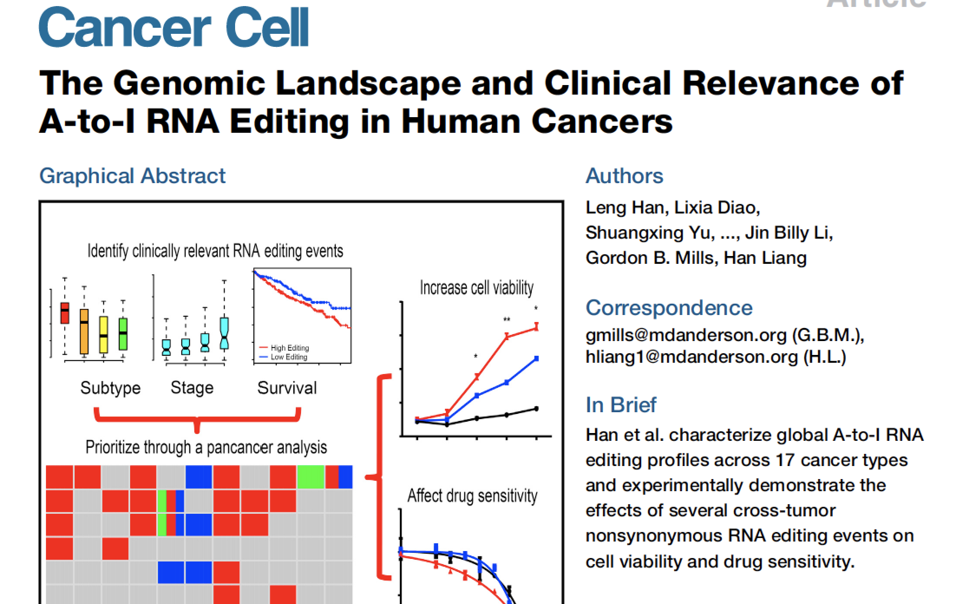
Paper 2: from Han Liang’s lab

Slide 10
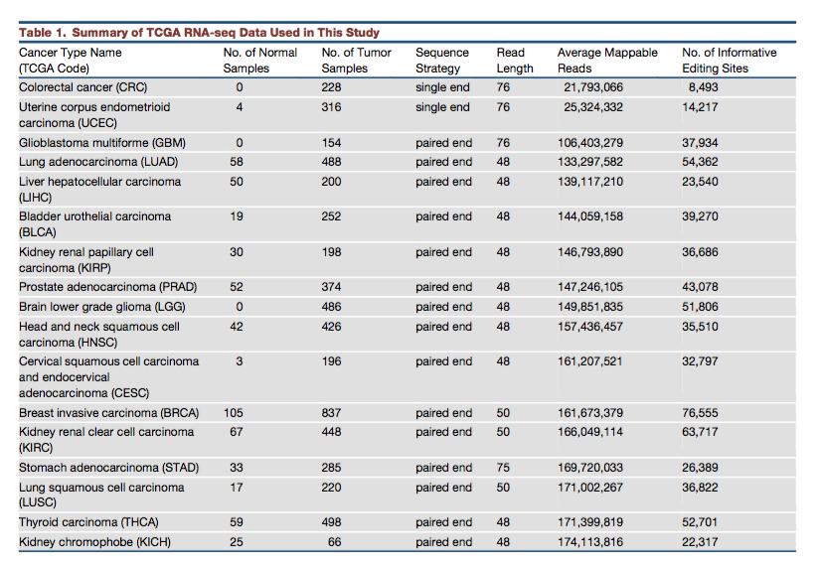

Slide 11
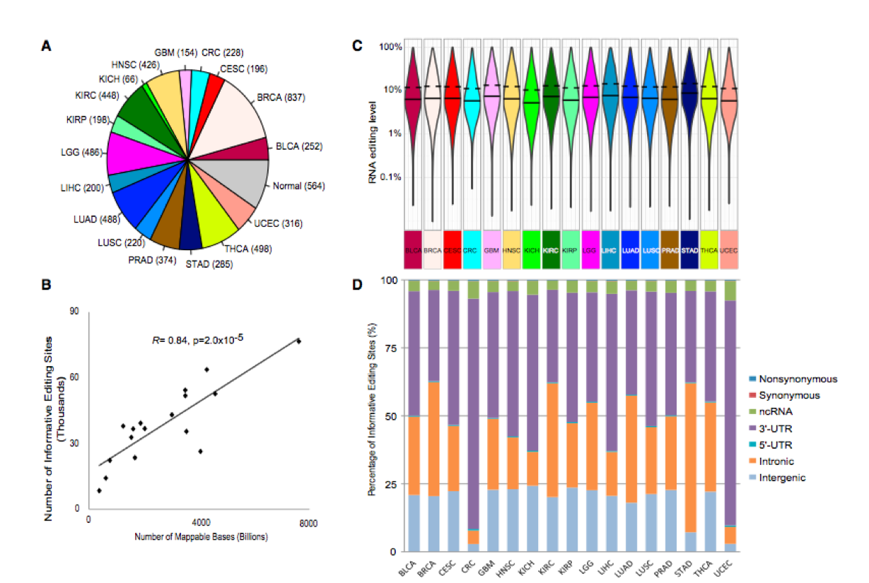

Slide 12
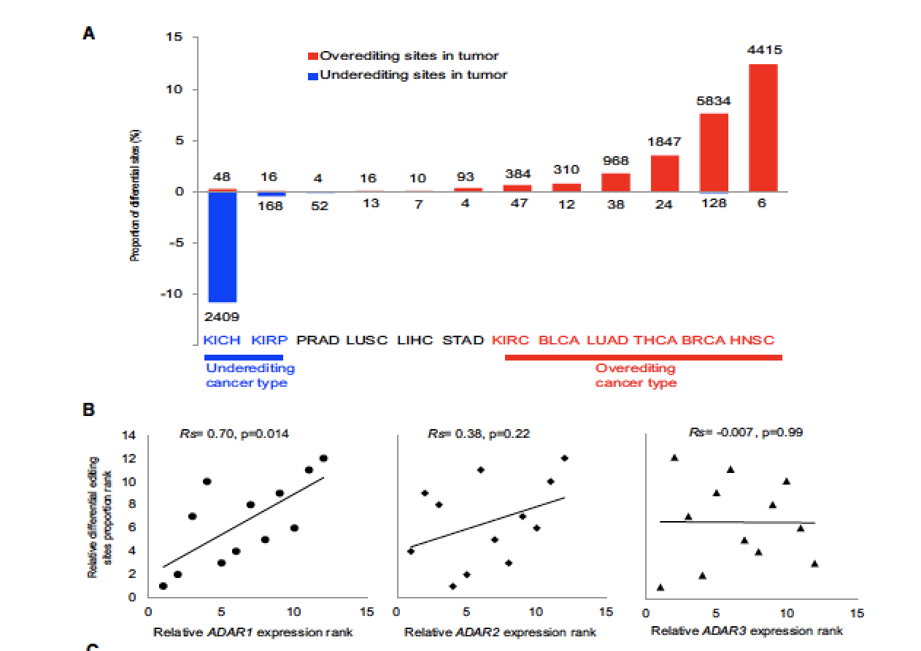
RNA editing level per sample = #(reads contain edited sites)/#(total reads)
Differential editing sites: Wilcoxon test after pulling all samples together

Slide 13
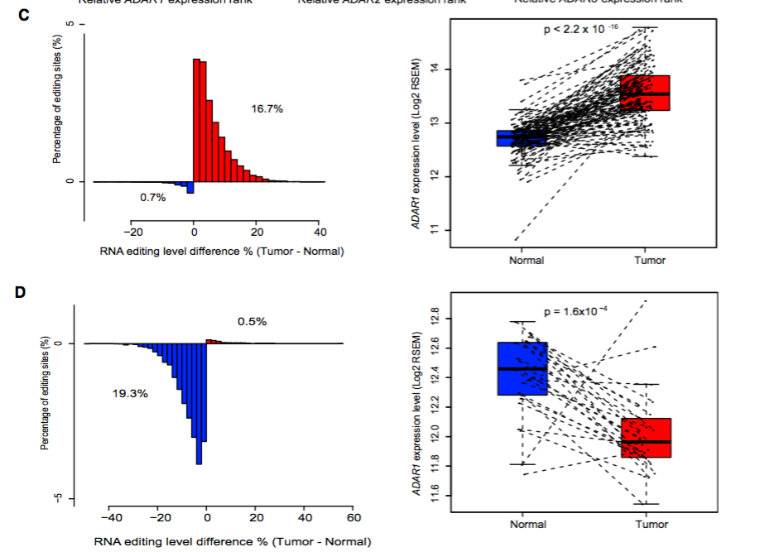
Only the differentially edited sites
BRCA
KIHC

Slide 14
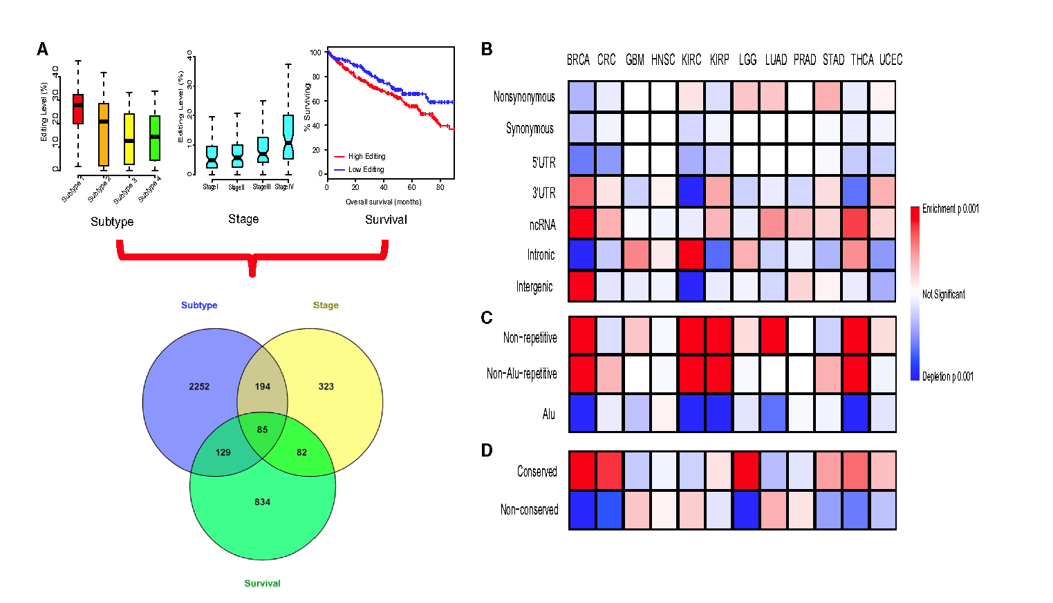
How to find out the clinically relevant editing sites in cancer
Using permutation tests

Slide 15
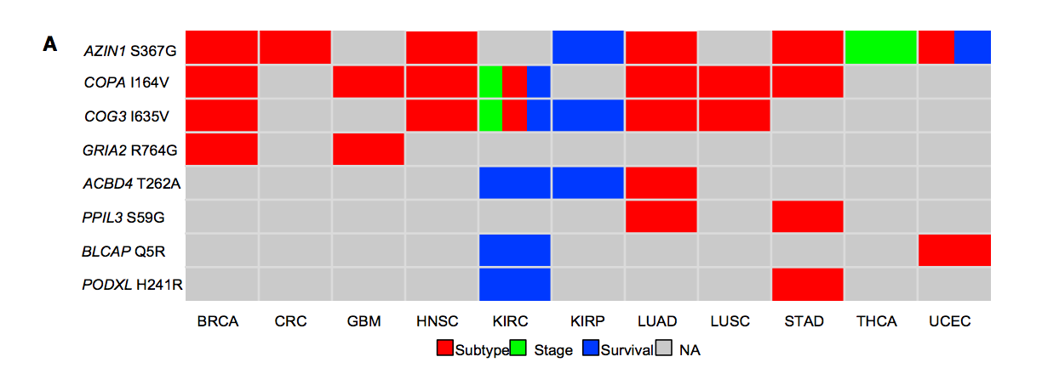

Slide 16
