Slide 1
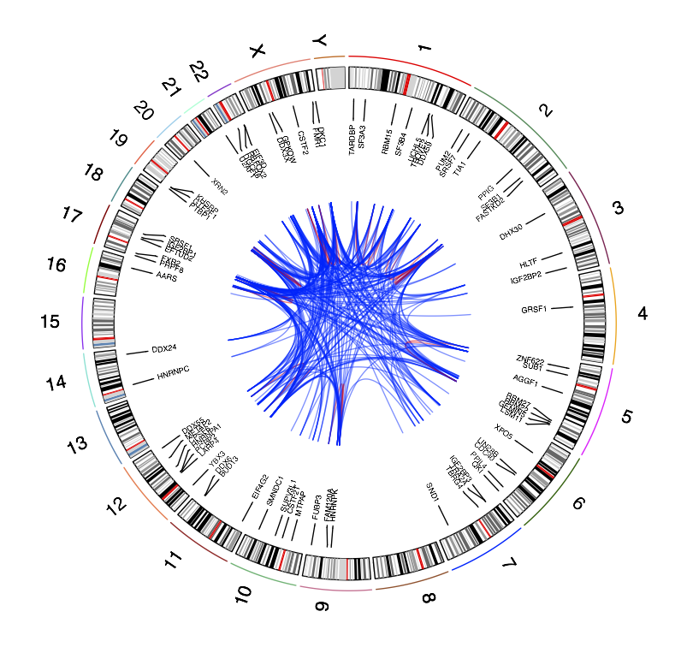
RADAR: an RNA binDing protein regulatory network resource for cAncer Research
JL, JZ, DL, LL

Slide 2
Purpose of RADAR Tool:
Annotation
  Targets of RBPs (regulatory network)
  Classification of peaks or variants: CDS, 3’ UTR, 5’UTR, 3’ Extended, 5’ extended, nearby Intron, other
Prioritization of RBPs
  RBP Activity prediction
  RBP as prognostic marker
Mutation Scoring
  FunSeq2-like entropy-based scoring system for variants specific to RBP binding regions
    Discrete entropy
    Quasi-continuous - Motif breaking events
    Quasi-continuous - Hotspots

Slide 3
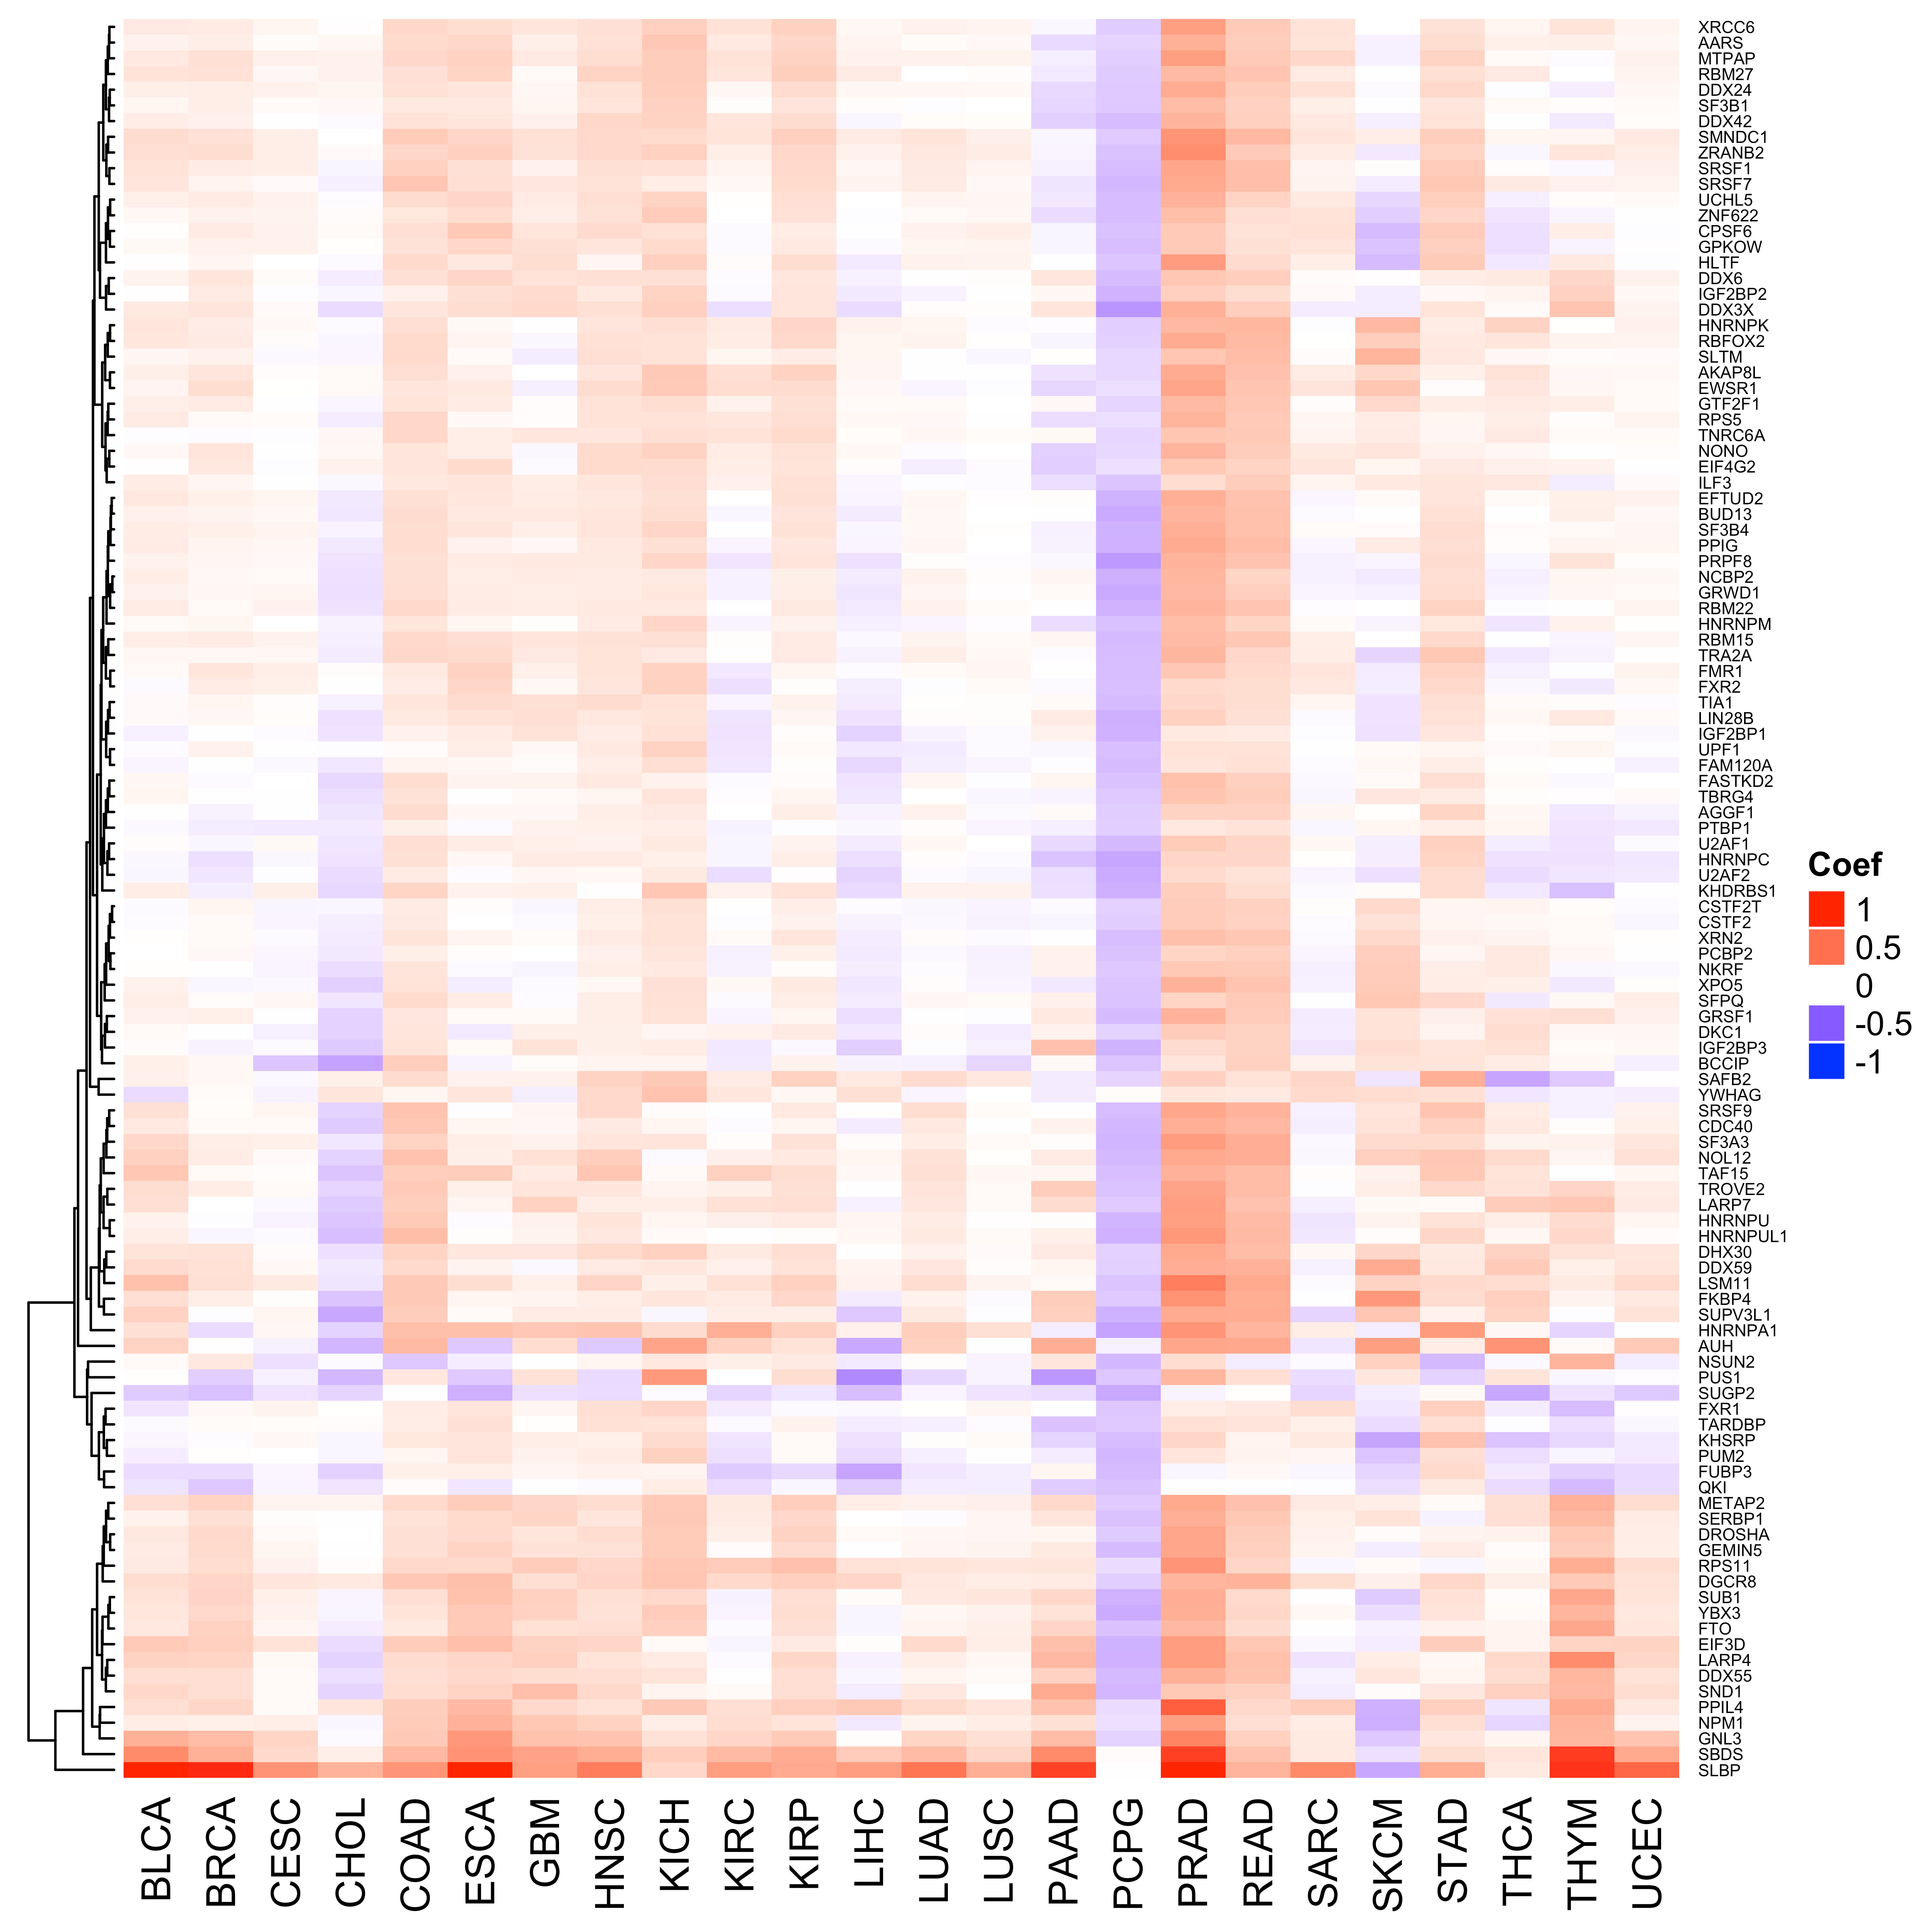
Previously: Pooled patients together for full network
We use FC of tumor-normal expression from DESeq2 to predict RBP activity. The network of RBP and target genes is established by finding CDS, UTR, Intron that intersect binding peaks.

Slide 4
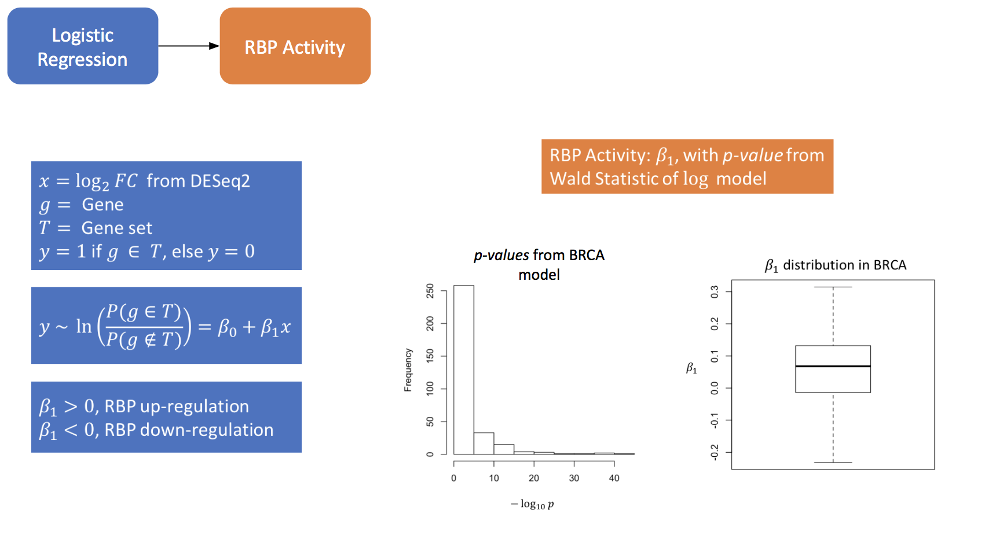

Slide 5
Aside from binding to CDS regions, RBPs predominantly bind in 3’ UTR regions, suggesting a functional significance of such regions.
Variants are also likely to fall in such regions.

Slide 6
Establishing a
3’ UTR Network
Network edges of the 3’ UTR network
(Only cancer related RBPs shown)
Previously the target network of an RBP was formed by intersecting RBP binding peaks with CDS, UTR, and intron regions. Here we only consider a network from 3’ UTR regions. Only RBP binding peaks intersecting gene associated 3’ UTR regions are included in the network.

Slide 7
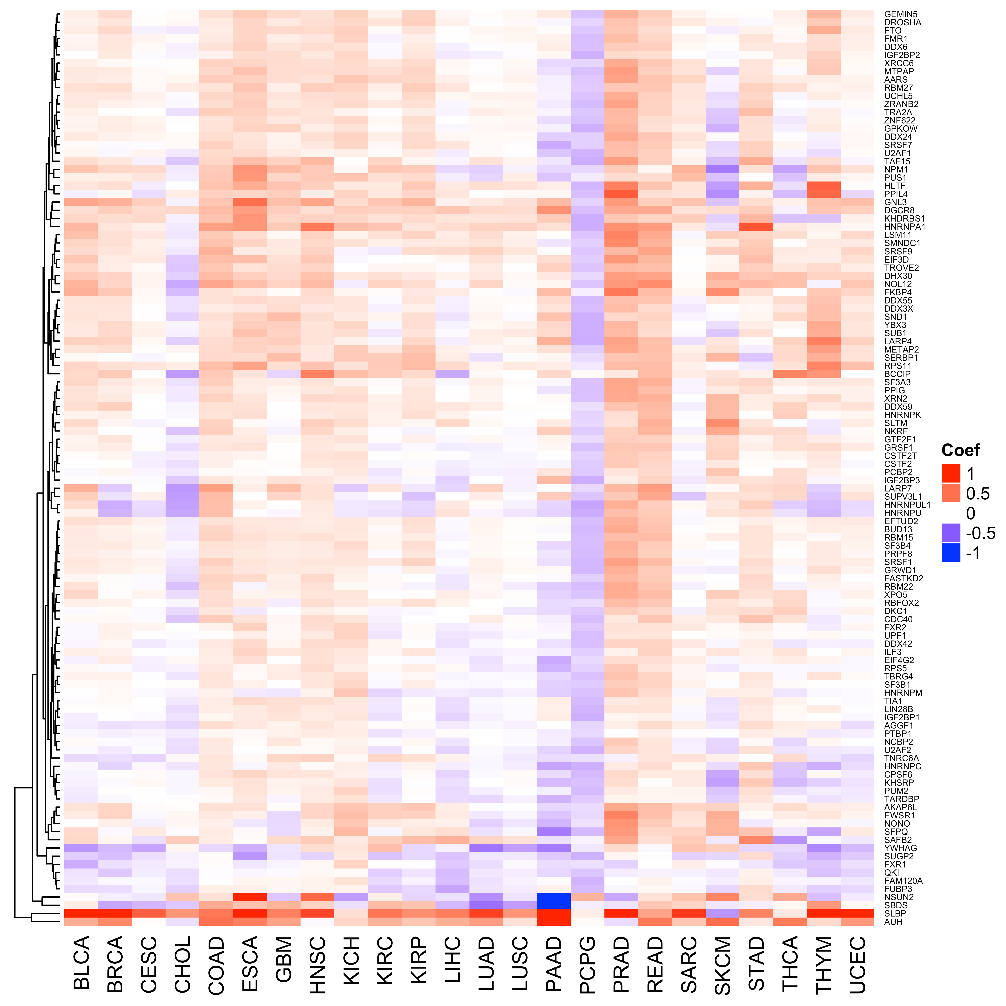
RBP Activity (derived full network)
RBP Activity (derived 3’ UTR network)

Slide 8
RBP Prioritization: Individual Expression and Clinical Profiles for Survival Analysis
The goal is to use an individual’s gene expression to predict an individual’s RBP activity.
Survival analysis is performed on each RBP to see if certain RBP activity (high, low) serve as prognostic markers.

Slide 9
Determining individual gene expression FC
Here we can’t use DESeq2.
For each gene, g, there consists of expression, e, for cancer (c) and normal (n). Then for each patient, i (cancer patients), we have a gene expression for each gene in cancer sample,
e_{i,cg}
and for each patient, j (normal patients), we have gene expression for each gene in normal sample as
e_{j,ng}
j and i are different sets

Slide 10
Determining individual gene expression FC
Let m_{ng} be the mean of e_{j,ng} for all j.
Then the fold change expression for gene, g, and patient, i, is defined as FC_{i,g}
FC_{i,g} = e_{i,cg} – m_{ng}
Across all FC_{i,g} we use the scale function to convert to Z-score
scaled_FC_{i,g}

Slide 11
TF Activity Inference from patient expression FC
After we obtain scaled_FC_{i,cg} we can use logistic regression (same as before) to predict RBP activity based on individual FC expression.
Patients with high (top 50%) and low RBP (bottom 50%) activity are grouped. The survival data is parsed from TCGA clinical files for matched patients.
Patients that are alive (censored) use “days since last followup” and patients that are deceased use “days to death”.
Patients with no clinical information documented are removed.

Slide 12
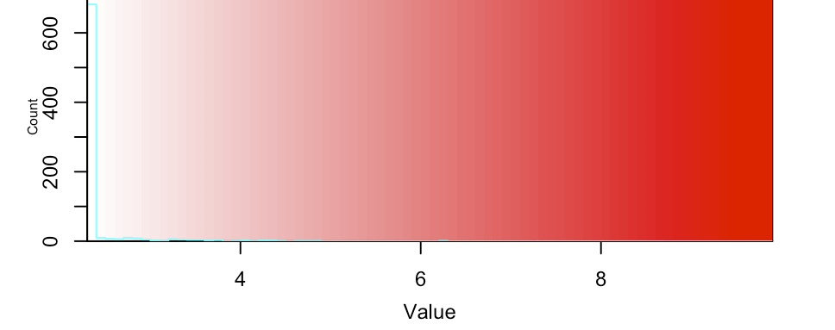
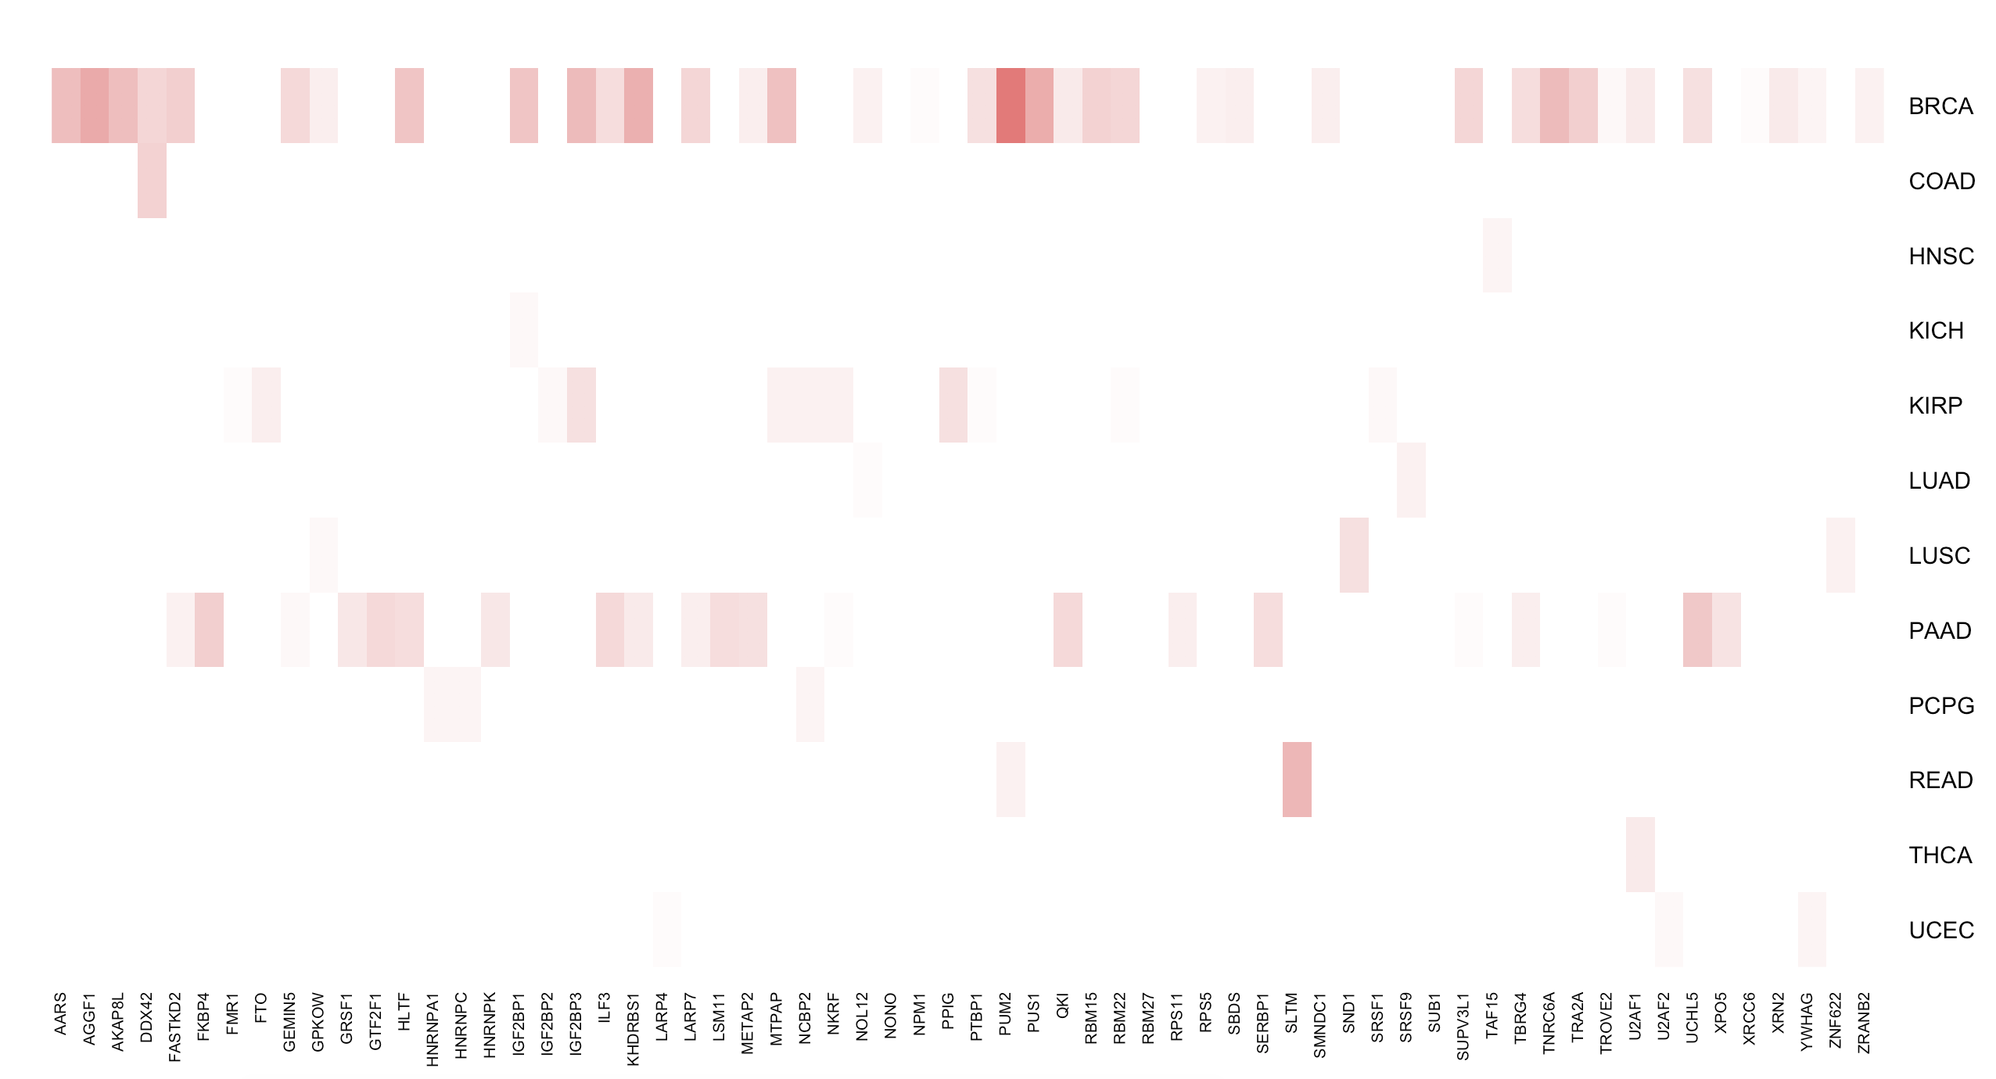
Summary of survival graphs p-value for full network
-log(p value)
Subsetted for
BH p_cor<0.005

Slide 13
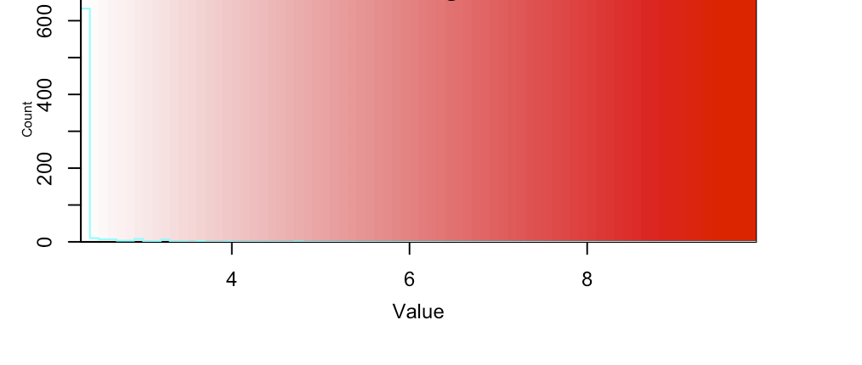
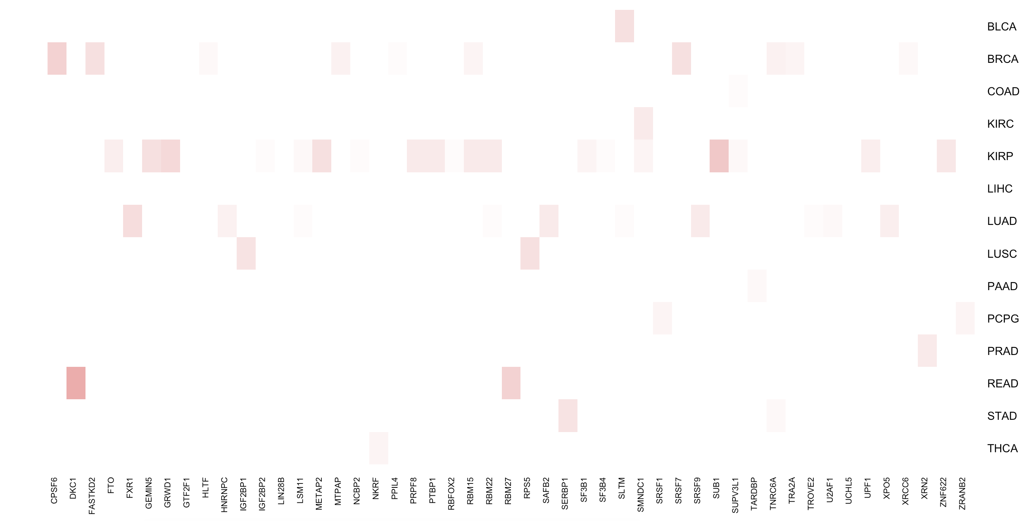
Summary of survival graphs p-value for 3’ UTR network
-log(p value)
Subsetted for
BH p_cor<0.005

Slide 14
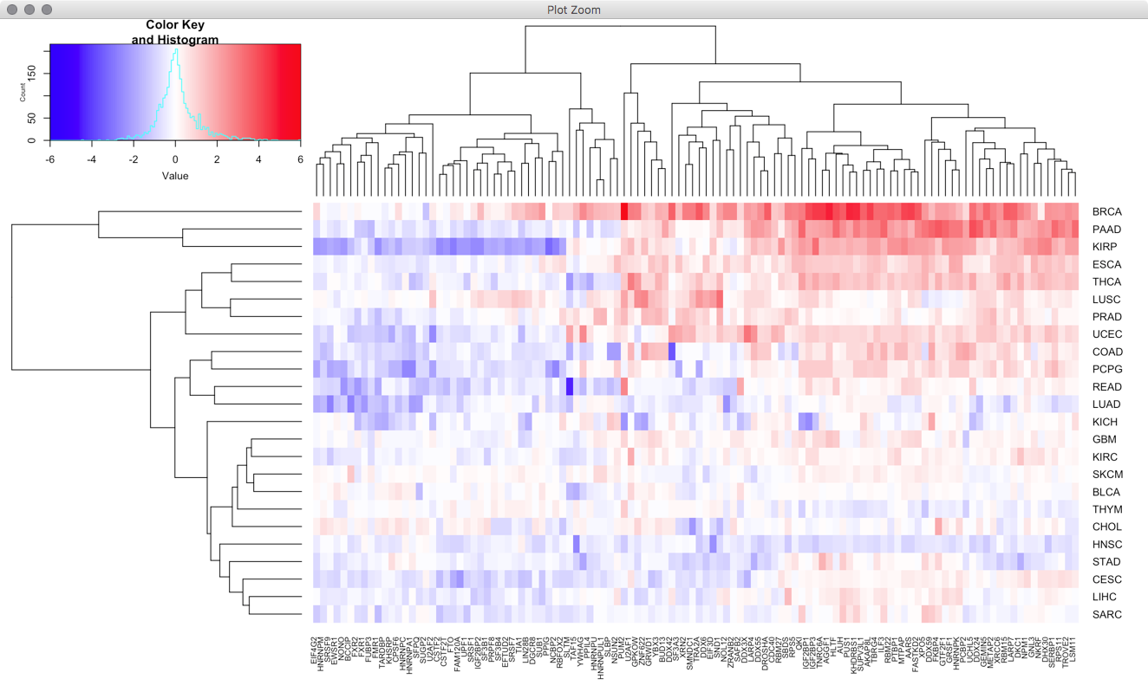
PUM2 -> E2F
regulation

Slide 15
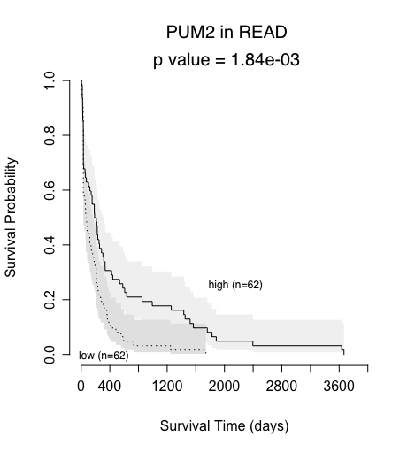
PUM2 | Functions as a translational repressor during embryonic development or cell differentiation.²
² Pruitt, Kim D., et al. "RefSeq: an update on mammalian reference sequences." Nucleic acids research 42.D1 (2014): D756-D763.

Slide 16
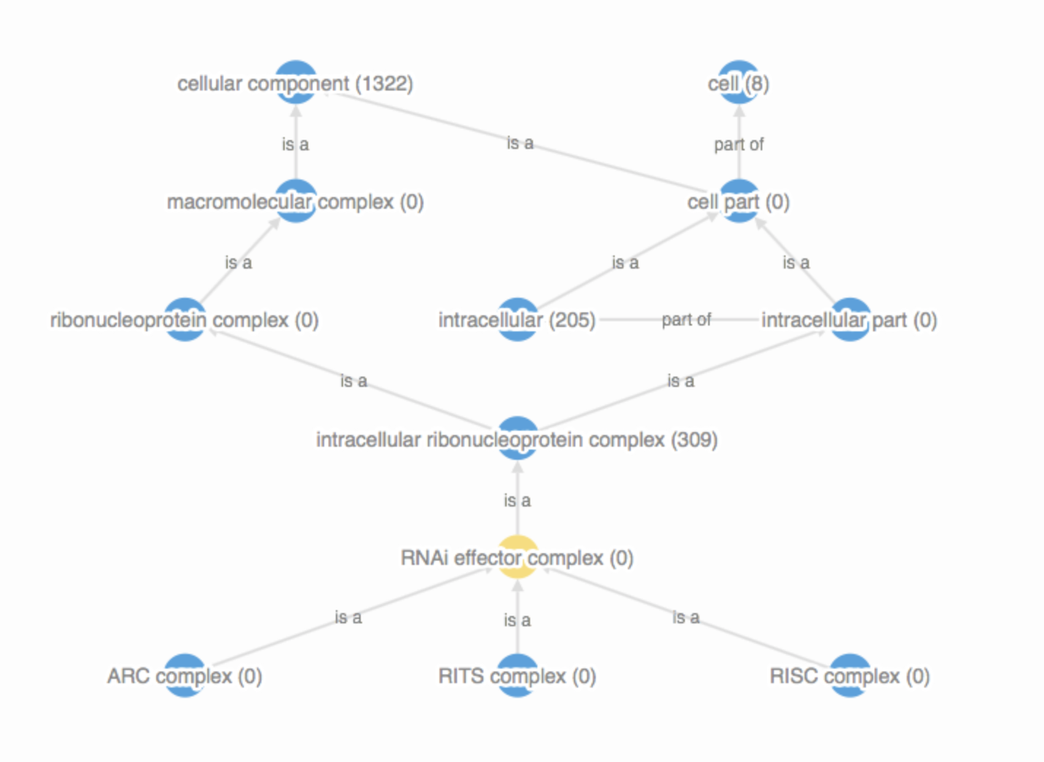
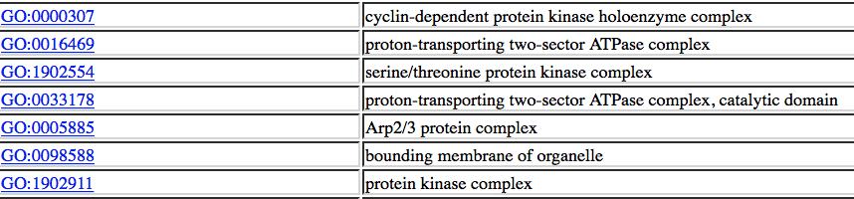

Slide 17
RADAR Score (Rscore)
Our goal is to prioritize variants from a RBP perspective focusing on those variants that fall specifically in the binding regions of such RBPs.
The scoring system is FunSeq2-like, in that relevant factors are modeled by Shannon entropy.
Discrete entropy for proportion of germline variants falling in peaks (1KG)
Quasi-Continuous entropy based on motif breaking events (d-score, DL)
Quasi-Continuous entropy based on “hot” variable

Slide 18
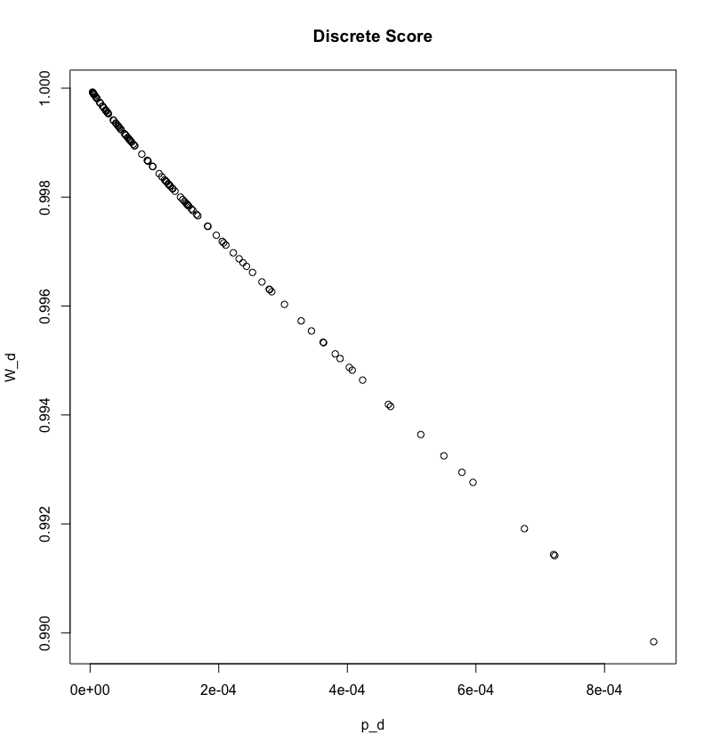
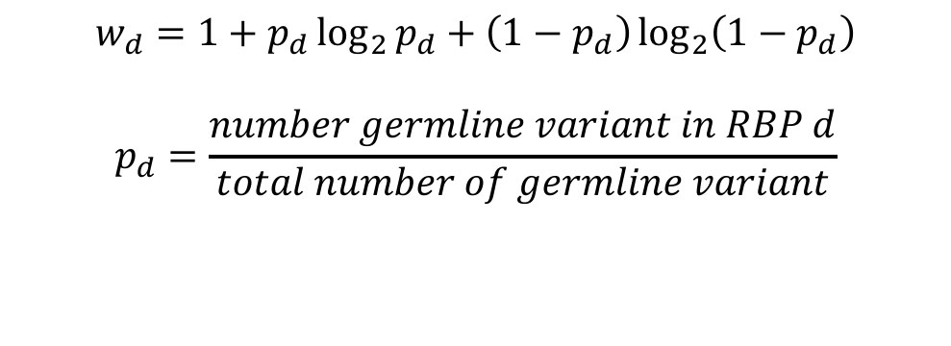
Discrete Score (Entropy model)
A discrete score is a property of an RBP. For each RBP a variant intersects, that discrete score is added. (Like FunSeq)
$$w_{d}=1+p_{d}\log_{2}{p_{d}}+\left(1−p_{d}\right)\log_{2}\left(1−p_{d}\right)$$
$$p_{d}=\frac{number germline variant in RBP d}{total number of germline variant}$$
n=112 RBPs

Slide 19
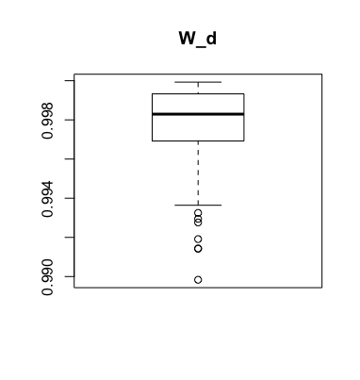
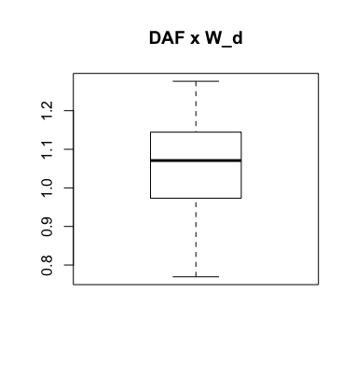
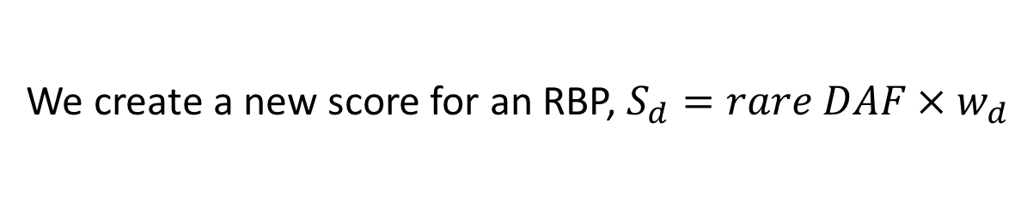
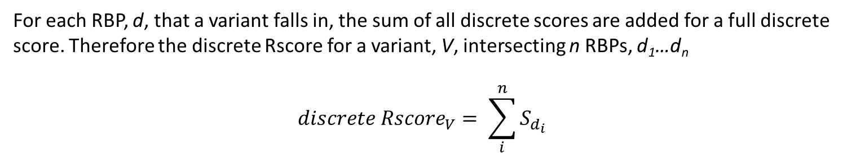
We create a new score for an RBP, $S_{d}=rare DAF × w_{d}$
For each RBP, d, that a variant falls in, the sum of all discrete scores are added for a full discrete score. Therefore the discrete Rscore for a variant, V, intersecting n RBPs, d₁…d_{n}
$$discrete {Rscore}_{V}= \sum_{i}^{n}{S_{d_{i}}}$$

Slide 20
Quasi-Continuous Score (motif breaking)
Given a variant, V, we want to add an entropy-based motif breaking score to the discrete entropy score.
We build a quasi-continuous entropy model.
We first need to score variants with general motif breaking events based on their PWMs. We use MotifTools (DL).

Slide 21
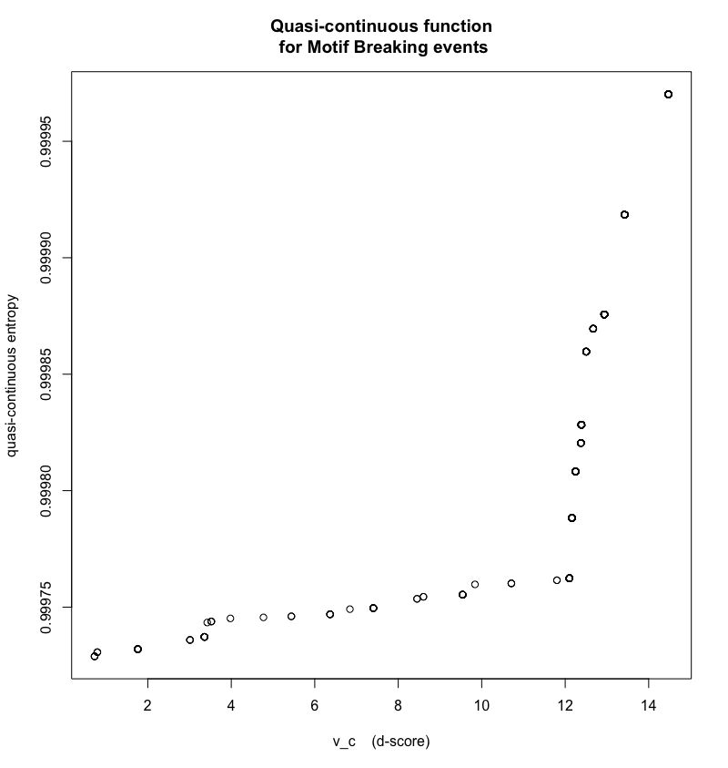

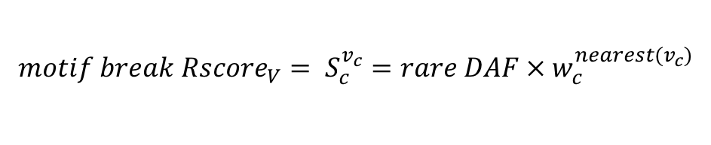
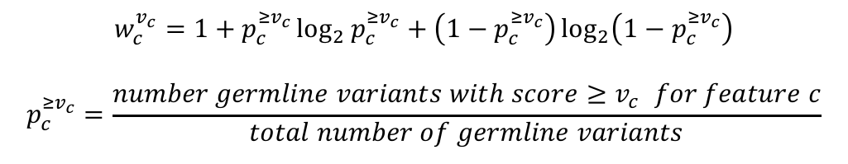
Quasi-Continuous Score (motif breaking)
Here, $v_{c}$ represents the d-score. We create a quasi continuous function between $w_{c}^{v_{c}}$ and $v_{c}$.
PUM2
$$w_{c}^{v_{c}}=1+p_{c}^{{≥v}_{c}}\log_{2}{p_{c}^{{≥v}_{c}}}+\left(1−p_{c}^{{≥v}_{c}}\right)\log_{2}\left(1−p_{c}^{{≥v}_{c}}\right)$$
$$p_{c}^{{≥v}_{c}}=\frac{number germline variants with score{≥v}_{c} for feature c}{total number of germline variants}$$
$${motif break {Rscore}_{V}= S}_{c}^{v_{c}}=rare DAF × w_{c}^{{nearest(v}_{c})}$$

Slide 22
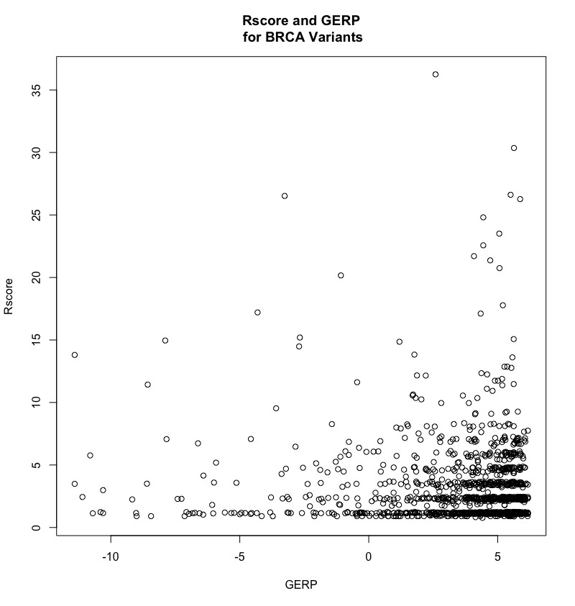
BRCA Variants

Slide 23
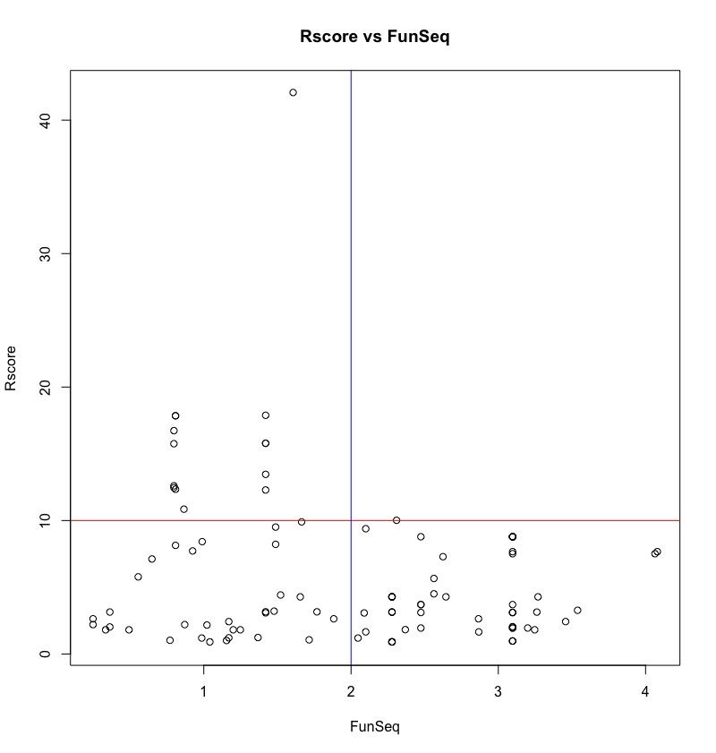
HGMD Variants n=179
UTR Region
AARS, BUD13, CDC40, CSTF2, CSTF2T, DDX24, DDX3X, DDX55, DDX6, DROSHA, EFTUD2, EIF4G2, FAM120A, FASTKD2, FMR1, FTO, FXR2, GEMIN5, GPKOW, GRWD1, GTF2F1, LARP7, METAP2, MTPAP, NCBP2, PCBP2, PPIG, RBM15, SERBP1, SLTM, SMNDC1, SND1, SRSF1, SRSF7, UCHL5, XRCC6, YWHAG, ZNF622, ZRANB2

Slide 24
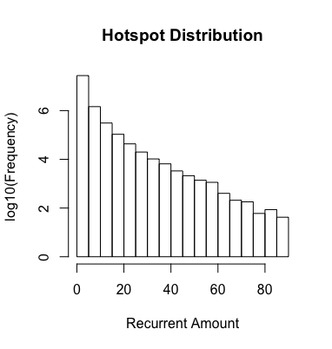
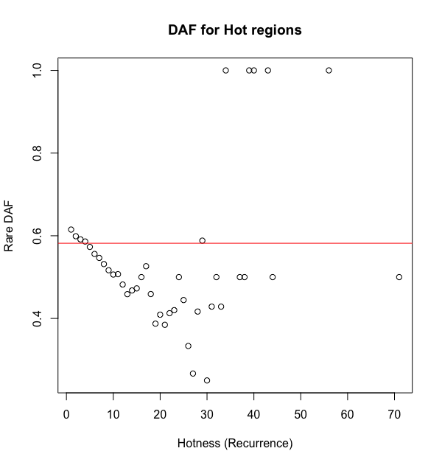
Hot score (to come), issue with DAF

