Slide 1
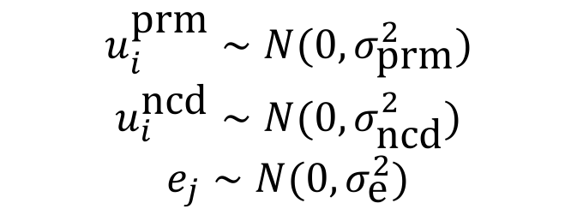
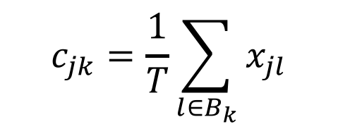
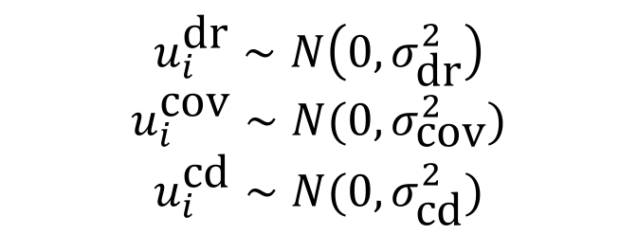
Nested model with covariates
$$c_{jk}=\frac{1}{T}\sum_{l∈B_{k}}{x_{jl}}$$
Covariate burdens:
Z-scores:
$$z_{jk}^{\text{cov}}=\text{zscore}(c_{jk})$$
$$y_{j}=μ+z_{j}^{\text{dr}}u^{\text{dr}}+\sum_{k}{z_{jk}^{\text{c}\text{ov}}u_{k}^{\text{c}\text{ov}}+}+\sum_{i}{z_{ij}^{\text{cd}}u_{i}^{\text{cd}}+}\sum_{i}{z_{ij}^{\text{prm}}u_{i}^{\text{prm}}+}\sum_{i}{z_{ij}^{\text{n}\text{cd}}u_{i}^{\text{n}\text{cd}}+e_{j}}$$
$$u_{i}^{\text{dr}}∼N\left(0,σ_{\text{dr}}^{2}\right)$$
$$u_{i}^{\text{cov}}∼N(0,σ_{\text{cov}}^{2})$$
$$u_{i}^{\text{cd}}∼N(0,σ_{\text{cd}}^{2})$$
$$u_{i}^{\text{prm}}∼N(0,σ_{\text{prm}}^{2})$$
$$u_{i}^{\text{ncd}}∼N(0,σ_{\text{n}\text{cd}}^{2})$$
$$e_{j}∼N(0,σ_{\text{e}}^{2})$$

Slide 2
Nested model without covariates
 | Drivers | Coding | Promoters | Non-coding | Total
Breast | 0.5063 | 0.0221 | 0.0275 | 0 | 0.5559
CNS | 0.1675 | 0.0274 | 0 | 0.01 | 0.205
Kidney | 0.3932 | 0.2513 | 0 | 0.2023 | 0.8468
Liver | 0.5163 | 0.0466 | 0.005 | 0.1796 | 0.7476
Ovary | 0.6263 | 0.042 | 0.1224 | 0 | 0.7906
Pancreas | 0.9497 | 0 | 0.0058 | 0 | 0.9555
Prostate | 0.2193 | 0.145 | 0 | 0 | 0.3643
Skin | 0.929 | 0 | 0.0066 | 0.0644 | 1
Pan-cancer | 0.5384 | 0.0668 | 0.0209 | 0.057 | 0.6832
Previous results
 | Drivers | Ncd+prm | All
Pan-cancer | 0.525 | 0.5795 | 0.6455

Slide 3
Nested model with covariates
 | Drivers | Covariates | Coding | Promoters | Non-coding | Total
Breast | 0.5104 | 0 | 0.0179 | 0.0272 | 0 | 0.5554
CNS | 0.1721 | 0.0252 | 0.0267 | 0.0003 | 0.0316 | 0.2559
Kidney | 0.4251 | 0.5269 | 0 | 0 | 0 | 0.952
Liver | 0.5377 | 0.0719 | 0 | 0.001 | 0.1606 | 0.7712
Ovary | 0.6281 | 0.0055 | 0.0413 | 0.1277 | 0 | 0.8026
Pancreas | 0.9326 | 0.0076 | 0.0173 | 0 | 0 | 0.9575
Prostate | 0.2457 | 0.0398 | 0.1071 | 0 | 0 | 0.3927
Skin | 0.6589 | 0.0481 | 0 | 0 | 0.293 | 1
Pan-cancer | 0.5138 | 0.0906 | 0.0263 | 0.0195 | 0.0607 | 0.7109
Without covariates
 | Drivers | Covariates | Coding | Promoters | Non-coding | Total
Pan-cancer | 0.5384 | - | 0.0668 | 0.0209 | 0.057 | 0.6832

Slide 4
Funseq thresholds
Without covariates
With covariates
 | Coding | Promoters | Non-coding
Breast | 4 | 2 | 5
CNS | 4 | 2 | 2
Kidney | 4 | 4 | 1
Liver | 4 | 4 | 1
Ovary | 5 | 1 | 4
Pancreas | 6 | 4 | 0
Prostate | 4 | 2 | 4
Skin | 6 | 0 | 4
Pan-cancer | 4.625 | 2.375 | 2.625
 | Coding | Promoters | Non-coding
Breast | 4 | 2 | 5
CNS | 4 | 2 | 2
Kidney | 6 | 0 | 0
Liver | 4 | 4 | 1
Ovary | 5 | 1 | 3
Pancreas | 5 | 0 | 0
Prostate | 4 | 2 | 4
Skin | 4 | 2 | 1
Pan-cancer | 4.5 | 1.625 | 2

Slide 5
Nested model with MoatSim randomization (10kb bins)
 | Drivers | Coding | Promoters | Non-coding | Total
Breast | 0.5107 | 0.0309 | 0.0185 | 0 | 0.5601
CNS | 0.1716 | 0.0129 | 0 | 0.087 | 0.2586
Kidney | 0.3893 | 0.2437 | 0 | 0.1457 | 0.7787
Liver | - | - | - | - | -
Ovary | 0.6639 | 0.0081 | 0.2116 | 0 | 0.8836
Pancreas | 0.9497 | 0 | 0.0058 | 0 | 0.9555
Prostate | 0.2234 | 0.1115 | 0.0 | 0.0023 | 0.3372
Skin | - | - | - | - | -
Pan-cancer | 0.4846 | 0.06785 | 0.03931 | 0.0391 | 0.63086
Previous results (PCAWG Inigo)
 | Drivers | Coding | Promoters | Non-coding | Total
Pan-cancer | 0.4762 | 0.0804 | 0.0252 | 0.03575 | 0.6177

Slide 6
Nested model with MoatSim randomization (10kb bins)
Funseq thresholds
 | Coding | Promoters | Non-coding
Breast | 4 | 2 | 5
CNS | 4 | 2 | 2
Kidney | 4 | 3 | 2
Liver | - | - | -
Ovary | 5 | 1 | 4
Pancreas | 6 | 0 | 0
Prostate | 4 | 3 | 4
Skin | - | - | -
Pan-cancer | 4.5 | 1.83 | 2.83

