Slide 1
Molecular Dynamics Simulations of Protein-ligand Complex Systems and Applications to Drug Design
Min Xu
National Institute on Drug Abuse
National Institutes of Health

Slide 2
Overview
Introduction
Protein Structural Memory Influences Ligand Binding Modes and Unbinding Rates
Discovery of CREBBP Bromodomain Inhibitors by High-throughput Docking and Hit Optimization Guided by Molecular Dynamics
Structural and Pharmacological Profiling Study of Sigma 1 Receptor by Molecular Dynamics

Slide 3
Molecular Dynamics (MD) Simulation:
A computational microscopy
Karo J., et al. (2012) J Biol Chem
Notes:
It is like a computational microscopy. You can directly study the protein without expressing it.
What is even better is that it can zoom into the very details of the biological system, capturing the movements of each individual atoms.
And this cannot be achieved eaily with any other experimental methods.

Slide 4
Molecular Dynamics (MD) Simulation:
A computational microscopy
Ode H. et al. (2012) Front Microbiol
Notes:
Temporally, MD simulations focuses on the transient state/changes.
Both advantage and disadvantage
With the increasing computational power….

Slide 5
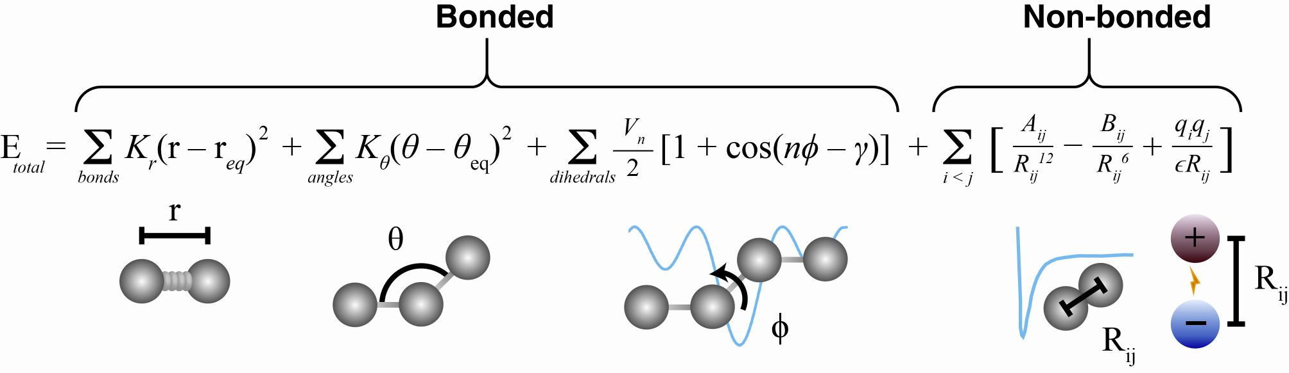
How to run a MD simulation?
Coordinates
A force field
Durrant JD. (2011) BMC Biology 9:71

Slide 6
Applications in Protein-ligand systems
Wet-lab Methods
Measure IC₅₀, K_{d}, X-ray crystallography, NMR…
VS
MD Simulations
Binding/unbinding kinetics/pathways,
free-energy estimation,
alternative binding modes…

Slide 7
Protein-ligand interaction is highly dynamic
OBSOLETE
Boehr D. and Wright P. (2008) Science 320, 1429

Slide 8
II. Protein Structural Memory Influences Ligand Binding Modes and Unbinding Rates

Slide 9
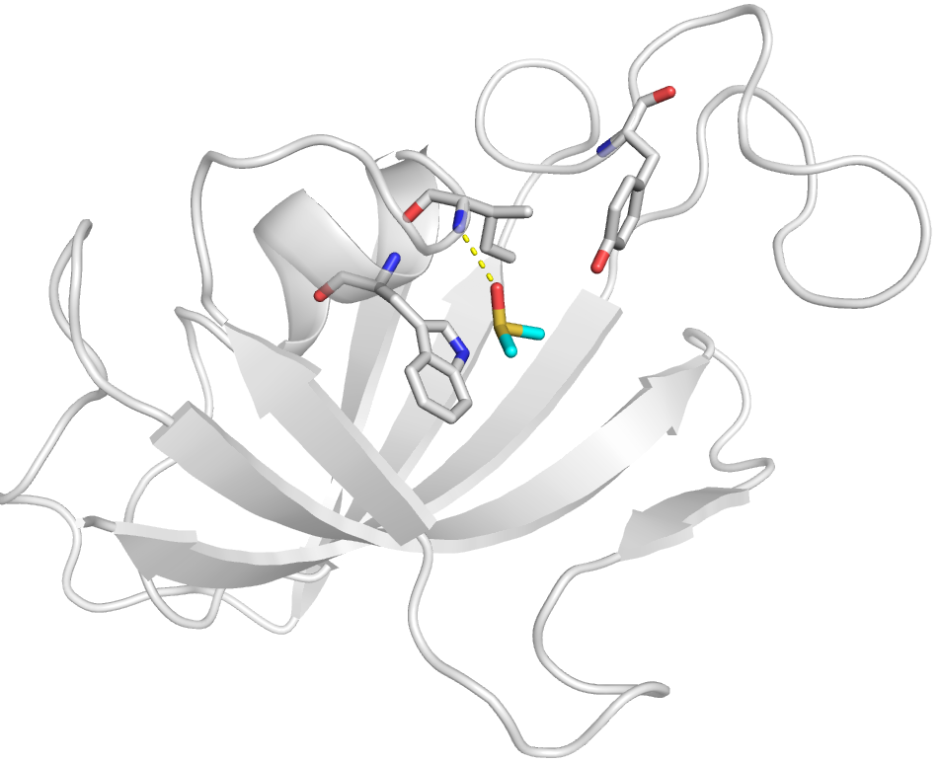
FKBP-DMSO complex is a good model for our study
Goal
  study how protein conformations might influence the binding/unbinding behaviors of small-molecular ligands
FKBP
  a peptidylprolyl isomerase (PPIase) with 107 residues
DMSO
  A small and weak binder
  Short unbinding time (~ 4 ns at 310 K)
Ile56
Tyr82
Trp59
DMSO
Huang D., Caflisch A. (2011) PLoS Comput Biol 7(2):e1002002
Huang D., Caflisch A. (2011) ChemMedChem 6(9):1578–1580

Slide 10
Two protein states were prepared and studied
From holo-relaxed state
150 ns unbinding simulations
Remove DMSO
~500 ns relaxation simulations to recover the equilibrium of the protein; Obtain apo-relaxed state
Add DMSO back
From crystal structure
Collecting 116 holo-relaxed structures with an iterative procedure
Sample rebinding and unbinding events for the apo-relaxed state
Two distinct states
  DMSO-bound state (holo-relaxed state)
  Apo-relaxed state
They correspond to high and low concentration of DMSO respectively.

Slide 11
Unbinding constant is affected by different states
data points
single-exponential function fitting
Unbinding Constant (k_{off}⁻¹)
23 ns for the holo-relaxed state
2.2 ns for the apo-relaxed state
ΔG_{apo} - ΔG_{holo} ≈ 2.3 k_{B}T ≈ 1.3 kcal/mol

Slide 12
Free-energy surface change of ligand binding
For holo-relaxed state (a), the most populated binding mode corresponds to the crystal structure;
For apo-relaxed state (b), a new metastable state is populated in which DMSO forms a hydrogen bond with Tyr82.

Slide 13
Global conformational change upon unbinding
The binding groove relaxation
The relaxation process takes a few 100 ns to finish.
Fitting with a stretched-exponential function:
S = A*exp(-(t/τ)^{β}) + A₀
reveals a time-constant of τ = 65 ns and a stretching factor of β = 0.77 that deviates significantly from 1.
100 1000 10000 100000
Time (ps)

Slide 14
Local conformational change
The side chain of Trp59, which forms the “floor” of the DMSO, changes its orientation upon DMSO unbinding with a time-scale of 36 ns by fitting a single-exponential function.
Integration

Slide 15
Water response is coupled with protein
The change of water density can be fitted with the same stretched-exponential function with the time-constant of τ = 65 ns and the stretching factor β = 0.77.
100 1000 10000 100000
Time (ps)

Slide 16
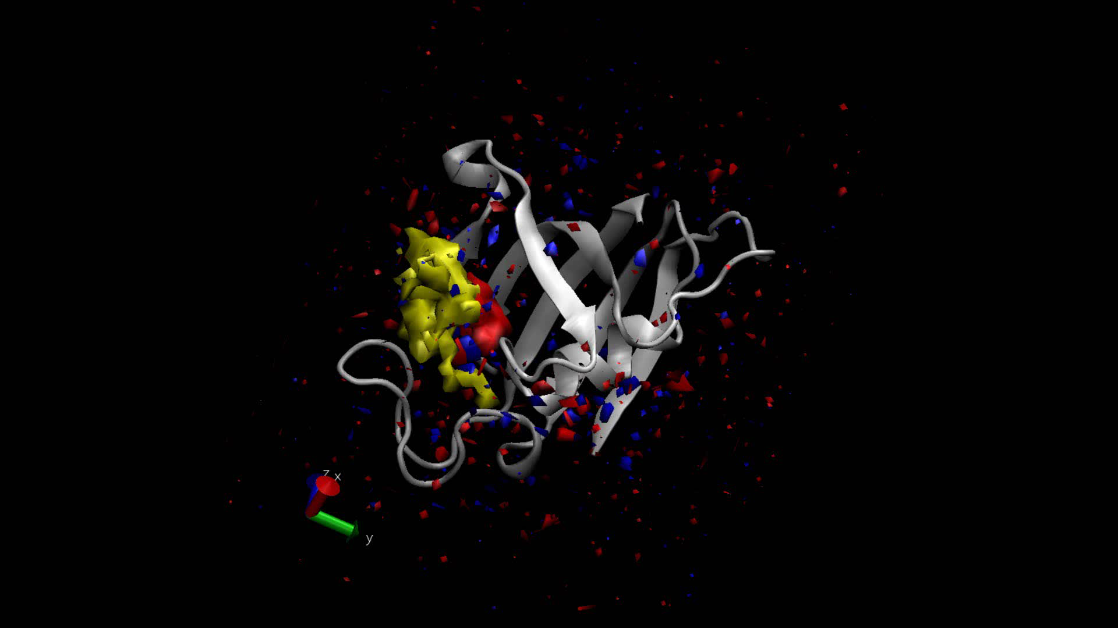
Water Response Movie
Yellow represents the density of DMSO;
Red and blue colors depict increased and decreased water density, respectively.

Slide 17
Conclusions
The binding/unbinding of DMSO, a small molecule of only four non-hydrogen atoms, has a sizeable effect on the protein structure.
Despite the fact that the the structural changes of the binding pocket are relatively small (< 1 Å), they have a significant effect on the unbinding constant and binding modes.
Memory of protein: the rearrangement of the protein and its solvation layer is nearly two order of magnitude slower than the dissociation of the ligand. Actual binding/unbinding rate depends on the state of the protein, which in turn has a long-lived memory.
The first layer of water molecules and atoms on the protein surface relax simultaneously.

Slide 18
III. Discovery of CREBBP Bromodomain Inhibitors by High-throughput Docking and Hit Optimization Guided by Molecular Dynamics

Slide 19
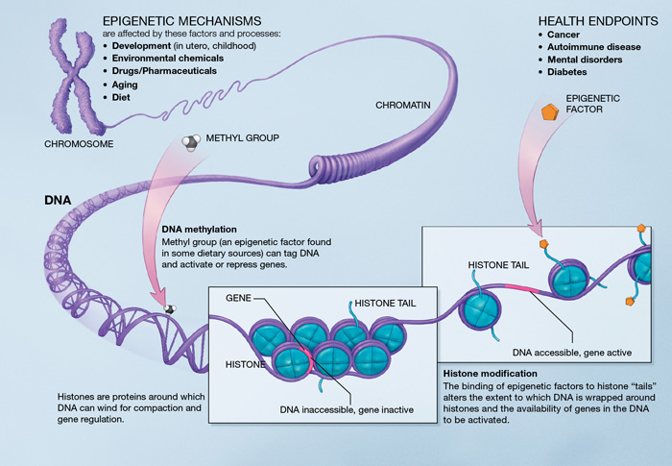
Bromodomain is important in epigenetics
Epigenetics
  Study of stable heritable traits that can not be explained by changes in DNA sequences. (Wikipedia)
Underlying Mechanism of
  Cell differentiation
  Disease progression
Molecular Mechanisms
  DNA methylation
  Histone modification

Slide 20
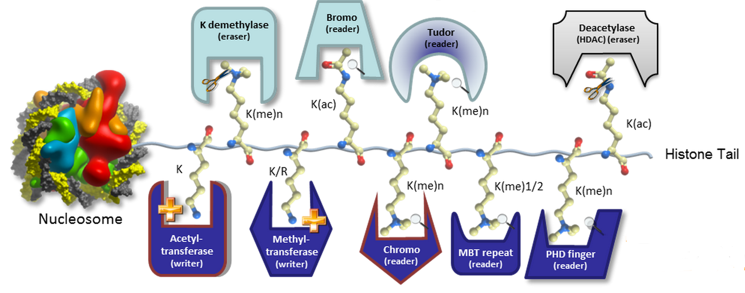
Bromodomain: Kac reader
There are three classes of epigenetic proteins: reader, writer and eraser.
http://www.thesgc.org/chemical-probes/epigenetics

Slide 21
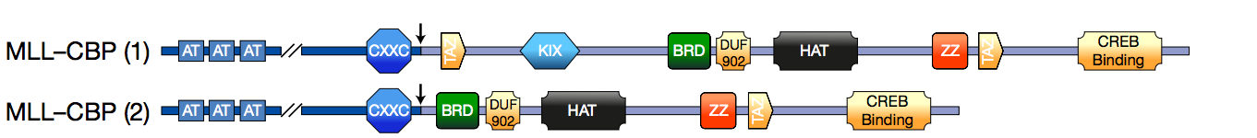
CREBBP bromodomain is implicated in cancers
Oncogenic fusions of CBP in acute leukemia;
CBP mutations are found in relapsed acute lymphoblastic leukemia (AML) and are very common in diffuse large B-cell lymphoma and follicular lymphoma;
CBP is also highly expressed in advanced prostate cancer and expression levels have been linked with cancer patient survival.
Expert Reviews in Molecular Medicine © Cambridge University Press 2011

Slide 22
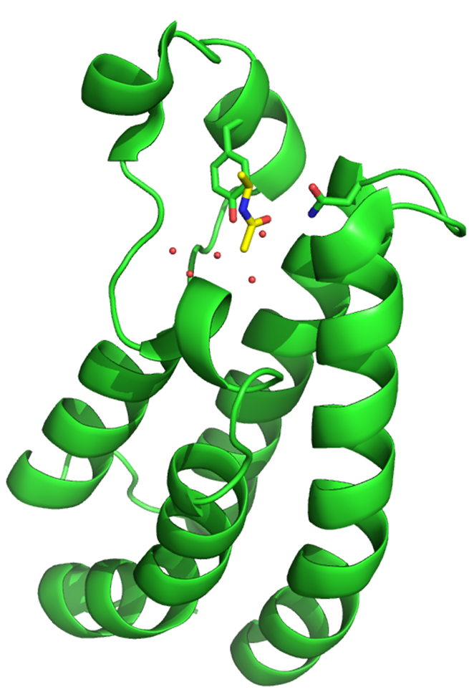
Structure-based approach was used
ZA loop
Receptor
Seven X-ray crystal structures; two of them were used in this study
Ligand
Very few known inhibitors
ASN
Protein structure
Unknown
BC loop
KAc
Known
αB
αA
Known
Unknown
αZ
Ligand structure
αC

Slide 23
Fragment-based procedure
17 compounds

Slide 24
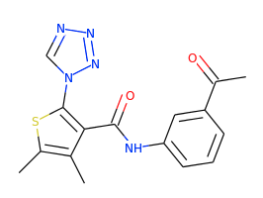
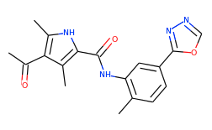
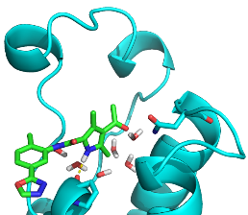
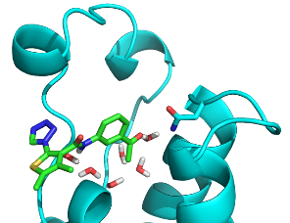
Two hits identified:
4-acyl pyrrole & acyl-benzene
1
2
K_{d} = 13 μM
K_{d} = 29 μM

Slide 25
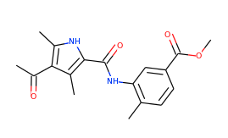
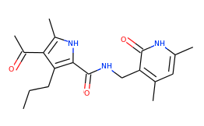
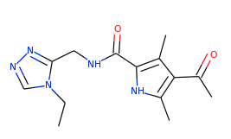
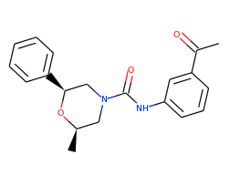
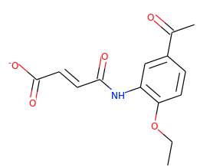
More similar compounds were identified by substructure search
3
4
5
20%
3.1%
4.7%
6
7
The percentage of the signal of the inhibitors at 50 µM with respect to the negative control DMSO in a competition binding assay.
9.4%
2.5%

Slide 26
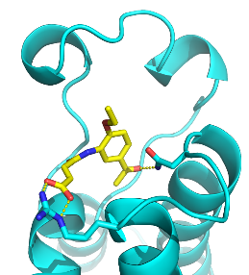
Initial hit was selected for optimization
Optimization of acyl-benzene started from compound 7
K_{d} = 5 μM, LE = 0.36
Novel scaffold, low molecular weight, high ligand efficiency.
Predicted binding pose of compound 7

Slide 27
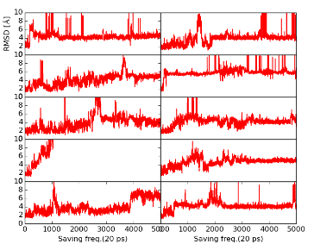
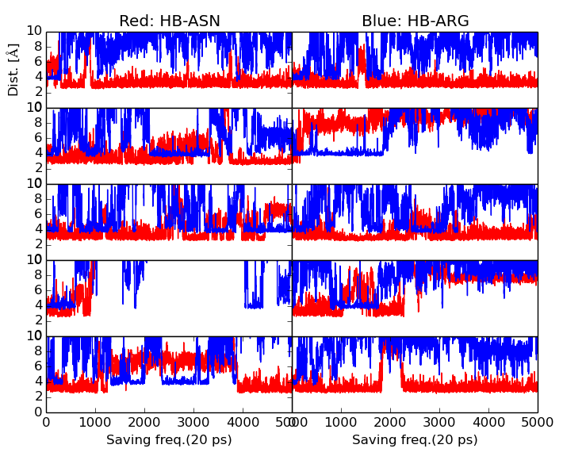
MD simulations showed the hint for optimization
MD simulation (10×100 ns) results implied that the hydrogen bond with ARG1173 is not stable.

Slide 28
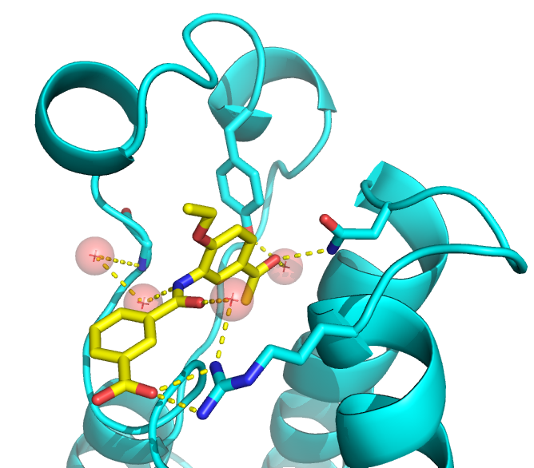
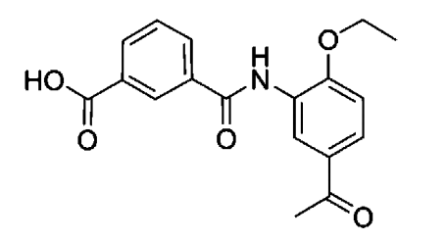
Compound 8 has a better affinity
8
Affinity is improved: K_{d} = 770 nM.
X-ray crystal structure of compound 8

Slide 29
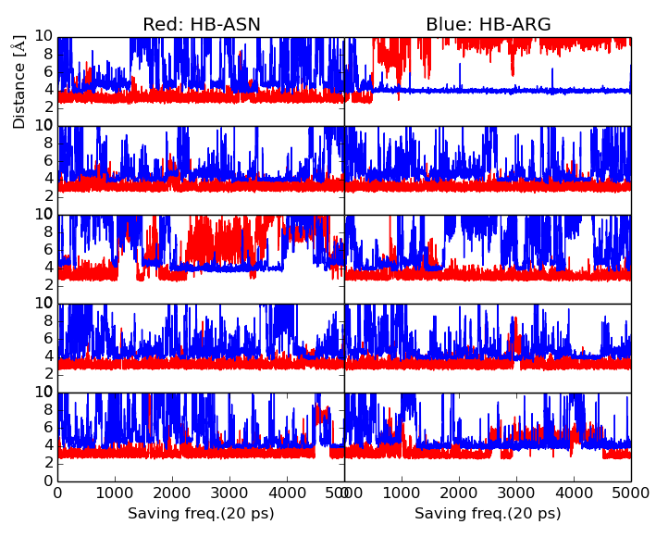
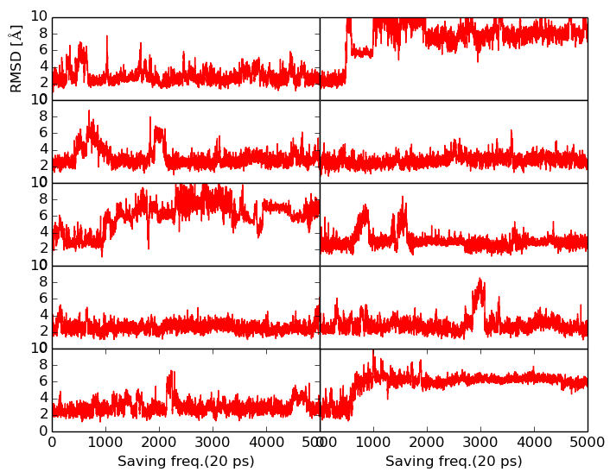
Improved stability of compound 8 in MD

Slide 30
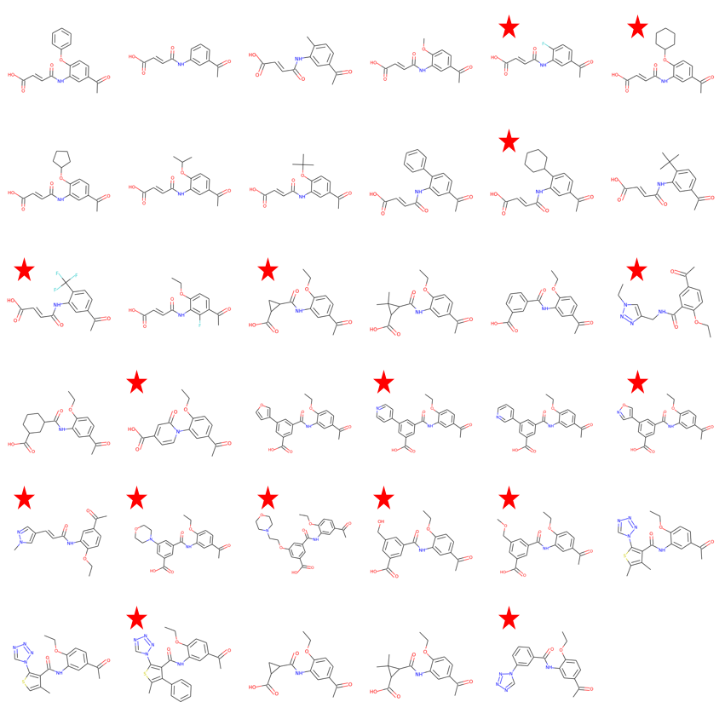
Computational approach was applied to prioritize the derivatives
35 derivatives of compound 8 were proposed;
Perform the docking procedure to all of them as before;
Run MD simulations to some of them based on the docking results & diversity.

Slide 31
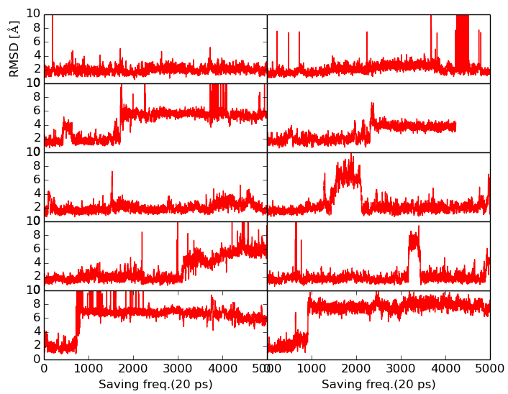
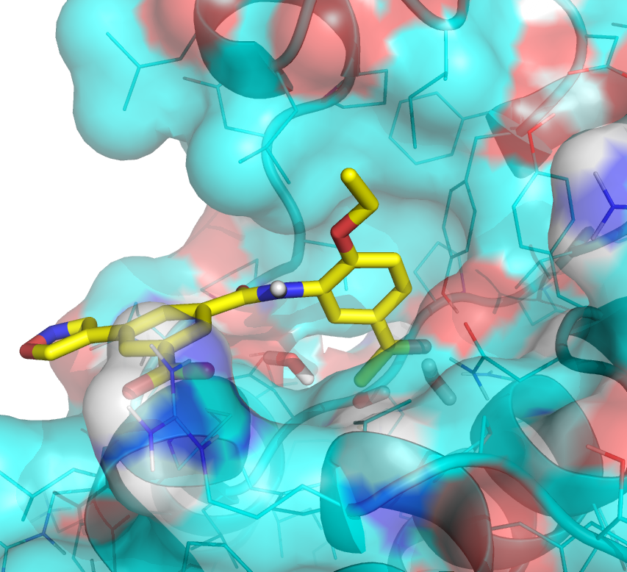
MD-aided selection: One example
A similar compound (9) with the 3-furyl group was synthesized and showed the better affinity (K_{d} = 170 nM).

Slide 32
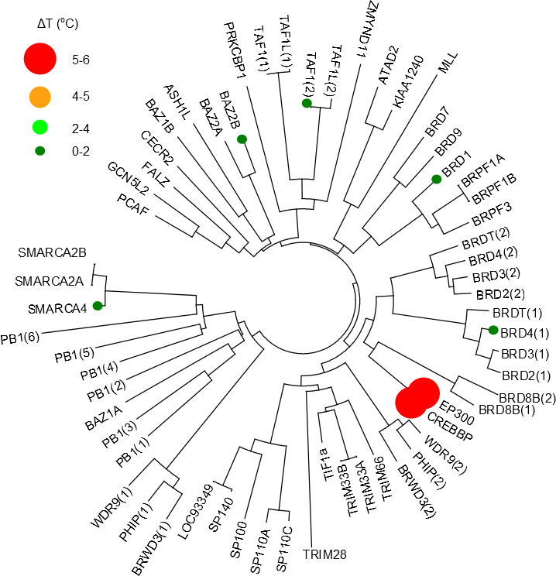
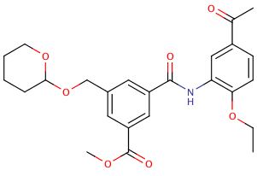
Selectivity and cellular activity was tested
Compound 10
Ligand | MOLM-13
 | Acid | Ester
8 | 71 | 46 (46 μM)
9 | 19 (33 μM) | 82
10 | 61 | 11 (5.33 μM)

Slide 33
Summary
Several low micro-molar range inhibitors for CREBBP were identified using fragment-based virtual screening;
Inhibitors within nano-molar range were obtained upon MD-guided optimization;
Selectivity and cellular activity was shown by the further experiments.

Slide 34
IV. Structural and Pharmacological Profiling Study of Sigma 1 Receptor by Molecular Dynamics

Slide 35
S1R – a unique membrane protein
No other homologous mammalian proteins
Sigma 1 receptor (S1R) resides at both ER and plasma membranes
Interactions with many other proteins have been experimentally observed
Functions as a chaperone and modulator
Implicated in many human diseases (CNS disorders, cancers)
Tsung-Ping Su et al. (2016) Trends in Pharmacological Sciences

Slide 36
Crystal structure of S1R lays the foundation for our study
ER lumenal side
Cytosolic side
Kourrich S. et al. (2016) Trends in Neurosciences
Schmidt H. R., et al. (2016) Nature
S1R is mostly found to form tetramer, hexamer or even higher-order oligomers, while in the crystal structure, it is in a trimeric state.
Nevertheless, the high resolution structure of trimer provides us with a good model to study the receptor-ligand interaction and oligomerization state of S1R.

Slide 37
Agonist vs Antagonist: Ambiguous definition
Some S1R ligands appear to be capable of functioning as both agonist and antagonist, depending on which client proteins interact with S1R (Cobos E., et al., Curr Neuropharmacol. 2008)
Oligomerization:
  Discrepancy:
    agonist prefers monomer/dimer (Ashish K. M. et al., Biochem J. 2015)
    agonist stabilizes the high-order oligomeric state, like tetramer (Katarzyna A. G. et al., J Biol Chem. 2014)
  Agreement: antagonist promotes the higher-order oligomerization

Slide 38
Questions to be addressed
Trimer vs monomer
Apo vs agonist-bound vs antagonist-bound
Simulation systems:
Conditions | apo | PNT-bound ((+)-pentazocine: agonist) | PD-bound (PD144418: antagonist) | HDL-bound (haloperidol: antagonist)
Trimer
Monomer

Slide 39
Summary
Two important structural regions were identified, whose conformations are affected by different oligomerization states and ligand binding.
Conformational changes caused by (+)-pentazocine or haloperidol/PD144418 underlie their ‘agonism’ or ‘antagonism’.
Different interaction patterns could be used to predict the pharmacological profile for new ligands and also shed light on the rational design of future drugs.

Slide 40
What am I offering:
My passion in computational biology & my expertise in data analysis.
I’m ready for the new challenge!
Biology
Computational Structural Biology
Bioinformatics

Slide 41
Acknowledgements
Caflisch group
Shi group
FKBP project: Peter Hamm, Andreas Vitalis
CREBBP project: Jing Dong, Dimitrios Spiliotopoulos, Nevado’s group, Danzhi Huang, Hongtao Zhao
Sigma 1 project: Hideaki Yano, Alessandro Bonifazi, Andrew Fant

