Slide 1
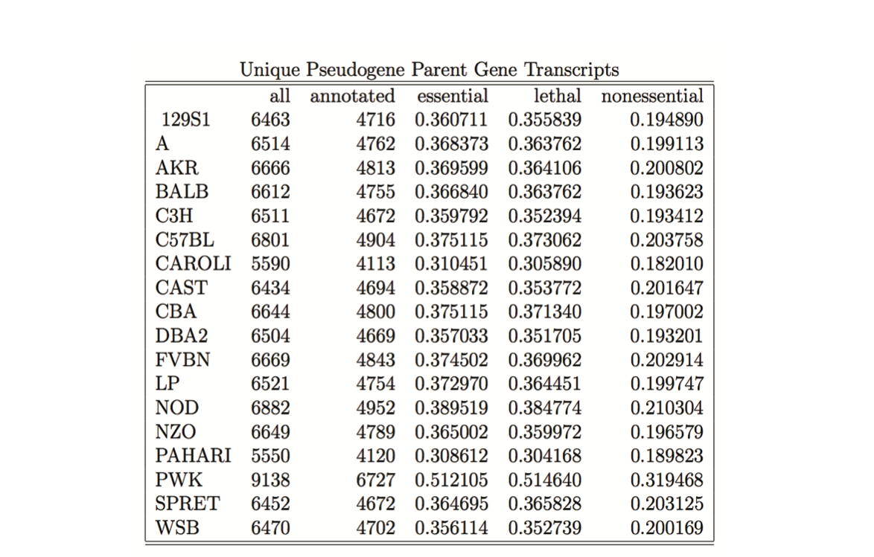
Enrichment of essential genes amongst pseudogene parent genes.

Slide 2
Essential gene enrichment amongst parent genes (unique)
Duplicated Pseudogenes | Essential | Nonessential
Parent gene | 432 | 467
Non-parent gene | 2,780 | 4,214
All Pseudogenes | Essential | Nonessential
Parent gene | 1,653 | 1,748
Non-parent gene | 1,559 | 2,933
Odds ratio: 1.402221
P value: 2 x 10⁻⁶
Processed Pseudogenes | Essential | Nonessential
Parent gene | 1,529 | 1,521
Non-parent gene | 1,683 | 3,160
Odds ratio: 1.779088
P value: 1.9 x 10⁻³⁵
Odds ratio: 1.887475
P value: 1.3 x 10⁻⁴¹

Slide 3
Essential gene enrichment amongst parent genes (abundance)
Annotated Genes | Essential | Nonessential
Parent gene | 3,212 | 4,681
Null hypothesis:
P(essential) = 3,212/7,893 = 0.407
P(nonessential) = 4,681/7,893 = 0.593
Duplicated Pseudogenes | Essential | Nonessential
Parent gene | 1,937 | 1,891
P-value: < 1 x 10⁻¹⁰
Processed Pseudogenes | Essential | Nonessential
Parent gene | 50,244 | 16,685
P-value: < 1 x 10⁻¹⁰
All Pseudogenes | Essential | Nonessential
Parent gene | 52,181 | 18,576
P-value: < 1 x 10⁻¹⁰

Slide 4
Lower Quantile | Upper Quantile | Essential Genes | Nonessential Genes | Total
0.1 | 0.2 | 438 | 1470 | 3525
0.2 | 0.3 | 438 | 1470 | 3525
0.3 | 0.4 | 438 | 1470 | 3525
0.4 | 0.5 | 438 | 1470 | 3525
0.5 | 0.6 | 438 | 1470 | 3525
0.6 | 0.7 | 1254 | 3224 | 8195
0.7 | 0.8 | 703 | 694 | 2849
0.8 | 0.9 | 618 | 427 | 2246
Lower Quantile | Upper Quantile | Essential Genes | Nonessential Genes | Total
0.0 | 0.6 | 438 | 1470 | 3525
0.6 | 0.7 | 1254 | 3224 | 8195
0.7 | 0.8 | 703 | 694 | 2849
0.8 | 0.9 | 618 | 427 | 2246

