Slide 1
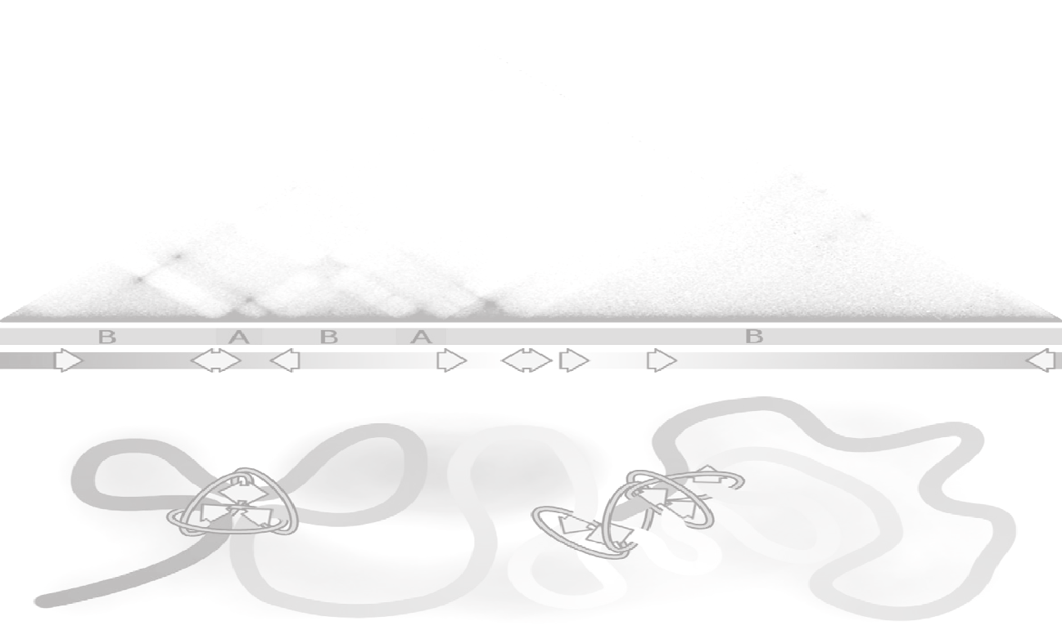
Evolutionarily Conserved Principles Predict 3D Chromatin Organization
Jordan Rowley, Michael Nichols, Xiaowen Lyu, Masami Ando-Kuri, Sarahi Rivera, Karen Hermetz, Ping Wang, Yijun Ruan, and Victor Corces

Slide 2
Highlights
Compartments are small
Domains = Compartments in Drosophila
not due to loops between borders
Transcriptional states can predict Hi-C
mostly in organisms lacking CTCF
Small compartments exist in mammalian cells
CTCF loops often obscure these
Drosophila Hi-C
~1 billion reads
(250 bp resolution)

Slide 3
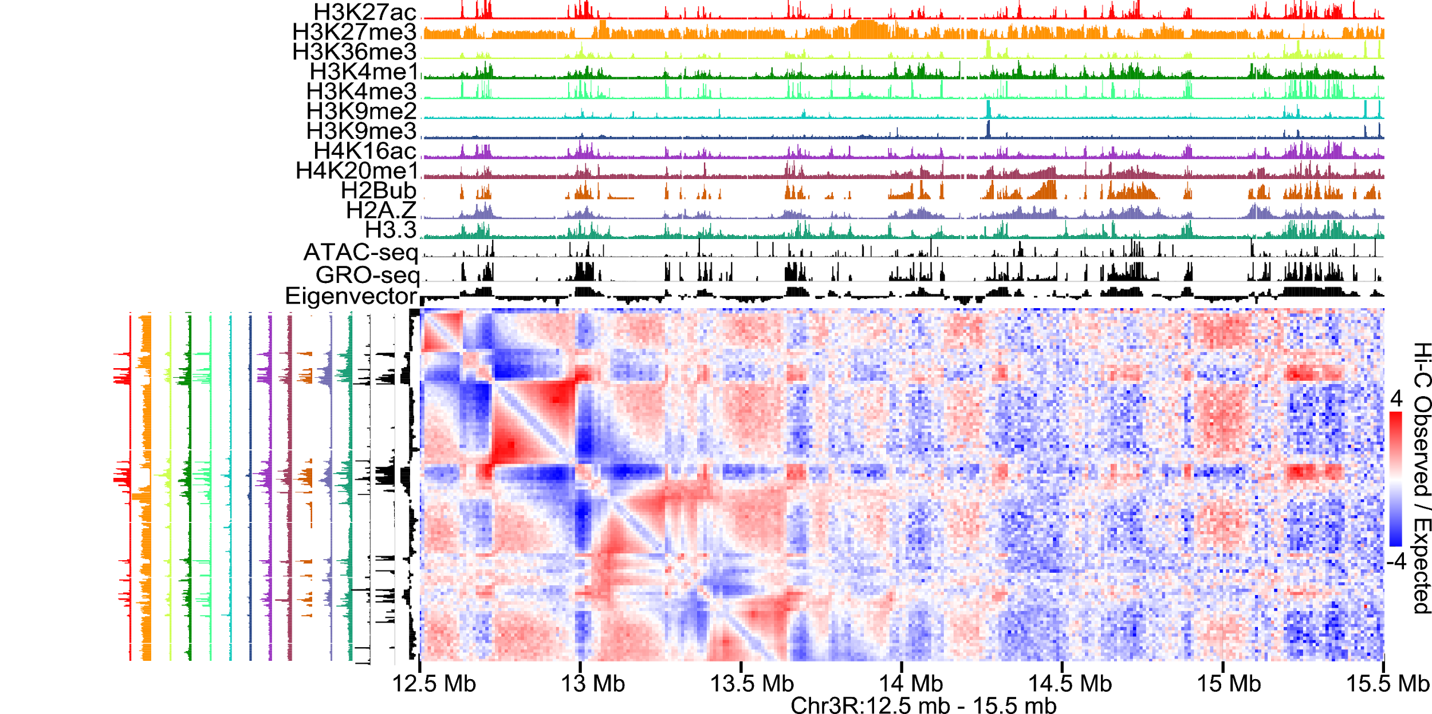
Compartments are Fine-Scale Features of Drosophila Chromatin Organization

Slide 4
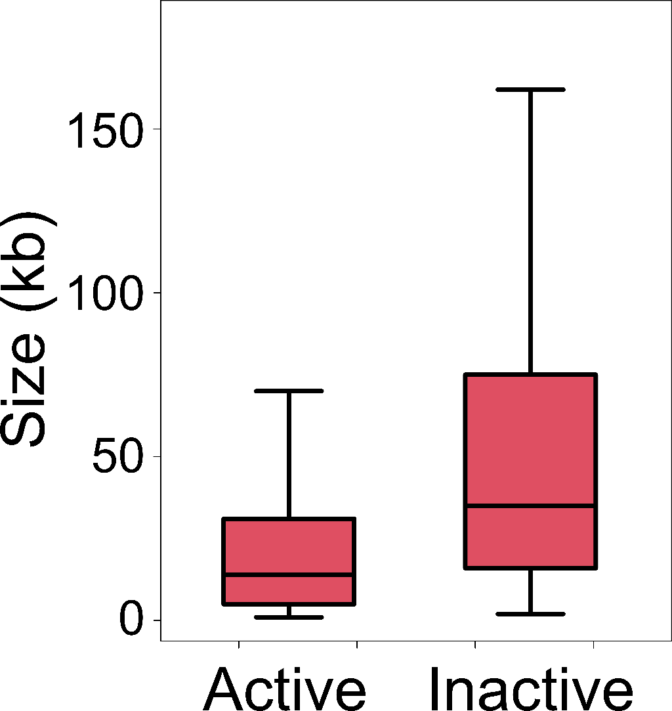
Compartments are Fine-Scale Features of Drosophila Chromatin Organization
Compartments
29 kb
15 kb

Slide 5
Drosophila Domain Organization is not a Result of CTCF Looping
Kc167 Drosophila
CTCF Loops
Not CTCF
Data from Rao et al, Cell 2014
Cubeñas-Potts et al, NAR 2016
Eagen et al, PNAS 2017

Slide 6
Drosophila Domains = Compartmental Domains
A
A
A
A
A
B
A
A
B
B
B
B
B

Slide 7
Compartments Underlie Low Resolution TAD Calls
Compartmental Domains

Slide 8
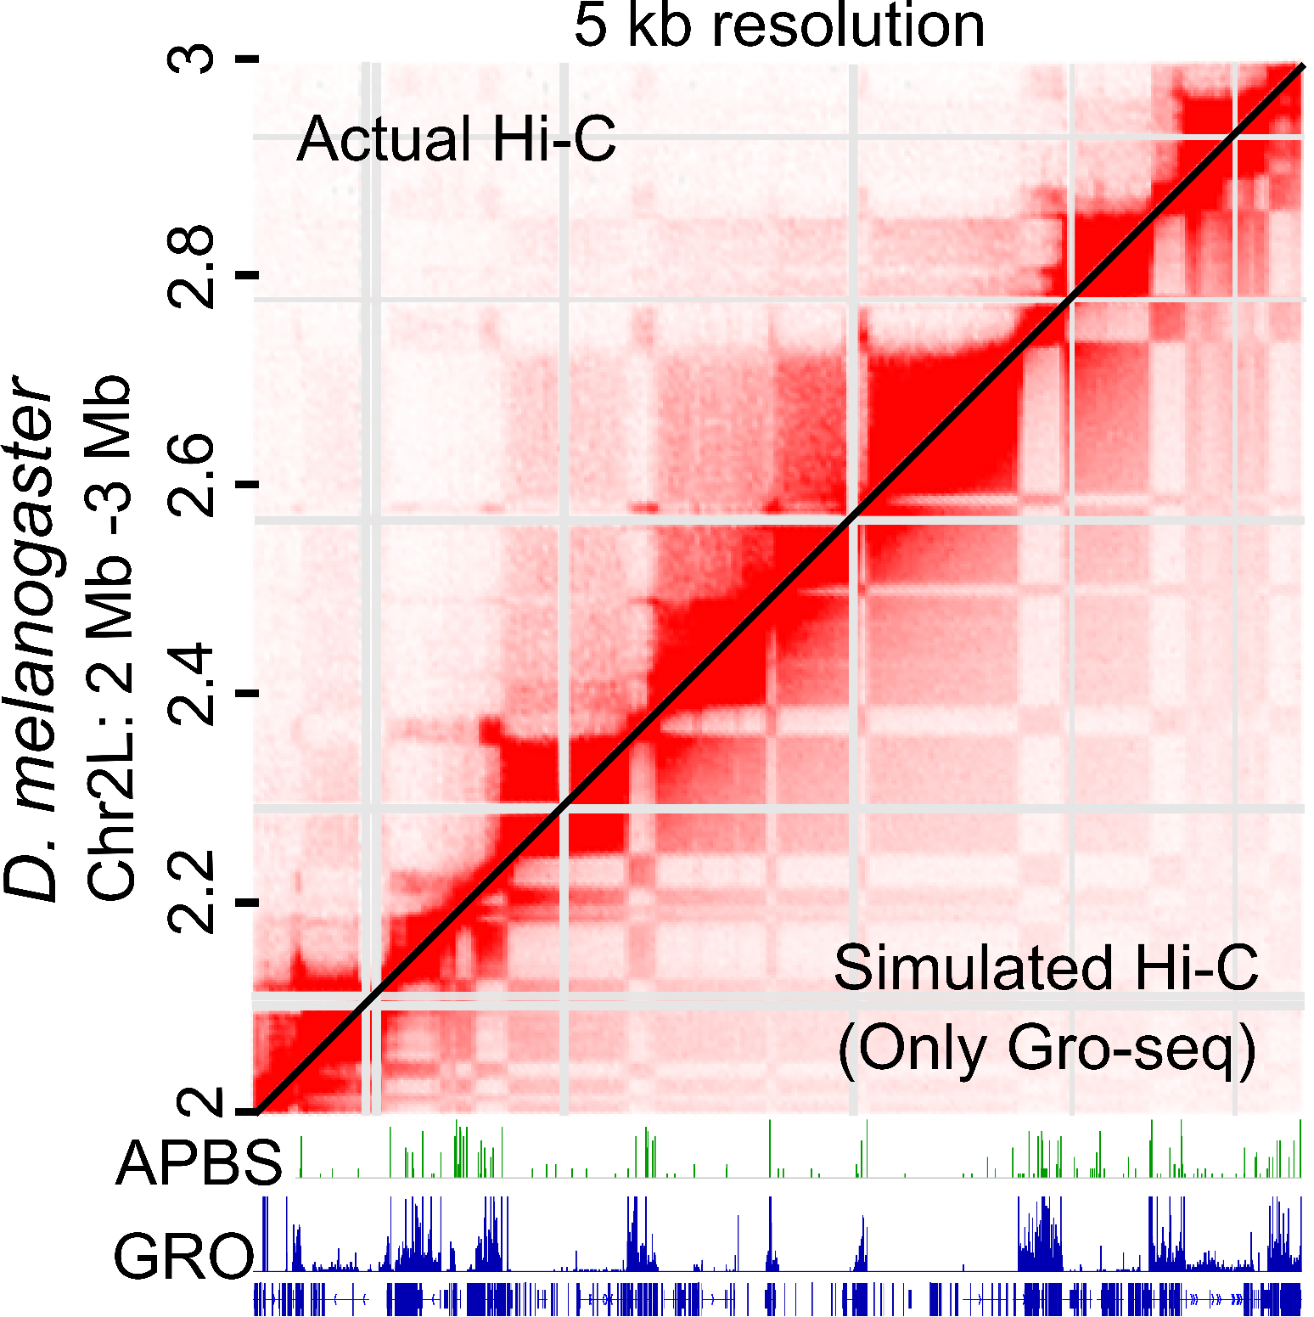
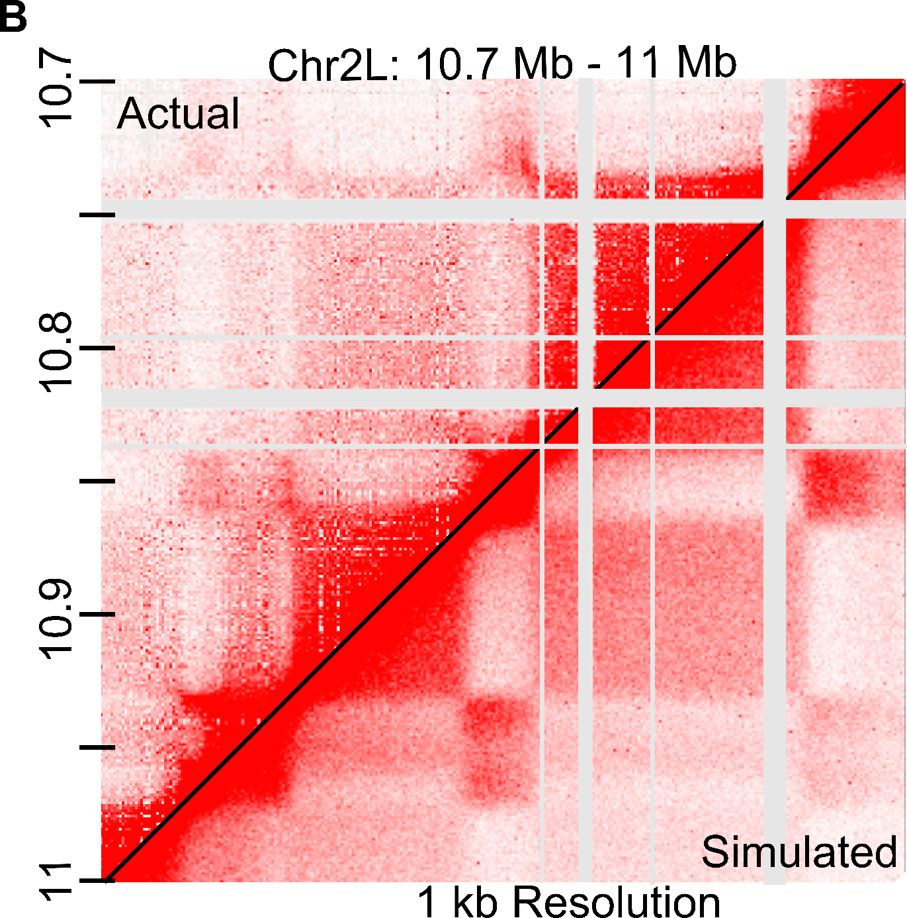
Transcriptional States Predict Chromatin Organization

Slide 9
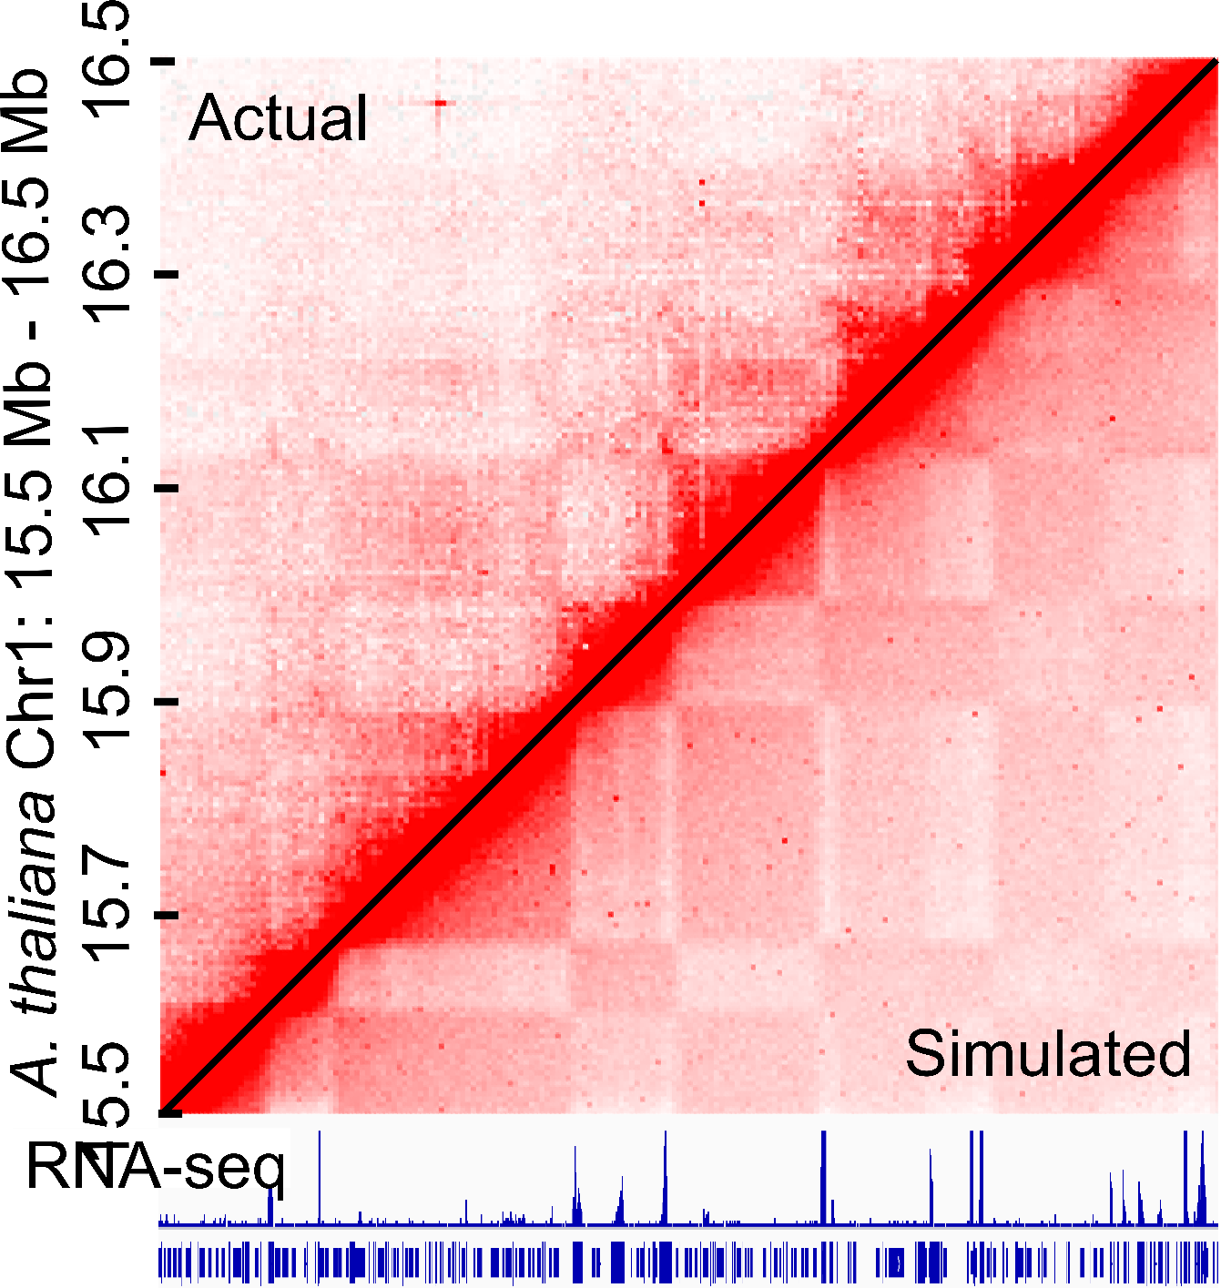
Transcriptional States Predict Chromatin Organization – in Other Organisms

Slide 10
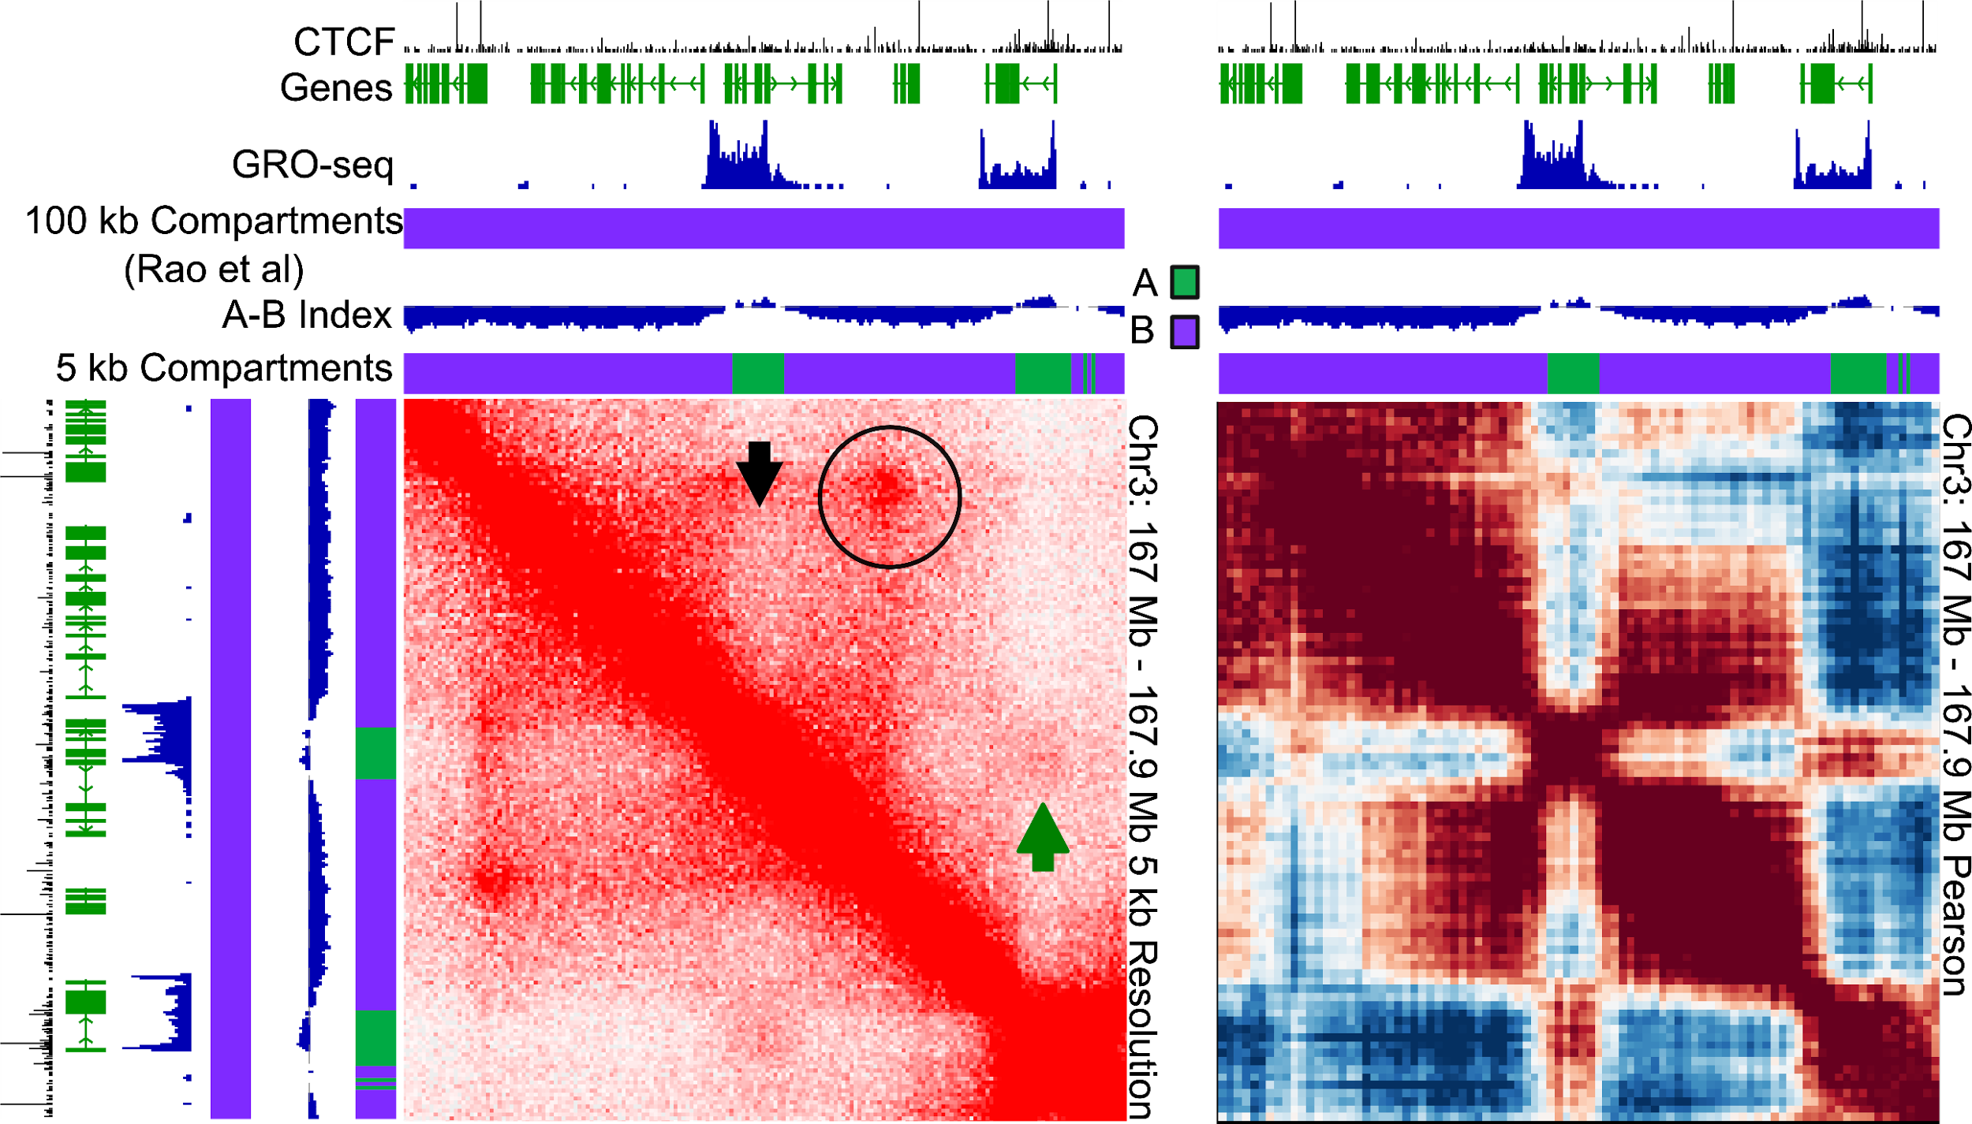
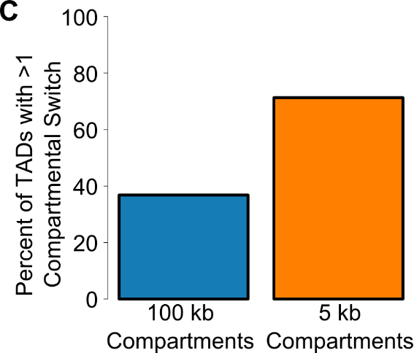
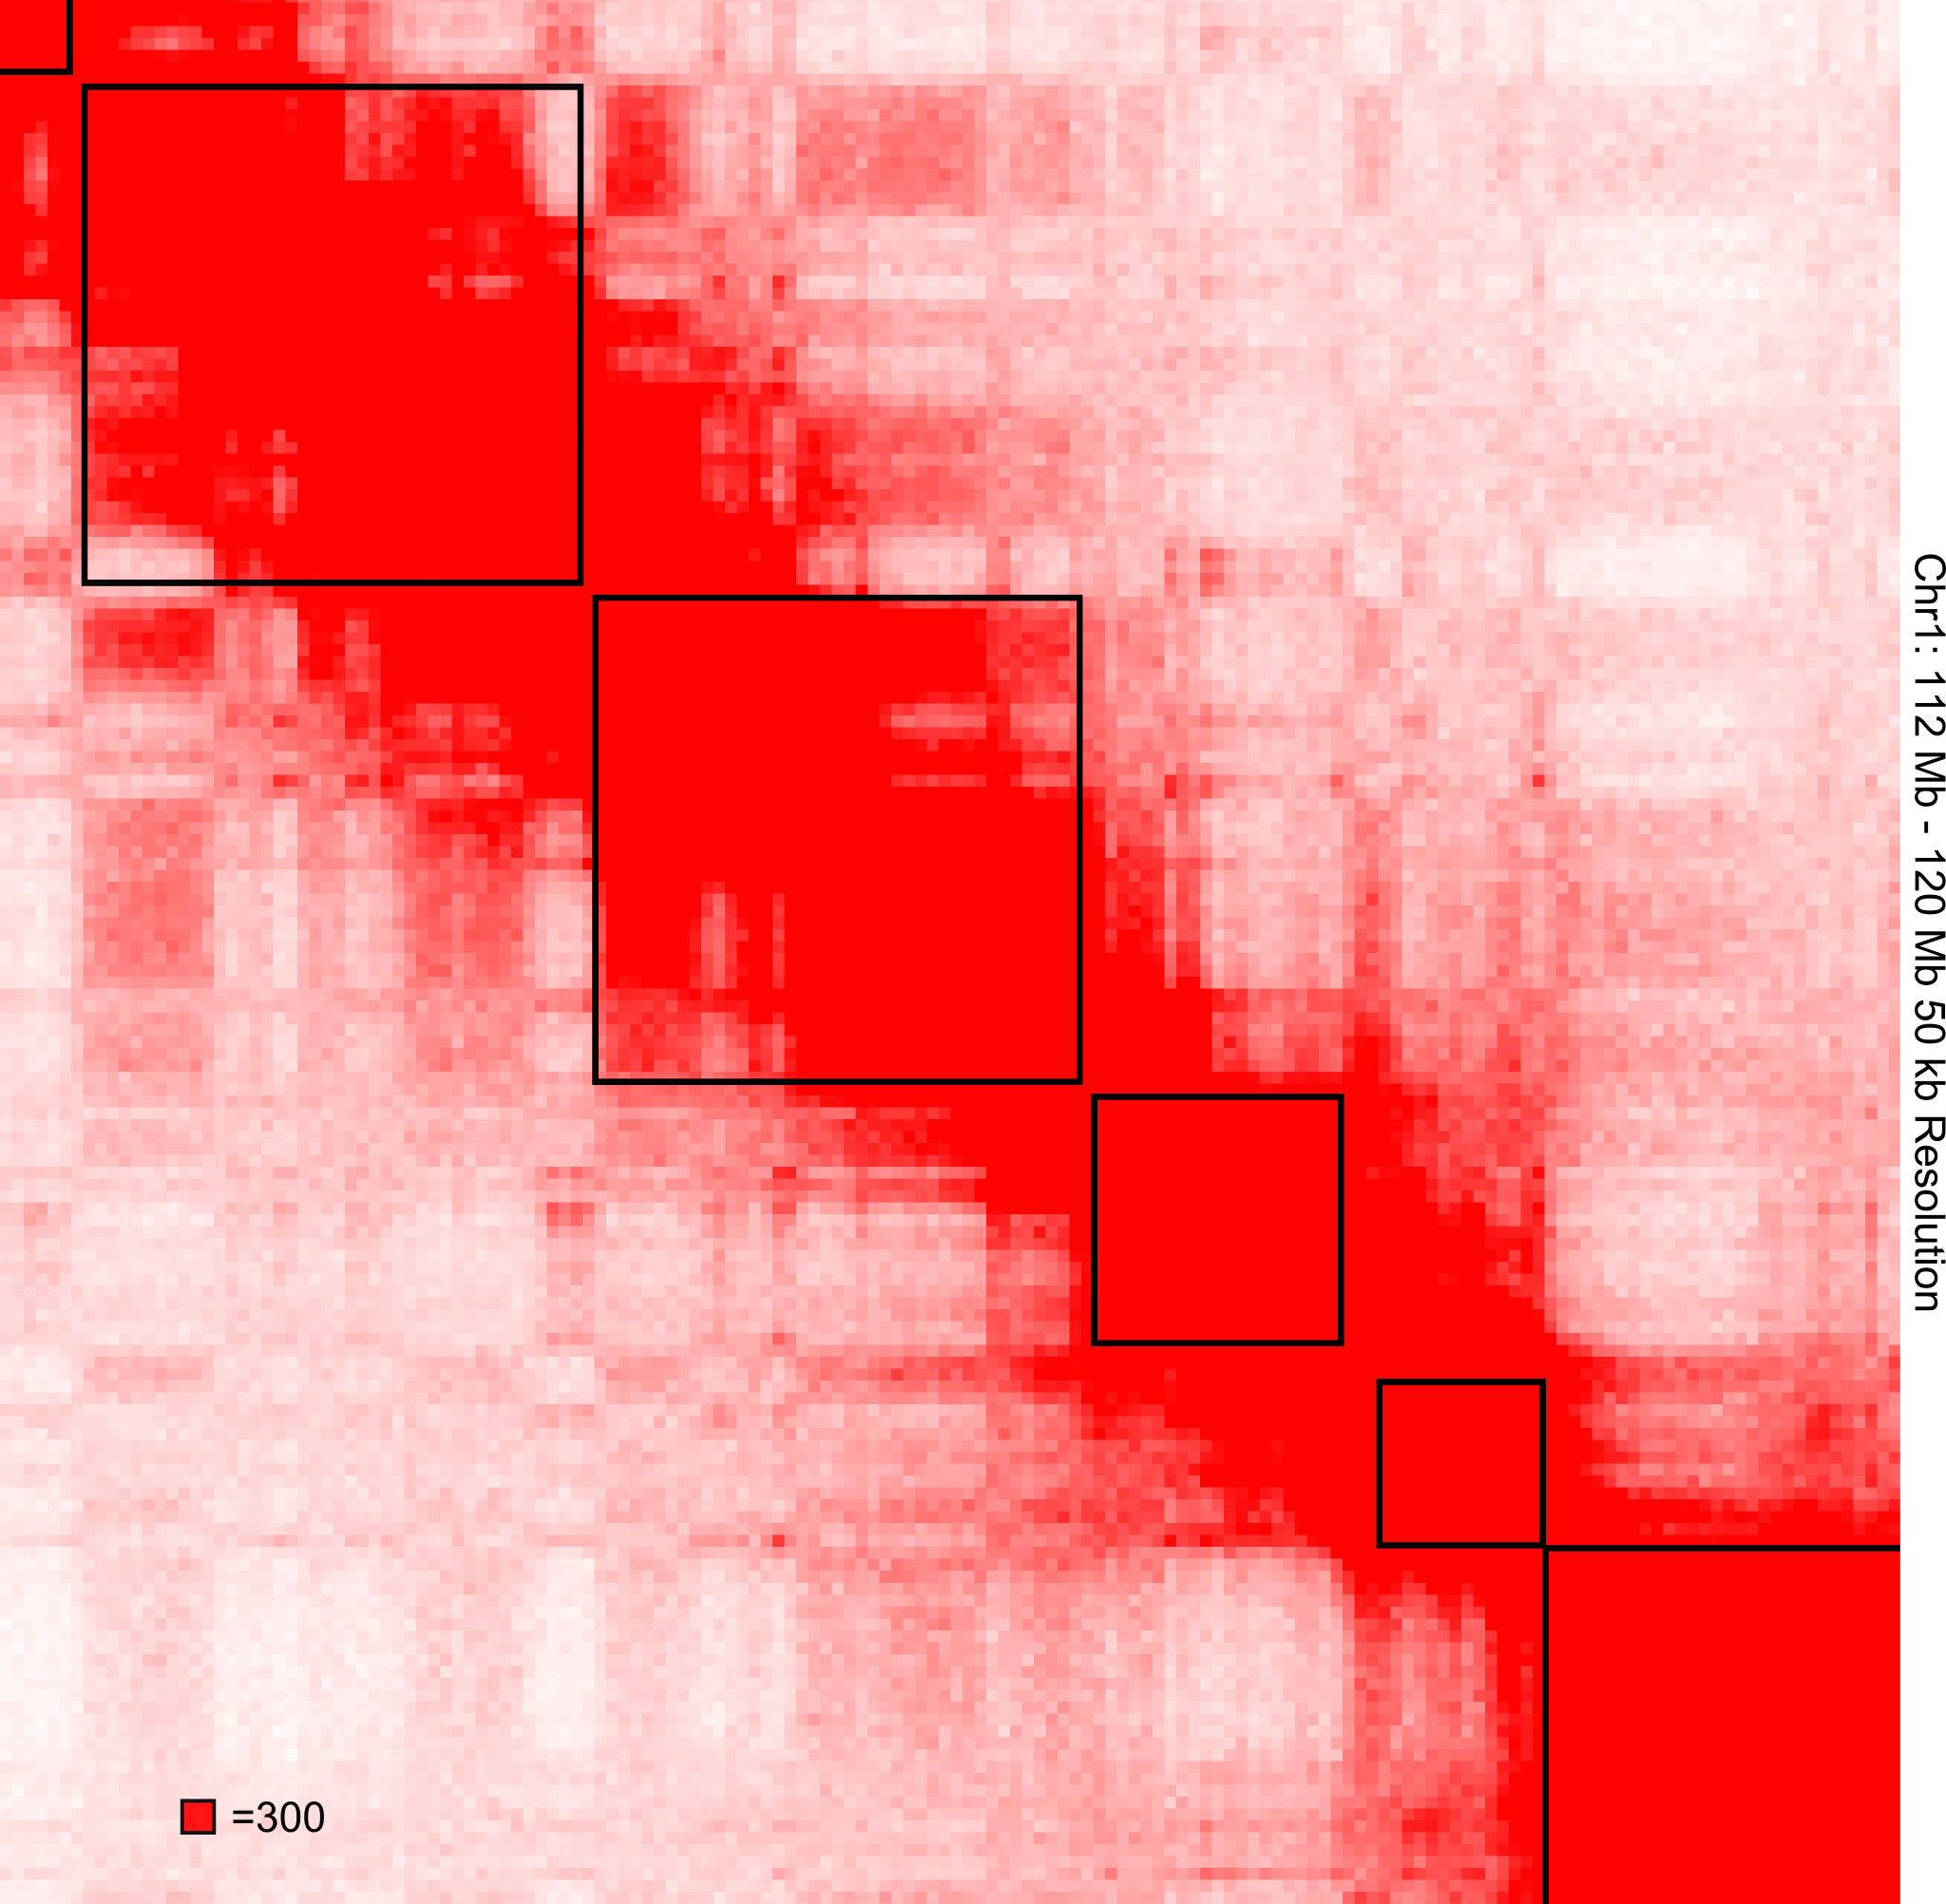
Compartments are Small Features Found in Human Cells

Slide 11
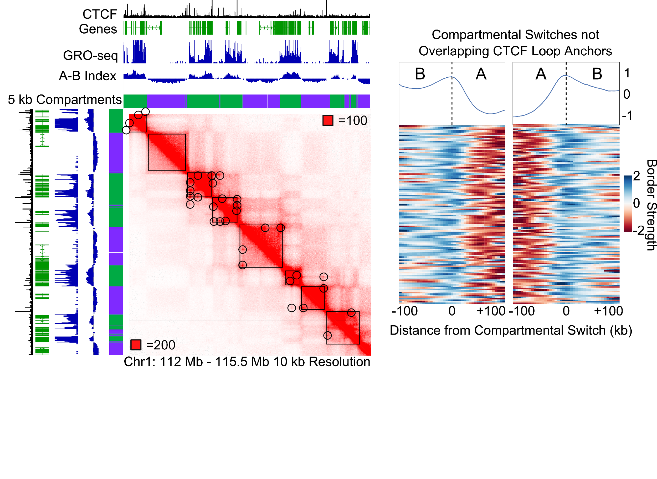
Compartmental Domains Exist in Human Cells

Slide 12
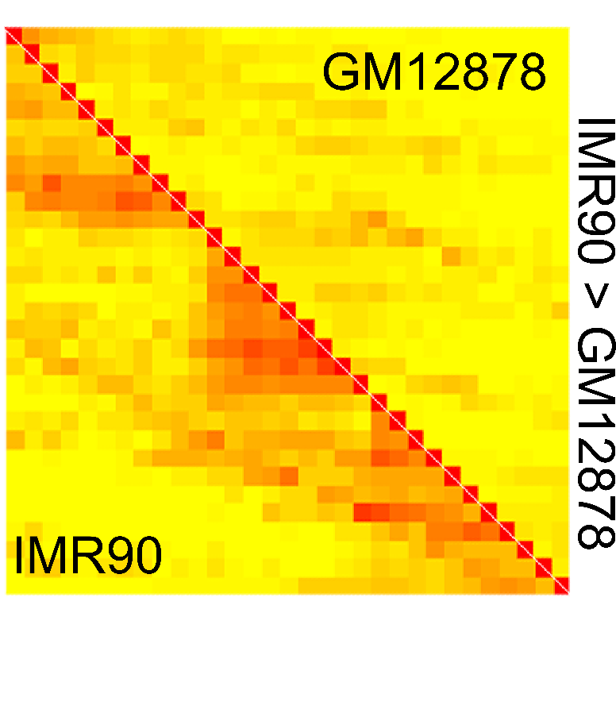
Domains Can Vary Between Cell Types

Slide 13
Hi-C Predictions in Human Cells - CTCF

Slide 14
Hi-C Predictions in Human Cells – Transcriptional State

Slide 15
Hi-C Predictions in Human Cells – CTCF & Transcriptional State

Slide 16
Highlights
Jordan Rowley, Michael Nichols, Xiaowen Lyu, Masami Ando-Kuri, Sarahi Rivera, Karen Hermetz, Ping Wang, Yijun Ruan, and Victor Corces
Funding: NIGMS F32 GM113570 AWARD
Compartments are small
Domains = Compartments in Drosophila
not due to loops between borders
Transcriptional states can predict Hi-C
Small compartmental domains exist in mammalian cells
CTCF loops often obscure these

