Slide 1
LL’s Journal Club
Aug 10, 2017

Slide 2
Two Papers on Disease Networks
Naldi, A. et al. Reconstruction and signal propagation analysis of the Syk signaling network in breast cancer cells. PLOS Computational Biology 13, e1005432 (2017).
Fang, H.-Y. et al. A network-based method for mechanistic investigation of Shexiang Baoxin Pill’s treatment of cardiovascular diseases. Scientific Reports 7, 43632 (2017).

Slide 3
First Paper
Naldi, A. et al. Reconstruction and signal propagation analysis of the Syk signaling network in breast cancer cells. PLOS Computational Biology 13, e1005432 (2017).
Fang, H.-Y. et al. A network-based method for mechanistic investigation of Shexiang Baoxin Pill’s treatment of cardiovascular diseases. Scientific Reports 7, 43632 (2017).

Slide 4
Overview
Focus on spleen tyrosine kinase (Syk) protein
  Functions in cell adhesion, motility, growth and death
  Known to be oncosuppressive in mammary epithelial cells
Previous work
  Target genes
  Low Syk levels correlated with advanced stage breast cancer and metastasis
  Syk inhibition is useful for treating auto-immune disease
Goal: Understand the molecular mechanisms by which Syk produces these phenotypes

Slide 5
Methods: Selection of Syk targets
Authors collected phospho-proteomics data from their own experiments and others
  Includes an MCF7 and an MDA-MB-231 dataset
  Found there is very little intersection between these two
Overlapped genes from each set with KEGG pathways
  Looked for overrepresented pathways from each set
  Very high overlap
Conclusion: Use the union of the datasets, owing to the complementarity of each approach
  687 targets

Slide 6
Methods: Interaction Network
Grow network from KEGG pathways
  Chosen over using the full network to reduce exploration of mostly irrelevant interactions
Augment KEGG data with Pathway Commons data
  Includes pathways from multiple sources
  Main sources: Reactome, Panther, and PID
Also added pathways that include Syk targets not included in the overrepresented pathways
Final network build
  6,438 proteins
  62,322 interactions
  552 pathways
  Covers 350 of 687 targets

Slide 7
Methods: Exploring the Network
Goal: Prune the network down to the essential genes and pathways that represent Syk’s molecular mechanisms
Overview of Previous Algorithms
Shortest path
  Self-explanatory
  Depends on weights reflecting biological reality
k shortest paths
  Extension which produces a set of paths that are close to the shortest distance
  Allows manual inspection to pick the most biologically sensible version
  Requires substantial separation of weights between the alternatives

Slide 8
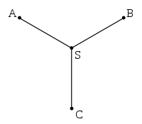
Methods: Exploring the Network
Overview of Previous Algorithms (cont’d)
Steiner trees
  Algorithm to find the shortest interconnect between multiple nodes
  Previous applications in biological networks have produced subtoptimal results
Random walk processes
  Start a random walker at seed nodes, let it “explore” the network
  Arrive on a stationary probability distribution for the walker’s location
  Useful for finding associated proteins
  Not so useful for finding pathways
  “Information flow” as represented by random walk doesn’t necessarily reflect the biological reality of signaling

Slide 9
Methods: Exploring the Network
Authors’ Choice
Combine shortest paths with random walk
Weights: functional annotations and experiments
  Lower weight for edges connected to proteins with significant change in phosphorylation
  Lower weight for edges connected to known Syk targets
  Favor functionally significant paths
Random walk over this weighted network

Slide 10
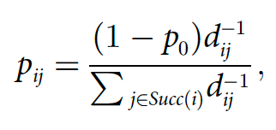
Methods: Exploring the Network
Transition probability matrix p_{ij}
p₀ = return probability to Syk
D_{ij} = distance matrix between pairs of nodes (i,j)
Succ(i) = Successors (direct targets) of i
Run this until the location probability distribution reaches equilibrium
Use reachability of each protein to refine the weights further
Manual inspection of biologically interesting proteins --> downweight these

Slide 11
Methods & Results: Exploring the Network
Apply near-shortest paths algorithm to the network
  All paths within 20% of the lowest score
  Alternative pathways ranked by score
    Assists in manual inspection
  Opens up the possibility of implicating novel proteins in Syk mechanisms
Output suggests new, previously unelucidated pathways for Syk’s actions
  Cortactin: regulates the cortical actin cytoskeleton
  Previously thought to be directly targeted by Syk
  Weighted sp selected a path through a (downweighted) phospho-tyrosine modifier: Src
  Putative actual pathway: Syk --> Src --> cortactin

Slide 12
Results
Validate with phospho-proteomic study
  Treat cells with Syk and Src pharmacological inhibitors
  Both inhibitors decreased cortactin phosphorylation and Src activity
  Src inhibition didn’t affect Syk phosphorylation
  Conclusion: Syk --> Src --> cortactin is correct
Link between Syk and ezrin
  Ezrin: mediates interactions between the plasma membrane and the actin cytoskeleton
  Initial results showed no intermediate between Syk and ezrin
    Interaction is direct?
  Added more nodes in the neighborhood of Syk and ezrin to be sure
    Same result obtained

Slide 13
Results
Validate Syk --> ezrin in vitro
  Fluorescent tags for Syk catalytic activity and ezrin phosphorylation
  Results indicate that the two are correlated
  Concluson: Syk --> ezrin is correct

Slide 14
Conclusions
Demonstrated the usefulness of weighted PPI network in understanding signaling pathways
  Adjusting weights for biological relevance
  Random walk to assess “reachability”
Validation of cortactin and ezrin signaling axes
All network data and source code released publicly
For the future, would like to use phospho-proteomics data from more cell models to refine parameters further

Slide 15
Second Paper
Naldi, A. et al. Reconstruction and signal propagation analysis of the Syk signaling network in breast cancer cells. PLOS Computational Biology 13, e1005432 (2017).
Fang, H.-Y. et al. A network-based method for mechanistic investigation of Shexiang Baoxin Pill’s treatment of cardiovascular diseases. Scientific Reports 7, 43632 (2017).

Slide 16
Overview
Centers around understanding the mechanisms of the Shexiang Baoxin Pill (SBP)
  Traditional Chinese medicine (TCM) that is highly effective at treating cardiovascular disease (CVD)
  Previous work has investigated SBP’s endpoints, but not mechanisms
  e.g. we know SBP increases nitric oxide (NO) which plays an important role in preventing CVD, but not the molecular pathways for getting from SBP to NO synthase
Goal: Understand the molecular mechanisms by which SBP produces these phenotypes

Slide 17
Methods: Data Collection
SBP is an amalgamation of 7 components, each with their own constituents
  Potentially hundreds of compounds to investigate
  Only a fraction of these will be found in the blood plasma of patients that ingest it
    Limit analysis to this fraction
Henceforth, study two version of SBP
  SBP all compounds (SBPac)
  SBP plasma-absorbed compounds (SBPpc)

Slide 18
Methods: Data Collection
Genes derived from Cytoscape's DiseaseGene Network plugin.
  Search for "Cardiovascular Disease"
Used TCM databases to find the compounds of SBP, and their chemical structures
With compounds, searched for putative targets from two databases:
  Herbal Ingredients' Targets Database (HIT): Lots of info on the proteomics of Chinese herbs
  Search Tool for Interactions of Chemicals (STITCH): Interaction database with structural similarity search
Final dataset has 522 proteins
  86 from HIT
  416 from STITCH
  20 from both

Slide 19
Methods: Data Collection
PPI data from STRING database version 9.05
  Collection of interaction data from many sources (spanning experimental data, computation-based prediction, and literature mining)
  Confidence score assigned to each interaction
Initially picked interactions above 0.9
  Doesn’t include all CVD and SBP genes from previous step
Lowered the threshold until the new network contains all of these genes
Final network: 9289 nodes and 57,179 edges

Slide 20


Methods: Data Collection & Algorithms
Pathway gene sets
  4722 derived from MSigDB
  Integration of BioCarta, Reactome, KEGG, and other major pathway databases
Random Walk with Restart
  Much like the first paper, start with a seed vector and transition probability vector
  Find location probability equilibrium --> “reachability”
  Do one analysis with seeds = {disease genes}
  Do one analysis with seeds = {drug targets}
  If these two overlap a lot, this drug is effective against this disease

Slide 21
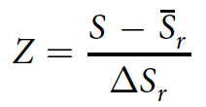
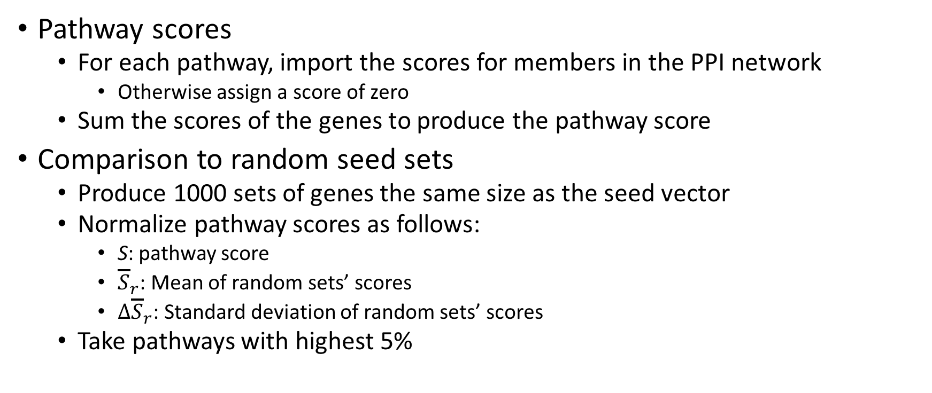
Methods: Algorithms
Pathway scores
  For each pathway, import the scores for members in the PPI network
    Otherwise assign a score of zero
  Sum the scores of the genes to produce the pathway score
Comparison to random seed sets
  Produce 1000 sets of genes the same size as the seed vector
  Normalize pathway scores as follows:
    S: pathway score
    ${\overline{S}}_{r}$: Mean of random sets’ scores
    $∆{\overline{S}}_{r}$: Standard deviation of random sets’ scores
  Take pathways with highest 5%

Slide 22
Results
Checking overlap between CVD genes and SBP target genes
  Of the 522 targets of SBPac, only 46 are CVD
  Of the 113 targets of SBPpc, only 11 targets are CVD
Seems insufficient for having a significant effect size on CVD
Effect scores of overlapping disease and drug networks
  SBPac: 0.4452
  SBPpc: 0.1138
Translated into Z-scores:
  SBPac: 12.193
  SBPpc: 7.749
Z-score value greater than 3 is indicative of a statistically significant deviation between actual and random
Conclusion: Drug influence is much clearer in pathway analysis

Slide 23
Results
Pathway analysis
  CVD pathways (top 5%): 236
  Did the same for SBPac and SBPpc
  Of these 236 CVD pathways:
    113 are regulated by SBPac
    97 are regulated by SBPpc
  Corresponds to 47.8% and 41% of CVD pathways

Slide 24
Results: Microarray Validation
MCF7 cell lines with/without SBP treatment
Save genes with mean expression ratio > 4 or < 0.25
621 differentially expressed genes
  31 are SBPac targets
  9 are SBPpc targets
  29 are CVD-associated
Gene only view is not that impressive
But when we use the 621 genes as seeds in the network analysis…
  Find 236 significant pathways
  119 are CVD-associated
  Of these, 67.2% and 58.8% are in the SBPac and SBPpc set, respectively
Again, the pathway view provides a more complete picture

Slide 25
Results: Western Blot Validation
Pick two proteins in the Western blot library
  COX-2
  ICAM-1
That are within these four sets:
  CVD disease genes
  SBPac target genes
  SBPpc target genes
  Differentially expressed genes under SBP treatment
Tested in HUVECs (Human Umbilical Vein Endothelial Cells)
Verified up-regulation of COX-2 and down-regulation of ICAM-1
  Mechanism of SBP through vasodilation and anti-inflammatory action

Slide 26
Conclusions
Pathway analysis makes it clear that SBP acts through multiple components and multiple targets to achieve its clinical effect
  Not visible in an individual gene analysis
FDA drugs are typically only focused on single targets
  Perhaps they could learn from TCM… ☺

Slide 27
The End
Q & A

