Slide 1



Tumor evolution model: Single pathway model
x
x
x
x
x
x
x
x
x
x
$$t=0$$
$$t_{1}$$
$$T$$

Slide 2
Tumor evolution model: Full model
x
x
x
x
x
x
x
x
x
x
x
x
x
x
x
x
x
x
x
x
x
x
x
x
$$t=0$$
$$t_{1}$$
$$T$$

Slide 3
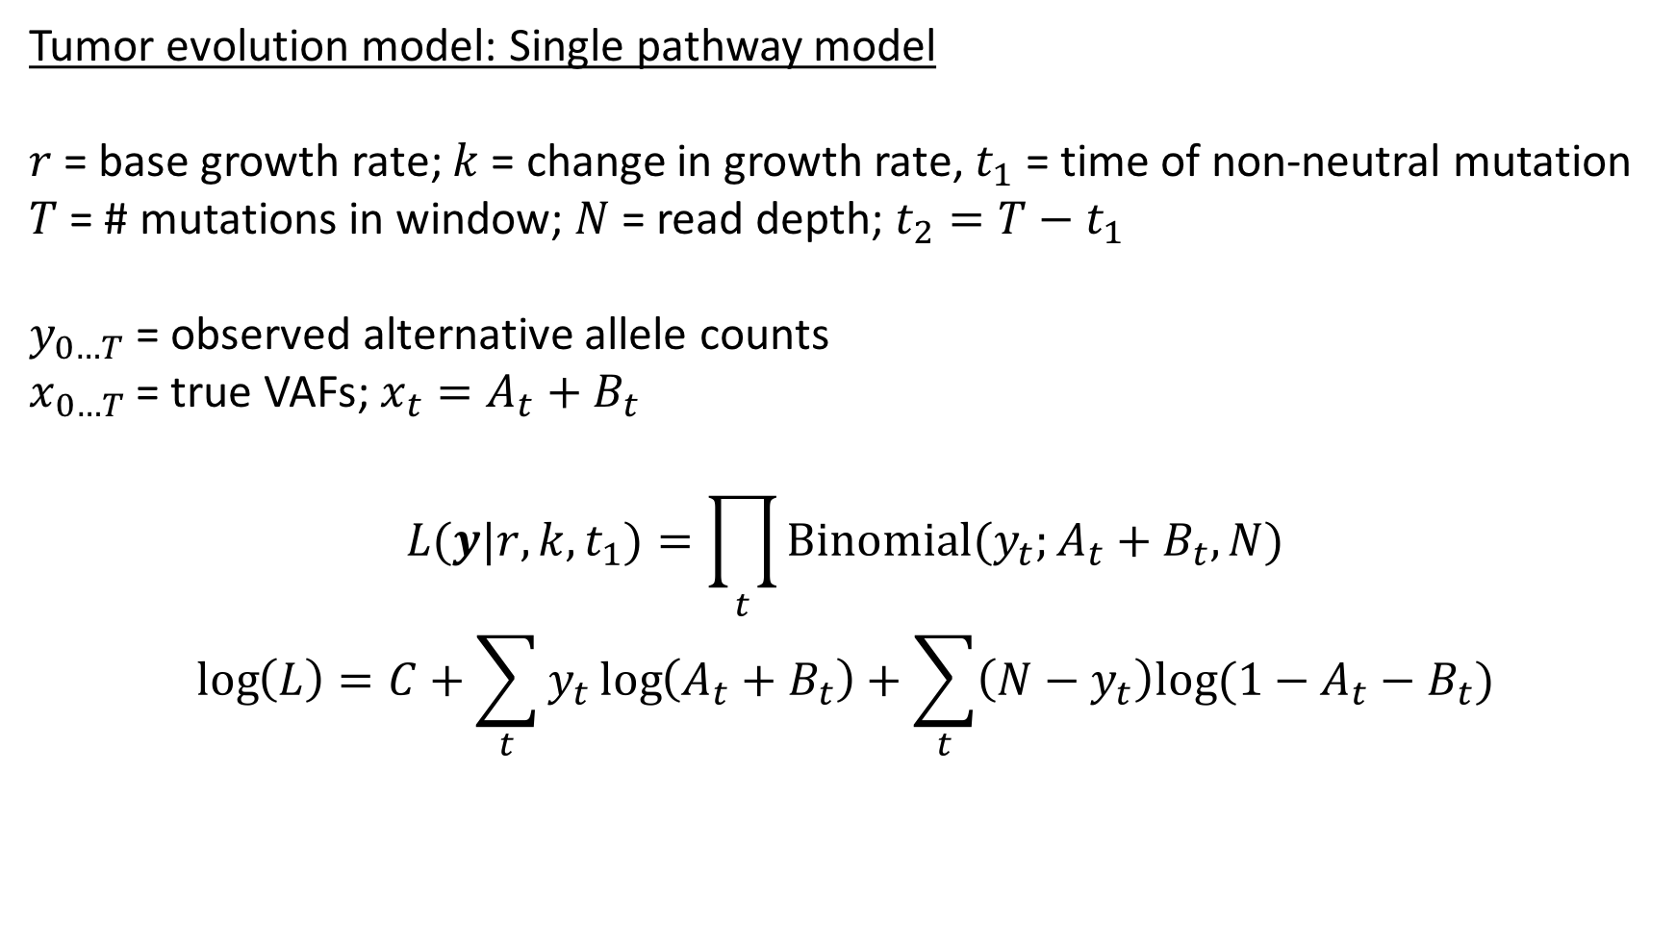



Tumor evolution model: Single pathway model
$r$ = base growth rate; $k$ = change in growth rate, $t_{1}$ = time of non-neutral mutation
$T$ = # mutations in window; $N$ = read depth; $t_{2}=T−t_{1}$
$y_{0…T}$ = observed alternative allele counts
$x_{0…T}$ = true VAFs; $x_{t}=A_{t}+B_{t}$
$$L(y|r,k,t_{1})=\prod_{t}{\text{Binomial}(y_{t};A_{t}+B_{t},N)}$$
$$\log\left(L\right)=C+\sum_{t}{y_{t}\log\left(A_{t}+B_{t}\right)+\sum_{t}{\left(N−y_{t}\right)log⁡(1−A_{t}−B_{t})}}$$
$$B_{t}=\left\{\begin{aligned}\frac{e^{krt_{2}}−e^{rt_{2}}}{N_{tot}}\text{if} t≤t_{1} \\ \frac{e^{rk(T−t)}}{N_{tot}}\text{otherwise}\end{aligned}\right.$$
$$A_{t}=\left\{\begin{aligned}\frac{e^{r(T−t)}}{N_{tot}}\text{if} t≤t_{1} \\ 0 \text{otherwise}\end{aligned}\right.$$
$$N_{tot}=e^{rT}+e^{krt_{2}}−e^{rt_{2}}$$

Slide 4
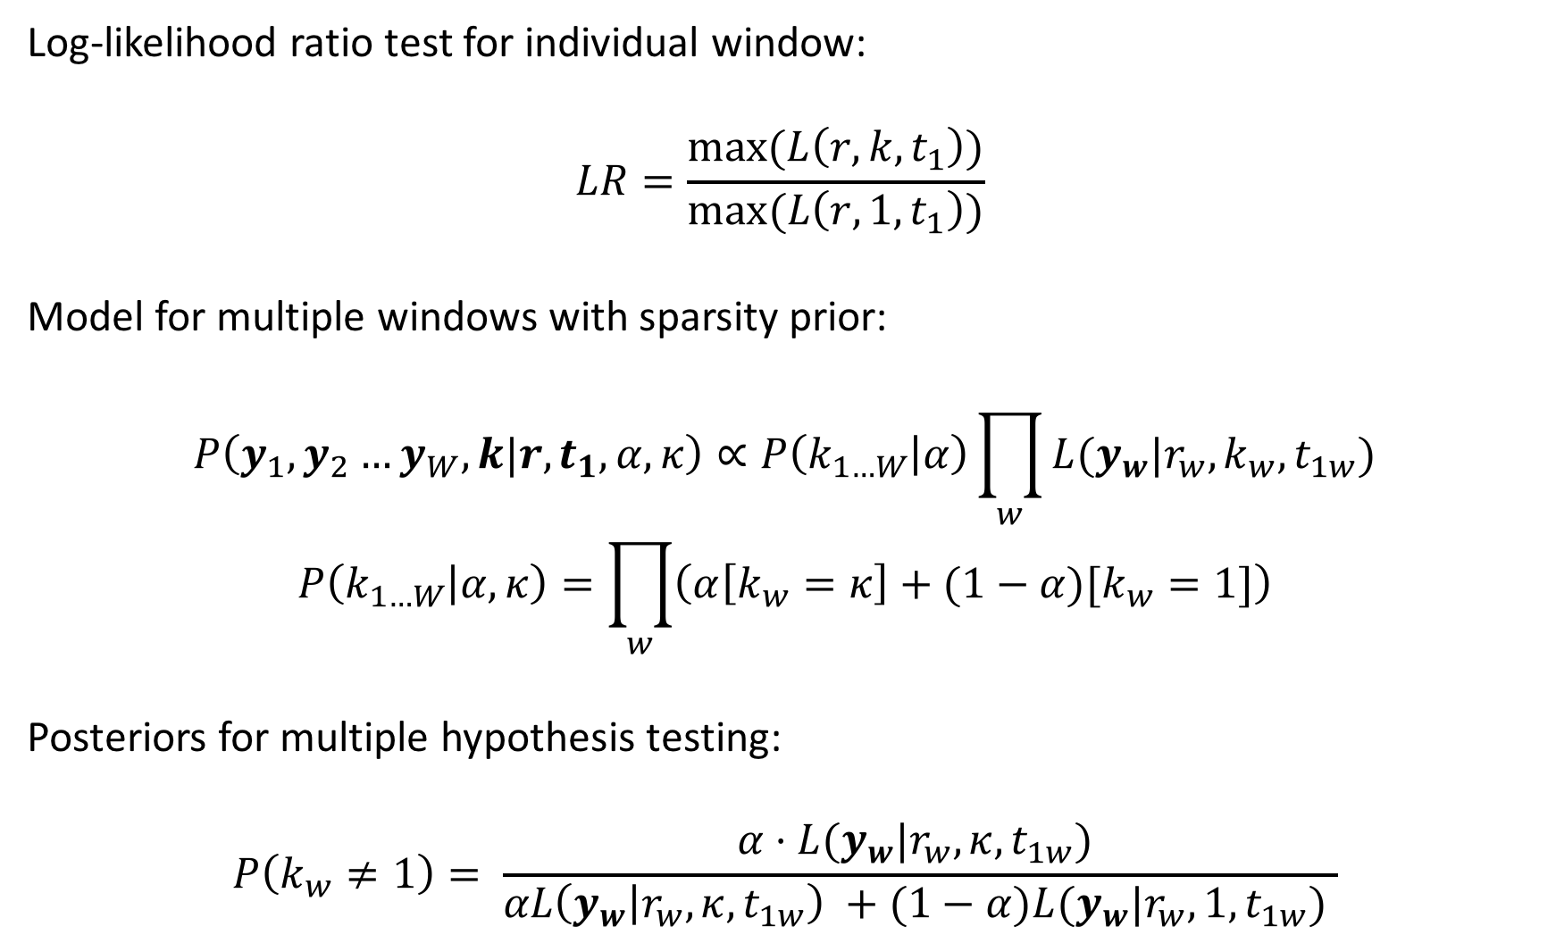
Log-likelihood ratio test for individual window:
$$LR=\frac{\text{max}(L\left(r,k,t_{1}\right))}{\text{max}(L\left(r,1,t_{1}\right))}$$
Model for multiple windows with sparsity prior:
$$P\left(y_{1},y_{2}…y_{W}, k|r,t_{1},α,κ\right)∝P\left(k_{1…W} | α\right)\prod_{w}{L(y_{w}|r_{w},k_{w},t_{1w})}$$
$$P\left(k_{1…W} | α,κ\right)=\prod_{w}{\left(α\left[k_{w}=κ\right]+(1−α)[k_{w}=1]\right)}$$
Posteriors for multiple hypothesis testing:
$$P\left(k_{w}≠1\right)= \frac{α⋅L(y_{w}|r_{w},κ,t_{1w}) }{αL\left(y_{w} | r_{w},κ,t_{1w}\right) +(1−α)L(y_{w}|r_{w},1,t_{1w}) }$$

Slide 5
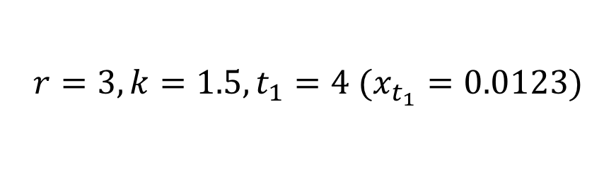





Simulations
$$r=3, k=1.5, t_{1}=4 (x_{t_{1}}=0.0123)$$
$$r$$
$$k$$
$$t_{1}$$
50 100 150 200 250 300
50 100 150 200 250 300
50 100 150 200 250 300
$$N$$
$$N$$
$$N$$
Log-likelihood ratio tests: $p=\{6∗{10}^{−4}, 4∗{10}^{−4}, 1∗{10}^{−7},∼0,∼0,$ $∼0\}$

Slide 6
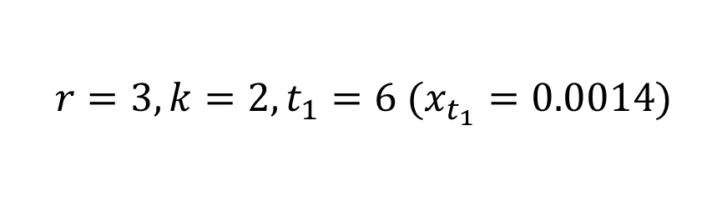
Simulations
$$r=3, k=2, t_{1}=6 (x_{t_{1}}=0.0014)$$
$$r$$
$$k$$
$$t_{1}$$
500 1000 1500 2000 2500 3000
500 1000 1500 2000 2500 3000
500 1000 1500 2000 2500 3000
$$N$$
$$N$$
$$N$$
Log-likelihood ratio tests: $p=\{5∗{10}^{−4}, ∼0,∼0,$ $∼0,∼0,∼0\}$

Slide 7


Simulations
$$max(\log\left(L | t_{1}\right))$$
$$t_{1}$$

Slide 8



Simulations
$$r$$
$$k$$
$$t_{1}$$
$$t_{1}$$

Slide 9









Multiple windows model
$$k=κ$$
$$t_{1}=7$$
$$k=1$$
$$t_{1}=2$$
$$k=κ$$
$$α=0.4$$
$$t_{1}=5$$
$$k=1$$
$$t_{1}=9$$
$$k=1$$
$$t_{1}=3$$

Slide 10
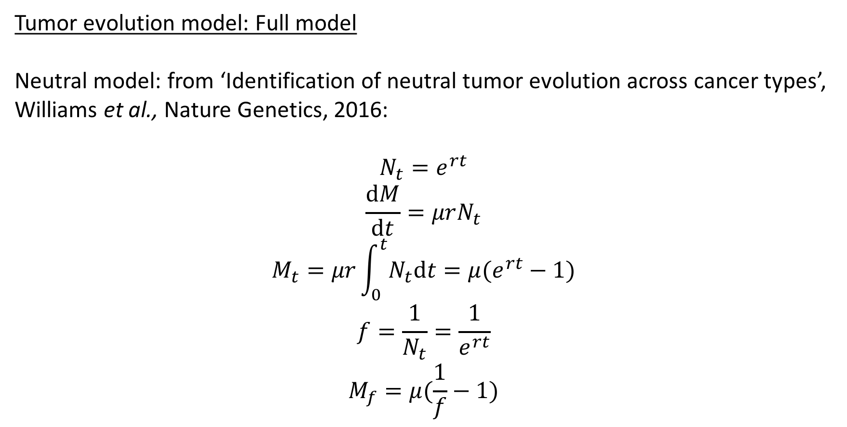
Tumor evolution model: Full model
Neutral model: from ‘Identification of neutral tumor evolution across cancer types’, Williams et al., Nature Genetics, 2016:
$$N_{t}=e^{rt}$$
$$\frac{\text{d}M}{\text{d}t}=μrN_{t}$$
$$M_{t}=μr\int_{0}^{t}{N_{t}\text{d}t}=μ(e^{rt}−1)$$
$$f=\frac{1}{N_{t}}=\frac{1}{e^{rt}}$$
$$M_{f}=μ(\frac{1}{f}−1)$$

Slide 11




Tumor evolution model: Full model
A
x
x
x
x
X
x
x
x
$$π$$
x
x
x
x
x
x
x
x
x
x
x
x
x
x
x
x
x
B
$$1−π$$
$$t=0$$
$$t_{1}$$
$$T$$

Slide 12
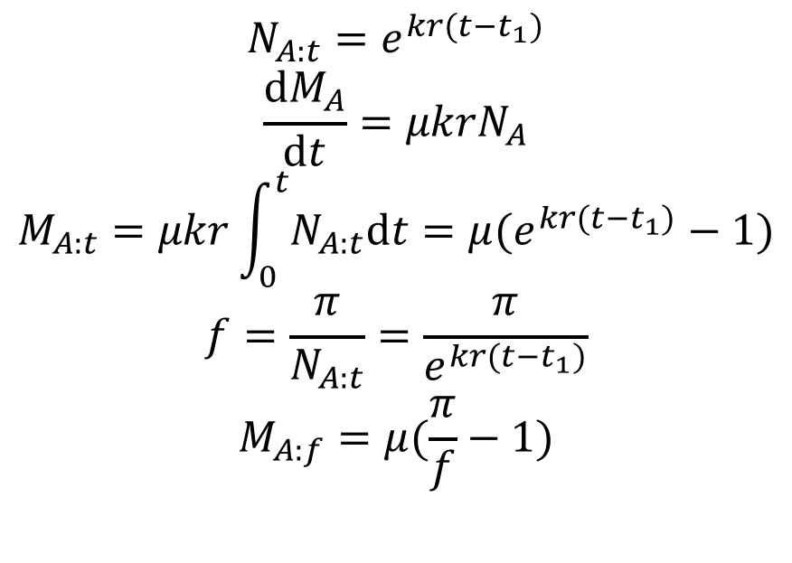
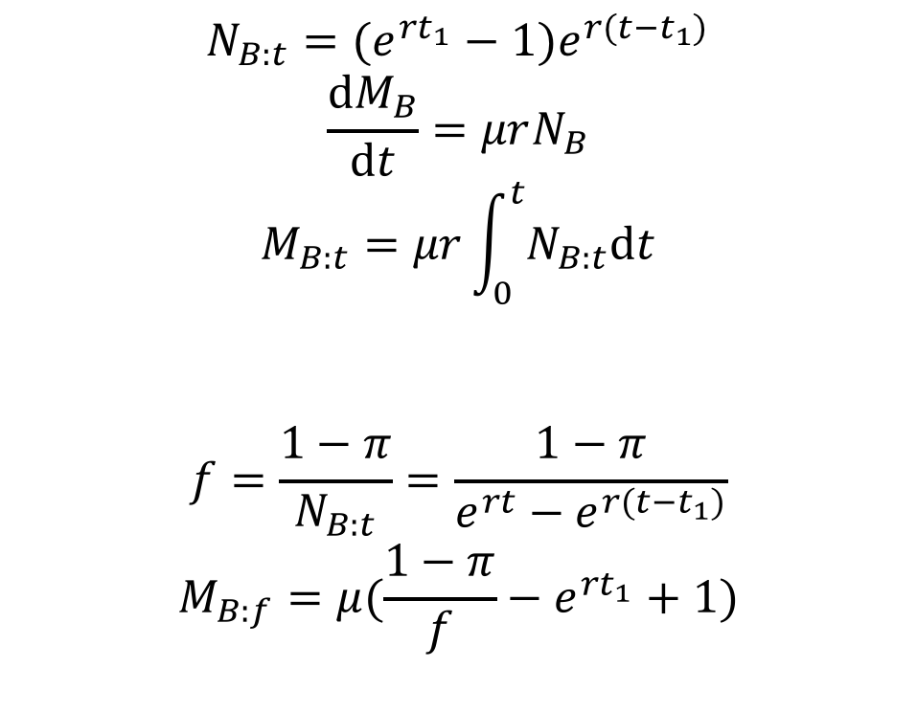
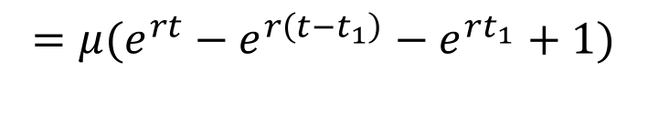
Tumor evolution model: Full model
Treating mutations in sets A, B and X separately:
For A:
For B:
$$N_{A:t}=e^{kr(t−t_{1})}$$
$$\frac{\text{d}M_{A}}{\text{d}t}=μkrN_{A}$$
$$M_{A:t}=μkr\int_{0}^{t}{N_{A:t}\text{d}t}=μ(e^{kr(t−t_{1})}−1)$$
$$f=\frac{π}{N_{A:t}}=\frac{π}{e^{kr(t−t_{1})}}$$
$$M_{A:f}=μ(\frac{π}{f}−1)$$
$$N_{B:t}={(e^{rt_{1}}−1)e}^{r(t−t_{1})}$$
$$\frac{\text{d}M_{B}}{\text{d}t}=μrN_{B}$$
$$M_{B:t}=μr\int_{0}^{t}{N_{B:t}\text{d}t}$$
$$f=\frac{1−π}{N_{B:t}}=\frac{1−π}{{e^{rt}−e}^{r(t−t_{1})}}$$
$$M_{B:f}=μ(\frac{1−π}{f}−e^{rt_{1}}+1)$$
$$=μ({e^{rt}−e}^{r\left(t−t_{1}\right)}−e^{rt_{1}}+1)$$

Slide 13
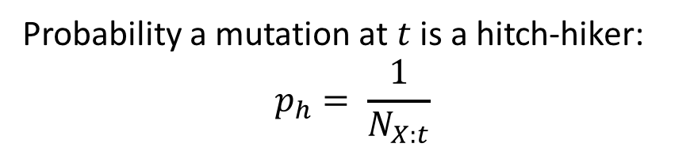

Tumor evolution model: Full model
For X:
Probability a mutation at $t$ is a hitch-hiker:
$$p_{h}= \frac{1}{N_{X:t}}$$
x
x
x
x
x
x
x
x
x
$$t=0$$
$$t$$
$$t_{1}$$
$$T$$

Slide 14
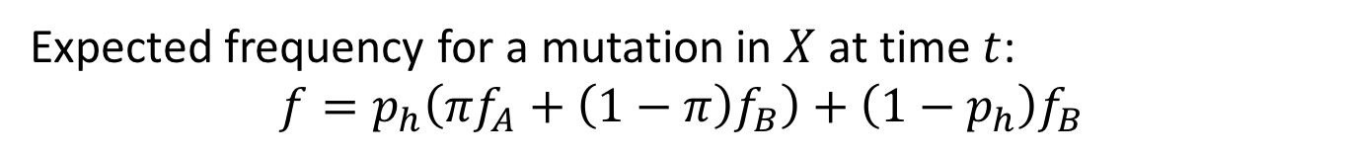

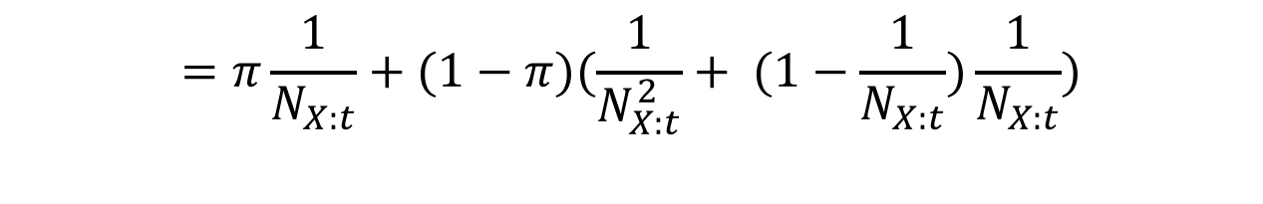


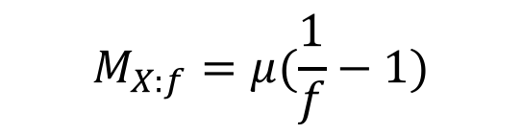
Tumor evolution model: Full model
For X:
Expected frequency for a mutation in $X$ at time $t$:
$$f=p_{h}\left(πf_{A}+\left(1−π\right)f_{B}\right)+\left(1−p_{h}\right)f_{B}$$
$$=\frac{1}{N_{X:t}}\left(π⋅1+\left(1−π\right)\frac{1}{N_{X:t}}\right)+\left(1−\frac{1}{N_{X:t}}\right)\frac{1}{N_{X:t}}$$
$$=π\frac{1}{N_{X:t}}+(1−π)(\frac{1}{N_{X:t}^{2}}+ (1−\frac{1}{N_{X:t}})\frac{1}{N_{X:t}})$$
$$=\frac{1}{N_{X:t}}=\frac{1}{e^{rt}}$$
Mutation frequencies:
$$M_{X:t}=μ(e^{rt}−1)$$
$$M_{X:f}=μ(\frac{1}{f}−1)$$

Slide 15






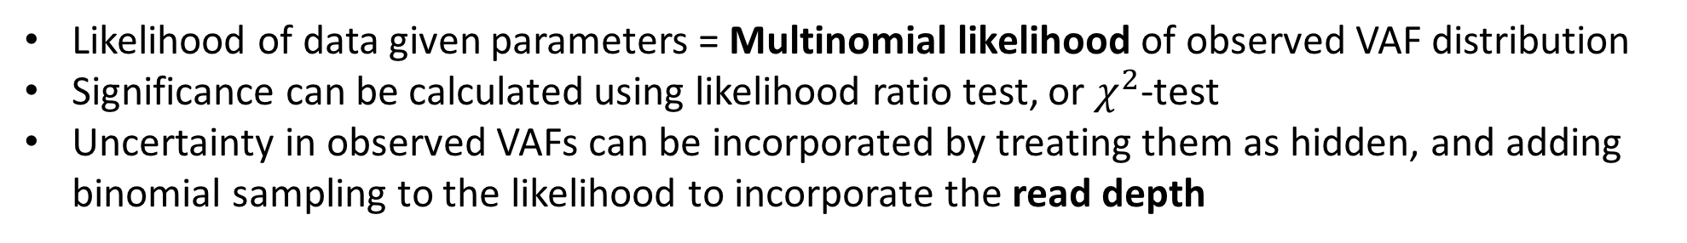

To construct the VAF distribution:
Frequency bins:
$$M_{X}$$
$$\frac{1}{e^{rt_{1}}}$$
$$M_{A}$$
1
$$M_{B}$$
$$π$$
$$\frac{1}{N_{tot}}$$
$$\frac{1−π}{e^{rt_{1}}−1}$$
Likelihood of data given parameters = Multinomial likelihood of observed VAF distribution
Significance can be calculated using likelihood ratio test, or $χ^{2}$-test
Uncertainty in observed VAFs can be incorporated by treating them as hidden, and adding binomial sampling to the likelihood to incorporate the read depth

Slide 16
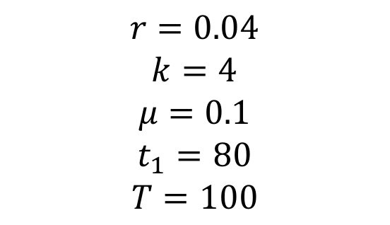
Example VAF distribution:
Parameters:
$$r=0.04$$
$$k=4$$
$$μ=0.1$$
$$t_{1}=80$$
$$T=100$$
Frequency
VAF

Slide 17
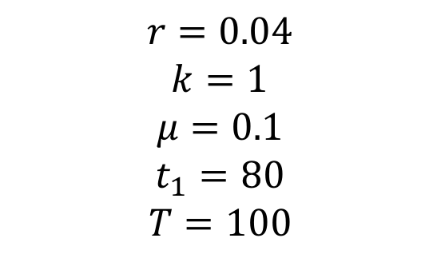
Example VAF distribution:
Parameters:
$$r=0.04$$
$$k=1$$
$$μ=0.1$$
$$t_{1}=80$$
$$T=100$$
Frequency
VAF

