Slide 1
Developing genomic annotations that capture TF binding and explain disease heritability
Bryce van de Geijn
Postdoctoral Fellow – Price lab – Harvard School of Public Health
Price/Raychaudhuri U01
8/4/2017

Slide 2
Goals of Price/Raychaudhuri U01
Develop statistical methods that localize disease heritability to functionally specialized annotations (FSA) of the human genome.
Construct maximally disease-informative FSA from functional data.
Integrate diverse functional data into context-specific FSA to infer disease mechanisms.

Slide 3
Current projects (*: abstract submitted to ASHG 2017 conference)
Tiffany Amariuta: Integrating non-coding and coding genome-wide functional genomic datasets from ENCODE to annotate the CD4+ T cell regulatory genome*
Emma Davenport: Identifying context-specific molecular eQTLs
(see Davenport et al. biorxiv, http://www.biorxiv.org/content/early/2017/03/20/118703)
Hilary Finucane: Heritability enrichment of specifically expressed genes identifies disease-relevant tissues and cell types*
Steven Gazal: Partitioning heritability of low-frequency variants reveals strength of negative selection across functional annotations*
(also see Gazal et al. in press Nat Genet, http://biorxiv.org/content/early/2017/04/03/082024)
Farhad Hormozdiari: Leveraging molecular QTL to understand the genetic architecture of diseases and complex traits*
Gleb Kichaev: Leveraging functional enrichment to improve GWAS power*
Yakir Reshef: Quantifying directional effects of transcription factor binding on polygenic disease risk using GWAS summary statistics*
Bryce van de Geijn: Annotations that capture tissue-specific transcription factor binding explain a large fraction of disease heritability*
Harm-Jan Westra: using ENCODE annotations to fine-map RA and T1D loci*
(see Westra et al. biorxiv, http://www.biorxiv.org/content/early/2017/06/19/151423)

Slide 4
Outline
Background and project goals
Building cell type specific TF annotations
Applying annotations to partition disease heritability

Slide 5
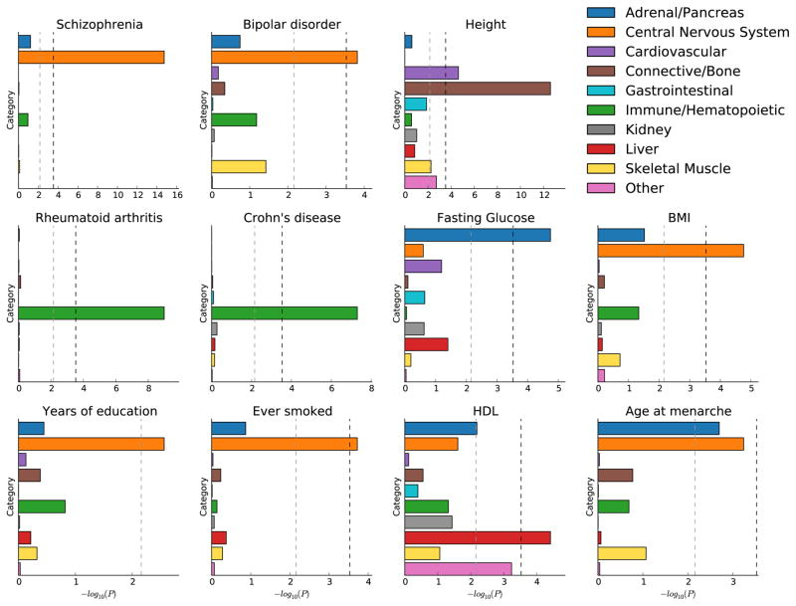
Background
Tissue specific functional annotations can help explain human disease heritability
Transcription factor binding is important for regulating gene expression, may influence diseases
Finucane et al. Nature Genetics 2015

Slide 6
Stratified LD score regression
Used to partition heritability of complex traits using GWAS summary statistics
A category of SNPs is enriched for heritability if SNPs with high LD to that category have higher chisq statistics than SNPs with low LD to that category
Informed by all associations, not just genome-wide significant ones
# of individuals
LD of SNP j to category q
Measure of confounding
Effect size of category q
LD scores computed on 1000G (479 EUR individuals) Regression using HapMap3 SNPs
Finucane et al. Nat Genet 2015

Slide 7
Comparing annotations with S-LDSC
Enrichment
%h_{g}² in annotation / %SNPs in annotation (Finucane et al. Nat Genet 2015)
Does not depend on other annotations in the model
τ*
- regression coefficient τ, adjusted for h_{g}² and annotation size (Gazal et al. in press Nat Genet)
- proportionate change in per-SNP heritability associated to a 1 s.d. increase in the value of the annotation
- Depends on other annotations in the model

Slide 8
Project goals
Develop tissue-specific genomic annotations that maximally explain the heritability of complex disease.
Focus on capturing transcription factor binding sites

Slide 9
Project goals
Develop tissue-specific genomic annotations that maximally explain the heritability of complex disease.
Focus on capturing transcription factor binding sites
Use TF ChIP-seq data?

Slide 10
Project goals
Develop tissue-specific genomic annotations that maximally explain the heritability of complex disease.
Focus on capturing transcription factor binding sites
TF binding, measured by ChIP-seq, is not currently available for most tissue/TF pairs

Slide 11
Project goals
Develop tissue-specific genomic annotations that maximally explain the heritability of complex disease.
Focus on capturing transcription factor binding sites
Sequence based TF binding annotations
MotifMap (Daily et al BMC Bioinformatics 2011)
Kheradpour (Kheradpour and Kellis NAR 2014)

Slide 12
Project goals
Develop tissue-specific genomic annotations that maximally explain the heritability of complex disease.
Focus on capturing transcription factor binding sites
Sequence based TF binding annotations
MotifMap (Daily et al BMC Bioinformatics 2011)
Kheradpour (Kheradpour and Kellis NAR 2014)
Binding predictions are not tissue specific and most sequence matches are not actually bound in a given tissue

Slide 13
Project goals
Develop tissue-specific genomic annotations that maximally explain the heritability of complex disease.
Focus on capturing transcription factor binding sites
Sequence based TF binding annotations
MotifMap (Daily et al BMC Bioinformatics 2011)
Kheradpour (Kheradpour and Kellis NAR 2014)
Use tissue specific enhancer and promoter associated measurements
H3K27ac, H3K4me1, H3K4me3, DNase in 127 tissue types from Roadmap
Data imputed using chromIMPUTE (Ernst et al. Nature Biotechol 2015)

Slide 14
Outline
Background and project goal
Building cell type specific TF annotations
Applying annotations to partition disease heritability

Slide 15
Creating tissue specific TF annotations
Intersect non-tissue specific TF annotations with tissue specific chromatin annotations
Master TFBS annotation
Tissue-specific chromatin annotation
Tissue-specific TFBS

Slide 16
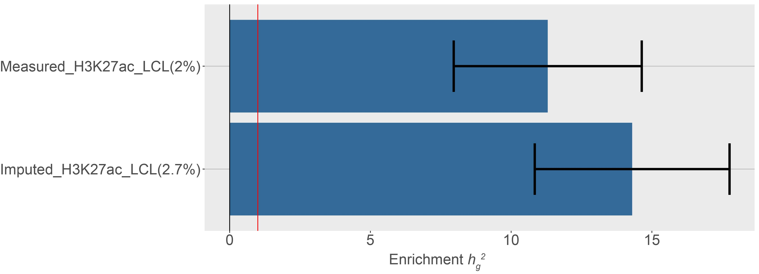
Imputed may outperform directly measured data
Compared enrichment for directly measured and chromIMPUTE LCL H3K27ac peaks meta-analyzed across 5 autoimmune diseases (Celiac, Crohn’s, Lupus, Rheumatoid Arthritis, Ulcerative Colitis)
Ernst et al. Nature Biotechnol 2015

Slide 17
Algorithm for choosing best “TF” annotation
Start with baselineLD model (Gazal et al. in press Nat Genet)
Iteratively add most conditionally significant new annotation from each possible intersection of:
Tissue specific chromatin
Union of all chromatin (5.4%)
H3K27ac (3.6% of SNPs)
H3K4me1 (4.9%)
H3K4me3 (1.8%)
DNase (2.5%)
Sequence based TF
MotifMap +- 100bp (9.4%)
Kheradpour (17%)
No overlap
∩

Slide 18
Choosing the best “TF” annotation
Focus on T-cells and meta-analyze across 5 autoimmune diseases (Celiac, Crohn’s, Lupus, Rheumatoid Arthritis, Ulcerative Colitis)
Annotation 1 | Annotation 2 | Frac_SNPs | Enrich | Enrich_se | p-val | tau* | tau*_se | p-val2
Chromatin | MotifMap+-100bp | 0.009 | 29.03 | 4.09 | 7.04E-12 | 2.2 | 0.38 | 4.94E-09
H3K4me1 | MotifMap+-100bp | 0.008 | 28.77 | 4.32 | 1.27E-10 | 2.1 | 0.38 | 2.72E-08
Chromatin | Kheradpour | 0.013 | 23.16 | 3.48 | 2.00E-10 | 1.96 | 0.37 | 1.49E-07
H3K4me1 | Kheradpour | 0.011 | 22.5 | 3.61 | 2.49E-09 | 1.83 | 0.37 | 5.51E-07
H3K27ac | MotifMap+-100bp | 0.006 | 31.02 | 5.17 | 6.45E-09 | 1.88 | 0.4 | 2.56E-06
….. | ….. | ….. | ….. | ….. | ….. | ….. | ….. | …..

Slide 19
LCL “TF” annotations are enriched for LCL TF ChIP-seq peaks
Looked at overlap of annotations with all LCL TF ChIP-seq from ENCODE

Slide 20
Outline
Background and project goal
Building cell type specific TF annotations
Applying annotations to partition disease heritability

Slide 21
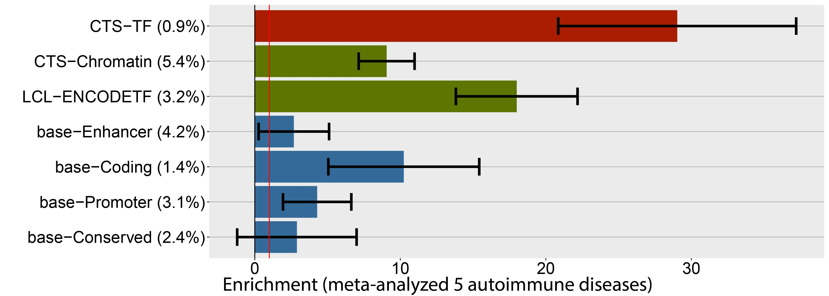
T-cell Chromatin ∩ MotifMap100 is highly enriched for autoimmune h_{g}²
*Chromatin annotation is similar to that used in Finucane et al. NG 2015

Slide 22
Intersection captures most of the h_{g}²

Slide 23
Tissue-specific annotations are enriched for corresponding traits
Created TF annotations for 127 Roadmap Epigenome tissue types
Partitioned heritability of 32 diseases with publicly available summary stats
Enrichments that don’t meet 1% FDR threshold are set to 1

Slide 24
Conclusions
Intersecting sequence based TF binding predictions with chromatin data can create meaningful tissue-specific TF annotations
The intersection of active chromatin marks and MotifMap+/-100bp yields the most informative annotations.
Tissue-specific TF annotations are highly enriched for disease h_{g}² explained for many diseases and tissue types

Slide 25
Future Directions
Incorporate more sequence-based TFBS prediction including deep-learning approaches (such as DeepBind) and other datasets (such as cis-BP)
Apply new annotations to fine-mapping

Slide 26
Acknowledgments
Alkes Price
Hilary Finucane
Steven Gazal
Alexander Gusev
Farhad Hormozdiari
Xuanyao Liu
Po-Ru Loh
Yakir Reshef
Other members of the Price lab
Manolis Kellis
Yue Li

