Slide 1
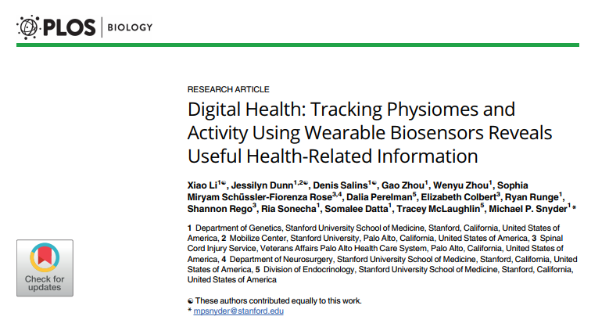
Notes:
Screenshot of article title/authors/journal

Slide 2
Summary of Experiment
Use of portable biosensors (wearables) to monitor physiological changes during different activities and conditions and discover their role in detecting diseases and managing health
Over 250,000 daily measurements for 43 individuals
  Changes in certain environments (airline flights)
Physiological parameters have always been able to indicate the health status of a person, but collected too infrequently
  Wearables = on the rise
Discovered wearables can identify the early signs of Lyme disease and inflammatory responses, help detect risk for type 2 diabetes
  Development of a computational algorithm

Slide 3
Investigation
Investigate use of wearables to:
  Record physiological measurements in individuals
  Reveal physiological responses to different daily cycles and environments
  Identify personalized baseline norms and differences among individuals
  Detect differences in health states among individuals
  Detect inflammatory responses and diagnose diseases in the early development stages

Slide 4
Approach
Intensely study one individual with many devices (7 devices)
  Collectively measured 12 parameters, some overlap, enabling cross-device comparison and assessment of accuracy
  Recorded activities and travel in real time with web-based and smartphone-based software
  Participant was extensively monitored with frequent standard medical tests
Analyze larger group of participants to find consistencies and differences
Physical monitoring of 43 people for up to 11 months, with a preference for those at risk for T2D
Analyze 4 self-reported ill people

Slide 5
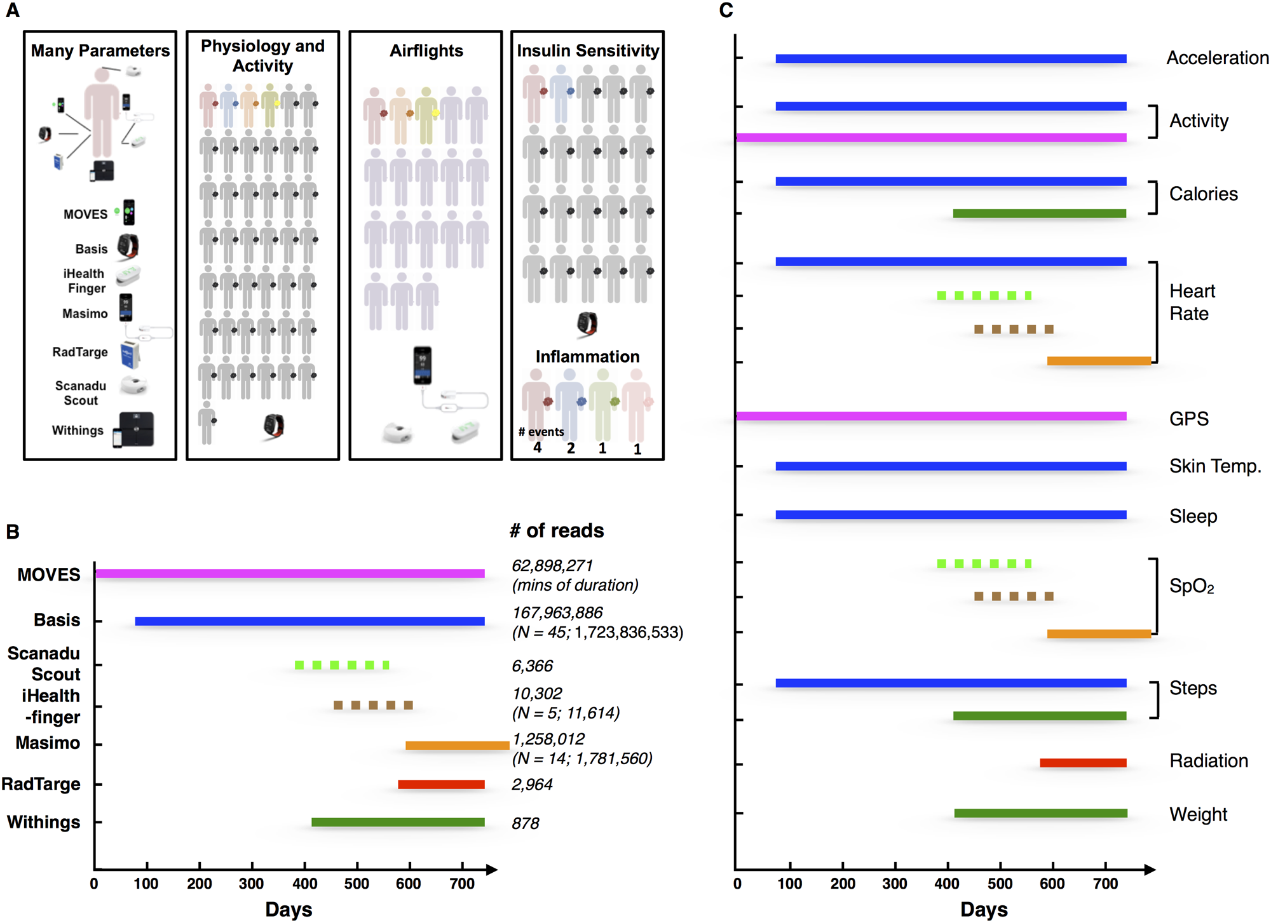
Devices
Basis device
Scanadu Scout
iHealth-finger
Masimo
MOVES
RadTarge
Withings

Slide 6
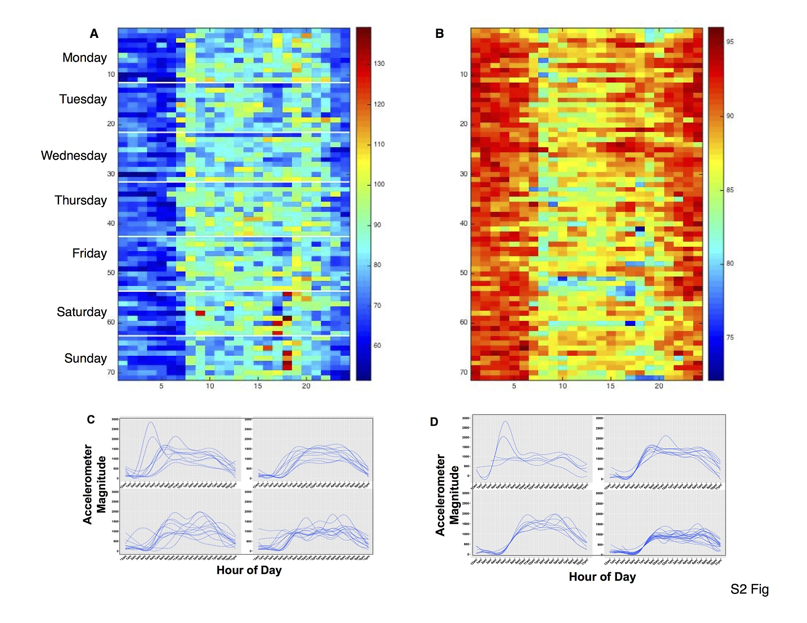
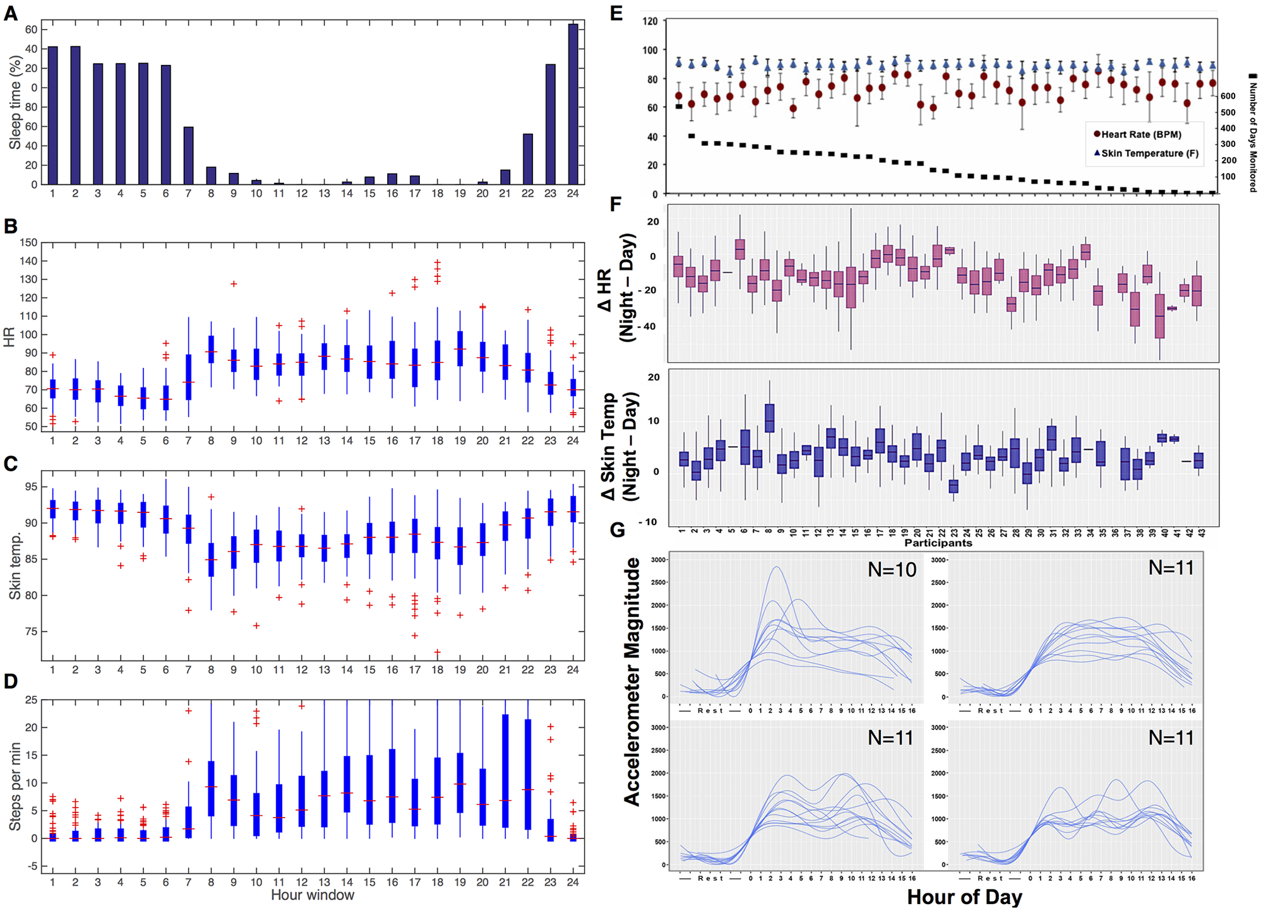
Collecting Data/Detecting Patterns

Slide 7
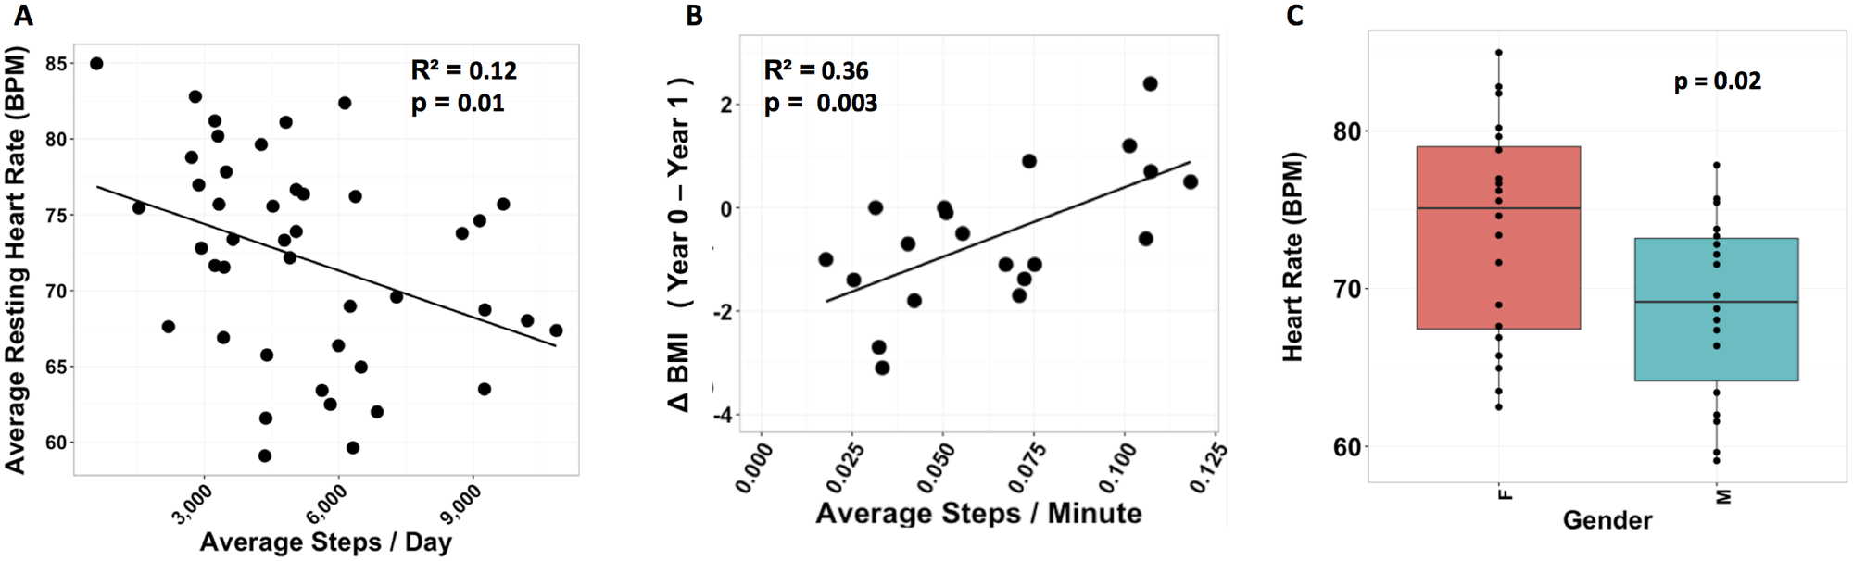
Analyzing Physiological Data
Discovered activity-related physiological responses (elevated HR during typical time for bike commuting on weekdays, which was later confirmed by MOVES info)
Confirmed well known patterns of physiological responses to events
  faster HR during exercise, decrease in SpO₂ during periods of fatigue
Examined difference in resting HR for men and women, HR increases and skin temp decreases with increasing activity

Slide 8
Analysis on Airline Flights
Measured SpO₂ and HR of Participant 1 for 96 flights, monitored by forehead device (Scanadu) and/or finger monitoring devices (iHealth-finger, Masimo)
  Decrease in SpO₂ levels as altitude increased → levels measured in 17 other individuals to confirm relationship between oxygen levels and altitude
On long flights, SpO₂ levels are higher toward the end of the flight than at the beginning- most likely due to adaptation
Examined measurements during periods when the participant logged alertness status as tired or alert (to determine how SpO₂ relates to macrophenotypes) → SpO₂ level reported when tired on flights was lower compared to that when alert

Slide 9
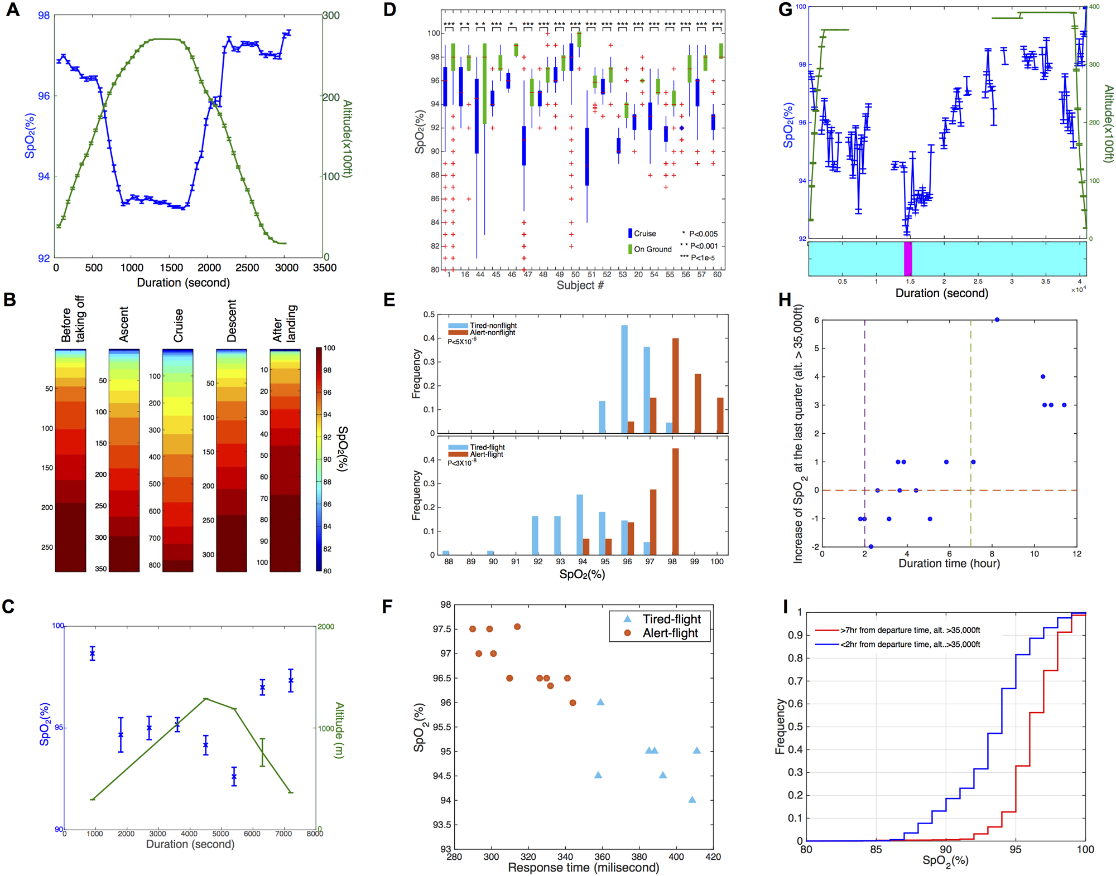
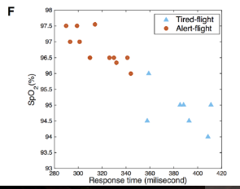
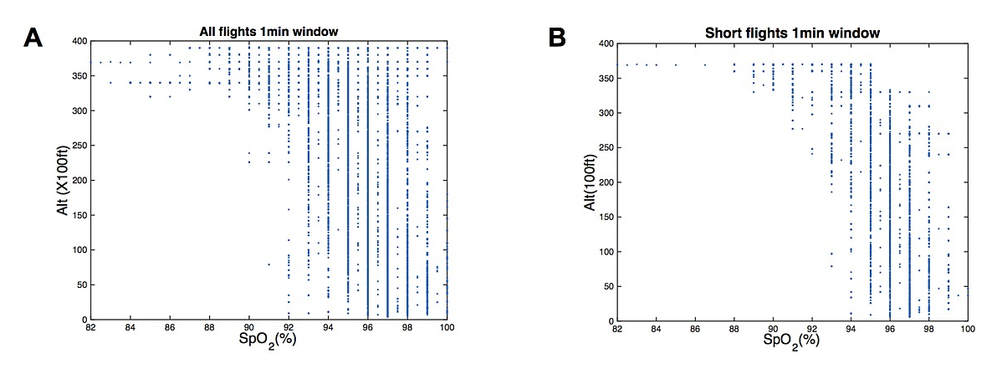
SpO₂ levels on drive
Correlation btw SpO₂ and fatigue
SpO₂ levels on flights

Slide 10
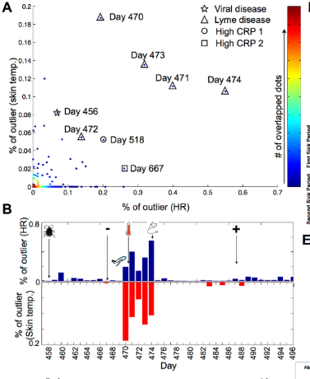
Application to Disease Diagnosis
Examine association between unusual physiological signals and disease status/markers
  Participant 1: each parameter was compared according to corresponding activity info → calculated outliers
Found 8 days with abnormal HR and skin temp pattern
  Most significant: 5 days, detected elevated HR and skin temp, Participant 1 had Lyme disease

Slide 11
Application to Disease Diagnosis (cont)
Tested on three other individuals who self-reported as ill → high CRP levels and elevated HRs were evident
To examine the resolution at which illness might be identified: “Change-of-Heart” (COH) computational approach to identify periods with abnormal HR patterns
  Focused on deviations in resting HR relative to an inactive period
  Applied a peak-finding-based algorithm to continuous HR signal to search for peaks
  Enabled identification of all the sick periods

Slide 12
Application to IR and Insulin Sensitivity
Investigate associations between info collected from wearables with clinical data- focus on diabetes-related measurements
Step-wise modeling approach to examine the relationship between SSPG values and HR, activity, BMI
  diabetes= associated with changes in diurnal variation of HR → daytime and change in HR were positively correlated with SSPG but nighttime HR wasn’t
    Daily steps wasn’t associated with daytime HR but had inverse relationship with nighttime HR
    BMI has positive correlation with HR and is negatively correlated with overall activity
  Delta HR= predictor of SSPG levels, independent of daily activity and BMI

Slide 13
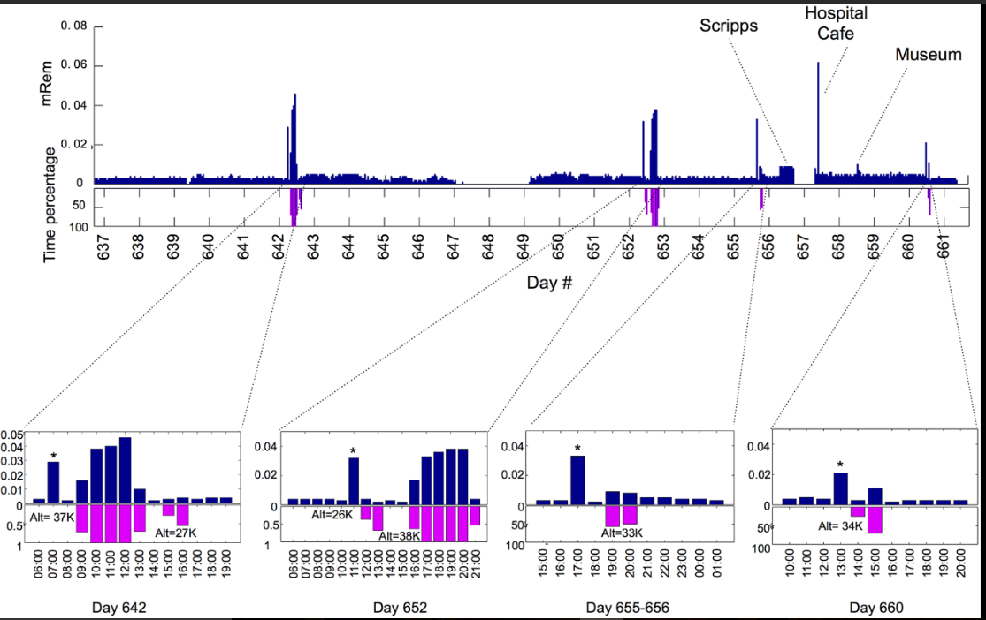
Exposure to Radiation
Explored whether individuals encounter periods of radiation exposure
Short flights with lower cruising altitude yield smaller increases in radiation (radiation-protective layer of atmosphere)
Only modest increases in radiation, not enough to change HR and skin temp levels

Slide 14
Conclusion
Wearables can provide insight into the health status of a person
  Measure acceleration, activity, calories, heart rate, GPS, skin temperature, sleep, oxygen levels, radiation exposure, weight
  Assist in diagnosing diseases and inflammatory responses in the early stages
  Provide information about the physiological differences between insulin resistant and -sensitive individuals and therefore determine early the risk for T2D

Slide 15
References
Li, Xiao, et al. “Digital Health: Tracking Physiomes and Activity Using Wearable Biosensors Reveals Useful Health-Related Information.” Plos Biology, doi:https://doi.org/10.1371/journal.pbio.2001402.

