Slide 1
Construction of Protein Co-crystal Structures for Binding Affinity Change under Mutations:
Whole RCSB PDB
(28019 entries)
RCSB: 795 PDBs covering 264 drugs
Resolution better than 3.0Å;
Human Protein only
No DNA/RNA/hybrid chain
Serving as PDB pool for drug-binding study
PDBBindDB: 379 PDBs covering 177 drugs
PDB Bind DB
(9221 entries)
Human protein subset from PDBBindDB serving as general ligand-binding study also serving as cross-validations by expt values
452 FDA approved and experimental drugs
Ligand not necessary to be drug
Exp. Affinity values (Ki, Kd) available
Maybe not from human
DrugBank: 563 PDBs covering 209 drugs
Drug Bank
(9215 entries)
Ligand ID Matching
DrugBankDB provides list of FDA-approved and experimental drug-ligand IDs to match with
All proteins are known targets;
May not be a co-crystal structure
PDID: 256 PDBs covering 112 drugs
PDID
(9652 entries)
Mapping with somatic and germline SNVs to get WT and Mutated structures for drill down analysis.
Known or putative targets;
Human Protein Only;
May not be a co-crystal structure

Slide 2
Unique Entries from 4 data sources: 1052
Note:
210 PDB_BindDB entries and 55 PDID
entries are not in the RCSB data pool
Possible reasons:
Resolution lower than 3Å;
Proteins are not homo sapiens (human)
Notes:
Drugbank provided the FDA-approved or expermental drug liland list in form of 3-letter ligand ID in PDB file;
Entire PDB served as the mother-set of all co-crystal human protein structures better than 3.0Å resolution;
PDB_BindDB contains co-crystal structures that has a experimental determined binding affinity data for cross-validation works;
PDID are those based on DrugBank, RCSB, and BindingDB protein-drug interaction records, it maybe a putative structure or non-co-crystal structure.
After matching all of the 4 database structures with FDA-approved or experimental drug lilgand list, what left for each database is shown on the venn-diagram above.
At least, each entry in the plot meets:
X-ray solved structure from RCSB (we downloaded PDBs for each of the other 3 datasets directly from PCSB website)
A co-crystal structure containing a drug ligand binding to the protein

Slide 3
RCSB-PDB drug ligand dataset (795 PDBs) for drug binding study on human protein;
Raw PDB_Bind_DB dataset (9221 PDBs) for general ligand binding study
Germline:
ExAC (TCGA in ExAC are the germline subset of TCGA
Somatic:
Non-germline TCGA
Special Case:
CMG data?
Mapping SNVs
Target PDB Source
Structure Feeding
Drilldown Analysis
Binding Affinity Change (general molecule & drug)
Variants Distributions (heat map & stats for positional and functional analysis)
Mechanism Studies and Case Studies
Stress and Frustration Analysis for local disruption & allosteric analysis

Slide 4
Preparing self-defined Plain Text as Data Resources
1) ExAC SNP component including information such as Chromosome number, SNP coordinate, ref and alt allele;
2) Variant Effect Predictor component including ref/alt allele,ENSG,ENST, a.a. mutation, PolyPhen and SIFT predictions with scores, allel frequency;
3) PDBMappingLogFile component including PDB ID, SNP coordinate, ENST & ENSG, wildtype and mutated a.a., a.a. position.
Usage:
A ready-to-analyse data resource for downstream analysis;
A web-interface resource for user inquiry ( similar to Intensification web source)

Slide 5
Framework of Genome-Protein Data Processing (Germline + Drug-ligand PDB dataset)
de-annotate to get clean .vcf
ExAC.VEP.vcf
ExAC.VAT.vcf
annotate w/VAT to process Sushant’s code
(GRCh37/hg19 as genomic assembly)
extract annotation
map SNP on PDB
(bioMart output)
ExAC SNP component (1)
VEP component (2)
PDBMappingLogFile component (3)
merge (1) (2) (3) by matching ENST and ENSG together with SNP coordinates
Self-defined Plain Text Data Source File

Slide 6
Mapping Results and Basic Statistics (Germline + Drug-ligand PDB dataset)
Statistics Considered | Count
Number of co-crystal protein + FDA approved, experimental and small molecule drug PDBs used for mapping (Union of PDBBindDB, PDID, DrugBank and PDB) | 1052
Number of PDBs to which SNPs from the ExAC data were mapped | 438
Total number of mutated PDBs (1 SNP per PDB) created by Modeler using modified version of Sushant’s Frustration code | 27,560
Average number of SNPs per PDB | 63

Slide 7
Redundancy Removal
438 PDBs (containing redundant entries)
BLASTClusp v2.2.26
230 non-redundant PDBs
within each group, choose the one that:
12359 SNPs
855 PDB chains in FASTA
most mutations mapped
highest structure resolution
most recent published
manual judgement
54 SNPs/PDB
256 grouped clusters by 96% identity

Slide 8
Binding Pocket Identification and Residue-Ligand(Drug) Distance
B. P. Id.: if at least one heavy atom of an a.a. residue from mapped chain has distance less than 8Å towards any heavy atom of target ligand in the co-crystal structure, then this a.a. residue is on the binding pocket.
R. L. Dis.: we define the distance between an a.a. residue and a ligand as the shortest distance of a heavy atom of that residue to a heavy atom to the target ligand.
For a given PDB from non-redundant dataset, we have:
list of binding pocket residues of the mapped chain;
List of distances of every residue of the mapped chain to the ligand.
Relative Distance (R.D.) Away from Ligand: a scaler is applied to represent the relative position of each a.a. residue on a given chain away from the ligand that binds to the chain. The scale is within range [0,1], with R.D. = ( X_{i} – Xmin ) / ( Xmax – Xmin ), where X_{i} is the R.L.Dis. of residue i on the chain.

Slide 9
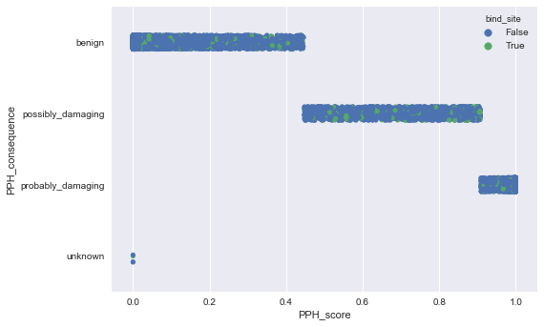
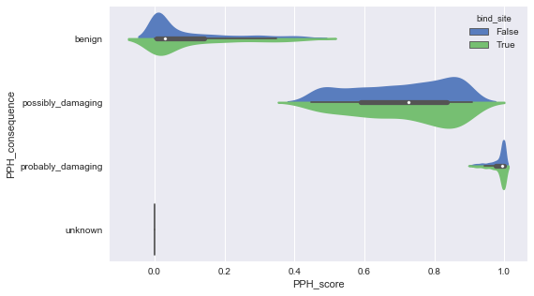
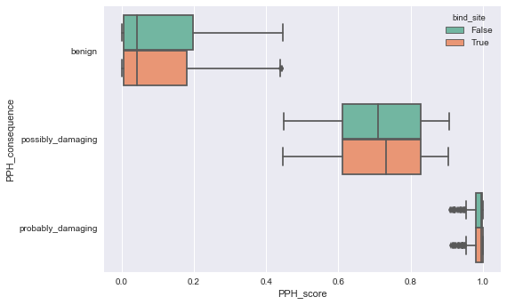
Preliminary Results: Distribution of PPH Score & Consequence for Binding Site and Non-binding Site Residues
Bind 37.9%; non-bind 48.7%
Bind 17.7%; non-bind 17.9%
Bind 44.2%; non-bind 33.3%
Mean = 0.0896
PolyPhen-2 predicts the effect of an amino acid substitution on the structure and function of a protein.
Polyphen score represents the probability that a substitution is damaging, values nearer to 1 are more confidently predicted to be deleterious.
Mean = 0.1047
Mean = 0.7050
Mean = 0.7218
Mean = 0.9834
Mean = 0.9855
Nat Methods. 2010 Apr; 7(4): 248–249

Slide 10
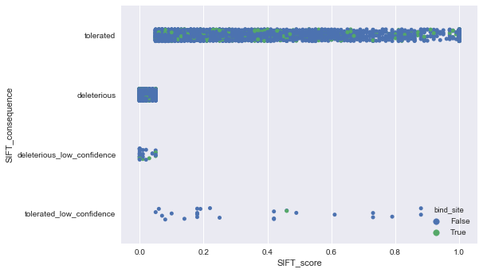
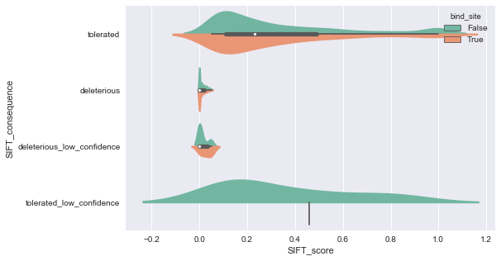
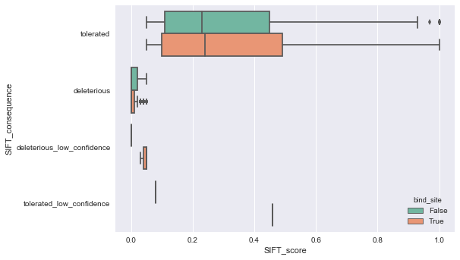
Preliminary Results: Distribution of SIFT Score & Consequence for Binding Site and Non-binding Site Residues
Bind 36.8%; non-bind 43.4%
Bind 62.5%; non-bind 55.9%
Mean = 0.3305
Sorting Intolerant From Tolerant (SIFT) is a program that predicts whether an amino acid substitution affects protein function within human variant database.
Substitutions with score less than 0.05 are predicted to affect protein function (deleterious)
Mean = 0.3369
Mean = 0.0089
Mean = 0.0112
Nucleic Acids Res. 2003 Jul 1; 31(13): 3812–3814

Slide 11
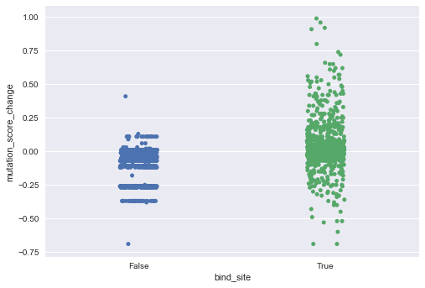
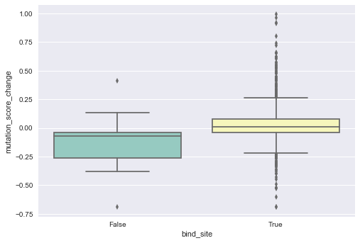
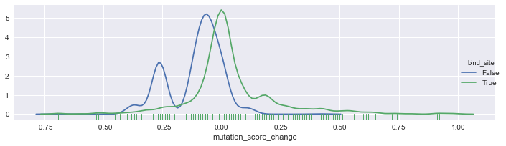
Preliminary Results: Binding Affinity Score Change for Binding Site and Non-binding Site Residues by AutoDock Vina
12%>0
56%>0
mean = 0.026
mean = -0.11
Std = 0.189
Std = 0.113
Autodock Vina 1.1.2's Local Search Protocol;
ligand binding pose in PDB as initial configuration;
protein was fixed; ligand was flexibly treated for locally optimize its binding configuration;
174 PSBs used, 56 kicked out due to 1) inconsistent chain ID, 2) NMR structure, 3) multiple ligands with same ID, 4) problematic PDB coordinates.
Data and Experiment by Chengfei Yan, Plot by Bo Wang

Slide 12
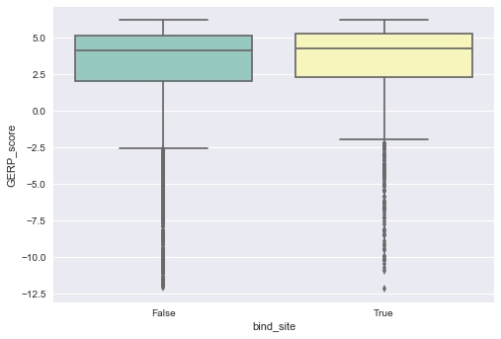
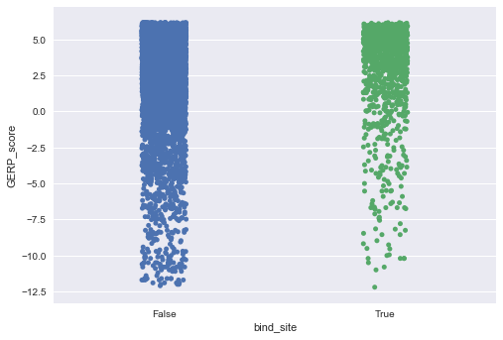
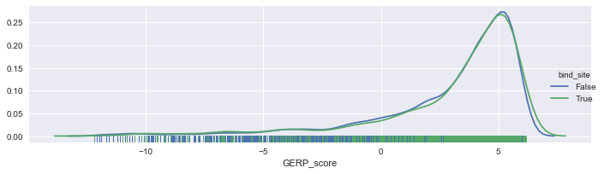
Preliminary Results: Distribution of GERP Score for Binding Site and Non-binding Site Residues

Slide 13
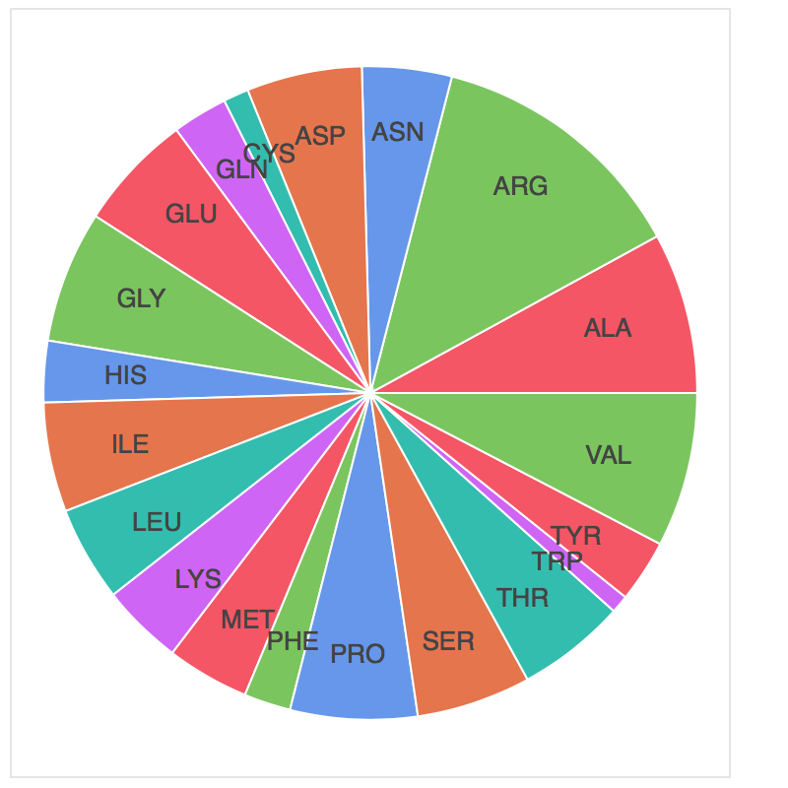
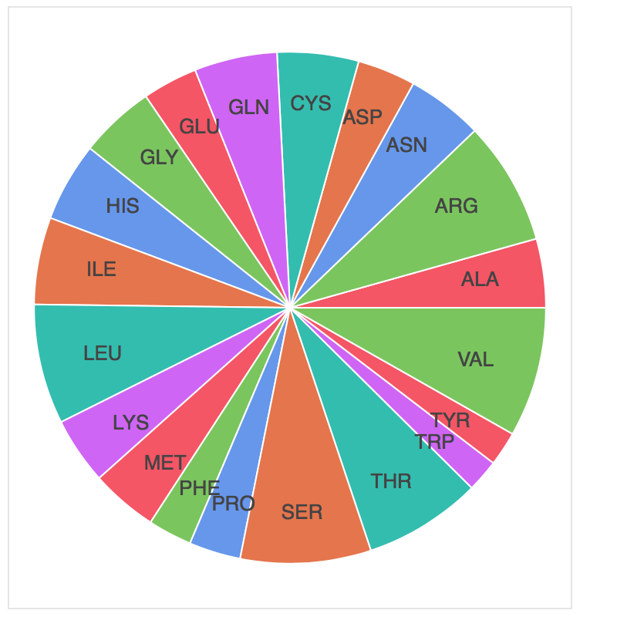
Preliminary Results: Distribution Change of Amino Acids Before and After Mutation
605
470
555
545
133
390
290
369
1380
512
613
505
530
828
692
844
583
322
844
574
803
810
870
499
328
230
94
448
429
217
571
448
434
789
245
666
600
295
346
875
Wild Type
Mutated

Slide 14
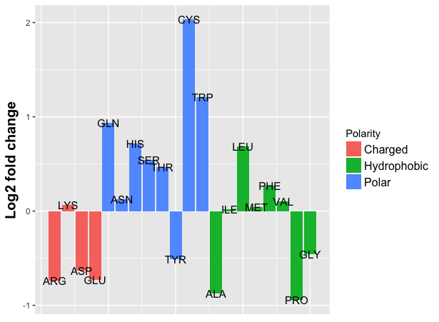
Preliminary Results: Distribution Change of Amino Acids Before and After Mutation
Polarity Index (PI) = 1, 0.5, 0
PI change = PI(mutated)-PI(WT)
Data by Bo Wang, Plot by Xiangmeng Kong

Slide 15
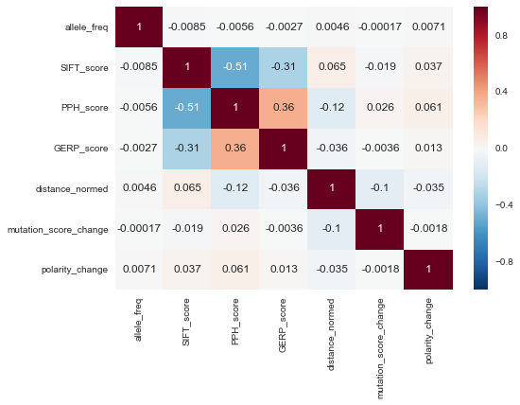
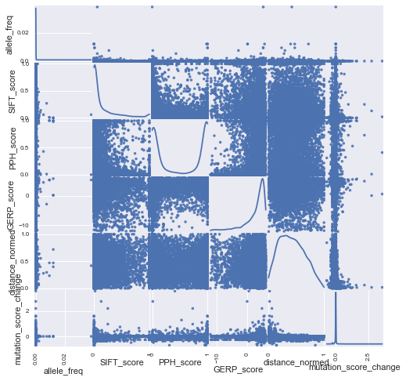
Preliminary Results: Correlation Matrix for Different Features Based on Normalized Distance away from Ligand
(*NAN values from docking experiment removed)

Slide 16
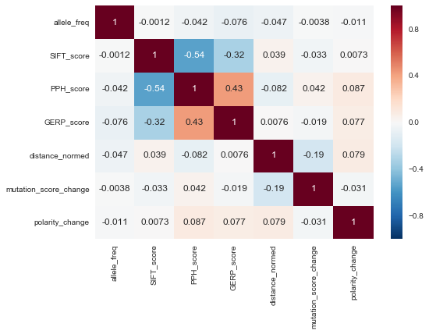
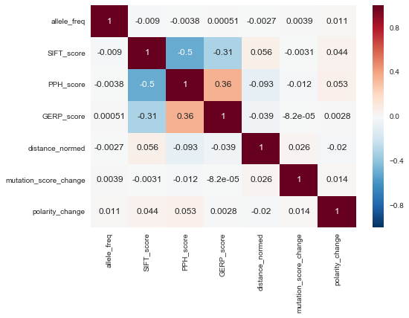
Preliminary Results: Correlation Matrix for Different Features Based on Normalized Distance away from Ligand
Binding Site
Non Binding Site

