Slide 1




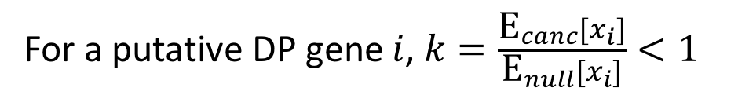
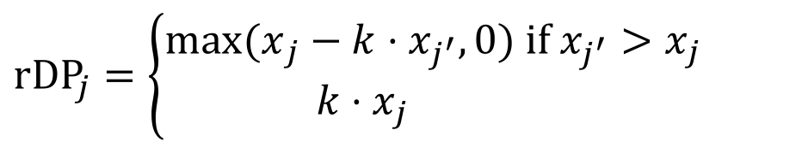






Estimating the number of retained DPs
For a putative DP gene $i$, $k=\frac{{\text{E}}_{canc}[x_{i}]}{{\text{E}}_{null}[x_{i}]}<1$
For cancer sample $j$ and matching null sample $j^{′}$, estimate # retained DPs as:
$$\text{r}\text{D}{\text{P}}_{j}=\left\{\begin{aligned}{max⁡(x}_{j}−k{⋅x}_{j^{′}},0) \text{if} x_{j^{′}}>x_{j} \\ k⋅x_{j} \end{aligned}\right.$$
$$\text{otherwise}$$
canc
$$\text{rDP}$$
$$x_{j}$$
$$x_{j^{′}}>x_{j}$$
null
$$x_{j^{′}}$$
$${kx}_{j^{′}}$$
$$x_{j}>x_{j^{′}}$$
canc
$$\text{rDP}$$
$$\text{rDP}$$
$$x_{j}$$
null
$$x_{j^{′}}$$
$${kx}_{j^{′}}$$

Slide 2
Retained DP estimates
Low estimate
High estimate
retained DPs
X axis: 1=Liver, 2=Skin, 3=Pancreas, 4=Kidney, 5=Ovary, 6=Breast, 7=Prostate, 8=CNS, 9=Pan-cancer
Blue=noncoding w/o promoters; Green=promoters; Red=coding
Pan-cancer low-high estimates: 7.8 - 18.6

Slide 3
Current WDs and removed DPs (low)

Slide 4
Gene set enrichment analysis
Gene set enrichment (fold-change)
DP / WD ratio
Apoptosis
Cancer-pathway
Cell cycle
DNA repair
Essential
Immune
Metabolic
Non-essential
Oncogenes
TSGs
Apoptosis
Cancer-pathway
Cell cycle
DNA repair
Essential
Immune
Metabolic
Non-essential
Oncogenes
TSGs
Apoptosis
Cancer-pathway
Cell cycle
DNA repair
Essential
Immune
Metabolic
Non-essential
Oncogenes
TSGs

Slide 5
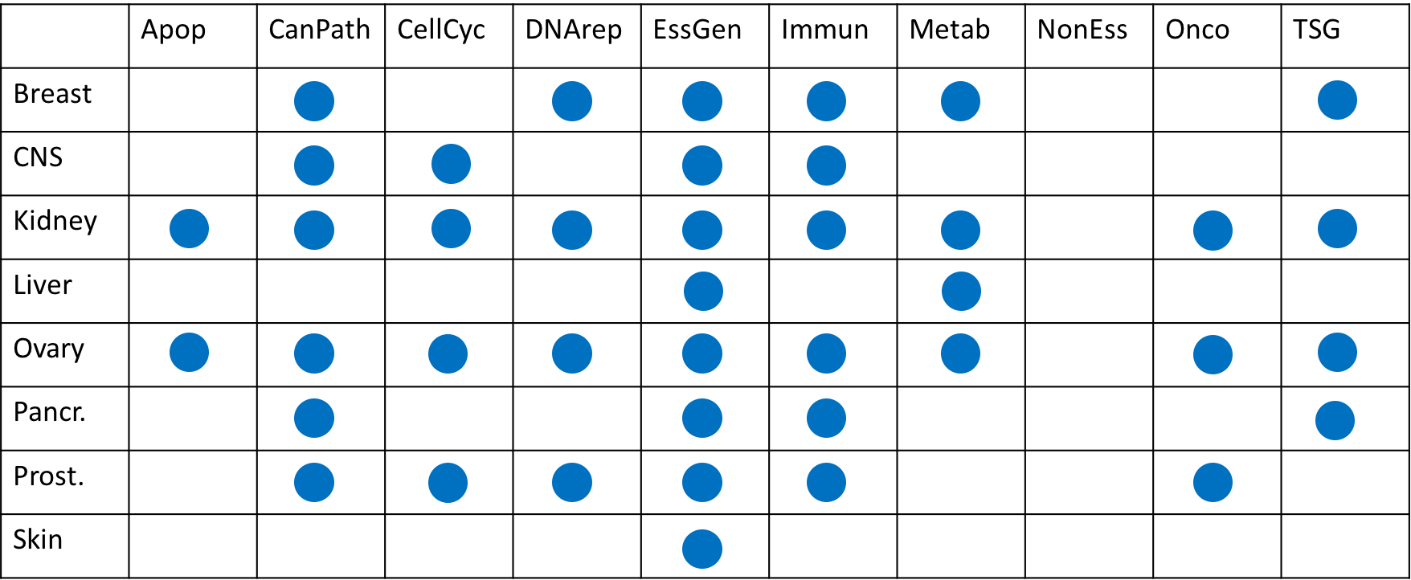
Gene set enrichment analysis: significance scores (FDR)
All enrichment q-vals
(green > 0.05, red < 0.05)
Significant enrichments (q>0.05)
Breast
CNS
Kidney
Liver
Ovary
Panc.
Prost.
Skin
Apoptosis
Cancer-pathway
Cell cycle
DNA repair
Essential
Immune
Metabolic
Non-essential
Oncogenes
TSGs

