Slide 1
Number of nonsense mutations
The role of mutation pattern
Cancer type (i.e tumor size, burden)
Negative selection

Slide 2
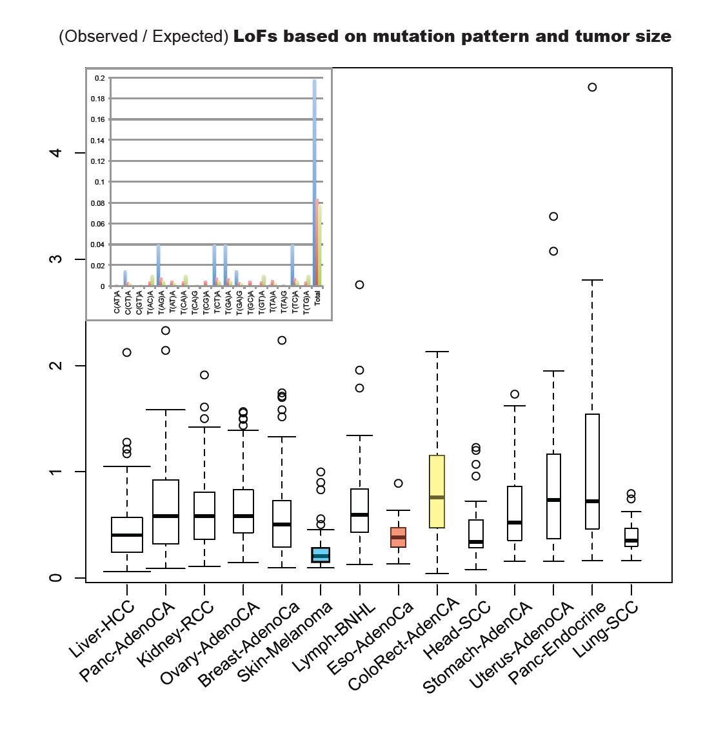
Observed vs Expected

Slide 3
