Slide 1
PsychENCODE Capstone #4
Developing a Brain Genomics Resource via Integrating CommonMind, ENCODE, GTEx, and Roadmap
Shuang Liu
Daifeng Wang
Fabio Navarro
Declan Clarke
Jonathan Warrell
Prashant Emani
Mengting Gu
Aparna Nathan
Mark Gerstein
James Knowles
Pamela Sklar
Mette Peters
Gabriel Hoffman
Laura Sloofman
Andrew Jaffe
Suhn Kyong Rhie
Peggy Farnham
Notes:
SL – slide 1 – did we forget anyone ?

Slide 2
Motivation
Creating a Brain-Specific Genomics Resource
  Previous development of Generic Resources to annotate the whole human genome (ENCODE, Roadmap, GTEx, 1000 Genomes, &c);
  Not focused on the brain
  Desire to provide a specific resource for the brain
  - Brain enhancers, specific splice forms, regulatory networks, & eQTLs
Question posed by this resource
  On a large-scale, are gene regulation, transcription and other aspects of the functioning of the genome similar in the brain to other tissues (ie the liver)? Or are they different?

Slide 3
Capstone #4 – talk outline
Resource
  Brain enhancers, eQTLs, expression modules, networks &c
Transcriptome analysis
  Spectral analysis of gene expression, unique brain expression patterns
  Non-coding transcription & retro-element activity, not atypical
Integrative network models
  Relating perturbations in gene expression to variants

Slide 4
Datasets
Datasets | Disease status | # samples | Brain region | Data Type
ENCODE/Roadmap | CTL |  | Multiple regions | ChIP-seq, RNA-seq
BrainSpan | CTL | 606 | 16 regions | ChIP-seq, RNA-seq, genotype
CommonMind | SCZ, BD, CTL | 613 | DFC | RNA-seq, genotype
GTEx | CTL | 92 | DFC | RNA-seq, genotype
BrainGVEX | SCZ, BD,C TL | 429 | DFC | RNA-seq, genotype
UCLA-ASD | ASD, CTL | 253 | DFC, CBC | ChIP-seq, RNA-seq, genotype
Yale-ASD | ASD, CTL | 45 | DFC, TC, V1, CBL | ChIP-seq, RNA-seq, genotype
CNON | SCZ, CTL | 63 | Olfactory Neuroepithelium | ChIP-seq
EpiGABA | CTL | 4 | OFC (BA11) | RNA-seq, genotype, ERRBS, Methylation
iPSC | CTL | 51 | iPSC | ChIP-seq, RNA-seq, WGS
TOTAL |  | ~2156
PsychENCODE

Slide 5
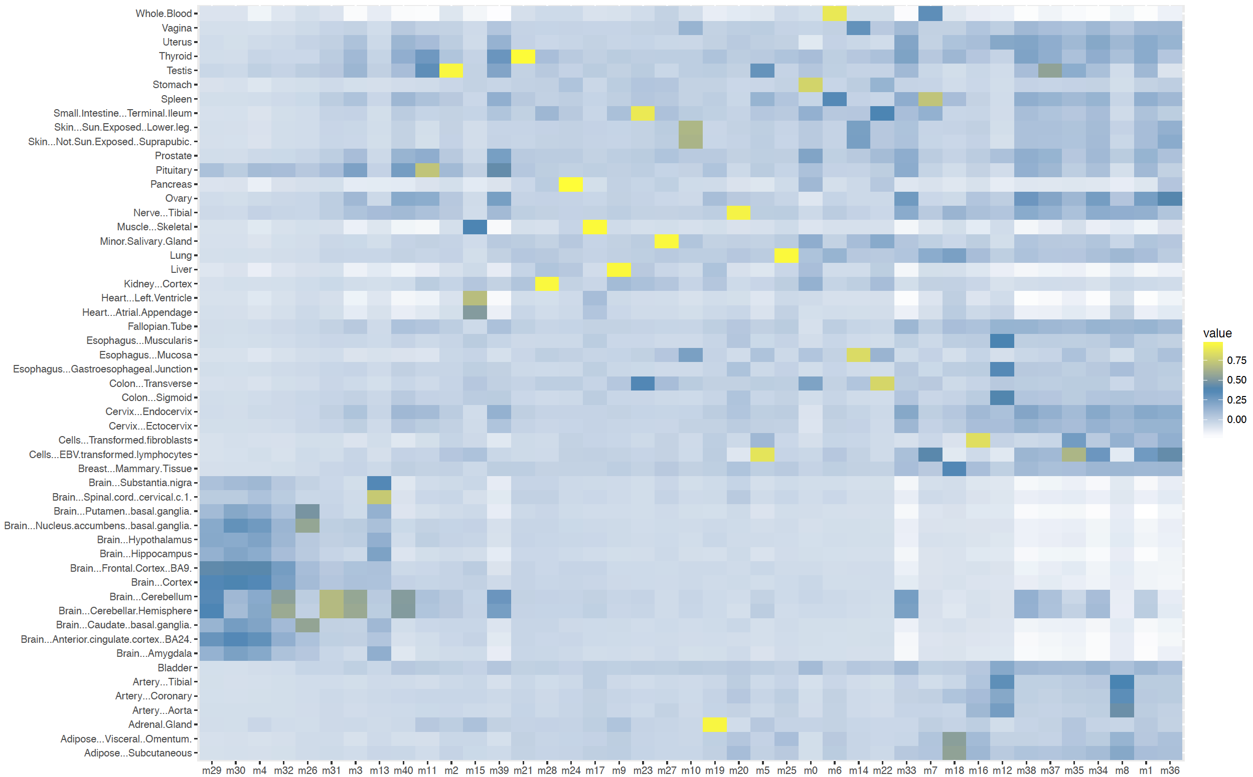
Brain Specific Enhancers and Coexpression Modules
Identifying brain-specific enhancers
Identifying brain coexpression modules
# of enhancers:
250K
200K
150K
Tissues
100K
50K
Brain regions
0
Tissues
+/-ve corr:
p<0.001:
Modules (ordered by brain-specificity)

Slide 6
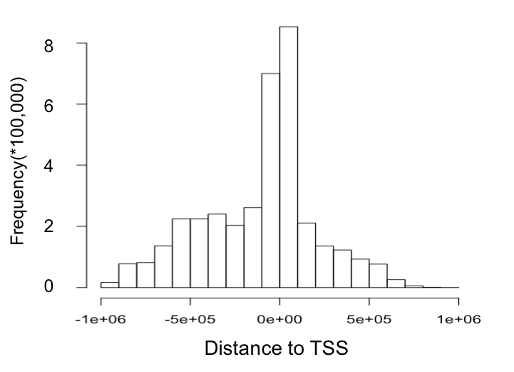
Brain eQTLS
1e+07
5e+06
2e+06
1e+06
5e+05
2e+05
Number of eQTLs
?
500 1000 1500 2000
(base pairs)
Number of samples
Notes:
SL (slide 6) – can you make type bigger on LHS & middle … need to discuss

Slide 7
Characteristic Statistics for the Brain
(Preliminary!)
 | Total
Enhancers^{[1]} | 2.3M
Genes^{[2]} | 23K
lncRNAs and pseudogenes^{[2]} | 33.2K
cis-eQTLs^{[2]} | 26.4M
Gene expression modules^{[2]} | 117
Differentially included exons^{[3]} | 2.5K
Active in Brain regions | Brain Specific
332.5K (14.5%) | 130.2K (5.7%)
17.6K (76.4%) | 386 (1.6%)
14K (42.2%) | 814 (2.4%)
3.25M (12.3%) | 1.02M (3.9%)
59 (50.4%) | 6 (5.1%)
- | 420 (16.4%)
Other tissue active (mean) | Other tissue specific (mean)
274.1K (11.9%) | 83.5K (3.6%)
16.9K (73.5%) | 25.9 (0.1%)
10K (30.1%) | 136.7 (0.4%)
599K (2.3%) | 189K (0.73%)
26.3 (22.4%) | 3.3 (2.8%)
- | 142 (5.5%)
[1] Roadmap Epigenomics Consortium. Integrative analysis of 111 reference human epigenomes. Nature, 2015.
[2] The GTEx Consortium. The Genotype-Tissue Expression (GTEx) pilot analysis: Multitissue gene regulation in humans. Science, 2015.
[3] Melé et.al. The human transcriptome across tissues and individuals. Science, 2015.
Notes:
1323 total rnaseq data

Slide 8
Capstone #4 – talk outline
Resource
  Brain enhancers, eQTLs, expression modules, networks &c
Transcriptome analysis
  Spectral analysis of gene expression, unique brain expression patterns
  Non-coding transcription & retro-element activity, not atypical
Integrative network models
  Relating perturbations in gene expression to variants

Slide 9
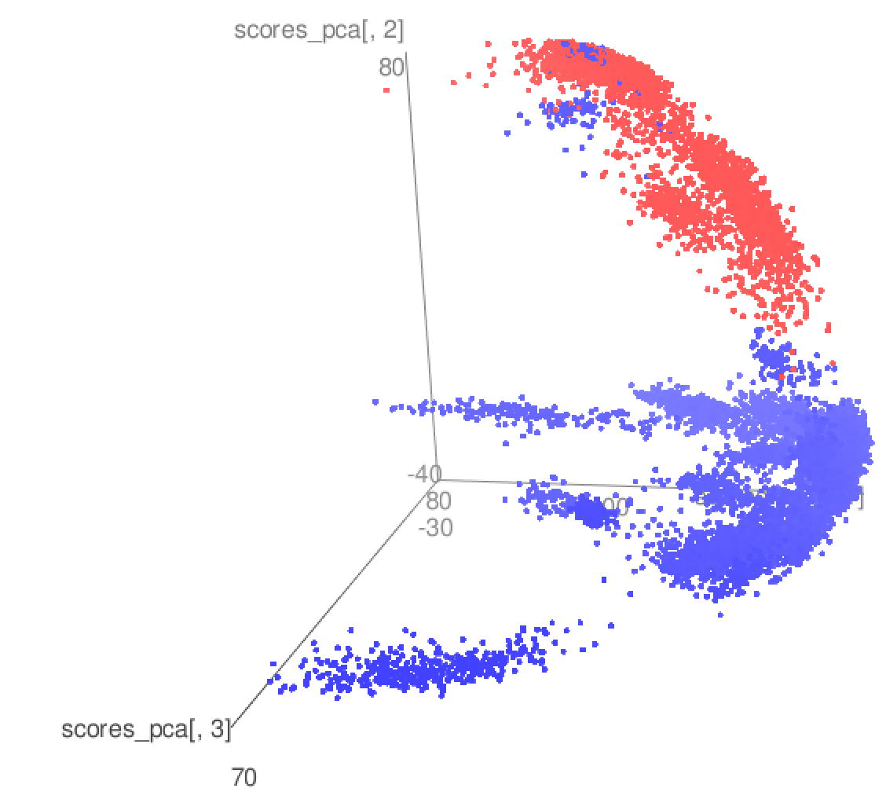
PCA of GTEX, GVEX, Brainspan, CMC, ASD
Brain samples
Other tissue samples in GTEx
Notes:
DW – can you merge 9 & 10 if easy

Slide 10
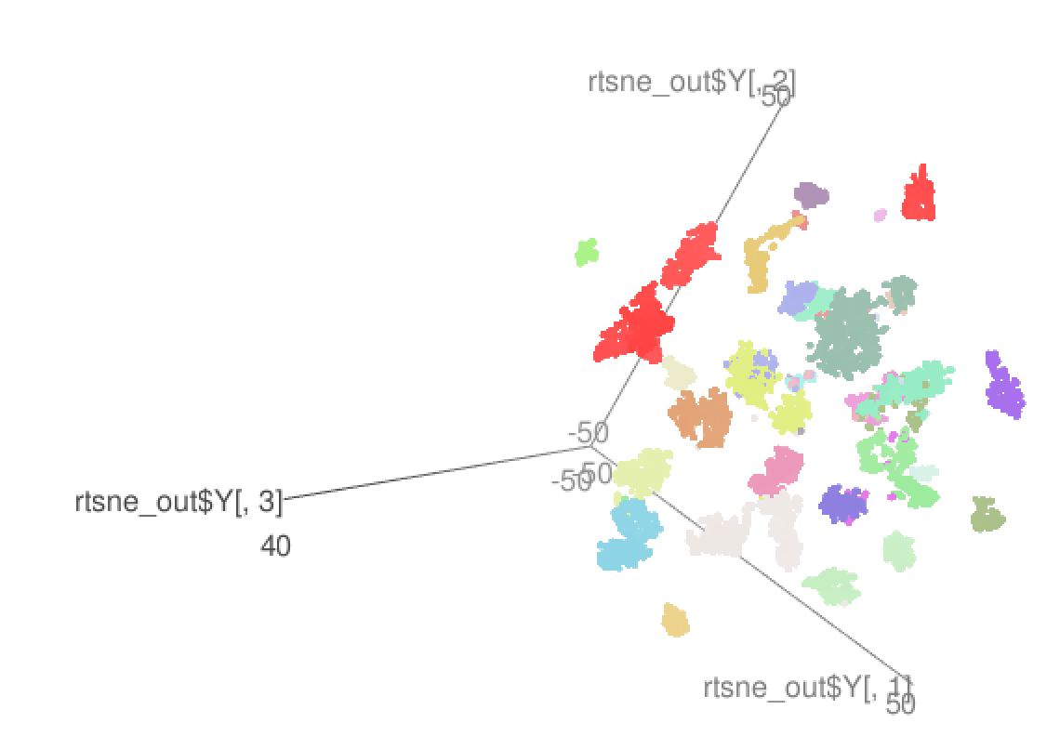
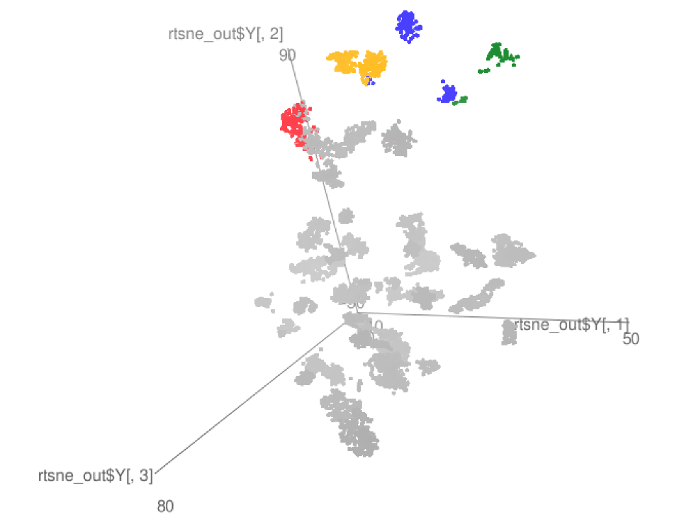
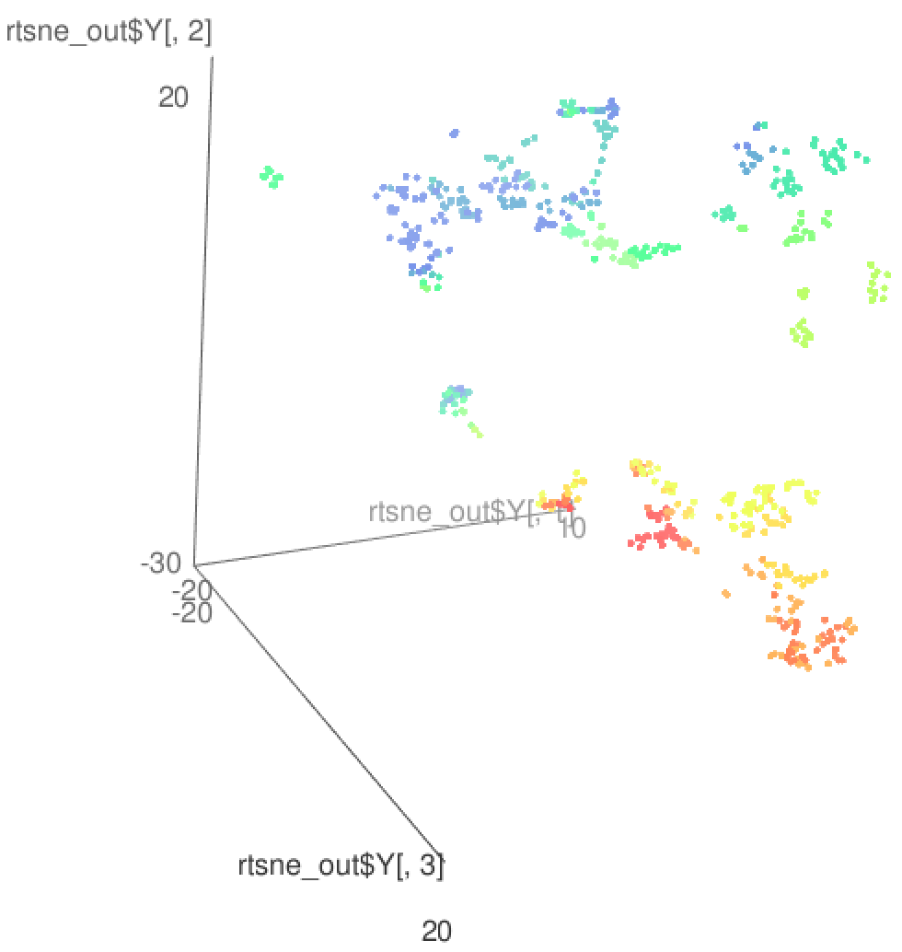
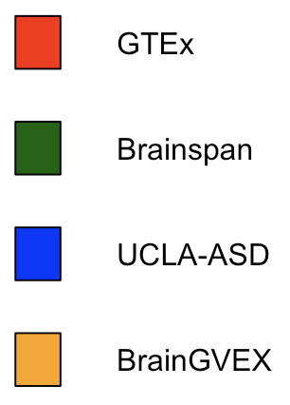
tSNE local clustering
Birth->
GTEx
GTEx + some PEC
Brainspan

Slide 11
RCA
Brain samples
Create a reference expression panel
  Select ~1,400 genes with tissue specific expression
  Calculating the median expression of all reference genes for all reference tissues
For each sample, we project the gene expression values to the reference panel
Finally we perform a PCA analysis using the projected values
Cerebellum samples

Slide 12
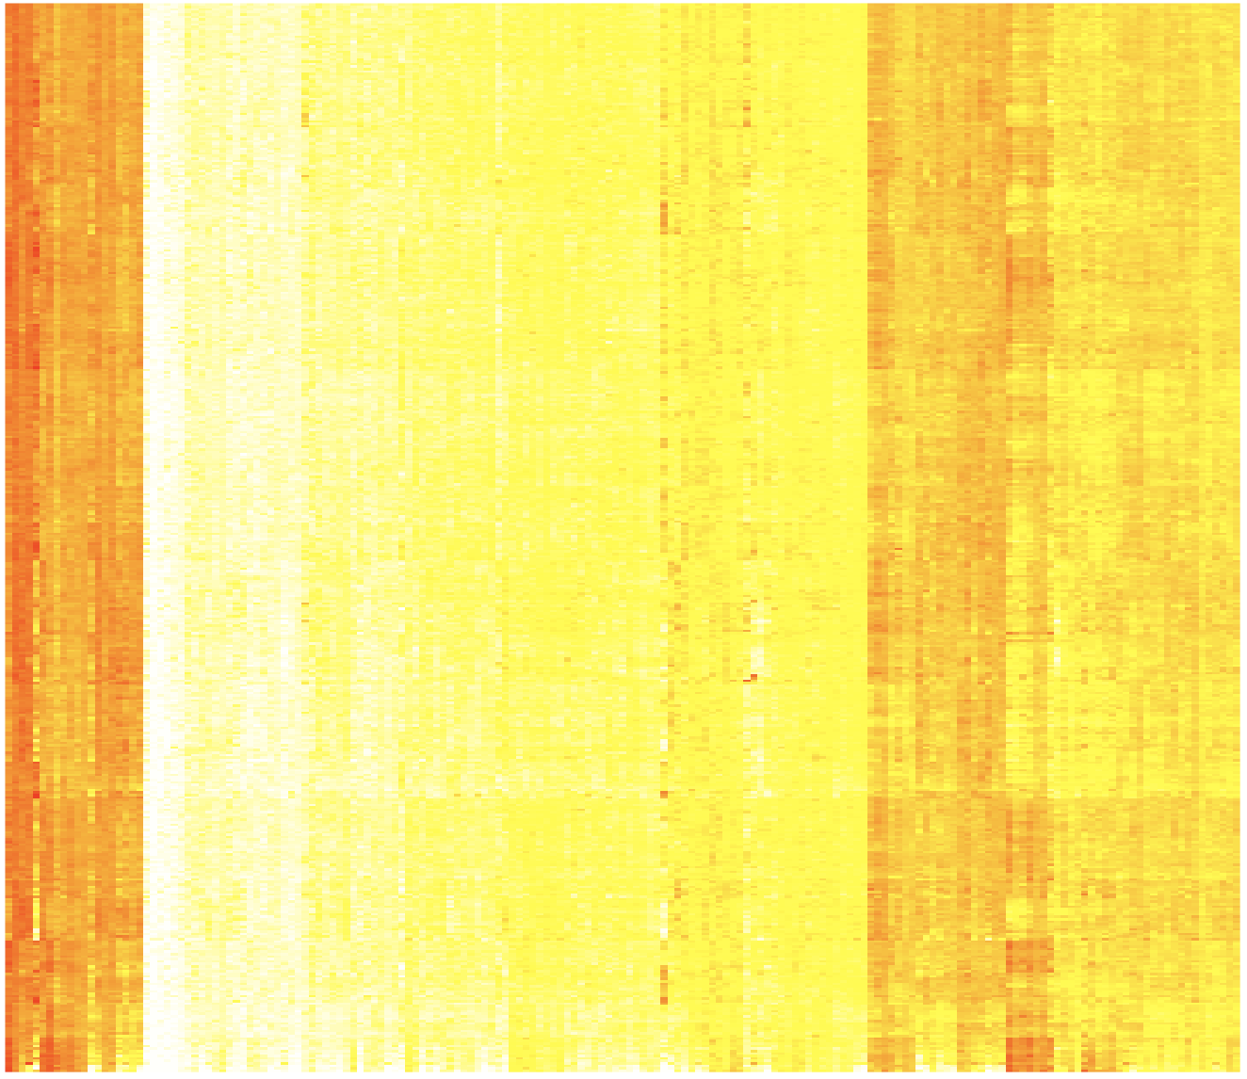
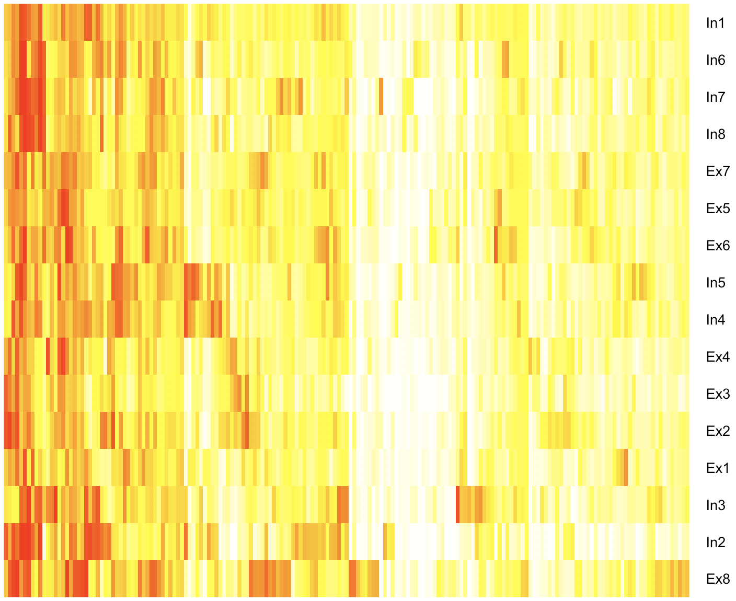
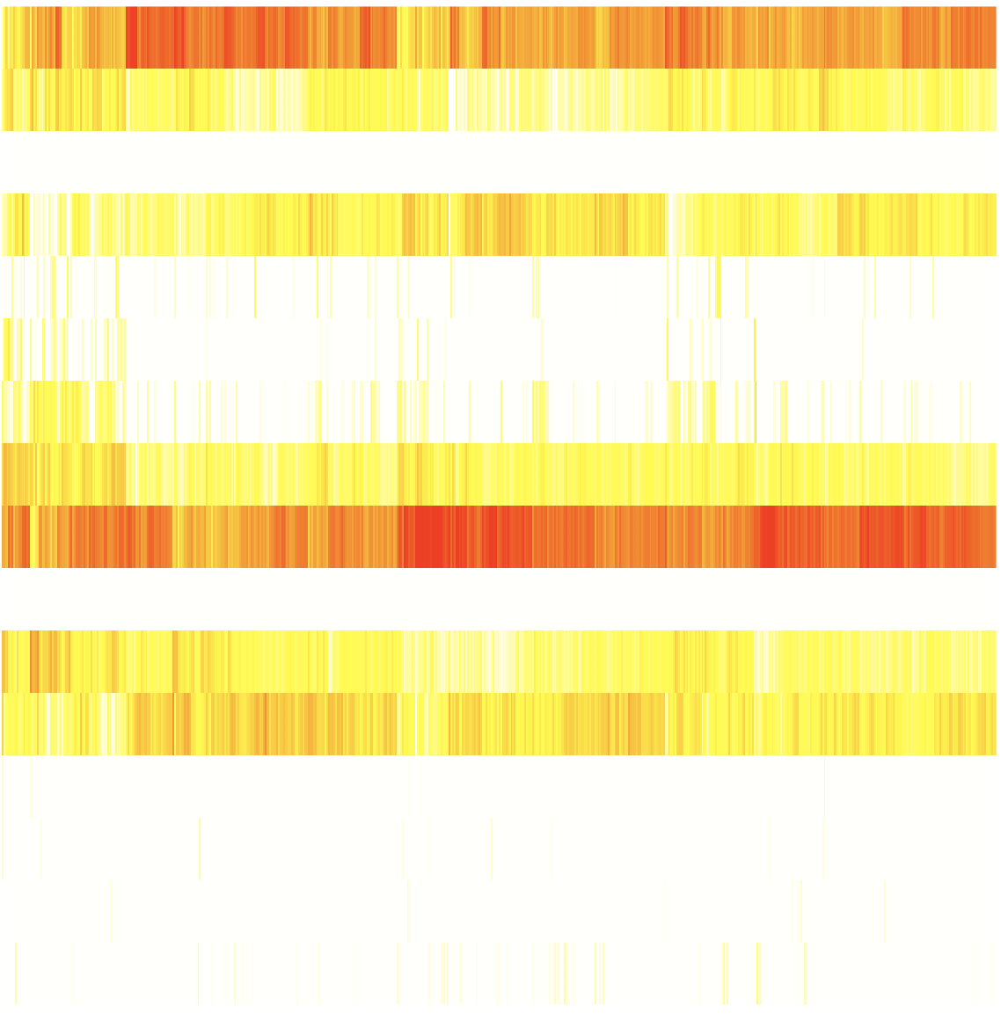
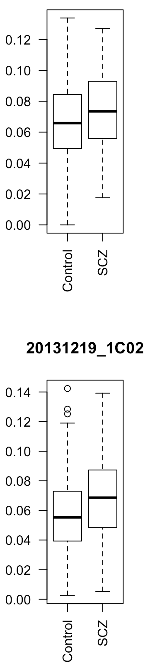
CMC
X
= W *
Y
16 neuronal cell types
Inhibitory (In) and Excitatory (Ex) neuronal single cell types,
Lake et. al, Science. ’16
Samples
182 biomarker genes
182 biomarker genes
X – gene expression matrix of 182 neuronal cell type biomarker genes across brain cortex tissue; Y – avg. gene expression matrix of 182 biomarker genes across 16 neuronal cell types; W – neuronal cell type contribution coefficient matrix by deconvolution using non-negative least square
GVEX
Excitatory (Ex) neuronal type 2
Single cell contribution coeffs for SCZ, BP, CTL brain cortex tissues
p<6e-3
p<2e-8

Slide 13
Capstone #4 – talk outline
Resource
  Brain enhancers, eQTLs, expression modules, networks &c
Transcriptome analysis
  Spectral analysis of gene expression, unique brain expression patterns
  Non-coding transcription & retro-element activity, not atypical
Integrative network models
  Relating perturbations in gene expression to variants

Slide 14
Transcriptome diversity, whole genome
90k
Transcribed regions
60k
30k
Notes:
FN – to discuss slide 14- is this genes + noncoding… what’s 9K?

Slide 15
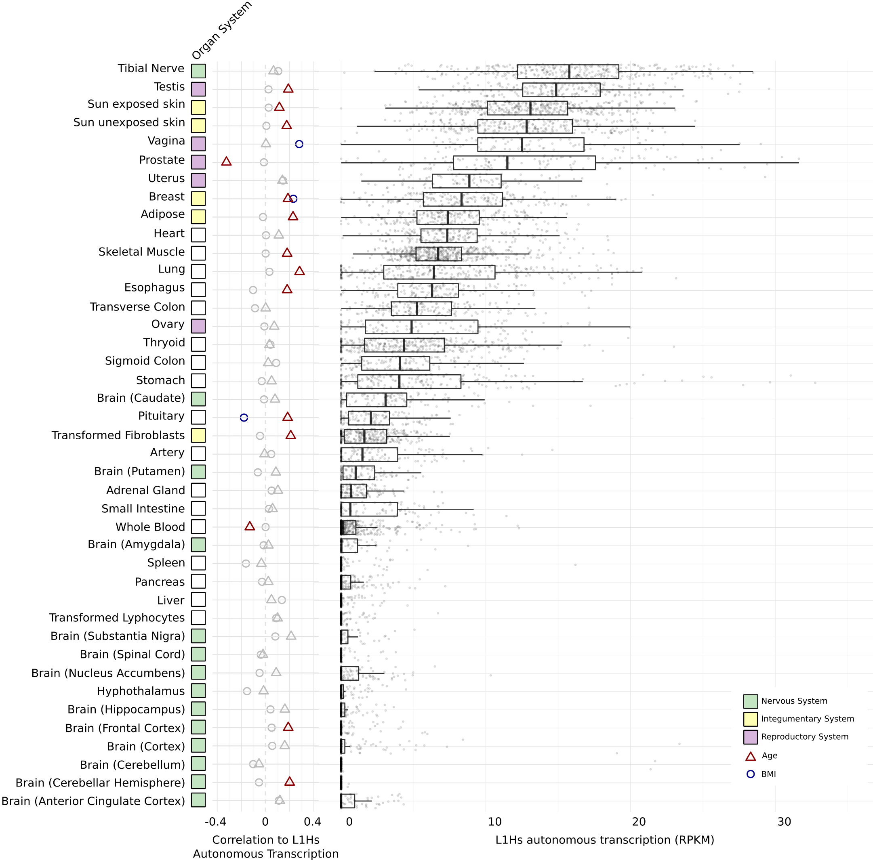
LINE-1 activity in the human brain
LINE-1 has been shown to be active in the human brain
  Creating somatic mosaicism across neurons (Muotri et. al.)
  Suggesting that LINE-1 might contribute to neuronal plasticity
We used RNA-seq data to uncover the activity of LINE-1 elements in brain regions
However, ~30% of the human genome is derived from LINE-1 elements.
  We developed Methods to decouple pervasive transcription from autonomous LINE-1 transcription.
Brain

Slide 16
Capstone #4 – talk outline
Resource
  Brain enhancers, eQTLs, expression modules, networks &c
Transcriptome analysis
  1) Spectral analysis of gene expression, unique brain expression patterns
  2) Non-coding transcription & retro-element activity, not atypical
Integrative network models
  Relating perturbations in gene expression to variants

Slide 17
Enhancer 1
Enhancer 2
Enhancer 3
eQTLs for brain gene (E_{l,i} is l^{th} eQTL’s genotype at i^{th} sample)
TF 1
TF 2
Enhancers linking to brain gene
TF 3
Brain gene promoter
Transcription Factors (TFs) with TFBSs (T_{k,i} is k^{th} TF expression at i^{th} sample)
G_{i} is the brain gene expression at i^{th} sample
TF 4
Promoter
Brain gene
TFBS affected by eQTLs
Integrative modeling
Regulatory network
TF 1
…
TF 4
Network structure analysis
Brain gene
Regulatory logic
Regulatory circuit
Contributions of TFs, eQTLs, interactions
of TFs and eQTLs
Input type | TF1 | 0 | 0 | 1 | 1
 | TF4 | 0 | 1 | 0 | 1
Output | Brain gene | 0 | 1 | 1 | 1
activation
repression

Slide 18
Example: enhancer regulatory network for CDNF (Cerebral Dopamine Neurotrophic Factor)
TFs having binding sites on CDNF enhancers
SPIB
BRCA1
SOX5
NFE2L1
MAFG
SPIB ⍺₁=0.18
BRCA1 ⍺₂= 0.053
SOX5 ⍺₃= -0.072
NFE2L1 ⍺₄= 0.051
MAFG ⍺₅= -0.389
rs72782895 β₁= 0.066
rs67337311 β₂= -0.025
rs35342583 β₃= -0.032
using CMC SCZ & CTRL gene expression and genotype data
G=CDNF
rs35342583
rs67337311
rs72782895
eQTLs breaking TFBSs

Slide 19
Capstone #4 – talk outline
Resource
  Brain enhancers, eQTLs, expression modules, networks &c
Transcriptome analysis
  Spectral analysis of gene expression, unique brain expression patterns
  Non-coding transcription & retro-element activity, not atypical
Integrative network models
  Relating perturbations in gene expression to variants

Slide 20
PsychENCODE Capstone #4
Developing a Brain Genomics Resource via Integrating CommonMind, ENCODE, GTEx, and Roadmap
Shuang Liu
Daifeng Wang
Fabio Navarro
Declan Clarke
Jonathan Warrell
Prashant Emani
Mengting Gu
Aparna Nathan
Mark Gerstein
James Knowles
Pamela Sklar
Hoffman, Gabriel
Andrew Jaffe
Suhn Kyong Rhie
Peggy Farnham

