Slide 1
Capstone 4 eQTL calculation
Shuang Liu

Slide 2
Capstone 4 - Datasets
Genotype data
Study name | # samples | Brain region | Disease status | Data type
UIC, Uchicago-BrainGVEX | 428 | DFC | SCZ, BD, ASD, control | Affymetrix SNP array PsychArray
UCLA-ASD | 73 | DFC, CBC | ASD, control | Affymetrix SNP array
CommonMind v1.2 | 603 | DFC | SCZ, BD, control | Illumina Infinium Human Omni Express Exome 8 v 1.1b chip
GTEx V6p (BA9) | 92 | DFC | control | Illumina OMNI 5M or 2.5M SNP array
Total | 1196 for DFC data
Notes:
1323 total rnaseq data

Slide 3
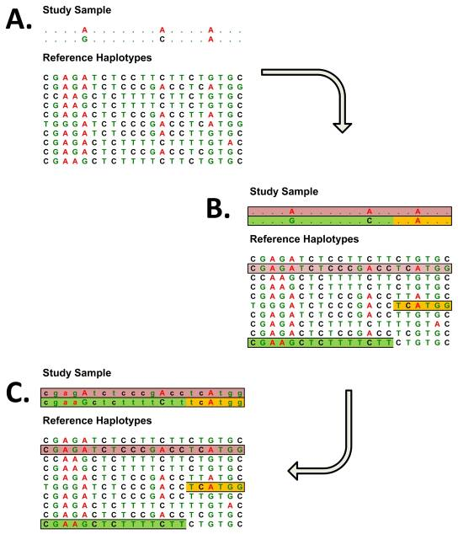
Genotype imputation
Evaluate the evidence for association at genetic markers that are not directly genotyped
Useful for combining data from studies that rely on different genotyping platforms
*Genotype imputation.
Li Y, et al, Annu Rev Genomics Hum Genet. 2009

Slide 4
Genotype imputation pipeline
Sample level quality control
  examining call rate
  Heterozygosity
  relatedness between genotyped individuals
  correspondence between sex chromosome genotypes and reported gender
Marker level quality control
  examining call rates
  excluding low frequency SNPs
Raw Genotype Calls
SNP QC using PLINK
Split data by chromosomes
Reference Panel
Pre-Phasing
using SHAPEIT2
haplotypes are estimated for all available samples
SNP imputation using IMPUTE2
Genotype filtering
Convert to SNP dosage
Genotype for eQTL

Slide 5
Compare imputation reference panel
1000 Genomes Phase 1 panel (1KGP,1,092 samples genotyped at 28,975,367 sites spanning the autosomes)
The Human Reference Consortium panel (HRC,32,470 samples genotyped at 39,635,008 sites spanning the autosomes and the X chromosome).
McCarthy S, et al. (2016) A reference panel of 64,976 haplotypes for genotype imputation. Nature Genetics, 48, 1279-83.

Slide 6
Genotype Imputation
Imputation and filtering for genotype data
Reference panel
McCarthy S, et al. (2016) A reference panel of 64,976 haplotypes for genotype imputation. Nature Genetics, 48, 1279-83.

Slide 7
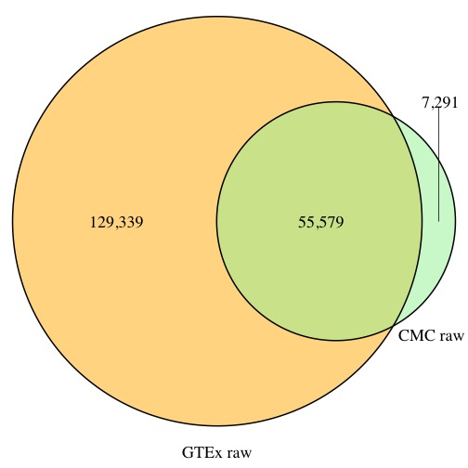
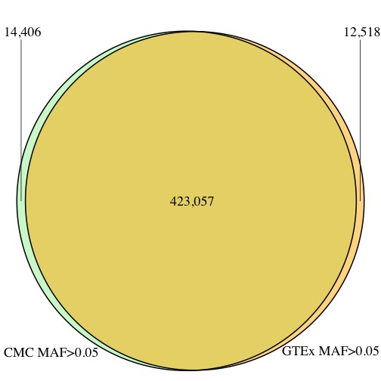
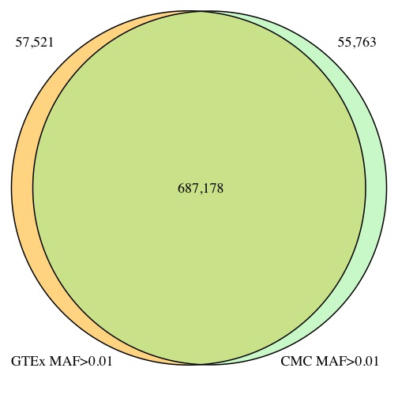
Genotype overlap
Before imputation
After imputation
MAF>0.01
MAF>0.05

Slide 8
eQTL analysis
Expression
Genes were selected based on expression thresholds of >0.1 RPKM in at least 10 individuals and ≥6 reads in at least 10 individuals.
Quantile normalized and inverse quantile normalized
Genotypes
Variants were imputed using HRC panel.
genotype filters applied:
  Call Rate Threshold 95%
  Imputation accuracy score INFO> 0.8
  MAF>= 1%
  Hardy-Weinberg Equilibrium p<1x10⁻⁶
Covariates
Top 3 genotyping principal components
Probabilistic Estimation of Expression Residuals (PEER) factors
Genotyping array platform
Gender
Disease status
eQTL Analysis using FastQTL
Mapping window --1 megabase from TSS
Genotype data
RNA-seq data
Genotype imputation pipeline
RNA-seq pipeline
Covariates
calculation
Imputed Genotype
Expression
Covariates
FastQTL
cis-eQTLs
trans-eQTLs
Notes:
age, gender, RIN value,
and PMI) and additionally the first six principal components
resulting from principal component analysis
(PCA) performed on the expression data with the four
known covariates regressed out (see Additional file 2:
Figure S4).
artifacts on expression
Nominal p-values were generated for each variant-gene pair by testing the alternative hypothesis that the slope of a linear regression model between genotype and expression deviates from 0.
Expression
Genes were selected based on expression thresholds of >0.1 RPKM in at least 10 individuals and ≥6 reads in at least 10 individuals.
quantile normalized to the average empirical distribution observed across samples.
For each gene, expression values were inverse quantile normalized to a standard normal distribution across samples.
A standard quality threshold for excluding samples with a low call rate is 95%.

Slide 9
FastQTL for eQTL calculation
eQTL
  P: a single molecular phenotype (expression)
  G: the set of genotype dosages
  L: variant sites located within a cis-window of +/- W Mb of the genomic location of P
  To discover the best candidate QTL for P, FastQTL measures Pearson product-moment correlation coefficients between P and all L variants in G, stores the most strongly correlated variant q
Corrections:
  Permutation-multiple genetic variants are tested per phenotype
  FDR estimation-multiple phenotypes are tested genome-wide
Notes:
G :the set of genotype dosages
L: variant sites located within a cis-window of +/- W Mb of the genomic location of P.
a single molecular phenotype P
To discover the best candidate QTL for P, FastQTL measures Pearson product-moment correlation coefficients between P and all L variants in G, stores the most strongly correlated variant q [ G as candidate QTL, and assesses its significance by calculating a nominal P-value pn with standard significance
tests for Pearson correlation.
strict brain specific gene
enhancer

Slide 10
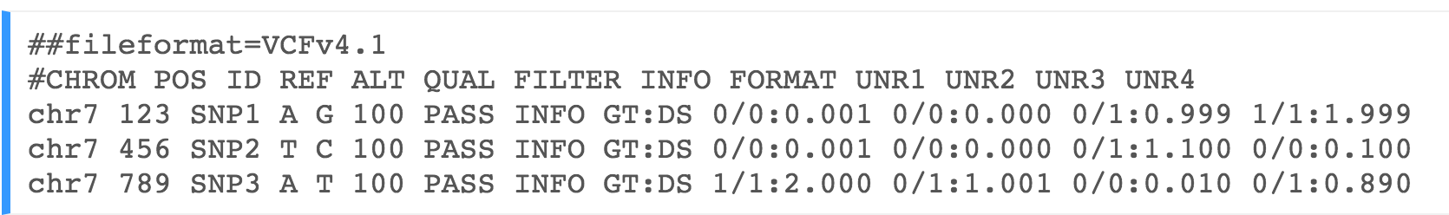
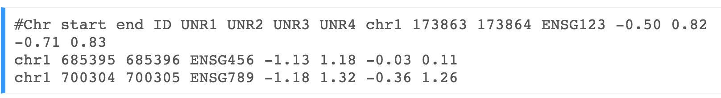
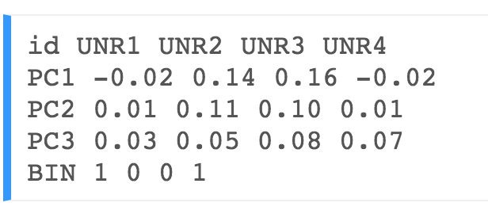
FastQTL inputs
Genotypes
Phenotypes
Covariates
Notes:
Reading phenotype data in [expression_RO.bed.gz]
* region = chr1:0-248956422
* 92 samples included
* 2405 phenotypes included

Slide 11
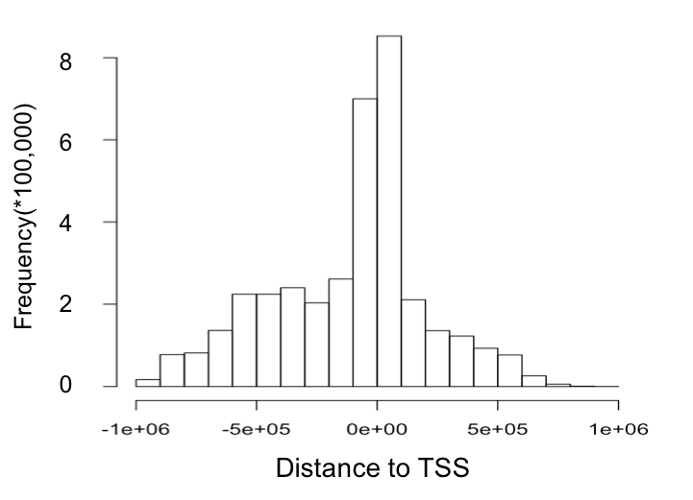
Brain eQTLS
1e+07
5e+06
2e+06
1e+06
5e+05
2e+05
Number of eQTLs
?
500 1000 1500 2000
(base pairs)
Number of samples
Notes:
SL (slide 6) – can you make type bigger on LHS & middle … need to discuss

Slide 12
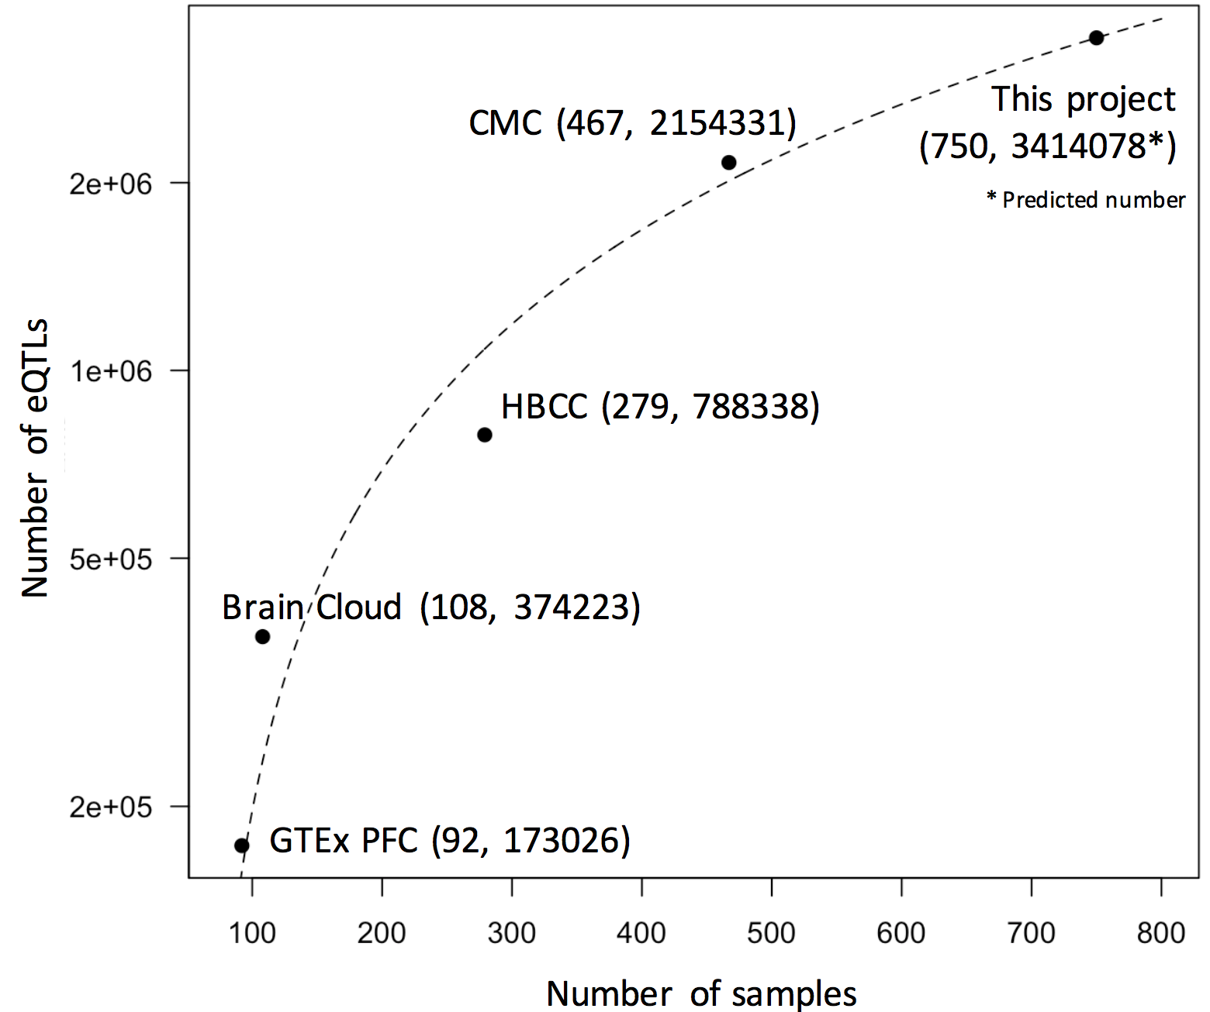
eQTL results
pid | sid | dist | npval
ENSG00000137960.5 | 1:78991197 | 479611 | 0.00716333
ENSG00000122420.5 | 1:79379411 | 609843 | 0.00154632
ENSG00000137959.11 | 1:78845586 | -240021 | 0.0013094
ENSG00000137965.6 | 1:78830851 | -284630 | 0.00495443
ENSG00000162618.8 | 1:80128274 | 655871 | 0.00106882
8
6
4
2
0
Frequency(*100,000)
Distance to TSS
Notes:
Next brain specific genes

