Slide 1
PsychENCODE Capstone 4
Integrative analysis with CommonMind, ENCODE, GTEx, and Roadmap
Capstone 4 group
06/23/2017

Slide 2
Acknowledgement
Mark Gerstein
Shuang Liu
Daifeng Wang
Fabio Navarro
Declan Clarke
Jonathan Warrell
Prashant Emani
Mengting Gu
Aparna Nathan
James Knowles
Pamela Sklar
Hoffman, Gabriel
Andrew Jaffe
Suhn Kyong Rhie
Peggy Farnham
All PsychENCODE Consortium members
http://psychencode.org/
http://commonmind.org/
http://www.roadmapepigenomics.org/
http://brainspan.org/
https://www.encodeproject.org/

Slide 3
Integrative modeling and analysis reveal brain gene regulatory networks for psychiatry
Genotypes
eQTLs, cQTLs, …
SNPS, CNVs, Indels
Regulatory elements
enhancers
promoters
Gene regulatory network
Integrative modeling
Regulatory logics
Regulatory circuits
Comparative analysis
Brain regions
Psychiatric disorders
Sex, Age, ...
History, Smoking,…
Brain gene expression
Tissue biomarkers
Disease biomarkers
Brain phenotype
Single cell contributions to tissues

Slide 4
Background to creation of a Brain Specific Resource
* Development of Generic Resources to annotate the Whole Human Genome
- ENCODE, Roadmap, GTEx, 1000 Genomes
- Not focused on the brain
* Desire to provide a specific resource for the brain and diseases that afflict it
- Brain enhancers, specific splice forms, regulatory networks, and eQTLs

Slide 5
Question posed by this resource
On a large-scale, are gene regulation, transcription and other aspects of the functioning of the genome similar in the brain to other tissues (ie the liver)? Or are they different?

Slide 6
Outline for Talk
Building the Resource
- Brain eQTLs
- Enhancers & brain regulatory networks
Analysis of how the brain compares to other organs
& how the resource is more powerful for just the brain
Quantitative models relating regulatory variation to gene output in brain important genes

Slide 7
Datasets
Datasets | Disease status | # samples | Brain region | Data Type
ENCODE/Roadmap | CTL |  | Multiple regions | ChIP-seq, RNA-seq
BrainSpan | CTL | 606 | 16 regions | ChIP-seq, RNA-seq, genotype
CommonMind | SCZ, BD, CTL | 613 | DFC | RNA-seq, genotype
GTEx | CTL | 92 | DFC | RNA-seq, genotype
BrainGVEX | SCZ, BD,C TL | 429 | DFC | RNA-seq, genotype
UCLA-ASD | ASD, CTL | 253 | DFC, CBC | ChIP-seq, RNA-seq, genotype
Yale-ASD | ASD, CTL | 45 | DFC, TC, V1, CBL | ChIP-seq, RNA-seq, genotype
CNON | SCZ, CTL | 63 | Olfactory Neuroepithelium | ChIP-seq
EpiGABA | CTL | 4 | OFC (BA11) | RNA-seq, genotype, ERRBS, Methylation
iPSC | CTL | 51 | iPSC | ChIP-seq, RNA-seq, WGS
TOTAL |  | ~2156
PsychENCODE

Slide 8
Characteristic Statistics for the Brain
What is final column
Why no enhancers?
Active other?
 | Total
Enhancers^{[1]} | 2.3M
Genes^{[2]} | 23K
lncRNAs and pseudogenes^{[2]} | 33.2K
cis-eQTLs^{[2]} | 26.4M
Gene expression modules^{[2]} | 117
Differentially included exons^{[3]} | 2.5K
Active in Brain regions | Brain Specific
332.5K (14.5%) | 130.2K (5.7%)
17.6K (76.4%) | 386 (1.6%)
14K (42.2%) | 814 (2.4%)
3.25M (12.3%) | 1.02M (3.9%)
59 (50.4%) | 6 (5.1%)
- | 420 (16.4%)
Other tissue specific (mean)
25.9 (0.1%)
136.7 (0.4%)
599K (2.3%)
142 (5.5%)
[1] Roadmap Epigenomics Consortium. Integrative analysis of 111 reference human epigenomes. Nature, 2015.
[2] The GTEx Consortium. The Genotype-Tissue Expression (GTEx) pilot analysis: Multitissue gene regulation in humans. Science, 2015.
[3] Melé et.al. The human transcriptome across tissues and individuals. Science, 2015.
Notes:
1323 total rnaseq data

Slide 9
Resource for brain enhancers
A. Brain enhancers
250000
200000
150000
Number of Enhancers
100000
50000
0
Tissues
8
Notes:
We have a good number (above average?) of enhancers for analysis?

Slide 10
Resource for regulatory network analysis
What’s the point
What’s schematic
A. Co-expression modules/sub-modules across GTEx tissues
B. Submodule relationships
Module 1:
Metabolic genes
Module 37:
Testis enriched
Module 29:
Cross brain enriched
Brain
regions
Module 4:
Synaptic functions
Cross brain enriched
Module 40:
Cerebellum enriched
Module 38:
Cerebellum + other tissues
Module 26:
Basal ganglia enriched

Slide 11
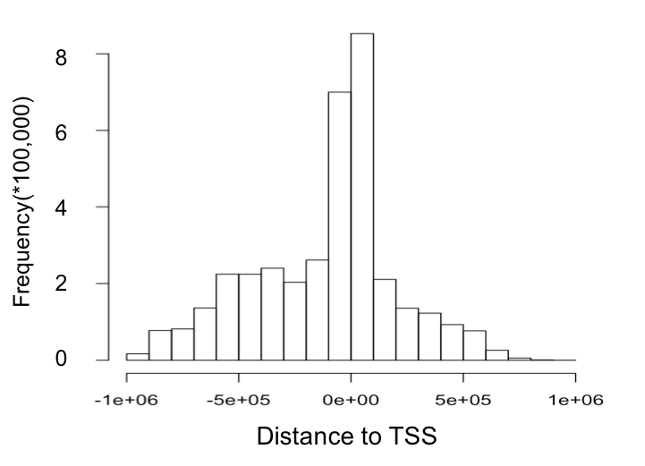
Resource for brain eQTLS
?
(base pairs)

Slide 12
Outline for Talk
Building the Resource
- Brain eQTLs
- Enhancers & brain regulatory networks
Analysis of how the brain compares to other organs
& how the resource is more powerful for just the brain
Quantitative models relating regulatory variation to gene output in brain important genes

Slide 13
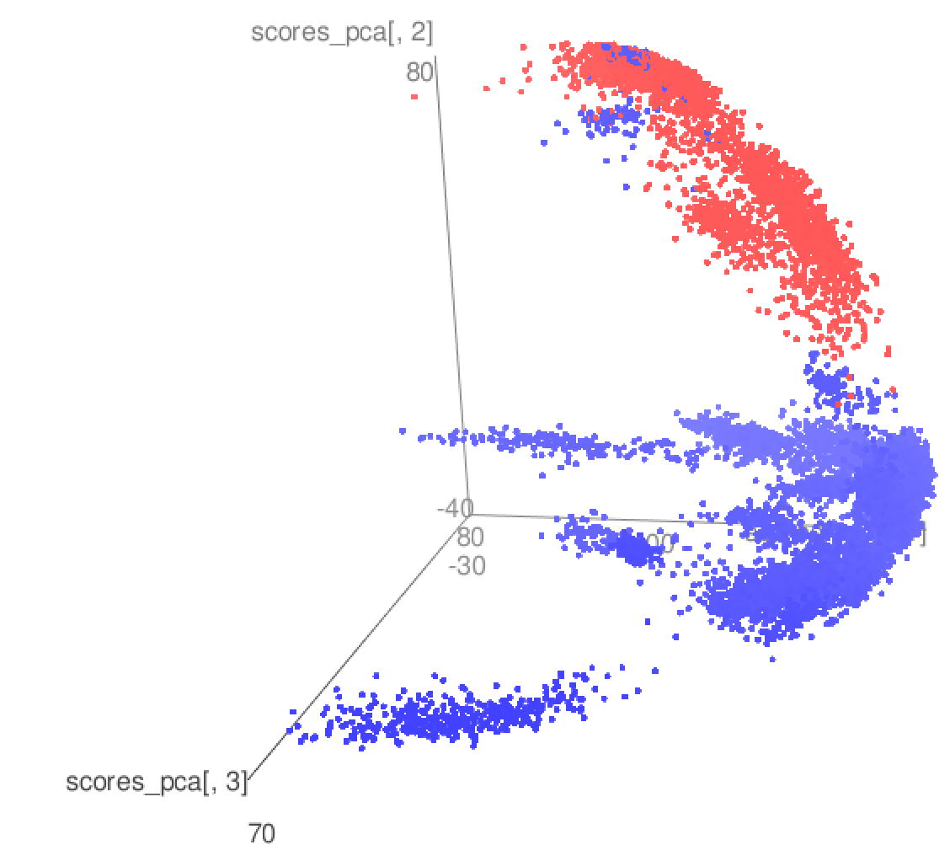
PCA of GTEX, GVEX, Brainspan, CMC, ASD
Brain samples
Other tissue samples in GTEx

Slide 14
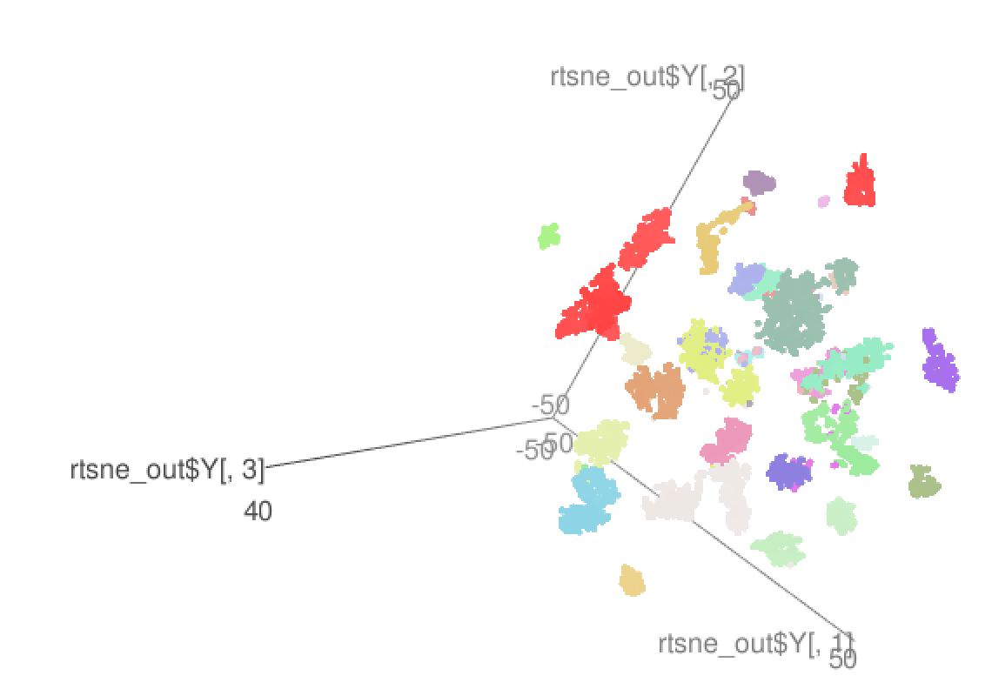
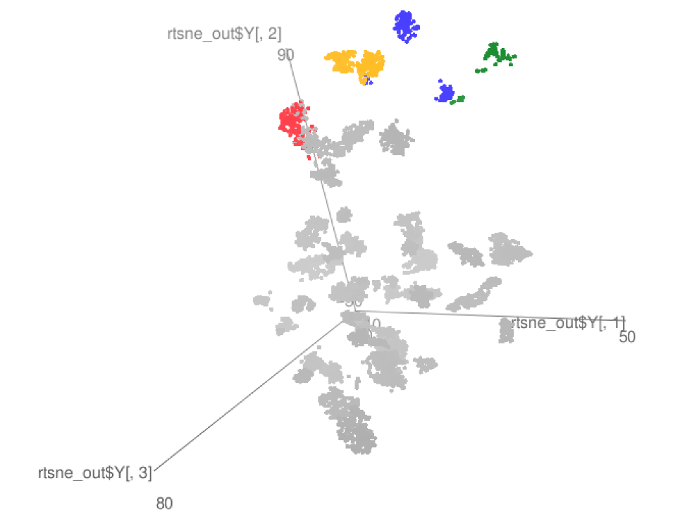
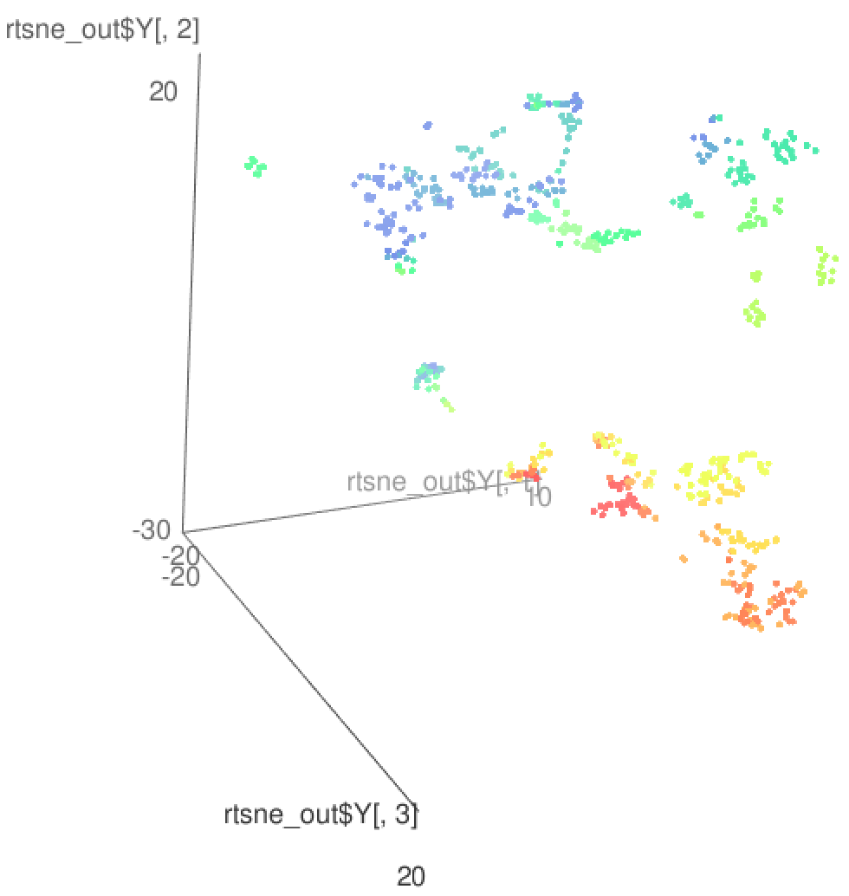
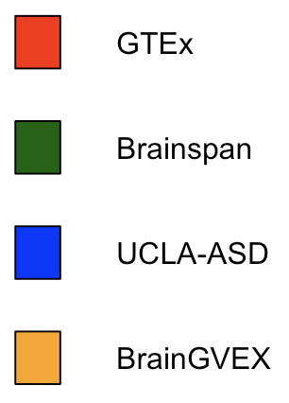
Brain sample clusters by tSNE, potentially driven by brain specific gene expression
Birth->
GTEx
GTEx+some PEC
Brainspan

Slide 15
Enhancer 1
Enhancer 2
Enhancer 3
eQTLs for brain gene (E_{l,i} is l^{th} eQTL’s genotype at i^{th} sample)
TF 1
TF 2
Enhancers linking to brain gene
TF 3
Brain gene promoter
Transcription Factors (TFs) with TFBSs (T_{k,i} is k^{th} TF expression at i^{th} sample)
G_{i} is the brain gene expression at i^{th} sample
TF 4
Promoter
Brain gene
TFBS affected by eQTLs
Integrative modeling
Regulatory network
TF 1
…
TF 4
Network structure analysis
Brain gene
Regulatory logic
Regulatory circuit
Contributions of TFs, eQTLs, interactions
of TFs and eQTLs
Input type | TF1 | 0 | 0 | 1 | 1
 | TF4 | 0 | 1 | 0 | 1
Output | Brain gene | 0 | 1 | 1 | 1
activation
repression

Slide 16
Example: enhancer regulatory network for CDNF (Cerebral Dopamine Neurotrophic Factor)
TFs having binding sites on CDNF enhancers
SPIB
BRCA1
SOX5
NFE2L1
MAFG
SPIB ⍺₁=0.18
BRCA1 ⍺₂= 0.053
SOX5 ⍺₃= -0.072
NFE2L1 ⍺₄= 0.051
MAFG ⍺₅= -0.389
rs72782895 β₁= 0.066
rs67337311 β₂= -0.025
rs35342583 β₃= -0.032
using CMC SCZ & CTRL gene expression and genotype data
G=CDNF
rs35342583
rs67337311
rs72782895
eQTLs breaking TFBSs

Slide 17
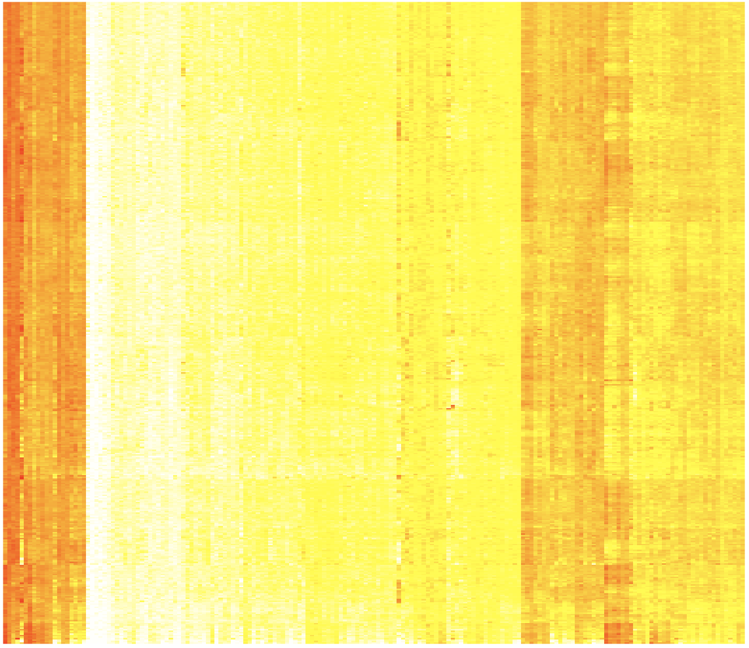
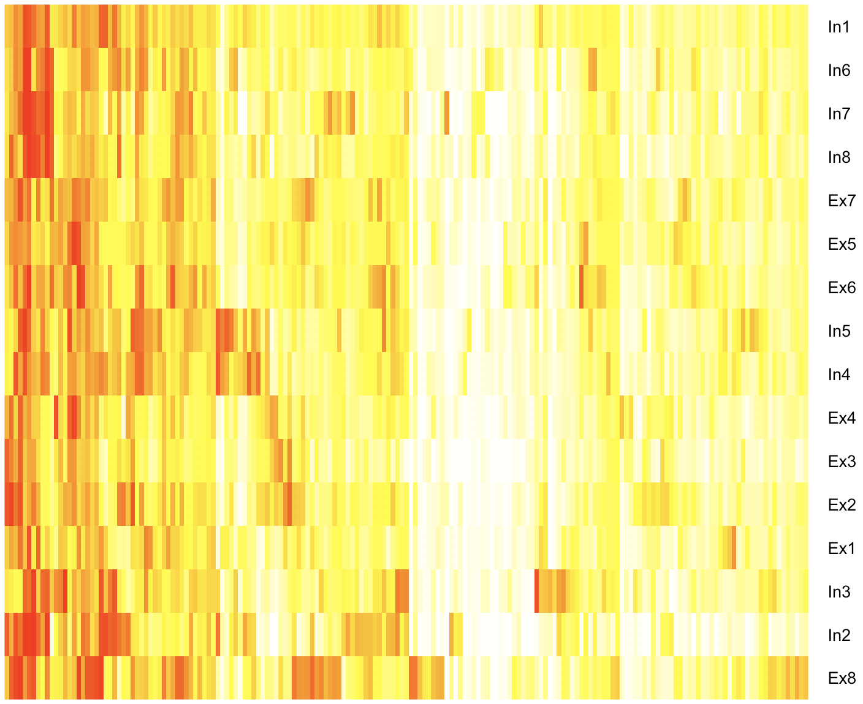
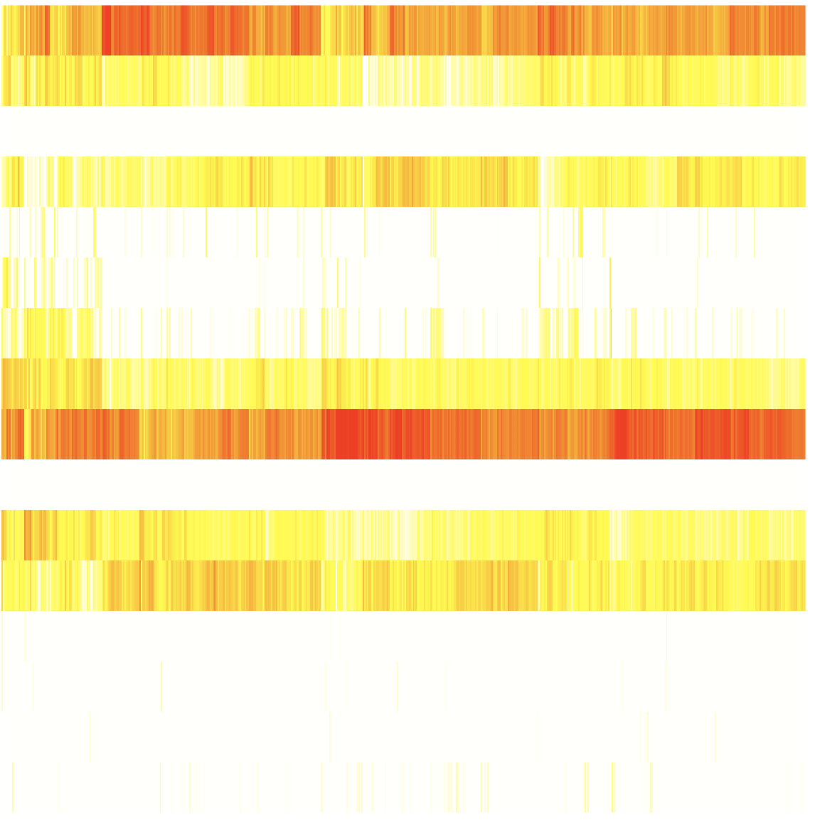
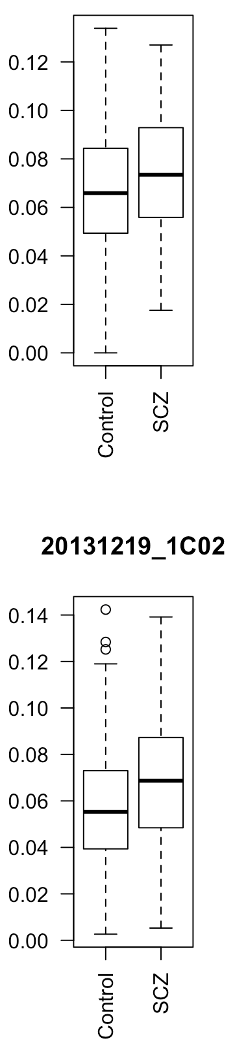
CMC
X
= W *
Y
16 neuronal cell types
Inhibitory (In) and Excitatory (Ex) neuronal single cell types, Lake et. al, Science. 2016
Samples
182 biomarker genes
182 biomarker genes
X – gene expression matrix of 182 neuronal cell type biomarker genes across brain cortex tissue; Y – avg. gene expression matrix of 182 biomarker genes across 16 neuronal cell types; W – neuronal cell type contribution coefficient matrix by deconvolution using non-negative least square
GVEX
Excitatory (Ex) neuronal type 2
Single cell contribution coeffs for SCZ, BP, CTL brain cortex tissues
p<6e-3
p<2e-8

Slide 18
RCA (Reference Component Analysis)
We create a reference expression panel by:
  Selecting genes with tissue specific expression (1,400 genes)
  Calculating the median expression of all reference genes for all reference tissues
For each RNA-seq sample, we project the gene expression values to the reference panel
Finally we perform a PCA analysis using the projected values to cluster samples in a two dimensional space.

Slide 19
Brain samples
Cerebellum samples

Slide 20
Transcriptome diversity

Slide 21
Repetitive element activity in the human brain
LINE-1 has been shown to be active in the human brain
  Creating somatic mosaicism across neurons (Muotri et. al.)
  Suggesting that LINE-1 might contribute to neuronal plasticity
We used RNA-seq data to uncover the activity of LINE-1 elements in brain regions
However, approximately 30% of the human genome is derived from LINE-1 elements.
  We developed Methods to decouple pervasive transcription from autonomous LINE-1 transcription.

Slide 22
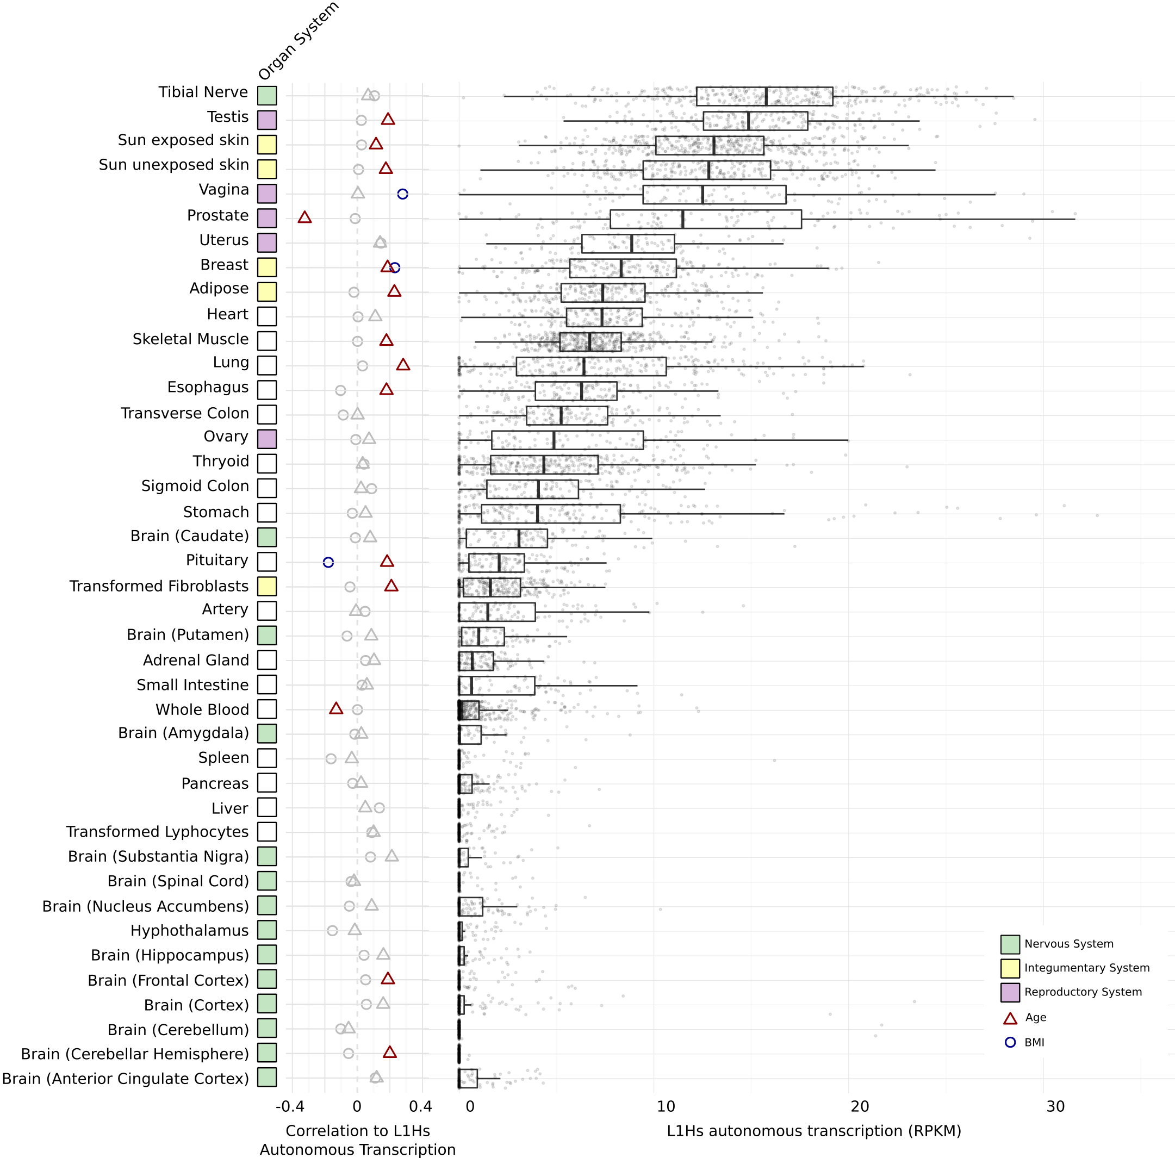
LINE-1 activity in the human brain
Brain

Slide 23
Outline for Talk
Building the Resource
- Brain eQTLs
- Enhancers & brain regulatory networks
Analysis of how the brain compares to other organs
& how the resource is more powerful for just the brain
Quantitative models relating regulatory variation to gene output in brain important genes

Slide 24
Outline
Question
Resource (SL,JW)
PCA,T-SNE and RCA genes exp (DW,FN)
2 slides unnanotated regions (FN)
2 slides building reg net (PE,MTG)
WGCNA(JW)
Single cell deconvolution (DW, TG)
2 slides model (DW)
FMRI (MTG)
Notes:
texp

Slide 25
RCA (Reference Component Analysis)
Cut?
Reference Panel
Projection Matrix
Reference Genes
Samples
Reference tissues
Reference tissues

Slide 26
Brain specific ncRNA
Enhanced Transcription
Cortex
Cerebellum
5
15
55
14
11
1
0
Other brain regions

