Slide 1
PsychENCODE Capstone 4
Integrative analysis with CommonMind, ENCODE, GTEx, and Roadmap
Capstone 4 group
06/23/2017

Slide 2
Background to creation of a Brain Specific Resource
* Development of Generic Resources to annotate the Whole Human Genome
- ENCODE, Roadmap, GTEx, 1000 Genomes
- Not focused on the brain
* Desire to provide a specific resource for the brain and diseases that afflict it
- Brain enhancers, specific splice forms, regulatory networks, and eQTLs

Slide 3
Question posed by this resource
On a large-scale, are gene regulation, transcription and other aspects of the functioning of the genome similar in the brain to other tissues (ie the liver)? Or are they different?

Slide 4
Outline for Talk
Building the Resource
- Brain eQTLs
- Enhancers & brain regulatory networks
Analysis of how the brain compares to other organs
& how the resource is more powerful for just the brain
Quantitative models relating regulatory variation to gene output in brain important genes

Slide 5
Capstone 4 - Datasets
Study name | Individuals | Brain region | Disease status | Data type
UIC, Uchicago-BrainGVEX | 428 | Frontal cortex | SCZ, BD, ASD, control | RNA-seq (waiting for genotype data of half samples)
UCLA-ASD | 73/96 | PreFrontal cortex, CBC | ASD, control | RNA-seq , ChIP-seq, genotype data
Yale-ASD | 68 | DLPFC | ASD, control | RNA-seq, ChIP-seq (waiting for genotype data)
CommonMind v1.2 | 603 | DLPFC | SCZ, BD, control | RNA-seq, genotype data (Illumina Infinium HumanOmniExpressExome 8 v 1.1b chip )
GTEx V6p (BA9) | 92 | DLPFC | control | RNA-seq, genotype data (Illumina OMNI 5M or 2.5M array)
Brainspan | 43 | 16 regions | control | RNA-seq, genotype data
ENCODE/Roadmap |  | Different regions | control | RNA-seq , ChIP-seq
Total | 1323(currently 754 with genotype) for DLPFC data
Notes:
1323 total rnaseq data

Slide 6
Characteristic Statistics for the Brain
 | Total
Enhancers^{[1]} | 2.3M
Genes^{[2]} | 23K
lncRNAs and pseudogenes^{[2]} | 33.2K
cis-eQTLs^{[2]} | 26.4M
Gene expression modules^{[2]} | 117
Differentially included exons^{[3]} | 2.5K
Active in Brain regions | Brain Specific
332.5K (14.5%) | 130.2K (5.7%)
17.6K (76.4%) | 386 (1.6%)
14K (42.2%) | 814 (2.4%)
3.25M (12.3%) | 1.02M (3.9%)
59 (50.4%) | 6 (5.1%)
- | 420 (16.4%)
Other tissue specific (mean)
25.9 (0.1%)
136.7 (0.4%)
599K (2.3%)
142 (5.5%)
[1] Roadmap Epigenomics Consortium. Integrative analysis of 111 reference human epigenomes. Nature, 2015.
[2] The GTEx Consortium. The Genotype-Tissue Expression (GTEx) pilot analysis: Multitissue gene regulation in humans. Science, 2015.
[3] Melé et.al. The human transcriptome across tissues and individuals. Science, 2015.
Notes:
1323 total rnaseq data

Slide 7
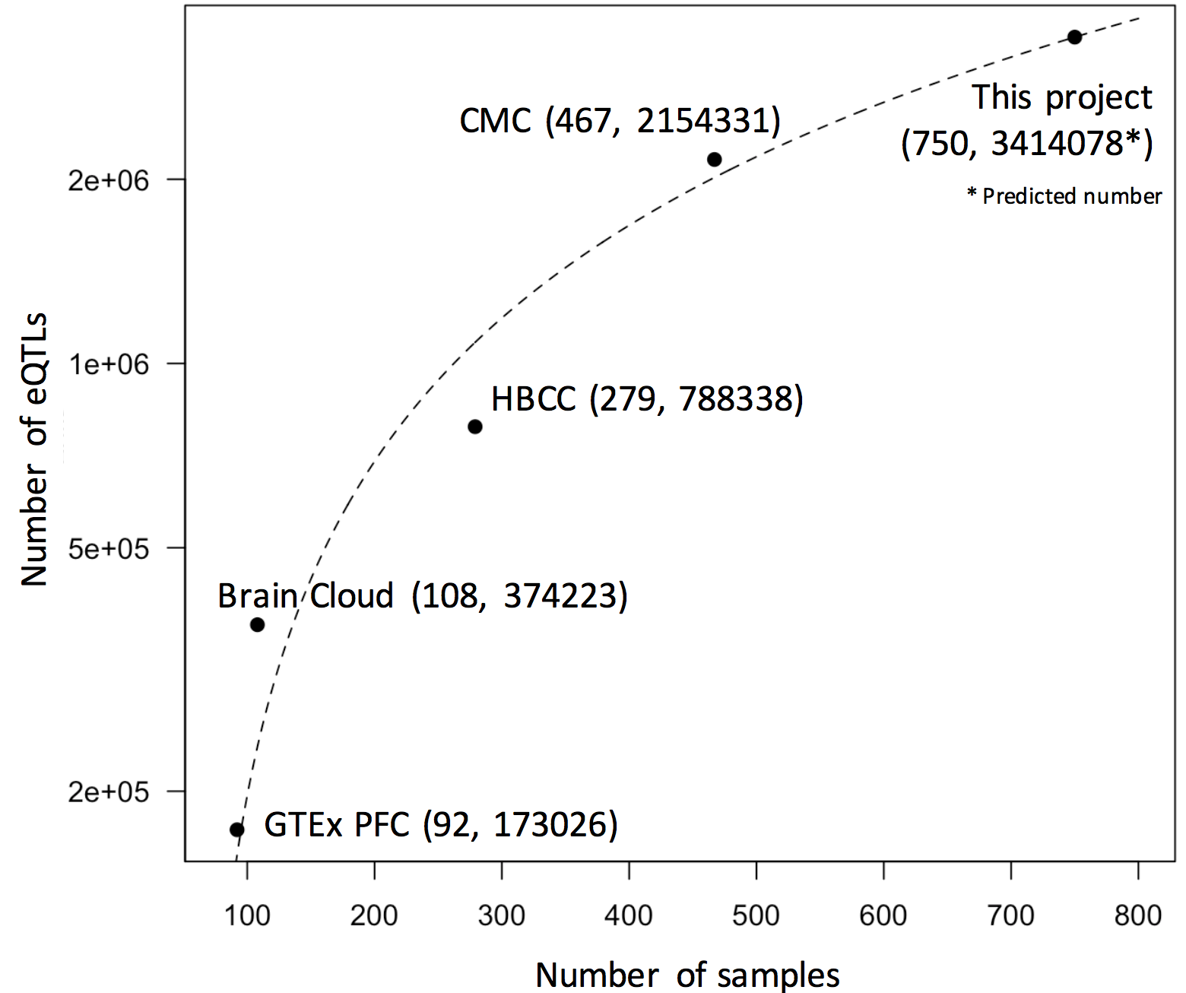
Resource for brain eQTLS
A. Brain eQTLs
B. Brain eQTL distribution
eQTL counts
Distance to TSS

Slide 8
Resource for brain enhancers
A. Brain enhancers

Slide 9
Resource for regulatory network analysis
A. Co-expression modules/sub-modules across GTEx tissues
B. Submodule relationships
Module 1:
Metabolic genes
Module 37:
Testis enriched
Module 29:
Cross brain enriched
Brain
regions
Module 4:
Synaptic functions
Cross brain enriched
Module 40:
Cerebellum enriched
Module 38:
Cerebellum + other tissues
Module 26:
Basal ganglia enriched

Slide 10
Outline for Talk
Building the Resource
- Brain eQTLs
- Enhancers & brain regulatory networks
Analysis of how the brain compares to other organs
& how the resource is more powerful for just the brain
Quantitative models relating regulatory variation to gene output in brain important genes

Slide 11
PCA for different tissues

Slide 12
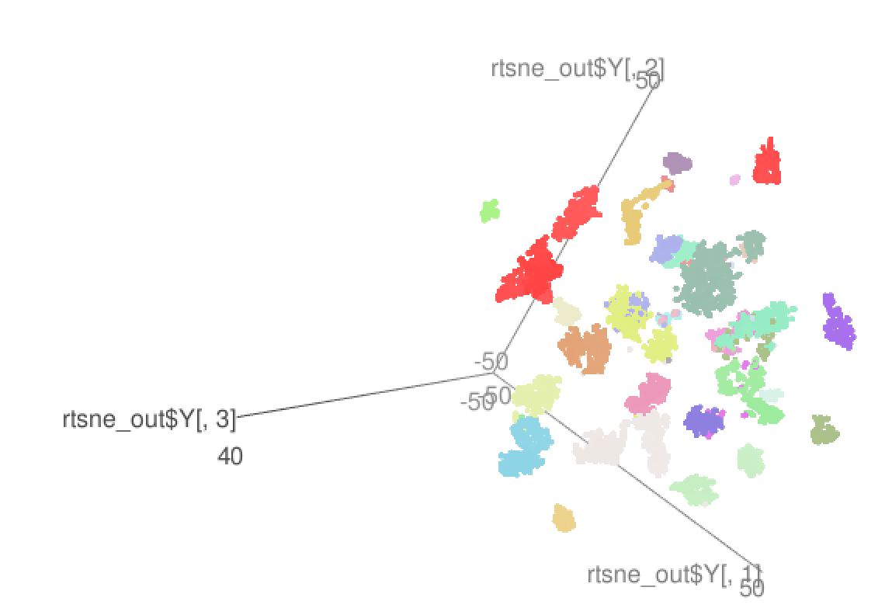
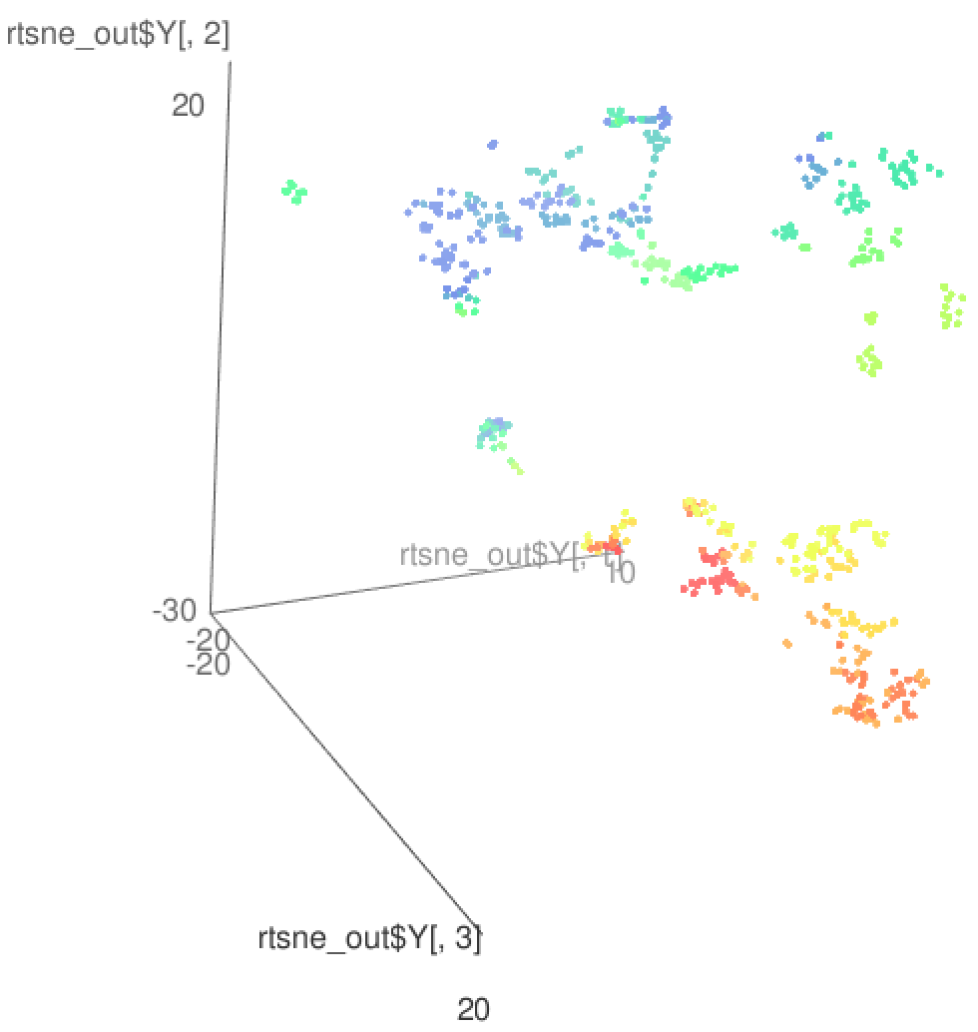
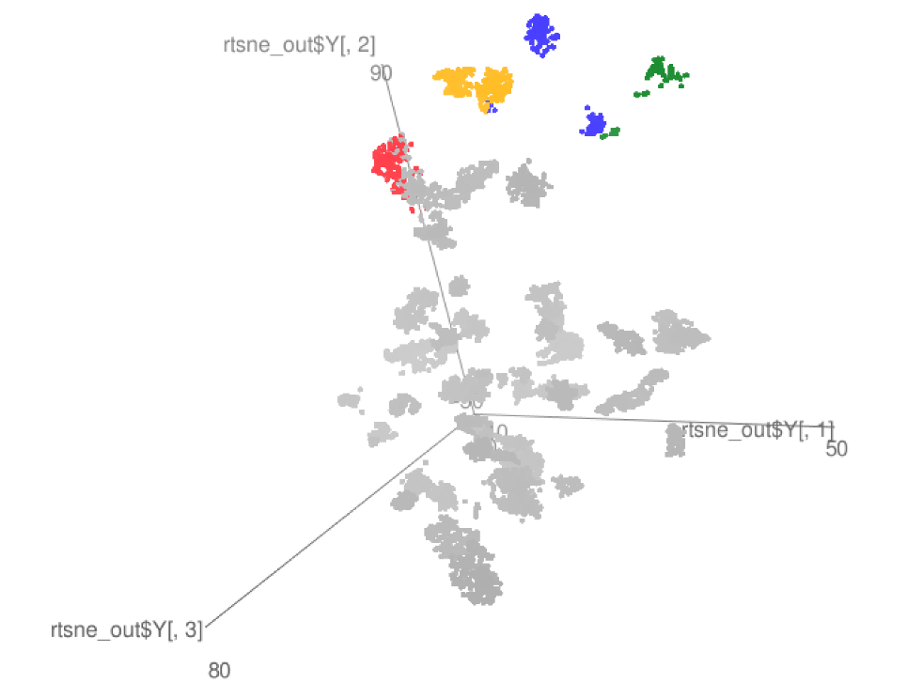
TSNE: Brain vs. other tissues
GTEx
Brainspan
GTEx+some PEC

Slide 13
RCA (Reference Component Analysis)
We create a reference expression panel by:
  Selecting genes with enrriched tissue expression (1,400 genes)
  Calculating the median expression of all reference genes for all reference tissues
For each RNA-seq sample, we project the gene expression values to the reference panel
Finally we perform a PCA analysis using the projected values to cluster samples in a two dimensional space.

Slide 14
RCA (Reference Component Analysis)
Reference Panel
Projection Matrix
Reference Genes
Samples
Reference tissues
Reference tissues

Slide 15
Brain samples
Cerebellum samples

Slide 16
Transcriptome diversity

Slide 17
Brain specific ncRNA
Enhanced Transcription
Cortex
Cerebellum
5
15
55
14
11
1
0
Other brain regions

Slide 18
Repetitive element activity in the human brain
LINE-1 has been shown to be active in the human brain
  Creating somatic mosaicism across neurons (Muotri et. al.)
  Suggesting that LINE-1 might contribute to neuronal plasticity
We used RNA-seq data to uncover the activity of LINE-1 elements in brain regions
However, approximately 30% of the human genome is derived from LINE-1 elements.
  We developed Methods to decouple pervasive transcription from autonomous LINE-1 transcription.

Slide 19
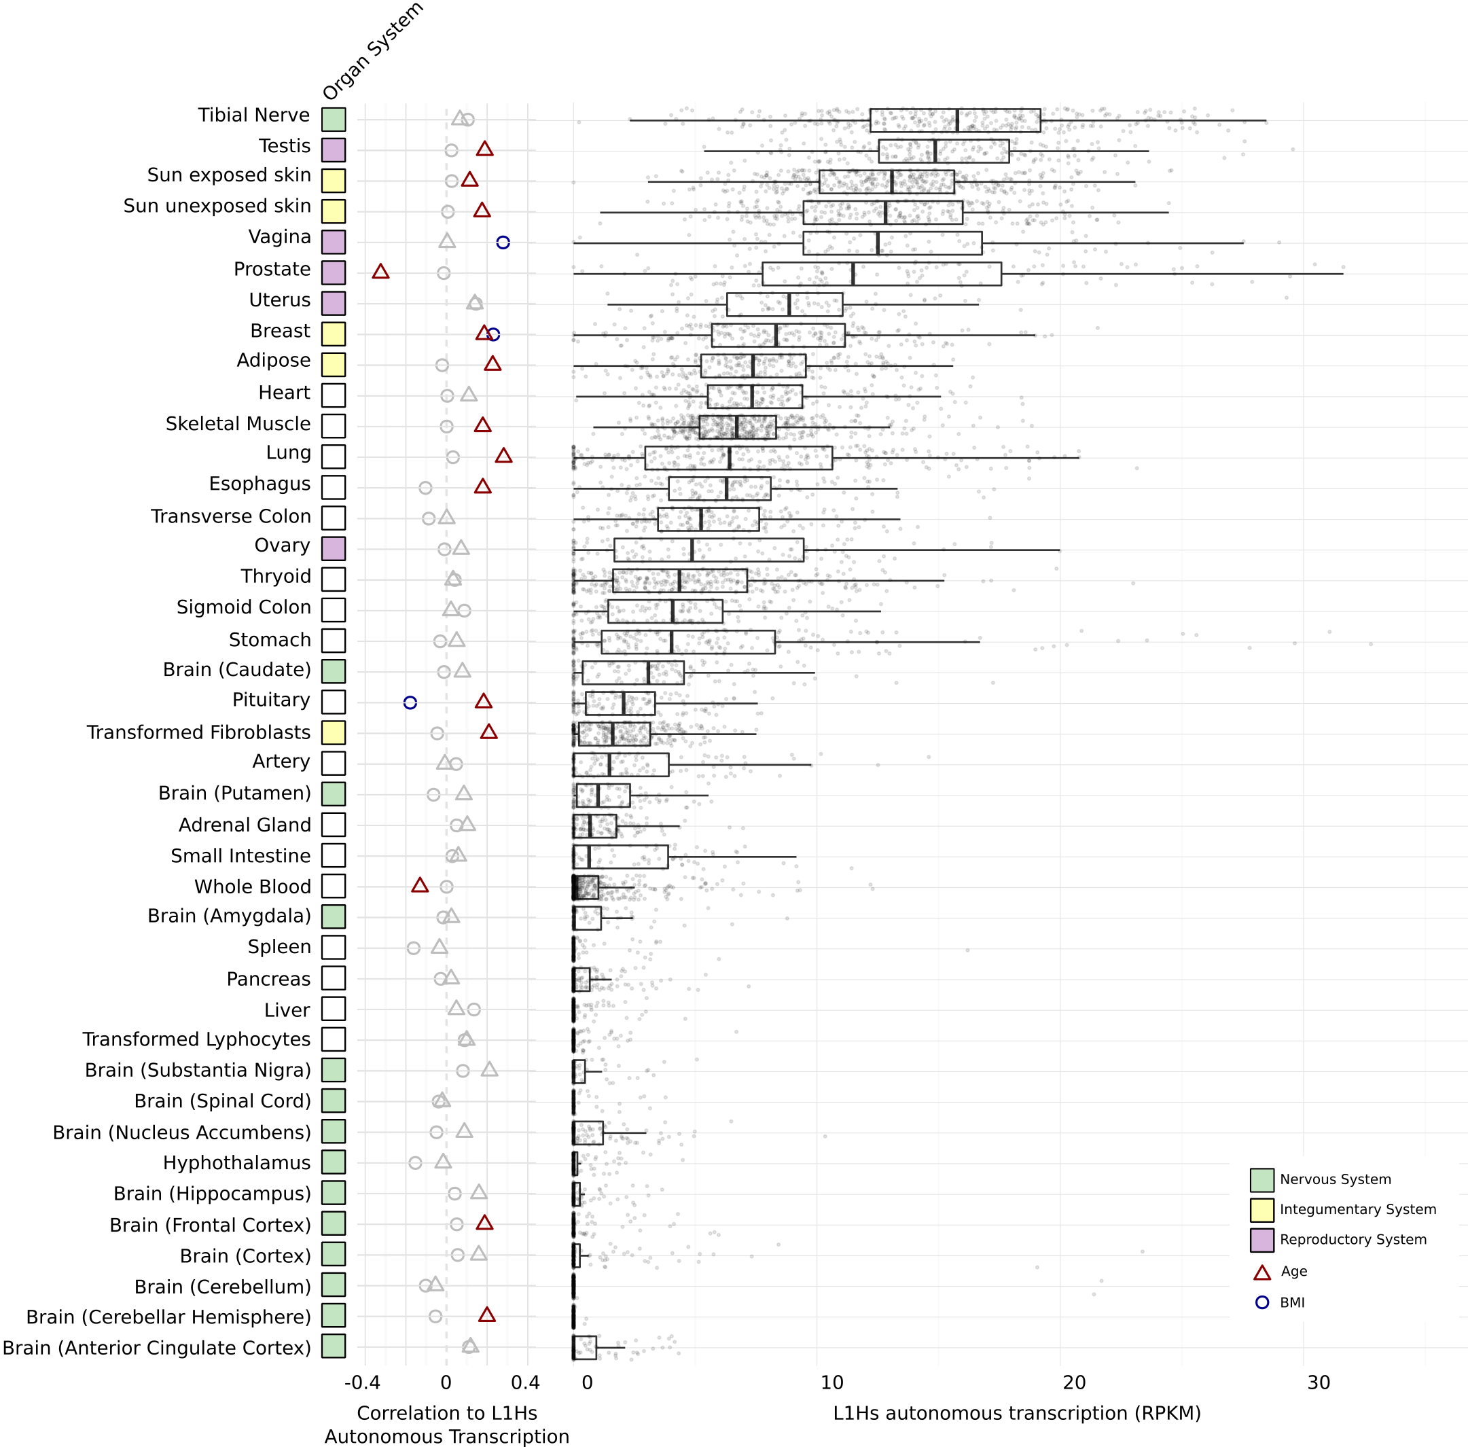
LINE-1 activity in the human brain
Brain

Slide 20
Outline for Talk
Building the Resource
- Brain eQTLs
- Enhancers & brain regulatory networks
Analysis of how the brain compares to other organs
& how the resource is more powerful for just the brain
Quantitative models relating regulatory variation to gene output in brain important genes

Slide 21
GVEX+CMC SCZ & CTRL gene expression
(Intercept) -0.59
SPIB 0.17
SOX5 -0.19
MAFG -0.33
BRCA1 0.14
NFE2L1 0.12
Cerebral Dopamine Neurotrophic Factor (CDNF)
brain gene
Promoters & Enhancers
Tissues-matched (Roadmap)
Hi-C matched (Bing Ren’s paper)
Fantom
Chr10:14555000:600
Roadmap: corr=0.897
HiC:corr=0.905
Gene regulatory network
  Predict target brain gene expression from TFs (and eQTL phenotypes); e.g, LASSO, Ridge, and Elastic Net
CMC SCZ & CTRL gene expression plus genotype
(Intercept) -0.56
SPIB 0.18
BRCA1 0.053
SOX5 -0.072
NFE2L1 0.051
MAFG -0.389
rs72782895 0.066
rs67337311 -0.025
rs35342583 -0.032
Broken TFBSs by eQTLs
rs72782895: chr10 14519724 C G MATCH=1;TF=NFE2L1_MafG;ScoreDiff=0
rs67337311: chr10 14541454 C T MATCH=1;TF=SPIB;ScoreDiff=0
rs35342583: chr10 14613012 C T MATCH=2;TF=BRCA1,Sox5;ScoreDiff=0,0
TFs

Slide 22


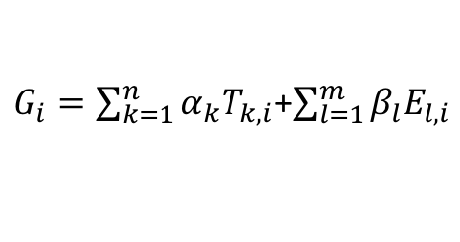
Enhancer 1
Enhancer 2
Enhancer 3
eQTLs for brain gene (E_{l,i} is l^{th} eQTL’s genotype at i^{th} sample)
TF 2
Enhancers linking to brain gene
TF 1
TF 3
Brain gene promoter
Transcription Factors (TFs) with TFBSs broken by eQTLs (T_{k,i} is k^{th} TF expression at i^{th} sample)
TF 4
G_{i} is the brain gene expression at i^{th} sample
Promoter
Brain gene
Brain gene regulatory networks
Brain gene regulatory logics
Brain gene regulatory circuits
TF1
TF 1
…
TF 4
TF 1
Brain gene
$$α_{1}$$
TF4
$$α_{4}$$
TF 4
Brain gene
Brain Gene
Input type | TF1 | 0 | 0 | 1 | 1
 | TF4 | 0 | 1 | 0 | 1
Output | Brain gene | 0 | 1 | 1 | 1
activation
$G_{i}=\sum_{k=1}^{n}{α_{k}T_{k,i}}$+$\sum_{l=1}^{m}{β_{l}E_{l,i}}$
repression

Slide 23
Building the regulatory network
A. Gene regulatory networks
Tissues-matched & Developmental-matched

Slide 24
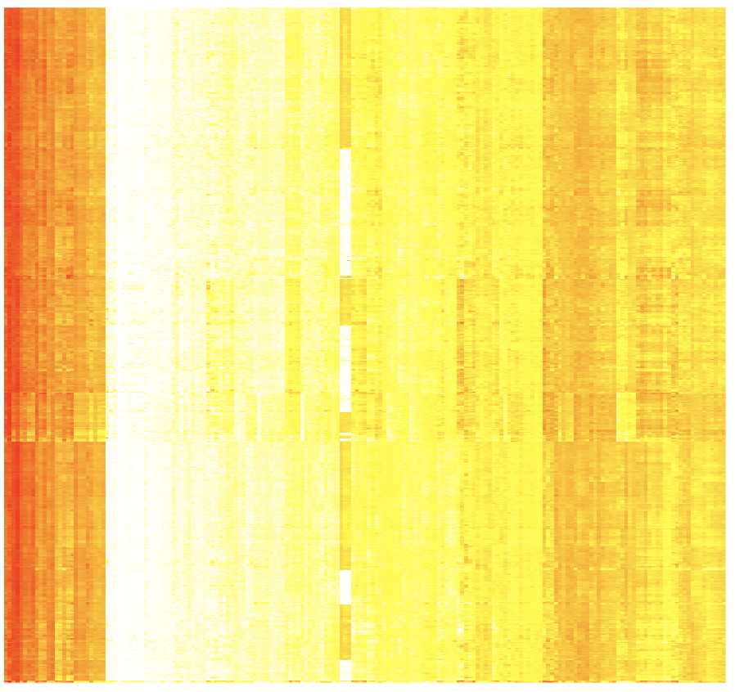
CMC
Incorporating single cell expression patterns
GVEX
Cell type contributions to brain cortex tissues by deconvolving tissue gene expression into six cell type signature expression
X=WY => W is coefficient matrix of using non-negative least square to predict X from Y
Neuron
Endothelial
Astrocytes
OPC
Microglia
Oligodendrocytes
X
= W *
Y
185 single cell biomarker genes
Samples
185 single cell biomarker genes
Notes:
neurons and inter-neurons

Slide 25
Outline
Question
Resource (SL,JW)
PCA,T-SNE and RCA genes exp (DW,FN)
2 slides unnanotated regions (FN)
2 slides building reg net (PE,MTG)
WGCNA(JW)
Single cell deconvolution (DW, TG)
2 slides model (DW)
FMRI (MTG)
Notes:
texp

