Slide 1
PsychENCODE Capstone 4
Integrative analysis with CommonMind, ENCODE, GTEx, and Roadmap
Capstone 4 group
06/23/2017

Slide 2
Background to creation of a Brain Specific Resource
* Development of Generic Resources to Annotate the Whole Human Genome
- ENCODE, Roadmap, GTEx, 1000 Genomes
- No focussed on the brain
* Desire to provide a specific resource for the brain and diseases that afflict it
- Brain enhancers, specific splice forms, regulatory networks, and eQTLs

Slide 3
Question posed by this resource
On a large-scale, are gene regulation, transcription and other aspects of the functioning of the genome similar in the brain to other tissues (ie the liver)? Or are they different?

Slide 4
Outline for Talk
Building the Resource
- enhancers & brain regulatory networks
- Brain eQTLs
Analysis of how the brain compares to other organs
& how the resource is more powerful for just the brain
Quantitative models relating regulatory variation to gene output in brain imporant genes

Slide 5
Capstone 4 - Datasets
Study name | Individuals | Brain region | Disease status | Data type
UIC, Uchicago-BrainGVEX | 428 | Frontal cortex | SCZ, BD, ASD, control | RNA-seq (waiting for genotype data of half samples)
UCLA-ASD | 73/96 | PreFrontal cortex, CBC | ASD, control | RNA-seq , ChIP-seq, genotype data
Yale-ASD | 68 | DLPFC | ASD, control | RNA-seq, ChIP-seq (waiting for genotype data)
CommonMind v1.2 | 603 | DLPFC | SCZ, BD, control | RNA-seq, genotype data (Illumina Infinium HumanOmniExpressExome 8 v 1.1b chip )
GTEx V6p (BA9) | 92 | DLPFC | control | RNA-seq, genotype data (Illumina OMNI 5M or 2.5M array)
Brainspan | 43 | 16 regions | control | RNA-seq, genotype data
ENCODE/Roadmap |  | Different regions | control | RNA-seq , ChIP-seq
Total | 1323(currently 754 with genotype) for DLPFC data
Notes:
1323 total rnaseq data

Slide 6
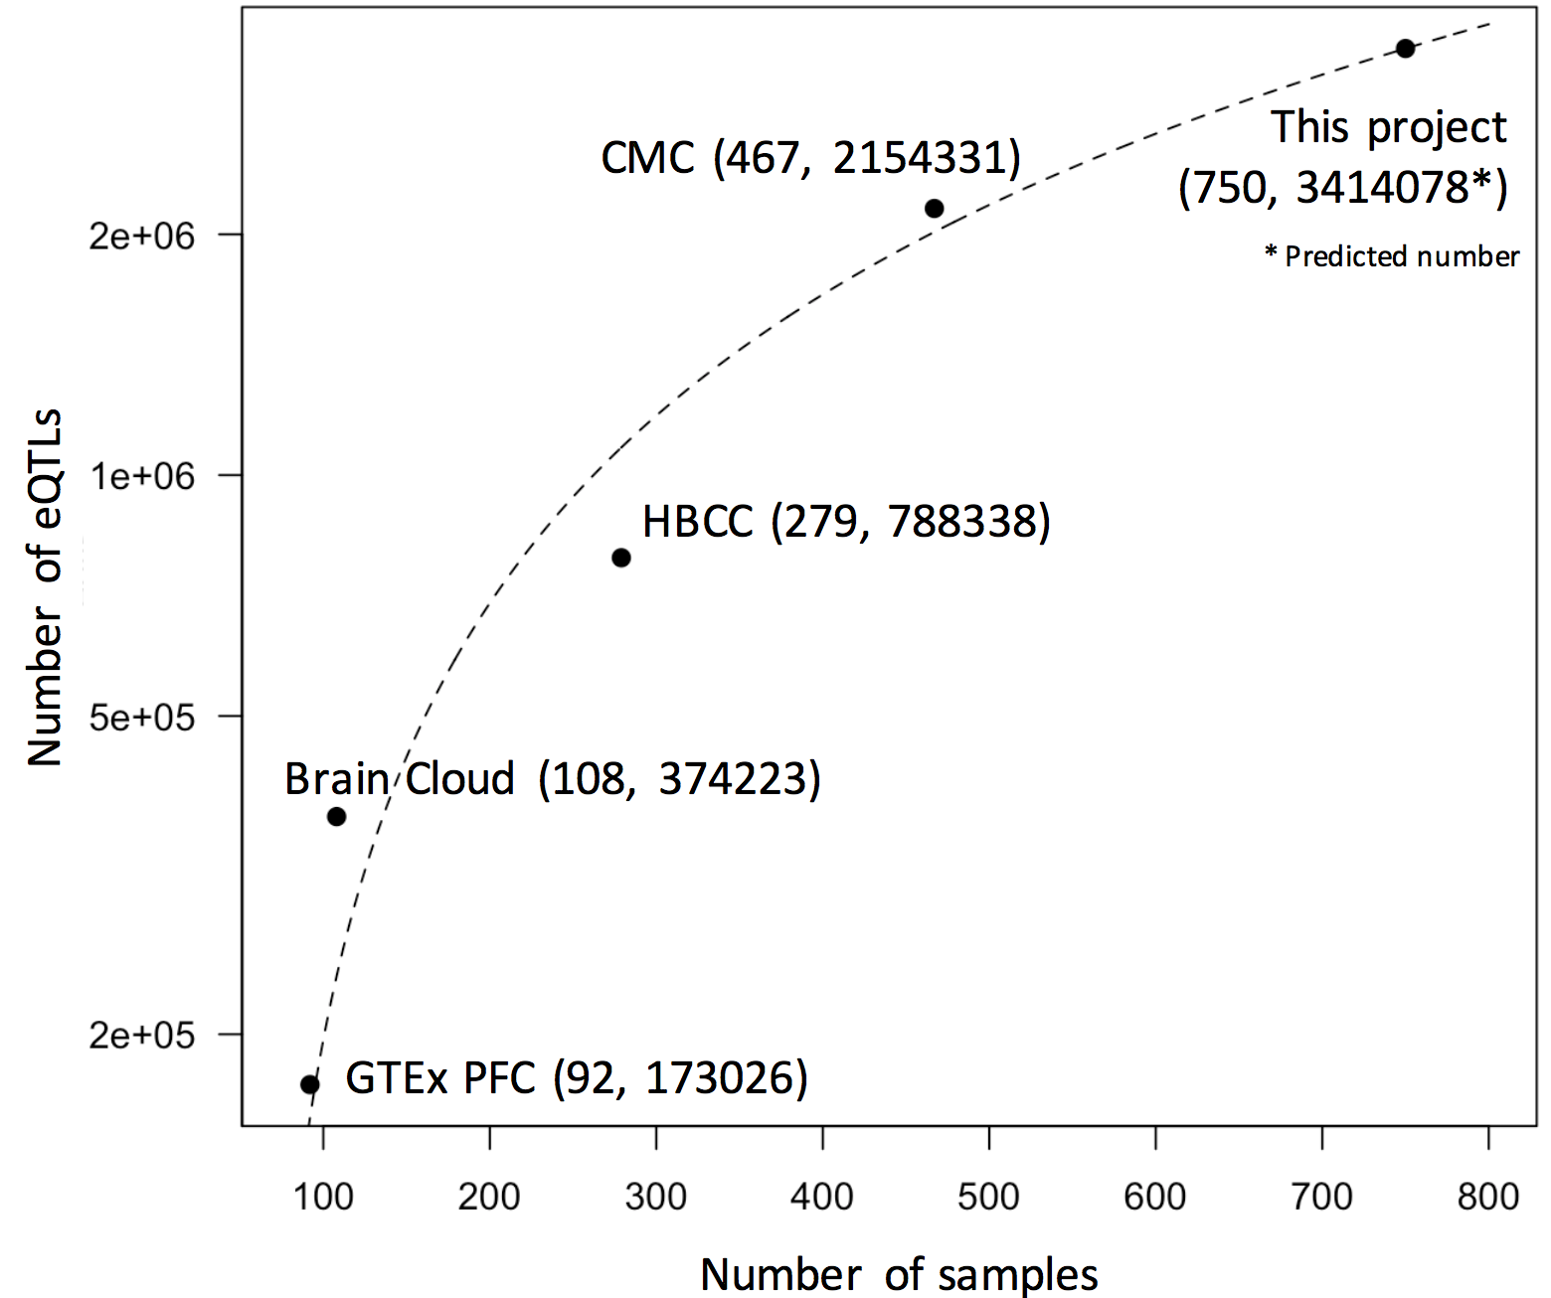
Generated Resource
eQTL counts
Number of eQTLs
GTEx
CMC
GTEx+CMC+PEC
Enhancer region
GTEx+CMC+PEC
Distance to TSS
 | Total | Active in Brain regions | Brain Specific
Enhancers^{[1]} | 2.3M | 332.5K (14.5%) | 130.2K (5.7%)
Genes^{[2]} | 56.2K | 31.6K (56.1%) | 1.2K (2.1%)
cis-eQTLs^{[2]} | 26.4M | 3.25M (12.3%) | 1.02M (3.9%)
Gene expression modules^{[2]} | 117 | 59 (50.4%) | 6 (5.1%)
[1] Roadmap Epigenomics Consortium. Integrative analysis of 111 reference human epigenomes. Nature, 2015.
[2] The GTEx Consortium. The Genotype-Tissue Expression (GTEx) pilot analysis: Multitissue gene regulation in humans. Science, 2015.

Slide 7
PCA for different tissues

Slide 8
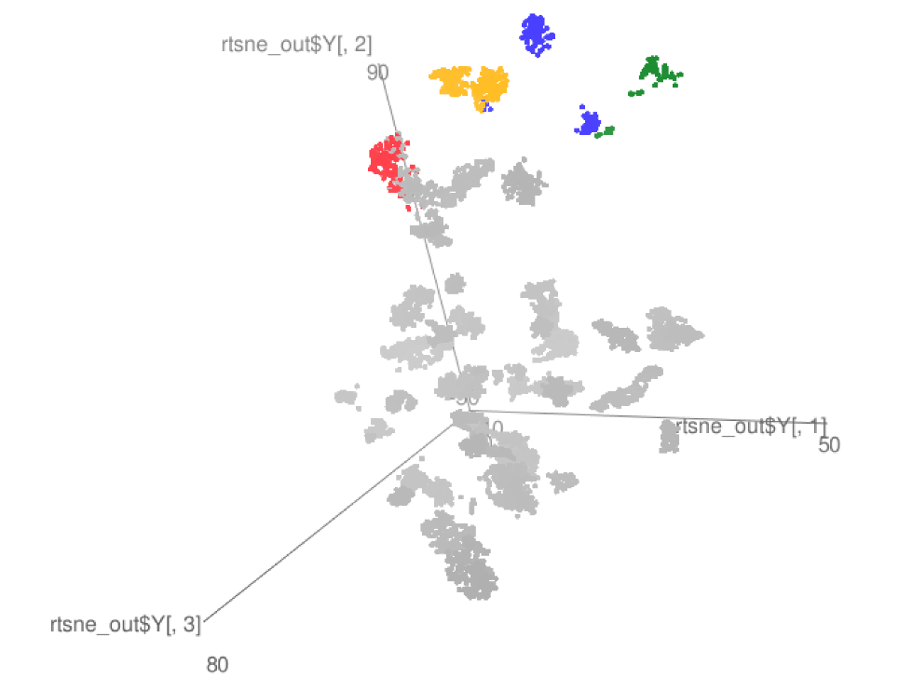
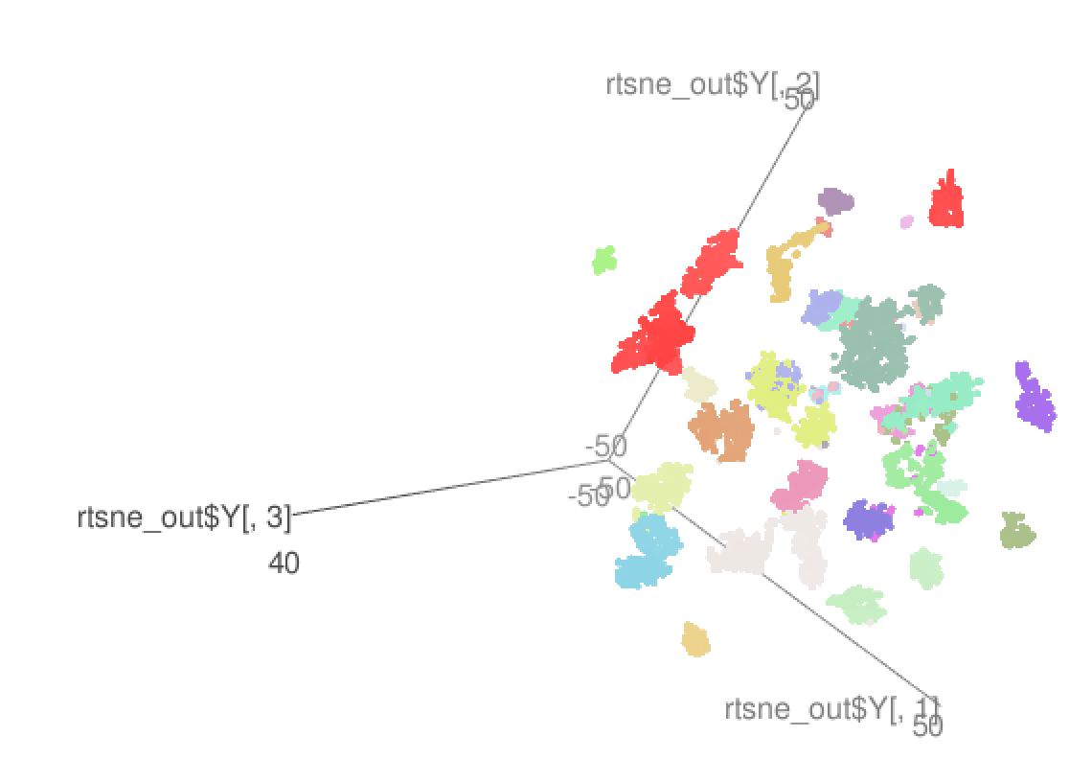
TSNE: Different tissues
GTEx
GTEx+ PEC

Slide 9
RCA (Reference Component Analysis)
We create a reference expression panel by:
  Selecting genes with enrriched tissue expression (1,400 genes)
  Calculating the median expression of all reference genes for all reference tissues
For each RNA-seq sample, we project the gene expression values to the reference panel
Finally we perform a PCA analysis using the projected values to cluster samples in a two dimensional space.

Slide 10
RCA (Reference Component Analysis)
Reference Panel
Projection Matrix
Reference Genes
Samples
Reference tissues
Reference tissues

Slide 11
Brain samples
Cerebellum samples

Slide 12
Transcriptome diversity

Slide 13
Brain specific ncRNA
Enhanced Transcription
Cortex
Cerebellum
5
15
55
14
11
1
0
Other brain regions

Slide 14
Repetitive element activity in the human brain
LINE-1 has been shown to be active in the human brain
  Creating somatic mosaicism across neurons (Muotri et. al.)
  Suggesting that LINE-1 might contribute to neuronal plasticity
We used RNA-seq data to uncover the activity of LINE-1 elements in brain regions
However, approximately 30% of the human genome is derived from LINE-1 elements.
  We developed Methods to decouple pervasive transcription from autonomous LINE-1 transcription.

Slide 15
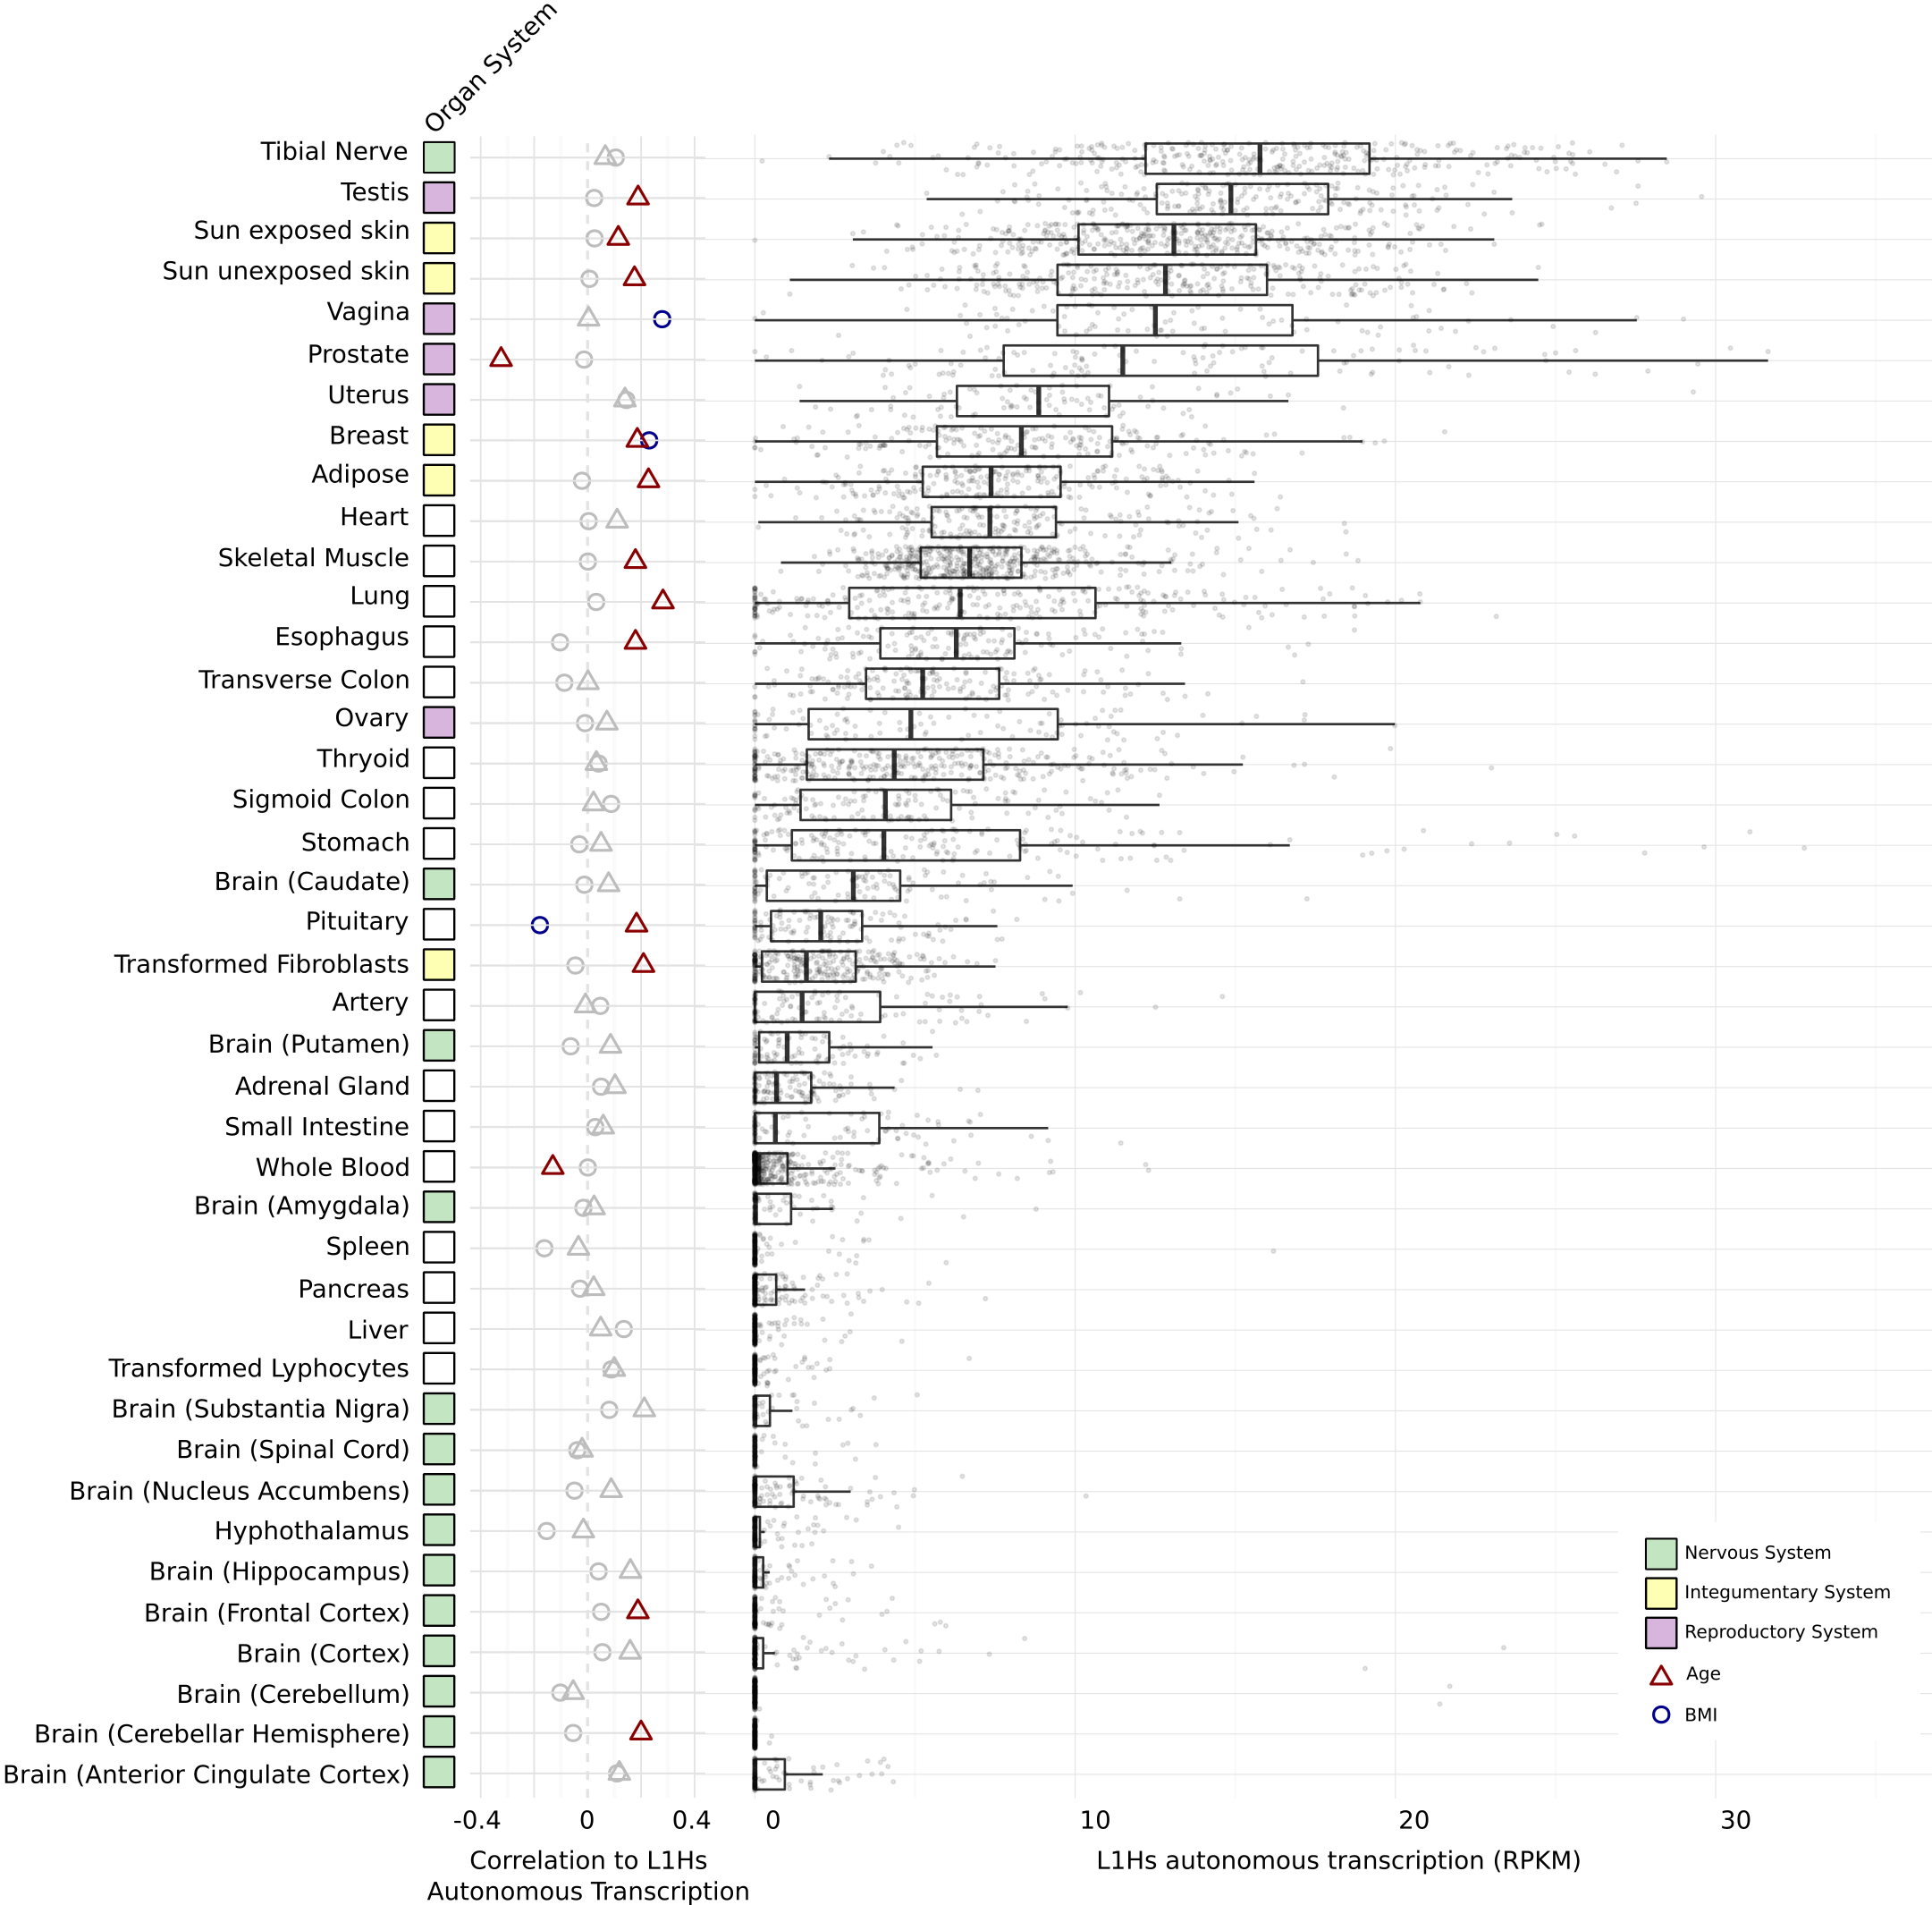
LINE-1 activity in the human brain
Brain

Slide 16
Brain gene regulation
A. Brain enhancers
B. Brain samples clustered by enhancers
Brain sample cluster
C. Brain enhancers vs. Brain genes
D. Gene regulatory networks
Tissues-matched & Developmental-matched
log #of cortex specific enhancers near cortex specific genes

Slide 17
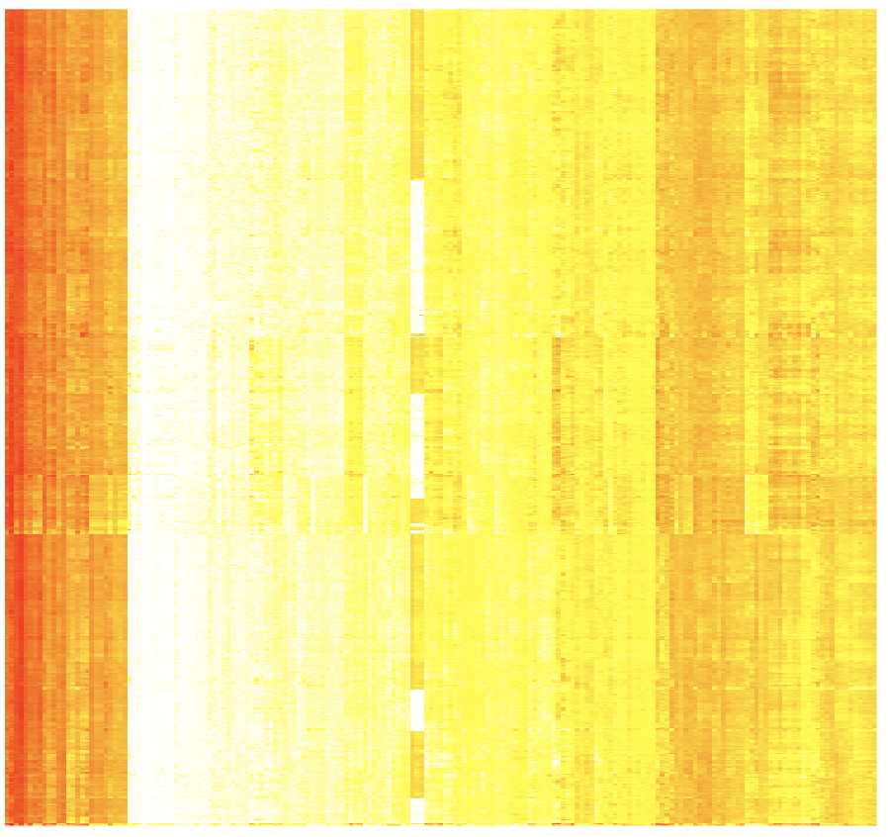
CMC
GVEX
Cell type contributions to brain cortex tissues by deconvolving tissue gene expression into six cell type signature expression
X=WY => W is coefficient matrix of using non-negative least square to predict X from Y
Neuron
Endothelial
Astrocytes
OPC
Microglia
Oligodendrocytes
X
= W *
Y
185 single cell biomarker genes
Samples
185 single cell biomarker genes
Notes:
neurons and inter-neurons

Slide 18
GVEX+CMC SCZ & CTRL gene expression
(Intercept) -0.59
SPIB 0.17
SOX5 -0.19
MAFG -0.33
BRCA1 0.14
NFE2L1 0.12
Cerebral Dopamine Neurotrophic Factor (CDNF)
brain gene
Promoters & Enhancers
Tissues-matched (Roadmap)
Hi-C matched (Bing Ren’s paper)
Fantom
Chr10:14555000:600
Roadmap: corr=0.897
HiC:corr=0.905
Gene regulatory network
  Predict target brain gene expression from TFs (and eQTL phenotypes); e.g, LASSO, Ridge, and Elastic Net
CMC SCZ & CTRL gene expression plus genotype
(Intercept) -0.56
SPIB 0.18
BRCA1 0.053
SOX5 -0.072
NFE2L1 0.051
MAFG -0.389
rs72782895 0.066
rs67337311 -0.025
rs35342583 -0.032
Broken TFBSs by eQTLs
rs72782895: chr10 14519724 C G MATCH=1;TF=NFE2L1_MafG;ScoreDiff=0
rs67337311: chr10 14541454 C T MATCH=1;TF=SPIB;ScoreDiff=0
rs35342583: chr10 14613012 C T MATCH=2;TF=BRCA1,Sox5;ScoreDiff=0,0
TFs

Slide 19
Gene co-expression modules by WGCNA
Co-expression across gtex tissues (JW)
Co-expression across developmental stages
Regions
Developmental stages

Slide 20
Outline
Question
Resource (SL,JW)
PCA,T-SNE and RCA genes exp (DW,FN)
2 slides unnanotated regions (FN)
2 slides building reg net (PE,MTG)
WGCNA(JW)
Single cell deconvolution (DW, TG)
2 slides model (DW)
FMRI (MTG)
Notes:
texp

