Slide 1
PsychENCODE Capstone 4
Integrative analysis with CommonMind, ENCODE, GTEx, and Roadmap
Capstone 4 group
06/23/2017

Slide 2
Background to creation of a Brain Specific Resource
* Development of Generic Resources to Annotate the Whole Human Genome
- ENCODE, Roadmap, GTEx, 1000 Genomes
- No focussed on the brain
* Desire to provide a specific resource for the brain and diseases that afflict it
- Brain enhancers, specific splice forms, regulatory networks, and eQTLs

Slide 3
Question posed by this resource
On a large-scale, are gene regulation, transcription and other aspects of the functioning of the genome similar in the brain to other tissues (ie the liver)? Or are they different?

Slide 4
Outline for Talk
Building the Resource
- enhancers & brain regulatory networks
- Brain eQTLs
Analysis of how the brain compares to other organs
& how the resource is more powerful for just the brain
Quantitative models relating regulatory variation to gene output in brain imporant genes

Slide 5
Capstone 4 - Datasets
Study name | Individuals | Brain region | Disease status | Data type
UIC, Uchicago-BrainGVEX | 428 | Frontal cortex | SCZ, BD, ASD, control | RNA-seq (waiting for genotype data of half samples)
UCLA-ASD | 73/96 | PreFrontal cortex, CBC | ASD, control | RNA-seq , ChIP-seq, genotype data
Yale-ASD | 68 | DLPFC | ASD, control | RNA-seq, ChIP-seq (waiting for genotype data)
CommonMind v1.2 | 603 | DLPFC | SCZ, BD, control | RNA-seq, genotype data (Illumina Infinium HumanOmniExpressExome 8 v 1.1b chip )
GTEx V6p (BA9) | 92 | DLPFC | control | RNA-seq, genotype data (Illumina OMNI 5M or 2.5M array)
Brainspan | 43 | 16 regions | control | RNA-seq, genotype data
ENCODE/Roadmap |  | Different regions | control | RNA-seq , ChIP-seq
Total | 1323(currently 754 with genotype) for DLPFC data
Notes:
1323 total rnaseq data

Slide 6
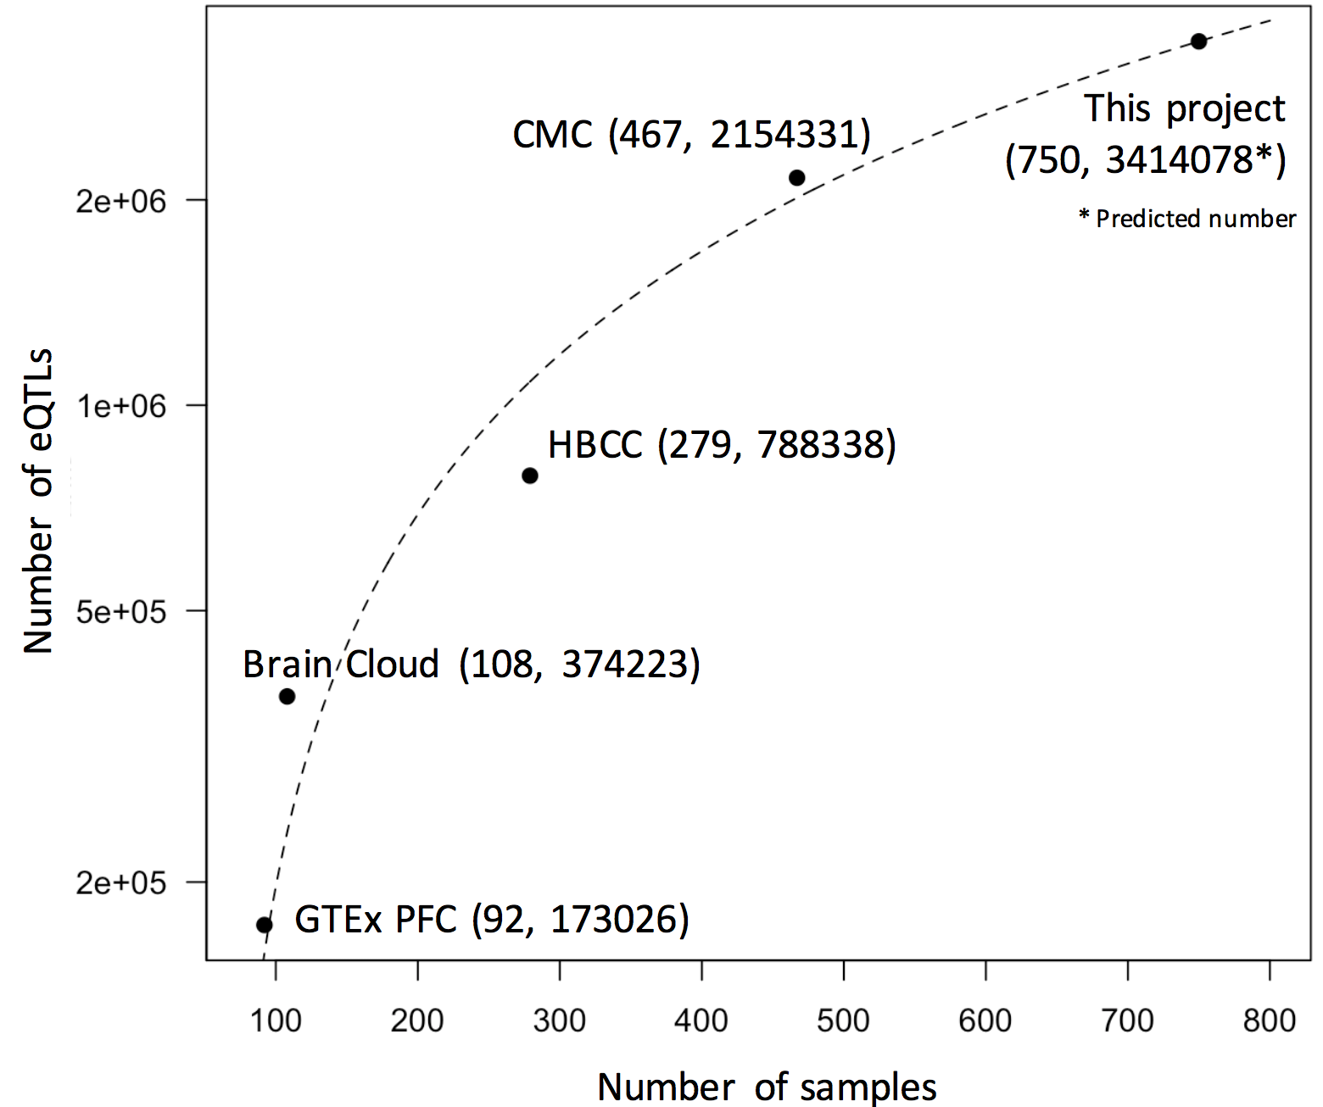
Generated Resource
eQTL counts
Number of eQTLs
GTEx
CMC
GTEx+CMC+PEC
Enhancer region
GTEx+CMC+PEC
Distance to TSS
 | Total | Active in Brain regions | Brain Specific
Enhancers^{[1]} | 2.3M | 332.5K (14.5%) | 130.2K (5.7%)
Genes^{[2]} | 56.2K | 31.6K (56.1%) | 1.2K (2.1%)
cis-eQTLs^{[2]} | 26.4M | 3.25M (12.3%) | 1.02M (3.9%)
Gene expression modules^{[2]} | 117 | 59 (50.4%) | 6 (5.1%)
[1] Roadmap Epigenomics Consortium. Integrative analysis of 111 reference human epigenomes. Nature, 2015.
[2] The GTEx Consortium. The Genotype-Tissue Expression (GTEx) pilot analysis: Multitissue gene regulation in humans. Science, 2015.

Slide 7
PCA for different tissues

Slide 8
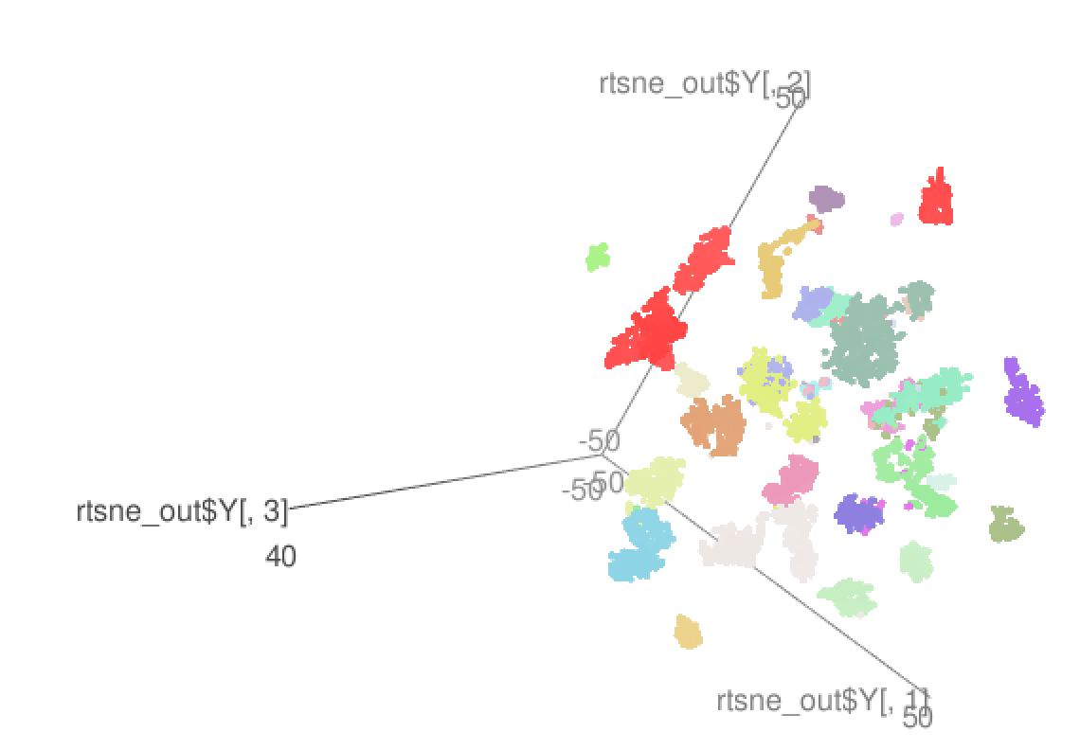
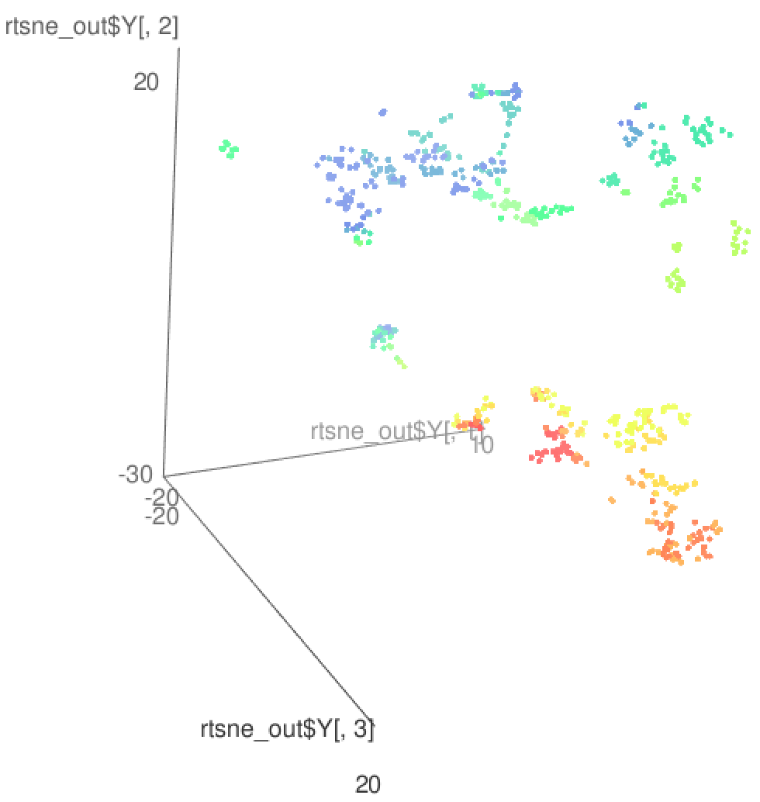
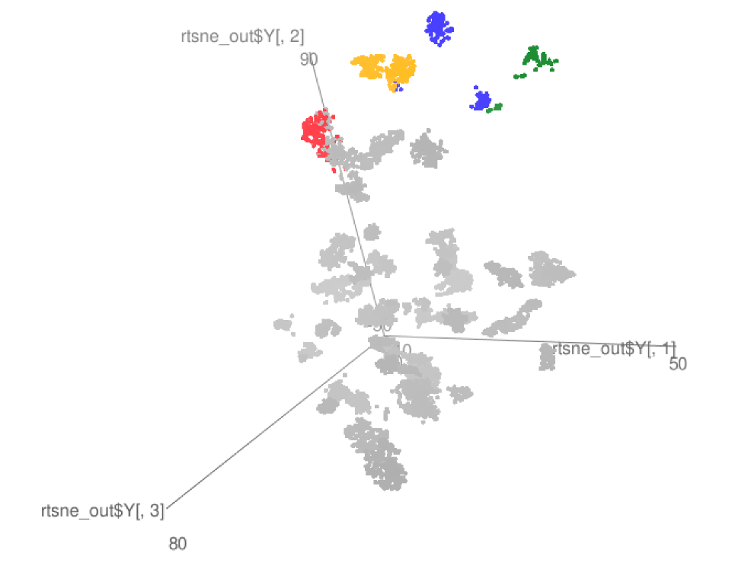
TSNE: Brain vs. other tissues
GTEx
Brainspan
GTEx+some PEC

Slide 10
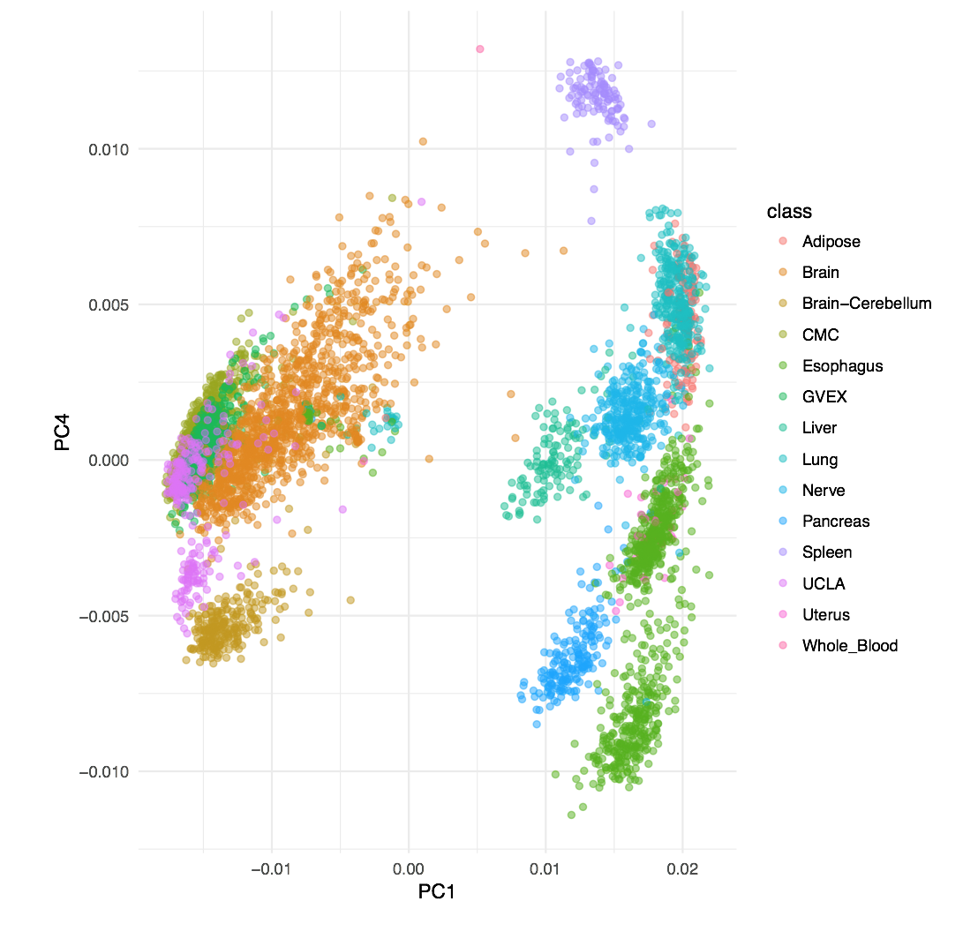
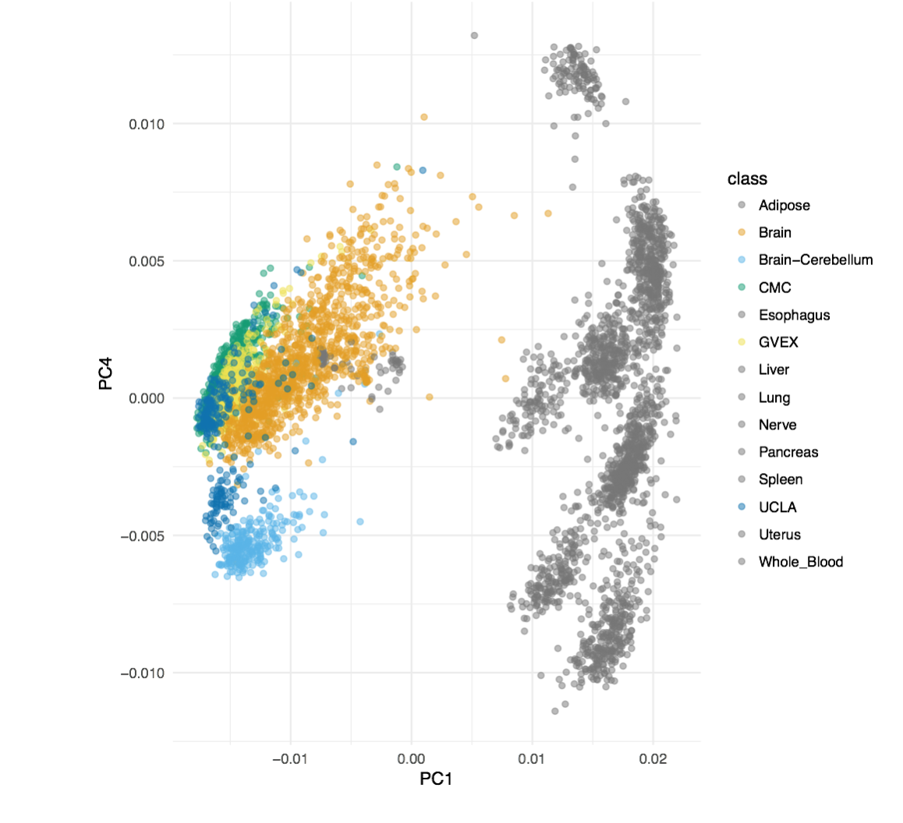

Slide 11
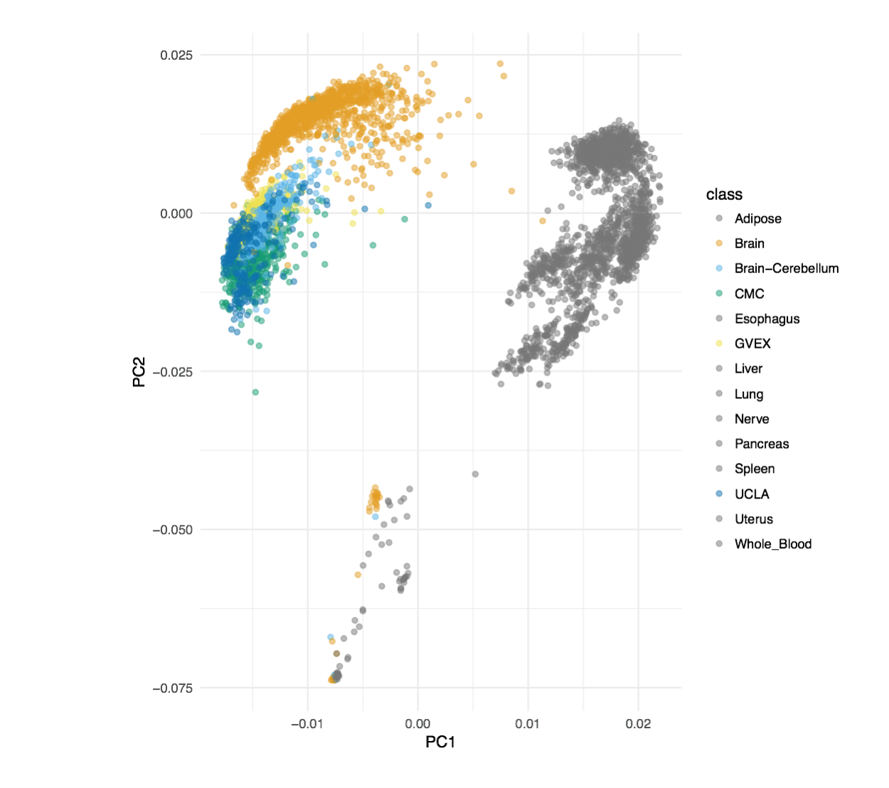
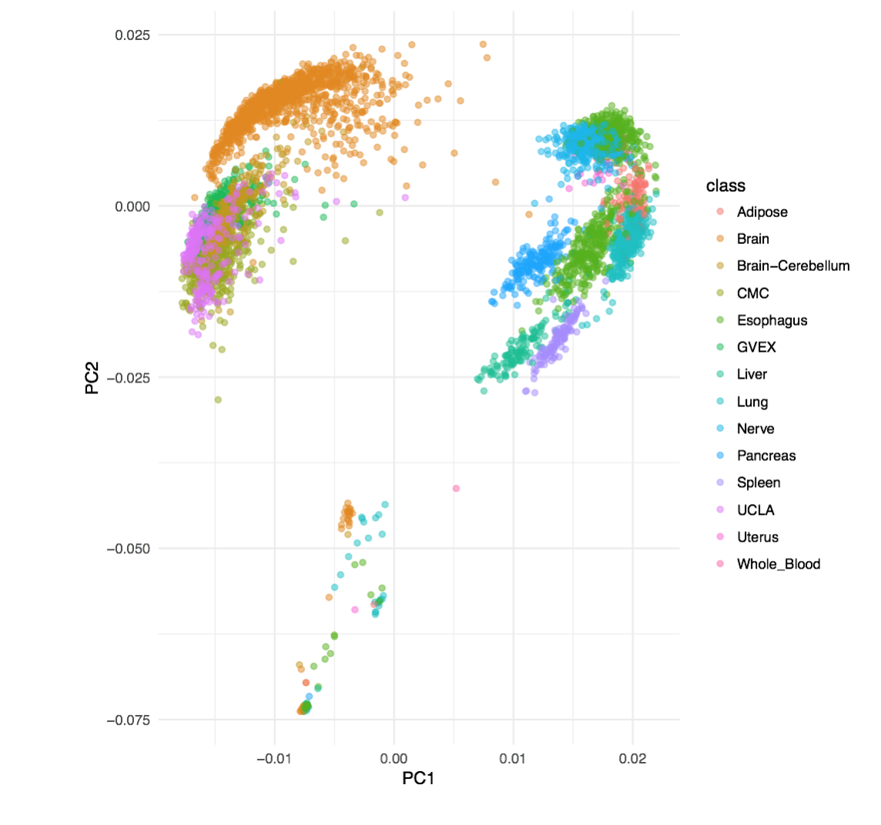
Notes:
Re-order legend?

Slide 12
Brain specific ncRNA
Specific Transcription
Enhanced Transcription
Cortex
Cerebellum
Cortex
Cerebellum
5
3
1
2
15
55
14
11
1
LINC00599
0
LINC01007
MIR124-2
LINC00507
RP11-491F9.6
RP11-491F9.5
Brain

Slide 13
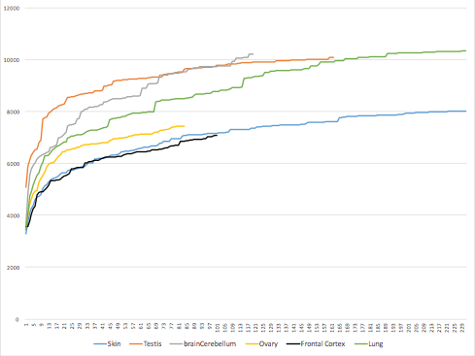
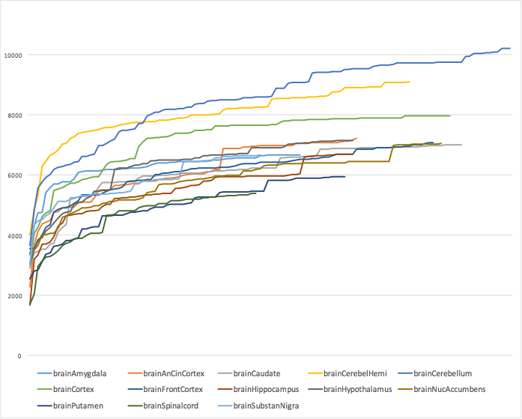
Transcriptome diversity

Slide 14
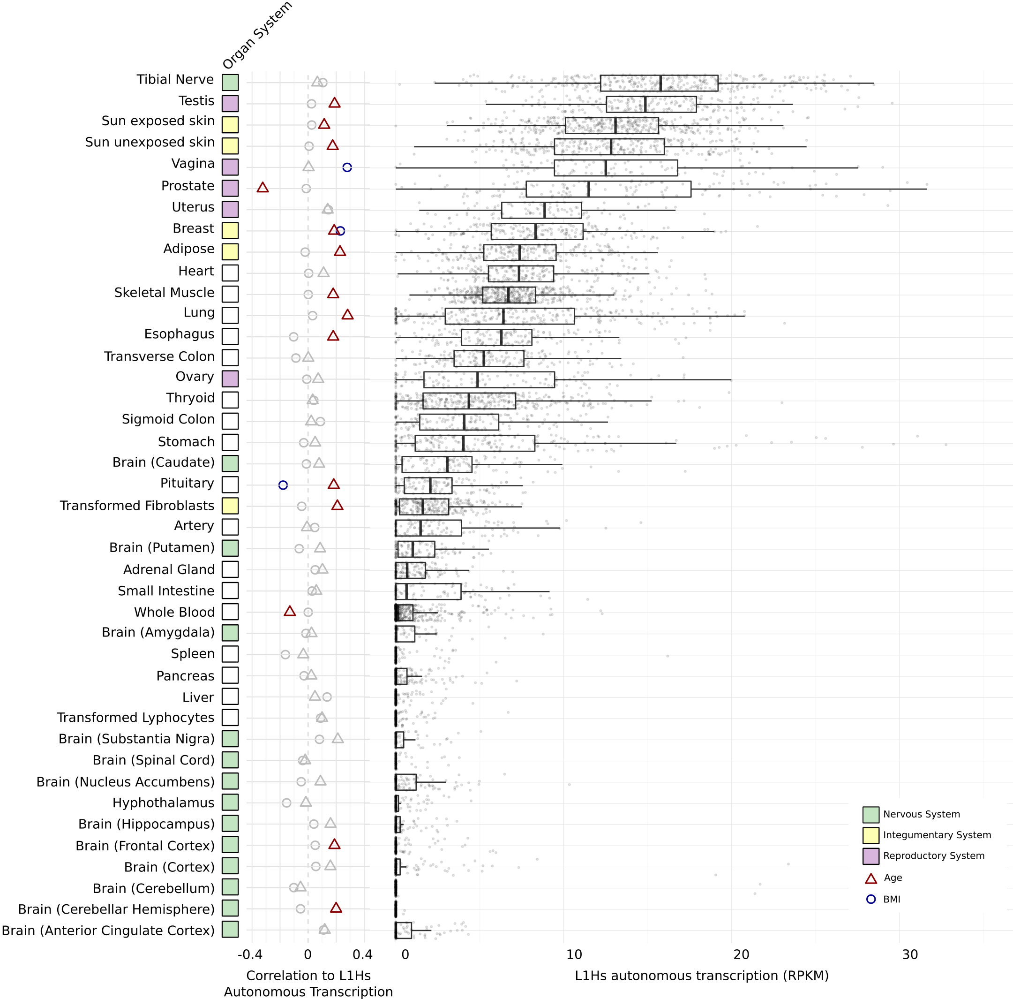
TE activity human brain
Brain

Slide 15
Brain gene regulation
A. Brain enhancers
B. Brain samples clustered by enhancers
Brain sample cluster
C. Brain enhancers vs. Brain genes
D. Gene regulatory networks
Tissues-matched & Developmental-matched
log #of cortex specific enhancers near cortex specific genes

Slide 16
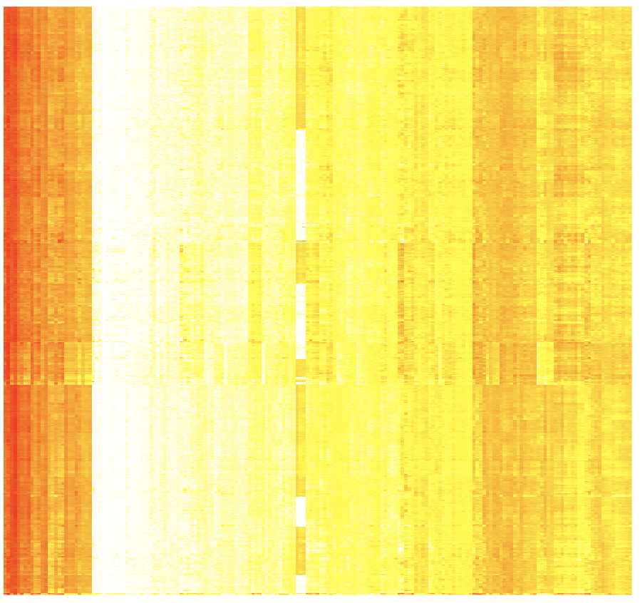
CMC
GVEX
Cell type contributions to brain cortex tissues by deconvolving tissue gene expression into six cell type signature expression
X=WY => W is coefficient matrix of using non-negative least square to predict X from Y
Neuron
Endothelial
Astrocytes
OPC
Microglia
Oligodendrocytes
X
= W *
Y
185 single cell biomarker genes
Samples
185 single cell biomarker genes
Notes:
neurons and inter-neurons

Slide 17
GVEX+CMC SCZ & CTRL gene expression
(Intercept) -0.59
SPIB 0.17
SOX5 -0.19
MAFG -0.33
BRCA1 0.14
NFE2L1 0.12
Cerebral Dopamine Neurotrophic Factor (CDNF)
brain gene
Promoters & Enhancers
Tissues-matched (Roadmap)
Hi-C matched (Bing Ren’s paper)
Fantom
Chr10:14555000:600
Roadmap: corr=0.897
HiC:corr=0.905
Gene regulatory network
  Predict target brain gene expression from TFs (and eQTL phenotypes); e.g, LASSO, Ridge, and Elastic Net
CMC SCZ & CTRL gene expression plus genotype
(Intercept) -0.56
SPIB 0.18
BRCA1 0.053
SOX5 -0.072
NFE2L1 0.051
MAFG -0.389
rs72782895 0.066
rs67337311 -0.025
rs35342583 -0.032
Broken TFBSs by eQTLs
rs72782895: chr10 14519724 C G MATCH=1;TF=NFE2L1_MafG;ScoreDiff=0
rs67337311: chr10 14541454 C T MATCH=1;TF=SPIB;ScoreDiff=0
rs35342583: chr10 14613012 C T MATCH=2;TF=BRCA1,Sox5;ScoreDiff=0,0
TFs

Slide 18
Gene co-expression modules by WGCNA
Co-expression across gtex tissues (JW)
Co-expression across developmental stages
Regions
Developmental stages

Slide 19
Outline
Question
Resource (SL,JW)
PCA,T-SNE and RCA genes exp (DW,FN)
2 slides unnanotated regions (FN)
2 slides building reg net (PE,MTG)
WGCNA(JW)
Single cell deconvolution (DW, TG)
2 slides model (DW)
FMRI (MTG)
Notes:
texp

