Slide 1
Will Meyerson
Group Meeting
Notes:
The ability to make something new. To grow. To adapt. To conquer, collaborate, or die. These abilities are the domain of all living things, and they derive majorly from two opposing properties of DNA in counterpoint: heritability and mutability.

Slide 2
Evolutionary forces act on life on every scale
gccgggcgcgCOPYMEgtggcgcgtg
Selfish DNA
Cellular fitness
Organismal fitness
Group selection
The Great Filter
Notes:
From the repetitive snippets that litter our genome, to the cells that compose our bodies, to organisms, species, and perhaps whole living worlds: life survives and reproduces in accordance with the suitability of its DNA to its environment. Tautologically, only the fit survive.

Slide 3
Organismal and cellular fitness landscapes can relate to each other
Organisms are made of cells
Knowledge that a mutation affects organismal fitness clues us to potential cellular fitness impacts, and vice versa
Cell image: Nissan, X. Cell Reports 2012
Notes:
In high school I worked with a staff scientist who was a creationist. She believed the world is 5000 years old. I asked her: how can you study evolution of cancer cells in the lab and yet continue to not believe in evolution? She said “Oh I believe in microevolution, I just don’t believe in macroevolution.” And she’s a fine scientist. To perform and interpret the best established studies out there of cancer evolution, there is little-to-no need to posit macroevolution. Now ten years later, I believe that macroevolution has some things to teach us about microevolution and vice verse.

Slide 4
Cancer is an apt setting to study cellular fitness landscapes
Clinically relevant: Will soon be #1 global killer
Data rich: PCAWG >2,500 WGS; TCGA >10,000 WES
Presents interesting questions about cellular fitness:
  How many undiscovered drivers remain?
  Do non-driver mutations affect tumor cell fitness?
Tractable setting: can infer somatic fitness effects from prevalence of mutations across tumors (recurrence) and prevalence of mutations within cancers (variant allele frequency)
  (LS , JW, and I are working on a way to more directly assess somatic fitness impact, which I will briefly sketch at the end of the presentation)

Slide 5

Key Question from Paper E: Most mutations in cancer are nominally lumped together as passengers, and then ignored. Is this biologically justified?
SK is the official driver of this car. Does his motley crew of passengers (JW, LS, PDM, STL, WM) leave him alone, egg him on, or slow him down?
PCAWG offers 30M variants in 2500 uniformly annotated tumors, complete with SVs, individual driver calls, and null models. A superb opportunity to investigate this question.

Slide 6
My approach: Use knowledge of organismal fitness impacts to assess cellular fitness impacts of nominal passenger variants
Assign a cellular fitness score and organismal fitness score to each PCAWG SNV such that
  Cellular fitness measures are entirely PCAWG-dependent
  Organismal fitness scores are entirely PCAWG-naïve
If nominal passenger variants have no cellular fitness effects, then their cellular fitness measures are just noise and they should not relate to organismal fitness scores
Conversely, if the nominal passenger variants’ cellular fitness measures do predictably relate to organismal fitness scores, this suggests that the putative fitness scores track some underlying real fitness effects

Slide 7
Variant Allele Frequency is a confounded but attractive measure of cellular fitness impact
Read 1: A C G A C
The variant allele here is T and its Variant Allele Frequency is 1/3
Read 2: C G A C T
Read 3: G T C T C
Attractive because
Proportional to tumor fraction bearing mutation, naturally fitness-related
Continuous, thus sensitive
Null-independent
Fresh
They are many (30M in PCAWG)
But confounded by | which is OK because
Copy number alterations | Can filter out
Read sampling noise | Aggregation raises signal/noise
Tumor purity | Can normalize out
Mutational timing | Admittedly confuses interpretation
Tumor heterogeneity | Admittedly confuses interpretation

Slide 8

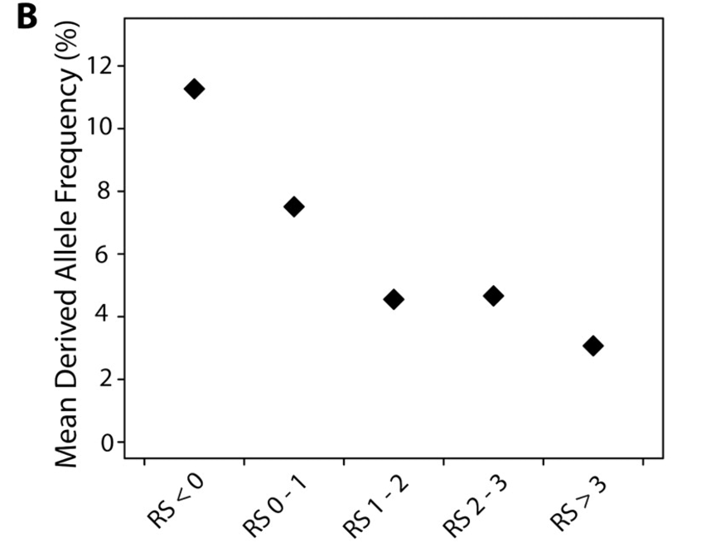

Evolutionarily conserved alleles promote organismal fitness
C
A
A
G
A
A
A
C
A
A
Ancestral allele A
A
A
G
A
Derived allele G
With derived allele frequency 25%
GERP score (RS) bin
Observed variation: 3
Expected variation: 5
Rejected substitutions (GERP) (RS) = 5-3=2
Goode, DL (2010)

Slide 9
In cancer genes, cellular fitness opposes organismal fitness
Fitness landscape of SNVs in driver genes and their noncoding regulators
This trend is expected: cancer is harmful to organisms.
This trend might solely reflect the impact of discovered driver variants.
On its own, this is not an interesting finding, but helps to validate my methodology.
Increased cellular fitness →
Reduced organismal fitness →
Notes:
Considered PCAWG SNVs that overlap a driver gene or driver gene regulator.
Removed SNVs that overlap unbalanced structural variants.
Divided SNVs into bins based off of their GERP scores (higher GERP => more conserved among mammals).
Calculated mean VAF per GERP bin.
Calculated 95% confidence intervals for mean VAF by bootstrapping

Slide 10
The exclusion of discovered driver variants reveals a signal from latent drivers.
Fitness landscape of SNVs in driver genes and their noncoding regulators,
excluding discovered driver SNVs
Cellular fitness continues to oppose organismal fitness, albeit noisily, even after excluding all known driver variants.
This trend is best explained by the presence of latent drivers among the variants in driver gene sets that were not individually called as drivers.
Increased cellular fitness →
Reduced organismal fitness →

Slide 11
Outside of cancer genes, cellular fitness tracks organismal fitness
Fitness landscape of SNVs outside driver genes and their noncoding regulators
Some non-cancer genes and elements support efficient cellular functioning. Disruption of these elements by mutation encumber tumor cells, slowing their growth relative to other cells in the tumor.
This is an interesting finding, because even though the existence of deleterious passengers is intuitive, it has been difficult for cancer genomicists to find clear evidence of deleterious passengers using existing methods.
Because there are a huge number of variants in PCAWG outside of driver gene-sets, we get strong significance despite small effect sizes. The small effect sizes may represent dilution of deleterious passengers with a large number of neutral passengers.
Although there may be some latent drivers outside of known driver genes, their impact is apparently outweighed by deleterious passengers.
Increased cellular fitness →
Reduced organismal fitness →

Slide 12
The cellular fitness effects of deleterious passengers is weaker or more dilute than those of driver variants

Slide 13
The strength of the association between cellular and organismal fitness allows estimation of the number of fitness-effecting mutations per tumor
0.022 VAF increase
Fraction of eligible variants that have been individually called by PCAWG as drivers
GERP
GERP
GERP
VAF surplus among highly conserved variants over and above non-conserved variants

Slide 14
Several retained deleterious passengers per tumor, but only the occasional latent driver
~10M eligible variants for deleterious passenger analysis, predict 21,971 retained deleterious passengers in PCAWG -> 8.6 per tumor
~ 3,000 eligible variants for latent driver analysis, predict 372 of these to be latent drivers -> 0.14 per tumor. But probably more because
  Started with a conservative set in order to detect VAF differences
  1 discovered driver presumably has higher VAF distortion than 1 latent driver

Slide 15
The organismal fitness landscape of cancer variants also reveals ~ 50 removed deleterious passenger variants per tumor.
PCAWG provides a neutral variant set in which variants have been shuffled intelligently.
Mutations of conserved portions of the genome are more rare in observed tumors than expected by the null models.
The shortfall in mutations at conserved positions could be explained by their preferential removal by negative selection.

Slide 16
Variants in haploid regions and essential gene-sets are particularly deleterious
The deleteriousness of recessive alleles is mostly masked by the persistence of a wild-type allele. Deletions lead to loss of heterozygosity and unmasking of the fitness impact of recessive alleles.
GERP represents conservation among mammals. Genes shared between humans and yeast should be of special relevance to cellular fitness.
 | Observed conserved mutation percentage | Expected conserved mutation percentage | Observed conserved mutation count as a percentage of expected
All noncoding passenger variants | 55.27% | 56.31% | 98.2%
Passenger variants in haploid regions of noncoding regulators of essential genes | 53.87% | 64.66% | 83.3%
Passenger variants in haploid regions of noncoding promoters of essential genes | 49.73% | 72.87% | 68.3%

Slide 17
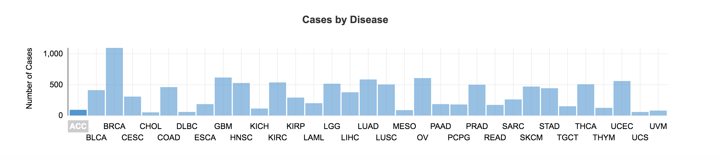
Whole exome sequencing permits deeper analysis of cellular fitness effects in coding regions
While PCAWG has ~2,500 samples, TCGA has ~10,000 from 33 subtypes
Cancer Genomics Cloud has re-processed and harmonized the TCGA data set to hg38 with four variant callers
Let me know individually if you would like me to help orient you to Cancer Genomics Cloud and the TCGA data set

Slide 18
Variants in ancient genes are especially deleterious to cancer cells
Grouped variants based on when their genes first evolved
Known and suspected driver genes have been removed
Ancient genes are more important for cellular survival. Clear and consistent trend.
Gene phylogeny from Cisneros 2017

Slide 19
Synonymous variants show a similar trend as missense variants, displaced by a constant
Option A: Artifact explains both
-Germline contamination explains trend?
Option B: Synonymous variants have some selective effects which are more pronounced in ancient genes
- Can impact RNA stability, translation efficiency

Slide 20
Ancient gene-low VAF trend not explained by germline contamination
Worry: Could germline contamination explain these results?
Rationale:
  Imagine there were pervasive contamination of germline SNPs. In theory, samples were take from TCGA’s conservative de-contaminated protocol, but one can imagine that even is conservative protocol is incomplete.
  On expectation these contaminant SNPs would have very high VAF (0.5), because they would be present in all cancer cells.
  Germline contamination is not problematic for assessing differences between groups that have the same level of germline contamination.
  However, we might worry that ancient genes have a lower germline rate than somatic rate of mutation due to especially strong negative germline selection.
  This would tend to reduce the mean VAF of ancient genes relative to more germline-contaminated, more recent genes.
Assessment: Fortunately, the ratio of germline SNPs to somatic SNPs appears to be very similar across phylostrata, which suggests that germline contamination should not be an issue.

Slide 21
Pathway analysis outliers tell a coherent narrative about the relation between organismal and cellular fitness
Assign variants to 21 (non-disjoint) Reactome high-level pathways (>200 non-cancer genes) plus two external sets:
Vogelstein’s cancer gene list; and
A set of yeast-human orthologues
Plot pathways by mean VAF vs mean GERP of variants.
Highest VAF pathway is Vogelstein’s drivers.
Lowest VAF pathway are Yeast genes.
Of Reactome pathways, the two pathways with both high GERP and high VAF are nervous system and developmental biology – which should impact organismal but not cancer cell fitness.

Slide 22
Conceptual Paradigms for Somatic-Germline Impact Classes
 |  | Germline
 |  | - | 0 | +
Somatic | - | Disrupt Cell-Essential Element | Balanced Increase in Tumor Suppression and Degenerative Disease | Optimize Tumor-Suppressive Element/Allele
 | 0 | Disrupt Metazoan Element | Vary Sequence-Nonspecific Region | Optimize Metazoan Element
 | + | Disrupt Tumor-Suppressive Element/Allele | Balanced Decrease in Tumor Suppression and Degenerative Disease | Optimize Cell-Essential Element

Slide 23
Cancer mutations might be able to tell us which mutations we should want for our bodies
Tumors explore the genetic fitness landscape more efficiently than big creatures like us
  Human generation time ~20 years
  Cancer cell generation time ~ 3 days
  Number of humans alive today ~7.5 billion
  Number of cells in even one tumor ~ 1 trillion
Could tumors discover mutations that would be helpful for our bodies? What manifestations might they take?
  Reverse germline mutation? Reverse somatic mutation? Return human allele to mammalian ancestor?

Slide 24
The curious case of Ichthyosis with Confetti
At birth, patients have a keratin10 mutation that damages skin
With time, patients develop patches of normal skin, which grow in size and number
Their K10 mutation spontaneously resolves in these patches by mitotic recombination

Slide 25
Conclusion
Macroevolution can teach us about microevolution and vice versa
Deleterious passengers exist in tumors, hurting them, helping us
With strict filtering we can detect a signal of occasional undiscovered driver variants.
Non-driver mutations in ancient genes are especially deleterious to cells
Among cancer’s mutations, there may be some that improve upon the human body (or that human body)

Slide 26
Acknowledgments
Paper E: JW, LS, SK, STL, PDM
Lab at large
MF
LI
HPC
MSTP office
NIH
ALW
MG

Slide 27
Extension: We may be able to quantify the fitness effects of mutations more directly

