Slide 1
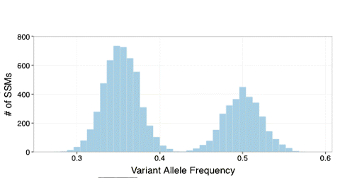
Modeling Clonal Evolution and the effect of fitness mutations
0.5
0.4
0.3
0.2

Slide 2


Hitchhiking prevalence
No fitness mutation
fitness mutation
0
1
2
3
4
0
1
2
3
4
8/16 = 0.5
12/20 = 0.6
4/16 = 0.25
8/20 = 0.4
8/16 = 0.5
8/20 = 0.4

Slide 3



Modeling growth
fitness mutation
By considering a steady mutation rate, the population is growing according to
In this situation, at any time point of sample observation T, the mutational frequency of a mutation that happened in time tm would be equal to
m
Now, let’s assume that at time t₁, a mutation occurs that increases the growth rate of the specific subpopulation by k, in a way that the new population is now expanding as
0
1
2
3
4
t₁
t₂

Slide 4
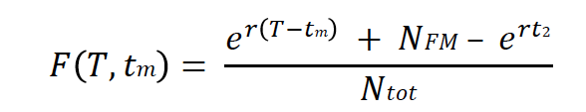

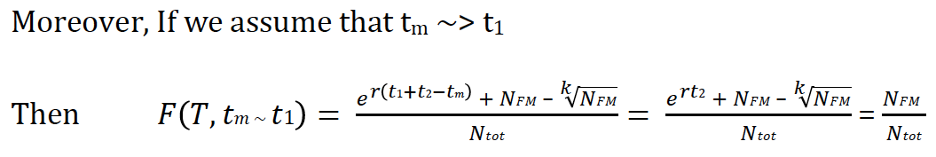
Hitchhiking prevalence
fitness mutation
Mutations that occurred on the blue lineage while t < t₁ (before fitness mutation), will also have a higher frequency since they are present in every k-fit cell by definition
0
1
2
3
4
t₁
t₂

Slide 5

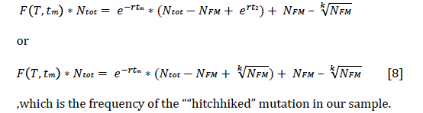
Hitchhiking prevalence
fitness mutation
In these terms, at total time T=t₁+t₂
0
1
2
3
4
t₂

Slide 6



Hitchhiking prevalence
Optimizing based on hitchhiking VAFs, each one satisfying
Which is in the form of
0
1
2
3
4
Allowing to estimate growth rate r from hitchhiking mutations
t₁
t₂

Slide 7
Hitchhiking prevalence
fitness mutation
Early Hitchhiked Mutations with growth r
Fit population
with growth K*r
fitness mutation
For Simulations
- Foreach (prevalent mutation)
  Estimate r from window of (5-6 or 7) hitchhike mutations
  Estimate the effect K (compared to real K)
- Identify peaks, drivers
For PCAWG data
Foreach (clonal mutation)
  - Optimize growth r using a window of (~100?)
  hitchhiking mutations and fit Non-Linear Least Square Reg.
  - Identify peaks, estimate effect K
  - Re-optimize for population size, clonal size
0
1
2
3
4
t₁
t₂

Slide 8
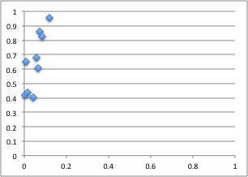
High Accuracy in Identifying Drivers using simulation data:
Roc curve
Sensitivity
K effect
1-Specificity

Slide 9
Identifying selection signal in 110 pcawg cancers
Average Distance
Driver high impact TSG mutations
Predicted peak
Average Distance from predicted peak (with effect K~2)
Random mutation
Driver

Slide 10
Identifying selection signal in 110 pcawg cancers
Average Distance
Driver high impact TSG mutations
Predicted peak
Average Distance from predicted peak (with effect K~2)

Slide 11
Individual Tumor growth model and future directions
Predict changes in Individual tumor growth rate r
Select peaks/effect size
Suggest the presence of a driver (?missing drivers?)
Identify driver candidates (improved with depth)
Compare the effect between different mutations/genes/genetypes/tumors
  (For example PTEN vs RAS; Prostate vs Lung; TSG vs Immune Response genes)
  Use for power calculations (define the effect and sequencing needed)
Compare our findings with Paper E
Model Liabilities:
Sequencing depth
Subclone assignment
Model fit optimization
Use of more complex models
Future directions
Compare different growth models based on ML
Under model and growth parameters, optimize for population size and fluctuations
Associate clonal evolution with Immune antibody repertoire evolution (Kleinstein)

Slide 12
Individual Tumor growth model and future directions
Predict changes in Individual tumor growth rate r
Select peaks/effect size
Suggest the presence of a driver (?missing drivers?)
Identify driver candidates (improved with depth)
Compare the effect between different mutations/genes/genetypes/tumors
  (For example PTEN vs RAS; Prostate vs Lung; TSG vs Immune Response genes)
  Use for power calculations (define the effect and sequencing needed)
Compare our findings with Paper E
Model Liabilities:
Sequencing depth
Subclone assignment
Model fit optimization
Use of more complex models
Future directions
Compare different growth models based on ML
Under model and growth parameters, optimize for population size and fluctuations
Associate clonal evolution with Immune antibody repertoire evolution (Kleinstein)

Slide 13
300x Amyloid tumor genome

Slide 14
300x Amyloid tumor genome

Slide 15
PCAWG
LOF and mutational ratios

Slide 16
PCAWG – LOF
Expected number of total stop mutations:
- TAG
- TAA
- TGA
- CTA
- TTA
- TCA
Number of LOF mutations per sample

Slide 17
PCAWG – LOF small samples vs big samples
Expected number of total stop mutations:
- TAG
- TAA
- TGA
- CTA
- TTA
- TCA
Number of LOF mutations per sample

