Slide 1
WGCNA updated methods
6/21/17

Slide 2
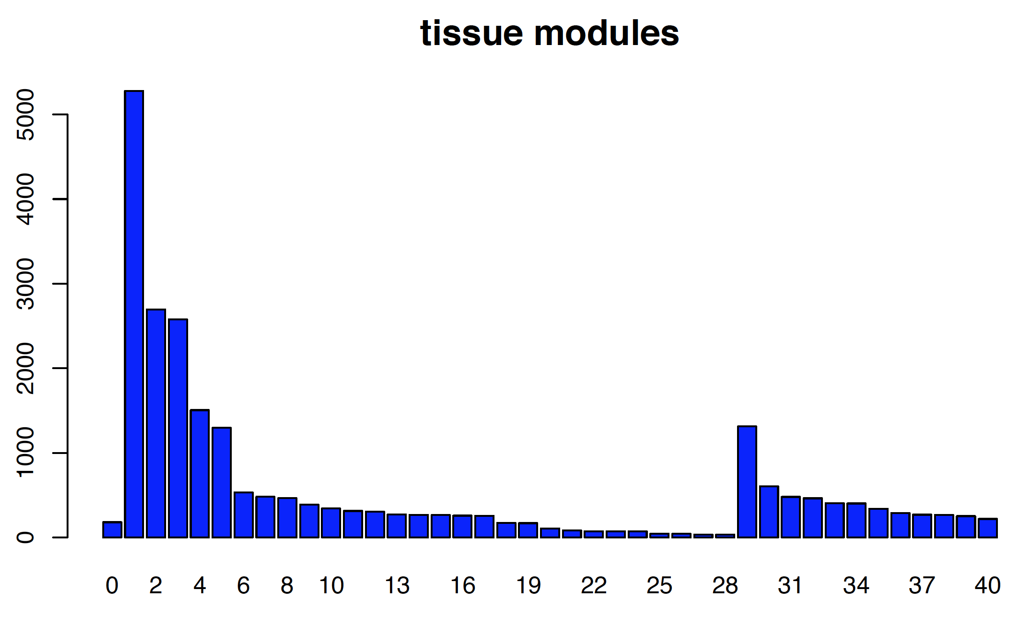
Module/Sub-module sizes in GTEx
Gene count
Containing module:
Module index

Slide 3
Splitting large WGCNA modules
Identify sub-modules whenever two subtrees are merged each containing at least T leaf-nodes (Below: T=4; For GTEx, set T=200)

Slide 4
Statistical test for submodule significance
N data points: 500
N simulations: 200
Standard normal distribution (dimensionality = D,
covariance matrix = ${\text{I}}_{D}$)
N data points: 500
N simulations: 200
Scaled normal distribution (D = 10, covariance matrix = $Λ_{D}$,
$Λ_{(i,i)}=λ^{i−1}$, $Λ_{(i,j)}=0$ for $i≠j$)
red: D = 20
green: D = 10
blue: D = 5
red: $λ$ = 1
green: $λ$ = 0.9
blue: $λ$ = 0.75
p(max(M)>n)
p(max(M)>n)
n
n
$M_{(T_{1},T_{2})}=min⁡(\left|T_{1}\right|,\left|T_{2}\right|)$, calculated when merging trees $T_{1}$ and $T_{2}$

Slide 5
Statistical test for submodule significance
Test using GTEx modules:
D = 52 (# tissues)
module 1, N = 5280 (# genes)
module 3, N = 2579
module 4, N = 1505
red: module 1
green: module 3
blue: module 4
p(max(M)>n)
n

Slide 6
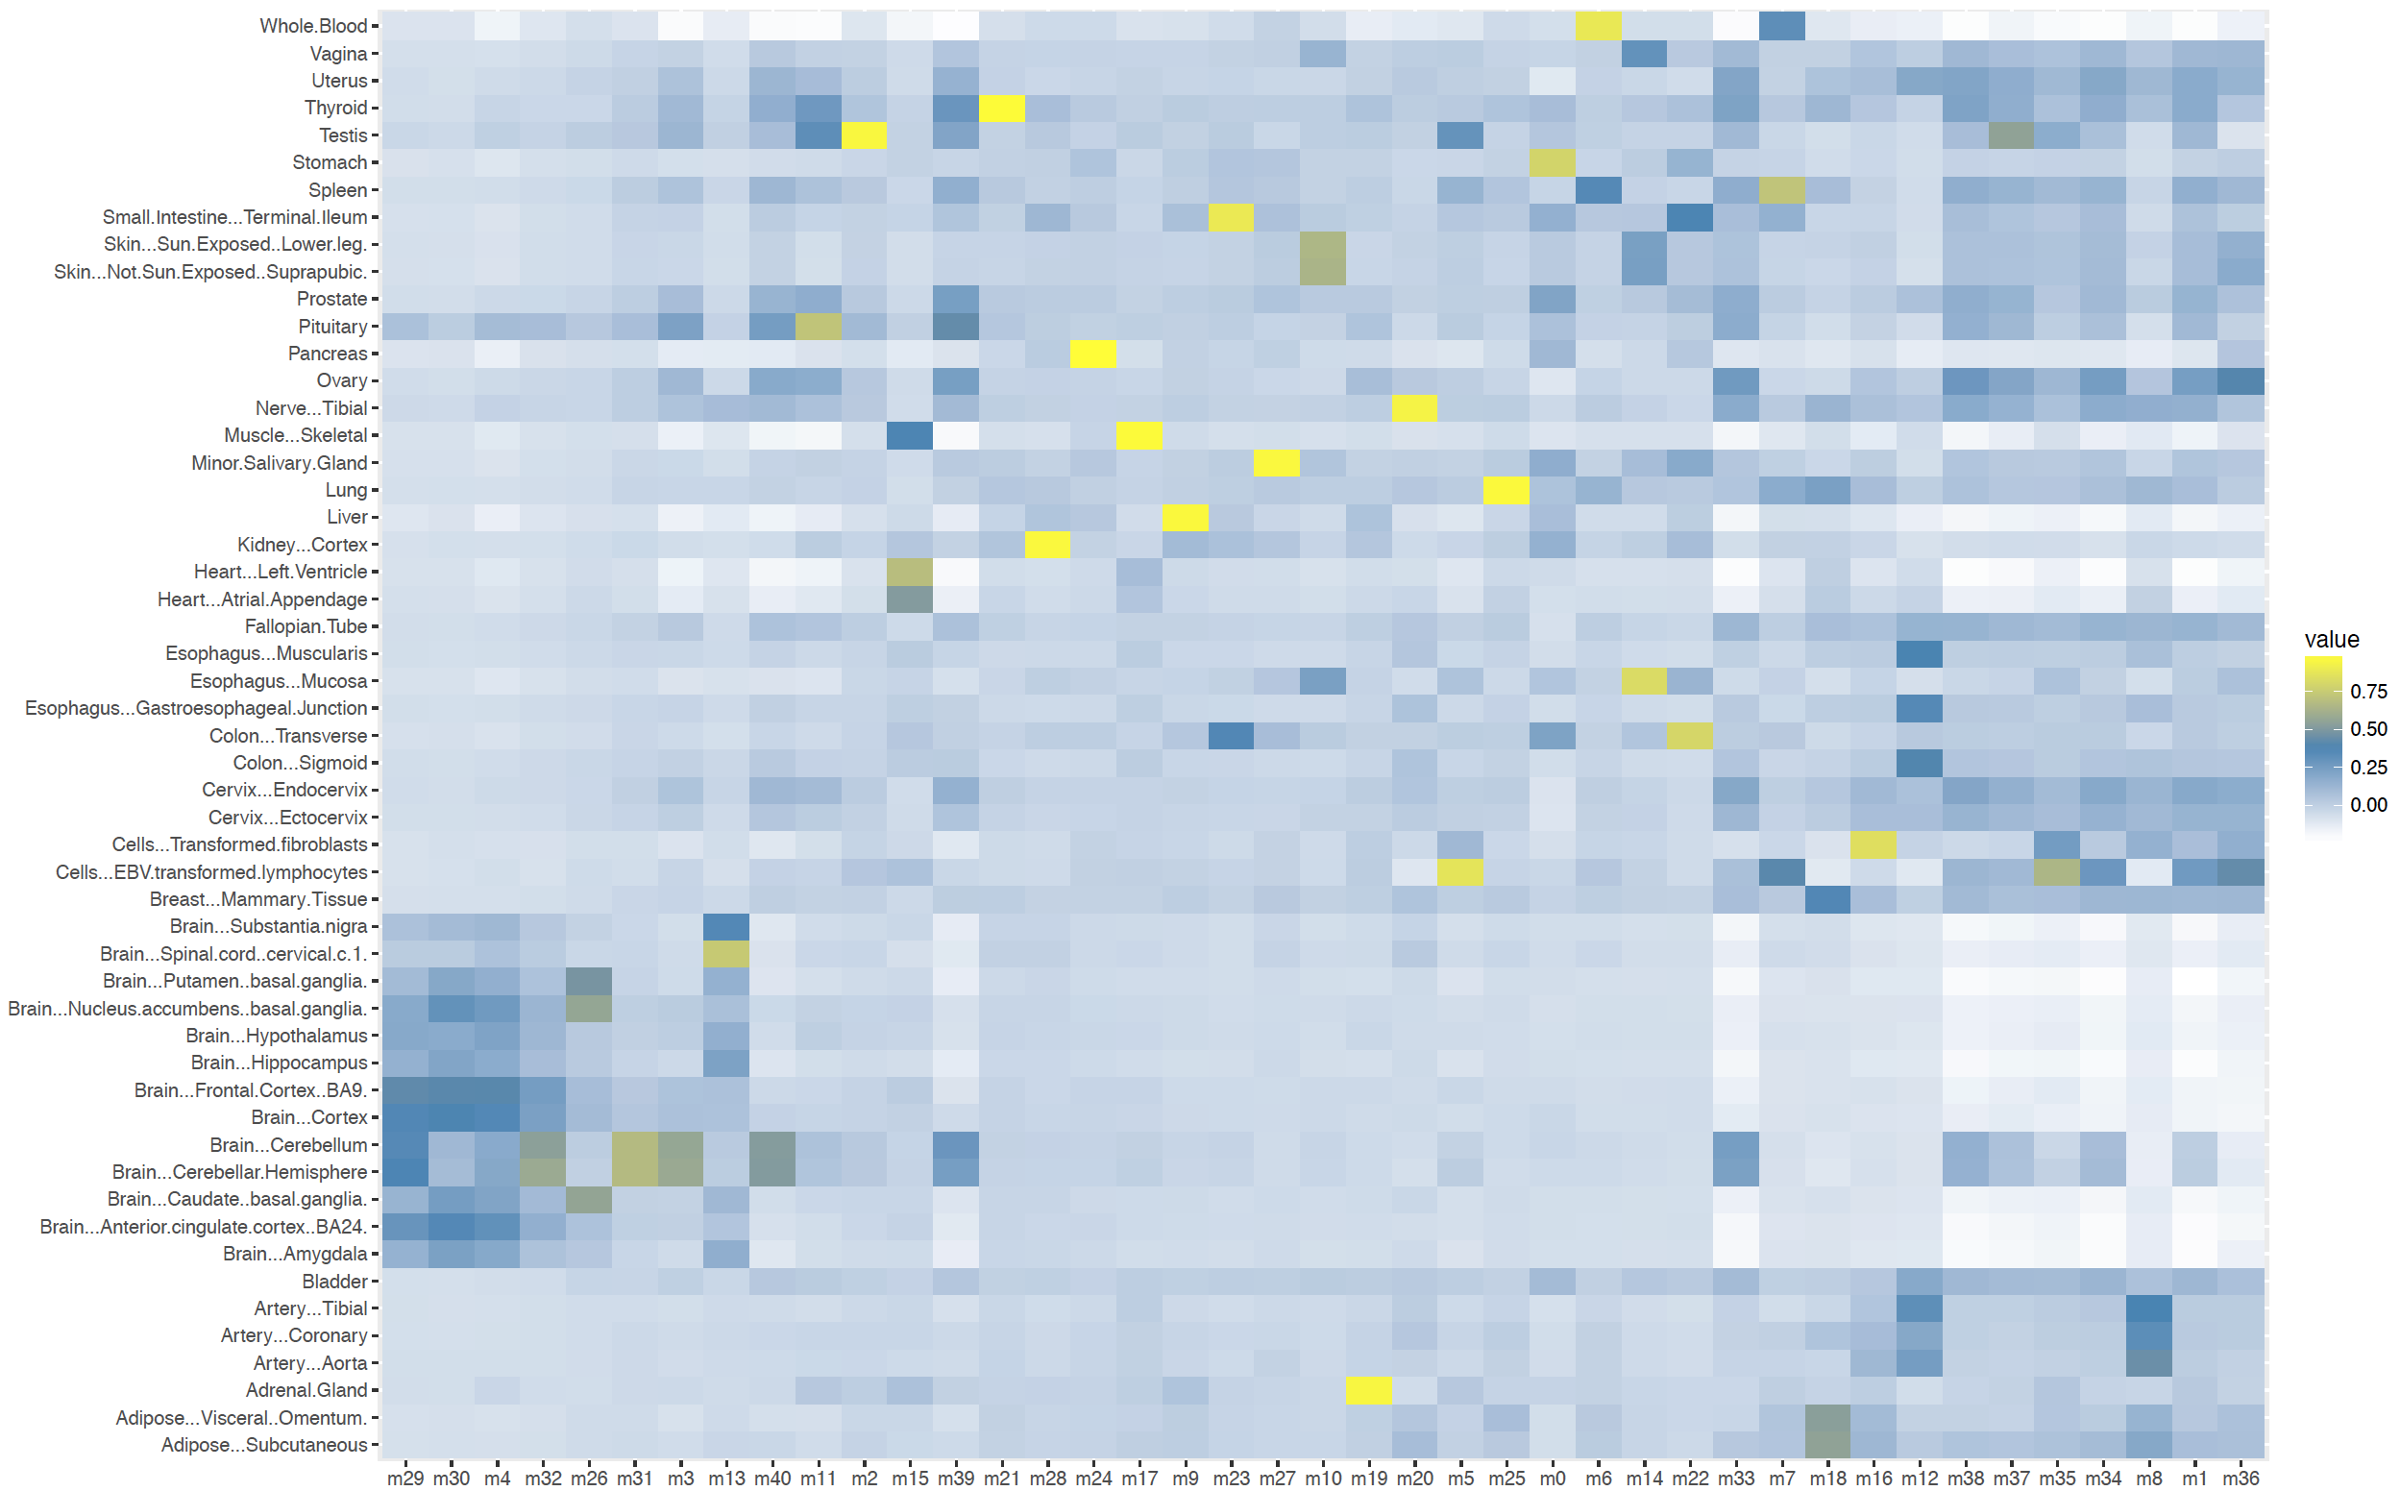
Module eigengenes ordered by brain region correlation
+/-ve corr:
p<0.001:

Slide 7
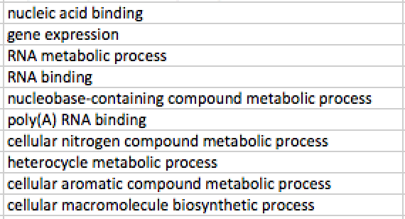
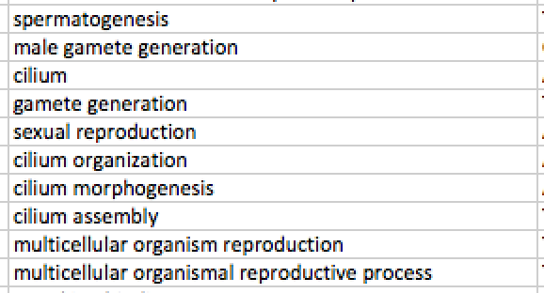
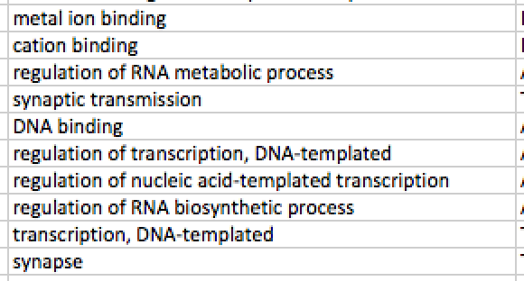
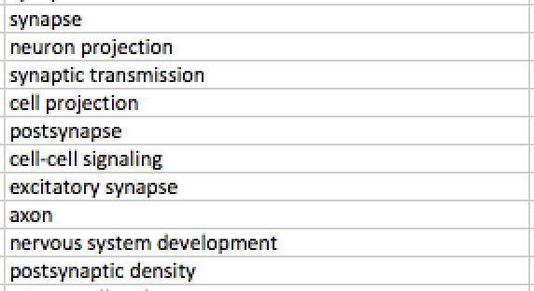
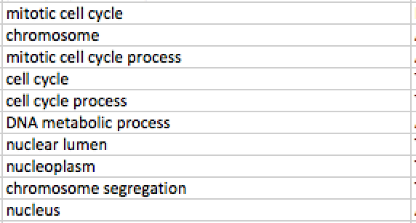
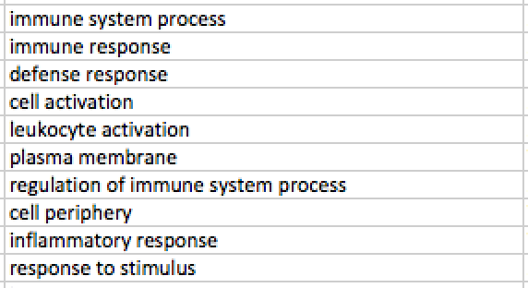
Enriched annotations in largest modules
1
2
3
4
5
6

Slide 8
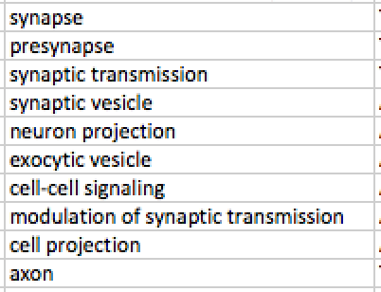
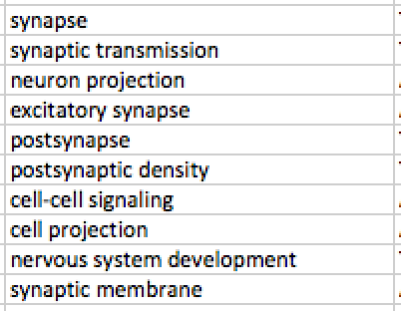
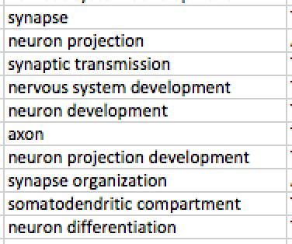
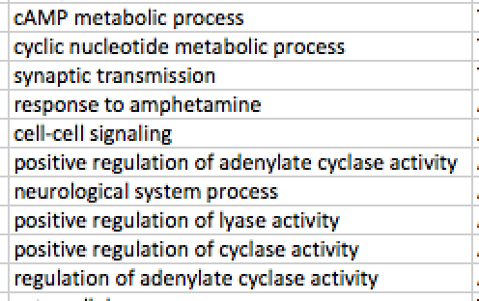
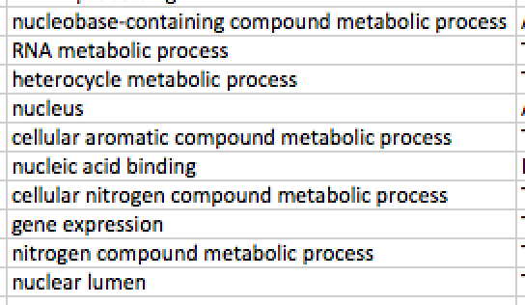
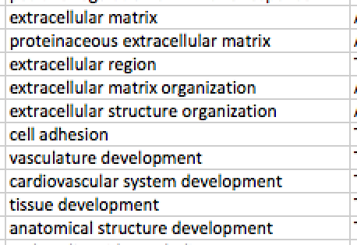
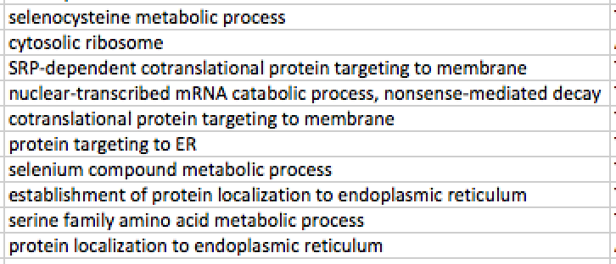
Enriched annotations in brain correlated/anti-correlated modules
Correlated: (also mods 3, 4, 31(3))
29 (4)
30 (4)
32 (3) (cereb+fr.cort)
26 (b. ganglia)
Anti-correlated: (also mod 1)
34 (1)
8
36 (1)

Slide 9
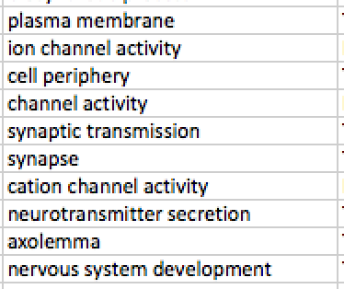
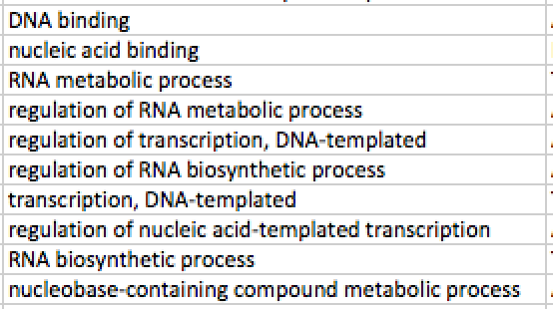
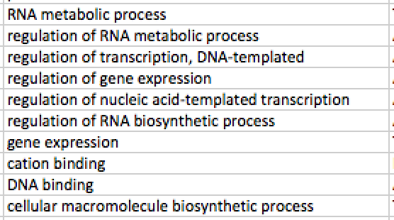
Correlated with Cerebellum but not other brain regions
31 (3)
3
40 (3)
39 (3)

