Slide 1
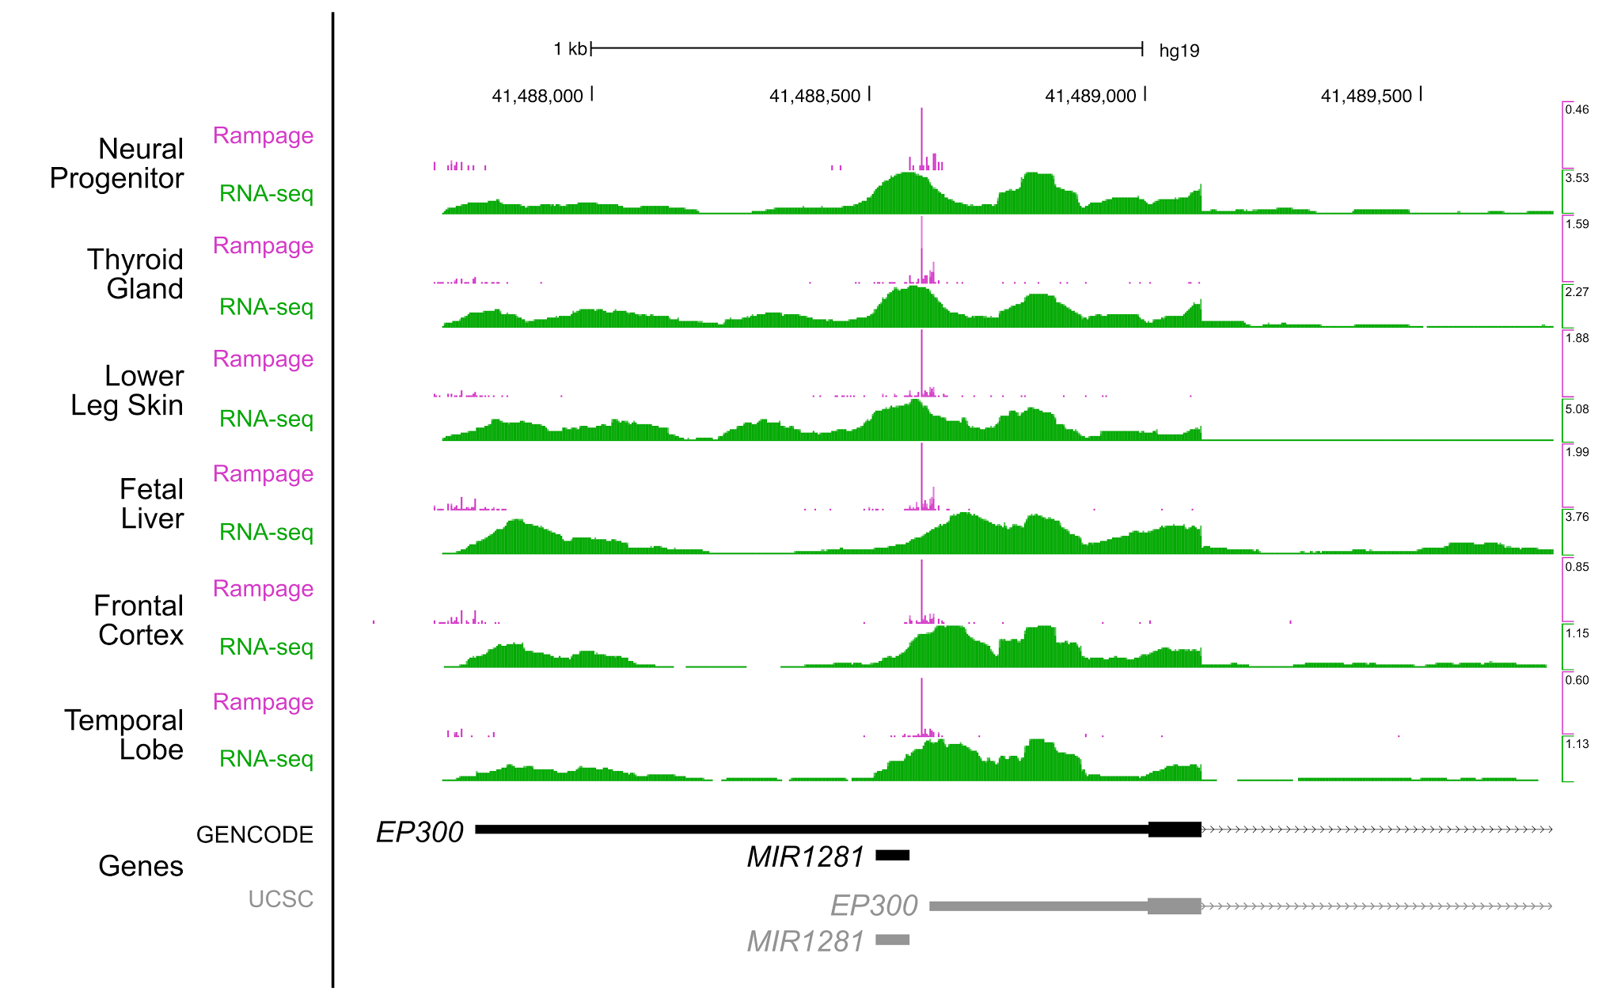
Notes:
Supplementary Fig. 1 | RAMPAGE data signal at EP300. RAMPAGE signals across six human tissues at EP300 demonstrate that both the GENCODE- and UCSC-annotated TSSs for EP300 are active.

Slide 2
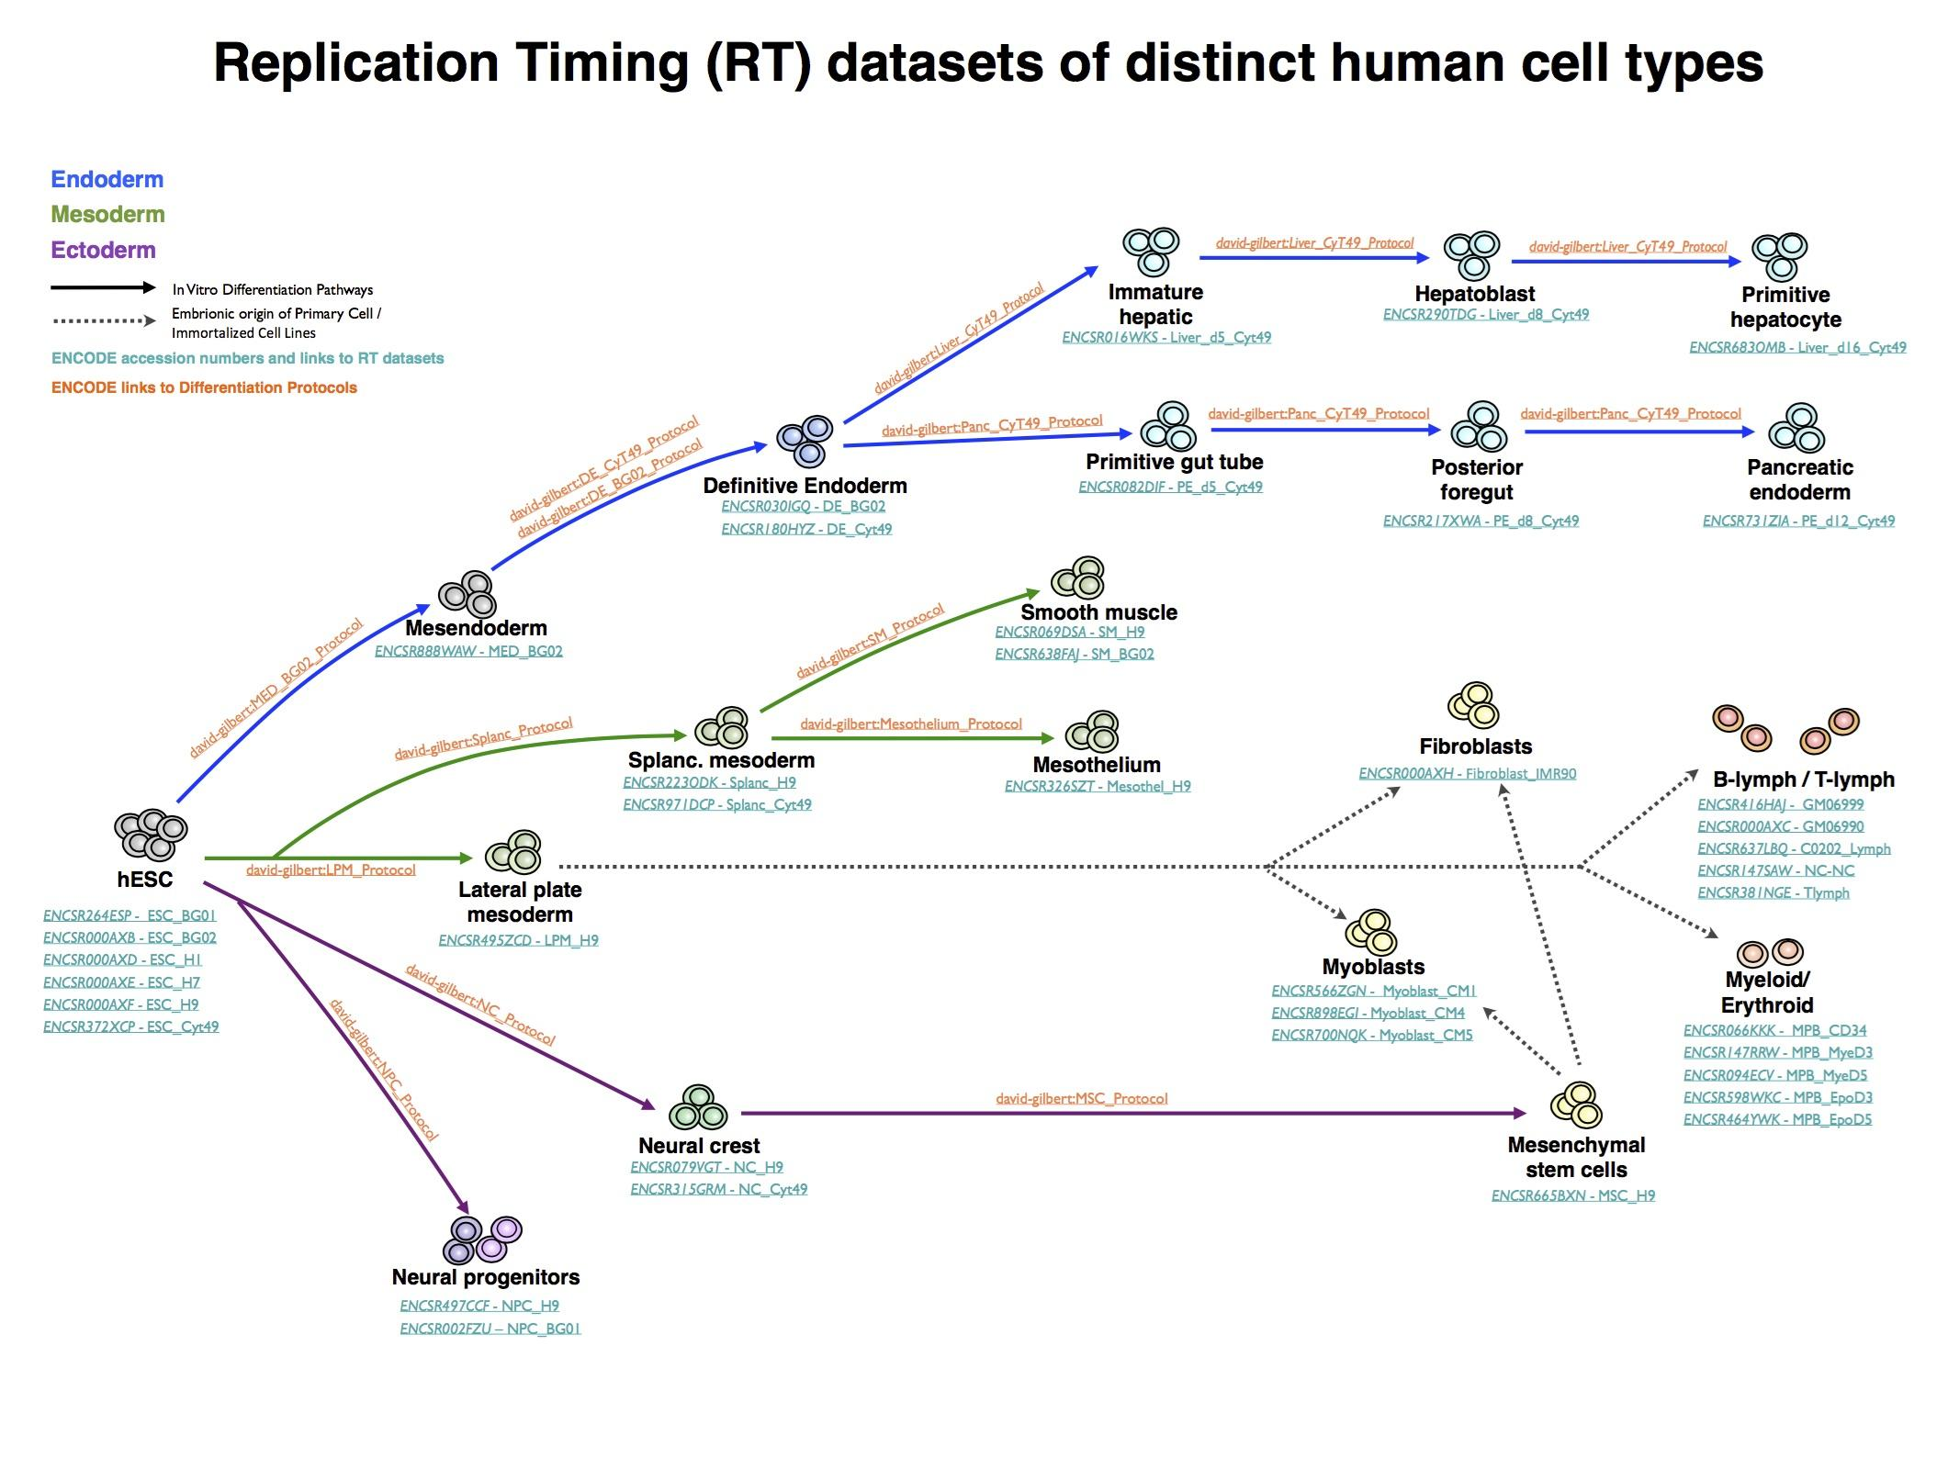
Notes:
Supplementary Fig. 2 | DNA replication timing (RT) programs of distinct human cell types.
Genome-wide RT programs were obtained for distinct human cell types, including embryonic stem cell (hESC)-derived, primary cells and established cell lines representing intermediate stages of endoderm, mesoderm, ectoderm, and neural crest development. Solid arrow lines depict the in vitro differentiation pathways of the distinct cell types from hESCs; dashed arrows depict the embryonic origin of the cell types not derived from hESCs (primary cells and cell lines). Dataset and protocol ENCODE IDs are shown in blue and brown for each cell type.

Slide 3
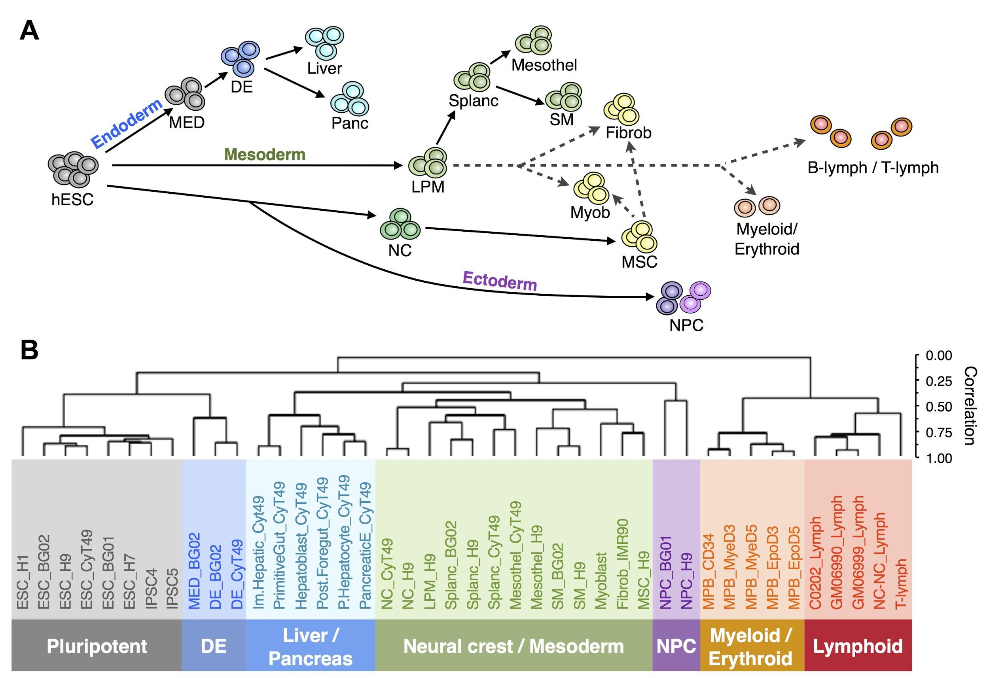
a
b
Notes:
Supplementary Fig. 3 | DNA replication timing (RT) programs are cell type-specific. a, Schematic diagram showing the three germ layers and the neural crest during the early stages of human development and differentiation pathways of the distinct cell types analyzed. b, Hierarchical clustering of RT programs from the distinct human cell types. Branches of the dendrogram were constructed based on the Pearson correlation coefficients between cell types (distance = 1 – correlation value). Clusters of cell types are indicated at the bottom: pluripotent, definitive endoderm (DE), liver and pancreas, neural crest and mesoderm cell types, neural precursors (NPC), myeloid and erythroid progenitors, and lymphoid cells. (NC) neural crest; (MED) mesendoderm; (DE) definitive endoderm; (LPM) lateral plate mesoderm; (Splanc) splanchnic mesoderm; (Mesothel) mesothelium; (SM) smooth muscle; (Myob) myoblasts; (Fibrob) fibroblasts; (MSC) mesenchymal stem cells; (NPC) neural progenitor cells.

Slide 4
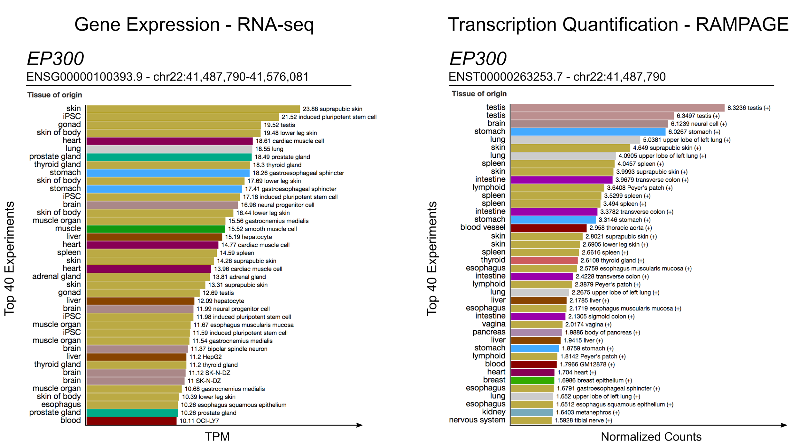
a
b
Notes:
Supplementary Fig. 4 | SCREEN display of gene and TSS expression levels. a, Gene expression of EP300 from whole-cell RNA-seq assays shown in tags per million (TPM). b, RAMPAGE signal at the TSS of ENST00000263253.7 (averaged over ± 50 bp window). Bars are colored by tissue of origin indicated on the left.

Slide 5
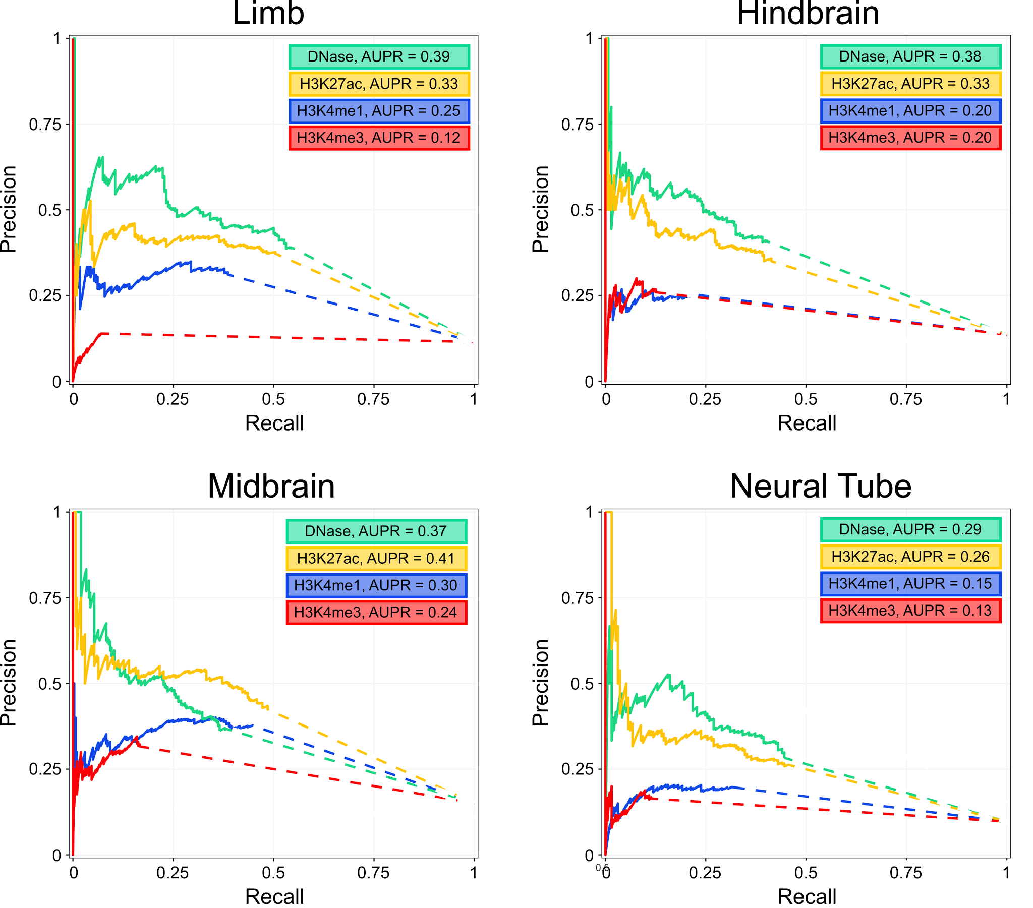
a
b
c
d
Notes:
Supplementary Fig. 5 | Precision-Recall (PR) curves for VISTA enhancer prediction. PR curves for a, limb, b, hindbrain, c, neural tube, and d, midbrain enhancers at e11.5. Colors indicate peaks and signal used for anchoring and ranking the enhancer predictions. All peaks were set to 300 bp centered on their summits and the 20k top-ranked peaks were used for each tissue to ensure consistent genome coverage.

Slide 6
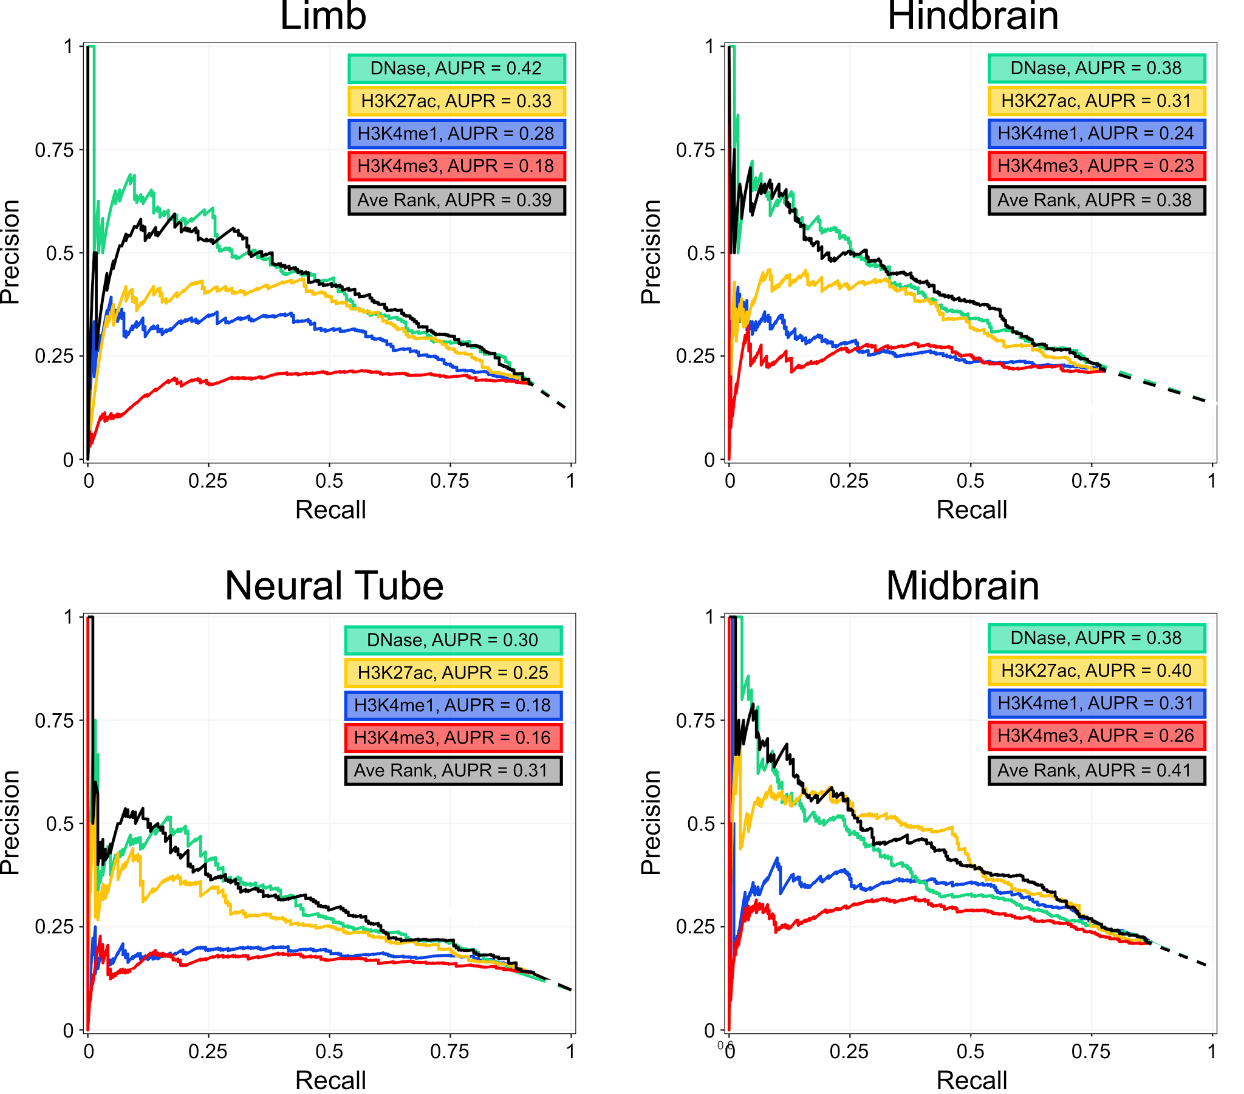
a
b
c
d
Notes:
Supplementary Fig. 6 | Precision-Recall (PR) curves for VISTA enhancer prediction anchored on DHSs. PR curves for a, limb, b, hindbrain, c, neural tube, and d, midbrain enhancers at e11.5. All predictions were anchored on DHSs in the respective tissue. Colors indicate signals used for ranking predictions; black indicates the average of DNase and H3K27ac signals.

Slide 7
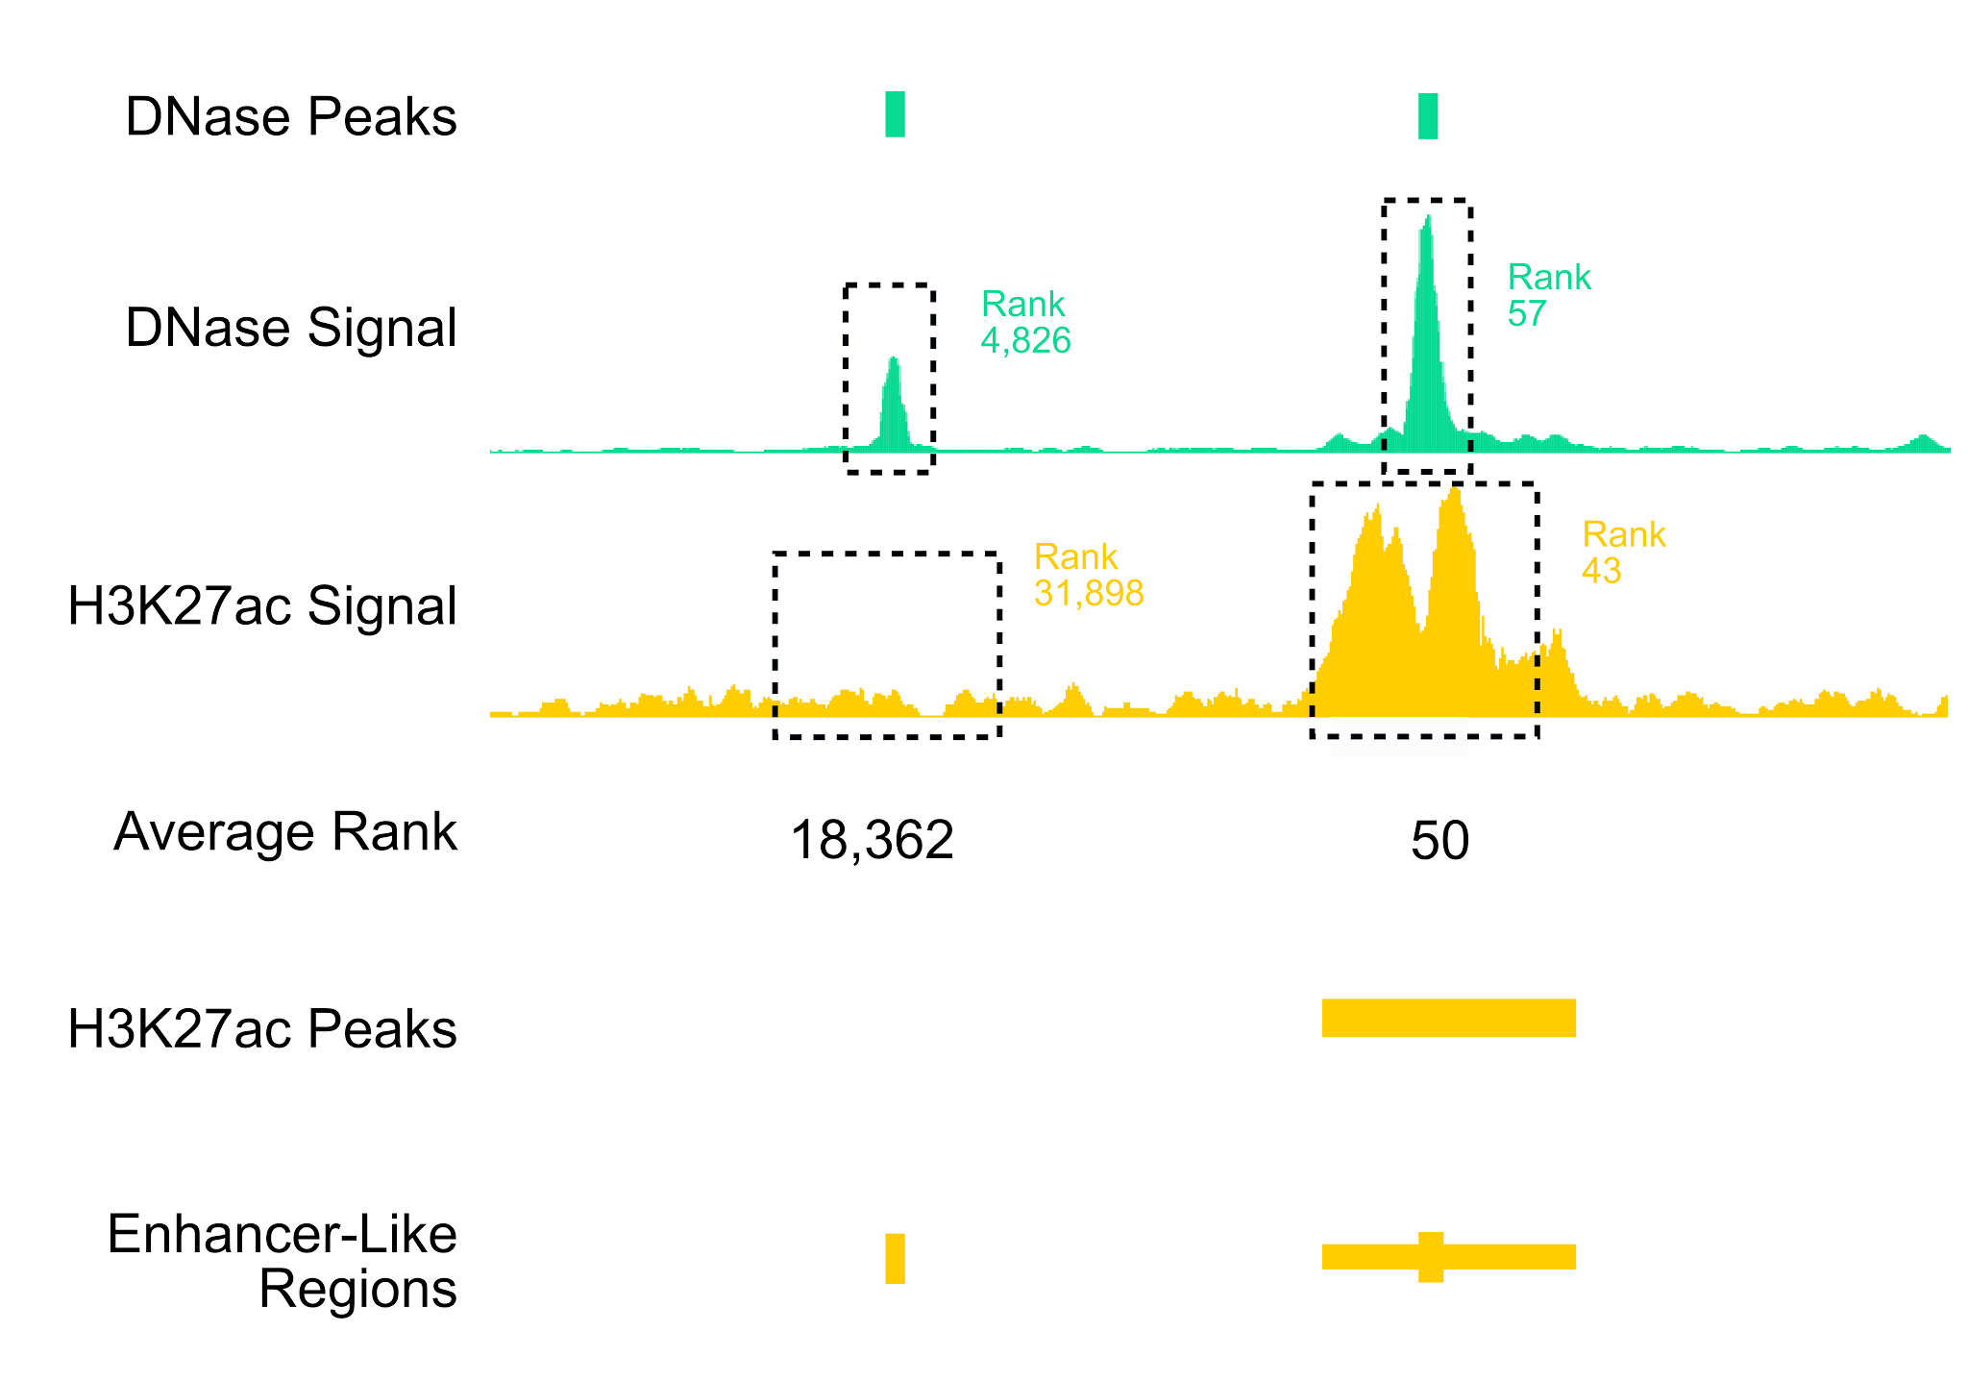
Notes:
Supplementary Fig. 7 | Enhancer prediction using the average rank of DNase and H3K27ac signals. For each tissue, we sorted DNase peaks by the average rank of DNase signal (green) and H3K27ac signal (yellow) and estimated enhancer boundaries using the overlapping H3K27ac peaks.

Slide 8
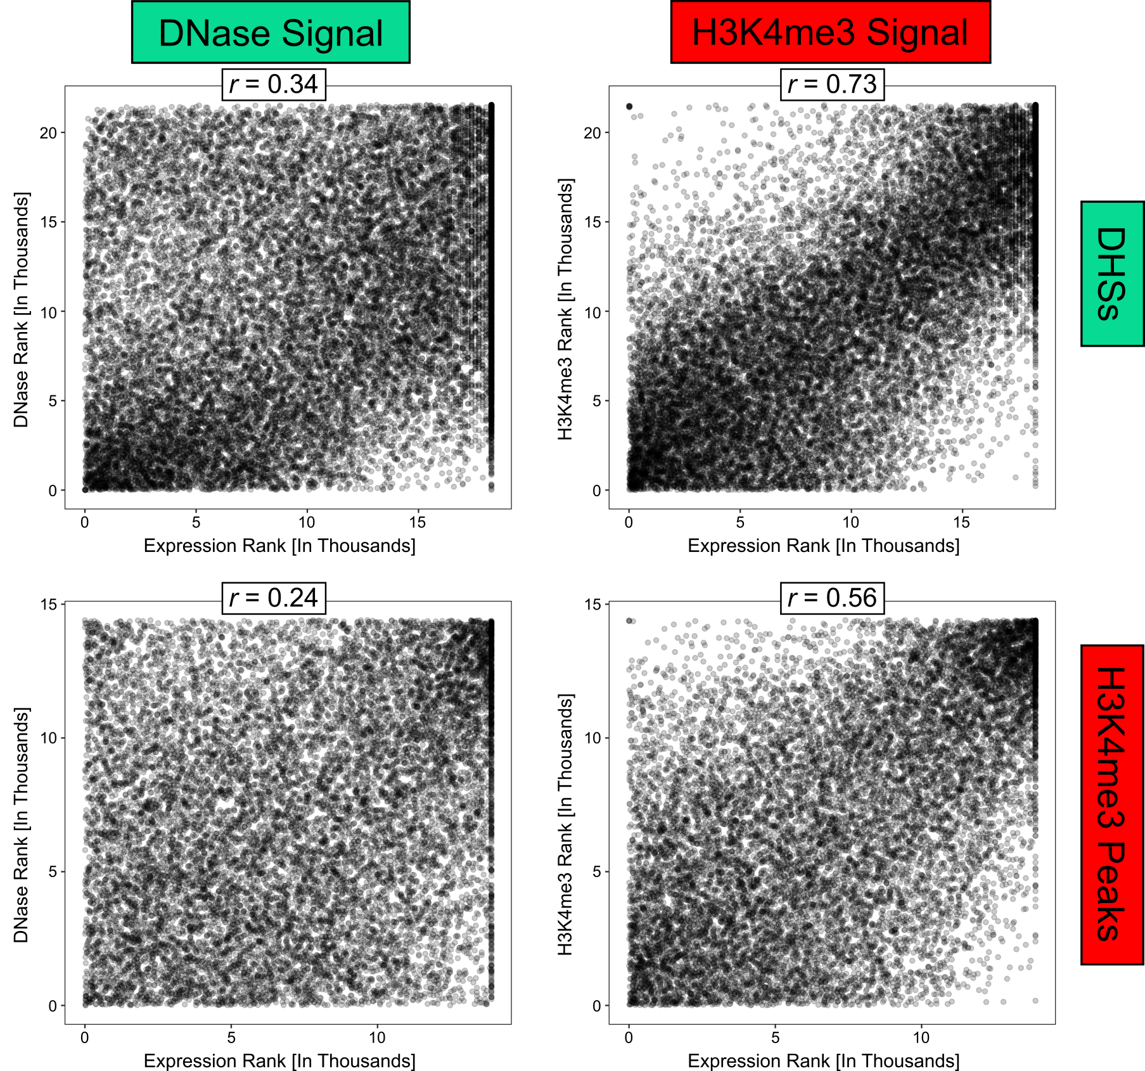
a
b
c
d
Notes:
Supplementary Fig. 8 | Correlation of gene expression with epigenomic signals to predict promoter-like regions in mouse hindbrain e11.5. Scatterplots demonstrating correlation of expression with a) DHSs ranked by DNase signal (r = 0.34), b) DHSs ranked by H3K4me3 signal (r = 0.73), c) H3K4me3 peaks ranked by DNase signal (r = 0.24), and d) H3K4me3 peaks ranked by H3K4me3 signal (r = 0.56).

Slide 9
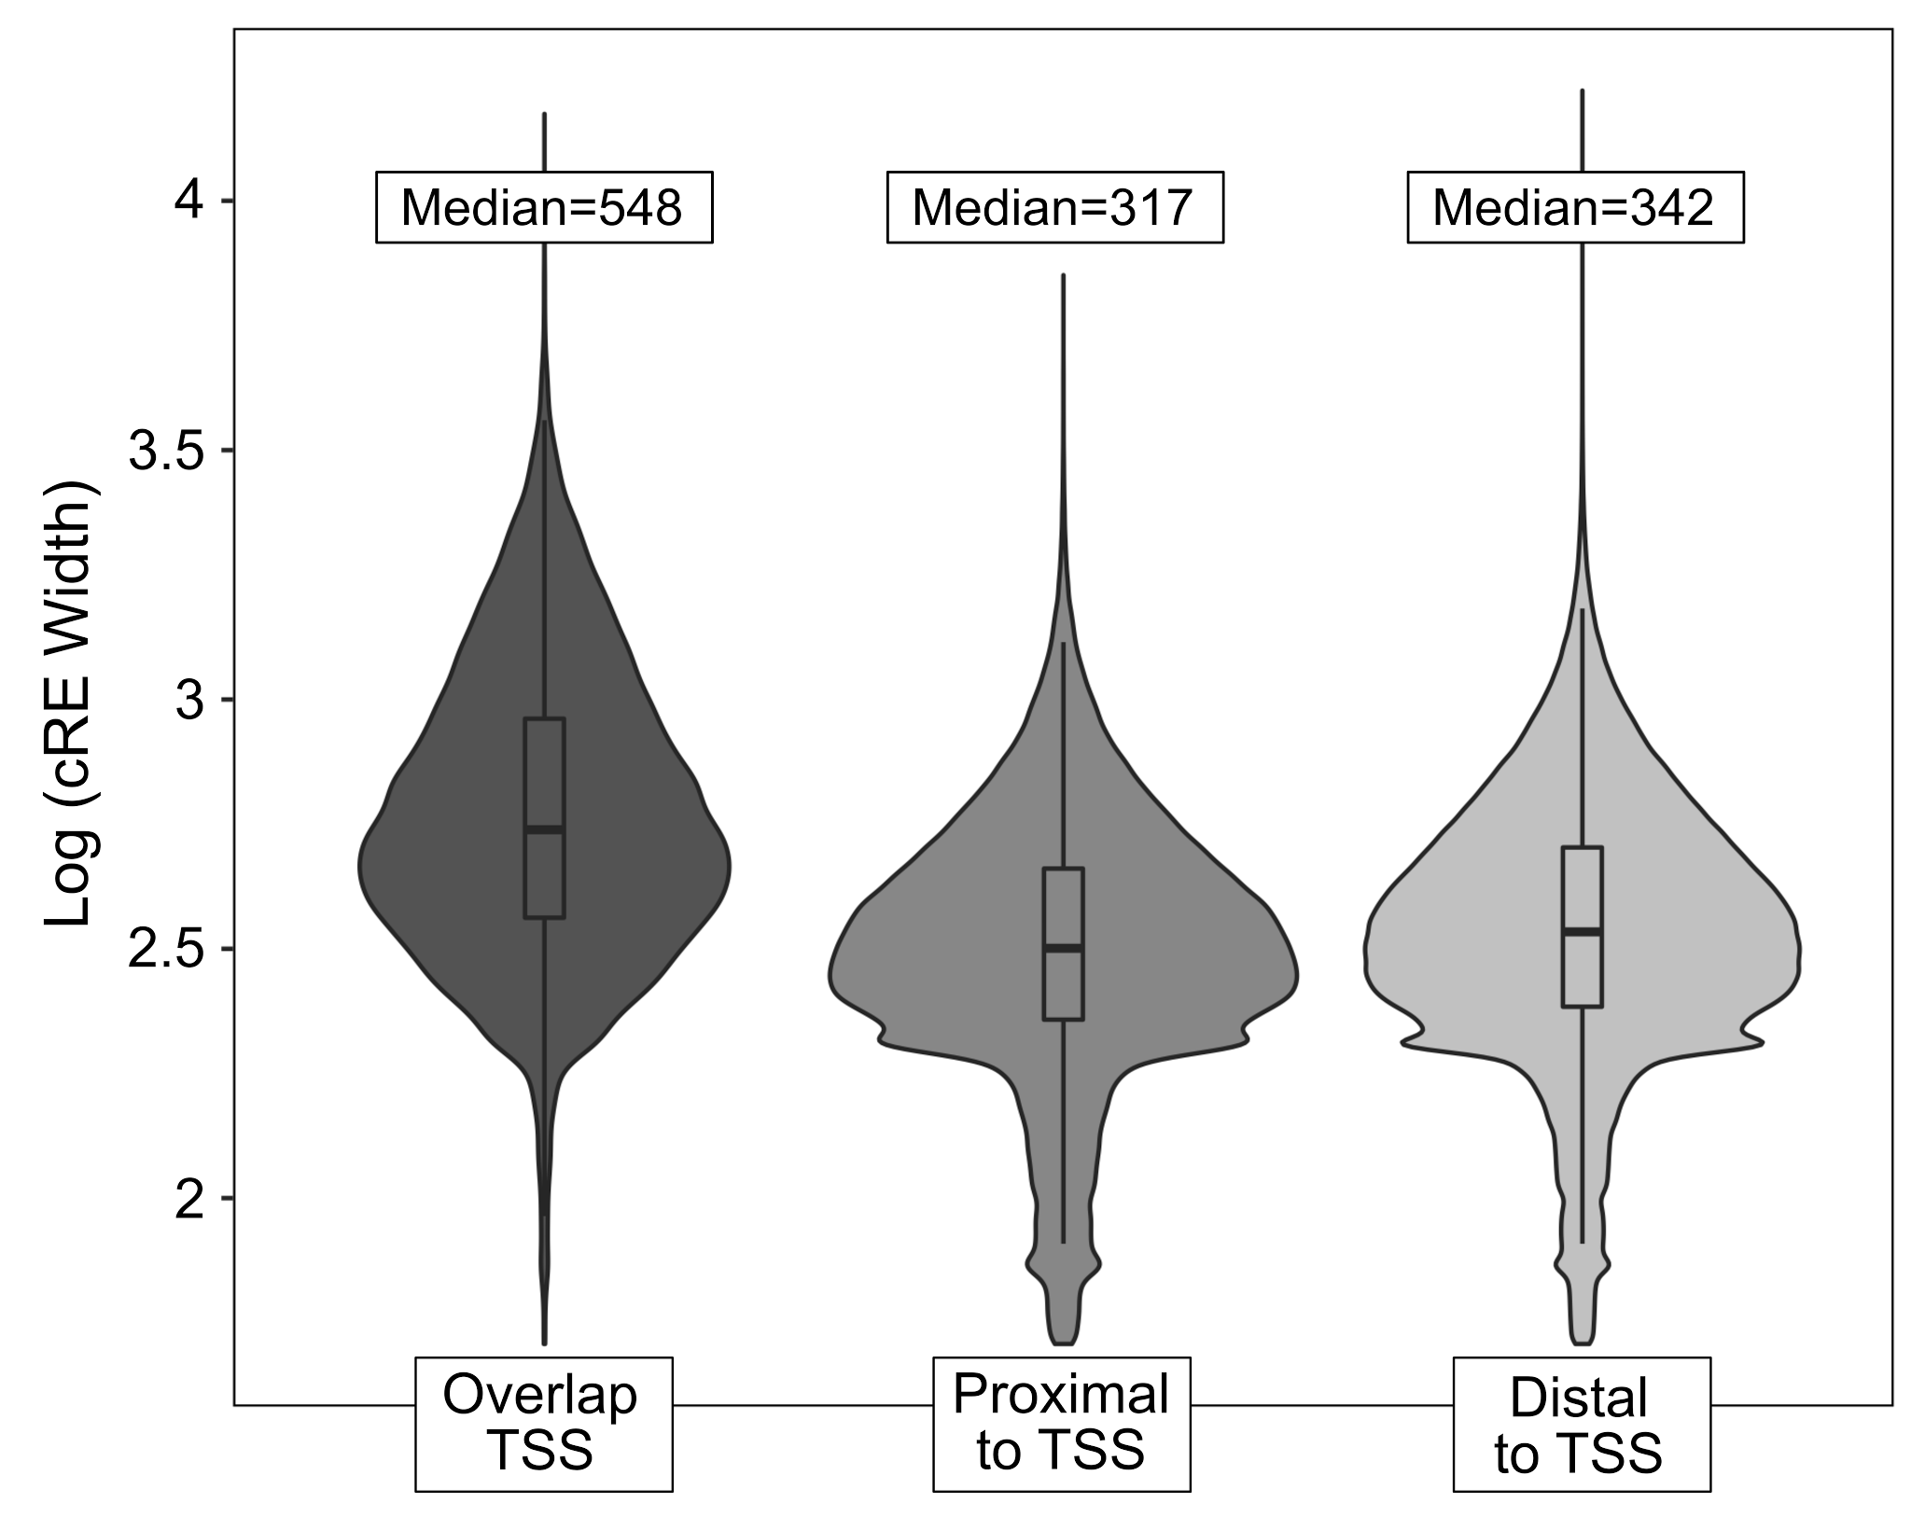
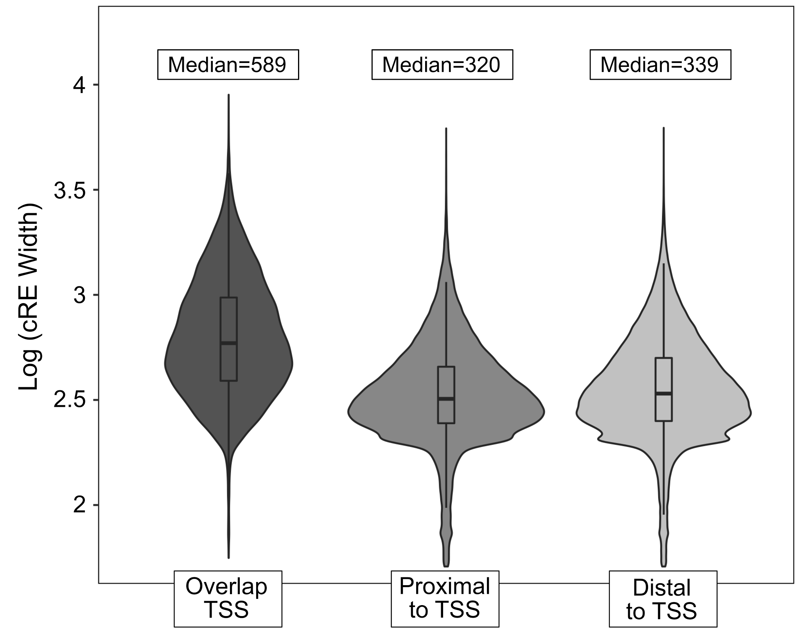
a
Human (hg19)
b
Mouse (mm10)
Notes:
Supplementary Fig. 9 | Distribution of cRE lengths stratified by distance from annotated TSSs. In a, human and b, mouse, cREs that overlap TSSs are longer than non-overlapping cREs (Wilcoxon test p-values < 2.2e-16).

Slide 10
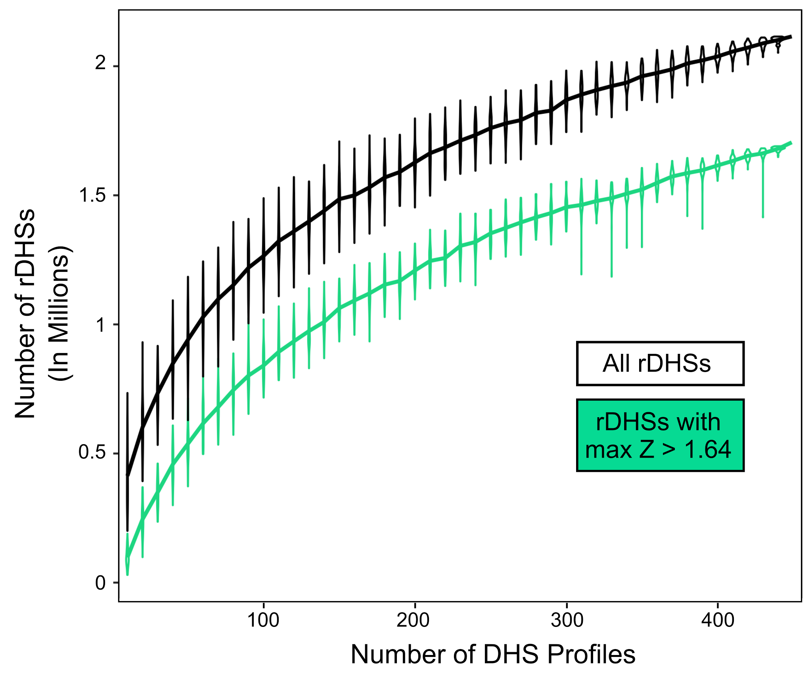
Notes:
Supplemental Fig. 10 | Estimating the total number of rDHSs and cREs in humans. To estimate the coverage of the current Registry of cREs, we generated rDHSs using varying numbers of cell types, randomly selecting the datasets each time. After performing this randomization 100 times for 10 to 440 cell types, we estimated the number of rDHSs at 95% saturation using a Weibull distribution (r²=0.99). We estimate that there are in total 2,677,746 rDHS and among them 1,760,045 have max-Z > 1.64. At 440 cell types, we have 2,115,300 rDHSs with 1,661,868 having max-Z > 1.64. Because only a subset of the 1,760,045 rDHSs max-Z > 1.64 can be cREs—those that are also supported by H3K4me3, H3K27ac, or CTCF in at least one cell type—the current coverage of the Registry is (1,310,152/1,760,045 = 74.4%).

Slide 11
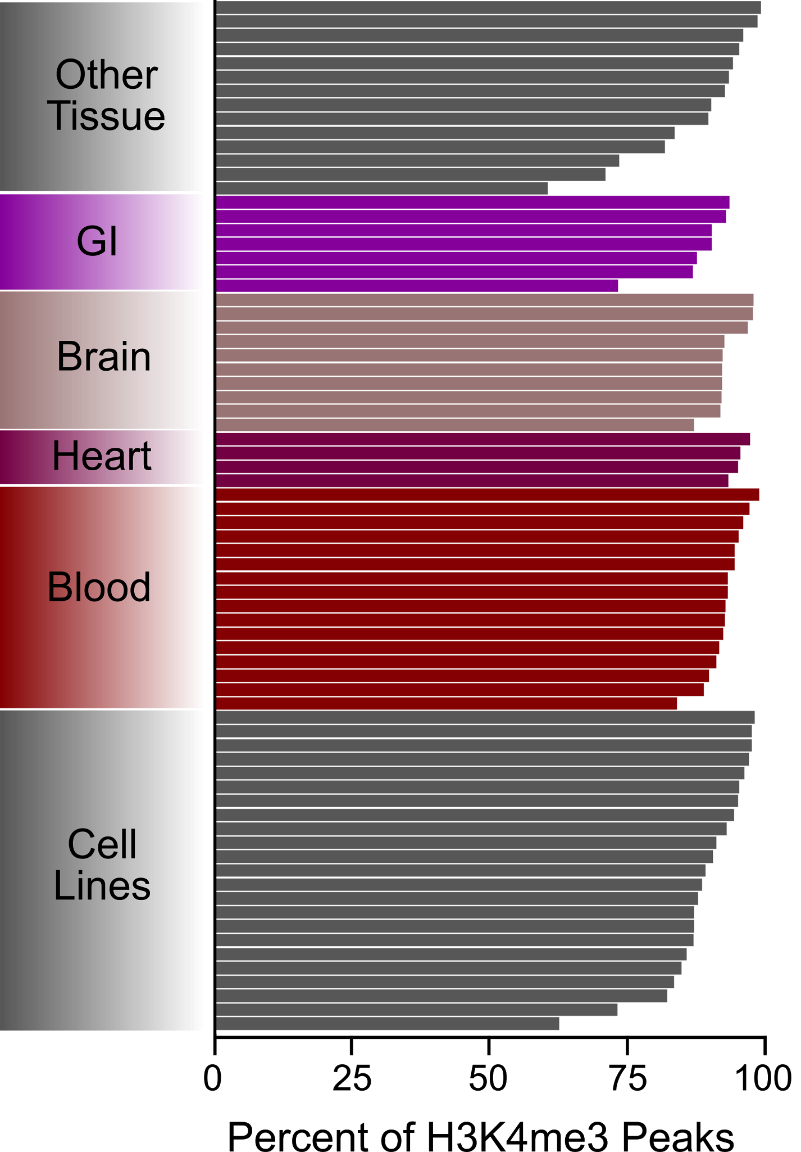
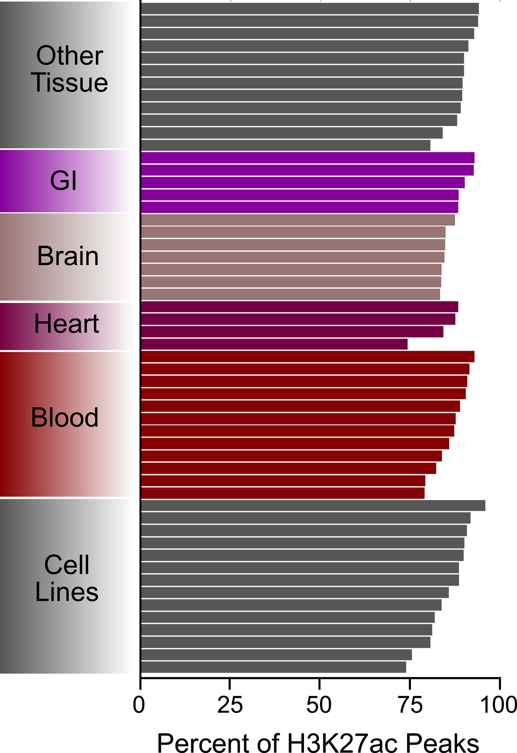
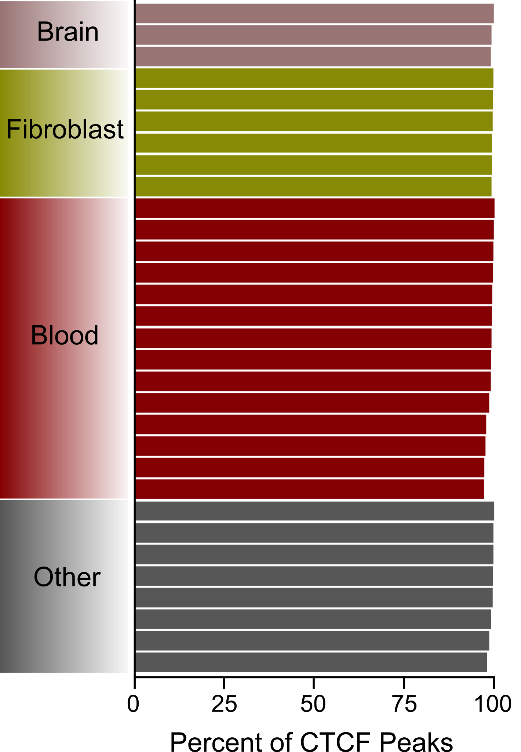
hg19 H3K4me3
hg19 H3K27ac
hg19 CTCF
a
b
c
Notes:
Supplementary Fig. 11 | Coverage of histone mark and CTCF peaks by the current human Registry of cREs. Overlap of cREs with a, H3K4me3 peaks, b, H3K27ac peaks and c, CTCF peaks from cell types without DNase data. On average 89.7%, 86.8%, and 99.1% of H3K4me3, H3K27ac, and CTCF peaks respectively overlap a cRE.

Slide 12
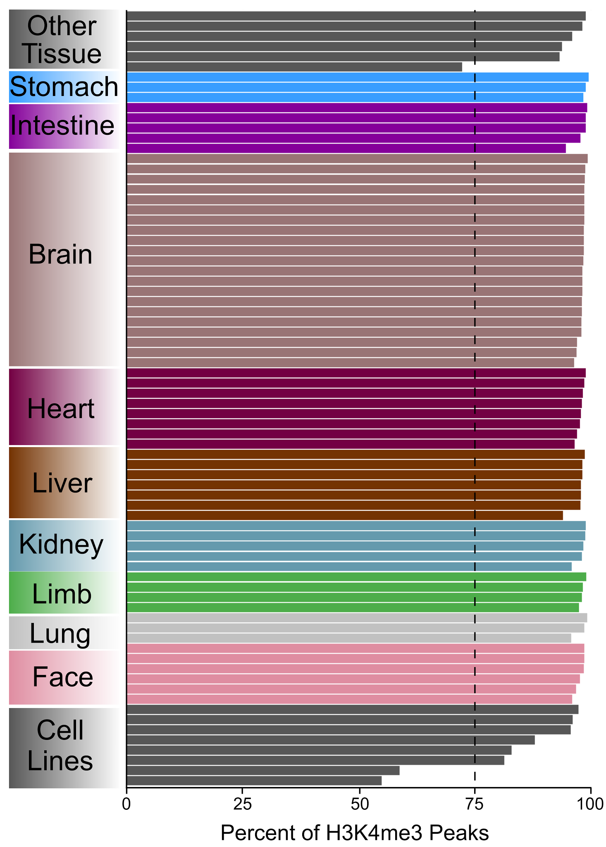
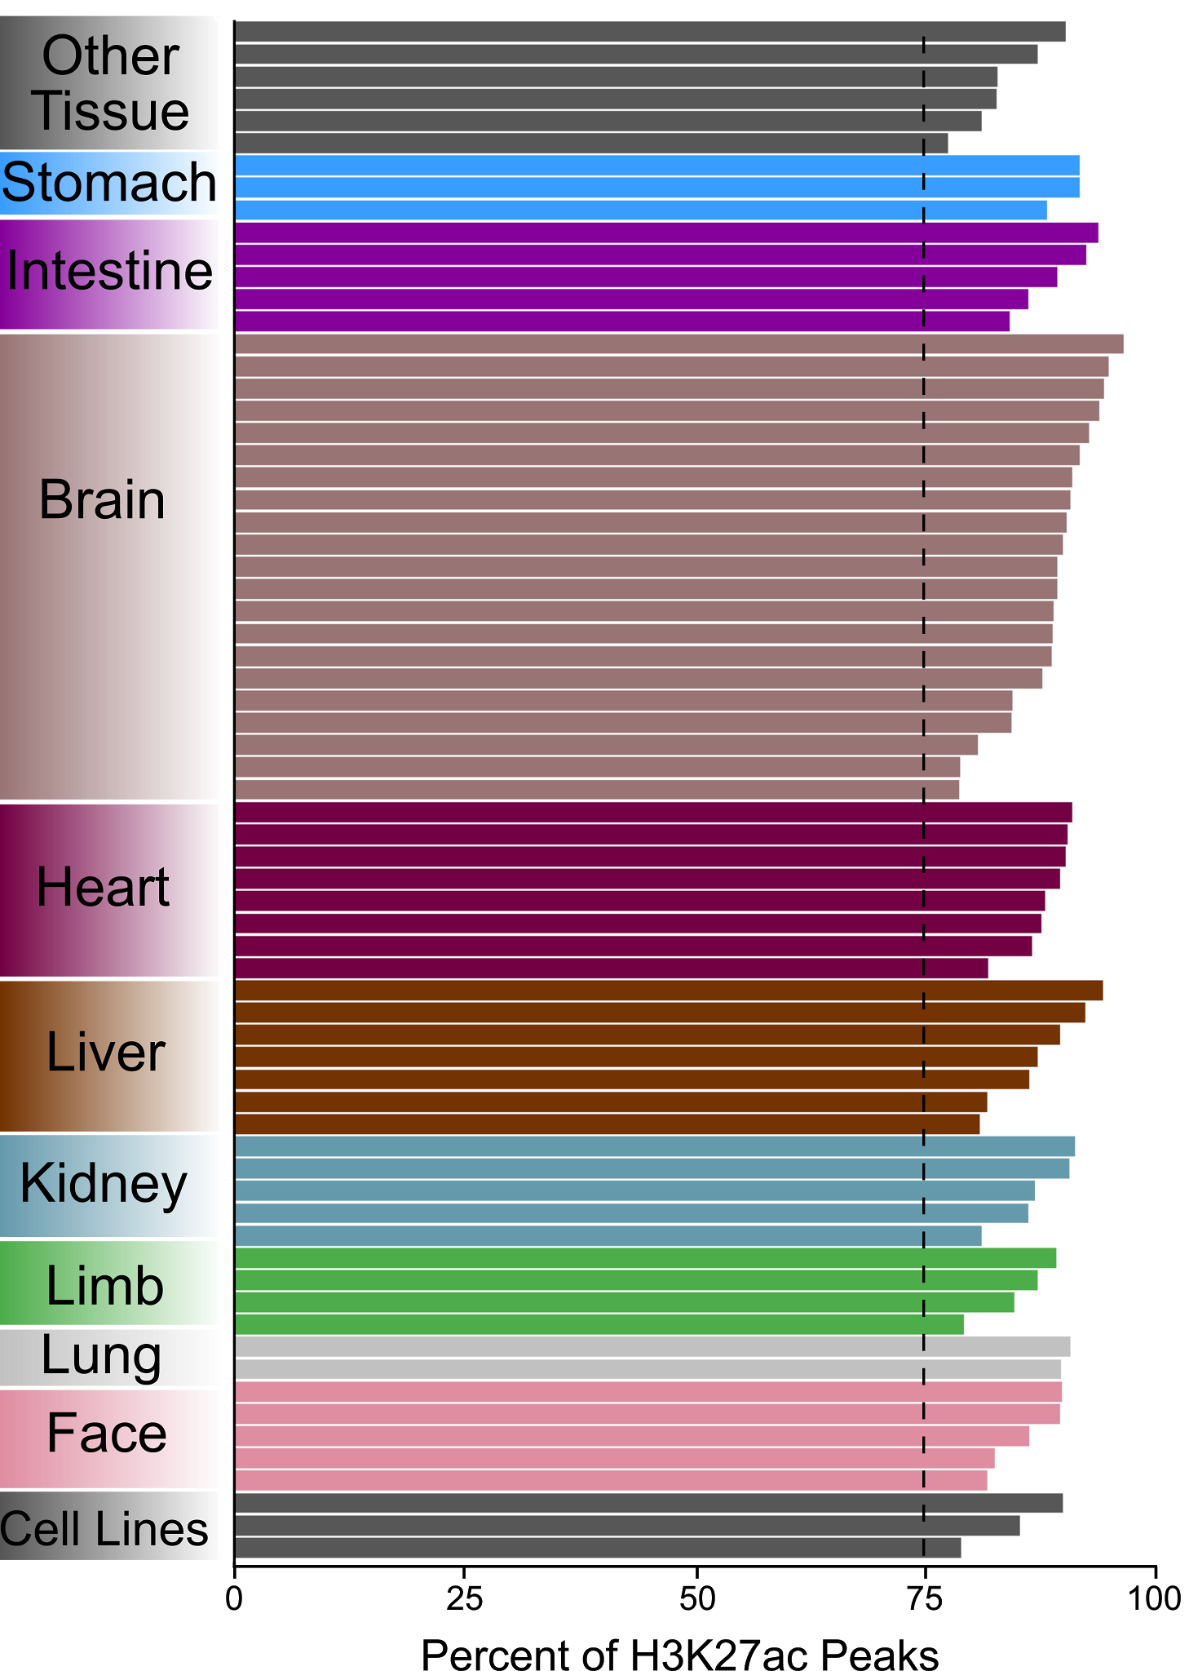
mm10 H3K4me3
mm10 H3K27ac
a
b
Notes:
Supplementary Fig. 12 | Coverage of histone mark peaks by the current mouse Registry of cREs. Overlap of cREs with a, H3K4me3 peaks and b, H3K27ac peaks from cell types without DNase data. On average 95.8% and 87.6% of H3K4me3 and H3K27ac peaks respectively overlap a cRE.

Slide 13
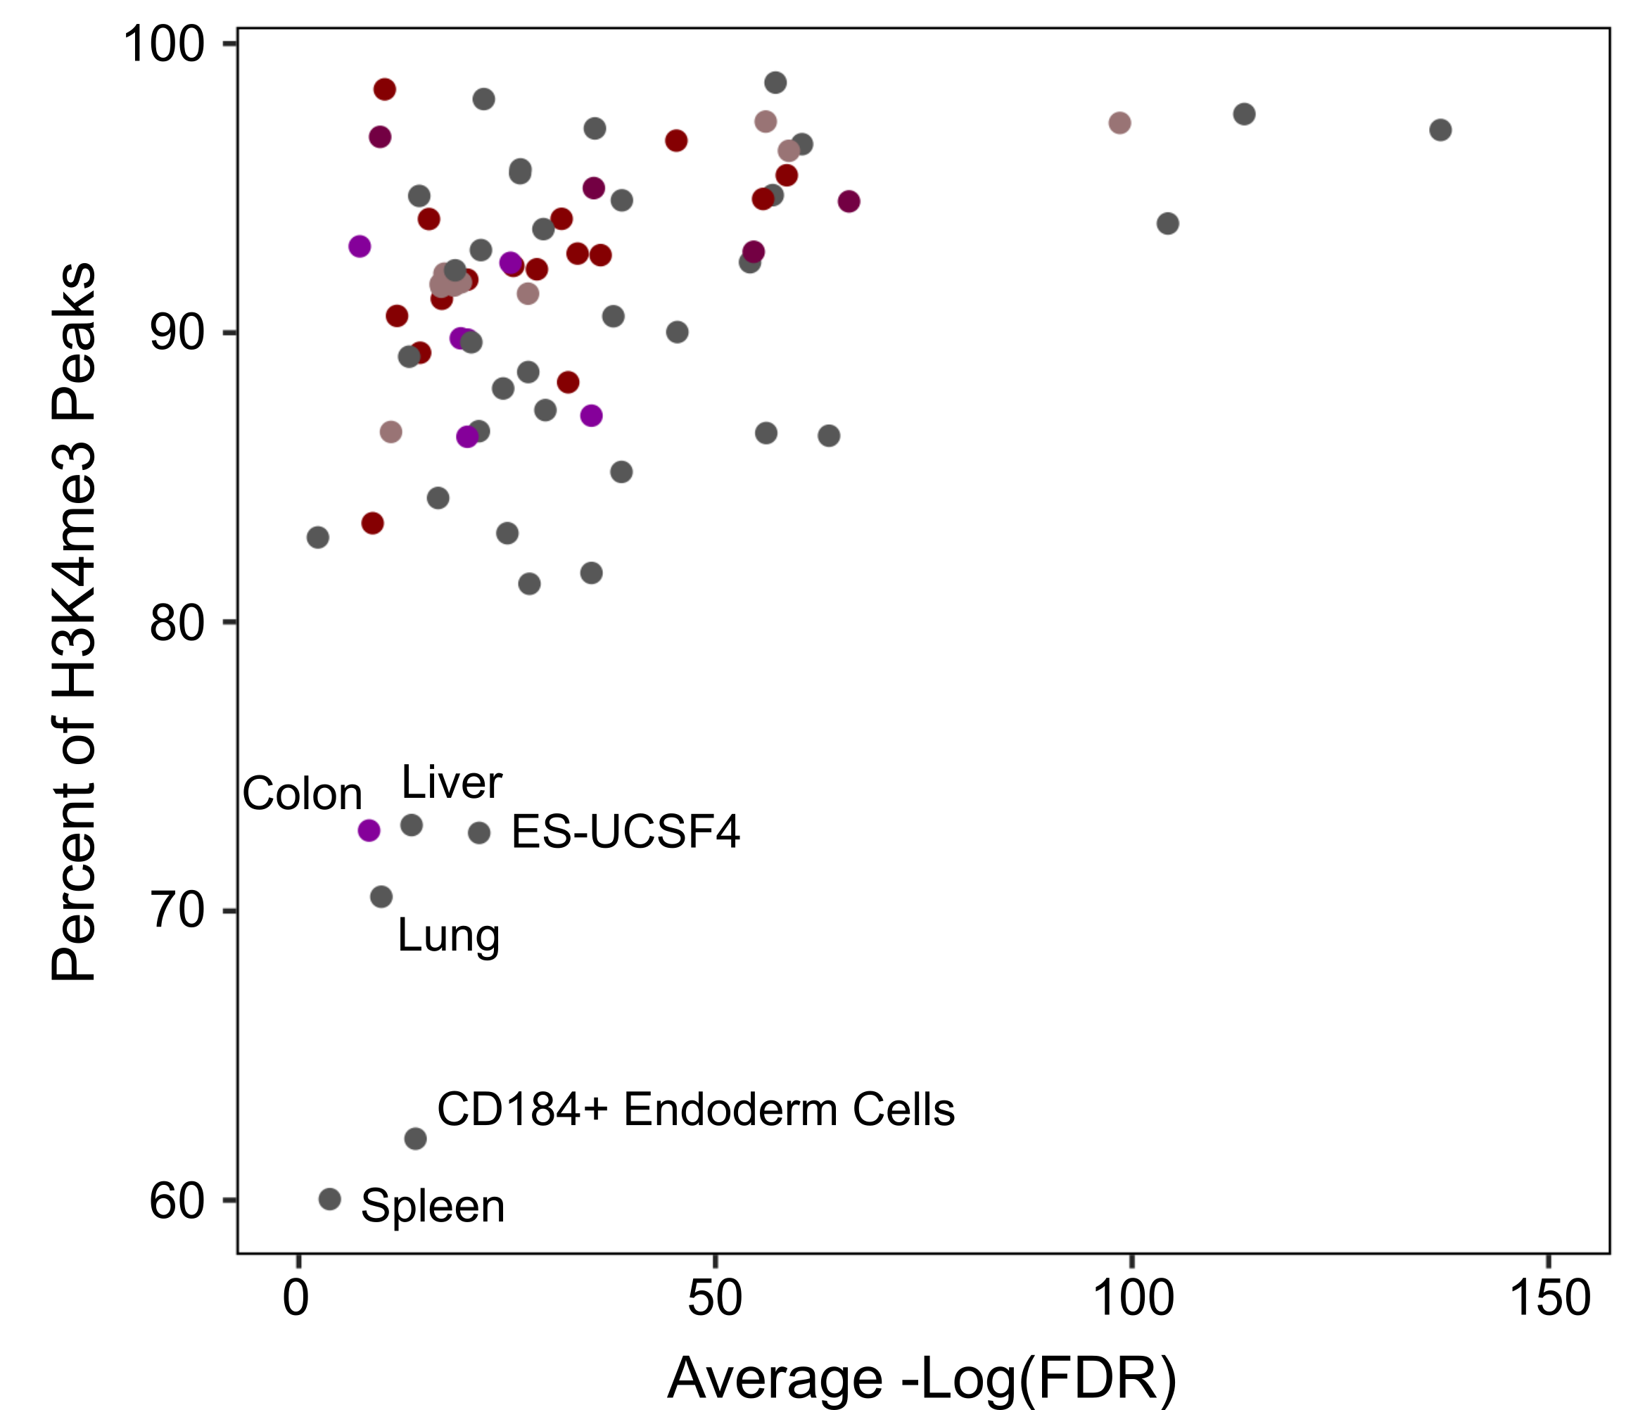
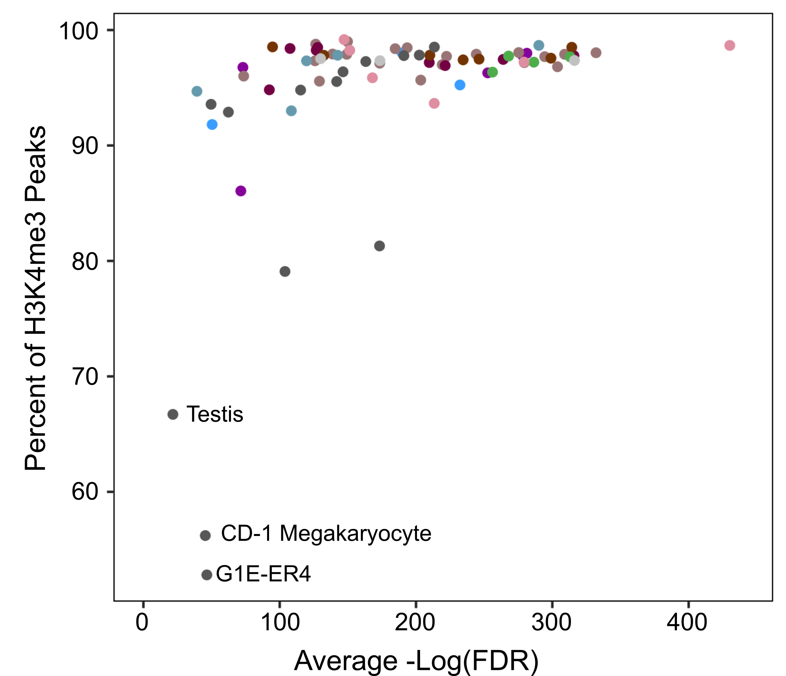
a
b
hg19
mm10
Notes:
Supplementary Fig. 13 | Coverage of the H3K4me3 peaks by the current Registry of cREs is plotted against the average -log(FDR) of the H3K4me3 peaks. In a, human and b, mouse, cell-types with peaks that have a lower average -log(FDR) across all peaks tend to have a lower percentage of peaks covered. Manual inspection reveals that this is due to lower-signal, false-positive peaks called by the algorithm for these datasets.

Slide 14
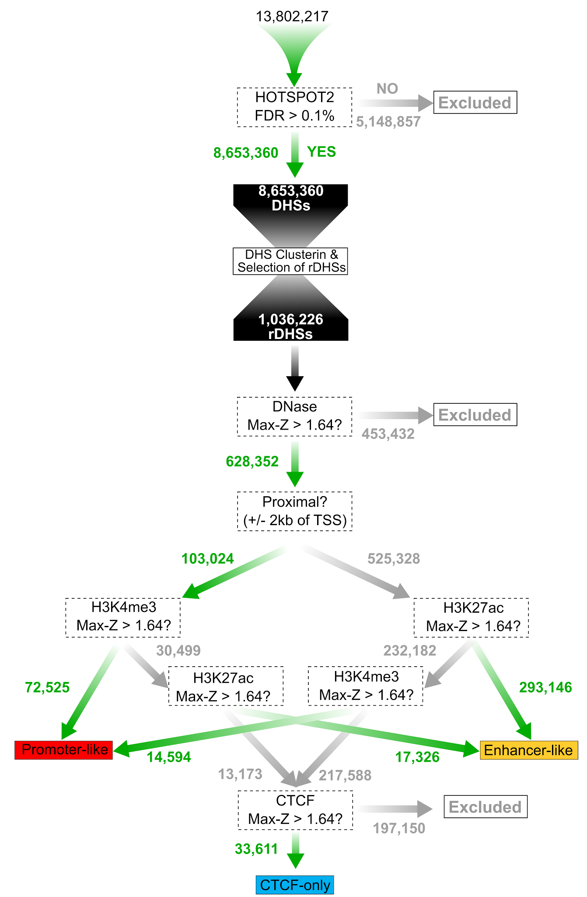
Notes:
Supplementary Fig. 14 | Method for classifying cREs in mouse. This figure corresponds to Fig. 4a, but for mouse. We begin by clustering high quality DHSs (FDR > 0.1%) to create representative DHSs (rDHSs). For each assay (DNase, H3K4me3, H3K27ac or CTCF), we calculate a Z-score for every rDHS in a particular cell or tissue type. We then obtain the maximum Z-score across all cell types, known as the Max-Z. Using the Max-Z as well as the distance to the nearest TSS, we classify cREs into three cell-type agnostic groups using the decision tree: cREs with promoter-like signatures, cREs with enhancer-like signatures, and cREs bound by CTCF only.

Slide 15
a
b
Notes:
Supplementary Fig. 15 | Genomic coverage by the Registry of cREs. Percent of the DNase-mappable (36 nt, single-end reads) genome covered by each group of cREs in a, human and b, mouse.

Slide 16
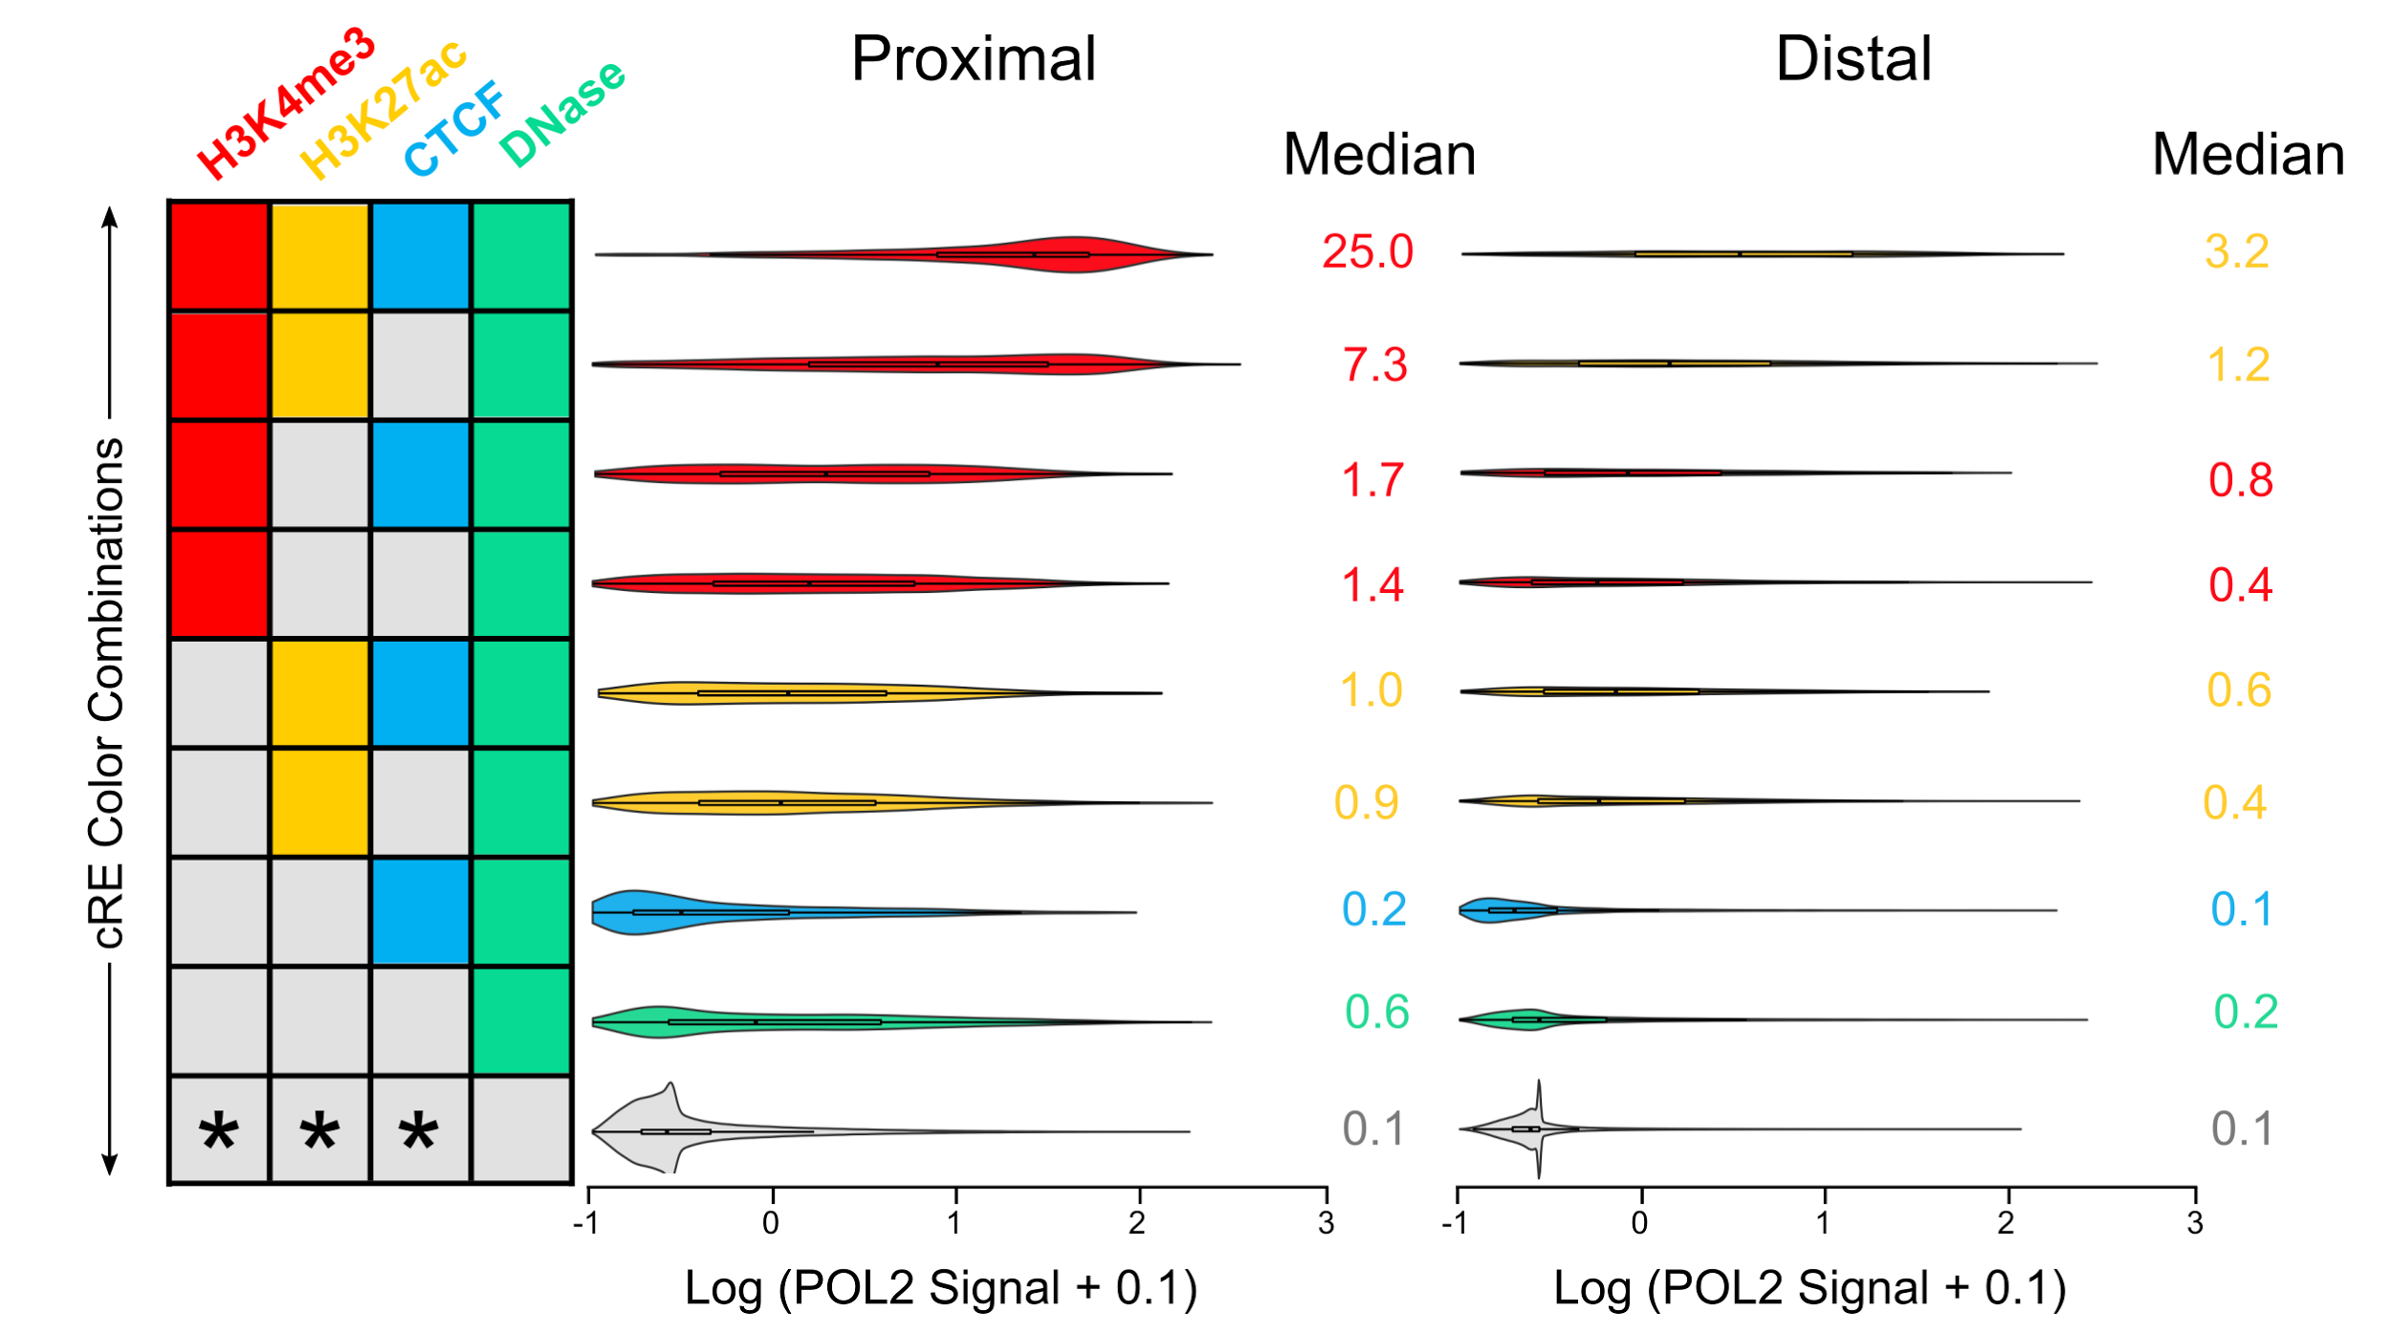
5,293
1,291
24,445
12,247
1,027
450
3,223
1,584
397
1,214
2,191
10,399
2,375
8,538
4,046
12,039
Notes:
Supplementary Fig. 15 | POL2 signals for GM12878 cREs. Violin plots show the average POL2 signal for cREs belonging to each of the nine cRE states. cREs proximal and distal to the nearest TSSs are displayed separately. Median values are displayed along with the number of cREs in each state. These median values are used in Supplementary Fig. 18.

Slide 17
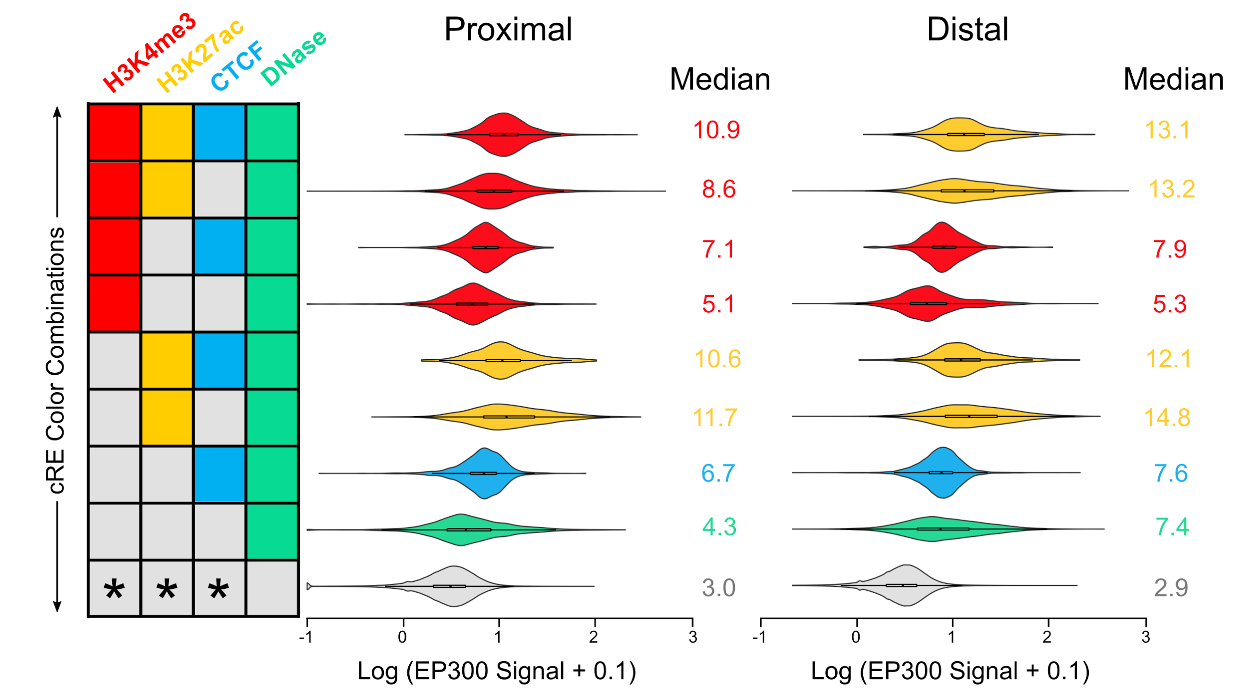
5,293
1,291
24,445
12,247
1,027
450
3,223
1,584
397
1,214
2,191
10,399
2,375
8,538
4,046
12,039
Notes:
Supplementary Fig. 17 | EP300 signals for GM12878 cREs. Violin plots show the average EP300 signal for cREs belonging to each of the nine cRE states. cREs proximal and distal to the nearest TSSs are displayed separately. Median values are displayed along with the number of cREs in each state. These median values are used in Supplementary Fig. 18.

Slide 18
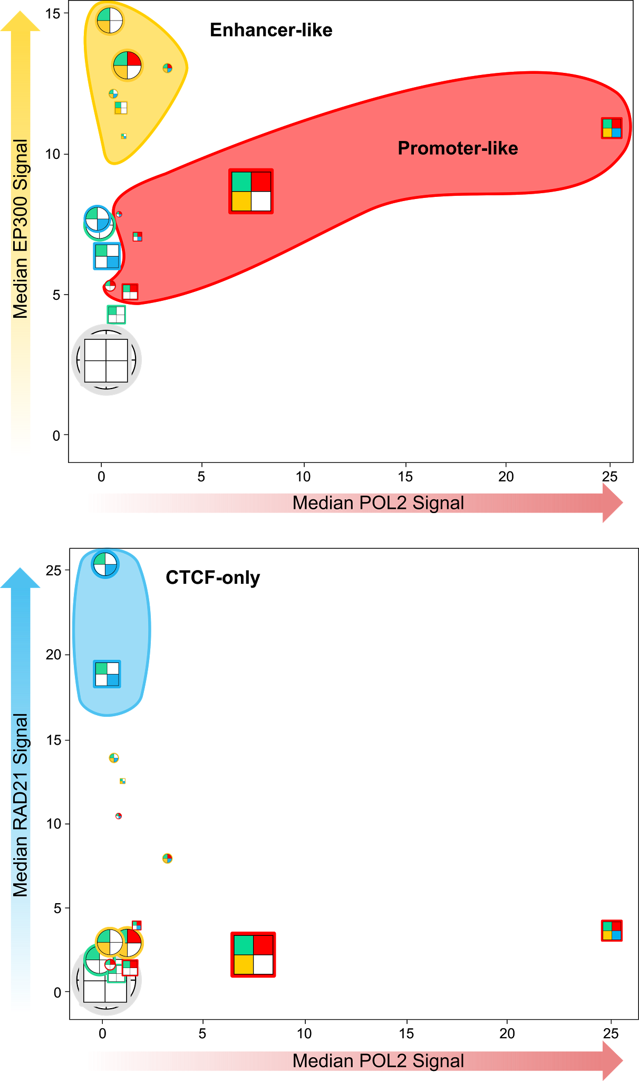
a
b
Notes:
Supplementary Fig. 18 | cRE states cluster into groups. Scatterplots of a, median EP300 signal or b, median RAD21 signal vs. median POL2 signal for each cRE state in GM12878. The size of an icon is proportional to the number of cREs in that state except for the inactive state. Proximal cREs are represented by square icons. Distal cREs are represented by circular icons.

Slide 19
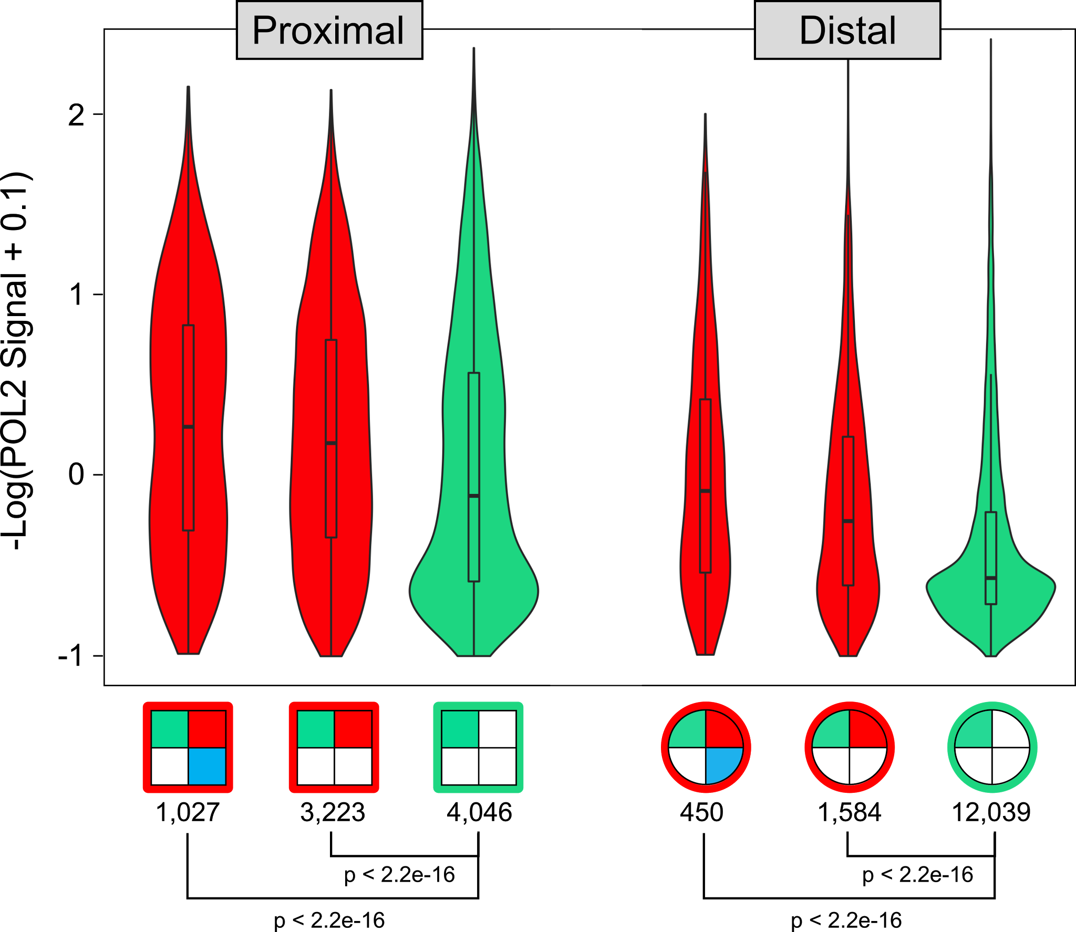
Notes:
Supplementary Fig. 19 | POL2 signals at cREs with Promoter-like and DNase-only signatures. Violin plots of POL2 signals for cREs belonging to three states, stratified by whether the cREs are proximal (±2kb) or distal to a GENCODE V19 TSS. p-values were calculated using a Wilcoxon test.

Slide 20
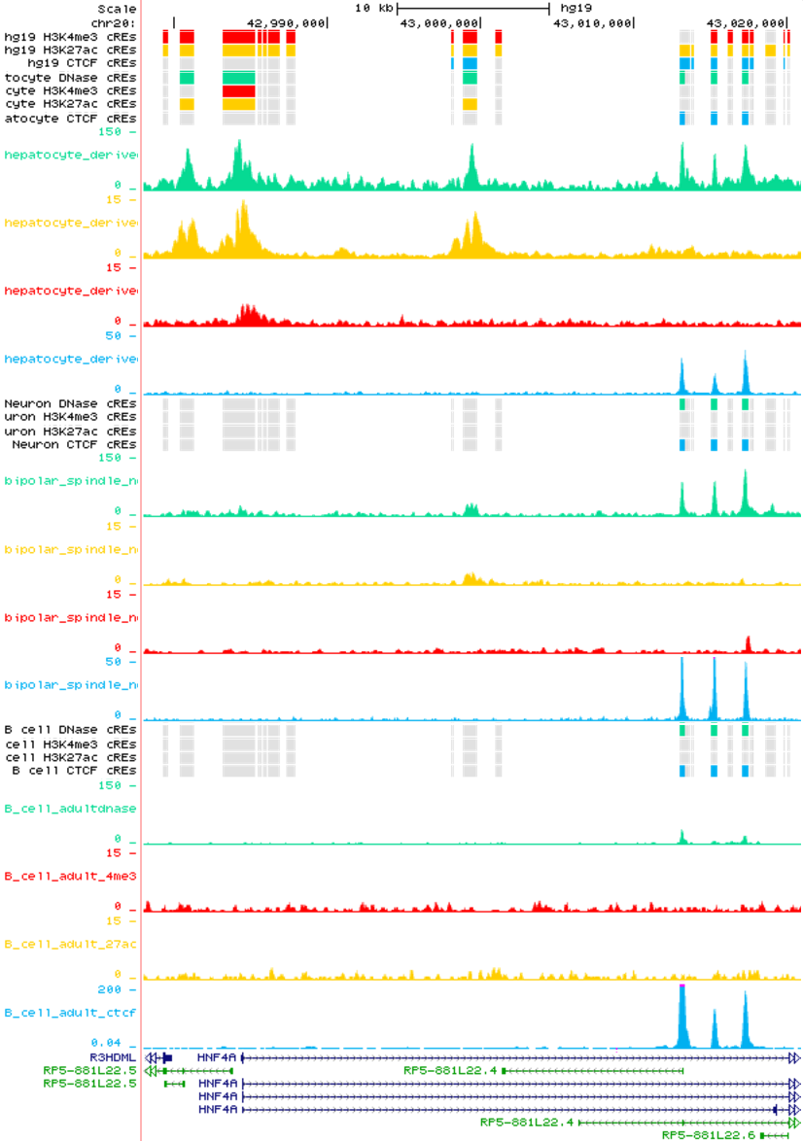
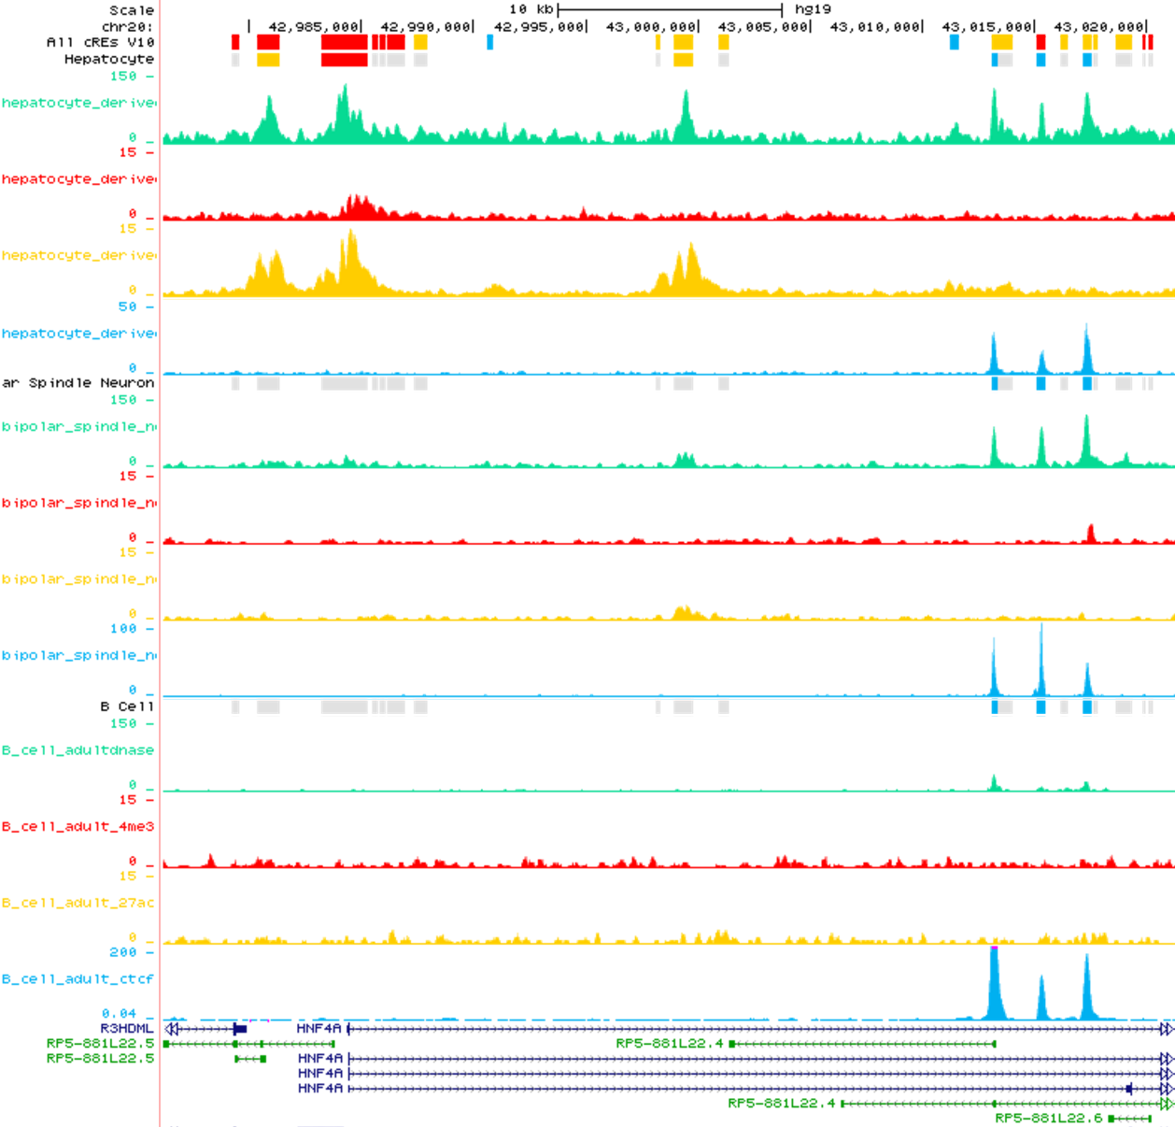
a
b
Hepatocyte
Hepatocyte
Bipolar Spindle Neuron
Bipolar Spindle Neuron
B Cell
B Cell
Notes:
Supplementary Fig. 20 | UCSC Genome Browser views of cREs around the HNF4a TSS. Browser views of hepatocyte, bipolar spindle neuron, and B cell cREs in a, five group and b, nine state classifications, revealing that the promoter region of HNF4a is active in hepatocytes but not in neurons or B cells.

Slide 21
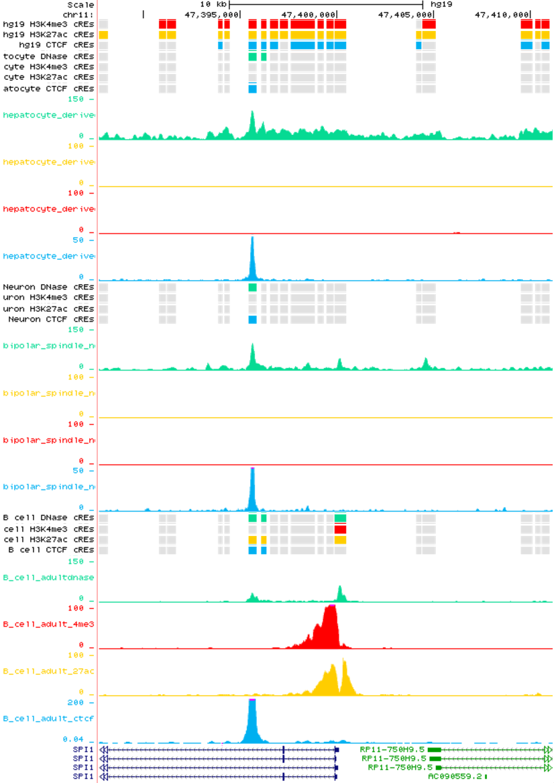
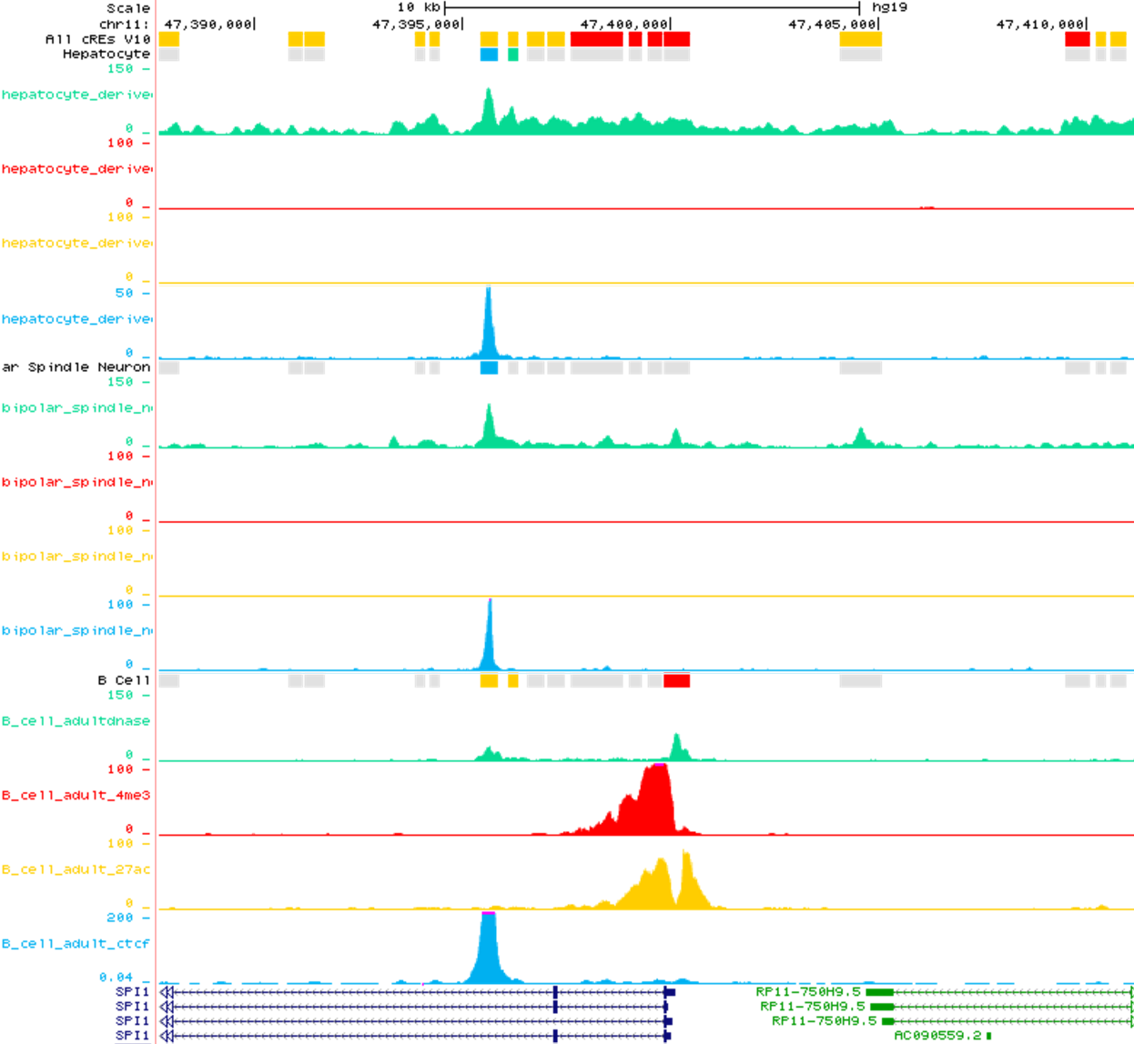
a
b
Hepatocyte
Hepatocyte
Bipolar Spindle Neuron
Bipolar Spindle Neuron
B Cell
B Cell
Notes:
Supplementary Fig. 21 | UCSC Genome Browser views of cREs around the SPI1 TSS. Browser views of hepatocyte, bipolar spindle neuron, and B cell cREs in a, five group and b, nine state classifications, revealing that the promoter region of SPI1 is active in B cells but not in neurons or hepatocytes.

Slide 22
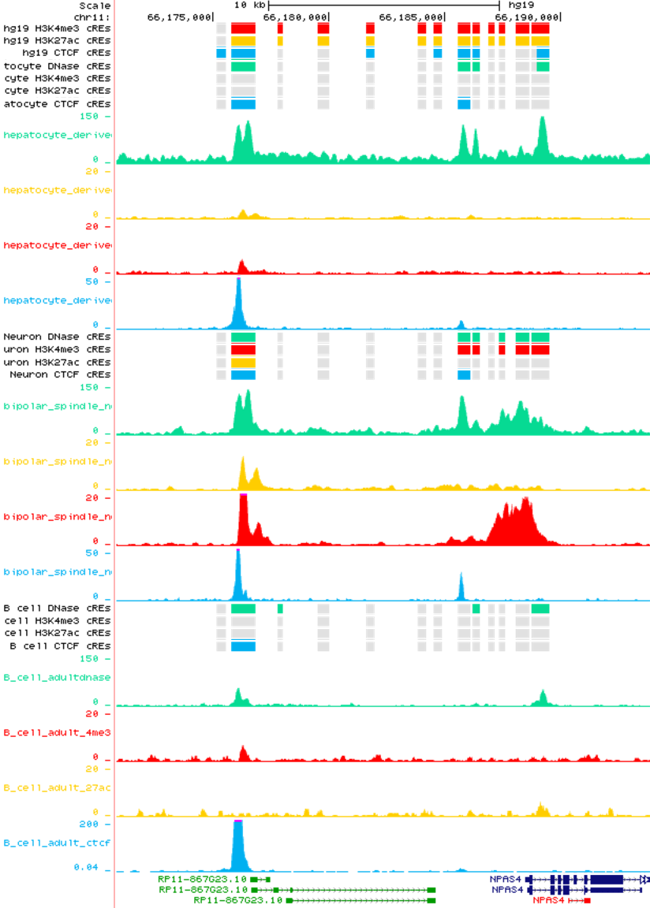
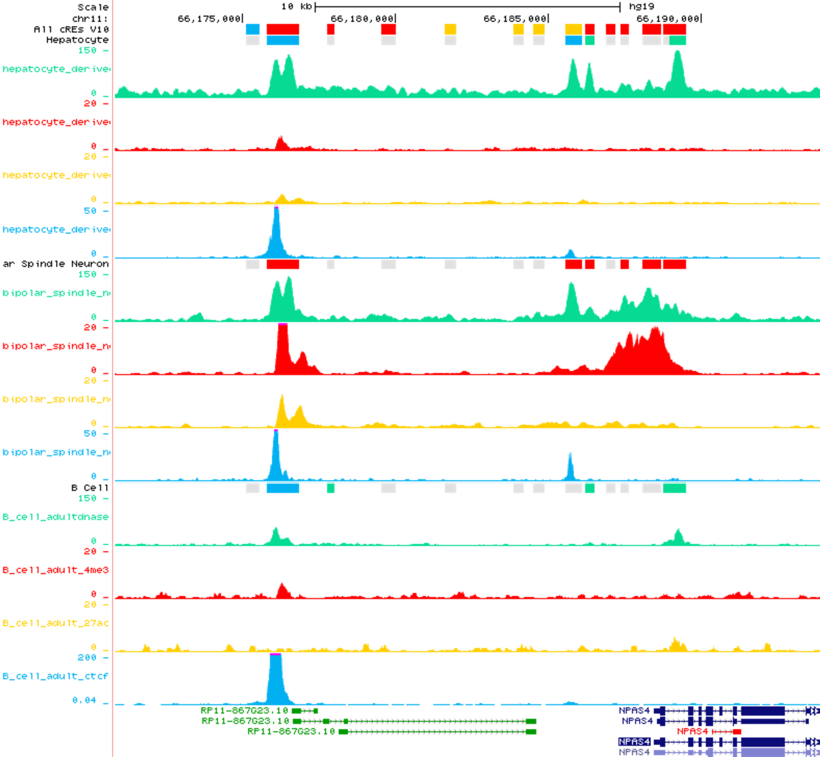
a
b
Hepatocyte
Hepatocyte
Bipolar Spindle Neuron
Bipolar Spindle Neuron
B Cell
B Cell
Notes:
Supplementary Fig. 22 | UCSC Genome Browser views of cREs around the NPAS4 TSS. Browser views of hepatocyte, bipolar spindle neuron, and B cell cREs in a, five group and b, nine state classifications, revealing that the promoter region of NPAS4 is active in bipolar spindle neurons but not in B cells or hepatocytes.

Slide 23
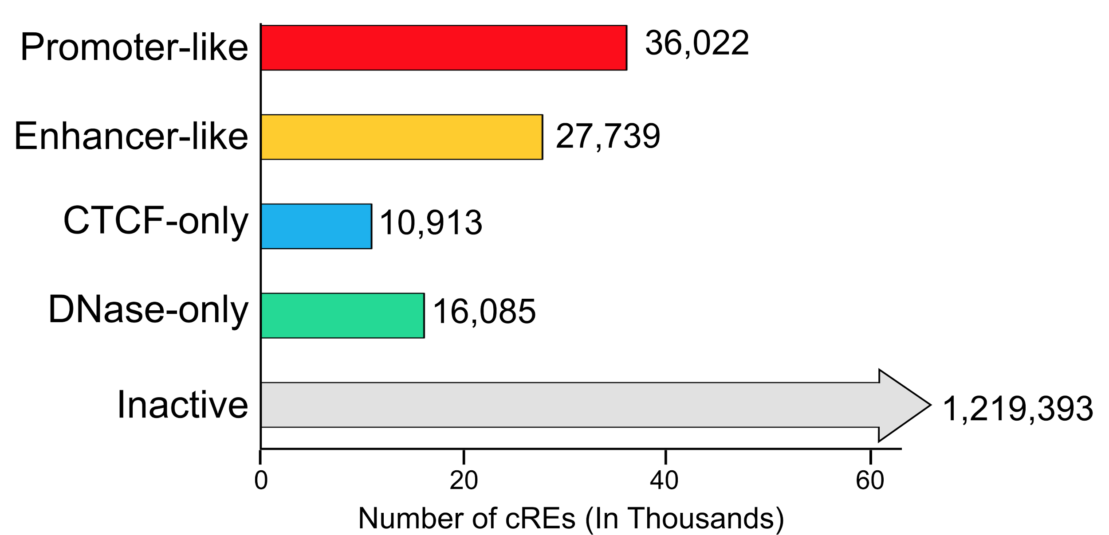
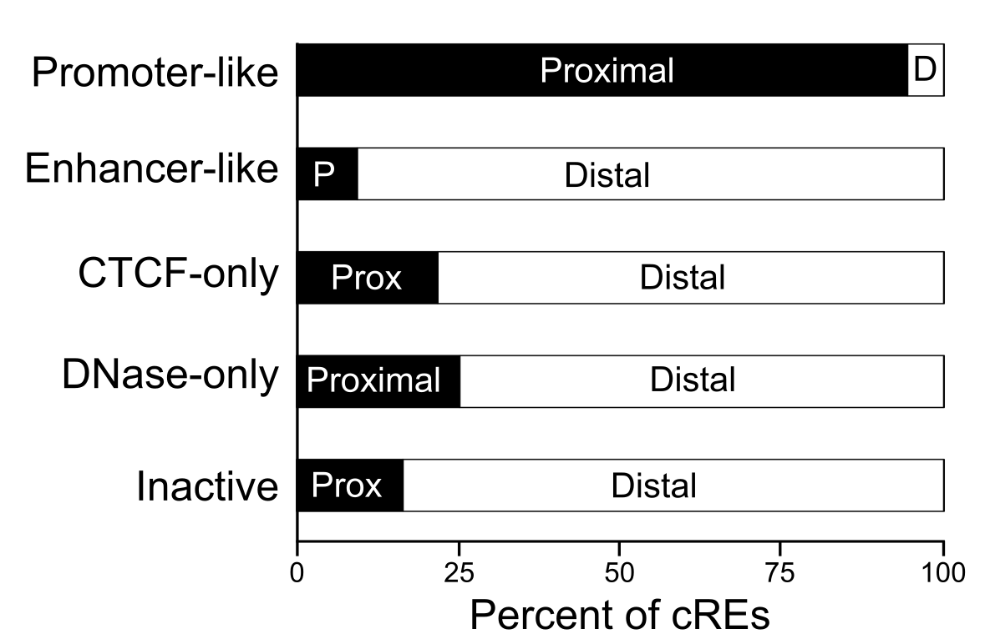
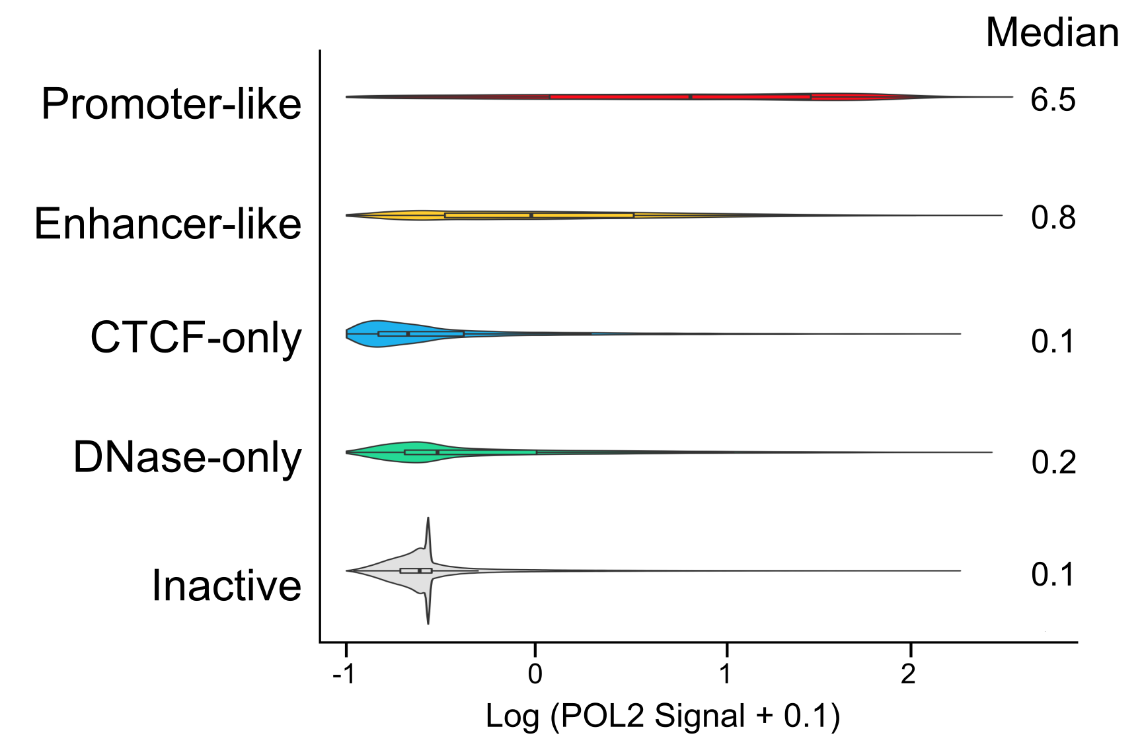
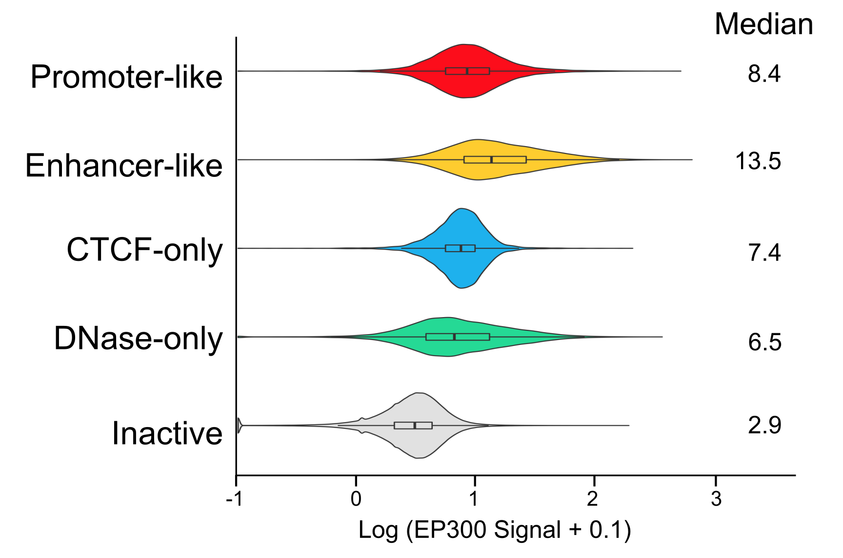
a
b
c
d
Notes:
Supplementary Figure 23 | Five group classification of cREs in GM12878. a, Number of GM12878 cREs in each group. b, Percent of cREs in each group which are proximal (± 2 kb) to a GENCODE annotated TSS. c, Violin plots of average POL2 signal across each of the cRE groups. d, Violin plots of average EP300 signal across each of the cRE groups.

Slide 24
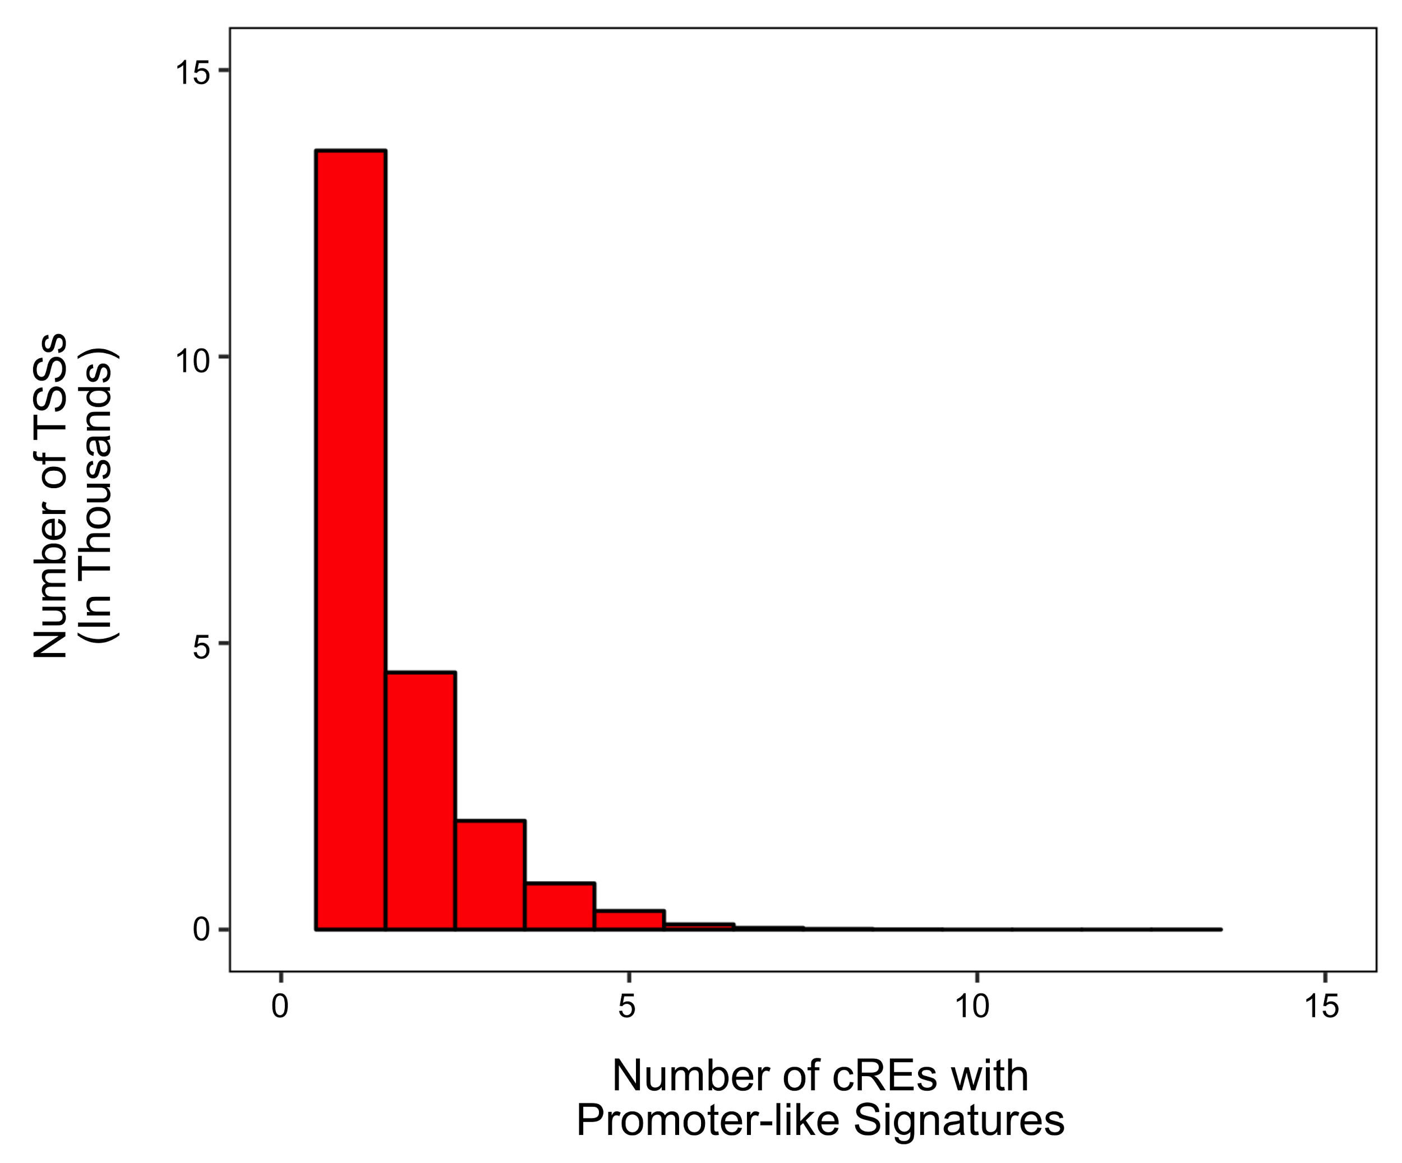
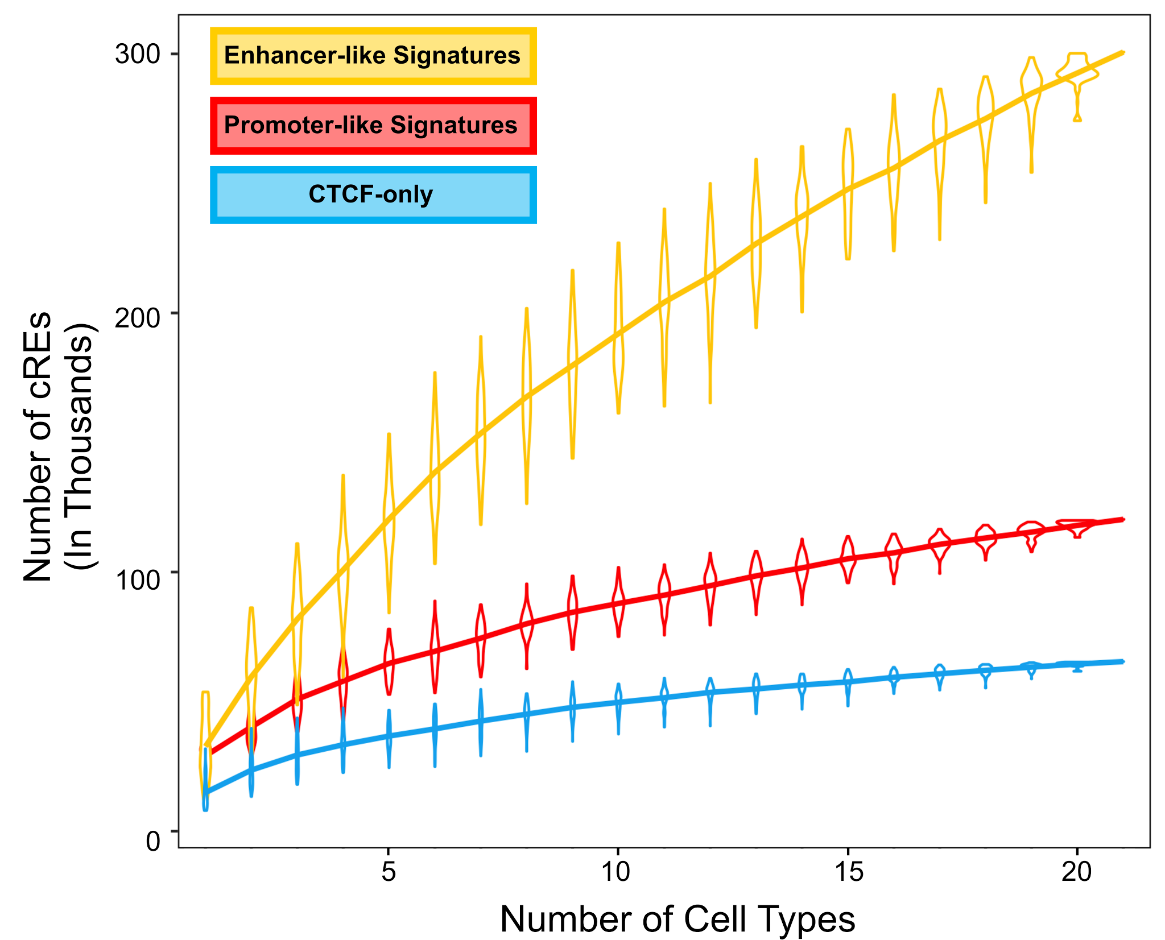
a
b
Notes:
Supplementary Figure 24 | Annotation of cRE groups. a, A histogram shows the number of TSSs with certain numbers of GM12878 cREs with promoter-like signatures. cREs were assigned to the closest TSS. Over 7 k TSSs have more than one assigned cRE. b, Total numbers of cREs with Promoter-like, Enhancer-like, or CTCF-only signatures grow when more cell types are considered. Enhancer-like cREs are more cell-type-restrictive than promotor-like cREs or CTCF-only cREs.

Slide 25
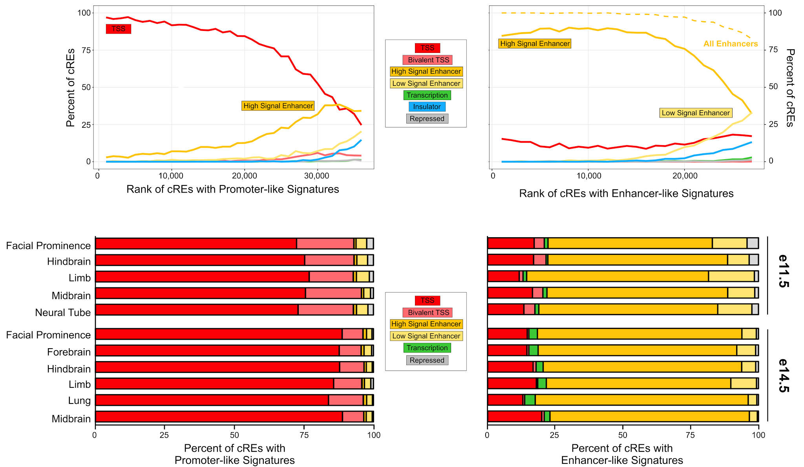
a
b
c
d
Notes:
Supplementary Figure 25 | Overlap of cREs with chromHMM states. In GM12878, we ranked cREs with a, promoter-like signatures and b, enhancer-signatures by H3K4me3 and H3K27ac Z-scores respectively. For each bin of 1 k cREs, we calculated the percent of cREs overlapping each chromHMM state. In mouse, we selected all cREs with c, promoter-like and d, enhancer-like signatures from tissue–time-point combinations with both DNase and histone data. We then calculated the percent of cREs which overlapped each chromHMM state. In all panels, high- and low-signal enhancers denote chromHMM enhancer states with high or low H3K27ac signals.

Slide 26
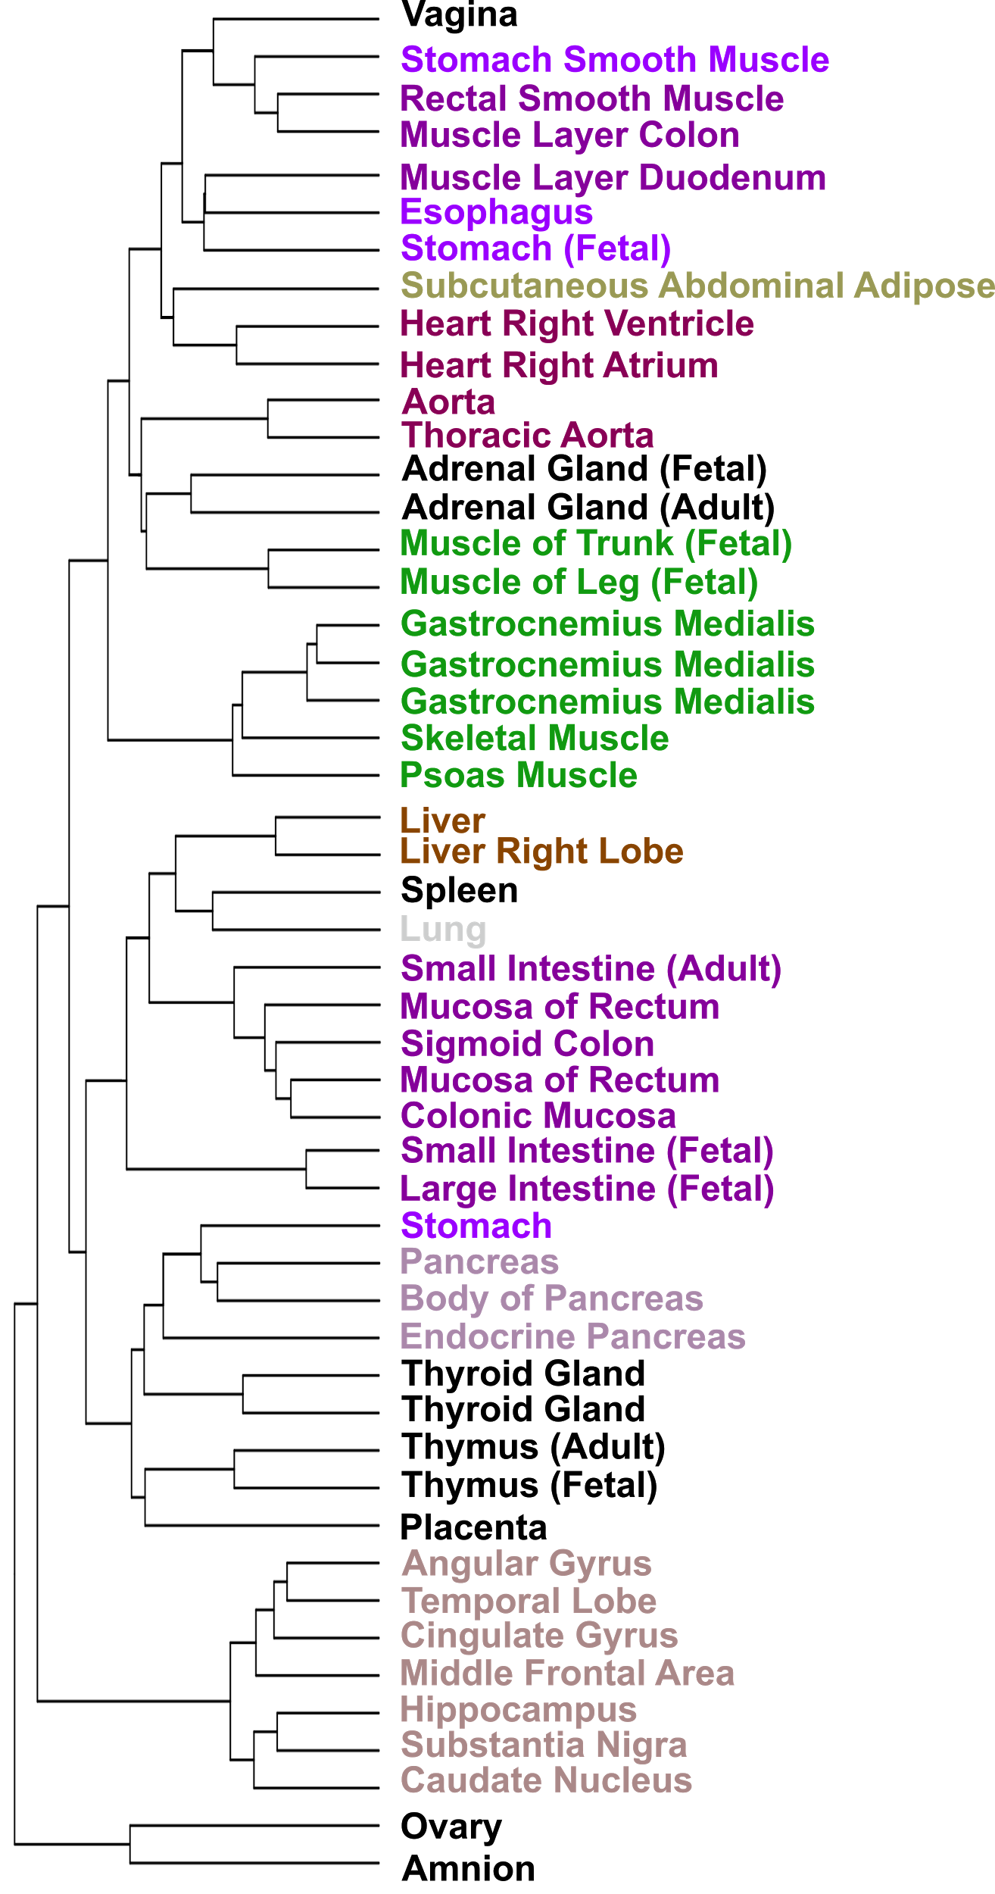
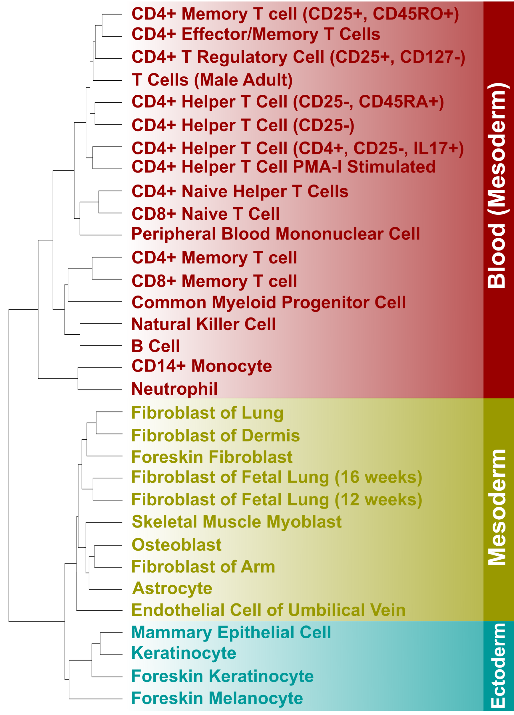
a
b
Notes:
Supplementary Figure 26 | Clustering of human cell and tissue types by cRE H3K27ac signal. Human a, primary cells and b, tissues were hierarchically clustered by the Jaccard similarity coefficient of cREs with high H3K27ac signal (Z-score > 1.64). Colors in a, indicate the embryonic origins of human primary cells. Colors in b, indicate the organs of the tissue samples.

Slide 27
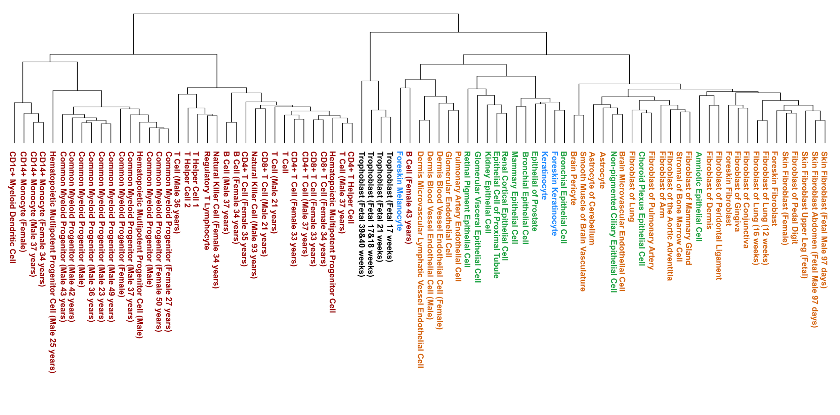
a
hg19 - Primary Cell - DNase
b
hg19 - Tissues - DNase
Notes:
Supplementary Figure 27 | Clustering of human cell and tissue types by cRE DNase signal. Human a, primary cells and b, tissues hierarchically clustered by the Jaccard similarity coefficient of cREs with high DNase signal (Z-score > 1.64). Colors in a, indicate the lineages of human primary cells. Colors in b indicate the organs of the tissue samples.

Slide 28
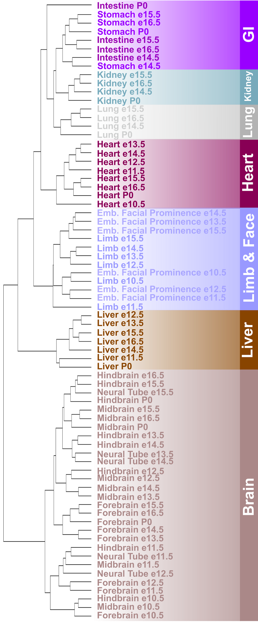
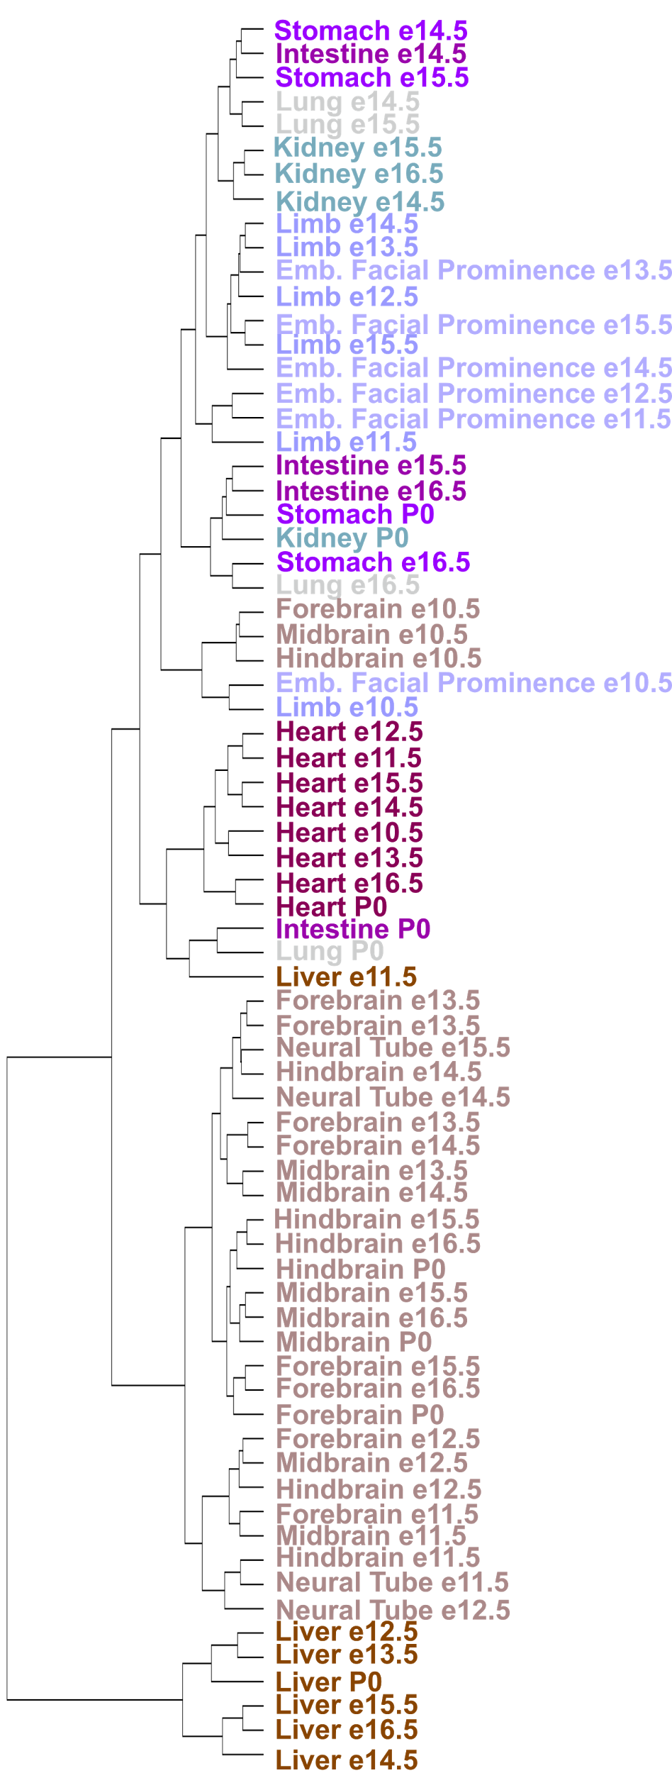
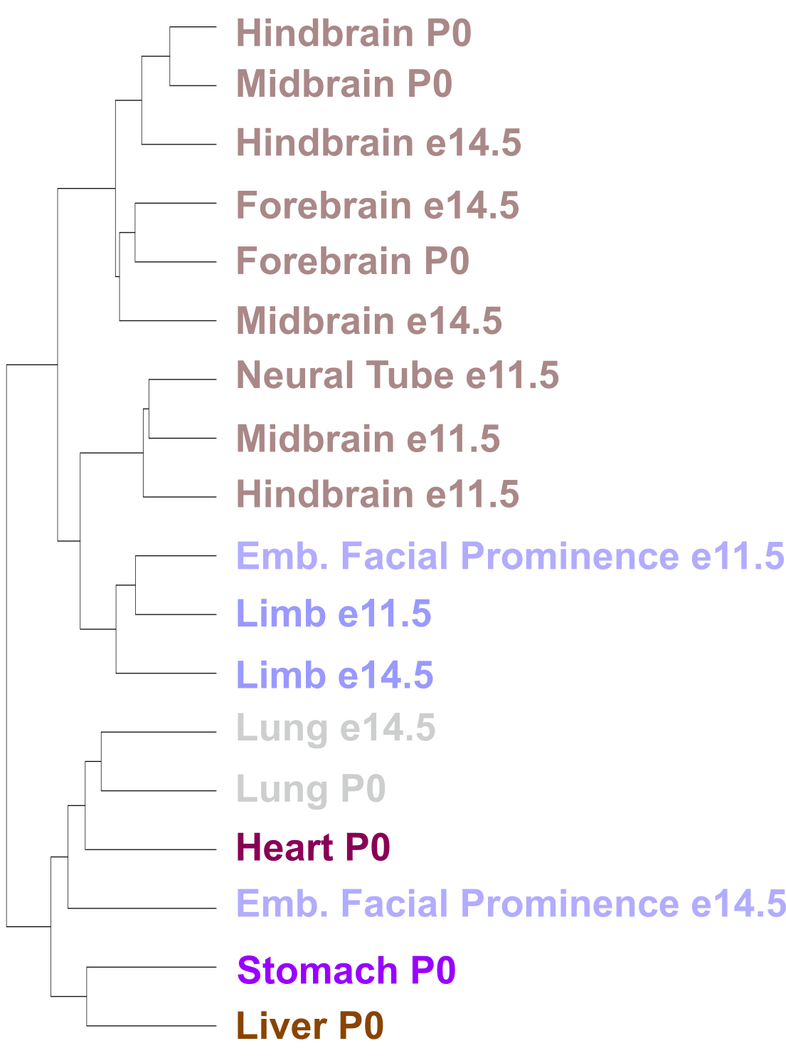
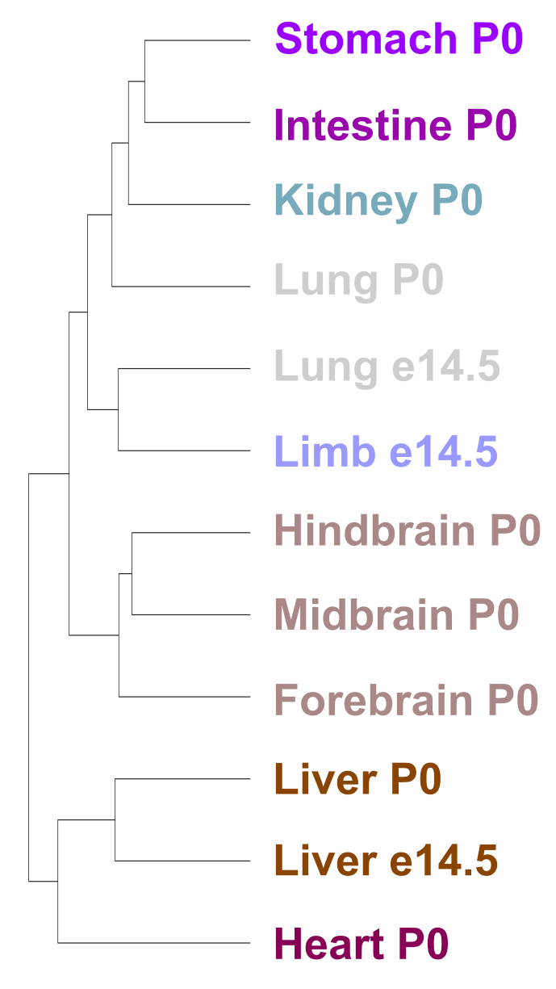
mm10 - H3K27ac
mm10 - H3K4me3
mm10 - DNase
mm10 - CTCF
a
b
c
d
Notes:
Supplementary Figure 28 | Clustering of and mouse cell types by cRE activity. Mouse embryonic tissues were hierarchically clustered by the Jaccard similarity coefficient of cREs with high a, H3K27ac b, H3K4me3 c, DNase and d, CTCF (Z-score > 1.64). Colors indicate the organs of the tissues.

Slide 29
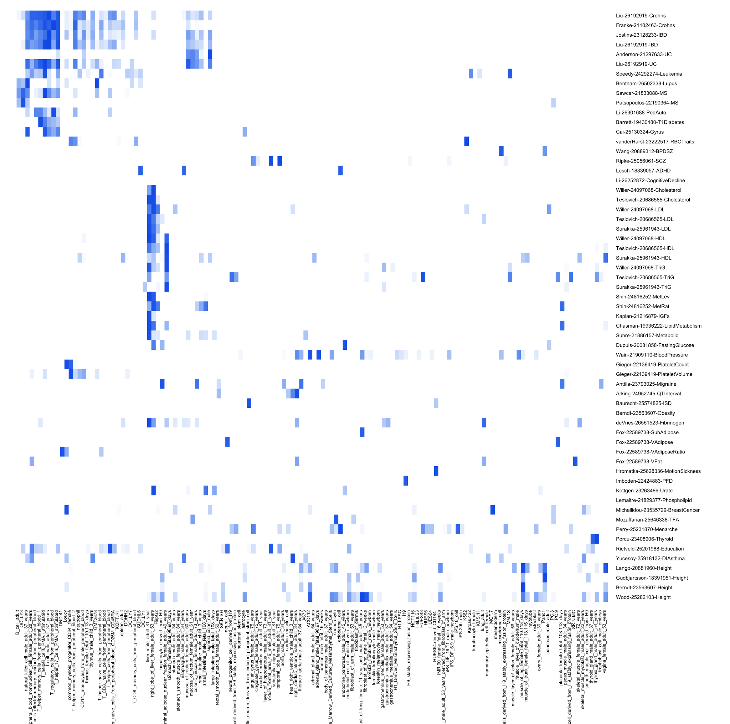
Notes:
Supplementary Figure 29 | Overall cell type enrichments for variants reported by genome-wide association studies. Heatmap indicates enrichment a -log(p-value) of the variants associated with each disease (rows) in cREs active in each cell type (columns). Activity is defined as H3K27ac Z-score > 1.64. Color values in each row are scaled per study.

Slide 30
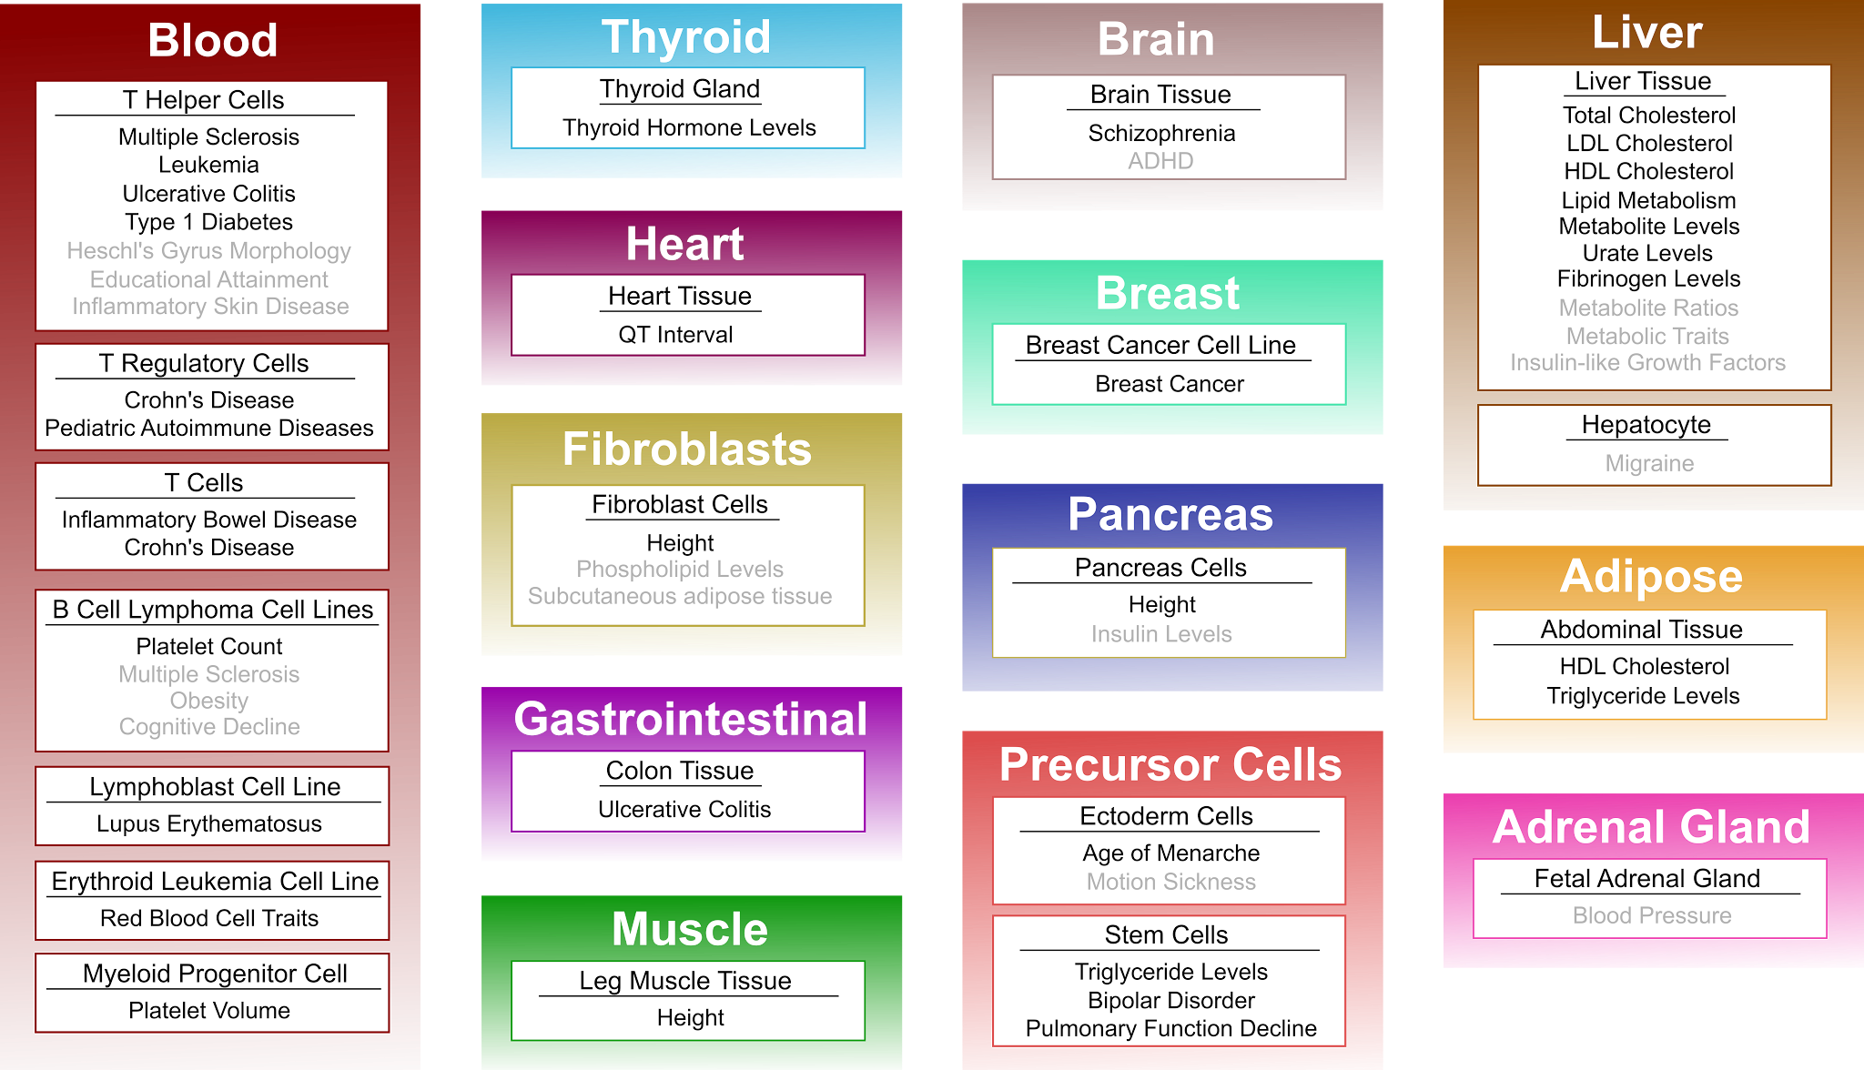
Notes:
Supplementary Figure 30 | Top cell type enrichments for variants reported by genome-wide association studies. For each GWAS included in SCREEN, we report the cell or tissue type of which active cREs are significantly enriched in the disease variants. Cell types that do not meet FDR threshold of 0.05 are in gray. The majority of studies have multiple significantly enriched cell types but only the top hit is reported here. Traits listed multiple times are from different studies.

Slide 31
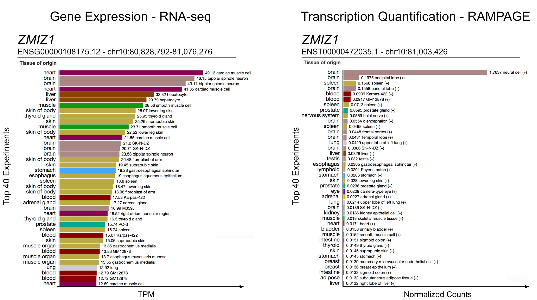
a
b
Notes:
Supplementary Figure 31 | SCREEN display of the ZMIZ1 gene and its TSS expression levels. a, Gene expression of ZMIZ1 from whole-cell RNA-seq assays shown in tags per million (TPM). b, RAMPAGE signal at the TSS of ENST00000472035.1 (averaged over ± 50 bp window). Bars are colored by tissue of origin indicated on the left.

Slide 32
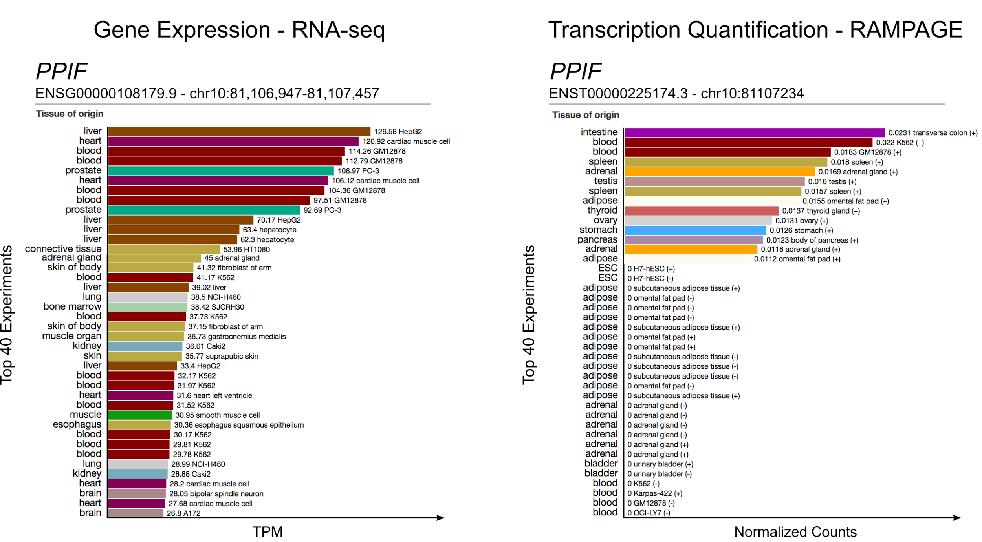
a
b
Notes:
Supplementary Figure 32 | SCREEN display of PPIF gene and its TSS expression levels. a, Gene expression of PPIF from whole-cell RNA-seq assays shown in tags per million (TPM). b, RAMPAGE signal at the TSS of ENST00000225174.3 (averaged over ± 50 bp window). Bars are colored by tissue of origin indicated on the left.

Slide 33
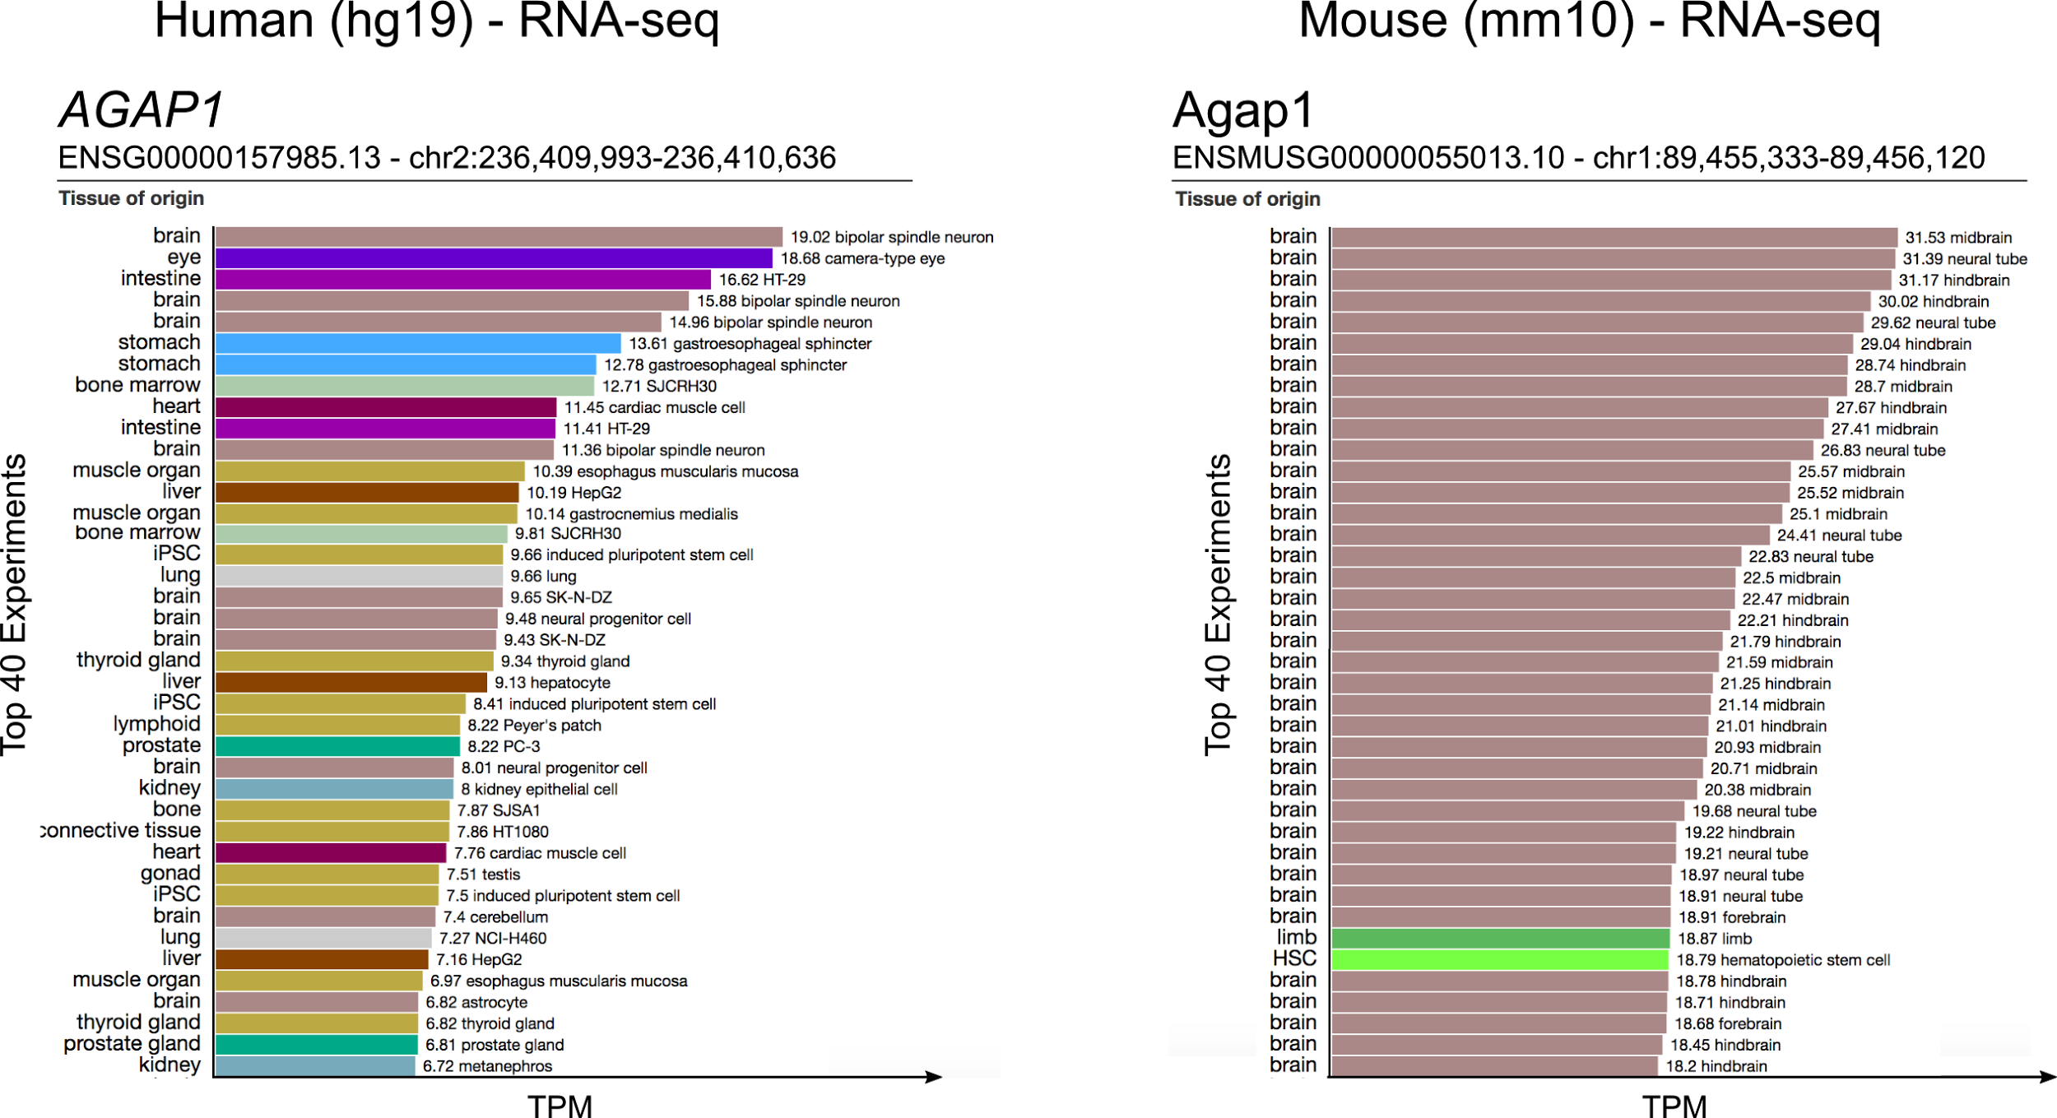
a
b
Notes:
Supplementary Figure 33 | SCREEN display of AGAP1 expression levels. a, In human. AGAP1 is expressed across many adult tissues. b, In mouse. Agap1 is primarily expressed in embryonic brain tissues. Expression values were calculated from whole-cell RNA-seq experiments and displayed in tags per million (TPM).

Slide 34
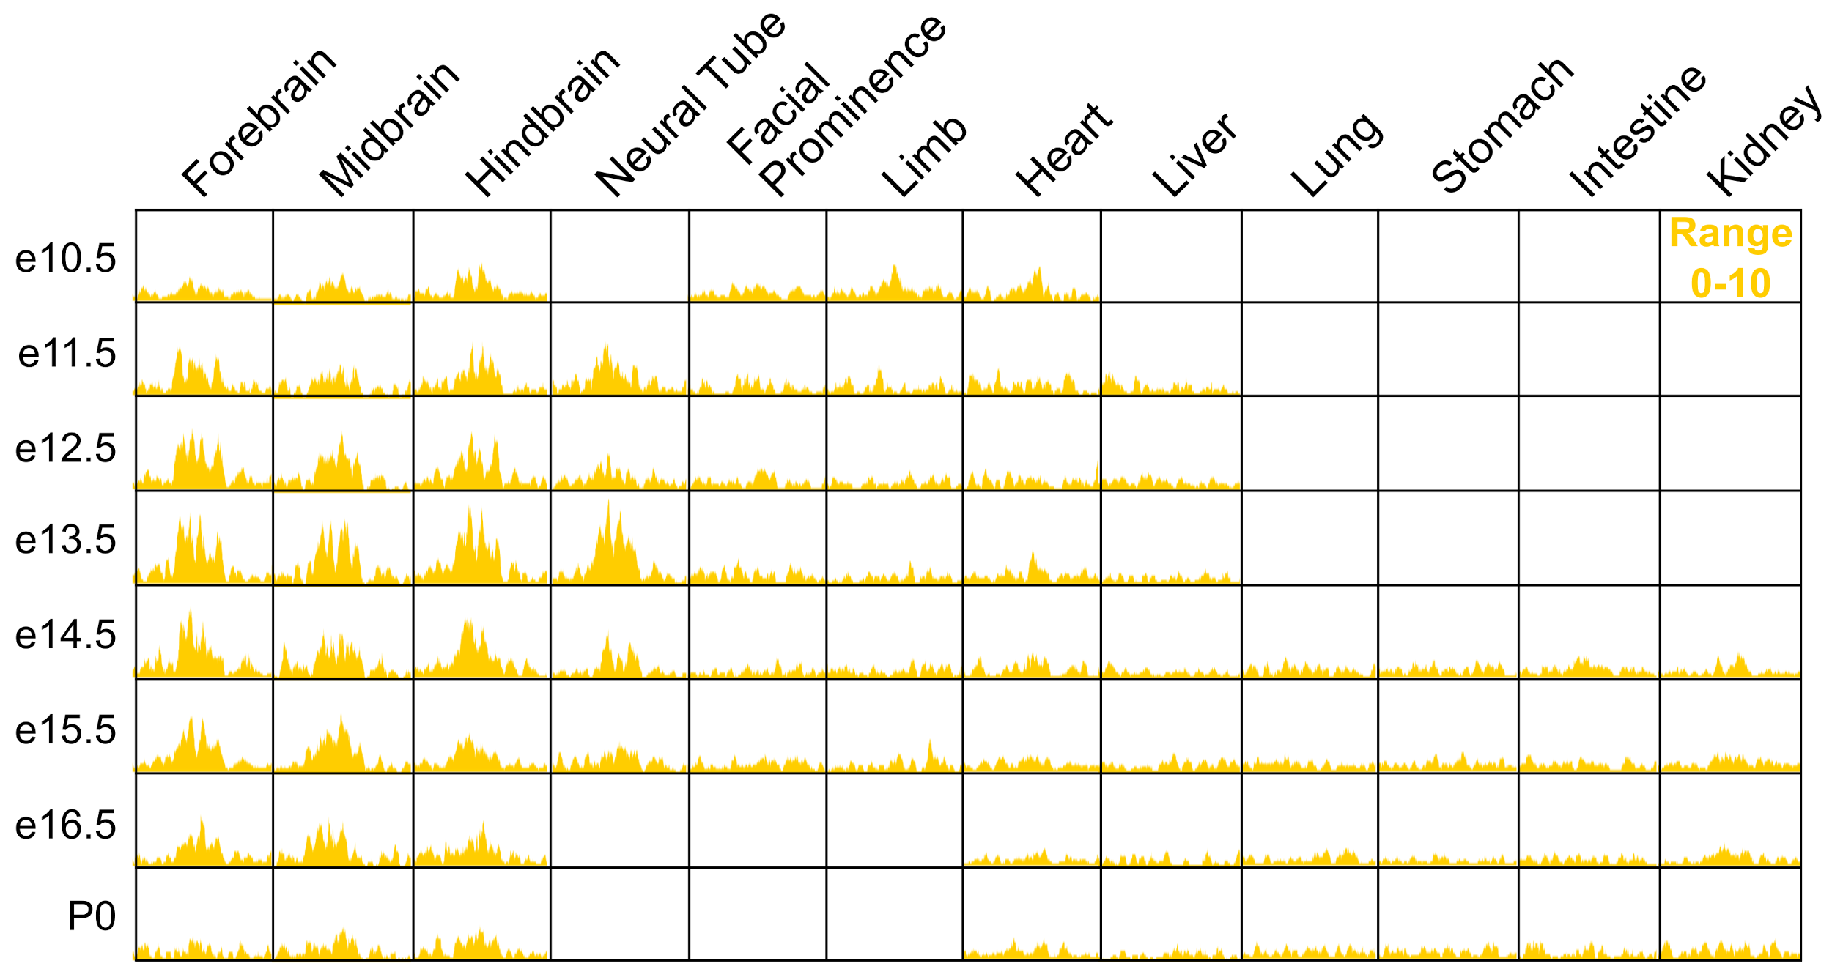
Notes:
Supplementary Figure 34 | H3K27ac signal at EM10E0042440 across mouse embryonic tissues. H3K27ac signal measured as fold-change between ChIP and input is displayed across 12 tissues and 8 time-points. Tissues without H3K27ac ChIP-seq data are left blank. The maximal height of signal is 10.

Slide 35
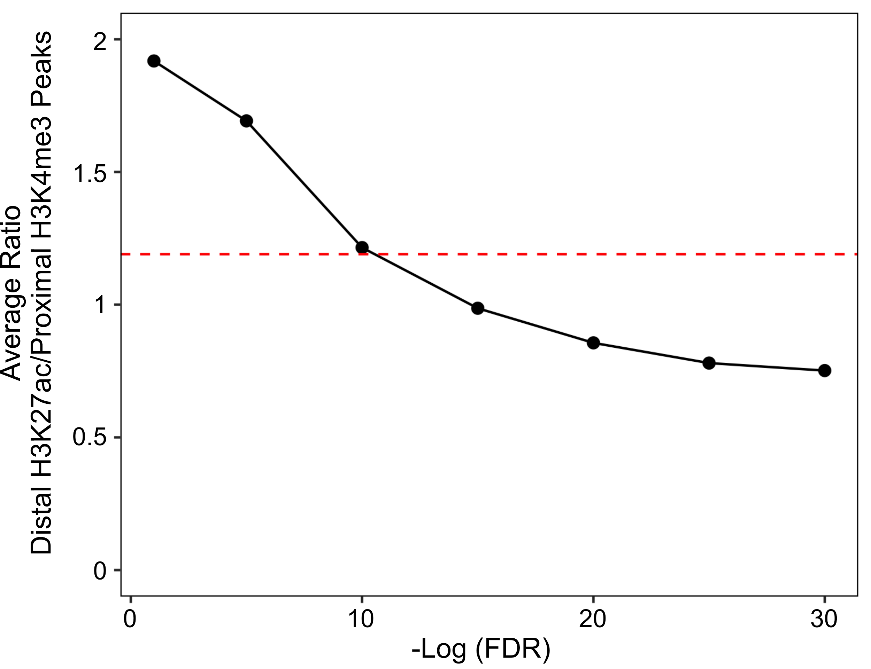
Notes:
Supplementary Figure ??? | Ratio of distal H3K27ac peaks to proximal H3K4me3 peaks. Averaged over X cell types, we analyzed the average ratio of distal H3K27ac peaks to proximal H3K4me3 peaks as we increased the FDR threshold of the peaks. The dashed line indicates the average ratio (1.19) of promoter-like to enhancer like cREs we observe using the Z-score method. This suggests our method is conservative and may not capture all distal enhancers.

Slide 36
a
b
Notes:
Supplementary Figure ??? | Overlap of cREs with histone peaks in GM12878. Using 1k bins, we ranked a, H3K4me3 peaks and b, H3K27ac peaks by p-value and calculated the number of peaks which overlapped cREs with promoter-like or enhancer-like signatures in GM12878. This demonstrates that vast majority of highly ranked peaks overlap one of these two groups of cREs.

Slide 37
a
b
c
Notes:
Supplementary Figure ??? | Tissue specificity of cREs active across 21 cell types. Looking exclusively at the 21 cell types with all four assays -- DNase, H3K4me3, H3K27ac, and CTCF -- we determined the number of tissues for which each cRE was active. Using cell type agnostic classifications for a, promoter-like, b, enhancer-like, or c, CTCF-only, we counted the number of cell types where each cRE was classified in the same group in a cell-type specific manner. cREs were stratified by whether they overlapped or were proximal (± 2kb) to a GENCODE v19 TSS. The number of cREs in each graph is in the top right corner.

Slide 38
a
b
Notes:
Supplementary Figure ??? | Histone signal across cREs with Promoter-like and Enhancer-like signatures. Violin plots of average a, H3K4me3 and b, H3K27ac for cREs belonging to different cREs states. cRE states are stratified by whether cREs are proximal (±2kb) or distal to a GENCODE V19 TSS.

Slide 39
a
c
Zero signal values
are assigned a
Z-score of -10
b
Notes:
Supplementary Figure 39 | Method for normalizing epigenomics signals. a, Distribution of the H3K27ac signals at rDHSs from five cell types (B cell, Liver, K562, T cell, and GM12878; shown in different colors). b, Distributions of the Log of the H3K27ac signals in a. Individually, log(signal) values of the rDHSs in each cell type roughly follow a normal distribution. c, Distribution of the Z-scores corresponding to the Log(signal) values in b. Zero signal values are assigned a Z-score of –10.

