Slide 1
Overview of the Registry of cREs
& SCREEN
Jill Moore, Michael Purcaro, Henry Pratt, and Zhiping Weng
University of Massachusetts Medical School
June 16, 2017

Slide 2
Creating the Registry of cREs
Defining representative DNase hypersensitivity sites (rDHSs)
Human: 2,115,300 rDHSs Mouse: 1,036,226 rDHSs
For this analysis, we adapted the DNase master peak script by Bob Thurman in John Stam's lab

Slide 3
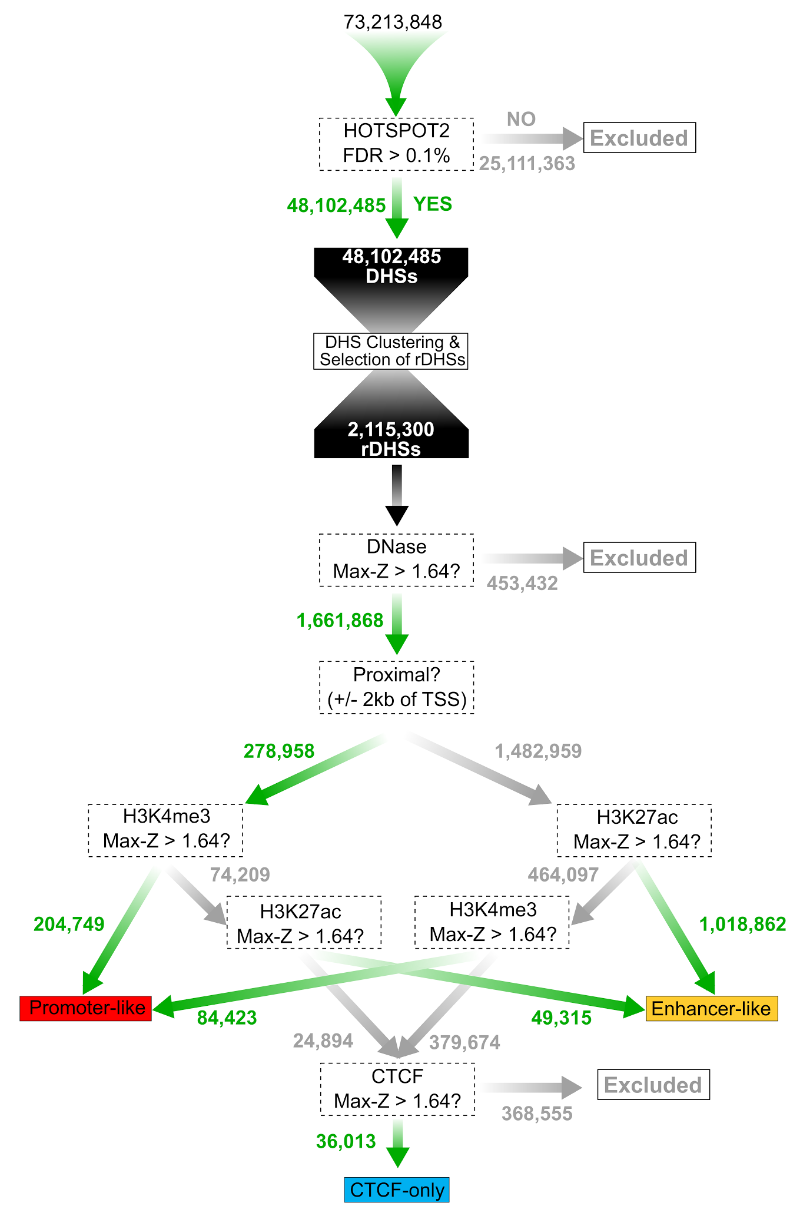
Creating the Registry of cREs
Defining representative DNase hypersensitivity sites (rDHSs)
Filter & classify rDHSs using DNase, H3K4me3, H3K27ac, and CTCF signals
Human: 1,310,152 cREs Mouse: 431,202 cREs

Slide 4
Genomic Coverage of cREs

Slide 5
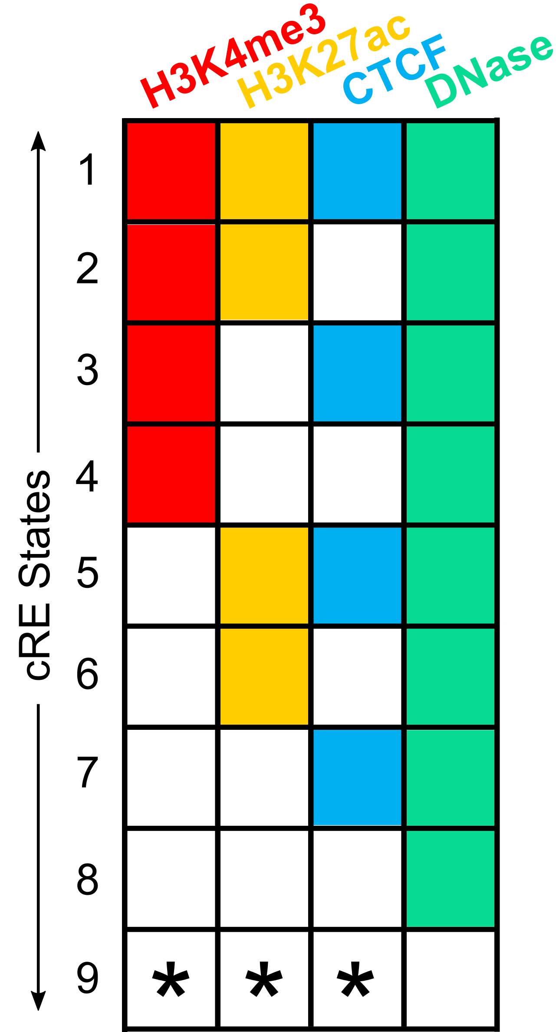
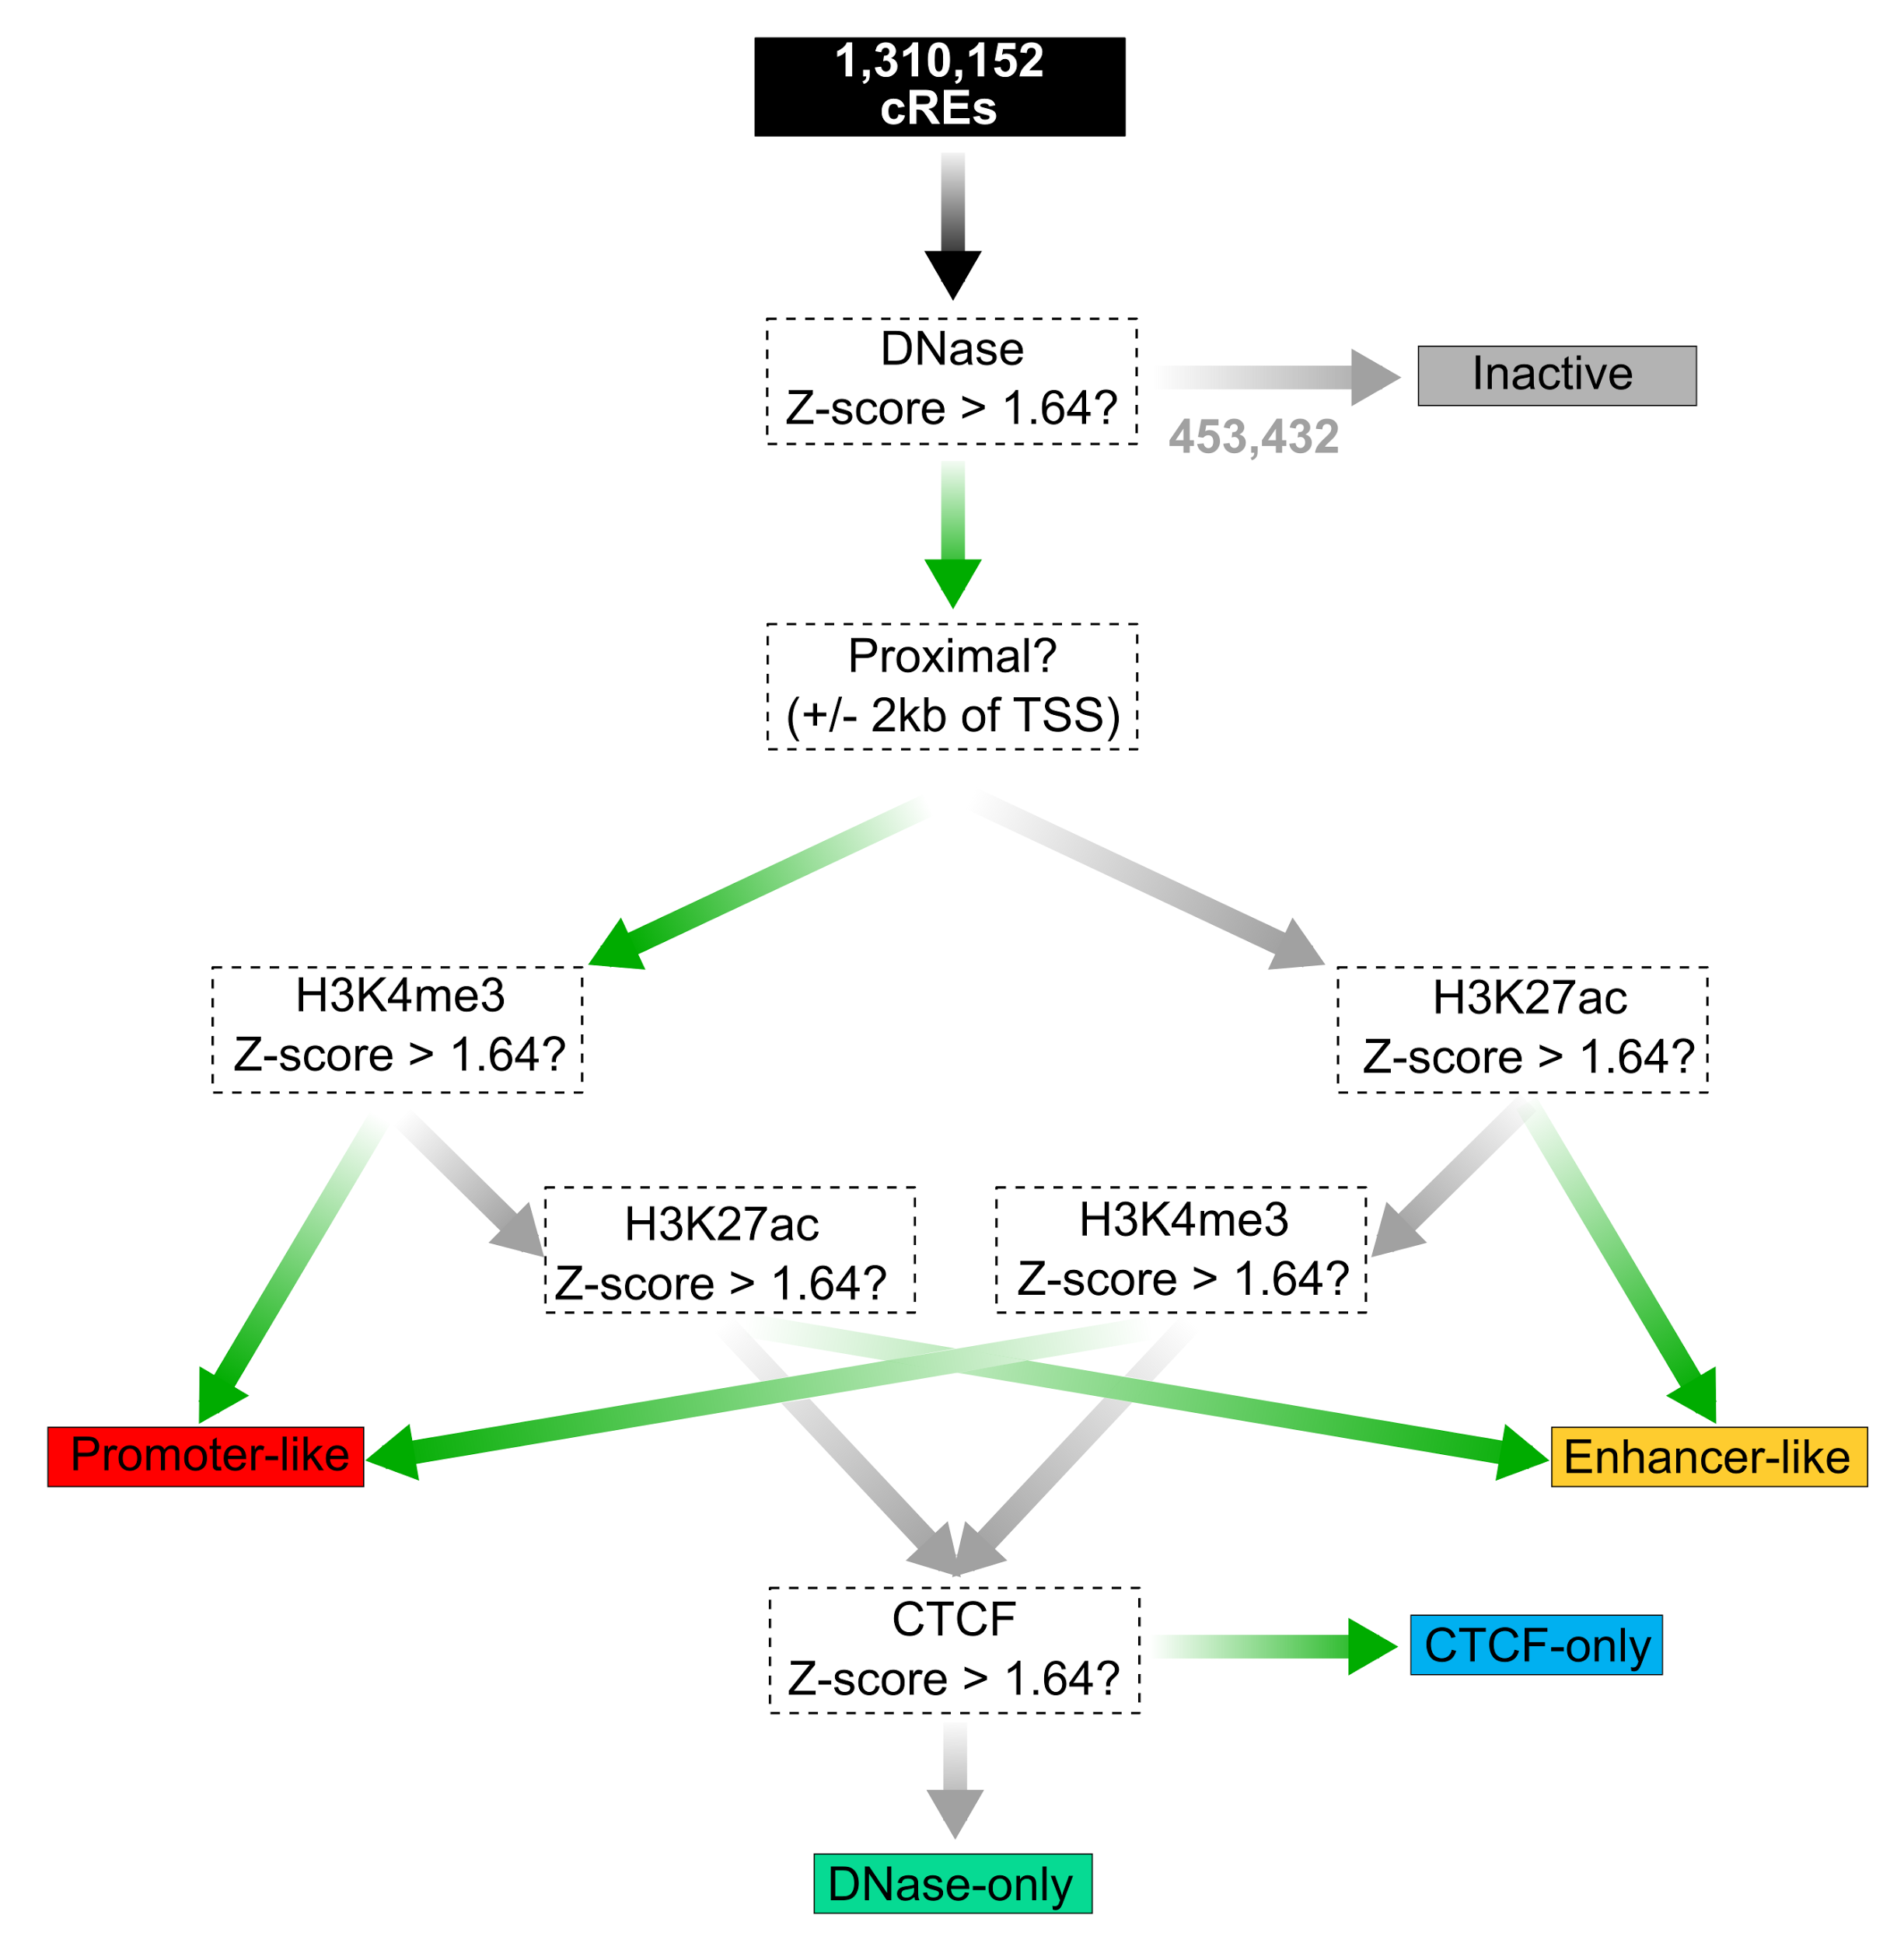
Cell Type Specific Classification: Two Models
9 States
5 Groups
For each cell type, we classify cREs with DNase Z-score < 1.64 as inactive (if DNase is available)
The remaining cREs fall into 8 states based on if the Z-scores for H3K4me3, H3K27ac, or CTCF are > 1.64
For example, a cRE with the grey-yellow-grey-green combination of colors would have H3K27ac & DNase Z-scores > 1.64 and H3K4me3 & CTCF Z-scores ≤ 1.64

Slide 6
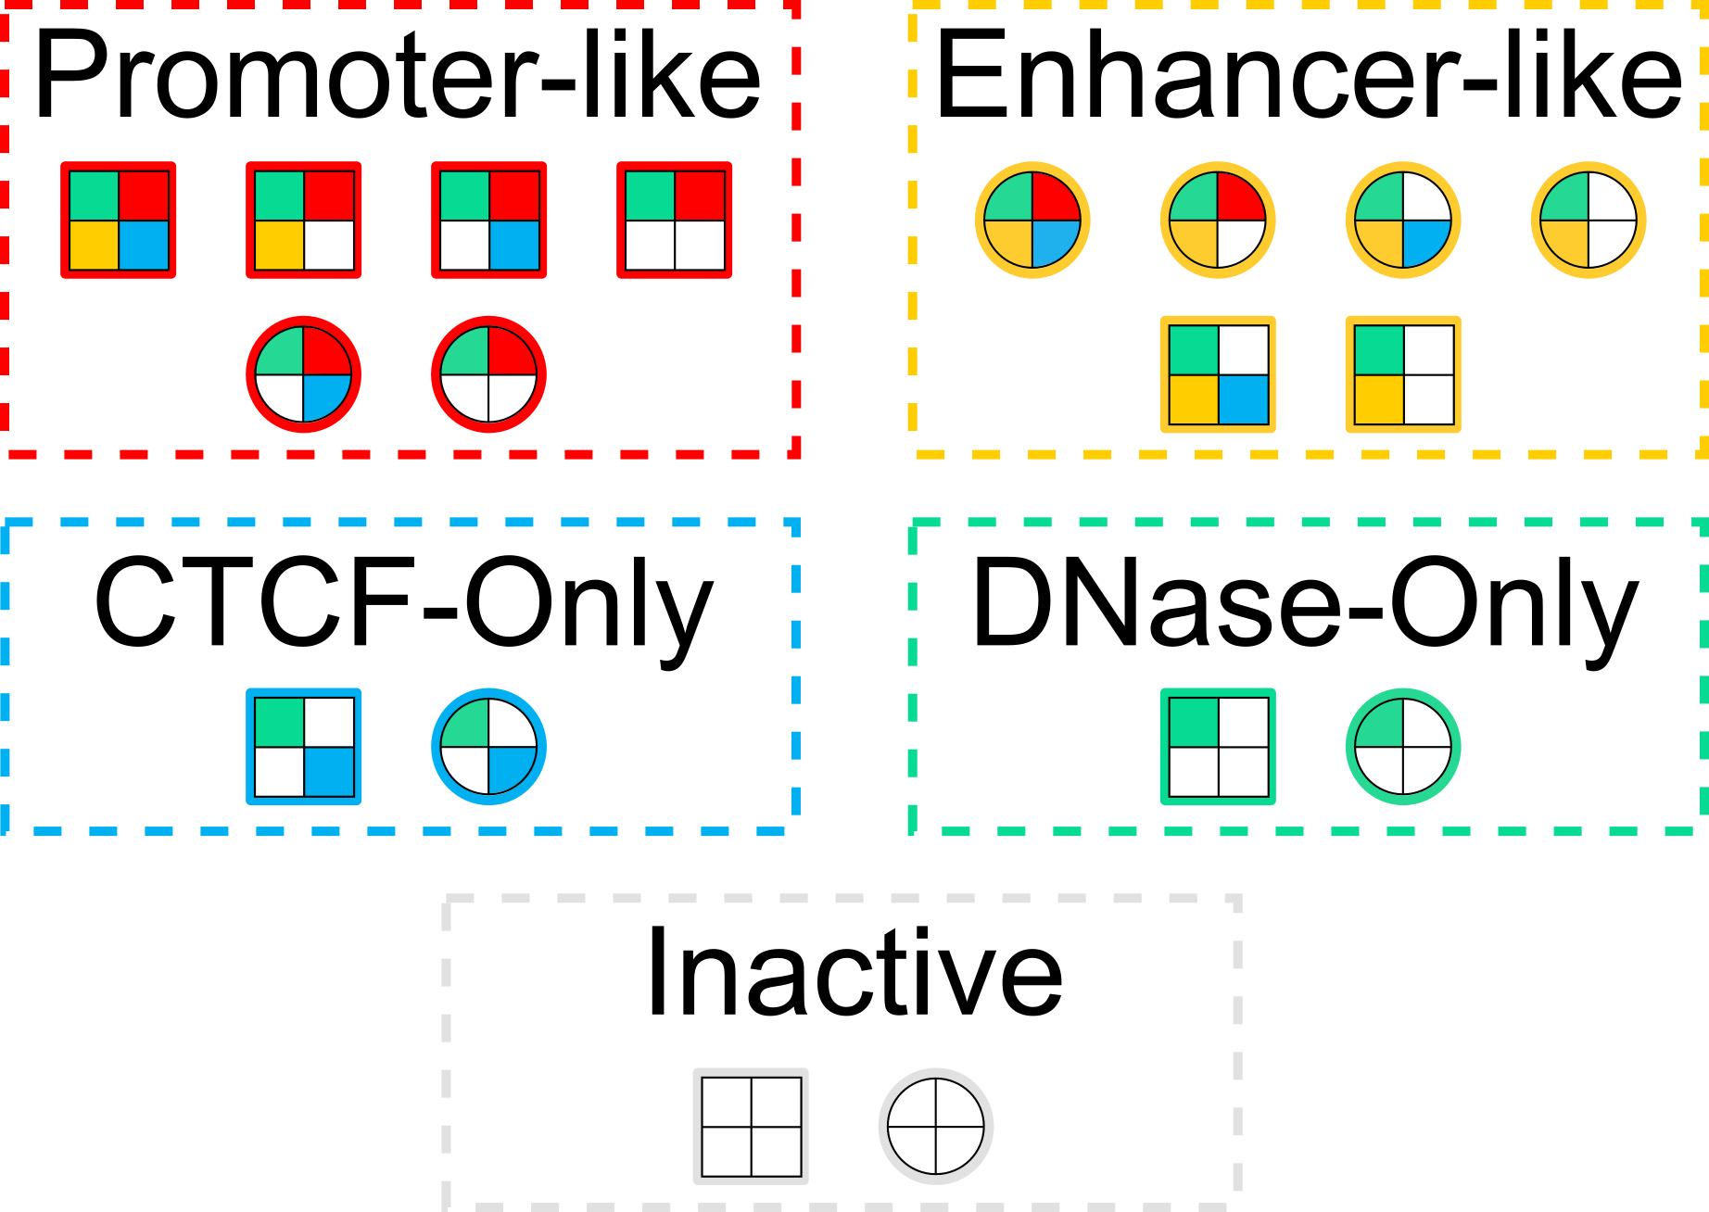
Cell Type Specific Classification: Relating Models
9 States
5 Groups
= Proximal
= Distal

Slide 7
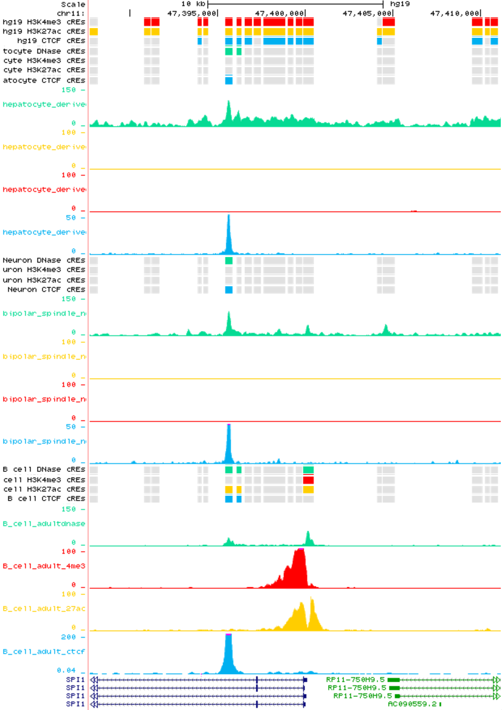
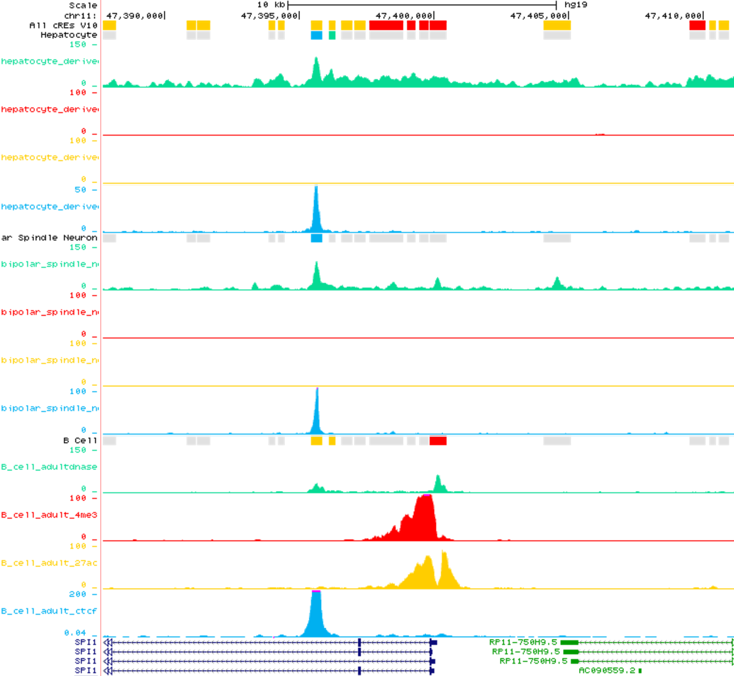
Cell Type Specific Classification: Visualization
9 States
5 Groups
Hepatocyte
Hepatocyte
Bipolar Spindle Neuron
Bipolar Spindle Neuron
B Cell
B Cell
Link to browser:
chr11:47,387,721-47,411,156
Link to browser:
chr11:47,387,721-47,411,156

Slide 8
Additional Analysis Using cREs (From Manuscript)
Enrichment of cREs in complementary data (i.e. cREs with promoter-like signatures are enriched in POL2 signal)
Cell type clustering
Use Cases:
Correlation of expression & cRE activity in Limb at Ogn locus during development
Fine mapping multiple sclerosis variant and identifying a new potential target gene
Fine mapping schizophrenia variants using orthologous human and mouse cREs

Slide 9
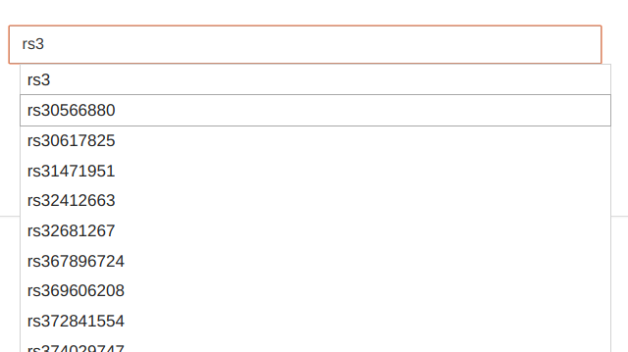
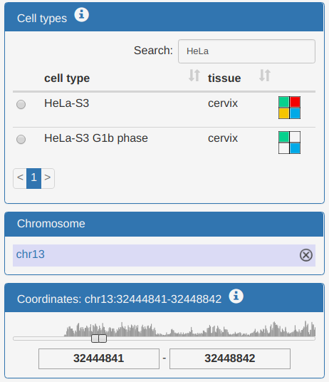
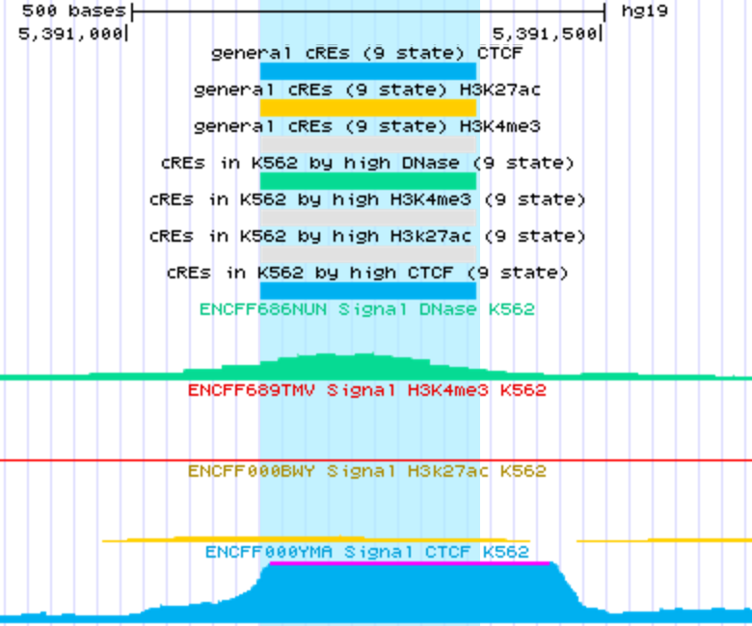
SCREEN overview (recap): three perspectives
cRE / locus-centric Search View
use facets to filter search results; click result for details
enter search keywords (genes, coordinates, SNPs…)

Slide 10
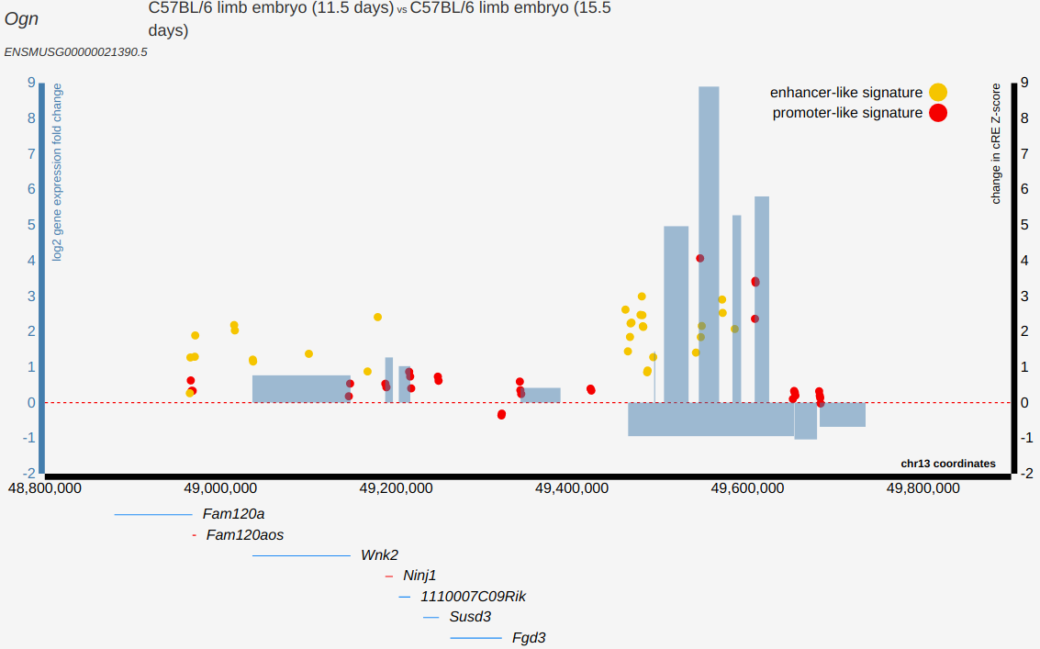
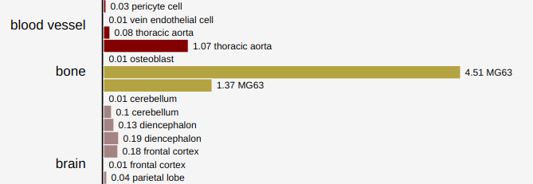
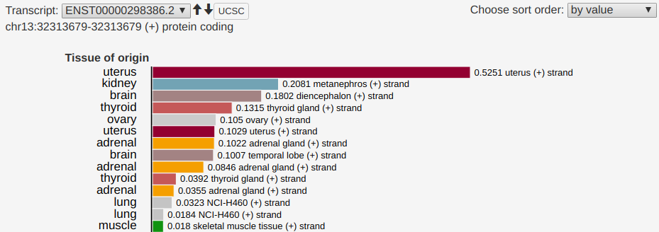
SCREEN overview (recap): three perspectives
a
b
Differential Expression: mouse only self-contained app
Gene-centric View
RNA-seq: human and mouse gene expression app, cRE details
RAMPAGE: human only cRE details

Slide 11
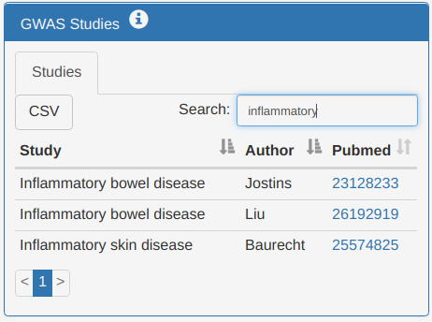
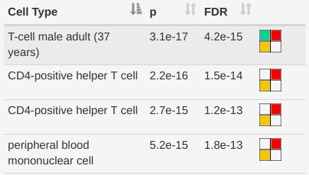
SCREEN overview (recap): three perspectives
SNP-centric GWAS View
browse cREs intersecting LD blocks from study by cell type
select study

Slide 12
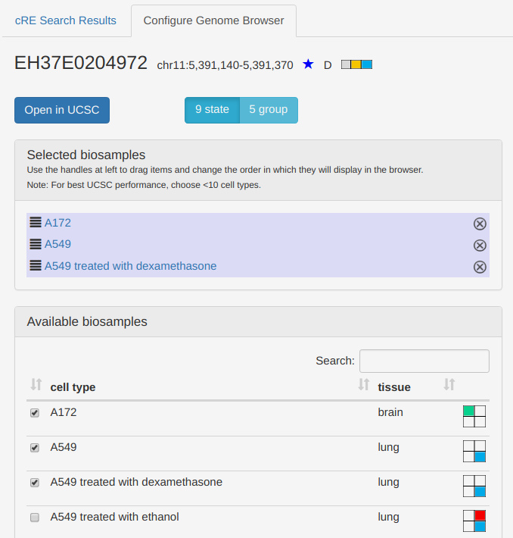
New since last update: UCSC browser configuration
tab opens after clicking a UCSC button
toggle 9-state or 5-group cRE tracks
click and drag selected cell types with handles to change order of tracks in the browser
click rows to toggle selected cell types

Slide 13
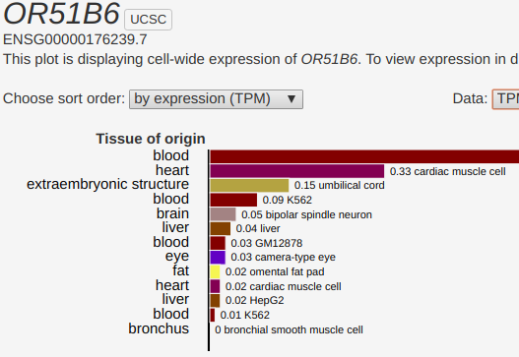
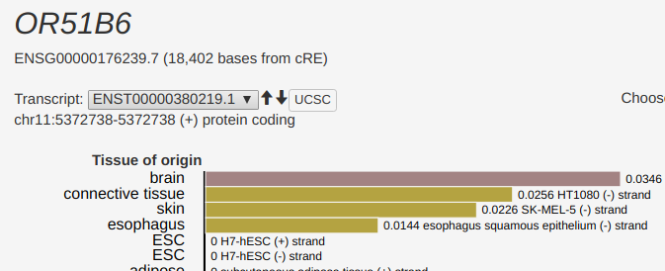
New since last update: UCSC buttons for transcripts
RNA-seq
RAMPAGE

Slide 14
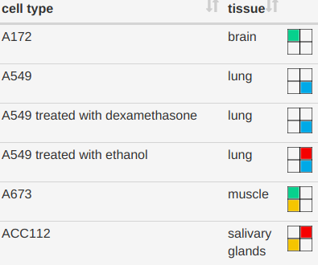
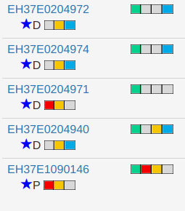
New since last update: summary symbols
Available data types by cell type
search results table: P/D (proximal/distal), concordant support star, Z-scores by data type
key below search results table

Slide 15
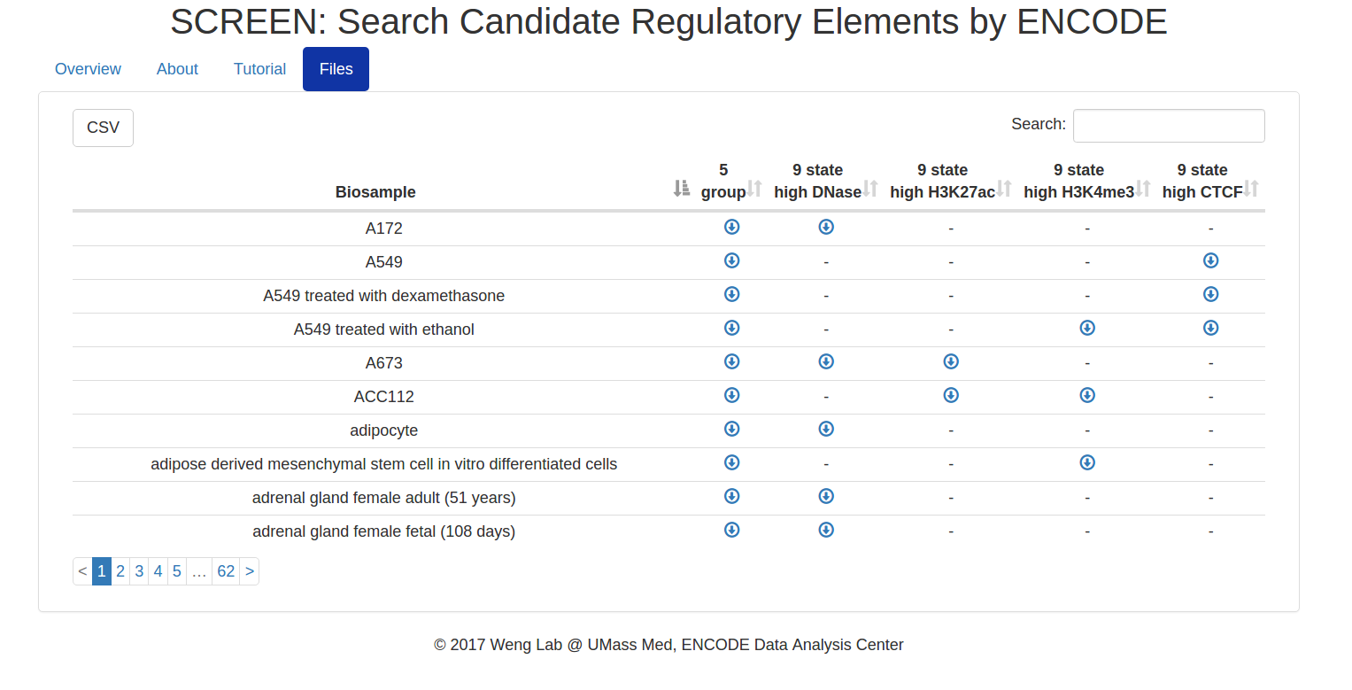
New since last update: cRE file download

Slide 16
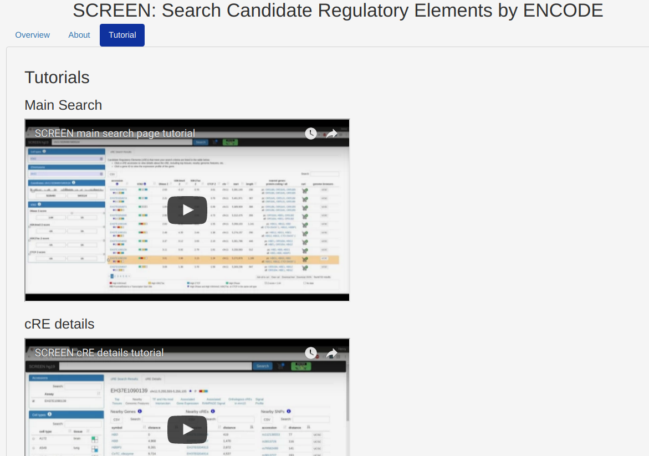
New since last update: new tutorials on homepage
six tutorials
main search
results table, cart, browser
cRE details
gene expression
differential expression
GWAS
hosted on SCREEN YouTube channel
https://www.youtube.com/channel/UCFX89WFjvf-1NCj_4mVObRg

