Slide 1
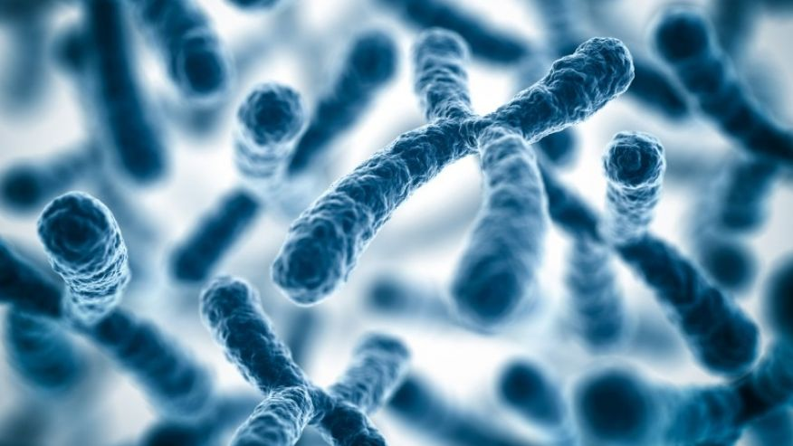
Predicting effects of noncoding variants with deep learning-based sequence model
Jian Zhou and Olga G. Troyanskaya Nature Methods, 12, August 2015
Journal Club | June 15, 2017

Slide 2
Outline
Motivation
Framework
Convolutional Neural Network (CNN)
Relative log-fold change
Regularized logistic regression
Predictive Tasks
In silico mutagenesis
Chromatin effect prediction
SNP Functional prioritization
Indel prioritization
Strengths & Weaknesses

Slide 3
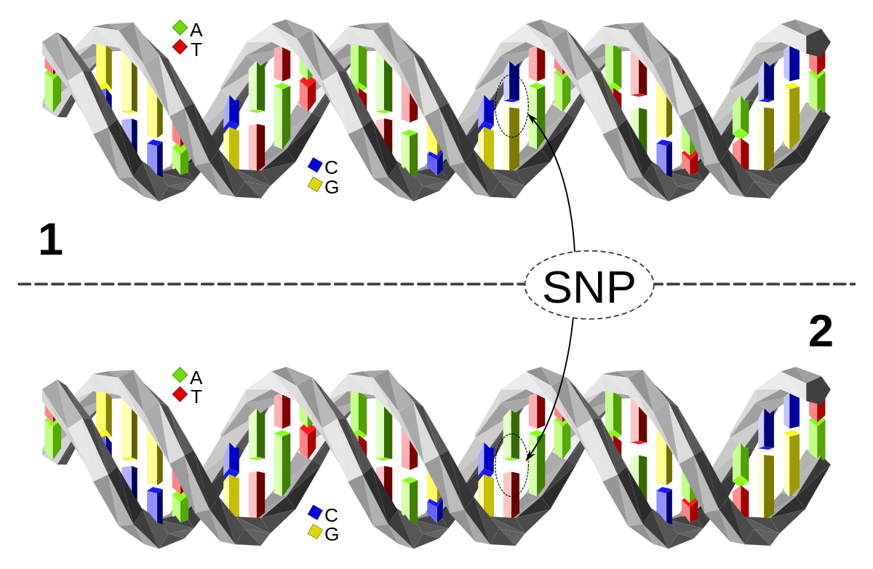
Motivation
Most disease-related SNPs lie in noncoding regions
Historically, coding regions have been given more attention
De novo predictions help prioritize in regions with no or poor annotation

Slide 4
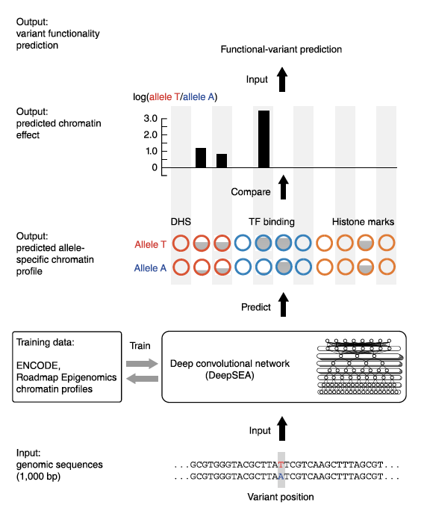
Framework
Deep learning-based Sequence Analyzer (DeepSEA)
DeepSEA Framework
Convolutional Neural Network (CNN)
Relative log-fold change
Regularized logistic regression

Slide 5
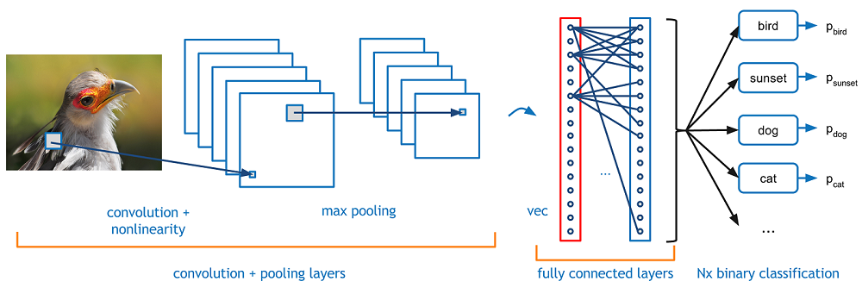
Framework Convolutional Neural Network
Works on spatial features where order of features is important
Inspired by receptive fields of animal visual cortex
One of few approaches that revolutionized Deep Learning
Popular for image classification

Slide 6
Framework Convolutional Neural Network
Learning discriminative features automatically
Output can be one or many values, depending on network architecture

Slide 7
Framework Convolutional Neural Network
Convolution Step
Scanning for each feature
Pooling Step
Shrinking feature map (~ zooming in), also called subsampling

Slide 8
Framework Convolutional Neural Network
Final layer is usually a fully connected neural network
Can be any other classifier, such as SVM as in [Tang, 2013]

Slide 9
Framework Convolutional Neural Network
Number of features, window size for scanning, and other parameters need to be optimized
But why does it work on sequence data?

Slide 10
Framework Convolutional Neural Network
Works on spatial features where order of features is important
DNA sequences, video frames, images, etc.

Slide 11
Framework Convolutional Neural Network
Works on spatial features where order of features is important
DNA sequences, video frames, images, etc.
Input: 1000-bp sequence
Outputs: Chromatin features
975 values (670 TF binding, 125 DHS, and 104 histone modification values)
Hundreds of features to scan for

Slide 12
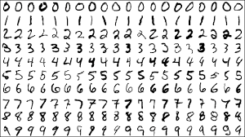
Framework Convolutional Neural Network
CNN Toy Example | MNIST Digit Classification via TensorFlow in Python [here]
Setup on Farnam (~ 5 minutes) [here]
Accuracy > 99%

Slide 13
Framework Predictive Tasks
Chromatin Feature Prediction
Training data
Genome wide chromatin profiles
670 TF binding, 125 DHS, and 104 histone mark profiles
ENCODE and Roadmap Epigenomics
521.6 Mbp (17%) of the genome bound 1+ of 160 chosen TFs
Testing
Holdout sequences from the genome
4,000 samples from chr7 region 30,508,751-35,296,850

Slide 14
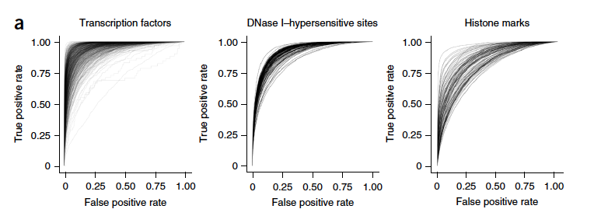
Framework Predictive Tasks | Chromatin Feature Prediction
Results
TF binding sites | Median AUC = 0.985
DHS | Median AUC = 0.923
Histone modifications | Median AUC = 0.865
SVM-based gkm-SVM
TF binding sites | Median AUC = 0.896
Two models: 300-bp & 1000-bp-based

Slide 15
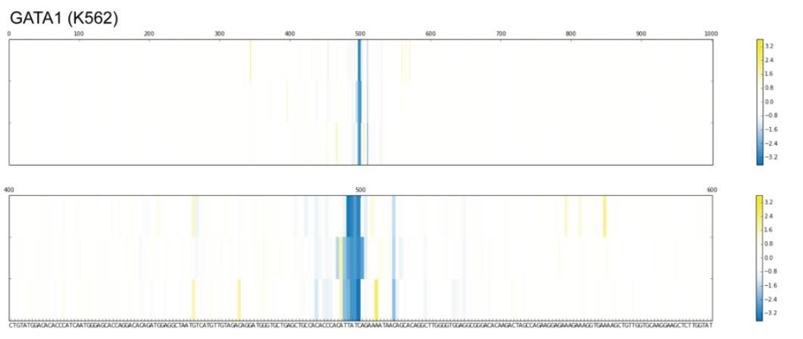
Framework Predictive Tasks | In Silico Mutagenesis
Computational generation of all possible SNVs (3x1000 per 1KB input sequence)
Validation against disease-related SNPs with experimental evidence
Results
Accurate prediction of TF binding effects on SNPs with experimentally validated known effects
Breast cancer risk locus C-to-T SNP rs4784227 in FOXA1
𝛂-thalassemia T-to-C creates a binding site for GATA1
Pancreatic agenesis A-to-G mutation has deleterious effect on FOXA2 binding
binding site
A > C > G > T order
Yellow increase in binding
Blue decrease in binding

Slide 16
Framework Predictive Tasks
SNP Functional Prioritization
CNN followed by regularized log-reg
Sequence & evolutionary features (PhyloP & others)
Data
Human Gene Mutation Database (HGMD)
Noncoding eQTLs from Genome-Wide Repository of Associations between SNPs and Phenotypes
Noncoding SNPs from HGRI GWAS Catalog

Slide 17
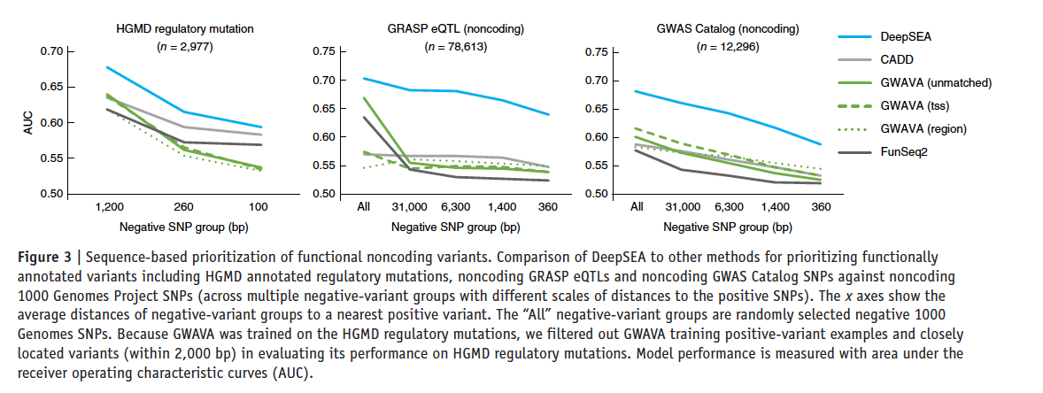
Framework Predictive Tasks | SNP Functional Prioritization
Discriminating negative SNPs close to positive (functional) ones
AUC (<0.7) lower on this task compared to all 3 previous chromatin effect prediction tasks
Relatively low FPR

Slide 18
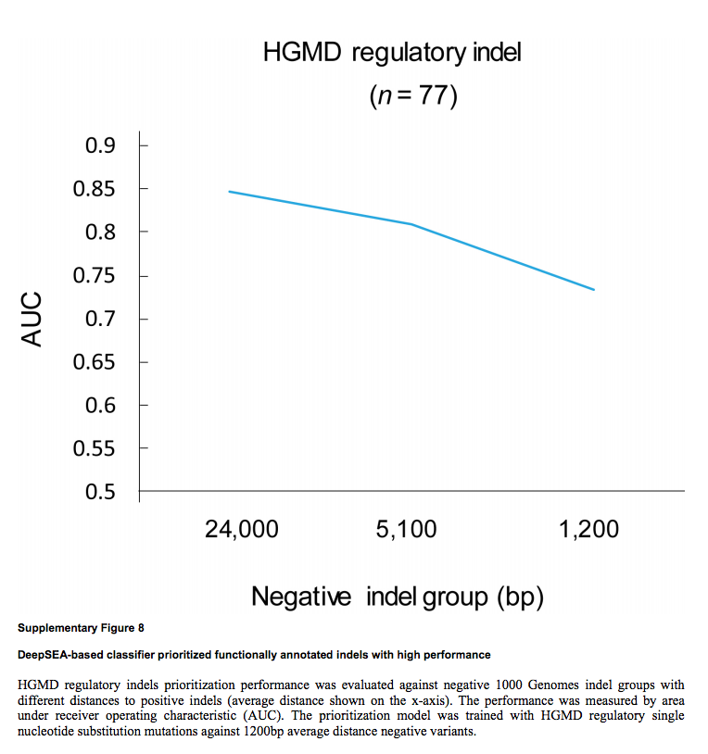
Framework Predictive Tasks | Indel Prioritization
Data from HGMD
0.85 > AUC > 0.75

Slide 19
Strengths & Weaknesses
Strengths
First deployment of deep learning methods in variant prioritization
De novo predictions for multiple tasks
Weaknesses
gkb-SVM optimized on 300-bp input sequences, not 1000-bp ones
N = 77 sequences only to test for indels
SNP functional prioritization is de novo, but not de novo
More focus on functionally negative rather than positive SNPs

Slide 20
END | THANK YOU

