Slide 1
The Aiden Lab as Part of ENCODE
Brian Glenn St Hilaire

Slide 2
Projected Data Production
80 “Loop Resolution” Hi-C maps.
“Loop Resolution” = 2-4 billion read pairs
  Compartments
  Domains
  Loops
Extant cell type coverage
  Aiden Lab data
  ENCODE data

Slide 3
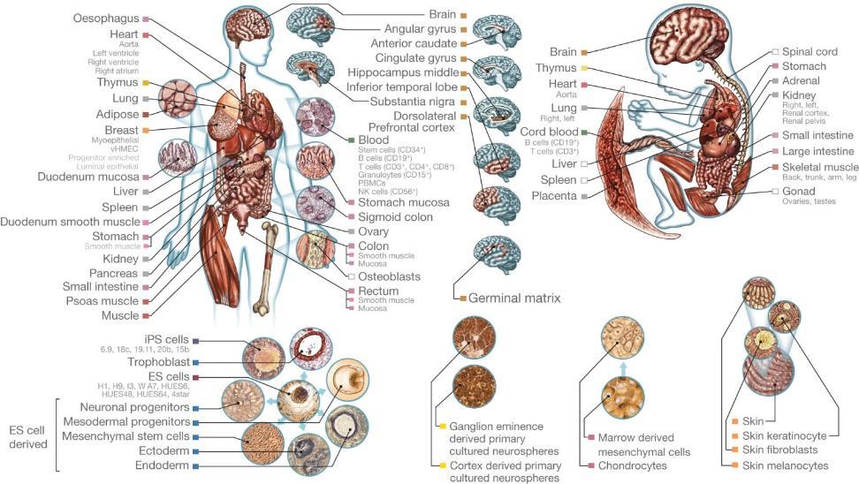
Expanding ENCODE Coverage
Roadmap Epigenomics Consortium et al. Nature 518, 317-330 (2015) doi:10.1038/nature14248

Slide 4
Loop Resolution in situ Hi-C
Suhas Rao

Slide 5
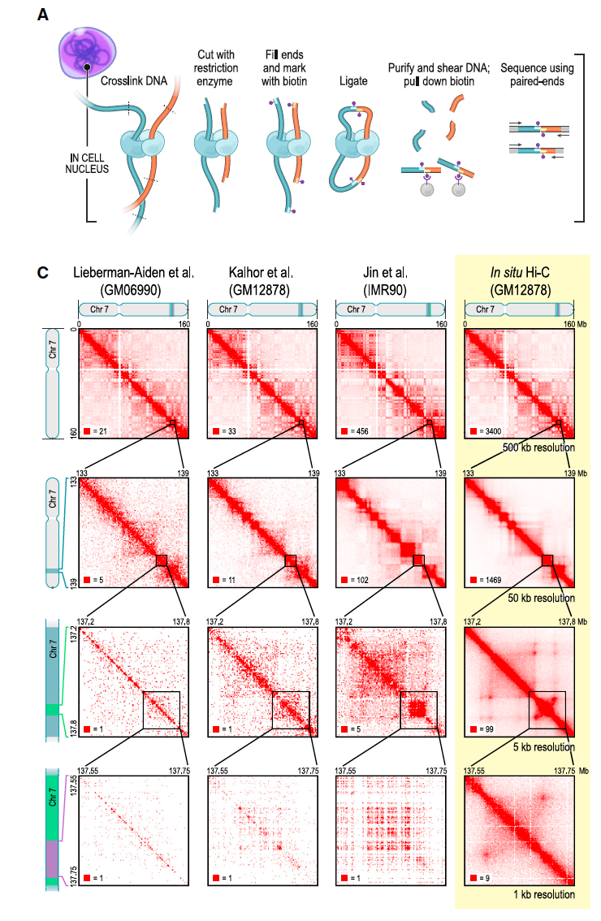
In situ Hi-C improves resolution
  Rao and Huntley et al., Cell 2014

Slide 6
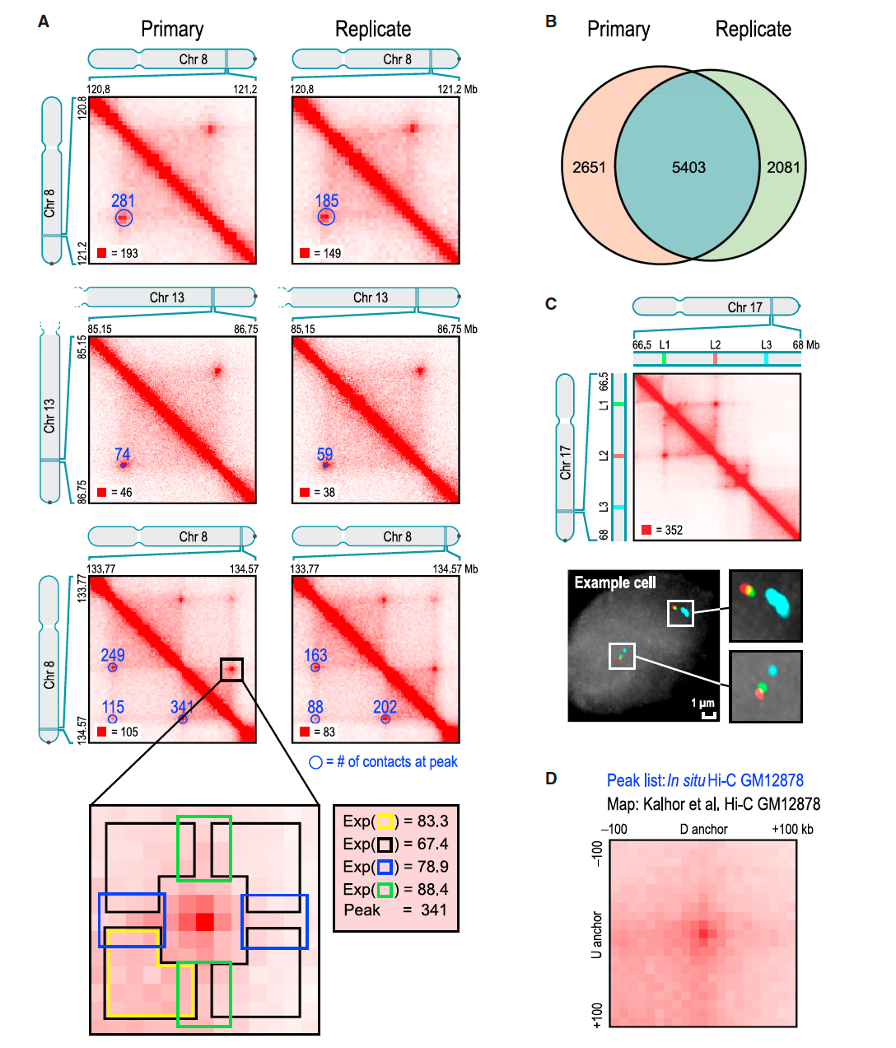
isHi-C can be used to map loops
  Rao and Huntley et al., Cell 2014

Slide 7
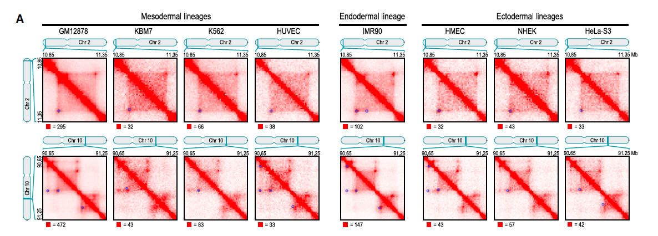
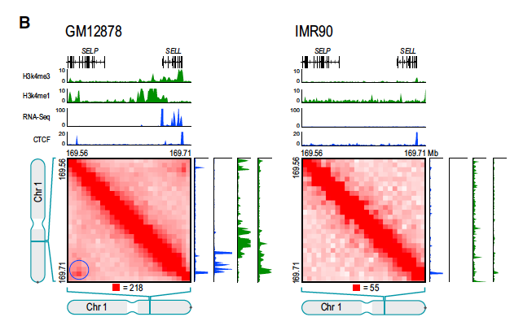
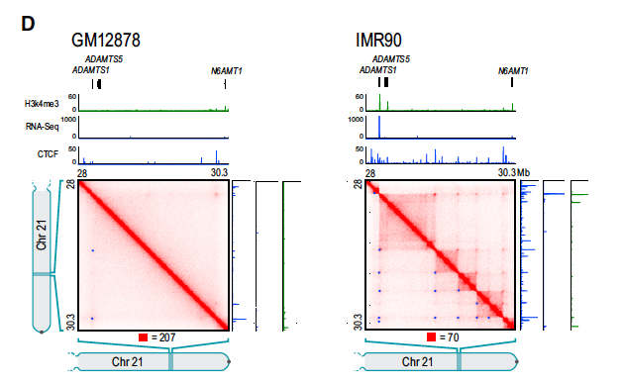
…across cell types
  Rao and Huntley et al., Cell 2014

Slide 8
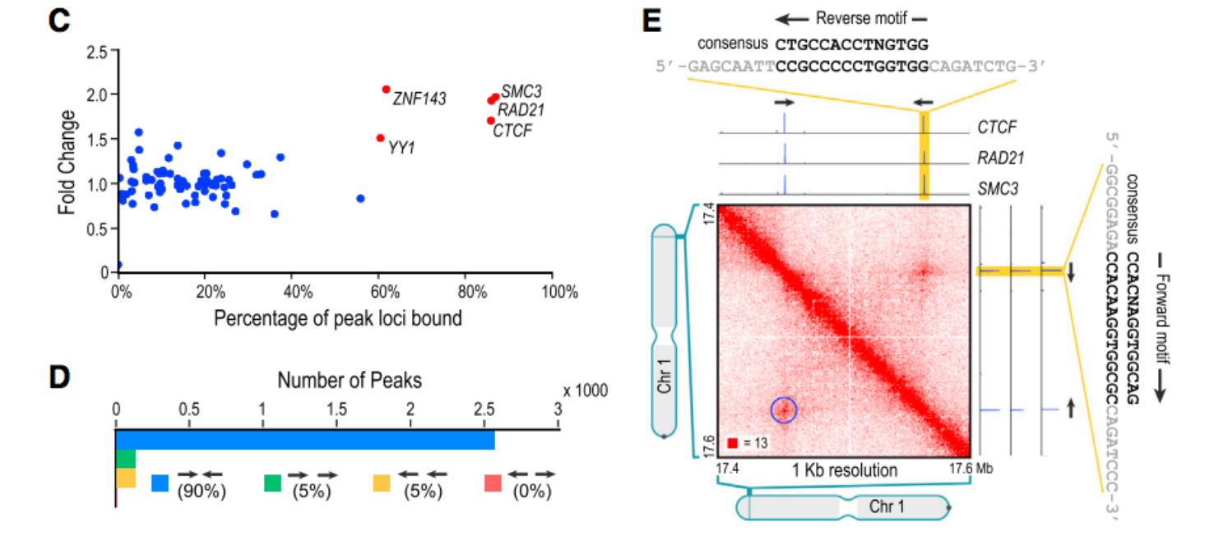
isHi-C data can be integrated with ENCODE ChIP-Seq data to yield mechanistic insights
  Rao and Huntley et al., Cell 2014

Slide 9
Processing and visualizing ChIA-PET and Hi-C Data
Neva C Durand
Aiden Lab

Slide 10
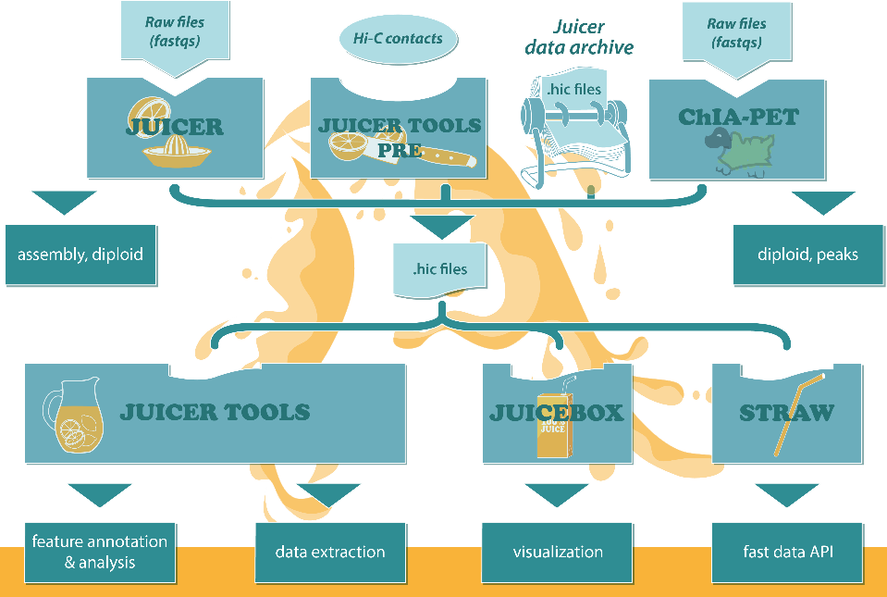
Notes:
Unified ecosystem supporting both Hi-C and ChIA-PET in an integrated way. Both mapping centers have been working on this tool system and proposal together since last year.
Long read ChIA-PET pipeline: Significant interactions, Loop annotations, Input to diploid pipeline
Hi-C pipeline Binned contact maps at many resolutions, Loop and domain annotations, Input to assembly pipeline, Input to diploid pipeline
Both pipelines result in a .hic file, to visualize in Juicebox
Both pipelines are peer-reviewed, open source, and have strong user bases

Slide 11
Li et al. Nature Methods 2017
Rao & Huntley et al., Cell 2014
Durand & Shamim et al., Cell Systems 2016
Durand & Robinson et al., Cell Systems 2016
Open source, peer reviewed, strong user bases
Notes:
Unified ecosystem supporting both Hi-C and ChIA-PET in an integrated way. Both mapping centers have been working on this tool system and proposal together since last year.
Long read ChIA-PET pipeline: Significant interactions, Loop annotations, Input to diploid pipeline
Hi-C pipeline Binned contact maps at many resolutions, Loop and domain annotations, Input to assembly pipeline, Input to diploid pipeline
Both pipelines result in a .hic file, to visualize in Juicebox
Both pipelines are peer-reviewed, open source, and have strong user bases

Slide 12
ChIA-PET tool
Notes:
ChIA-PET pipeline, note Juicer tool usage as well.

Slide 13
ChIA-PET tool
Notes:
ChIA-PET pipeline, note Juicer tool usage as well.

Slide 14
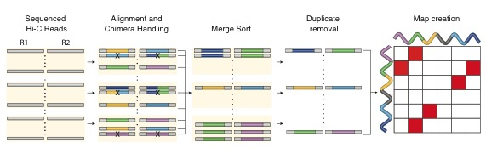
Juicer pipeline
Both pipelines produce .hic files to store binned contact matrices at multiple resolutions
Juicer produces the “merged_nodups.txt” file, input to our assembly and diploid pipelines
Juicer automatically annotates loops & domains

Slide 15
ChIA-PET data and loops visualized in Juicebox

Slide 16
Loop calling
ChIA-PET tool produces loop annotations on ChIA-PET data through clustering
HiCCUPS (run as part of the Juicer pipeline) produces loop annotations on Hi-C data
Loop annotations are given in tab-delimited text files that can be loaded into Juicebox for visualization (c.f. previous slide)

Slide 17
.hic file format
Both pipelines produce .hic files
Binary, highly compressed, fully indexed
Essentially 2D version of bigWig file
  As you zoom in, access differently binned data
  Data stored intelligently in block format, so nearby points in 2D are stored together
Normalization vectors and metadata included in .hic file
Juicebox and Juicebox Web allow easy exploration of hundreds of publicly available .hic files
ENCODE tracks can be visualized alongside heat maps

Slide 18
Aiden Lab Juicer processing

Slide 19
Juicer usage by ENCODE and other labs
Genomics of Gene Regulation uses Juicer, .hic files on ENCODE site
Ruan lab: ChIA-PET tool produces .hic file
Bernstein lab: Juicer for Hi-C, both for folding and assembly
Snyder lab: Juicer for both ChIA-PET and loop-resolution Hi-C
Forum: 180 members from labs all over the world

Slide 20
Loop resolution Hi-C maps to date: ENCODE PIs in red; all used Juicer
SSP Rao, MH Huntley, NC Durand, EK Stamenova, ID Bochkov, JT Robinson, AL Sanborn, I Machol, AD Omer, ES Lander, EL Aiden, Cell 2014: most cited research paper in Cell in past 4 years
AL Sanborn, SSP Rao, S Huang, NC Durand, MH Huntley, AI Jewett, ID Bochkov, D Chinnappan, A Cutkosky, J Li, KP Geeting, A Gnirke, A Melnikov, D McKenna, EK Stamenova, ES Lander, EL Aiden, PNAS 2015
EM Darrow, MH Huntley, O Dudchenko, EK Stamenova, NC Durand, Z Sun, S Huang, AL Sanborn, I Machol, M Shamim, AP Seberg, ES Lander, BP Chadwick, EL Aiden, PNAS 2016
SSP Rao, S Huang, BG St Hilaire, JM Engreitz, EM Perez, K Kieffer-Kwon, AL Sanborn, SE Johnstone, ID Bochkov, X Huang, MS Shamim, AD Omer, BE Bernstein, R Casellas, ES Lander, EL Aiden, Submitted 2017
DH Phanstiel, K Van Bortle, DV Spacek, GT Hess, MS Shamim, I Machol, MI Love, EL Aiden, MC Bassik, MP Snyder, Submitted 2017
JHI Haarhuis,RH van der Weide, VA Blomen, J Omar Yanez-Cuna, M Amendola, MS van Ruiten, PHL Krijger, H Teunissen, RH Medema, B van Steensel, TR Brummelkamp, E de Wit, BD Rowland, Cell 2017
N Kubo, H Ishii, D Gorkin, F Meitinger, X Xiong, R Fang, T Liu, Z Ye, B Li, J Dixon, A Desai, H Zhao, B Ren, bioRxiv 2017
L Vian, A Pekowska, S Rao, K Kieffer-Kwon, S Jung, L Baranello, M Dose, N Pruett, A Oksanen, A Sanborn, W Resch, X Li, AL Kovalchuk, S Huang, Z Tang, S Nelson, M Di Pierro, RR Cheng, I Machol, BG St. Hilaire, N Durand, M Shamim, E Stamenova, JN Onuchic, Y Ruan, D Levens, EL Aiden, R Casellas, Submitted 2017
K Kieffer-Kwon, K Nimura, S Rao, J Xu, S Jung, A Pekowska, M Dose, E Stevens, E Mathe, P Dong, S Huang, MA Ricci, L Baranello, Y Zheng, FT Ardori, W Resch, D Stavreva, S Nelson, M McAndrew, A Casellas, E Finn, C Gregory, SM Johnson, W Dubois, MP Cosma,E Batchelor, D Levens, RD Phair, T Misteli, L Tessarollo, G Hager, M Lakadamyali, Z Liu, M Floer, H Shroff, EL Aiden, R Casellas, Submitted 2017
A Canela, Y Maman, S Jung, N Wong, A Day, E Callen, K Kieffer-Kwon, A Pekowska, H Zhang, S Rao, S Huang, PJ Mckinnon, PD Aplan, Y Pommier, EL Aiden, R Casellas, A Nussenzweig, Submitted 2017
CS Cheng, RE Gate, AP Aiden, A Siba, M Tabaka, D Lituiev, I Machol, M Subramaniam, M Shamim, KL Hougen, I Wortman, S Huang, NC Durand, T Feng, PL De Jager, HY Chang, EL Aiden, C Benoist, MA Beer, CJ Ye, A Regev, bioRxiv 2016
Notes:
These 11 papers comprise every single mammalian loop resolution Hi-C experiment published, preprinted, or submitted to the best of our knowledge; spanning work by 4 of 8 mapping centers. Every single one used juicer ecosystem & hiccups.

Slide 21
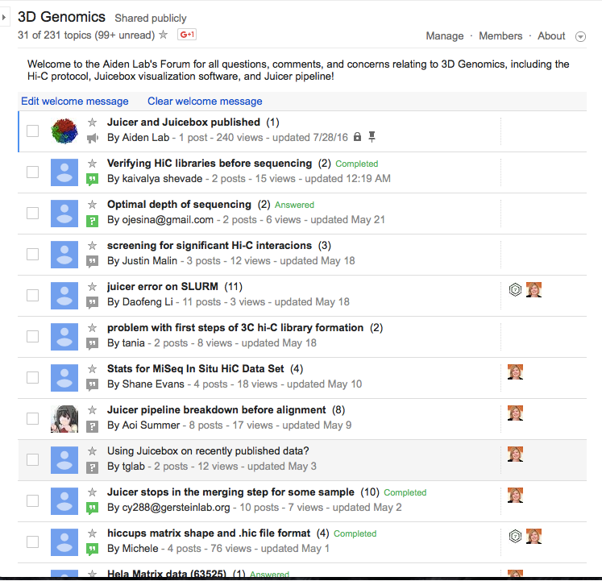
Notes:
Over 180 members of forum using Juicer from different labs all over the world

Slide 23
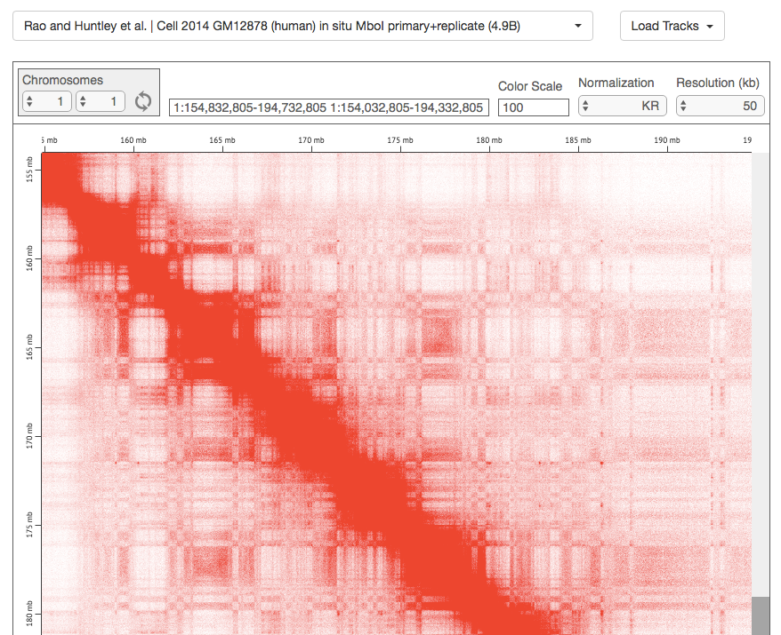

Slide 24
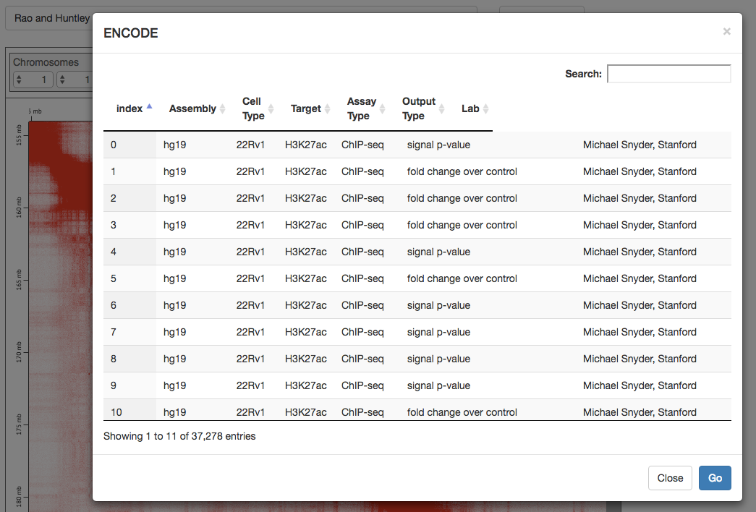

Slide 25
Visualization checklist
Visualize data at small and large scales
Compare ChIA-PET and Hi-C maps
Support real-time loading of tracks from ENCODE
Support loading arbitrary tracks (ChIP-Seq etc.) without preprocessing
Analyze data interactively, side-by-side comparison
Share data easily via web with a link
Juicebox + JB Web are the only visualization system to support all of these features
We now release .hic files with preprints to enable peer-review

Slide 26
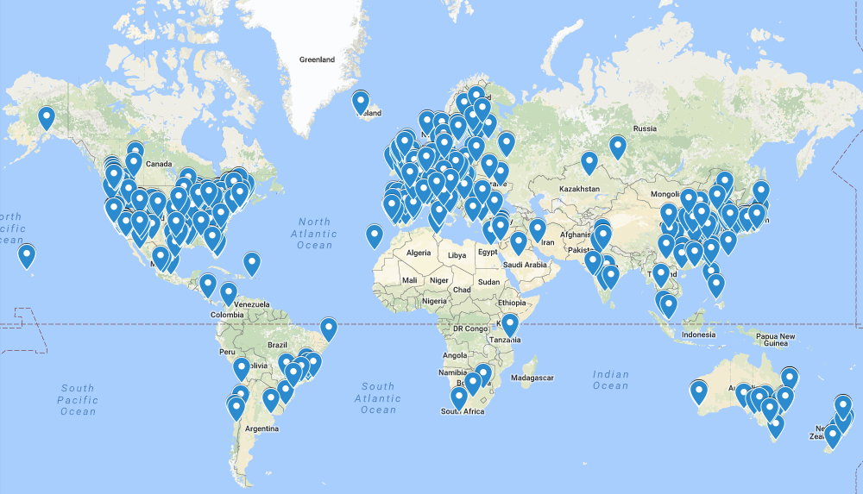
Juicebox around the world: >11K downloads, 38.5M maps rendered

