Slide 1
A 3D Map of the Human Genome at Kilobase Resolution Reveals Principles of Chromatin Looping
Journal Club
Lilly Reich

Slide 2

Overview
Why do we care about spatial organization in studying transcriptional control of genes?
  -get information of chromosomal proximities to better understand gene expression
  -Enhancers typically far away from genes in DNA sequence

Slide 3
What should we do?
Use Hi-C!!!
    To study 3D structure of genomes
    Typical distance between an enhancer and gene is between 1kb to 1MB including transcription binding
    We need detailed maps to be aware of exact loop anchors and domain borders

Slide 4
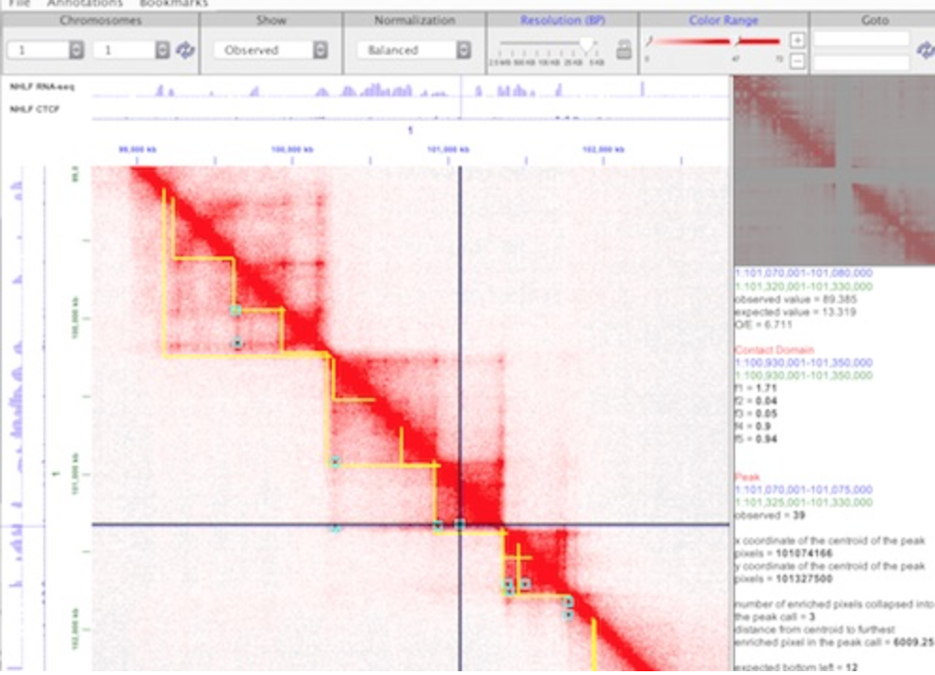
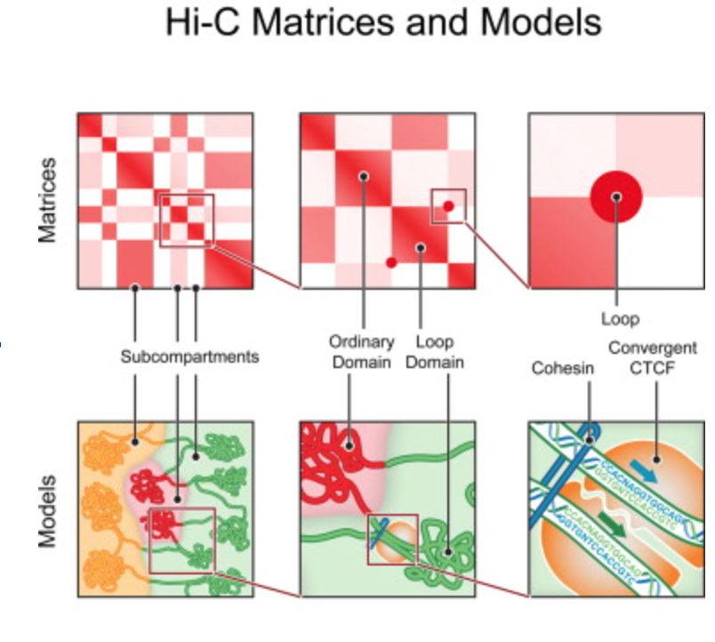

Slide 5
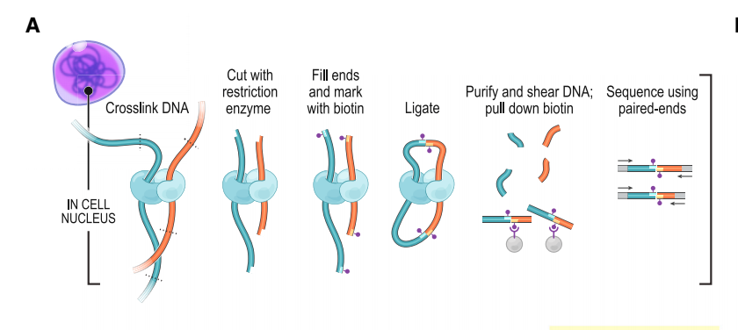
In Situ Hi-C Methodology and Maps
3 advantages over dilution Hi-C
      In situ ligation
      Protocol is faster
      Enables higher resolution

Slide 6
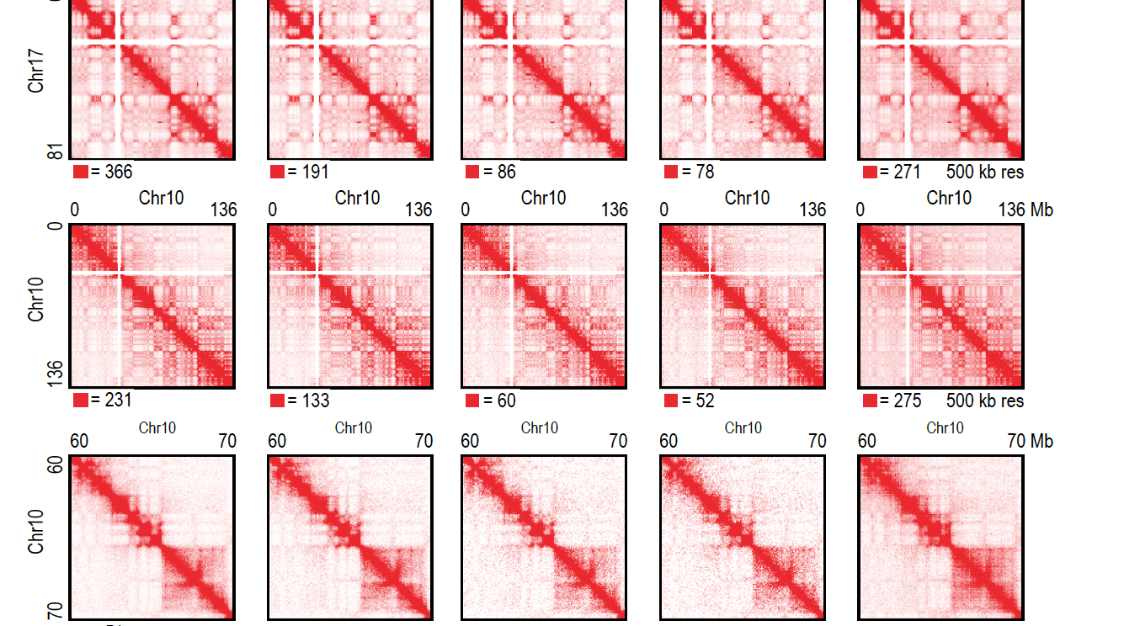

Slide 7
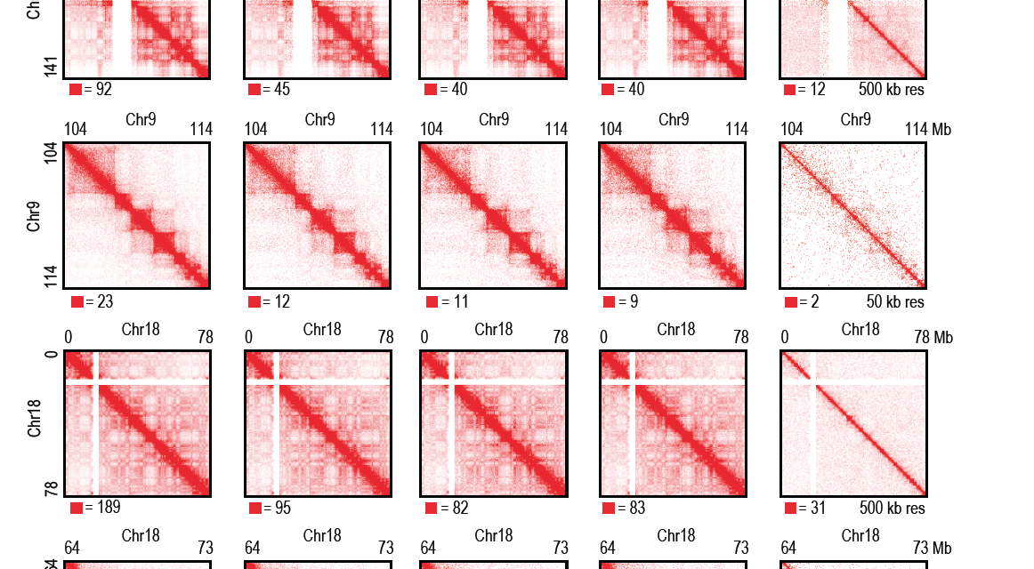

Slide 8
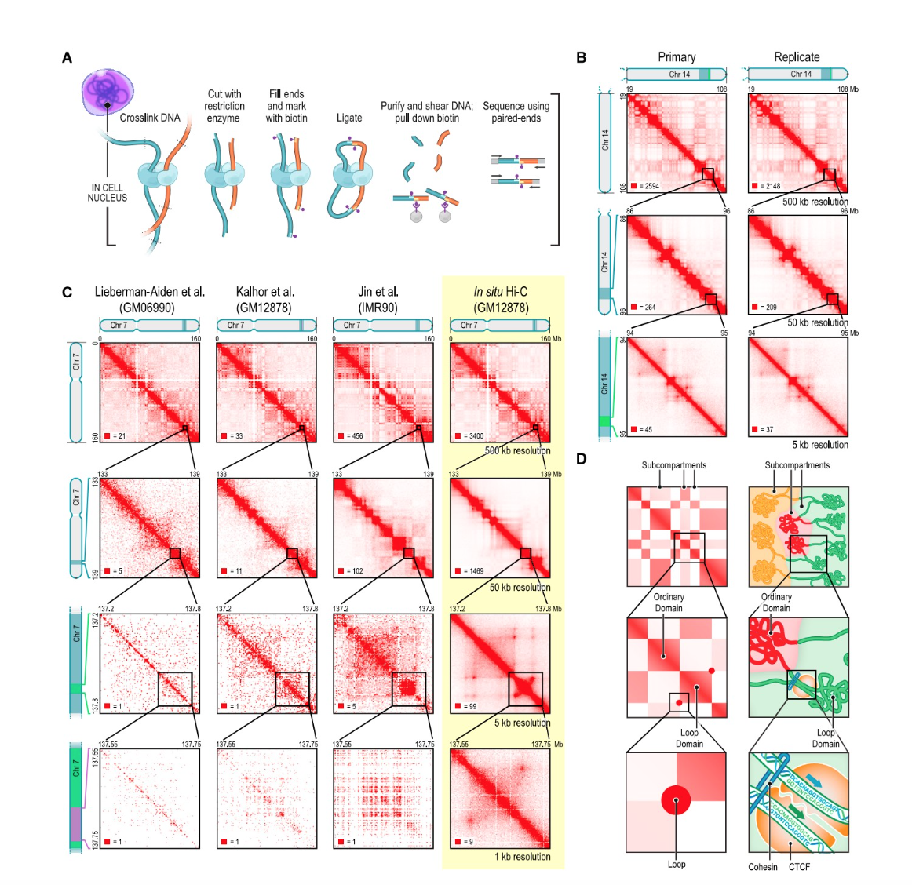
Contact Maps Spanning Nine Cell Lines Containing over 15 billion contacts
Constructed in situ Hi-C maps of nine cell lines in human and mouse

Slide 9
Constructed in situ (DNA-DNA) Hi-C maps of nine cell lines in human and mouse
Original Hi-C experiments had a map resolution of 1Mb.
These maps have a resolution of 1kb or 5Kb
Hi-C maps at 5kb resolution, using cell lines HMEC, NHEK, K562, HUVEC, HeLa, and KBM7
Mouse B-lymphoblasts CH12-Lx
Each map contains between 395M and 1.1B contacts

Slide 10
Used original dilution Hi-C protocol to generate maps of GM12878, IMR90, HMEC, NHEK, HUVEC, and CH12-LX
Situ Hi-C resolution maps superior at high resolutions, but closely resembled dilution Hi-C at lower resolution
        -Ex, dilution map of GM12878 (3.2 billion contacts) correlated highly with in situ map at 500, 50, and 25kb resolutions (R>0.96, 0.90, and 0.87, respectively)(Data S1, 1; Figure S1)

Slide 11
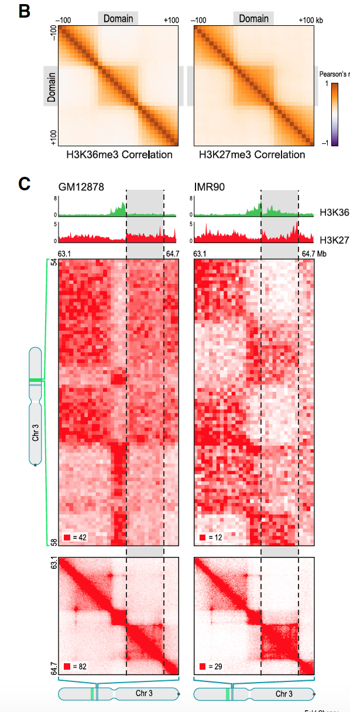
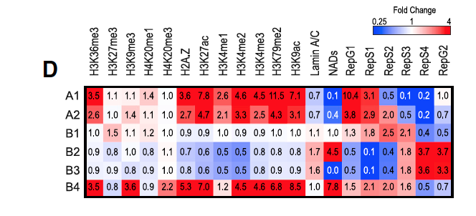
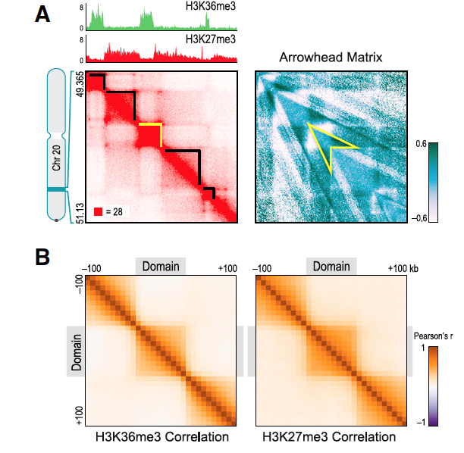
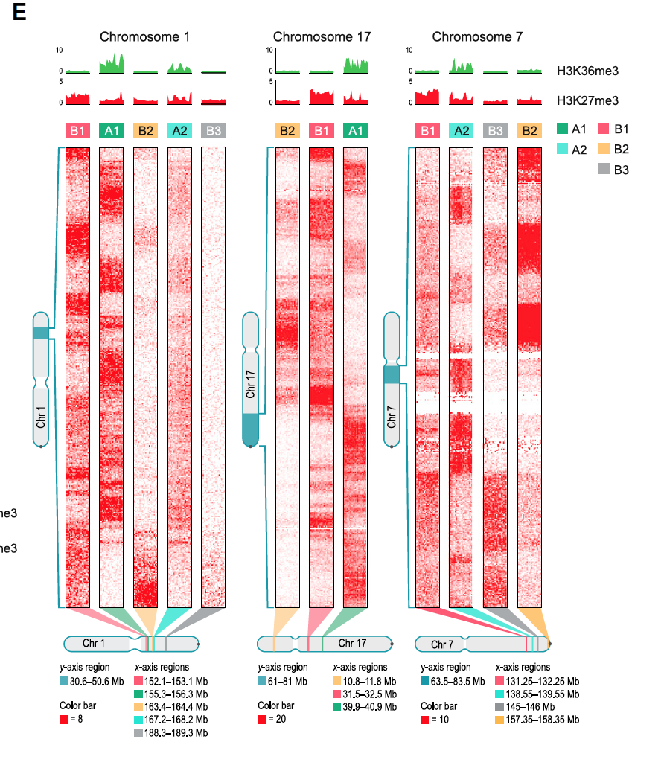
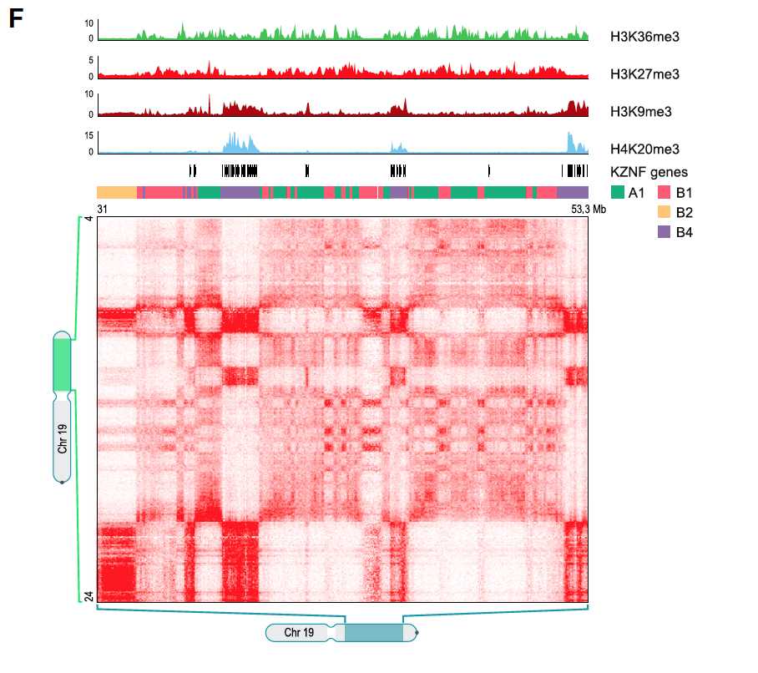
Largest map in GM12878 B-lymphoblastoid cells contains 4.9 billion pairwise contacts
Has a map resolution of 950bp

Slide 12
Also performed 112 supplementary Hi-C experiments using three different protocols
-situ Hi-C, dilution Hi-C, and Tethered Conformation Capture
- techniques like crosslinking, restriction enzyme, ligation volume/time, and biotinylated nucleotide
Included several in situ Hi-C experiments in which the formaldehyde crosslinking step was omitted.
      Structural features cannot be due to crosslinking procedures
In total, 201 independent Hi-C experiments were successfully performed (see Data S1 and S2)

Slide 13
The Genome is partitioned
Small domains median length is 185kb
Probing 3D partitioning of the genome:
      Earlier experiments at 1Mb map resolution (Lieberman-Aiden et al., 2009) squares partitioned genome into 5-20Mb intervals, which were called “megadomains”
      Individual 1Mb loci assigned to one of two long-range contact patterns
      Megadomains and the associated squares along the diagonals arise when 1Mb loci in an interval exhibit the same genome wide contact pattern.

Slide 14
In new higher resolution maps
-200 to 1,000-fold more contacts
Observed many small squares of enhanced contact frequency that tile the diagonal of each contact matrix (Figure 2A)
Used Arrowhead algorithm to annotate these contact domains genome-wide

Slide 15
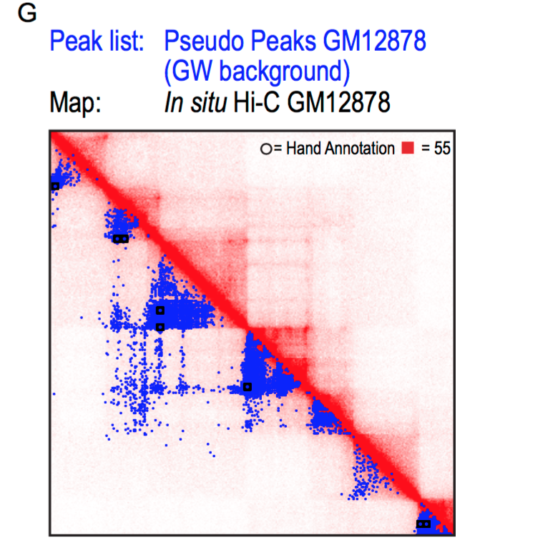
Observed domains ranged in size from 40kb to 3Mb (median size 185kb)
Abrupt drop in contact frequency with megadomains (33%)

Slide 16
Contact Domains Exhibit Consistent Histone Marks
Associated with changes in Long-Range Contact Pattern
Loci within a contact domain show correlated histone modifications for 8 different factors
          H3K36me3, H3K27me3, H3K4me1, H3K4me2, H3Kme3, H3K4me3, H3K9me3, H3K79me2, and H4K20me1

Slide 17
Loci at comparable distance but residing in different domains showed less correlation in chromatin state

Slide 18
Six Nuclear Subcompartments with Distinct Patterns of Histone modifications
Partitioned loci into categories based on long-range contact patterns alone: (Slide 11: 2D, 2E,2F)
  Manual annotation and three unsupervised clustering algorithms
    HMM (Hidden Markov Model)
    K-Means (cluster analysis algorithm)
    Hierarchical (hierarchy of clusters)

Slide 19
Analyzed data at low matrix resolution (1Mb), reproduced earlier version finding of two compartments (A and B)
At high resolution (25kb), found evidence for at least 5 “subcompartments” defined by long range interaction patterns, both within and between chromosomes
Found median length of an interval lying completely within a subcompartment 300kb

Slide 20
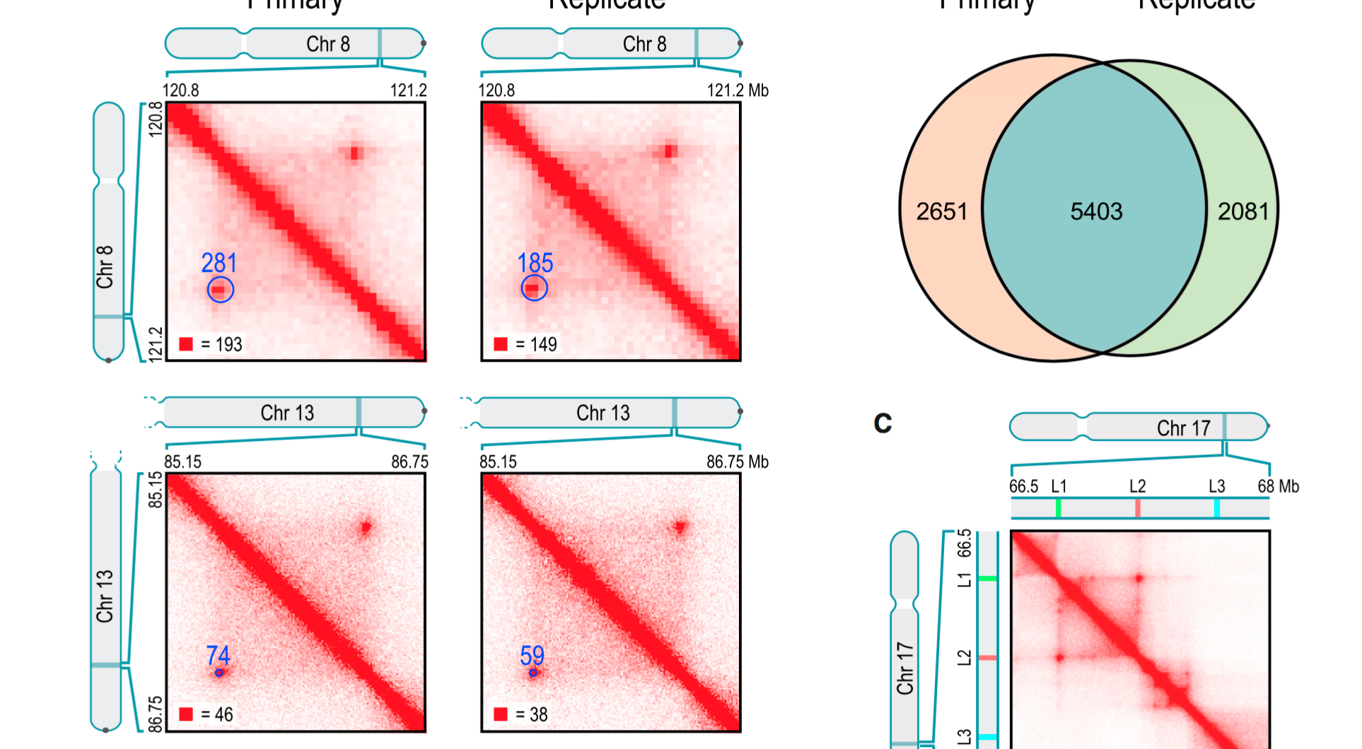
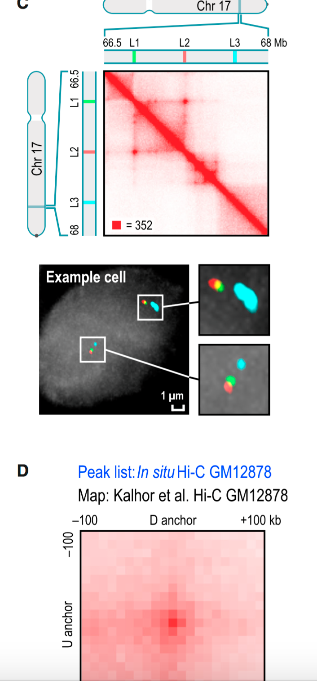
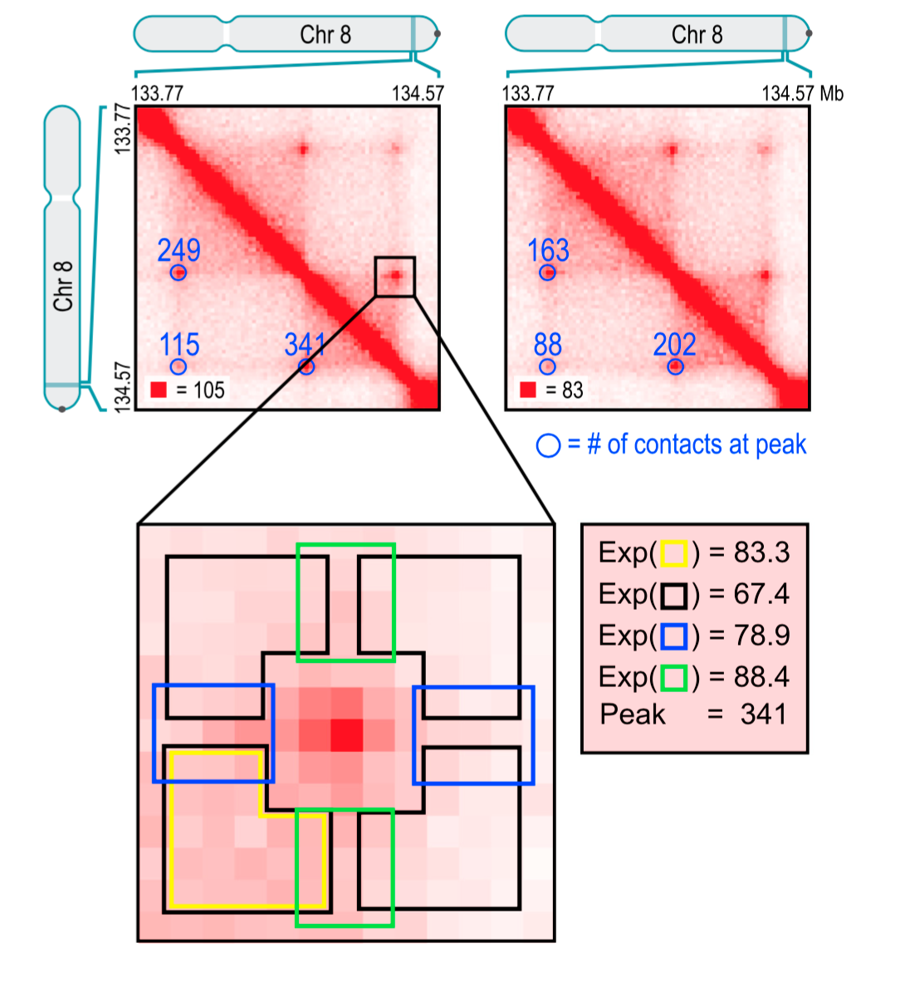

Slide 21
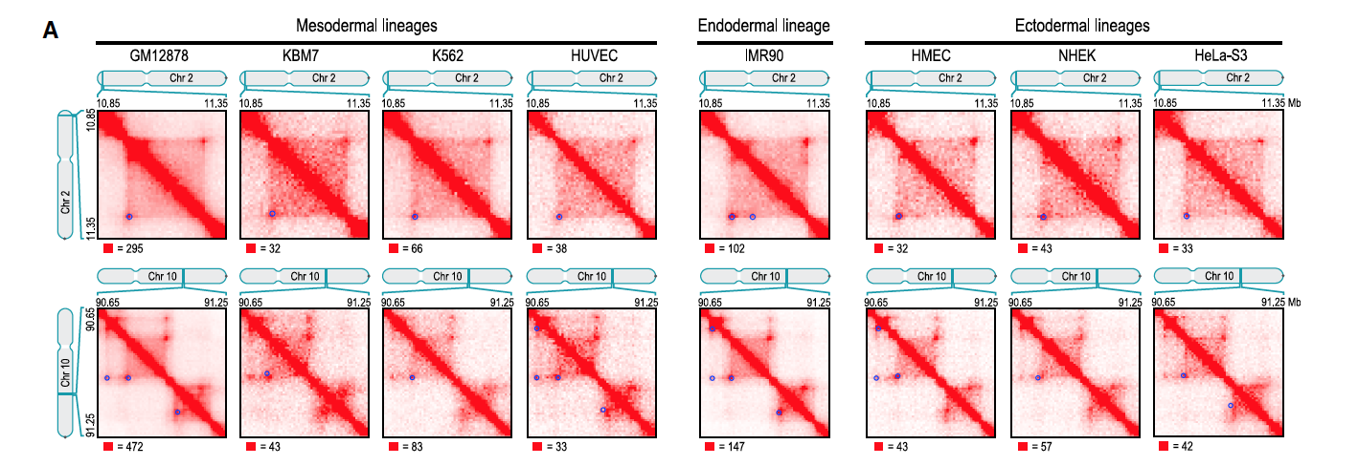
Conservation of Peaks among human cell lines and across evolution
Identified peaks in other seven human cell lines
      These maps contain fewer contacts, sensitivity is reduced and fewer peaks are reserved (ranging from 2,634 to 8,040)
      Found peaks conserved across cell types

Slide 22
Compared peaks in mouse
    CH12-LX mouse B-lymphoblasts identified 2,927 high-confidence contact domains and 3,331 peaks
GM12878
    Orthologous regions had 50% of peaks and 45% of domains in mouse were also called in humans
    Suggests conservation of 3D genome structure across mammals

Slide 23
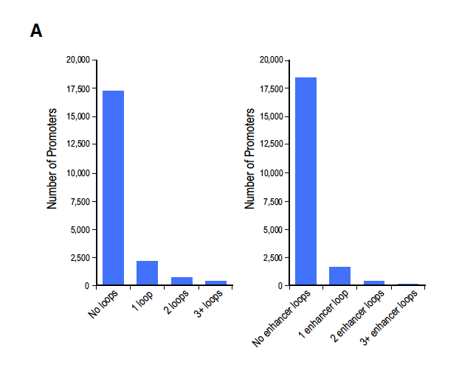
Loops anchored at promoter are associated with enhancers and increased gene activation
Peaks frequently known promoter at one peak locus and a known enhancer at the other

Slide 24
For example, 2,854 of the 9,448 peaks in GM12878 map bring together known promoters and known enhancers (30% versus 7%)
Genes whose promoters are associated with a loop are much more highly expressed than genes that are not associated with a loop (6 fold)

Slide 25
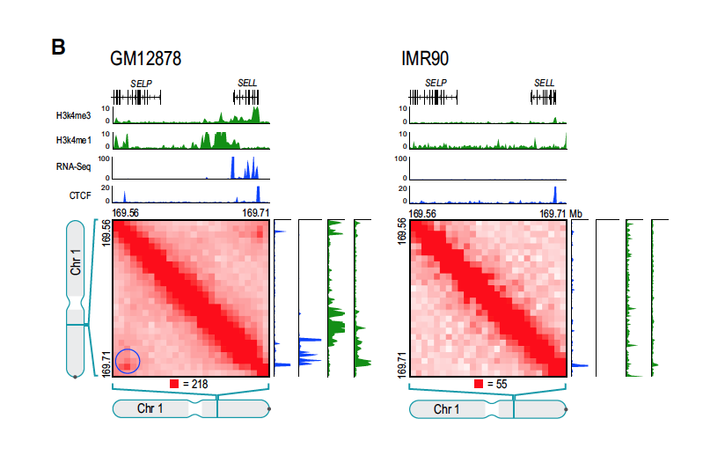
Presence of cell type specific peaks associated with changes in expression
        -examining RNA-seq data found that appearance of a loop in a cell type was accompanied by activation of a gene whose promoter overlapped one of the peak loci
        - Ex, cell-type specific loop is anchored at promoter of gene encoding L-selection (SELL), which is expressed in GM12878, but not in IMR90 where loop is absent

Slide 26
Observed 557 loops in GM12878 but not in IMR90
        -corresponding peak loci overlapped the promoters of 43 genes that were upregulated (750 fold) in GM12878 , but of only one gene markedly upregulated in IMR90
        -Also found 510 loops in IMR90 absent in GM12878
        -corresponding peak loci overlapped promoters of 94 genes that were upregulated in IMR90, but of only three genes that were markedly upregulated in GM12878

Slide 27
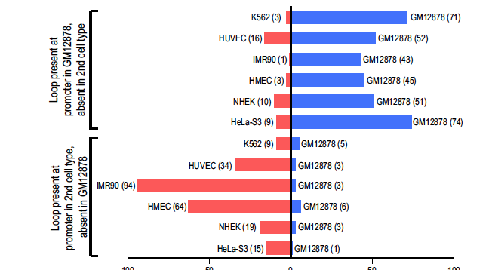

Slide 28
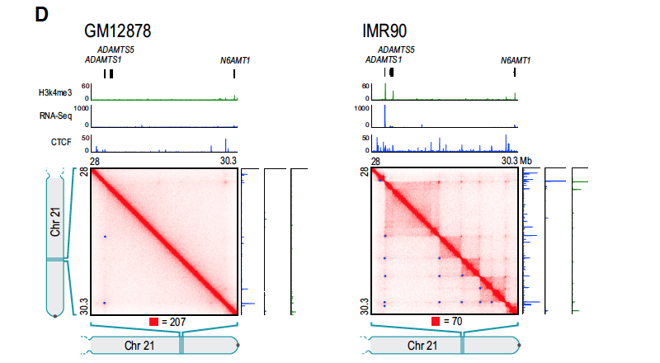

Slide 29
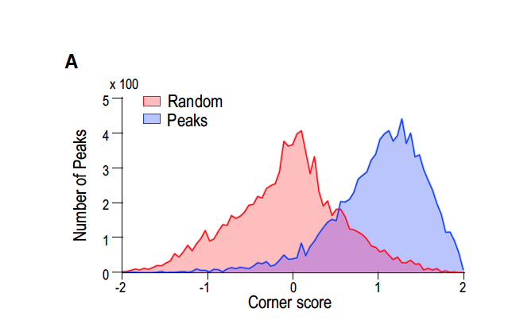
Loops frequently demarcate the boundries of contact domains
- Loops are anchored at a pair of convergent CTCF/RAD21/SMC3 binding sites

Slide 30
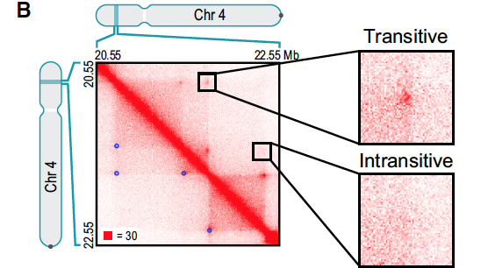

Slide 31
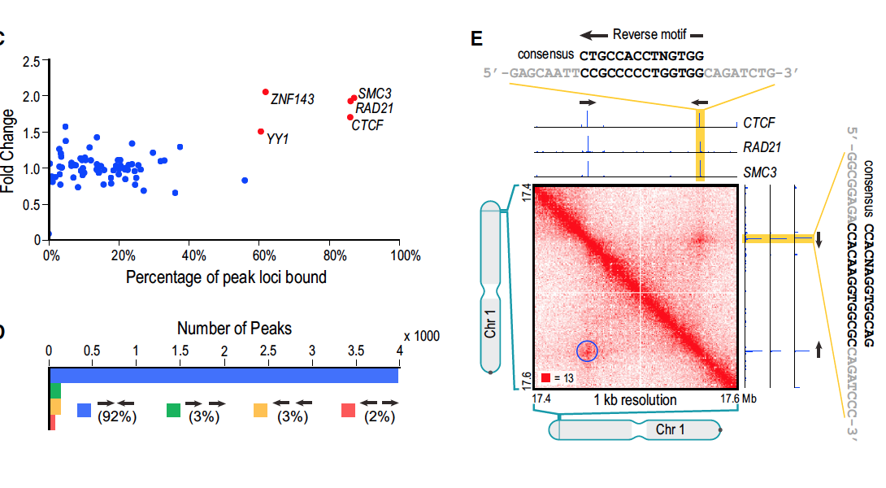

Slide 32
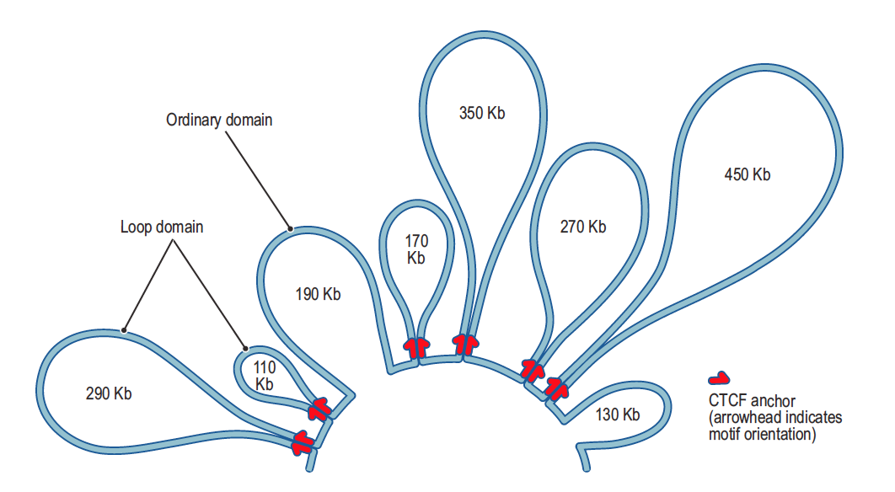

Slide 33
CTCF sites on the same chromosome can have four orientations
      1)Same direction on one strand
      2) Same direction on the other strand
      3) Convergent on opposite strands
      4) Divergent on opposite strands

Slide 34
They found 4,322 peaks in GM12878 where two corresponding peak loci contained a single CTCF binding motif
92% are convergent (Figures 6D and 6F)
Overall, presence of pairs at peak loci bound CTCF sites in convergent orientation enriched 102 fold over random expectation

Slide 35
Convergent orientation was more frequent than divergent orientation
Despite divergent motifs lie on opposite strands
GM12878 (3,971-78) , IMR90(1,456-5), HMEC(968-11), K562(723-2), NHEK(556-9), CH12-LX(625-8)
Pattern suggests pair of CTCF sites in convergent orientation is required for formation of loop

Slide 36
CTCF-Binding Exapted SINEB2 Repeat in Mouse Shows Preferential Orientation with Respect to Loops
CTCF motifs at peak anchors in SINEB2 elements show same strong bias toward convergent orientation seen throughout genome (89% are oriented toward opposing loop anchor versus 94% genome-wide)

Slide 37
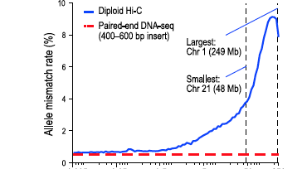
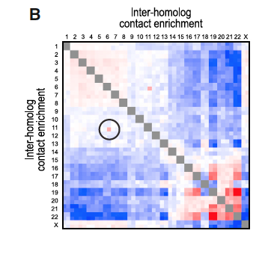
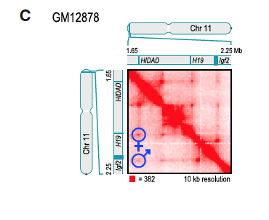
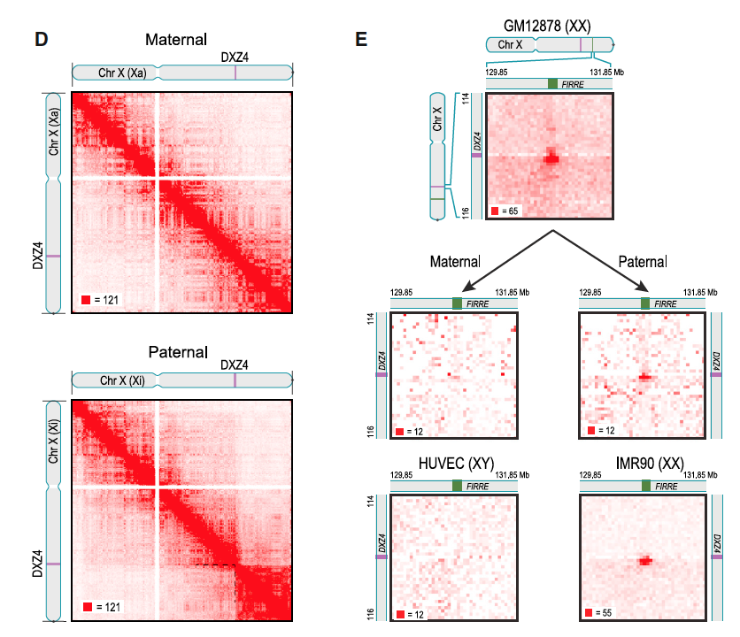
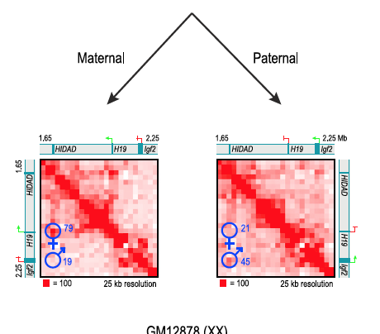

Slide 38
Significant differences in loop structure between Chromosome X homologs
Observed 27 large “superloops” spanning between 7 and 74Mb (Figure 7E)
Peak loci of most other loops nearly all superloop anchors bind CTCF (23 of 24)
Six anchor regions most frequently associated with superloops are large (up to 200kb)
Four anchor regions contain whole long noncoding RNA genes: loc550643, XIST, DXZ4, and FIRRE.
          Three (loc550643, DXZ4, and FIRRE) contain CTCF –binding tandem repeats that only bind CTCF on the inactive homolog

Slide 39
Conclusion
GM12878 had 9,448 loops
Most striking property of loops is that the pair of CTCF motifs present at the loop anchors occurs in a convergent orientation in >90% of cases (versus 25% expected by chance)

