Slide 1
Additive variance based methods
Journal Club
JW 05/25/17; updated 06/01/17

Slide 2
Main paper and GCTA tools

Slide 3
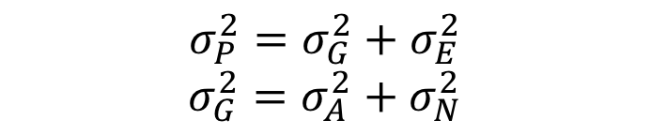

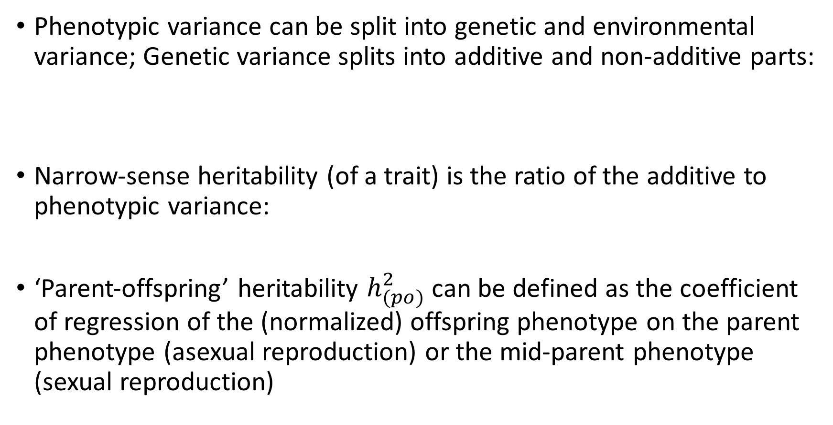
Heritability and additive variance
Phenotypic variance can be split into genetic and environmental variance; Genetic variance splits into additive and non-additive parts:
Narrow-sense heritability (of a trait) is the ratio of the additive to phenotypic variance:
‘Parent-offspring’ heritability $h_{(po)}^{2}$ can be defined as the coefficient of regression of the (normalized) offspring phenotype on the parent phenotype (asexual reproduction) or the mid-parent phenotype (sexual reproduction)
$$σ_{P}^{2}=σ_{G}^{2}+σ_{E}^{2}$$
$$σ_{G}^{2}=σ_{A}^{2}+σ_{N}^{2}$$
$$h^{2}= \frac{σ_{A}^{2}}{σ_{P}^{2}}$$

Slide 4

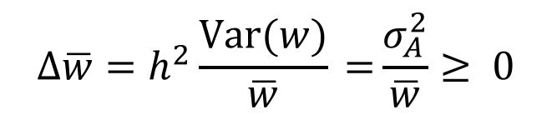
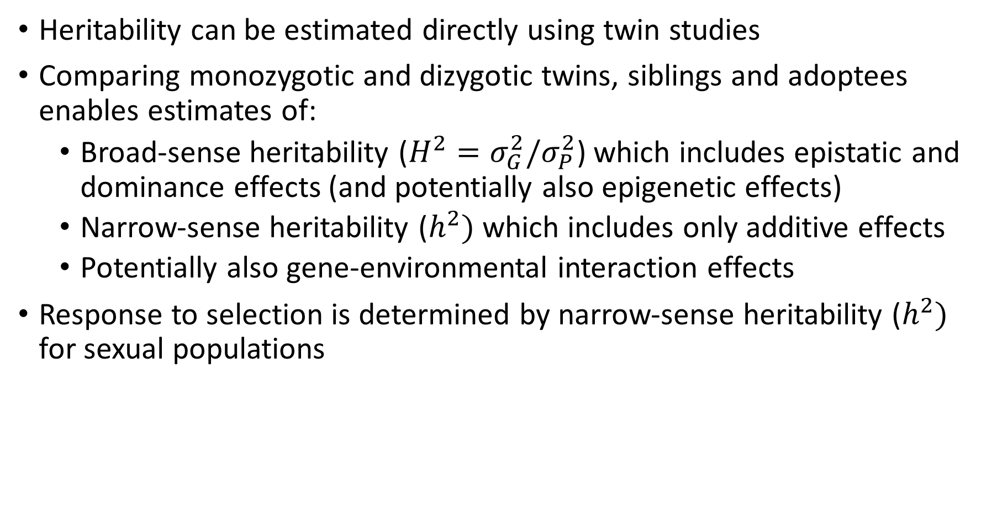
Heritability and additive variance
Heritability can be estimated directly using twin studies
Comparing monozygotic and dizygotic twins, siblings and adoptees enables estimates of:
  Broad-sense heritability (${H^{2}=σ}_{G}^{2}/σ_{P}^{2}$) which includes epistatic and dominance effects (and potentially also epigenetic effects)
  Narrow-sense heritability ($h^{2})$ which includes only additive effects
  Potentially also gene-environmental interaction effects
Response to selection is determined by narrow-sense heritability ($h^{2})$ for sexual populations
[Price’s equation: holds for sexual and asexual populations (special case for no transmission bias)]
$$Δ\overline{z}=h_{(po)}^{2}\text{Cov}\text{(}z,ω\text{)}$$
$$Δ\overline{w}=h^{2}\frac{\text{Var}(w)}{\overline{w}}\text{ =}\frac{σ_{A}^{2}}{\overline{w}}≥\text{ 0}$$
[Fisher’s fundamental theorem of natural selection (assuming sexual reproduction)]

Slide 5
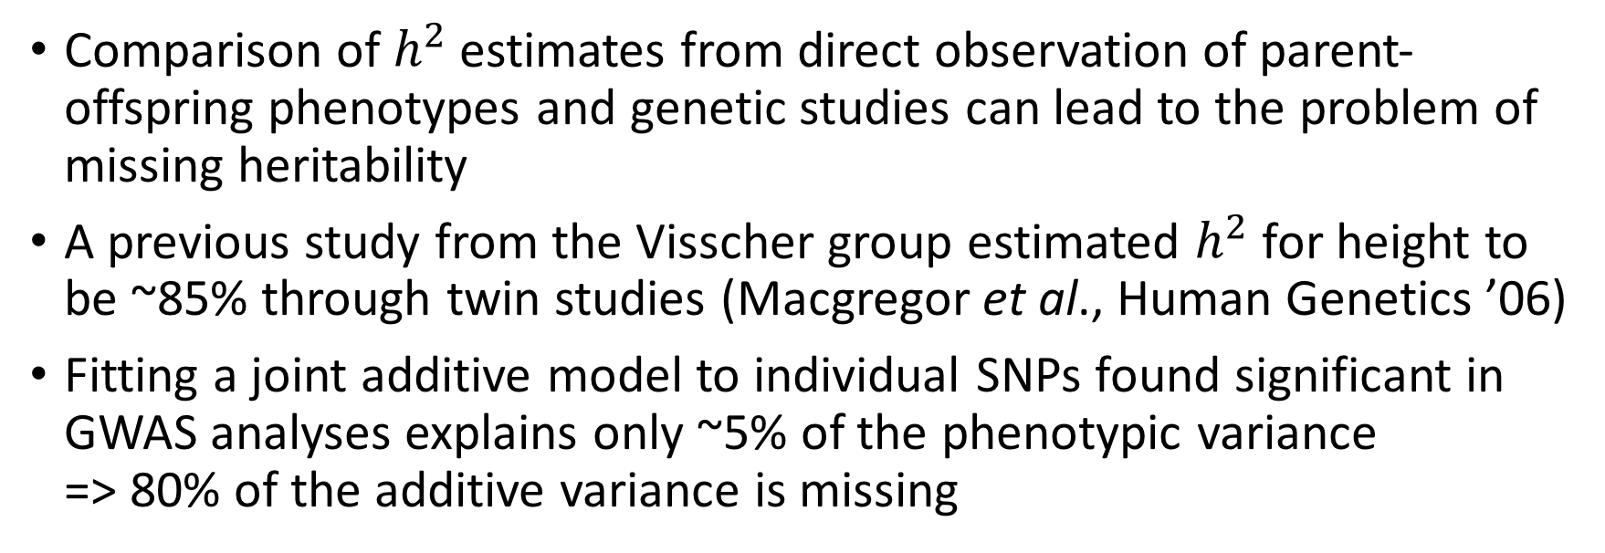
Heritability and additive variance
Comparison of $h^{2}$ estimates from direct observation of parent-offspring phenotypes and genetic studies can lead to the problem of missing heritability
A previous study from the Visscher group estimated $h^{2}$ for height to be ~85% through twin studies (Macgregor et al., Human Genetics ’06)
Fitting a joint additive model to individual SNPs found significant in GWAS analyses explains only ~5% of the phenotypic variance => 80% of the additive variance is missing

Slide 6
Linear model with random effects
Model for the effect of an individual SNP on a phenotype
Extension to model the combined effects of multiple SNPs
where: y=phenotype; x_ij is the ’genetic dosage’ of the i’th SNP in individual j, taking
values {0,1,2}; a_i is the fixed effect size of SNP i, and e_j is the environmental effect
where: z_ij is a ‘normalized genetic dosage’, i.e. the z-score of x_ij; u_i is the effect
size of SNP i treated as a random variable; g_j is the combined effect of all SNPs for individual j

Slide 7
Linear model with random effects
The variance-covariance matrix of y can be expressed using matrix notation
[from previous slide]
additive variance
NB: $Z∈$ { }

Slide 8

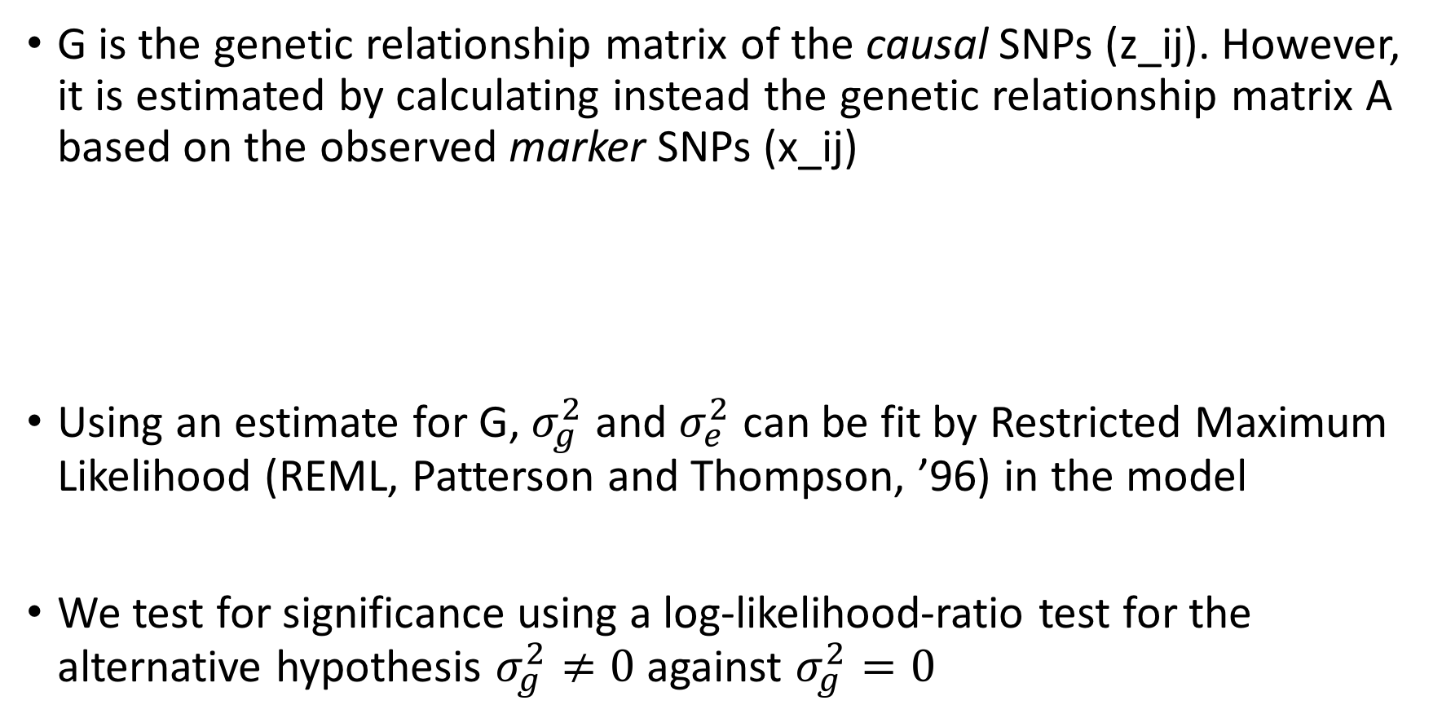
Linear model with random effects
G is the genetic relationship matrix of the causal SNPs (z_ij). However, it is estimated by calculating instead the genetic relationship matrix A based on the observed marker SNPs (x_ij)
Using an estimate for G, $σ_{g}^{2}$ and $σ_{e}^{2}$ can be fit by Restricted Maximum Likelihood (REML, Patterson and Thompson, ’96) in the model
We test for significance using a log-likelihood-ratio test for the alternative hypothesis $σ_{g}^{2}≠0$ against $σ_{g}^{2}=0$
$$\text{V}=$$

Slide 9
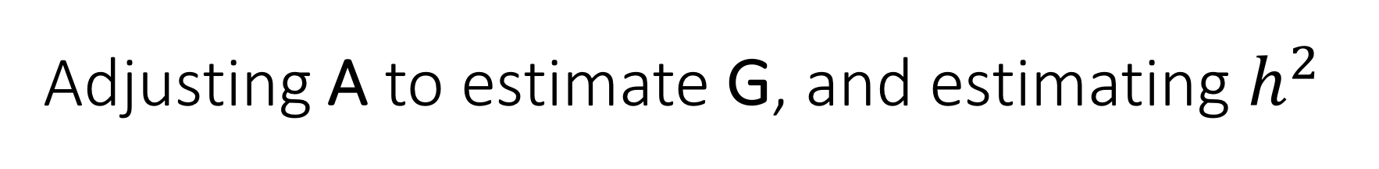
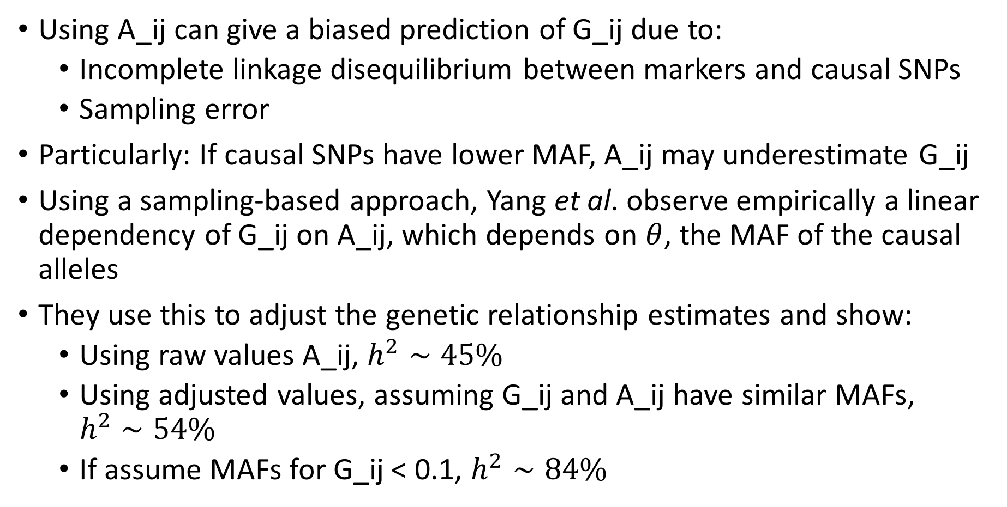
Adjusting A to estimate G, and estimating $h^{2}$
Using A_ij can give a biased prediction of G_ij due to:
  Incomplete linkage disequilibrium between markers and causal SNPs
  Sampling error
Particularly: If causal SNPs have lower MAF, A_ij may underestimate G_ij
Using a sampling-based approach, Yang et al. observe empirically a linear dependency of G_ij on A_ij, which depends on $θ$, the MAF of the causal alleles
They use this to adjust the genetic relationship estimates and show:
  Using raw values A_ij, $h^{2}∼45\%$
  Using adjusted values, assuming G_ij and A_ij have similar MAFs, $h^{2}∼54\%$
  If assume MAFs for G_ij < 0.1, $h^{2}∼84\%$

Slide 10
Study details
Sample consists of 3535 unrelated adults, and 724 unrelated 16-year-old adolescents
1318 individuals (both adults and adolescents) genotyped at 516K marker SNPs
Remaining 2607 individuals genotyped at 294K marker SNPs
Quality controls applied to a larger cohort to avoid including any pairs too closely related

Slide 11
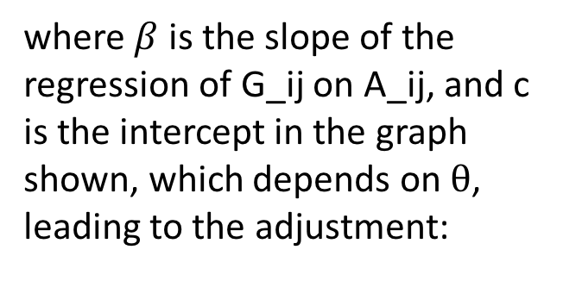
Sampling-based method to adjust A
where $β$ is the slope of the regression of G_ij on A_ij, and c is the intercept in the graph shown, which depends on $θ$, leading to the adjustment:

Slide 12

Adjusted $h^{2}$ estimates, assuming equal MAFs

Slide 13

Simulations to explore case in which causal MAFS < 0.1 ($θ=0.1$)

Slide 14
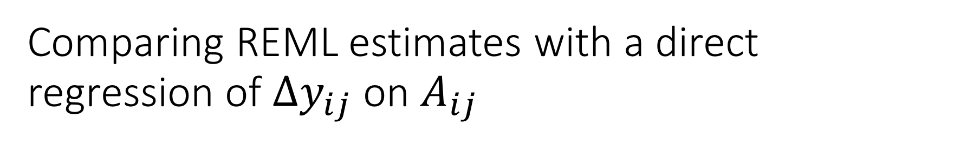
Comparing REML estimates with a direct regression of $Δy_{ij}$ on $A_{ij}$

Slide 15
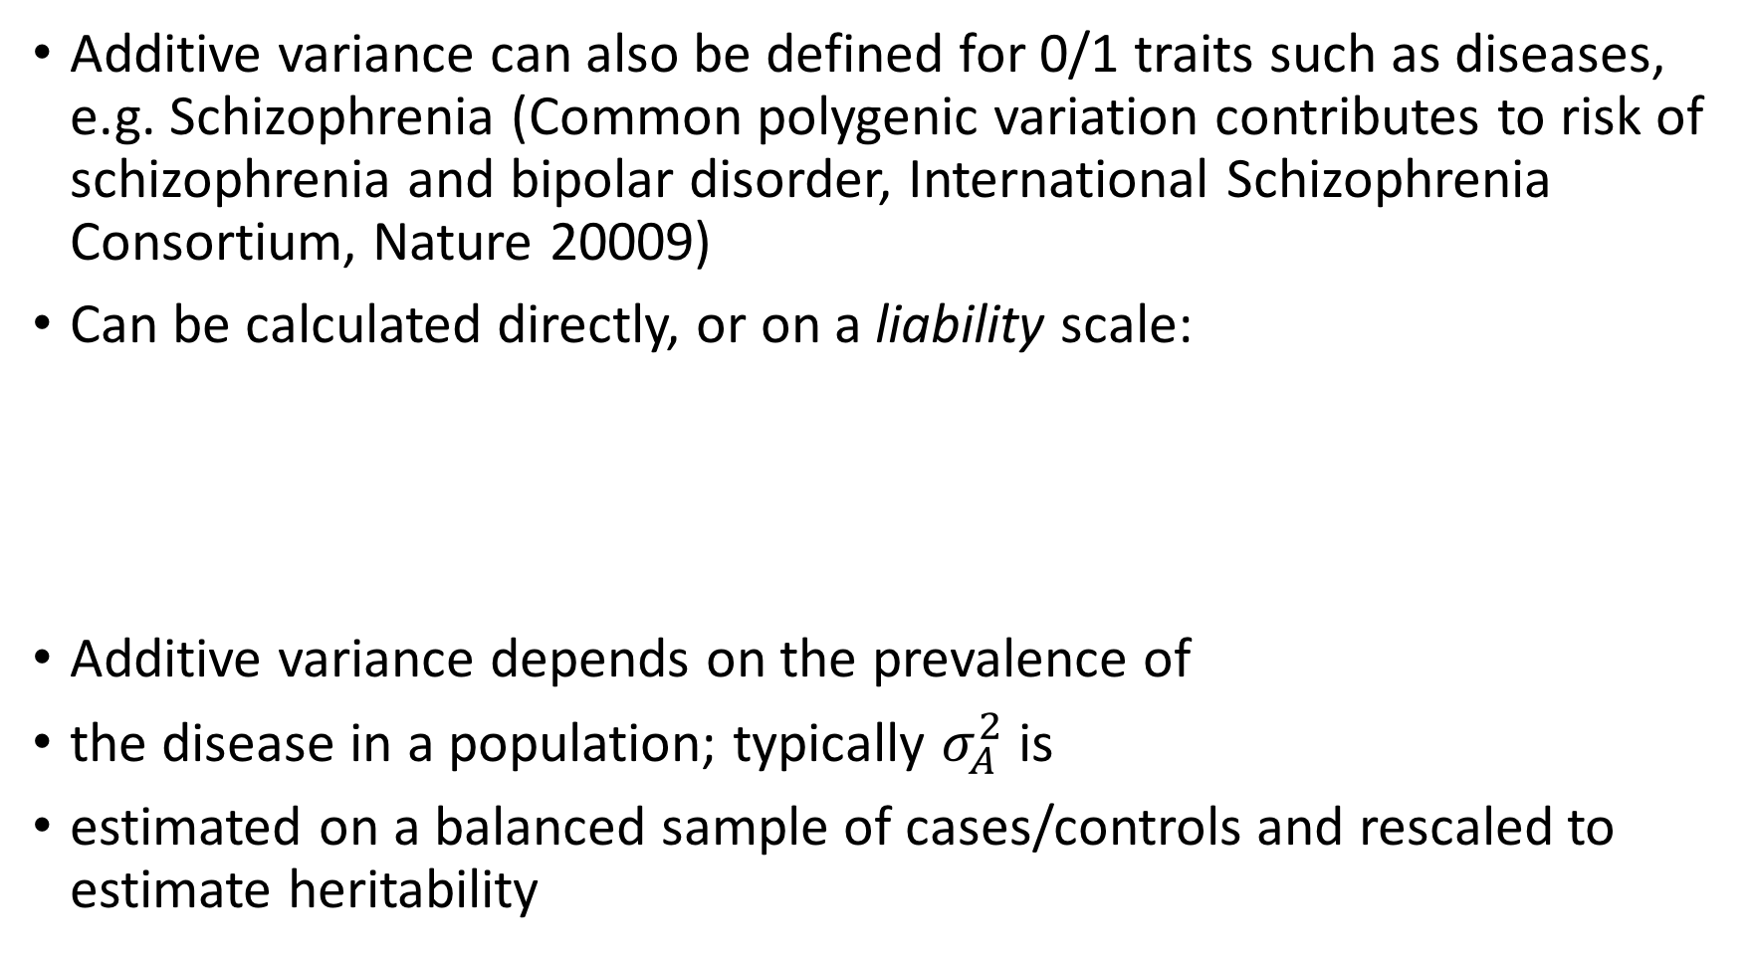
Extension for 0/1 phenotypes
Additive variance can also be defined for 0/1 traits such as diseases, e.g. Schizophrenia (Common polygenic variation contributes to risk of schizophrenia and bipolar disorder, International Schizophrenia Consortium, Nature 20009)
Can be calculated directly, or on a liability scale:
Additive variance depends on the prevalence of
the disease in a population; typically $σ_{A}^{2}$ is
estimated on a balanced sample of cases/controls and rescaled to estimate heritability
Lee et al., American Journal of Human Genetics, 2011

Slide 16
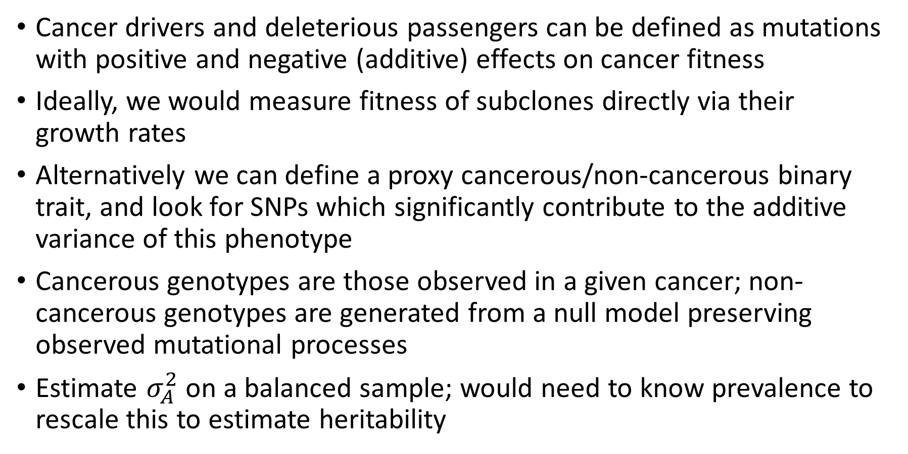
Using additive variance analysis to detect SNPs with weak effects on cancer phenotypes
Cancer drivers and deleterious passengers can be defined as mutations with positive and negative (additive) effects on cancer fitness
Ideally, we would measure fitness of subclones directly via their growth rates
Alternatively we can define a proxy cancerous/non-cancerous binary trait, and look for SNPs which significantly contribute to the additive variance of this phenotype
Cancerous genotypes are those observed in a given cancer; non-cancerous genotypes are generated from a null model preserving observed mutational processes
Estimate $σ_{A}^{2}$ on a balanced sample; would need to know prevalence to rescale this to estimate heritability

Slide 17
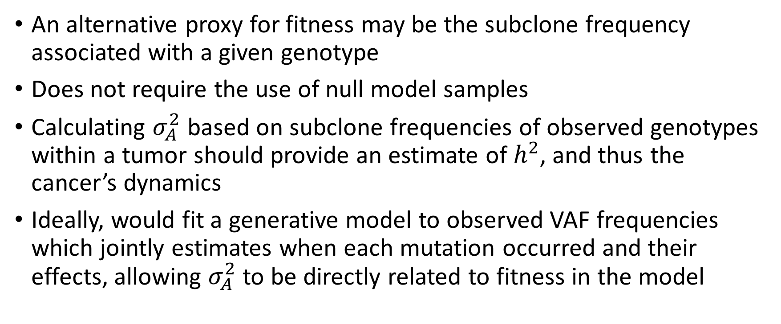
Potential relevance to cancer evolutionary models
An alternative proxy for fitness may be the subclone frequency associated with a given genotype
Does not require the use of null model samples
Calculating $σ_{A}^{2}$ based on subclone frequencies of observed genotypes within a tumor should provide an estimate of $h^{2}$, and thus the cancer’s dynamics
Ideally, would fit a generative model to observed VAF frequencies which jointly estimates when each mutation occurred and their effects, allowing $σ_{A}^{2}$ to be directly related to fitness in the model

Slide 18
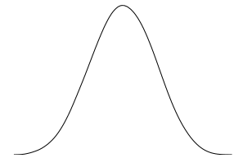



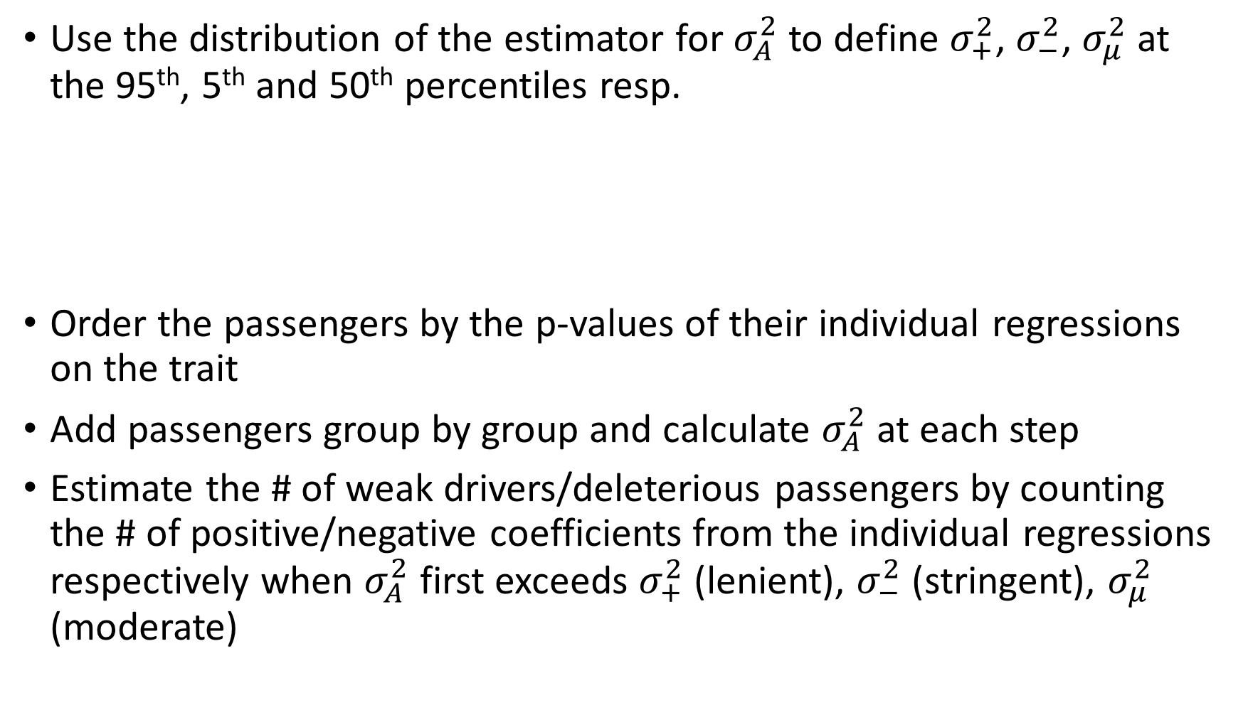
Statistical test for the number of weak drivers / deleterious passengers
Use the distribution of the estimator for $σ_{A}^{2}$ to define $σ_{+}^{2}$, $σ_{−}^{2}$, $σ_{μ}^{2}$ at the 95th, 5th and 50th percentiles resp.
Order the passengers by the p-values of their individual regressions on the trait
Add passengers group by group and calculate $σ_{A}^{2}$ at each step
Estimate the # of weak drivers/deleterious passengers by counting the # of positive/negative coefficients from the individual regressions respectively when $σ_{A}^{2}$ first exceeds $σ_{+}^{2}$ (lenient), $σ_{−}^{2}$ (stringent), $σ_{μ}^{2}$ (moderate)
$$σ_{−}^{2}$$
$$σ_{μ}^{2}$$
$$σ_{+}^{2}$$

Slide 19
Combined effects, Liver-HCC
p-values
Additive variance
fsq | all | all (-drivers) | coding | Coding (-drivers) | Non-coding (-drivers)
1 | - | - | 8e-8 | 0.2 | -
2 | 1e-12 | 3e-7 | 7e-8 | 0.4 | 1e-7
3 | 1e-10 | 6e-4 | 2e-8 | 0.4 | 1e-4
4 | 2e-9 | 0.08 | 4e-9 | 0.2 | 0.1
5 | 4e-10 | 0.2 | 2e-10 | 0.3 | 0.3
6 | 0.3 | 0.3 | 0.3 | 0.3 | -
fsq | all | all (-drivers) | coding | Coding (-drivers) | Non-coding (-drivers)
1 | - | - | 0.231 | 0.025 | -
2 | 0.671 | 0.461 | 0.226 | 0.012 | 0.429
3 | 0.390 | 0.149 | 0.220 | 0.01 | 0.150
4 | 0.227 | 0.036 | 0.203 | 0.019 | 0.016
5 | 0.171 | 0.01 | 0.173 | 0.008 | 0.002
6 | 0.002 | 0.002 | 0.002 | 0.002 | -
Coding drivers: 34/118; Non-coding drivers: 7/6740; Cases/controls: 328/328

Slide 20
Test for # (weak) drivers, Liver-HCC
Non-coding
Coding
Additive variance
Partitions added (by pval)
Total weak drivers: 431 (lower:340, upper:-)
Per tumor: 2.20 (lower:1.76, upper:-)
Total (weak) drivers: 40(34)(lower:10, upper:-);
Per tumor: 0.43 (lower:0.21, upper:-)

Slide 21
Combined effects, Skin-Melanoma, Chromosome 1
p-values
Additive variance
fsq | all | all (-drivers) | coding | Coding (-drivers) | Non-coding (-drivers)
1 | 0.001 | 0.001 | 0.06 | 0.1 | 0.001
2 | 0.006 | 0.007 | 0.07 | 0.1 | 0.004
3 | 0.002 | 0.004 | 0.08 | 0.2 | 4e-4
4 | 0.002 | 0.01 | 0.06 | 0.3 | 4e-4
5 | 4e-5 | 0.01 | 1e-4 | 0.02 | 0.3
6 | - | - | - | - | -
fsq | all | all (-drivers) | coding | Coding (-drivers) | Non-coding (-drivers)
1 | 0.278 | 0.278 | 0.149 | 0.109 | 0.279
2 | 0.227 | 0.227 | 0.148 | 0.098 | 0.231
3 | 0.238 | 0.238 | 0.141 | 0.085 | 0.242
4 | 0.236 | 0.236 | 0.142 | 0.047 | 0.177
5 | 0.247 | 0.247 | 0.230 | 0.097 | 0.008
6 | - | - | - | - | -
Coding drivers: 2/301; Non-coding drivers: 0/22085; Cases/controls: 107/107

Slide 22
Skin-Melanoma, Chromosome 1
Non-coding
Coding
Additive variance
Partitions added (by pval)
Total weak drivers: 20 (lower:2, upper:-)
Per tumor: 1.17 (lower:0.2, upper:-)
Total (weak) drivers: 2(2) (lower:1, upper:50)
Per tumor: 0.21 (lower:0.12, upper:1.23)

Slide 23
Combined effects, Skin-Melanoma, all chromosomes
p-values
Additive variance
fsq | all | all (-drivers) | coding | Coding (-drivers) | Non-coding (-drivers)
1 | - | - | - | - | -
2 | - | 0.006 | - | 0.06 | 0.004
3 | - | 0.001 | - | 0.07 | 0.0001
4 | - | 0.002 | - | 0.1 | 9e-5
5 | - | 0.0009 | - | 0.07 | 2e-6
6 | - | 0.3 | - | 0.5 | 9e-6
fsq | all | all (-drivers) | coding | Coding (-drivers) | Non-coding (-drivers)
1 | - | - | - | - | -
2 | - | 0.227 | - | 0.129 | 0.242
3 | - | 0.238 | - | 0.122 | 0.312
4 | - | 0.236 | - | 0.112 | 0.364
5 | - | 0.247 | - | 0.130 | 0.208
6 | - | - | - | 1e-5 | 0.039
Cases/controls: 107/107

Slide 24
Skin-Melanoma, all chromosomes
Non-coding
Coding
Additive variance
Partitions added (by pval)
Total weak drivers: 140 (lower:3, upper:-)
Per tumor: 10.89 (lower:0.62, upper:-)
Total (weak) drivers: 2 (lower:1, upper:124)
Per tumor: 0.27 (lower:0.14, upper:4.04)

Slide 25
Combined effects, Lung-AdenoCA
p-values
Additive variance
fsq | all | all (-drivers) | coding | Coding (-drivers) | Non-coding (-drivers)
1 | 0.05 | 0.06 | 0.1 | 0.5 | 0.06
2 | 0.1 | 0.2 | 0.09 | 0.5 | 0.2
3 | 0.07 | 0.2 | 0.1 | 0.5 | 0.2
4 | 0.06 | 0.3 | 0.08 | 0.5 | 0.2
5 | 0.09 | - | 0.05 | - | -
6 | - | - | - | - | -
fsq | all | all (-drivers) | coding | Coding (-drivers) | Non-coding (-drivers)
1 | 0.283 | 0.273 | 0.126 | 0.002 | 0.277
2 | 0.166 | 0.098 | 0.130 | 0.001 | 0.112
3 | 0.218 | 0.080 | 0.093 | 1e-4 | 0.097
4 | 0.180 | 0.038 | 0.113 | 6e-4 | 0.052
5 | 0.094 | - | 0.112 | - | -
6 | - | - | - | - | -
Coding drivers: 3/11; Non-coding drivers: 0/797; Cases/controls: 38/38

Slide 26
Lung-AdenoCA
Non-coding
Coding
Additive variance
Partitions added (by pval)
Total weak drivers: 5 (lower:5, upper:-)
Per tumor: 0.26 (lower:0.26, upper:-)
Total (weak) drivers: 4(3) (lower:1, upper:-)
Per tumor: 0.28 (lower:0.13, upper:-)

Slide 27
Increasing the power of the statistical test
Test is underpowered to detect deleterious passengers, since relies on individual SNPs occurring in multiple null samples, but not in the cancer samples
Also, limited power may lead to low estimates of # weak drivers
Liver-HCC SNPs
Blue = Null model
Red = Observed
Log10(# of SNVs)
# samples in which SNV appears

Slide 28
Increasing the power of the statistical test
Power to detected additive variance effects may be increased by pooling (impactful) SNPs over gene/regulatory-element/gene-class (e.g. onco/TS/essential) regions
For pooled SNPs, we let x_ij take integer values, representing the entire SNP dosage of the region (treating pooled SNPs as equivalent)
An estimate of the # of DPs removed in an individual tumor can be made by:
  Estimate the regions which contribute to the additive variance as in the previous test, and which have negative individual coefficients
  Sum the differences at these regions between the given tumor, and the mean counts at each region across the null samples
The same test using positive coefficients estimates the # weak drivers contributing to the differential fitness between nulls and cancer samples

Slide 29
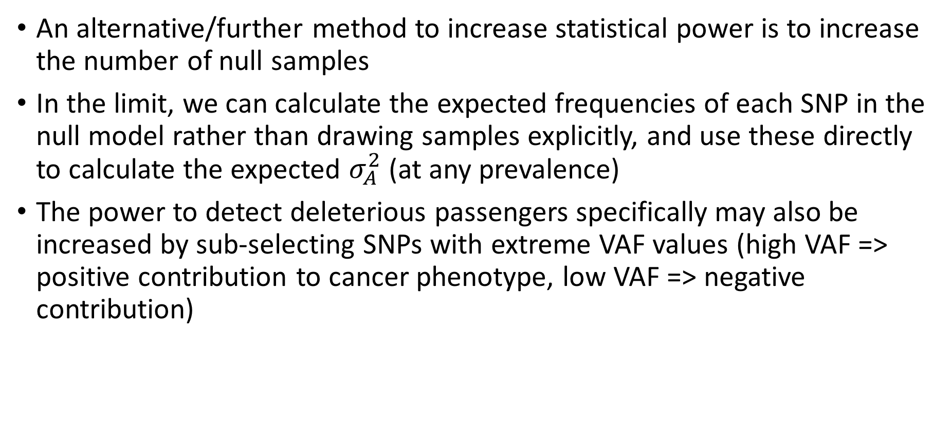
Increasing the power of the statistical test
An alternative/further method to increase statistical power is to increase the number of null samples
In the limit, we can calculate the expected frequencies of each SNP in the null model rather than drawing samples explicitly, and use these directly to calculate the expected $σ_{A}^{2}$ (at any prevalence)
The power to detect deleterious passengers specifically may also be increased by sub-selecting SNPs with extreme VAF values (high VAF => positive contribution to cancer phenotype, low VAF => negative contribution)

