Slide 1
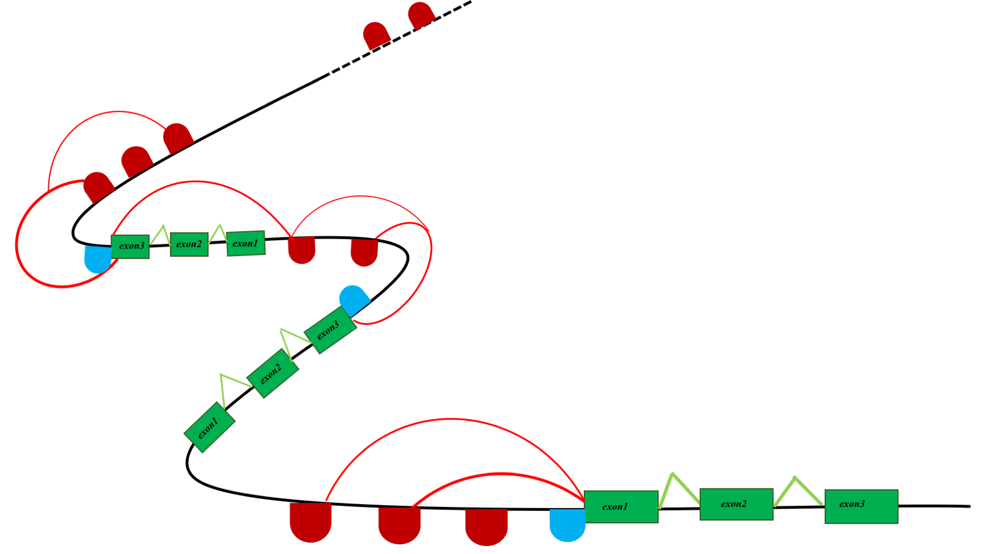
B
A
n= N
n= N - 1
n=3
n=2
n=1
ACTGA
L

Slide 2
20K
100K
20K

