Slide 1
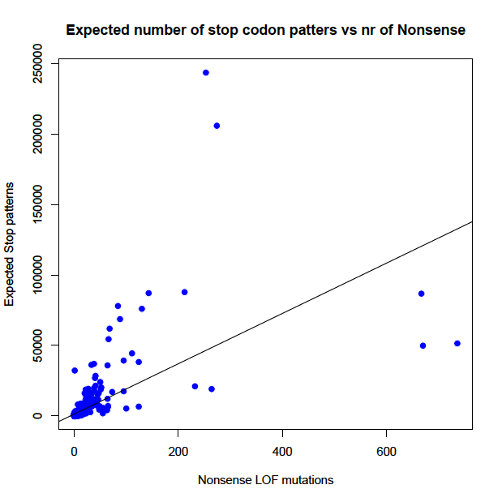
All samples
Expected number of potential stop mutations:
- TAG
- TAA
- TGA
- CTA
- TTA
- TCA
Y=1262+178*X
R²=0.36 , p-value<2.2e-16

Slide 2
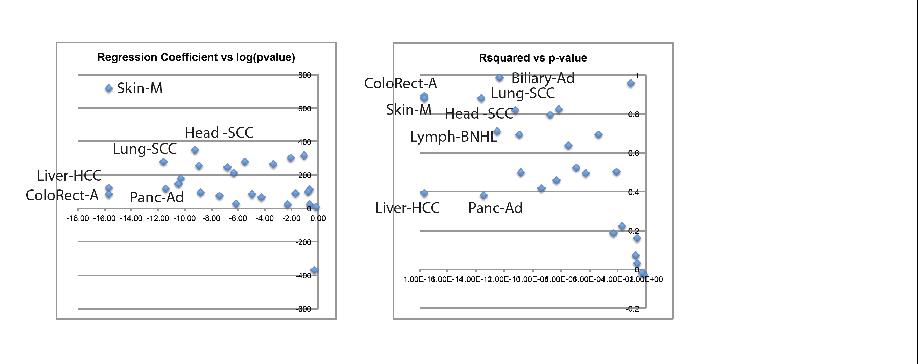
All Cancers
Expected number of potential stop mutations:
- TAG
- TAA
- TGA
- CTA
- TTA
- TCA
Y=1262+178*X
R²=0.36 , p-value<2.2e-16
- Higher Regression coefficient means less LOFs than expected. Or saturation of LOFs
- Higher R² means that they follow a more random/neutral model

