Slide 1
Structural Modeling of a Coding SNP in Subject Z
Yekaterina Kovalyova, Acer Xu, and Hussein Mohsen
May 18, 2017

Slide 2
Amino Acid Mutations
Why Structural Modeling?
SNPs might lead to changes in
Size
Charge
Hydrophobic effect
Potential energy
[McKee, T., & McKee, J. R. (2012). Biochemistry: The molecular basis of life. Oxford: Oxford University Press]
[Slide from Megan, Amber, and Krystle’s presentation] 2

Slide 3
Favorable Mutations
I35V
-2.775
I35Y
-2.660
I35E
-2.652
[Slide from Megan, Amber, and Krystle’s presentation]
I35L
-1.712
I35A
-1.097
I35P
-0.115
3

Slide 4
Unfavorable Mutations
I35G
+1.013
I35D
+1.887
I35M
+2.087
[Slide from Megan, Amber, and Krystle’s presentation]
I35F
+4.821
I35R
+11.913
4

Slide 5
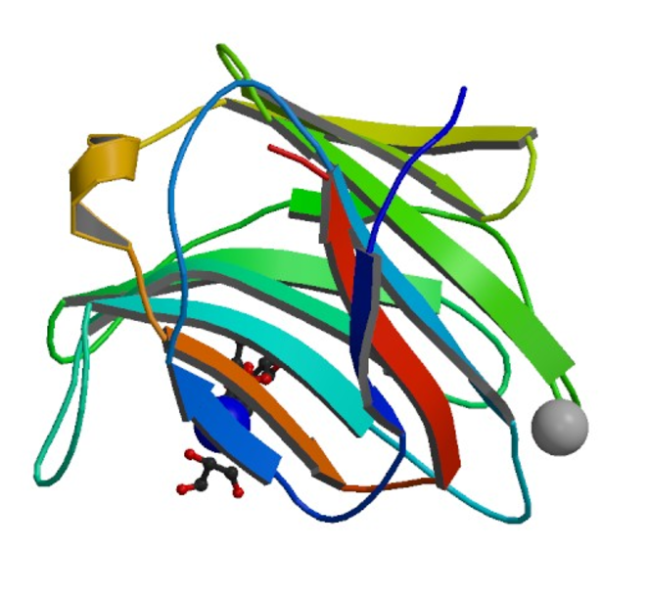
Introduction
The gene 3VKO codes for the Galectin-8 protein
During infections, Galectin-8 is thought to restrict the proliferation of pathogens by targeting them for autophagy
We Analyze it in Carl’s genome for 4BMB (galectin-8)

Slide 6
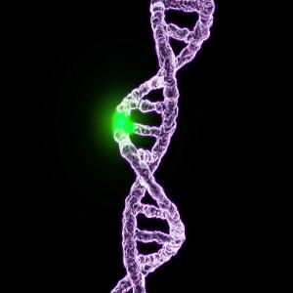
F19 Mutation
From an initial side-chain chemistry standpoint, this mutation should be relatively minor, as it occurs away from the binding pocket
The residue does not appear to play a major role in the interaction of the two domains of the protein
[http://images.medicaldaily.com/sites/medicaldaily.com/files/styles/headline/public/2016/02/04/genetic-mutation.jpg]

Slide 7
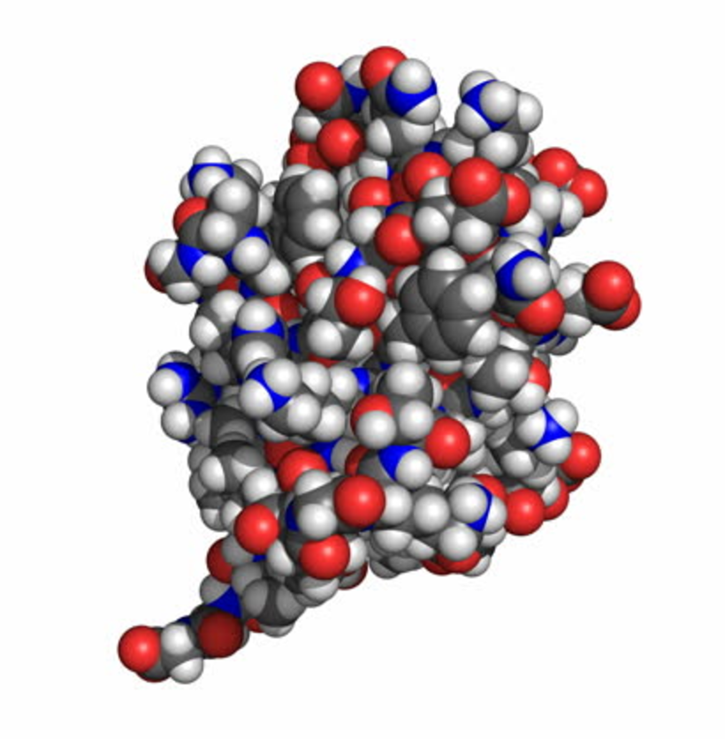
F19Y
From a space-filling perspective, the tyrosine mutation is about as large as phenylalanine
May disrupt the structural stability of the protein, but not majorly
https://www.shutterstock.com/video/clip-7512706-stock-footage-insulin-molecule-rotating-space-filling-model-seamless-loop-insulin-is-a-pancreatic-hormone.html

Slide 8
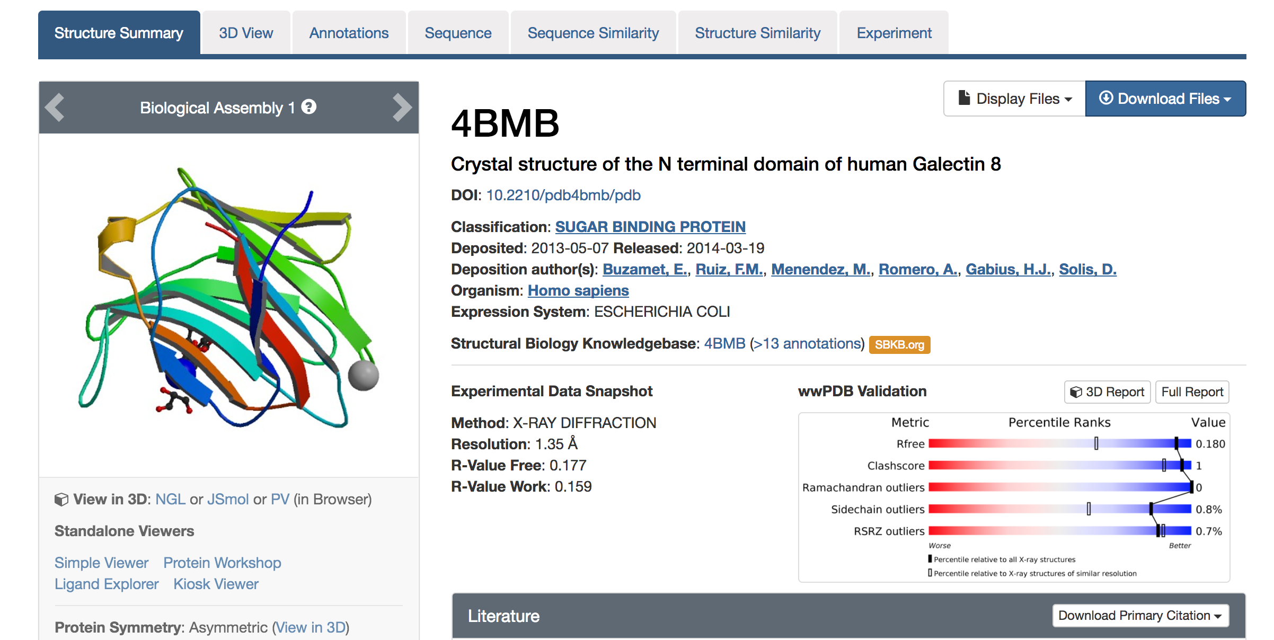
Pipeline
4BMB PDB file
Six steps
Relaxing the protein PDB file
Repacking the structure
Calculating Delta G of the wild type protein
Repacking the structure with a point mutation at position 19
Calculating Delta G' of the mutated protein
Calculating the change in binding energy.

Slide 9
Pipeline
Rosetta 2017.08
Suite of algorithms for computational modeling and analysis of protein structures
Introducing mutations

Slide 10
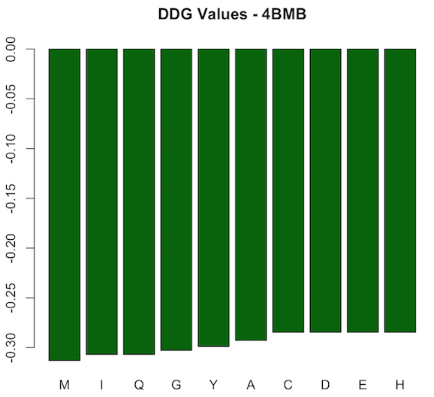
Pipeline
10 AA point mutations at position 19 of 4BMB
All stabilizing ddG < 0
Most stabilizing: M
Least stabilizing: C, D, E, and H

Slide 11
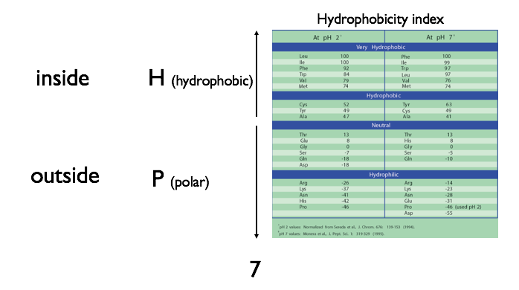
Pipeline
Why M?
M & T are “very hydrophobic”
Other AAs among chosen 10 are either hydrophilic or “hydrophobic”

Slide 12
Pipeline
Changes in stability might lead to changes in protein function

Slide 13
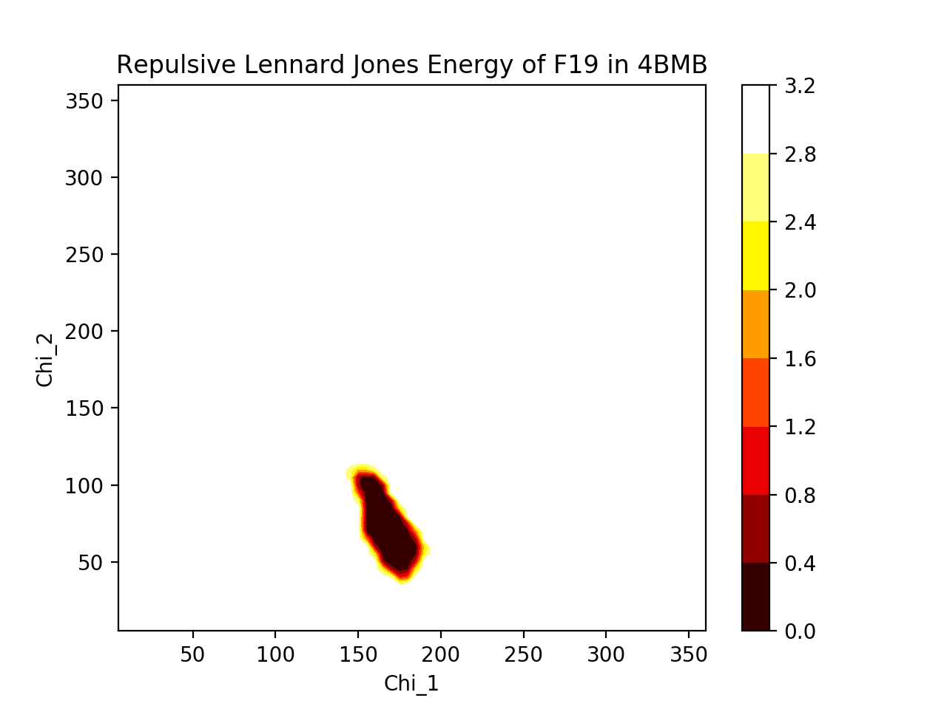
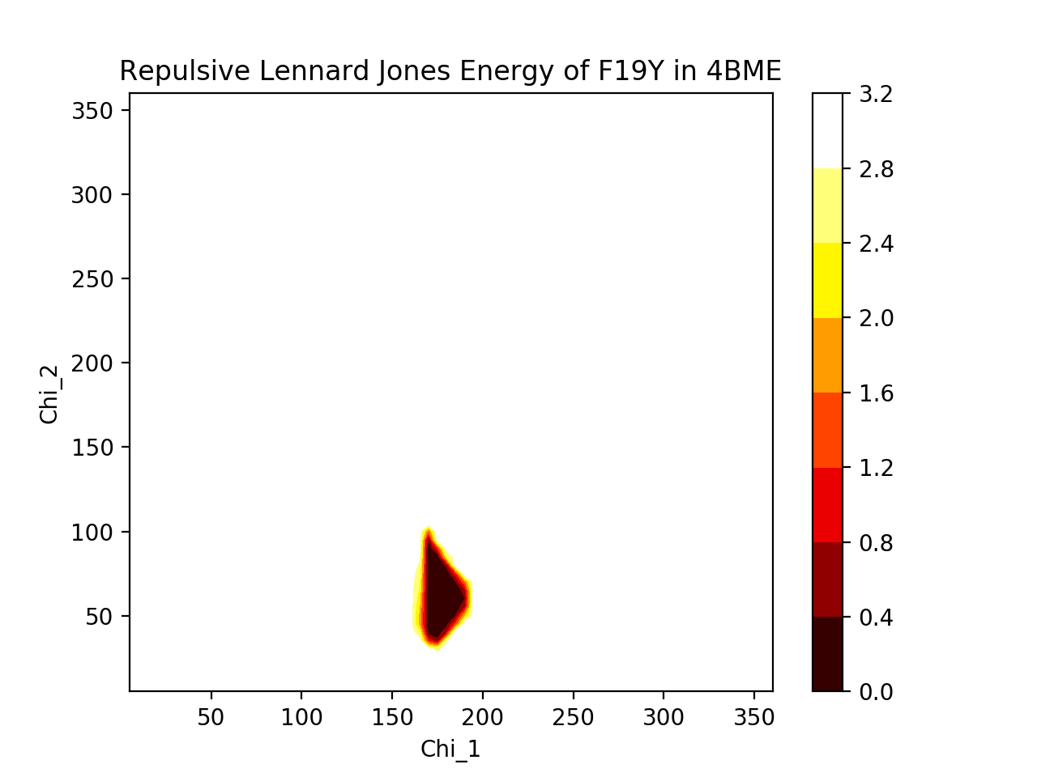
WT vs. Mutant: Repulsive Energy
Very similar energy dips
Dihedral angles of Y should roughly match those of F
-OH of Y probably decreases allowable conformations

Slide 14
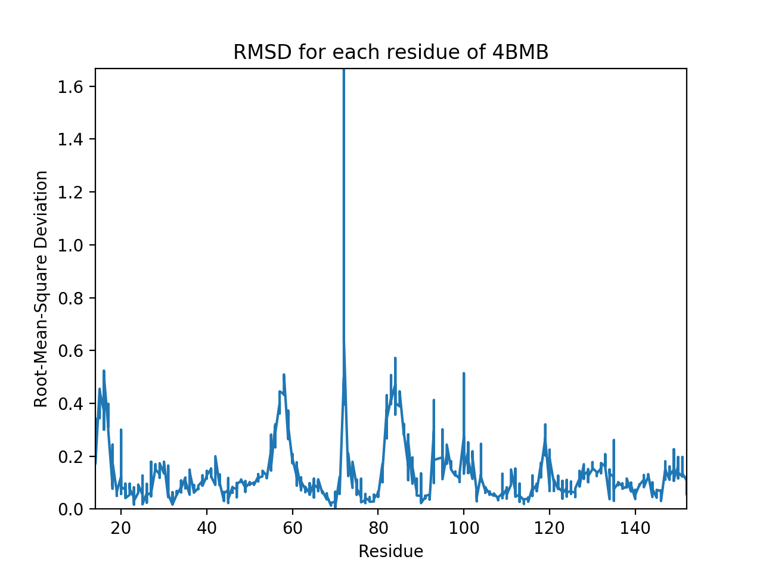
WT vs. Mutant: RMSD
Take backbone heavy atoms C, N, O, Cα
Mean distance between atoms in WT vs Mutant

Slide 15
END | Thank You

