Slide 1
CBB752 Final Project presentation
05/18/2017
Mengting Gu, Paul Muir

Slide 2
Zimmerome
Proteomics
Genomics
Modeling
Networks
Class organization
……

Slide 3
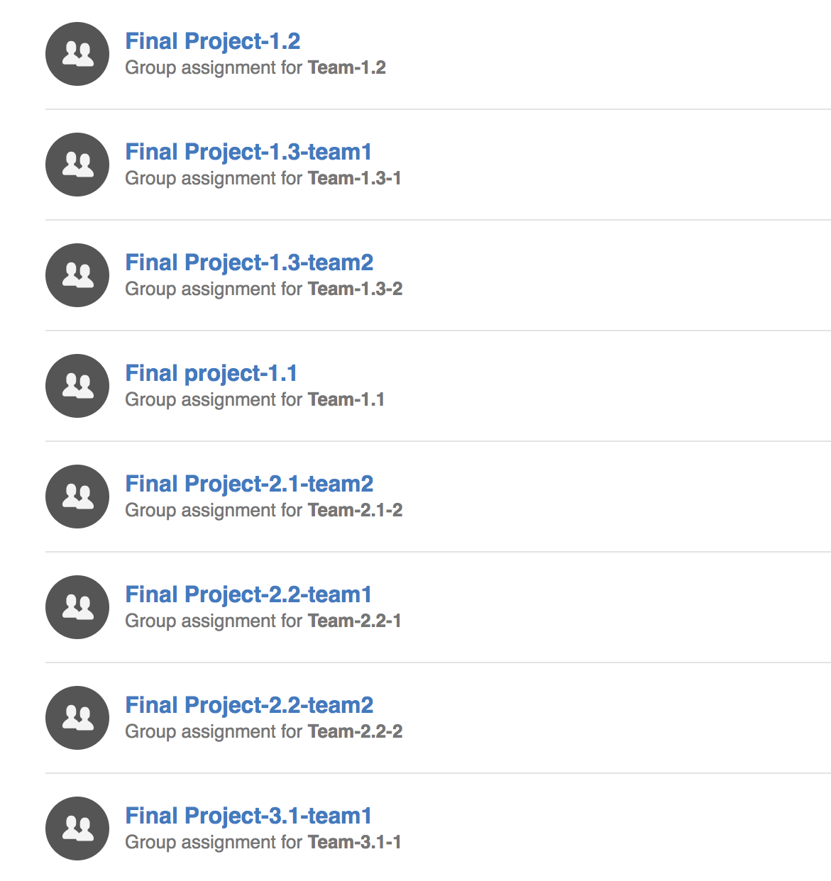

8 different projects under 4 main topics (website)
Collaboration on Github

Slide 4
Group organization
Writing
  Write introductory and background text and work with the other students in the group to document code and results.
Coding
  Write custom scripts that perform a specific analysis on a subset of Subject Z’s genome.
Pipeline
  Install and run existing genomic analysis software on Subject Z’s genome. Then analyze and compare the results.

Slide 5
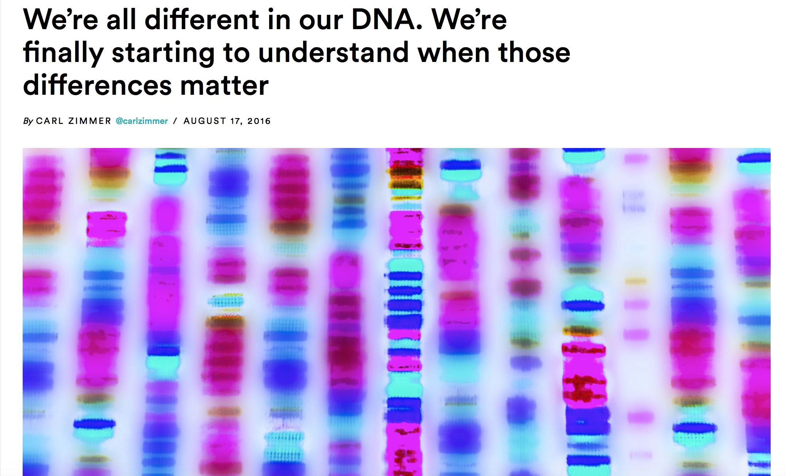
1.1 Compare the variants in Carl’s genome with variants in the gnomAD and 1000 Genome database.
Notes:
gnomAD: Genome Aggregation Database

Slide 6
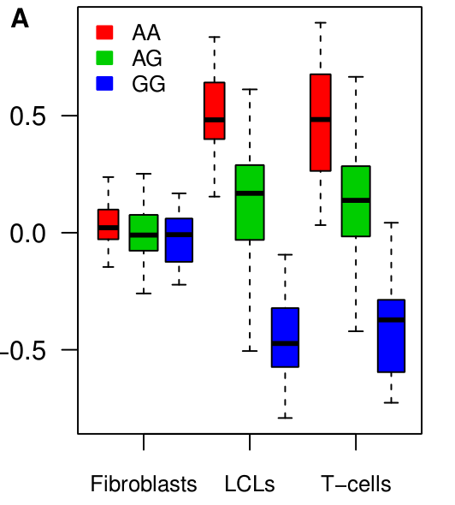
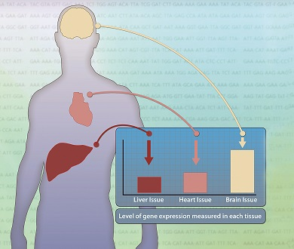
1.2 Compare the variants in Carl’s genome with variants in the GTEx database.
Flutre, Timothée, et al. PLoS Genet (2013)
https://commonfund.nih.gov/gtex/
Notes:
Use the results to predict gene expression in various tissues and better estimate the impact of noncoding variants in Carl’s genome.

Slide 7
1.3 Analyze the protein coding mutations in the Zimmerome
Variant prioritization by incorporating different types of functional information
Score and rank the deleteriousneses of the identified protein coding mutations
Compare with functional prediction programs

Slide 8
2.1 Identifying off target CRISPR sites
Off target mutagenesis is a risk with CRISPR editing of human cells.
Predicting off target sites is important for ranking potential guideRNAs for specificity.
Many factors in addition to simple sequence distance have a role in determining off target cutting efficiency of a given site.
Segal et al. Current Opinion in Chemical Biology 2015

Slide 9
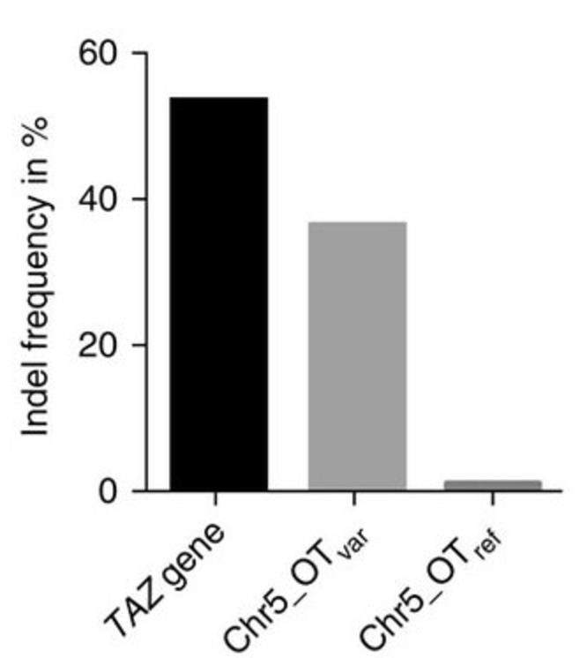
2.2 CRISPR and personal genomics: The impact of SNPs on gRNA sets and off target mutations
CRISPR off target prediction depends on the reference genome used.
SNPs in Subject Z’s genome change possible off target sites by introducing new PAM sites or mutating potential off target sites to more closely resemble a given gRNA.
How many PAM sites are introduced or removed by SNPs in Subject Z?
Yang et al. Nature Communications 2014

Slide 10
3.1 Calculate and analyze the degree centrality and betweenness centrality of proteins containing and not containing SNPs in Carl’s genome
Looking at proteins in the context of the protein protein interaction (PPI) network.
Overlapping Subject Z’s coding SNPs on the PPI network provides additional information about the possible impact of each SNP.
http://www.nature.com/nrm/journal/v6/n11/full/nrm1778.html

Slide 11
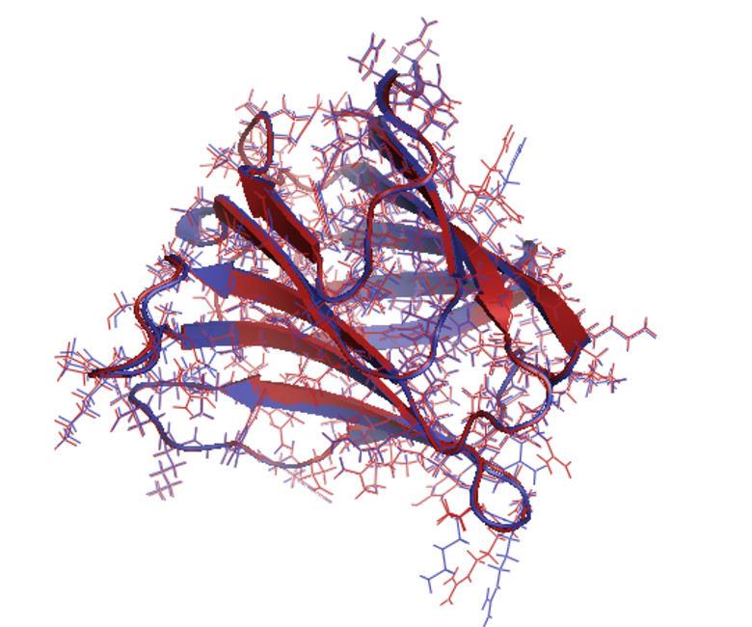
4.1 Structural analysis of coding mutations in Carl’s genome.
Structural modeling of Subject Z’s coding SNPs can provide additional details about a variant’s impact.
Modelling of coding mutations can indicate which variants might disrupt a protein’s structure and which will likely be tolerated.

