Slide 1
Project 1.3
Assessing Deleteriousness of SNVs in Carl’s Genome
Megan Brady, Nir Neumark, Ramya Prathuri, Yuyang Liu and Zhaolong Yu

Slide 2
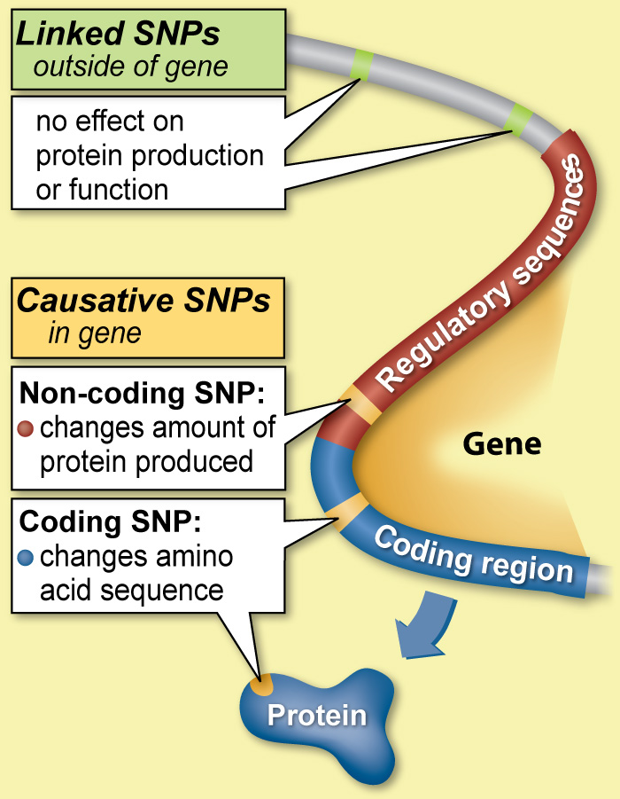
http://learn.genetics.utah.edu/content/precision/snips/

Slide 3
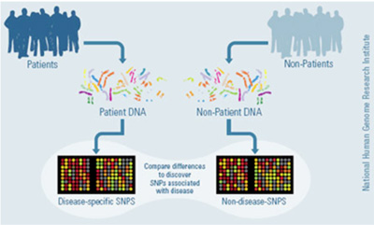
What is Variant Prioritization?
The process of identifying deleterious SNVs
SNP = seen in > 1% population
SNV = no limitation on frequency

Slide 4
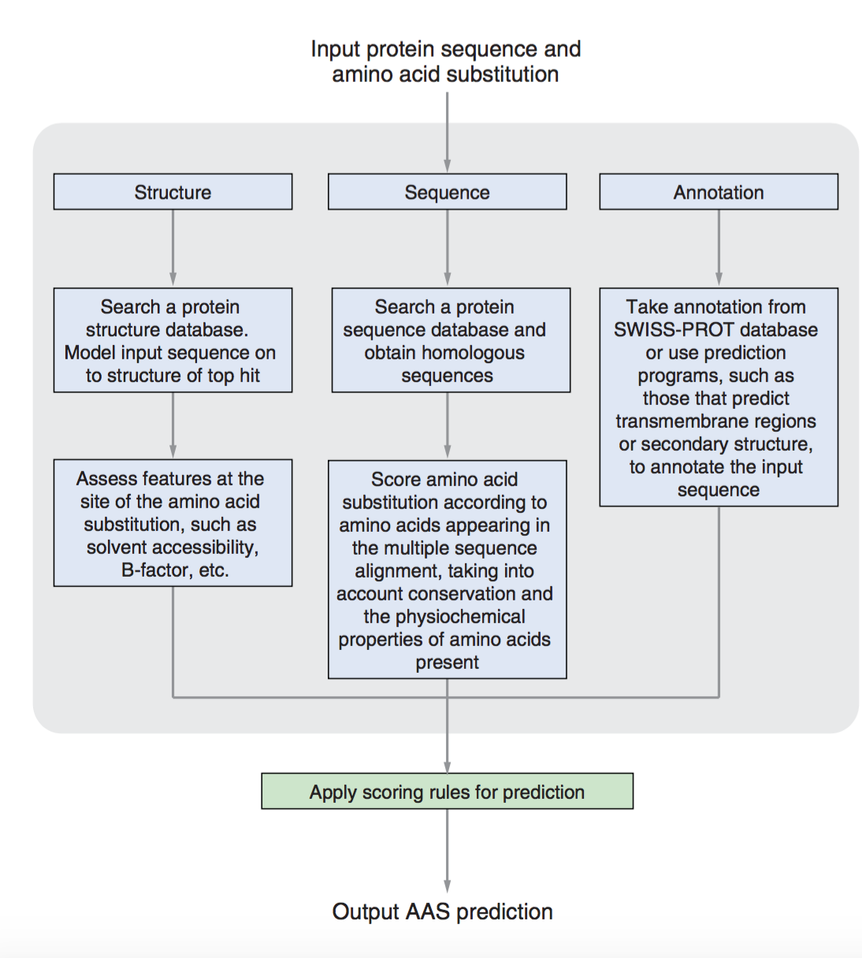
Principles of Variant Prioritization
Sequence:
synonymous or not?
missense or nonsense?
aa charge? size?
Structure:
Phyre2, TMHMM
Annotation:
dsSNP? GO term?

Slide 5
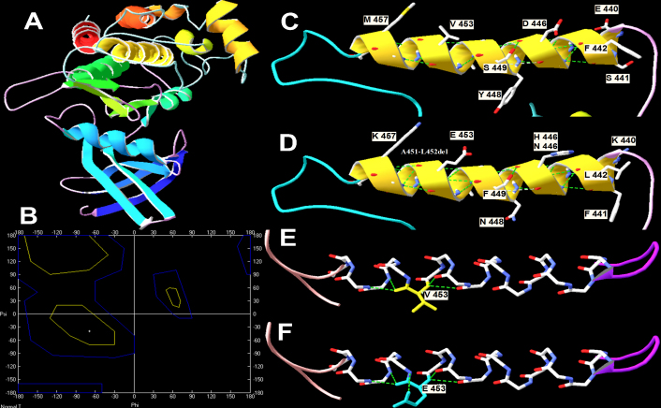
1. L. Zhang, L.-G. Gao, M. Zhang, X.-L. Zhou, Genotype-phenotype analysis of F-helix mutations at the kinase domain of TGFBR2, including a type 2 Marfan syndrome familial study. Molecular Vision 18, 55-63 (2012).

Slide 6
S. A. Smith et al., Adaptive evolution of Toll-like receptor 5 in domesticated mammals. BMC Evolutionary Biology 12, 122 (2012).

Slide 7
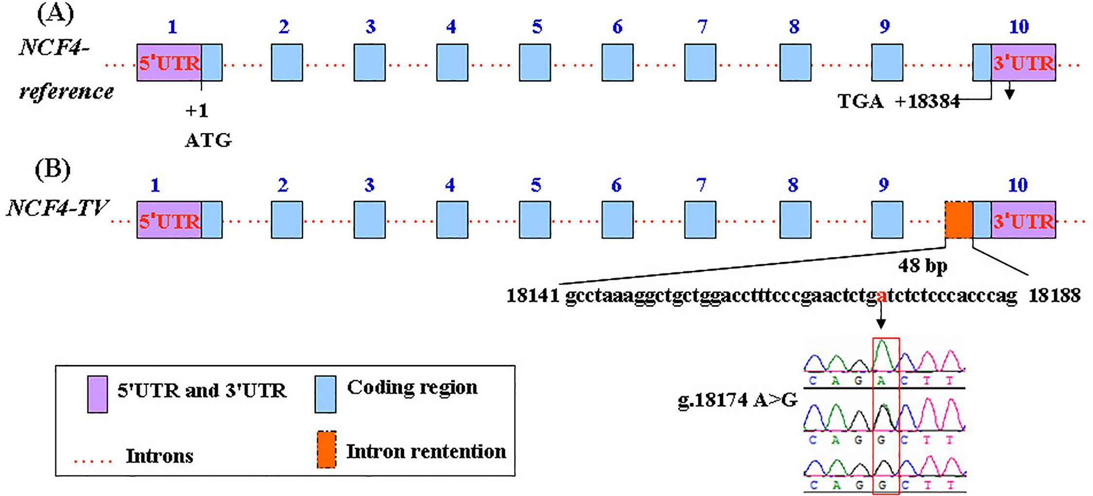
Z. Ju et al., Role of an SNP in Alternative Splicing of Bovine NCF4 and Mastitis Susceptibility. PLOS ONE 10, e0143705 (2015).

Slide 8
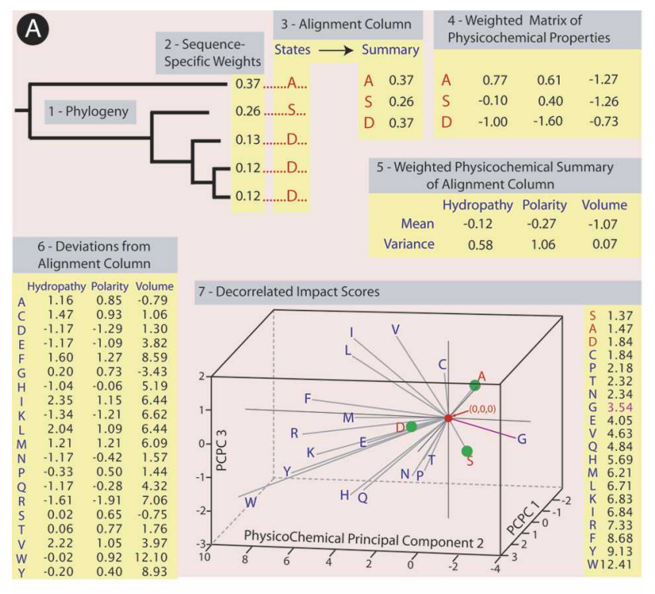

Slide 9
P. Kumar, S. Henikoff, P. C. Ng, Predicting the effects of coding non-synonymous variants on protein function using the SIFT algorithm. Nat. Protocols 4, 1073-1081 (2009).

Slide 10
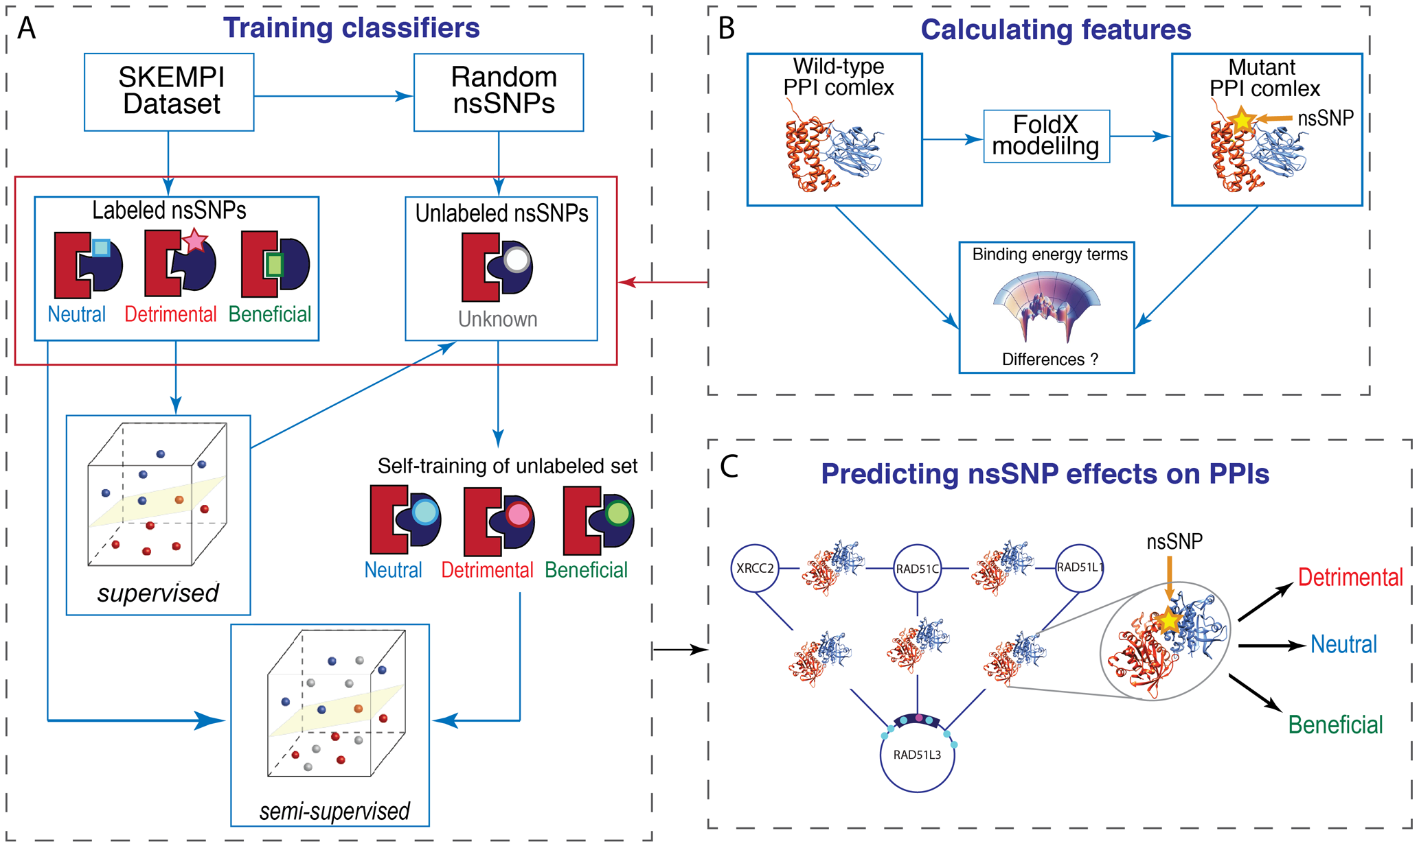
N. Zhao, J. G. Han, C.-R. Shyu, D. Korkin, Determining Effects of Non-synonymous SNPs on Protein-Protein Interactions using Supervised and Semi-supervised Learning. PLOS Computational Biology 10, e1003592 (2014).

Slide 11
Programs to Classify SNPs
Polyphen2
PROVEAN
SIFT

Slide 12
Comparison of Various Programs
10.4%
11.9%
18.6%
8.9%
80.7%
87.9%
80.8%
Brown = Neutral
Yellow = Damaging
Blue = Possibly damaging
Gray = Undetermined

Slide 13
Estimation Tool
Deleteriousness Estimation V2
Estimating the deleteriousness of a mutation based on properties of amino acids and evolutionary constraint
Command line version and online version
Deleteriousness Estimation V2
Synonymous
Single Amino Acid Substitution
Indels, Stop Codon Introduction and Disruption

Slide 14
Website

Slide 15
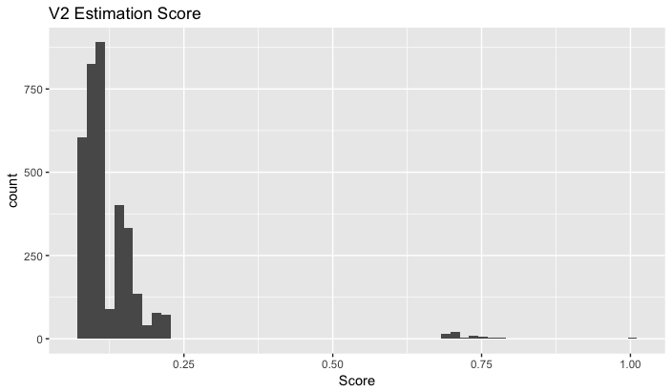
Score
Results
The distributions are basically the same
Our method provides more detailed information about the deleteriousness of some less deleterious mutations

Slide 16
Acknowledgements
Carl
Mengting and Paul
All the Professors in CBB752

Slide 17
Analyzing the Zimmer Genome
Brown = Present in dbSNP
Blue = Unique

Slide 18
Comparison of Various Programs
 | PolyPhen2 | PROVEAN | SIFT
Benign | 2669 | 3104 | 2851
Possibly Damaging | 293 | 0 | 0
Damaging | 344 | 420 | 658
Undetermined | 0 | 6 | 21
 | PolyPhen2 | PROVEAN | SIFT
Single Amino Acid Change | 3281 | 3514 | 3514
Synonymous | 15 | 10 | 10
Nonsense | 10 | 6 | 6

Slide 19
PolyPhen2
Adzhubei et al. 2010

Slide 20
PROVEAN
http://provean.jcvi.org/about.php

Slide 21
SIFT
Kumar et al. 2009

Slide 22
Polyphen2
Probability calculated through Bayes classifier
Benign (0-.45), possibly damaging (.45-.95), probably damaging (.95-1)
Adzhubei et al. 2015

Slide 23
PROVEAN & SIFT

Slide 24
Comparison of Various Programs
http://provean.jcvi.org/about.php

