Slide 1
Analyses
Merge Enhancers over 98 Roadmap tissues
Rank Enhancers by correlation
Establish set of 18 tissues common to Roadmap and GTex
Build heatmaps of correlation and genomic location
Find Enhancers found in the 18 tissues (0 or 1)
Point-biserial corr. bet. Binary Enhancer vector and Continuous Gene Expression
PCA of genes

Slide 2
Patterns for Notch4 in Chr. 6

Slide 3
Patterns for VegfA in Chr. 6

Slide 4
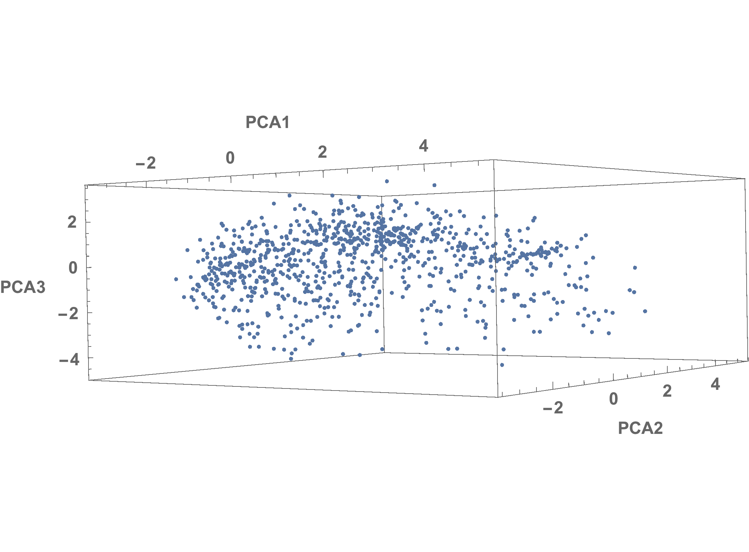
PCA for genes in Chromosome 6

