Slide 1
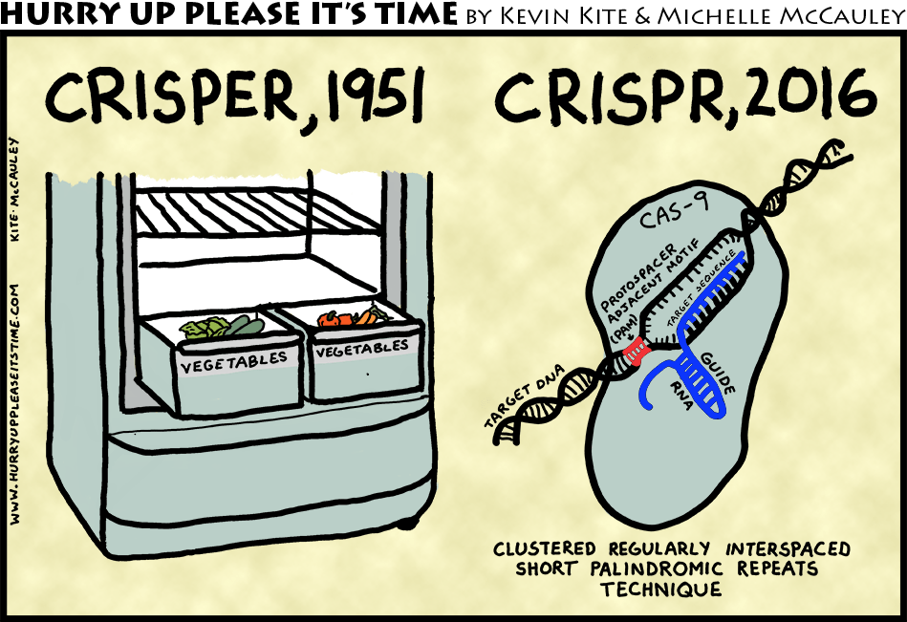
Project 2.1: Identifying Off-Target CRISPR Sites
Daniel Chawla, Ramya Prathuri, and Jay Stanley

Slide 2
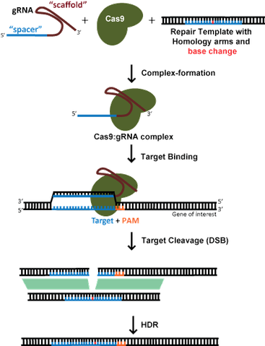
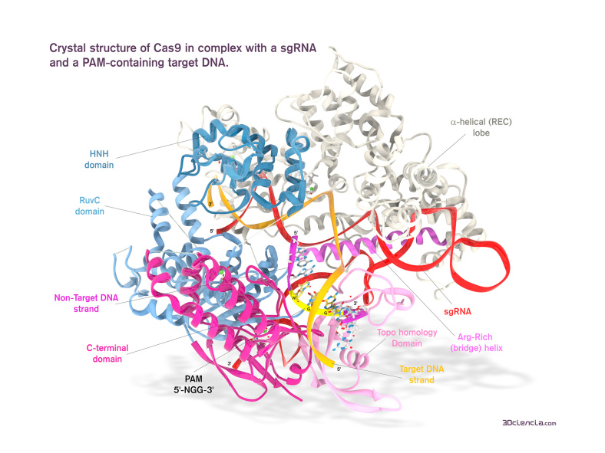
What is CRISPR?
A new tool to allow precise genome editing
Notes:
https://www.addgene.org/crispr/guide/
https://3dciencia.wordpress.com/2015/06/11/the-cas9-sgrna-dna-complex/

Slide 3
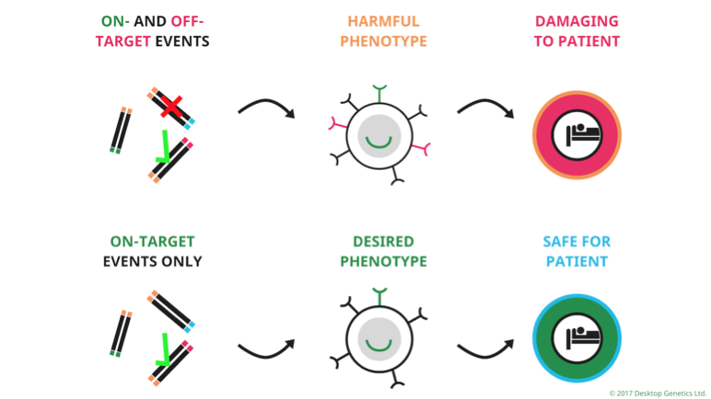
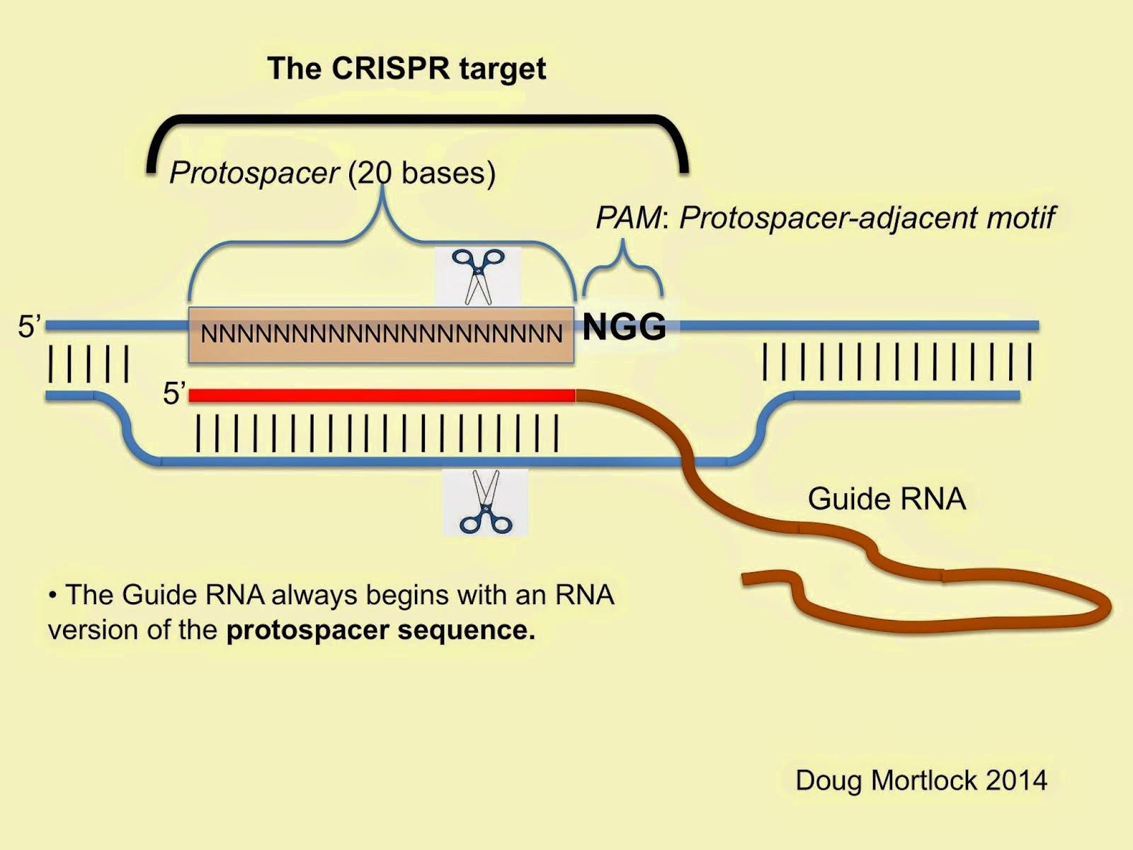
Off-Target Effects
The major setback for clinical CRISPR/Cas9 use
human genome
3,000,000,000 base pairs
“NGG” occurs ~ 160,000,000 times
gRNA
20 bases (12 absolute)
… A LOT of potential binding sites!
Notes:
https://www.addgene.org/crispr/guide/
https://3dciencia.wordpress.com/2015/06/11/the-cas9-sgrna-dna-complex/
https://www.idtdna.com/pages/docs/default-source/synthetic-biology/crispr_faq_043015.pdf?sfvrsn=2

Slide 4
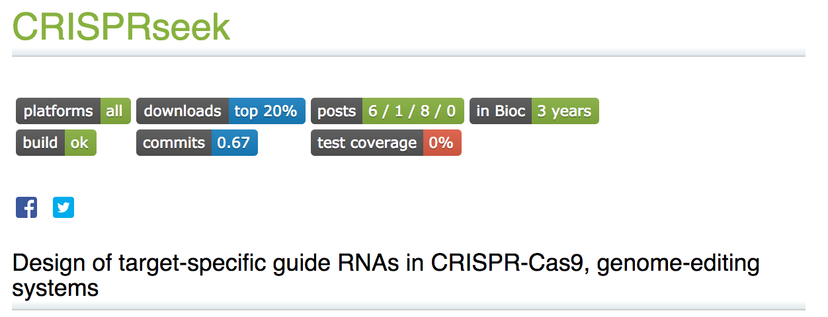
Goal: How to predict off-target sites?
Computational methods to assess gRNAs

Slide 5
Principles of CRISPR/Cas9 Specificity
PAM site
gRNA: PAM Proximal vs PAM Distal
Chromatin Structure
Methylation
Cas9 Related Factors
PAM site
gRNA: PAM Proximal vs PAM Distal
Chromatin Structure
Methylation
Cas9 Related Factors

Slide 6
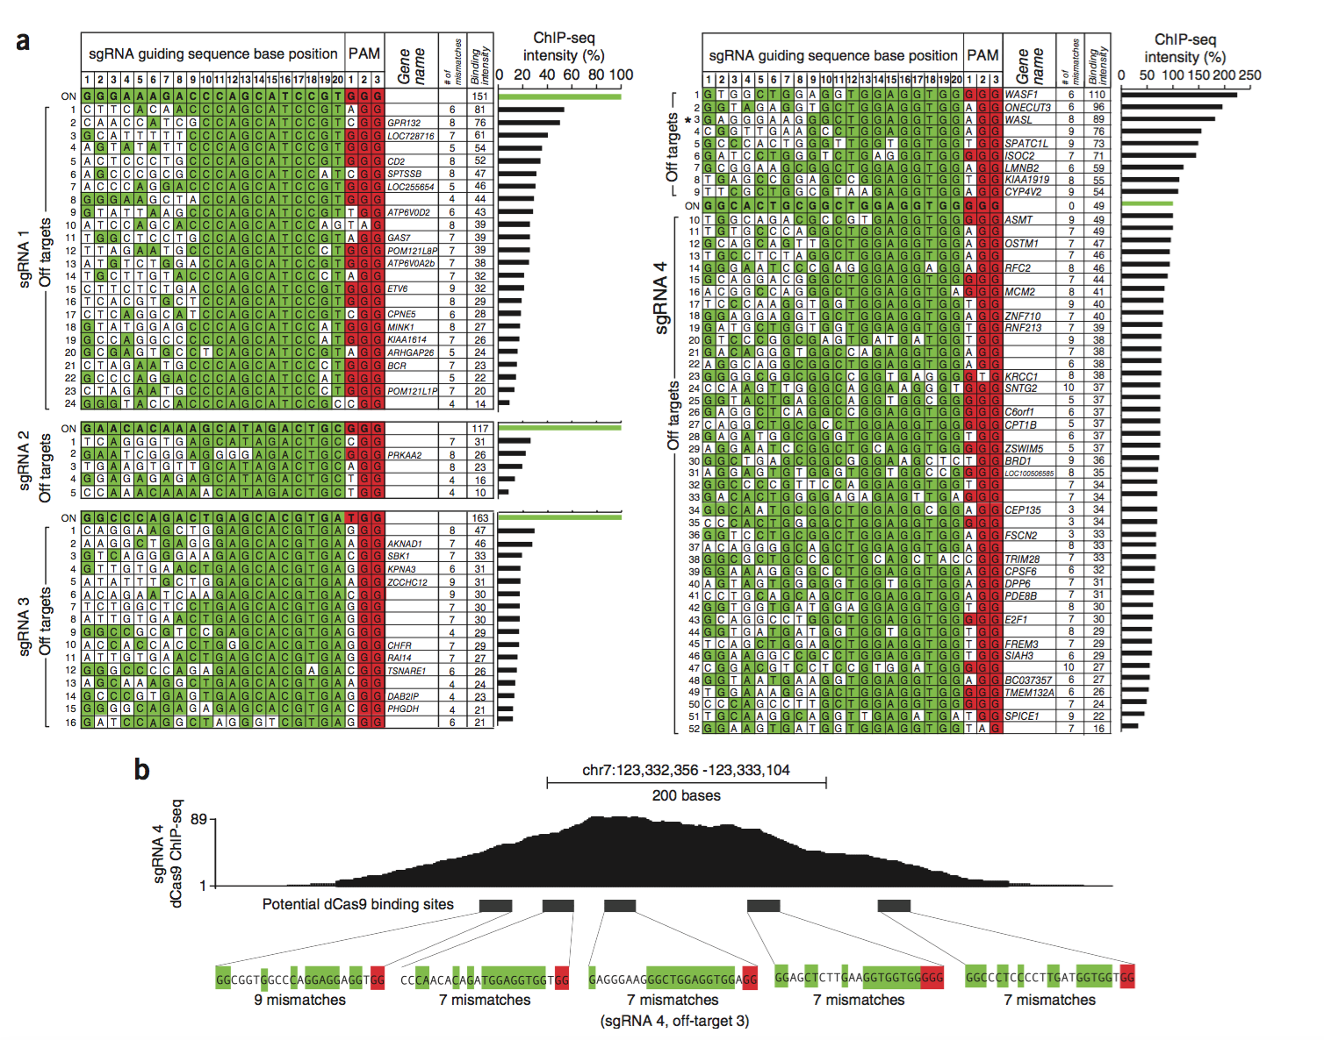
Proximal >> Distal
gRNA tolerates ~7-10 mismatches in Distal
gRNA must be 20 bases
Kuscu, Cem, Sevki Arslan, Ritambhara Singh, Jeremy Thorpe, and Mazhar Adli. "Genome-wide analysis reveals characteristics of off-target sites bound by the Cas9 endonuclease." Nature Biotechnology32.7 (2014): 677-83. Web.

Slide 7
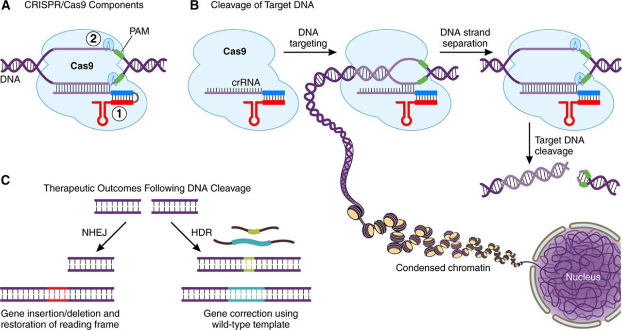
Chromatin Structure
Cas9 preferentially accesses open chromatin
ENCODE contains ChIP-seq data detailing chromatin structures in cells
Notes:
http://circ.ahajournals.org/content/circulationaha/134/11/777/F1.large.jpg

Slide 8
Pipelining to Identify Off-Target Effects
Many published tools, limited experimental data
Haeussler et al. 2016 published a compilation of 31 guides and 650 experimentally validated off target sites

Slide 9
Pipelining to Identify Off-Target Effects
Many published tools, limited experimental data
Haeussler et al. 2016 published a compilation of 31 guides and 650 experimentally validated off target sites
Pipeline goal: compare the performance of two pipeline tools on this dataset

Slide 10
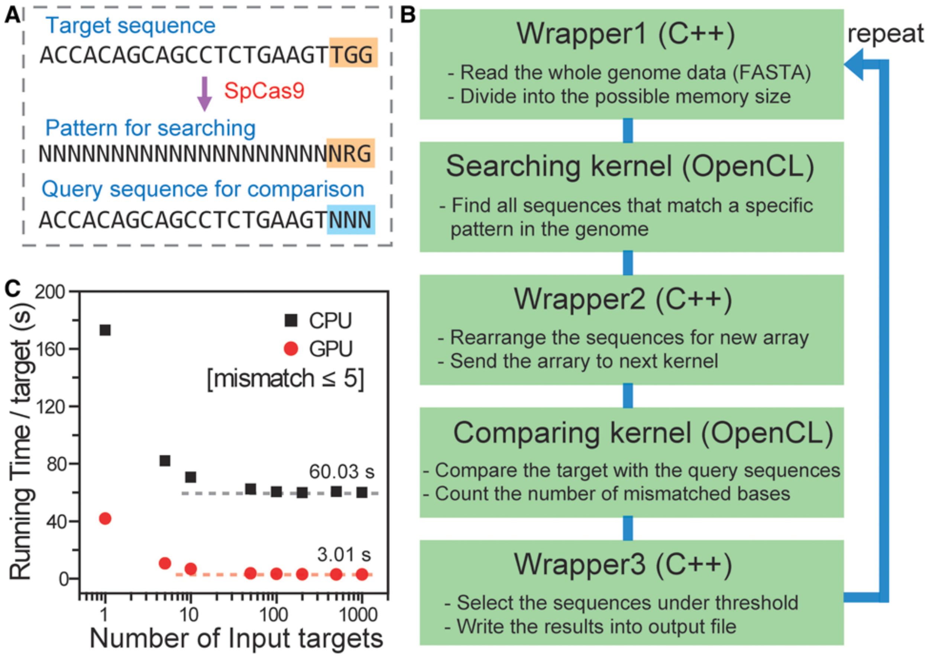
Pipeline: Algorithm 1 - Cas-OFFinder

Slide 11
Pipeline: Algorithm 2 - CRISPR-SEEK

Slide 12
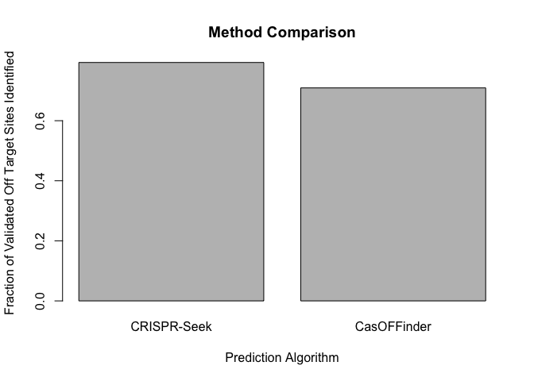
Pipelining Results on hg38
CRISPR-Seek: 516/650
CasOFFinder: 461/650

