Slide 1
modERN Updates
Jinrui
May 4th 2017

Slide 2
Number of binding sites (i.e. sig. peaks) varies among TFs
Expression features correlated with the variation

Slide 3
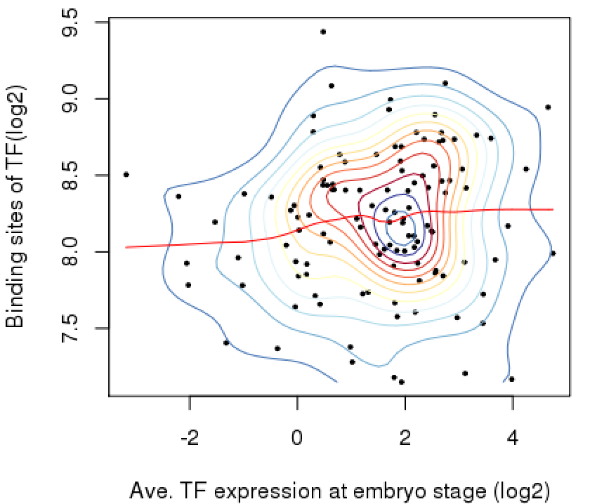
TF abundance and the number of binding sites?
Data used
ChIP-seq of embryo stage (E0-24)
TF abundance is ave. RPKM from RNA-seq data from embryo stage
Rho = 0.11, p = 0.22
Sample: 117

Slide 4
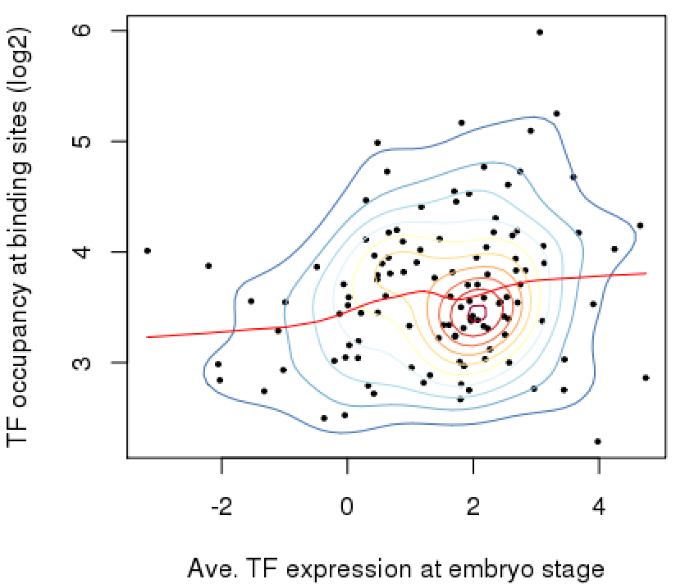
TF abundance and binding site occupancy?
The occupancy is, in binding site regions, the difference of reads per million btwn IP and control
Rho = 0.19, p = 0.03
Sample: 117

Slide 5
Many factors vanish the correlation (but fail)
RPKM not equal to protein abundance of TF
RNA-seq (ave. over embryogenesis) and ChIP-seq (one time point of embryo?) are not done at the same developmental time point
Multiple cell types in embryo
e.g. TF lowly expressed in each cell type but have specific binding sites => lowly expressed TF have many binding sites
Notes:
This information can be used in discussion, the figure may be as supplementary data

Slide 6
TF expressed in multiple tissues and number of binding sites?
Lack of clear hypothesis
Highly expressed genes in all tissues have many binding sites?
Lack of data
Currently, only 30 fly TFs and 15 tissues/cell lines at L3 stages
To figure out the expression-binding pattern, use machine learning (TSNE) for single cell RNA-seq of a whole organism?

Slide 7
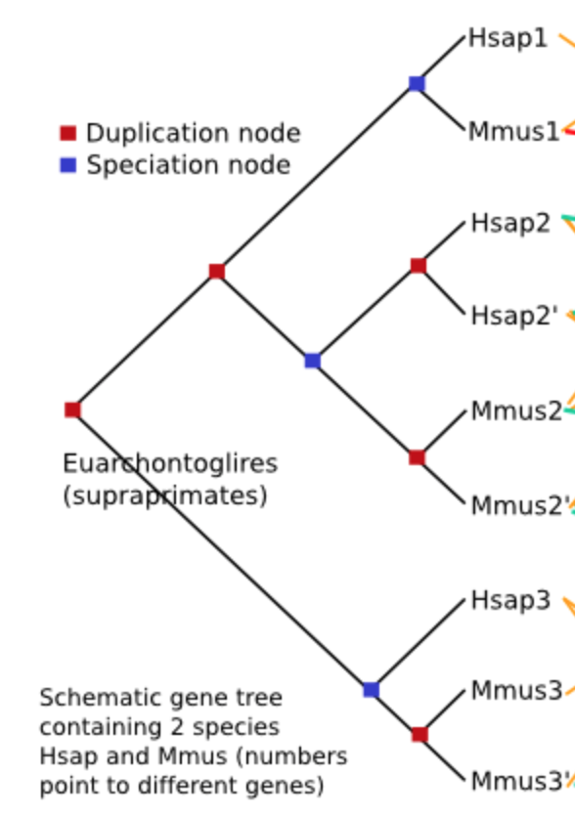
Tree-based method:
Compara from Ensembl
Hsap1 vs Mmus1 are 1to1 orthologs
Hsap2/Hsap2’ vs Mmus2/Mmus2’
are manyToMany orthologs
Hsap3 vs Mmus3/Mmus3’
are 1ToMany orthologs

Slide 8
Fly-worm orthologs
Tree-based method is superior to sequence similarity method
Tree-based: Compara => 9989 orthologous pairs,
Similarity based: OMA => 5074 orthologous pairs

Slide 9
Compara’s 9989 pairs
5461 fly genes vs 5904 worm genes
modERN TFs
239 fly TF vs 141 worm TFs => 23 orthologous pairs, using the Compara pairs
At most, 31/239 fly TFs have worm orthologs

Slide 10
DIOPT slaves 9 predictors, including Compara to detect orthologs
It finds 109 fly TFs involved in 310 fly-worm pairs, with relaxed cutoff

