Slide 1

Very Varying Variant Ventures
V4
LL group meeting
2017-05-04

Slide 2
Outline
MOAT
ENCODE & cancer
One more thing…

Slide 3
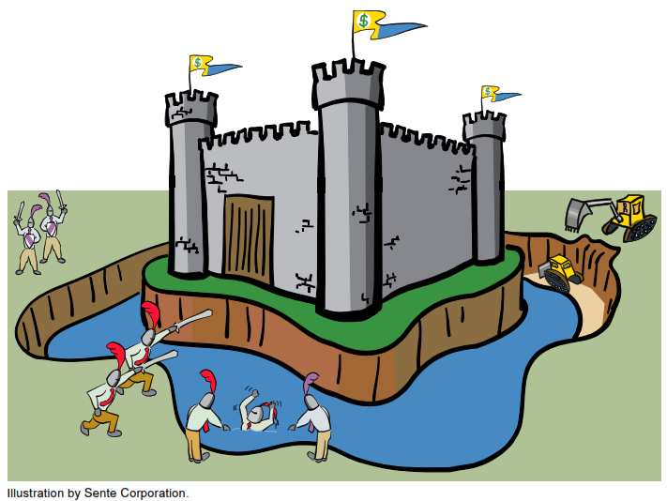
Outline
MOAT
ENCODE & cancer
One more thing…

Slide 4
MOAT Recap
Mutations Overburdening Annotations Tool
Approach to mutation burden involving empirical, nonparametric method
Background mutation rate derived from permuting variants and annotations
Accelerate code with mass parallelization frameworks
  Nvidia CUDA
  OpenMPI

Slide 5
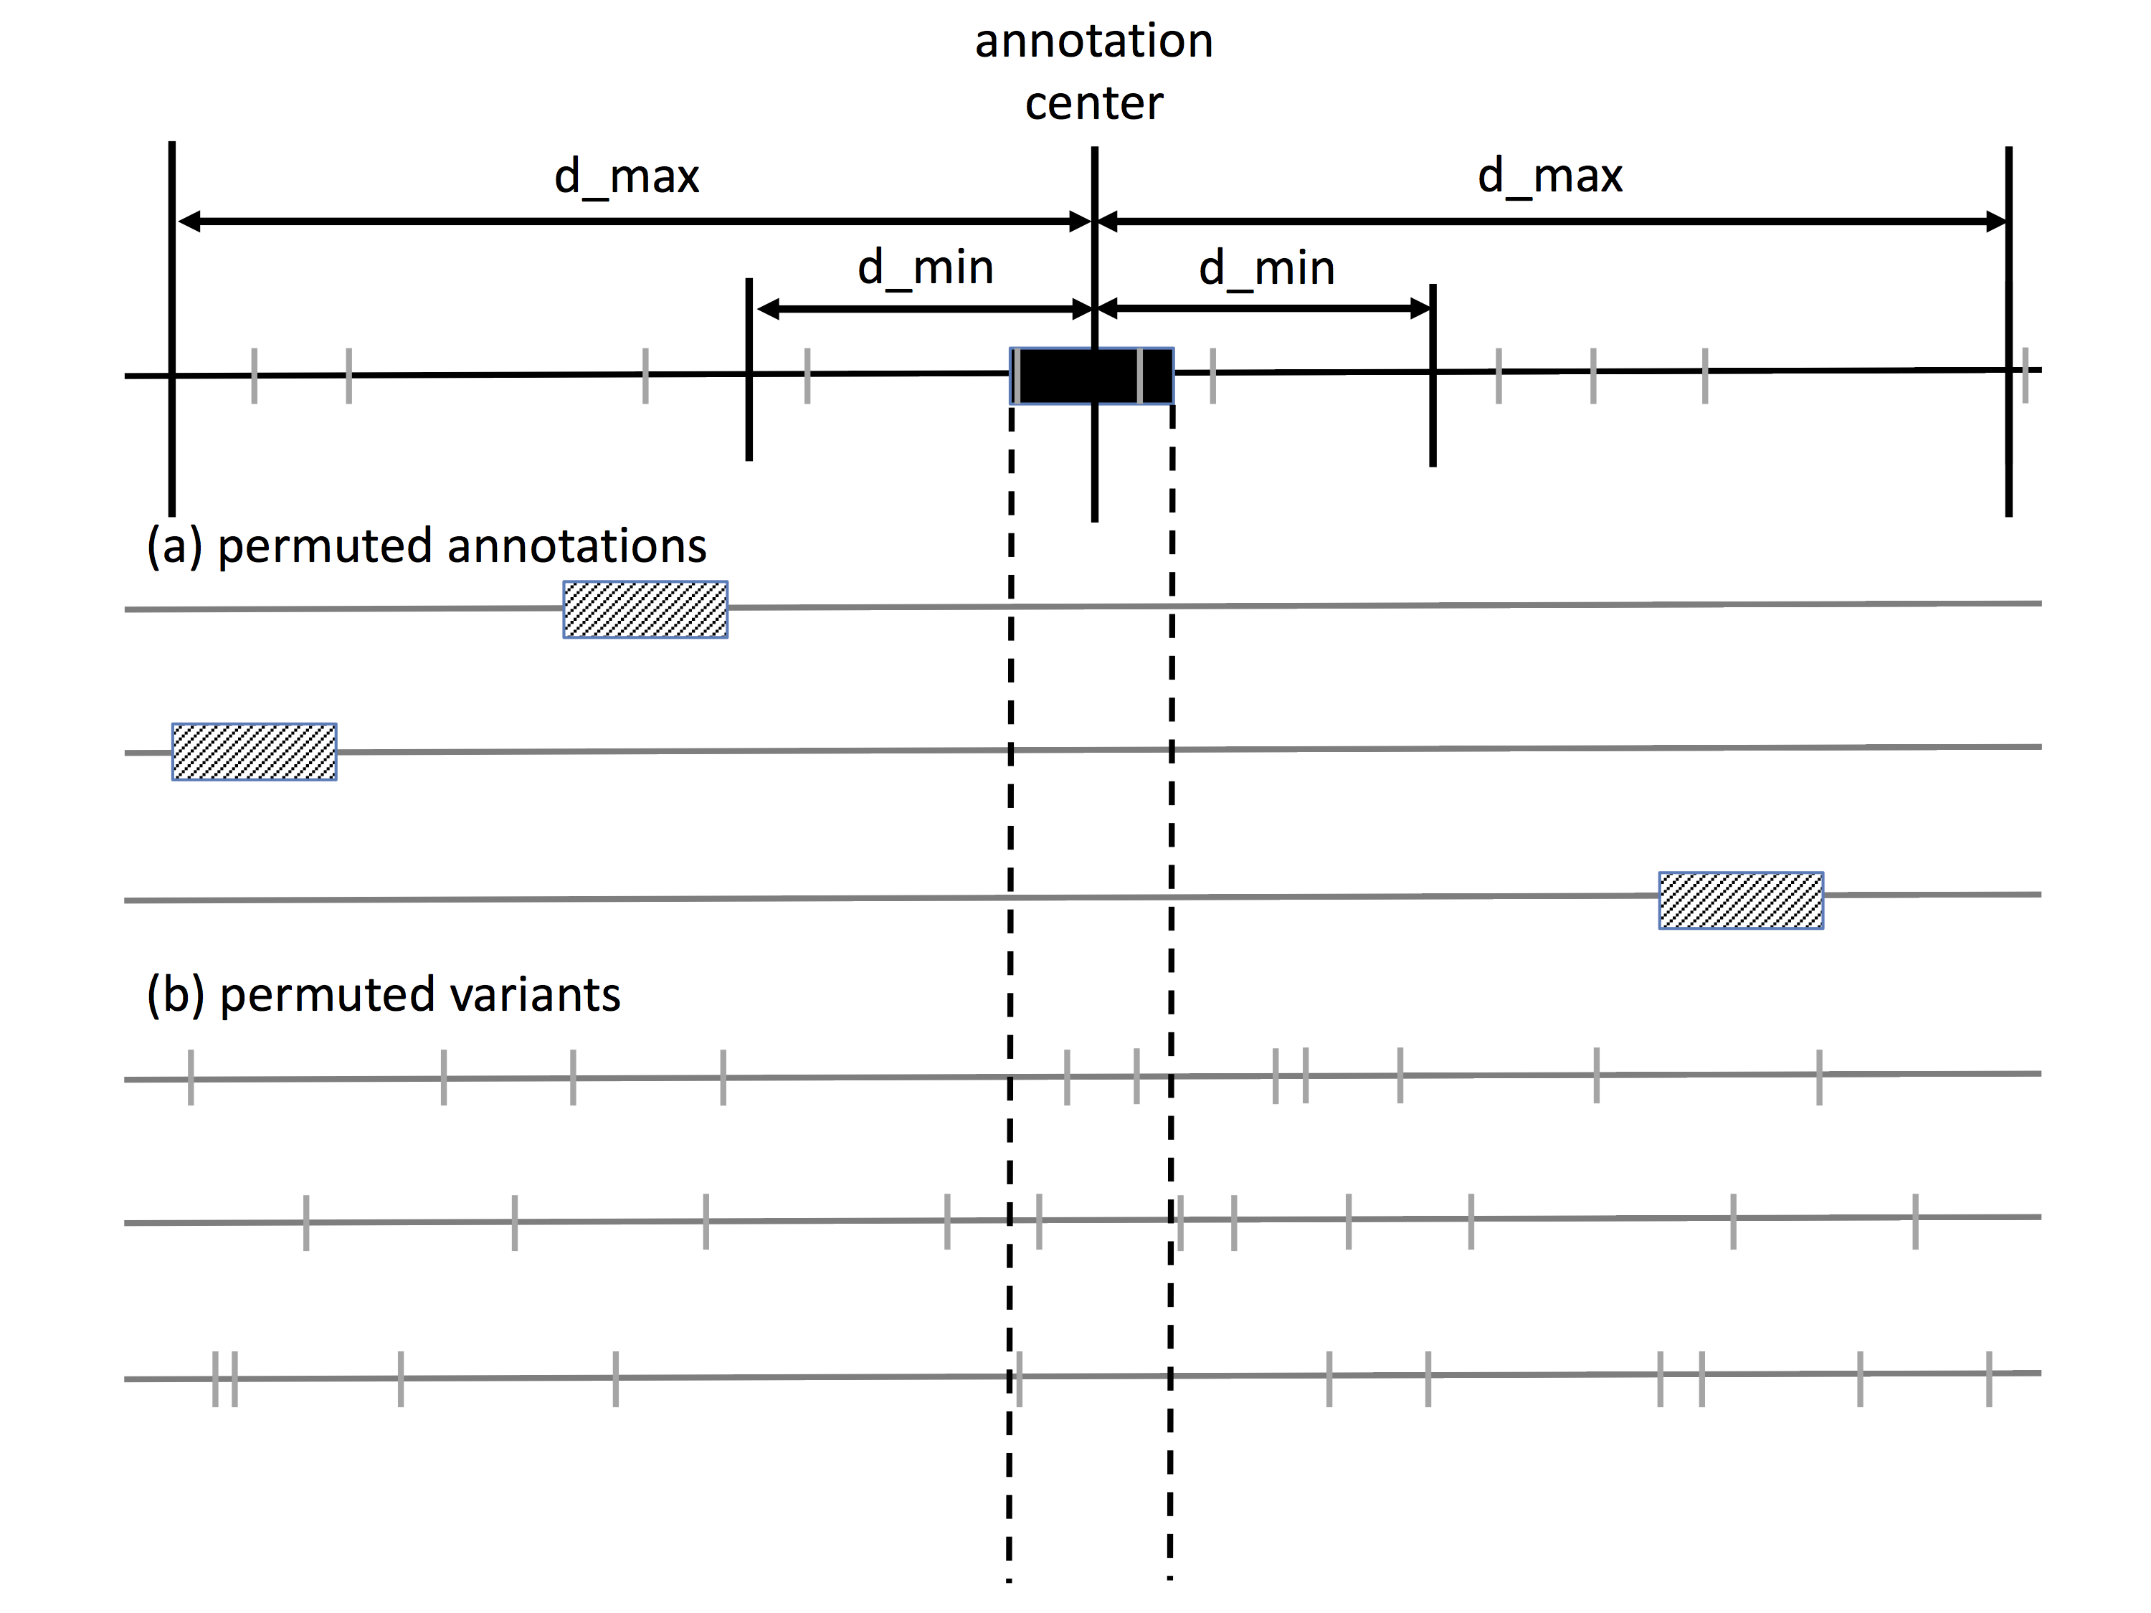
MOAT Recap
Permute annotations and variants in “local genome context”
  Factors influencing background mutation rate are roughly constant

Slide 6
MOATsim
A somatic variant simulator
Inputs:
  Bin size: Resolution of covariate signals
  Genome coordinate file: Indicates chromosome boundaries. Whole genome bins automatically generated from this and bin size.
  Blacklist file: Low mappability regions that are excluded. WG bins are cut around these.
  Covariate files: bigWig signal files for wg covariates. Accepts an arbitrary number of these.

Slide 7
MOATsim
Read genome coordinates into memory
Divide into bins of user-specified size
Subtract blacklist regions
Use bigWigAverageOverBed to derive covariate values for each bin
Generate covariate matrix
 | covar 1 | covar 2 | covar 3
bin 1
bin 2
bin 3
bin 4
bin 5
…
…

Slide 8
Covariate matrix: row clustering
Goal: Find similar bins (i.e. similar covariate vectors) and treat as single block
Currently using k-means clustering
  Found that the optimal cluster number k was around 30 using MutSig covariate file (defined over exome only)
  Within-sum-of-squares prone to stochastic variation beyond this point
Rough location for beginning of
Stochastic variation in within-ss

Slide 9
Variant Placement Step
Start with many bins
Mark which have similar covariate vectors
Which ones are more likely to have variants?
Populate the bins accordingly
1
5
1
50
50
5

Slide 10
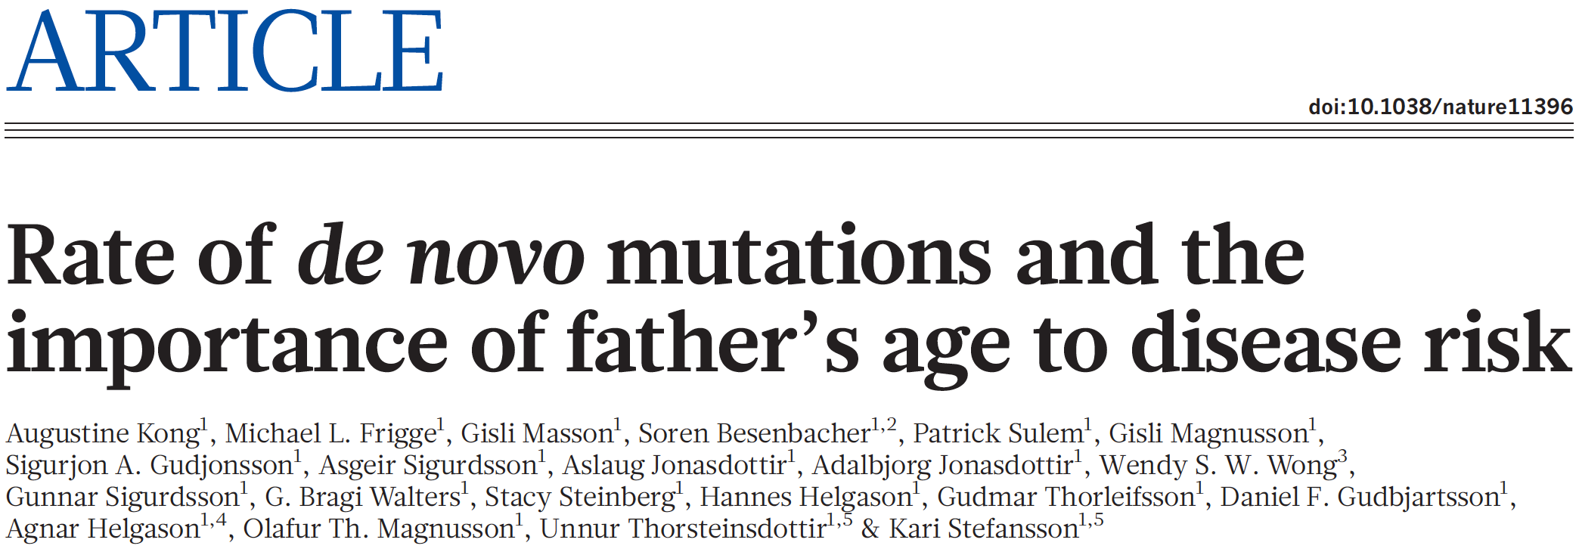
MOAT Germline Variant Analysis
Demonstrate MOAT capability on germline variants
Work with a large (~5000) de novo mutation set from:
  Kong, A. et al. Rate of de novo mutations and the importance of father’s age to disease risk. Nature 488, 471–475 (2012).
Sequencing of 78 trios, 44 of which have autism spectrum disorder (ASD)
  Evaluate MOAT recapitulation of ASD-associated genes

Slide 11
De novo results
Results are typically a range of p-values, but after BH correction, all p-values are mapped to either 0s or 1s
Counts for p-value=0 genes:

Slide 12
De novo results
Kong et al. drew attention to variants in the exons of 3 ASD-associated genes
  NRXN1, CUL3, EPHB2
MOAT-v with low bin width produces a small set
  But at 1kb/10kb, only CUL3 is recapitulated
At higher bin widths, all 3 are recapitulated, but we also see many more unrelated genes
  Sensitivity/specificity tradeoff

Slide 13
De novo results with ANNOVAR
Combine recurrence with functional impact
For gene-based annotations, there is ANNOVAR
  Wang K, Li M, Hakonarson H. ANNOVAR: Functional annotation of genetic variants from next-generation sequencing data Nucleic Acids Research, 38:e164, 2010
  Chang X, Wang K. wANNOVAR: annotating genetic variants for personal genomes via the web Journal of Medical Genetics, 49:433-436, 2012
  Yang H, Wang K. Genomic variant annotation and prioritization with ANNOVAR and wANNOVAR Nature Protocols, 10:1556-1566, 2015
Pick out the nonsynonymous variants

Slide 14
De novo results

Slide 15
MOAT Germline Variant Analysis: Take two
Variants
  ExAC TCGA variants
Annotations
  Exons merged into genes
  Wrote custom code to split gene with exon block annotations into block intervals for intersection step, then aggregate into genes for p-value calculation
Algorithm
  Make a new genome out of the exome

Slide 16
New Permutation Algorithm
Introns
Intergenic regions
Exons in the human genome
Exons in the exome-genome
And so on…
Each exon’s bp is mapped into coordinates for a new ”genome”
Variants are permuted with this “exome-genome”
  Excludes introns and intergenic regions
Notes:
My git repo is littered with alternate versions like this.

Slide 17
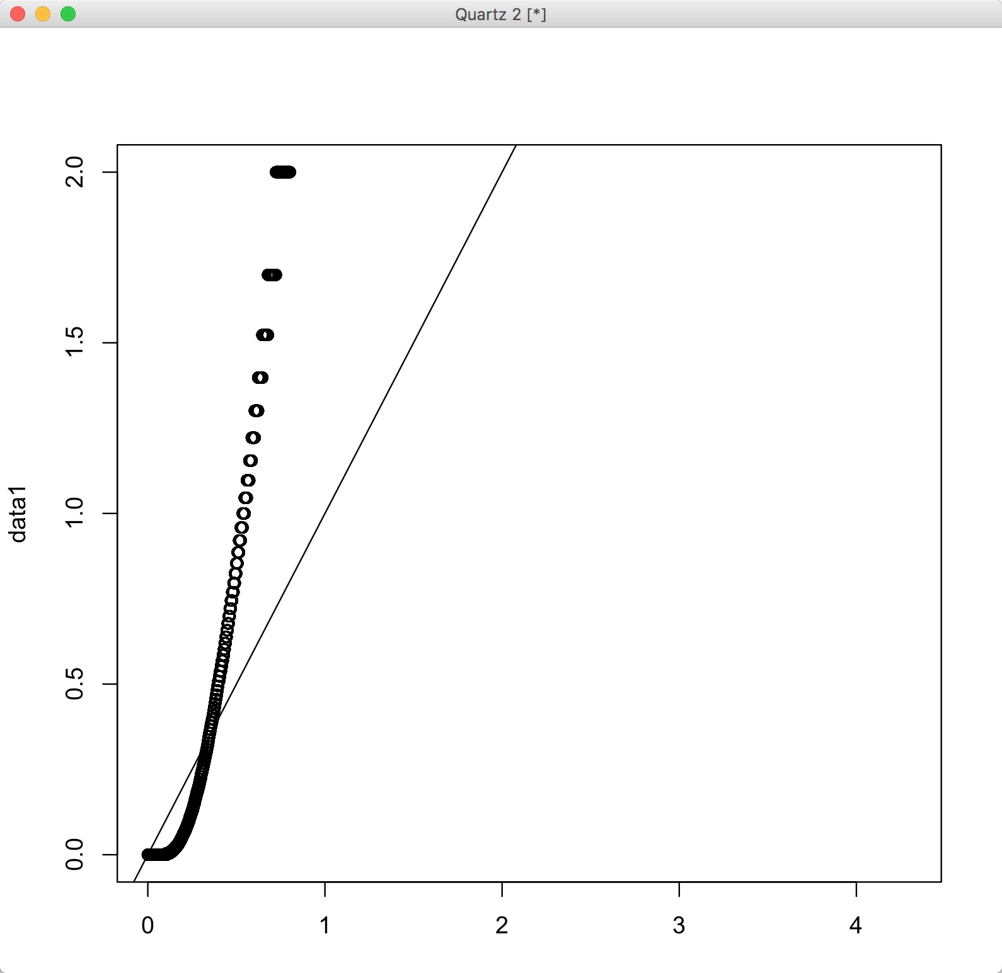
Results
QQ-plot vs uniform
3193 genes come back significant
after BH p-value adjustment
~15% of the exome is
significant?
DAVID gene clusters:
Group 1: Olfactory genes
Group 2: Hormones
Group 3: Metabolic enzymes
Group 4: Collagen and related
Group 5: ATP binding
Group 6: Leucine rich repeat domains
Known artefact

Slide 18
Take Three
Filter ExAC TCGA variant for rarity
  AF<0.005 (0.5%)
  But very few variants were filtered out (most are already rare)
Use Funseq2 to filter for variants with functional impact
Use PCAWG CDS annotations (previously used GENCODE v15)

Slide 19
QQ-plot of p-values vs. uniform dist
Then – 3193 sg (BH-adjusted)
Now – 601 sg (BH-adjusted)
Sample Quantiles
Theoretical Quantiles

Slide 20
Take Four
New Procedure: Sliding String
Start with all exons end-to-end (string)
The intersecting variants are “notches”
Slide the string a certain distance in one direction (with wraparound)
  New variant positions form a single permutation
  Repeat n times (typically n = 100)
  Sliding distance: runif in [-10 kbp, +10 kbp]
1. Exons
2. String
3. Slide

Slide 21
MOAT Germline Analysis Evaluation
QQ plot: P-value quantiles vs. uniform quantiles
Also, 252 significant
genes (q-value<0.05)

Slide 22
Take Five? (I could use a break)
Actually, we’re going to dive into germline variants as a spinoff project
Finish a publishable MOAT
Instead, add Funseq2 functional impact score significance assessment
  Is the functional impact of an annotation’s intersecting variants significantly elevated relative to its permutations?

Slide 23
Funeq2 Integration
Run Funseq2 over the whole genome
  Produce signal track that is the maximum score at each position
  Calculate an annotation signal by summing the intersecting variants’ scores
  Use the same procedure on permuted data
  These are background scores to determine if the observed score is significantly elevated
80
80
50
50
20
20
+
30
20
= 50
0
40

Slide 24
Funseq2 Integration
Compiled list of annotations with significantly elevated Funseq2 scores
  TSSes, promoters, enhancers
  Results comparable to the elevated mutation burden analysis
MOAT implementation is generalizable to any whole genome signal track
  e.g. can plug in a GERP score or K27 acetylation file
Negligible effect on runtime
  Parallelization scalability preserved
MOAT officially SUBMITTED!
  Once we address the page limit issue
Notes:
Seems that the list for Funseq2 is longer than for mutation burden → higher false positive rate?

Slide 25

Future Work
Get the germline analysis working
Planning to use denovo db variants (PMID: 27907889)
  Literature-mined de novo variants
  40 studies (most of which focus on brain disease)
  32,991 variants
  23,098 trios
  Hosted at: http://denovo-db.gs.washington.edu/denovo-db/

Slide 26
Outline
MOAT
ENCODE & cancer
One more thing…

Slide 27
Variant Calling
Chinese (BGI Shenzhen) liver cancer dataset
  88 genomes
  PMID: 23788652 (Genome Res 2013)
  Paired end FASTQ (requires full alignment + calling)
  Somatic and germline variant calling
TCGA Breast cancer dataset
  116 genomes
  WGS BAMs available as of Oct 2016
  Somatic calling
TCGA Lung cancer dataset
  197 genomes
  WGS BAMs available as of Oct 2016
  Somatic calling
Chronic lymphocytic leukemia
  150 genomes
  ICGC data housed in European Genome-Phenome Archive (EGA)
  Still downloading

Slide 28
Summary of distribution of variant calls per cancer sample
Cancer Type | Summary statistics of variants per sample
 | Min | 1st Qu | Median | Mean | 3rd Qu | Max
Liver - germline | 4,024,000 | 4,138,000 | 4,156,068 | 4,167,000 | 4,179,000 | 4,556,000
Liver - somatic | 4329 | 10,510 | 13,647 | 132,100 | 20,620 | 979,700
Breast | 1898 | 5779 | 8485 | 13,290 | 14,370 | 294,100
Lung | 159 | 40,490 | 83,402 | 229,200 | 295,000 | 2,127,000
Notes:
As anticipated, somatic cancer variants have a huge skew, while germline is very well-behaved. ☺

Slide 29
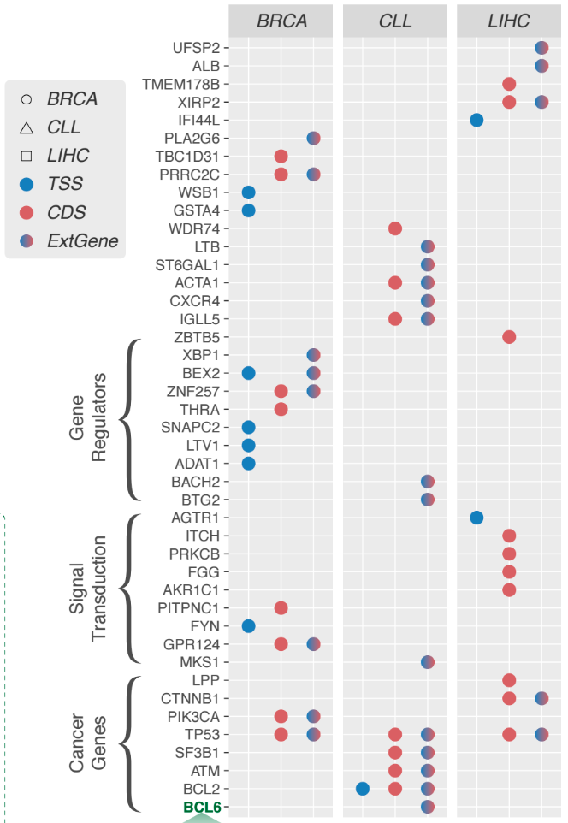
Overview
Starting with BGI liver germline variant calls
  88 samples
~4.1-4.2 million variants per sample
  Before blacklist and 1KG filtering
  After filtering, ~320,000 variants per sample
  Treat these as “rare germline variants”
See these genes over here?
  Let’s see how many samples have at least one rare mutation in these genes

Slide 30
Number of samples with >= 1 mutation/length

Slide 31

Outline
MOAT
ENCODE & cancer
One more thing…

Slide 32

Network Mutation Burdens (NMB)
Extension of LARVA (+ other related methods) mutation burden analysis to networks
LARVA can tell us which genes and regulatory elements have a significant mutation burden
Map this information onto a network
  What insights can be gained?
Concept: Using mutation burden genes as starting points, can the structure of the network be used to implicate other, previously undiscovered cancer-associated genes?

Slide 33
NMB Setup
Variants: TCGA lung
  Cancer type with high mutation density
Annotations: CDS
Network: InWeb PPI
  Curated, high quality PPI set used in other network mutation burden analyses (Horn et al. 2015)¹
Start with high mutation burden genes as reported by LARVA
Connect pairs of burdened genes in the PPI network
  In a manner that represents ”information flow” between genes
  Something that correlates with lung cancer association or lung functionality
1. Horn, H. et al. A comparative analysis of network mutation burdens across 21 tumor types augments discovery from cancer genomes. bioRxiv 025445 (2015).

Slide 34
NMB Methods Testing
Initially connected pairs with shortest path
  Paths kept leading through ubiquitous hub genes
Tried shortest path with betweenness centrality edge weights
  Betweenness(e): Number of paths from set P that pass through e.
  P: the set of shortest paths that connect two nodes (s,t) for every possible instantiation of s and t
  Idea is to find paths that only specific information travels down
    Disfavor hub genes
B
0.5
0.4
A
0.01
C
0.02
E
0.8
0.9
D

Slide 35

NMB Methods Testing
Both approaches found genes with low lung cancer association scores, according to OpenTargets.org
  Database that keeps track of gene-disease pairs, along with evidence for each association
Switched to looking at genes which had a burdened promoter according to LARVA
Initial results indicated that using edge betweenness centrality shortest paths might yield genes with high lung cancer associations

Slide 36
NMB Methods Testing
Case: Run this weighted sp algorithm on all pairs of promoters
  Collect intermediary genes
  Look at distribution of lung cancer associations scores (OpenTargets.org)
Control: Run weighted sp algorithm on pairs of randomly chosen genes
  Collect intermediary genes
  Look at distribution of lung cancer associations scores (OpenTargets.org)

Slide 37
NMB Results
If we use the genes with q-value < 1E-03, then the intermediary genes produced by weighted sp do (slightly) better than random in lung cancer association scores
Wilcoxon rank sum test with continuity correction
  W = 1151.5, p-value = 0.003657
Seed Genes | Min | 1st Qu | Median | Mean | 3rd Qu | Max
(LARVA q-value < 1E-03) genes | 0.04419 | 0.09335 | 0.18690 | 0.28152 | 0.29404 | 1.00000
Random control | 0.01202 | 0.04422 | 0.09068 | 0.16919 | 0.13782 | 1.00000
Notes:
Tried same thing with 1-betweenness centrality, and though there appears to be a distribution difference, the Wilcoxon test returned a non-significant p-value.

Slide 38
NMB Future Development
Also investigating subnetworks surrounding high burden genes
Many genes within 4-5 hops from the lung cancer seed genes have high lung cancer association scores
Many seed genes are close in the network
  Can we use network flow/diffusion to predict genes with high disease association?

Slide 39
Acknowledgements
Jing Zhang
Sushant Kumar
VARiation subgroup
MG
Aditya Gudibanda
Declan Clarke
Misc others

Slide 40
Extra Slides

Slide 41
MOATsim Variant Placement Procedure
Plug the covariates into a linear regression as the “x” variables
Each bin has a “y”
  Take the smallest y (let’s call it min_y), assign this bin a value of 1, and for each of the other ones, assign a value equal to its y divided by min_y
Use these values as the probability distribution for assigning random somatic variant positions
  Bin determined by taking a uniformly-drawn number over 0 and the sum of the values computed in the previous step
Drop a variant with uniform probability in this bin

