Slide 1
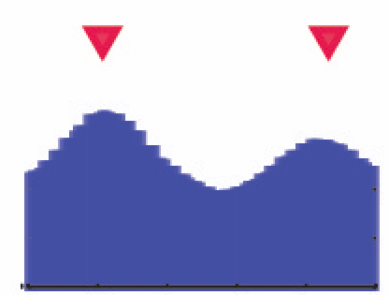
Trimming predicted enhancer region
Intersect with DHS peaks
Based on H3K27ac signal
Matched Filter prediction
Between double peaks
DHS track
Extend around trough

