Slide 1
Power analysis for non/coding cancer drivers
04/24/2017

Slide 2
Interaction of annotated region length (L) and driver density (d)
Nested contiguous regions (e.g. binding regions at multiple scales/motifs)
Nested sparse regions (e.g. defined by funseq score levels)
x
x
x
x
x
x
x
x
x
(x = driver)
x
x
x
x
x
x
x
(x = driver)
3 2 2 3 3 1 2 2 3 3 1

Slide 3
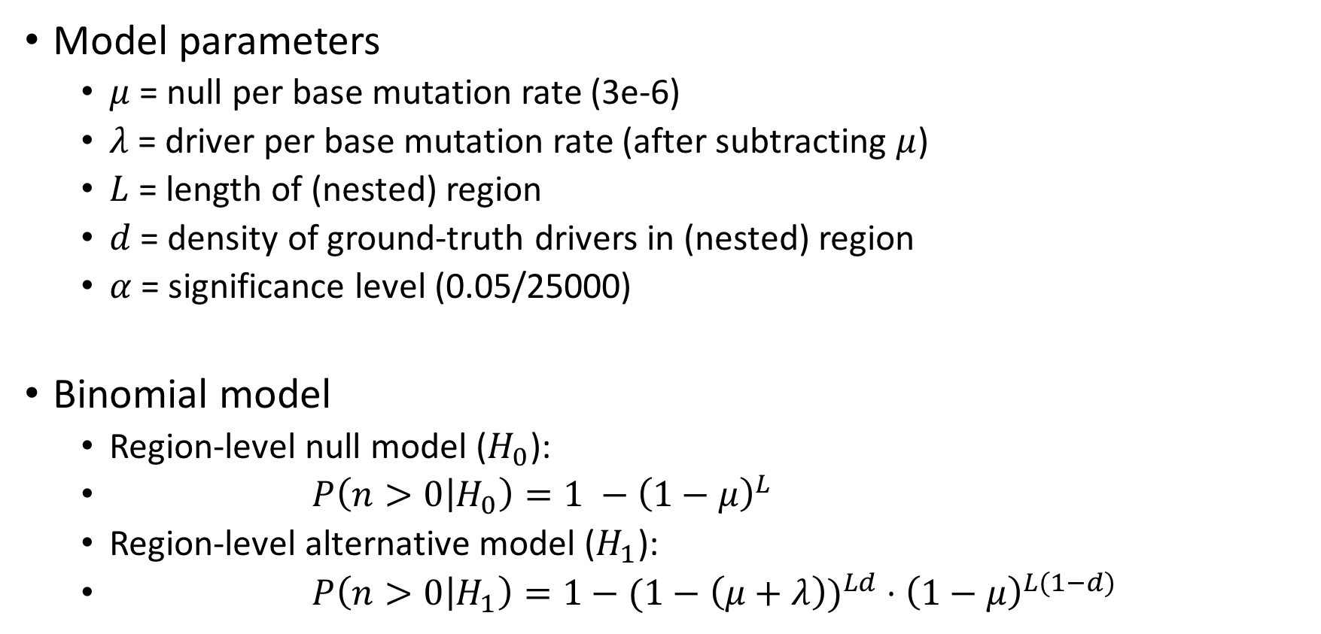
Binomial region-level model
Model parameters
  $μ$ = null per base mutation rate (3e-6)
  $λ$ = driver per base mutation rate (after subtracting $μ$)
  $L$ = length of (nested) region
  $d$ = density of ground-truth drivers in (nested) region
  $α$ = significance level (0.05/25000)
Binomial model
  Region-level null model ($H_{0}$):
  $P\left(n>0 | H_{0}\right)=1 −{\left(1−μ\right)}^{L}$
  Region-level alternative model ($H_{1}$):
  $P\left(n>0 | H_{1}\right)=1−(1−{\left(μ+λ\right))}^{Ld}{⋅\left(1−μ\right)}^{L(1−d)}$

Slide 4
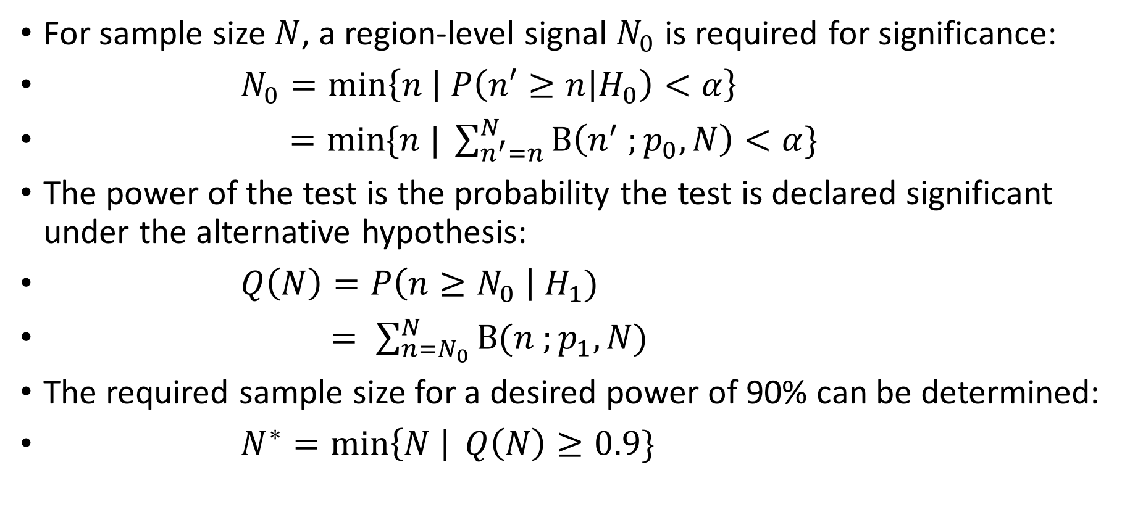
Power analysis
For sample size $N$, a region-level signal $N_{0}$ is required for significance:
$N_{0}=\text{min}\left\{n | P\left(n′≥n | H_{0}\right)<α\right\}$
$=\text{min}\text{\{}n | \sum_{n^{′}=n}^{N}{\text{B}\left(n^{′} ;p_{0}, N\right)}<α\}$
The power of the test is the probability the test is declared significant under the alternative hypothesis:
$Q\left(N\right)=P\left(n≥N_{0} \right| H_{1})$
$= \sum_{n=N_{0}}^{N}{\text{B}(n ;p_{1}, N)}$
The required sample size for a desired power of 90% can be determined:
$N^{∗}=\min\left\{N \right| Q\left(N\right)≥0.9\}$

Slide 5

Sample size dependence on region length (L) and driver density (d)
Vary L and d as $L=\{250, 500,…1250\}$, $d=\{0.2, 0.4 …1\}$
Fix $μ=3e−6$, $λ=3e−4$, $α=0.05/25000$
Calculate values of $N^{∗}$:
r/g/b/m/c for d=.2,.4,.6,.8,1
(d=driver density)
L
 | 1250 | 1000 | 750 | 500 | 250
0.2 | 137 | 171 | 226 | 338 | 672
0.4 | 63 | 78 | 104 | 132 | 262
0.6 | 38 | 46 | 61 | 90 | 177
0.8 | 24 | 35 | 39 | 57 | 112
1 | 20 | 24 | 31 | 46 | 90
d
N* (sample size)
L (region length)

Slide 6
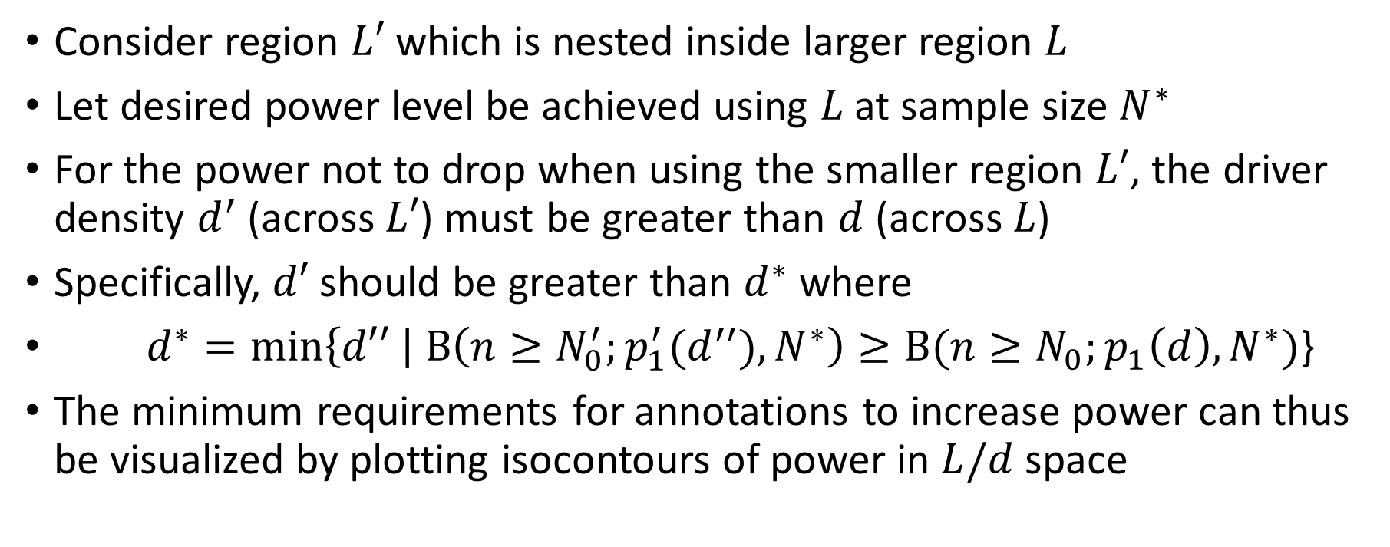
Can more informative annotations increase power?
Consider region $L′$ which is nested inside larger region $L$
Let desired power level be achieved using $L$ at sample size $N^{∗}$
For the power not to drop when using the smaller region $L′$, the driver density $d^{′}$ (across $L′$) must be greater than $d$ (across $L$)
Specifically, $d′$ should be greater than $d^{∗}$ where
$d^{∗}=\min\left\{d′′ \right| \text{B}\left(n≥N_{0}^{′};p_{1}^{′}(d^{′′}),N^{∗}\right)≥\text{B}(n≥N_{0};p_{1}\left(d\right),N^{∗})$}
The minimum requirements for annotations to increase power can thus be visualized by plotting isocontours of power in $L/d$ space

Slide 7
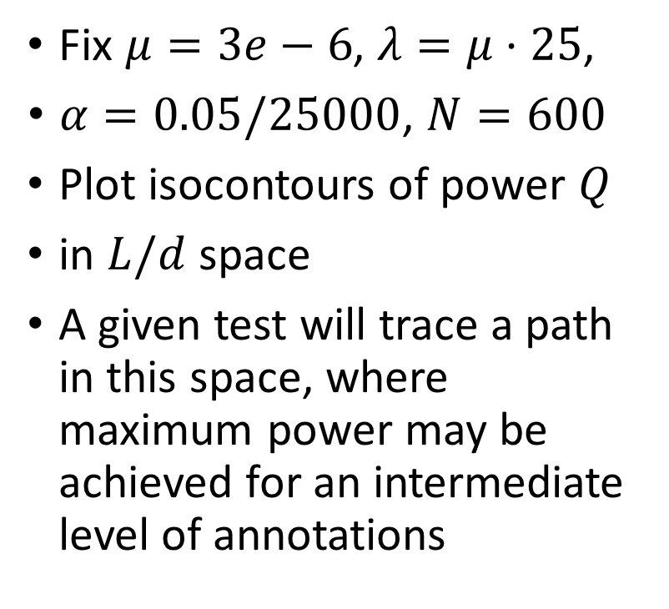
Can more informative annotations increase power?
Fix $μ=3e−6$, $λ=μ⋅25$,
$α=0.05/25000$, $N=600$
Plot isocontours of power $Q$
in $L/d$ space
A given test will trace a path in this space, where maximum power may be achieved for an intermediate level of annotations
Q=.9
Q=.7
Q=.5
d (driver density)
Q=.3
Q=.1
L (region length)

Slide 8
Can more informative annotations increase power?
Fix $μ=3e−6$, $λ=μ⋅25$,
$α=0.05/25000$, $N=600$
Plot isocontours of power $Q$
in $L/d$ space
A given test will trace a path in this space, where maximum power may be achieved for an intermediate level of annotations
Q=.9
Q=.7
Q=.5
d (driver density)
Q=.3
Q=.1
L (region length)

Slide 9
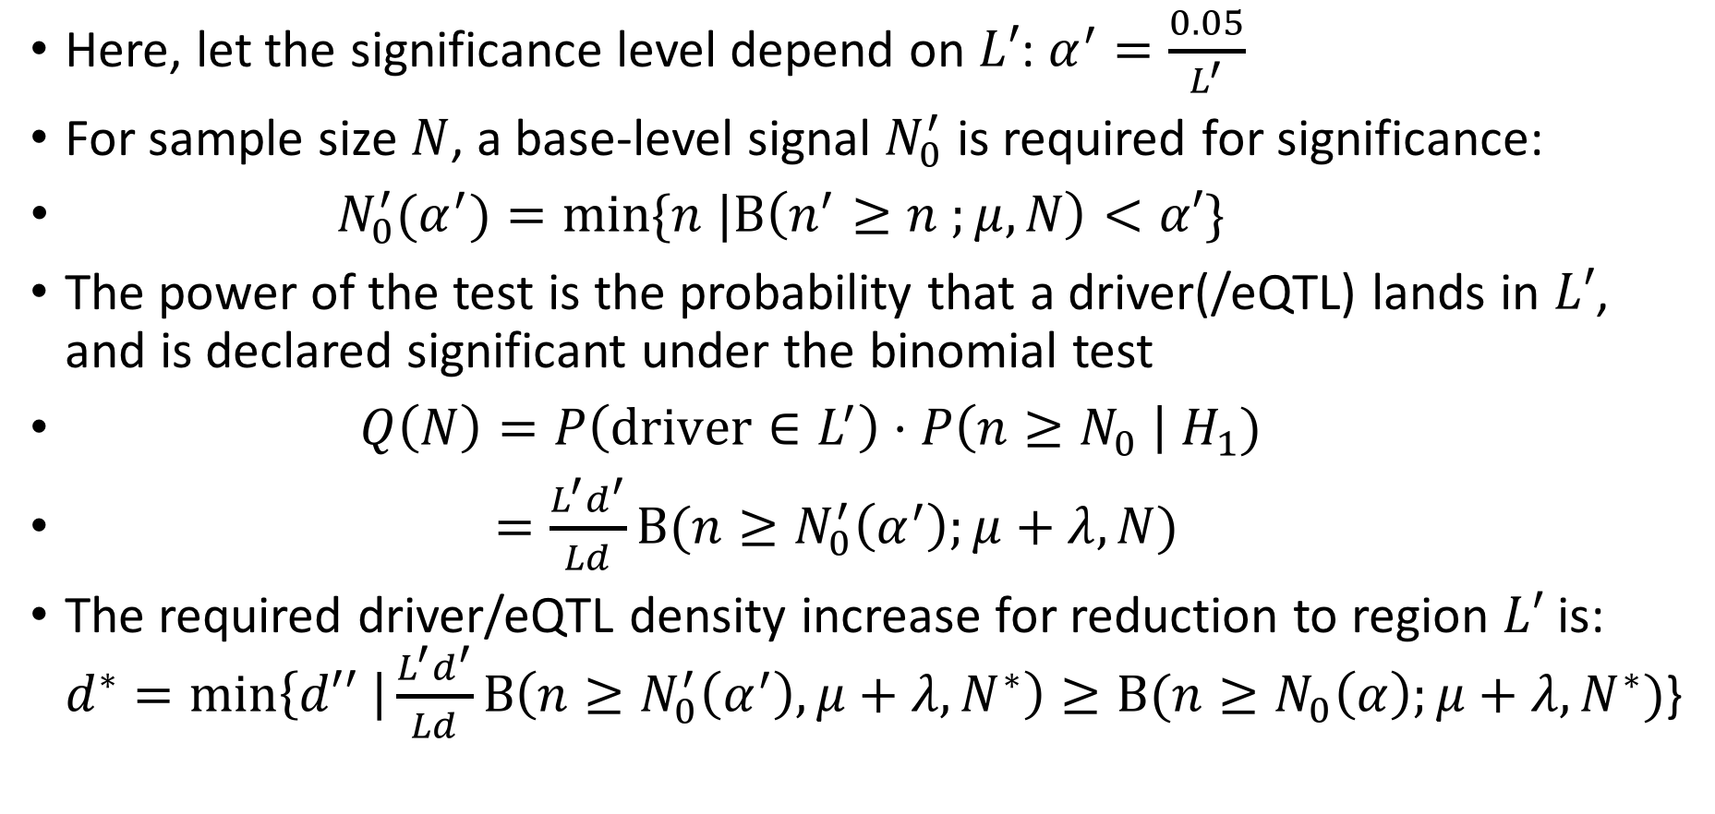
Power analysis for base-level model (relevant for individual driver detection and eQTL analysis)
Here, let the significance level depend on $L′$: $α^{′}=\frac{0.05}{L^{′}}$
For sample size $N$, a base-level signal $N_{0}^{′}$ is required for significance:
$N_{0}^{′}(α^{′})=\text{min}\text{\{}n |\text{B}\left(n^{′}≥n ;μ, N\right)<α′\}$
The power of the test is the probability that a driver(/eQTL) lands in $L′$, and is declared significant under the binomial test
$Q\left(N\right)=P\left(\text{driver}∈L^{′}\right)⋅P\left(n≥N_{0} \right| H_{1})$
$=\frac{L^{′}d^{′}}{Ld}\text{B}(n≥N_{0}^{′}\left(α^{′}\right);μ+λ, N)$
The required driver/eQTL density increase for reduction to region $L′$ is: $d^{∗}=\min\left\{d′′ \right|\frac{L^{′}d^{′}}{Ld}\text{B}\left(n≥N_{0}^{′}\left(α^{′}\right), μ+λ,N^{∗}\right)≥\text{B}(n≥N_{0}\left(α\right);μ+λ,N^{∗})$}

Slide 10
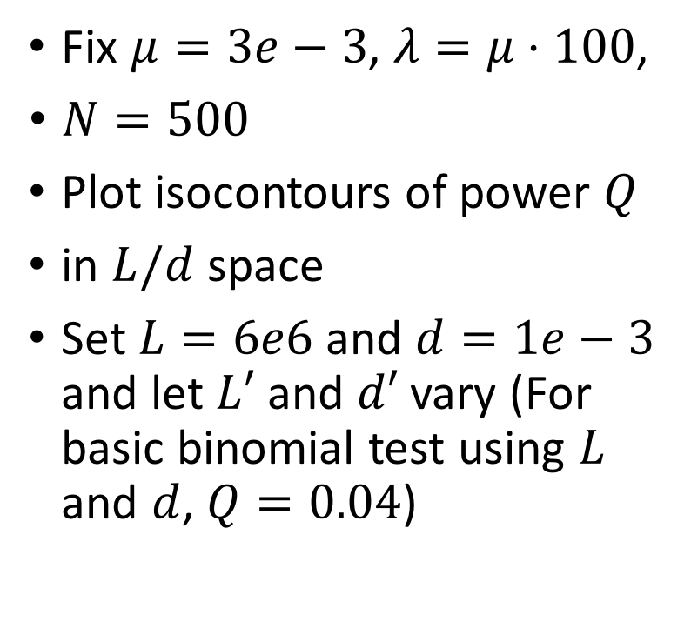
Isocontour power plot for base-level model
Fix $μ=3e−3$, $λ=μ⋅100$,
$N=500$
Plot isocontours of power $Q$
in $L/d$ space
Set $L=6e6$ and $d=1e−3$ and let $L′$ and $d′$ vary (For basic binomial test using $L$ and $d$, $Q=0.04$)
Q=.9
Q=.7
d’ (driver/eQTL density)
Q=.5
Q=.3
Q=.1
L’ (region length)

Slide 11
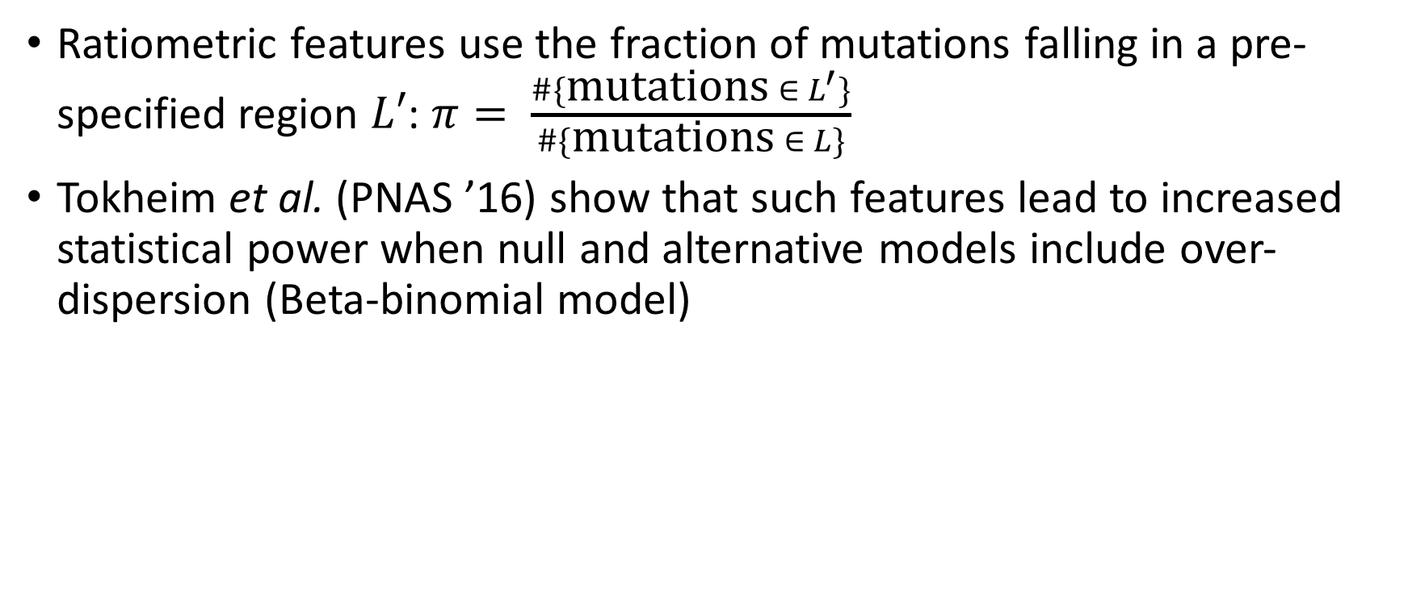
Ratiometric features
Ratiometric features use the fraction of mutations falling in a pre-specified region $L′$: $π= \frac{\#\{\text{mutations} ∈{ L}^{′}\}}{\#\{\text{mutations} ∈ L\}}$
Tokheim et al. (PNAS ’16) show that such features lead to increased statistical power when null and alternative models include over-dispersion (Beta-binomial model)

Slide 12
Related papers

