Slide 1
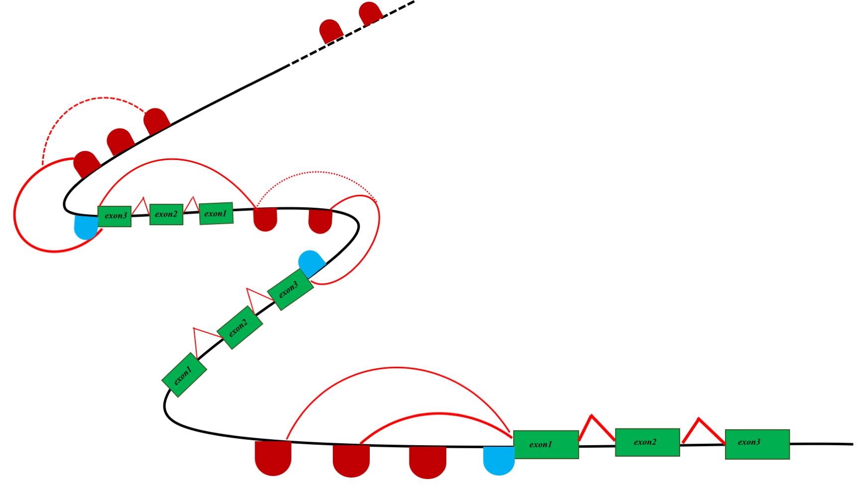
ACTGA
Notes:
A) Connection between multiple exons (green blocks) in the coding regions is well defined. Connection of promoter and other CREs (cis-regulatory elements) for genes are not well defined. Moreover the length of functional territory/motif (L) is much smaller compared to the entire CRE peak.
B) Impact of number (N) and length of promoter (L) on the power of driver discovery: 1) solid black , 2) dotted black and 3) dashed black lines correspond to power curve when number of promoters(N) are 20K, 100 and 40K, respectively. Solid red line corresponds to power curve when mutations are aggregated over promoter core instead of entire promoter length.

