Slide 1
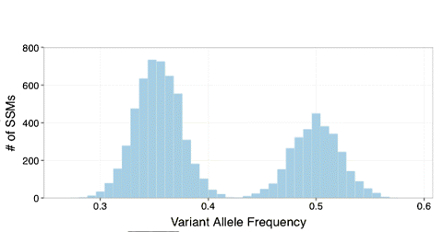
Modeling Clonal Evolution and the effect of fitness mutations
0.5
0.4
0.3
0.2

Slide 2


Hitchhiking prevalence
No fitness mutation
fitness mutation
0
1
2
3
4
0
1
2
3
4
8/16 = 0.5
12/20 = 0.6
4/16 = 0.25
8/20 = 0.4
8/16 = 0.5
8/20 = 0.4

Slide 3
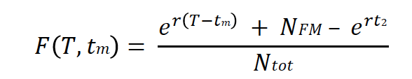
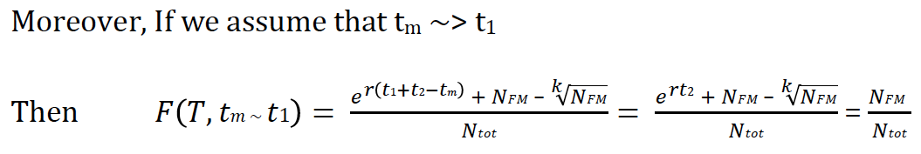

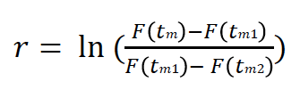
Hitchhiking prevalence
fitness mutation
Optimizing based on hitchhiking VAFs
Which is in the form of
0
1
2
3
4
Allowing to estimate growth rate r from hitchhiking mutations
t₁
t₂

Slide 4
Estimate growth rate r and effect k
Early Hitchhiked Mutations with growth r
Fit population
with growth K*r
fitness mutation
For Simulations
- Foreach (prevalent mutation)
  Estimate r from window of (5-6 or 7) hitchhike mutations
  Estimate the effect K (compared to real K)
- Identify peaks, drivers
For PCAWG data
Foreach (clonal mutation)
  - Optimize r using a window of (~100?) hitchhiking mutations and fit Non-Linear Least Square Regression
  - Identify peaks, estimate effect K
  - Re-optimize for population size, clonal size

Slide 5
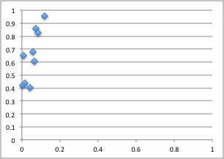
High Accuracy in Identifying Drivers using simulation data:
Roc curve
Sensitivity
Real K
Median K
1-Specificity
Window Size

Slide 6
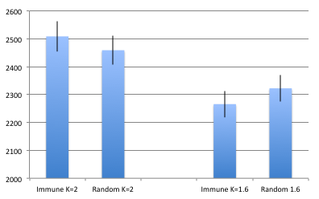
Identifying selection signal in 110 pcawg cancers
Driver or high impact TSG mutations
Average Distance from peak (effect K~2)
High impact Immune response mutations
Average Distance from peak (K~2) or (K~1.6)

Slide 7
Individual Tumor growth model and future directions
Predict changes in Individual tumor growth rate r
Select peaks/effect size
Suggest the presence of a driver (?missing drivers?)
Identify driver candidates (improved with depth)
Compare the effect between different mutations/genes/genetypes/tumors
  (For example PTEN vs RAS; Prostate vs Lung; TSG vs Immune Response genes)
  Use for power calculations (define the effect and sequencing needed)
Compare our findings with Paper E
Model Liabilities:
Sequencing depth
Subclone assignment
Model fit optimization
Use of more complex models
Future directions
Compare different growth models based on ML
Under model and growth parameters, optimize for population size and fluctuations
Associate clonal evolution with Immune antibody repertoire evolution (Kleinstein)

